Slide 1
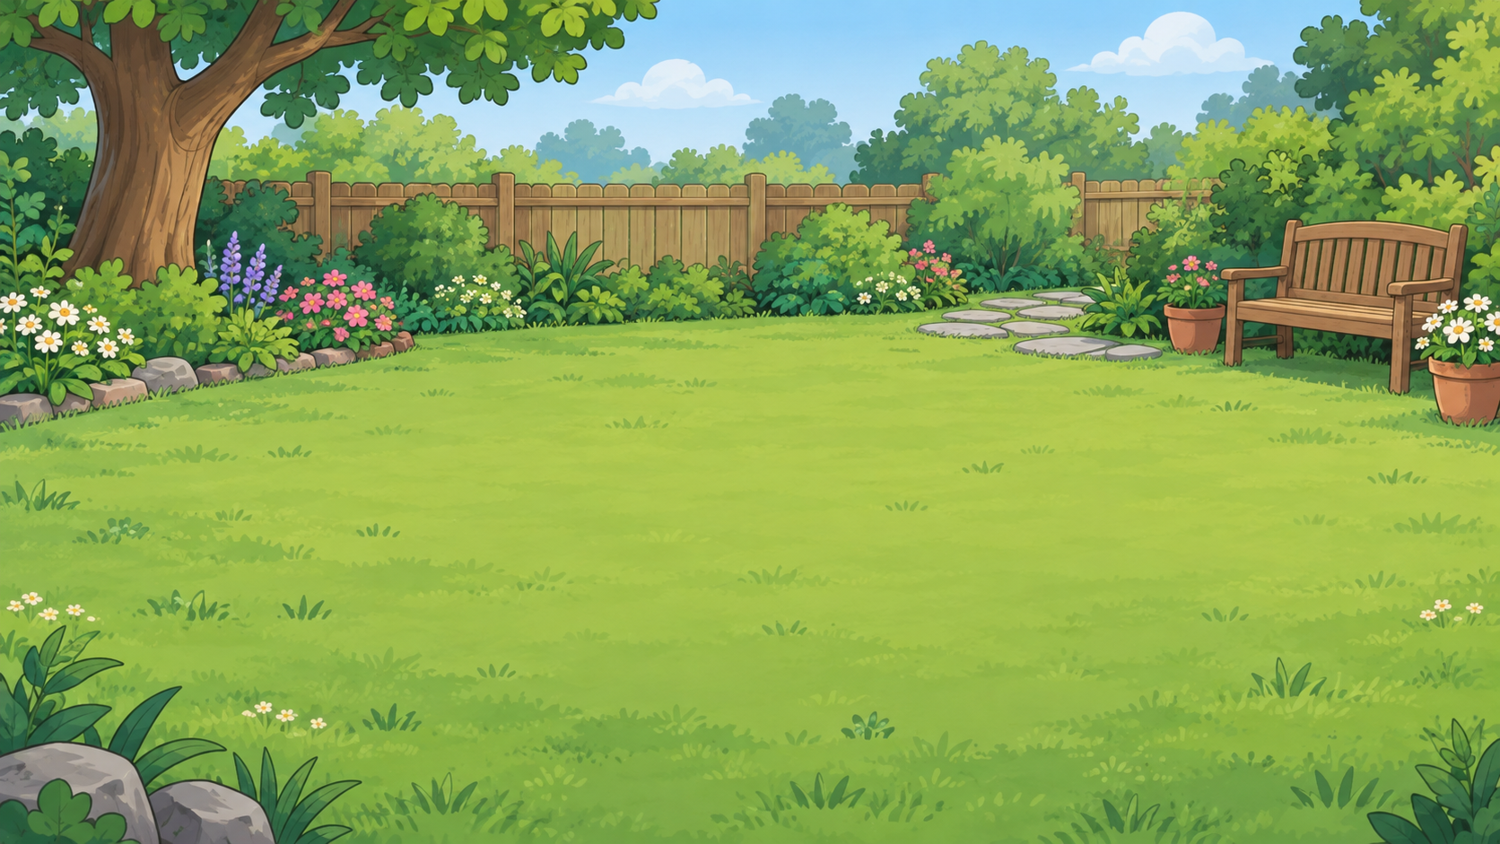
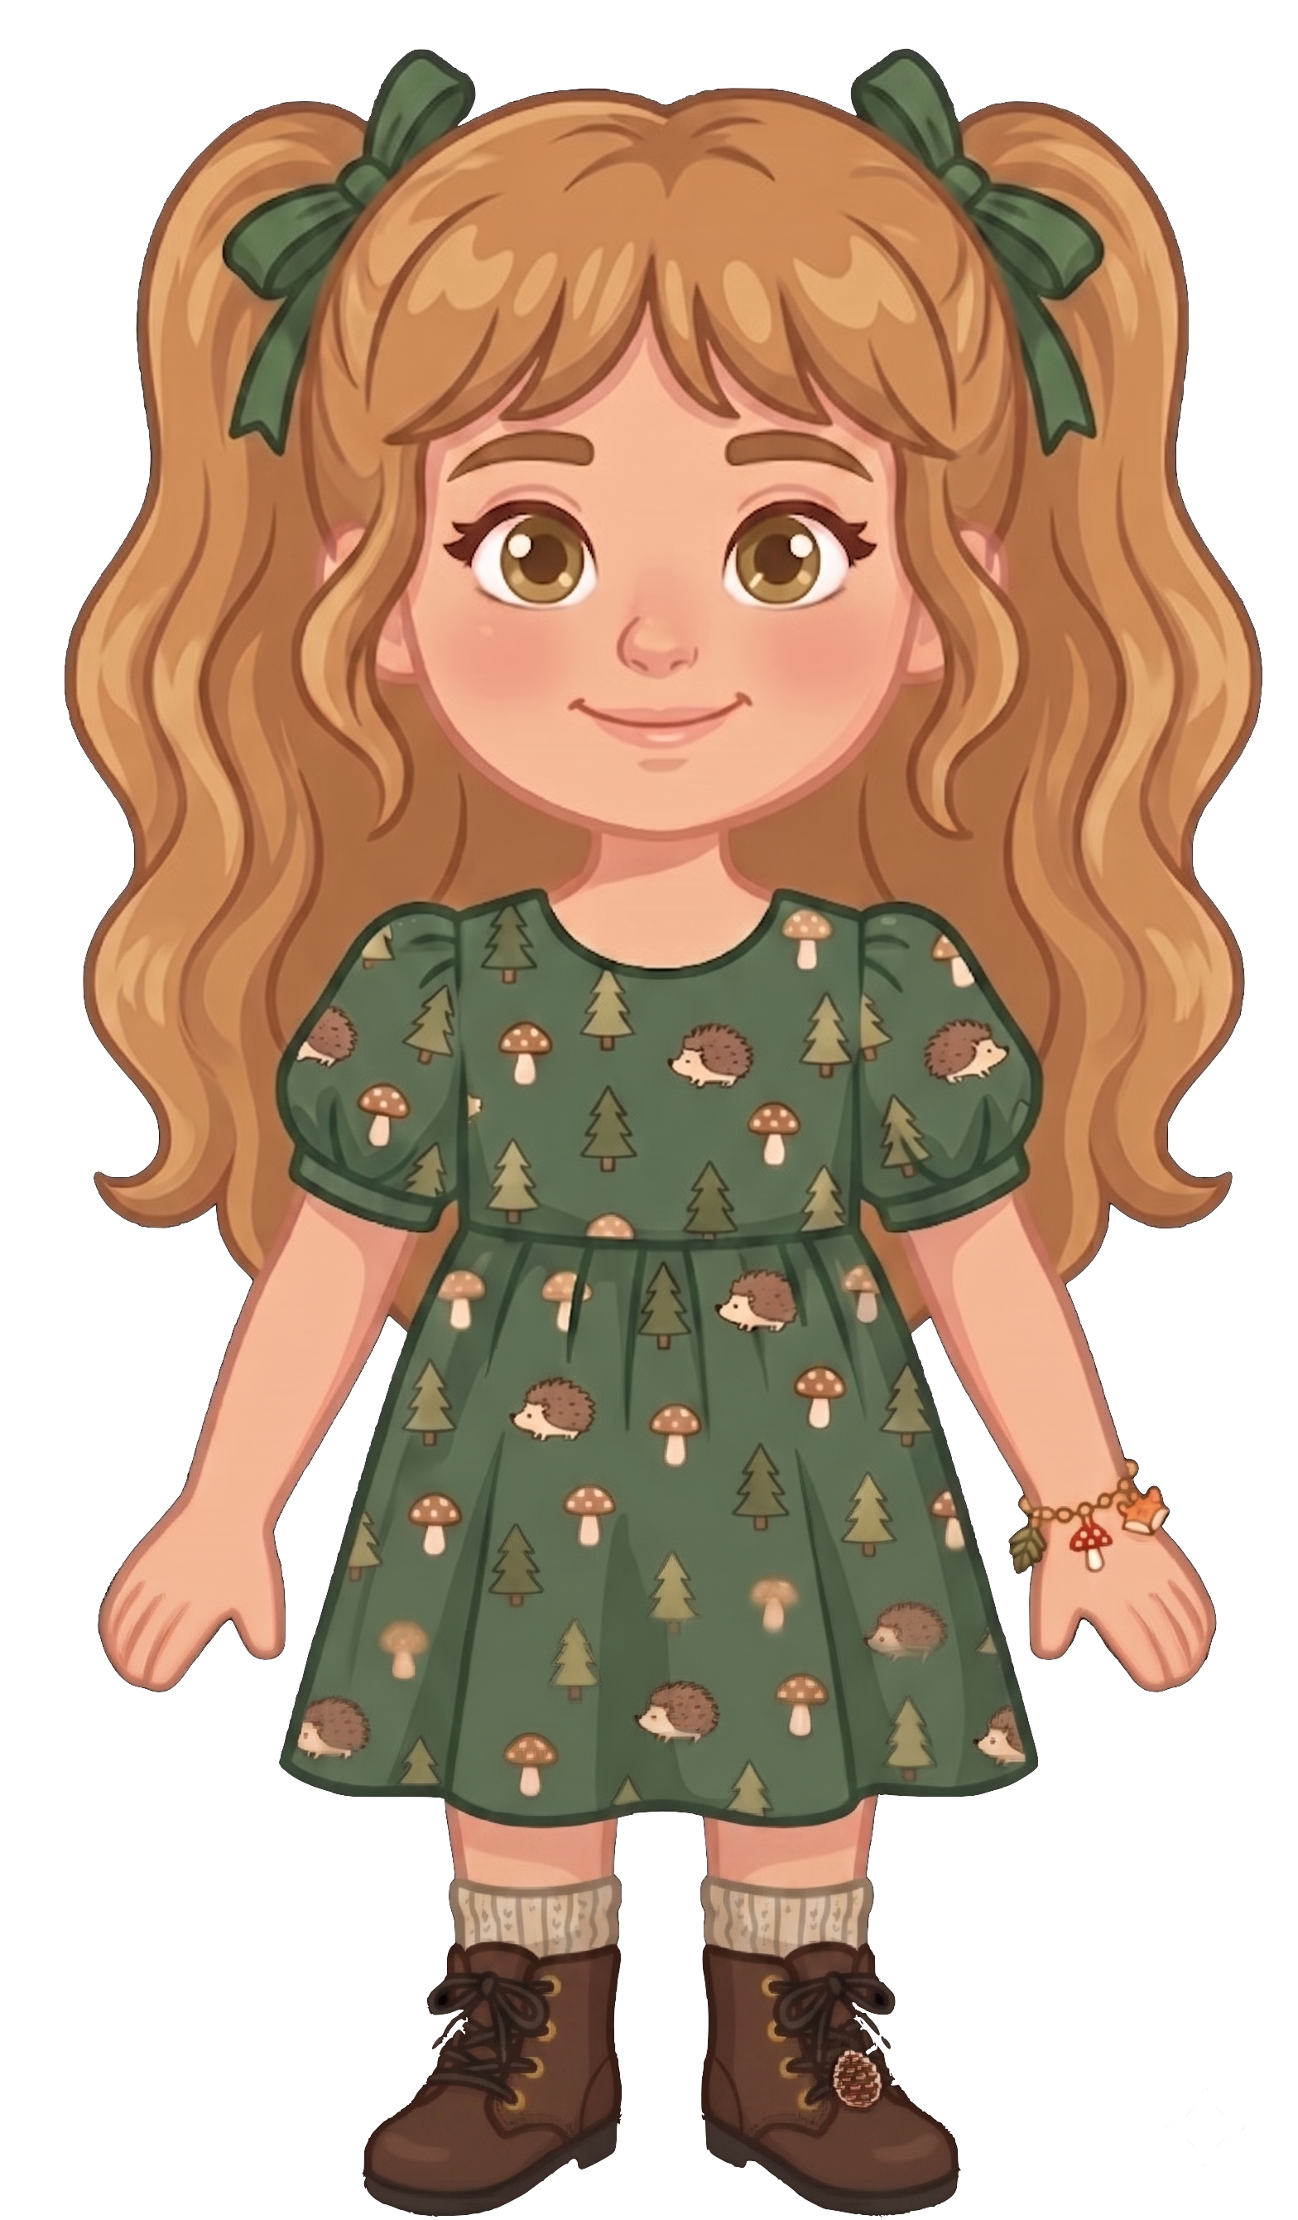
This is Nora.

Slide 2


Nora has 8 cookies.

Slide 3
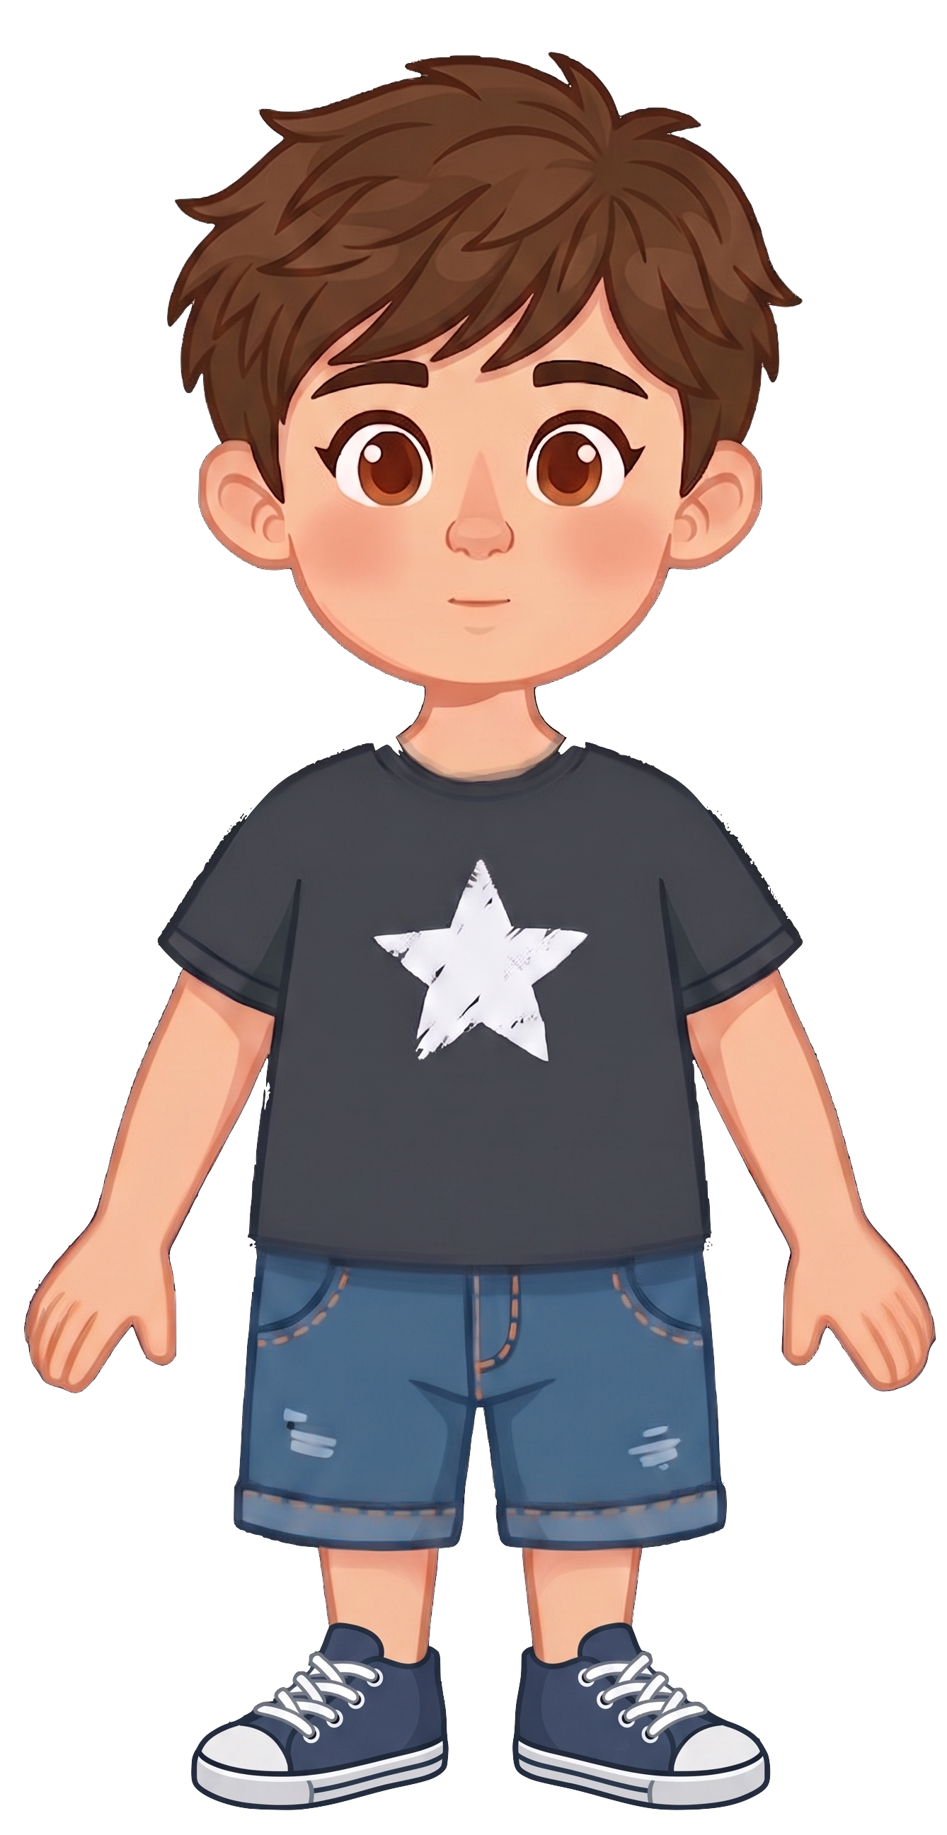
This is Eric.

Slide 4
Eric has 2 cookies.

Slide 5
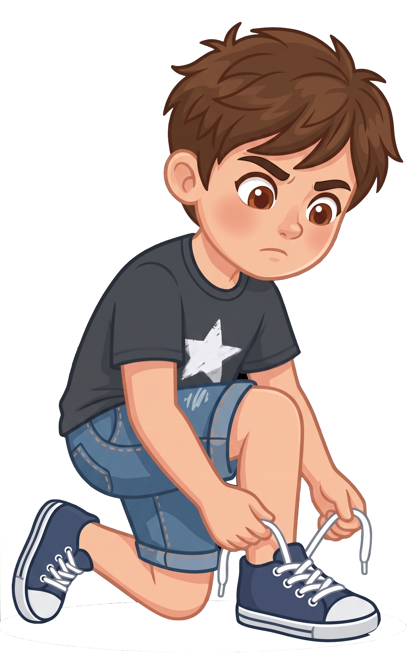
Eric is tying his shoelaces.

Slide 6
Eric tells Nora, “I know a squirrel could eat my cookies.”

Slide 7
Eric tells Nora, “I’m not okay with that.”

Slide 8
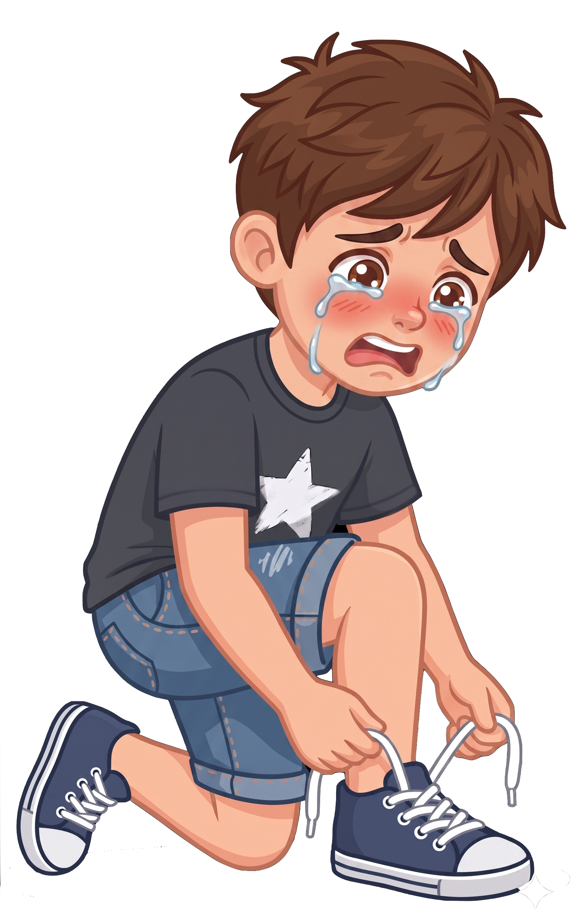
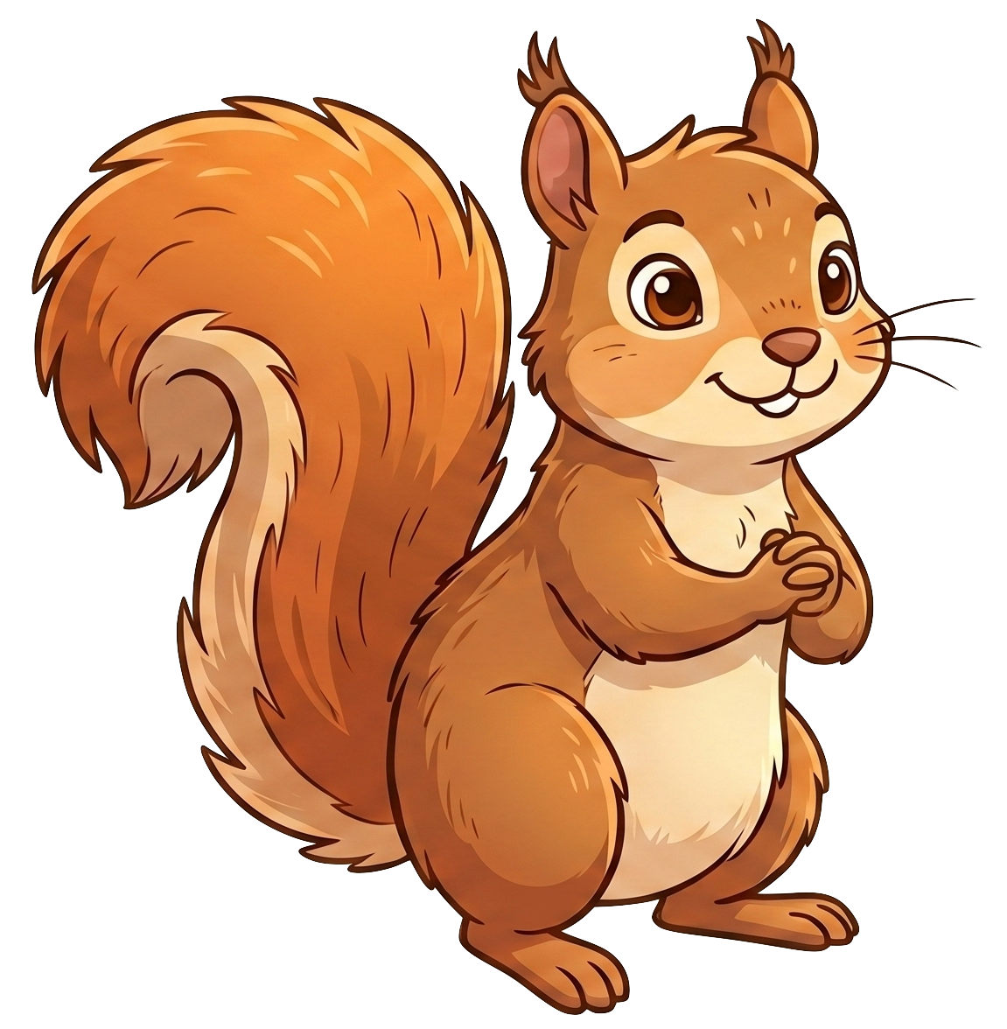
Oh no! A squirrel eats 2 of Eric’s cookies!

Slide 9
Nora still has 8 cookies. Eric now has 0 cookies.

