Slide 1

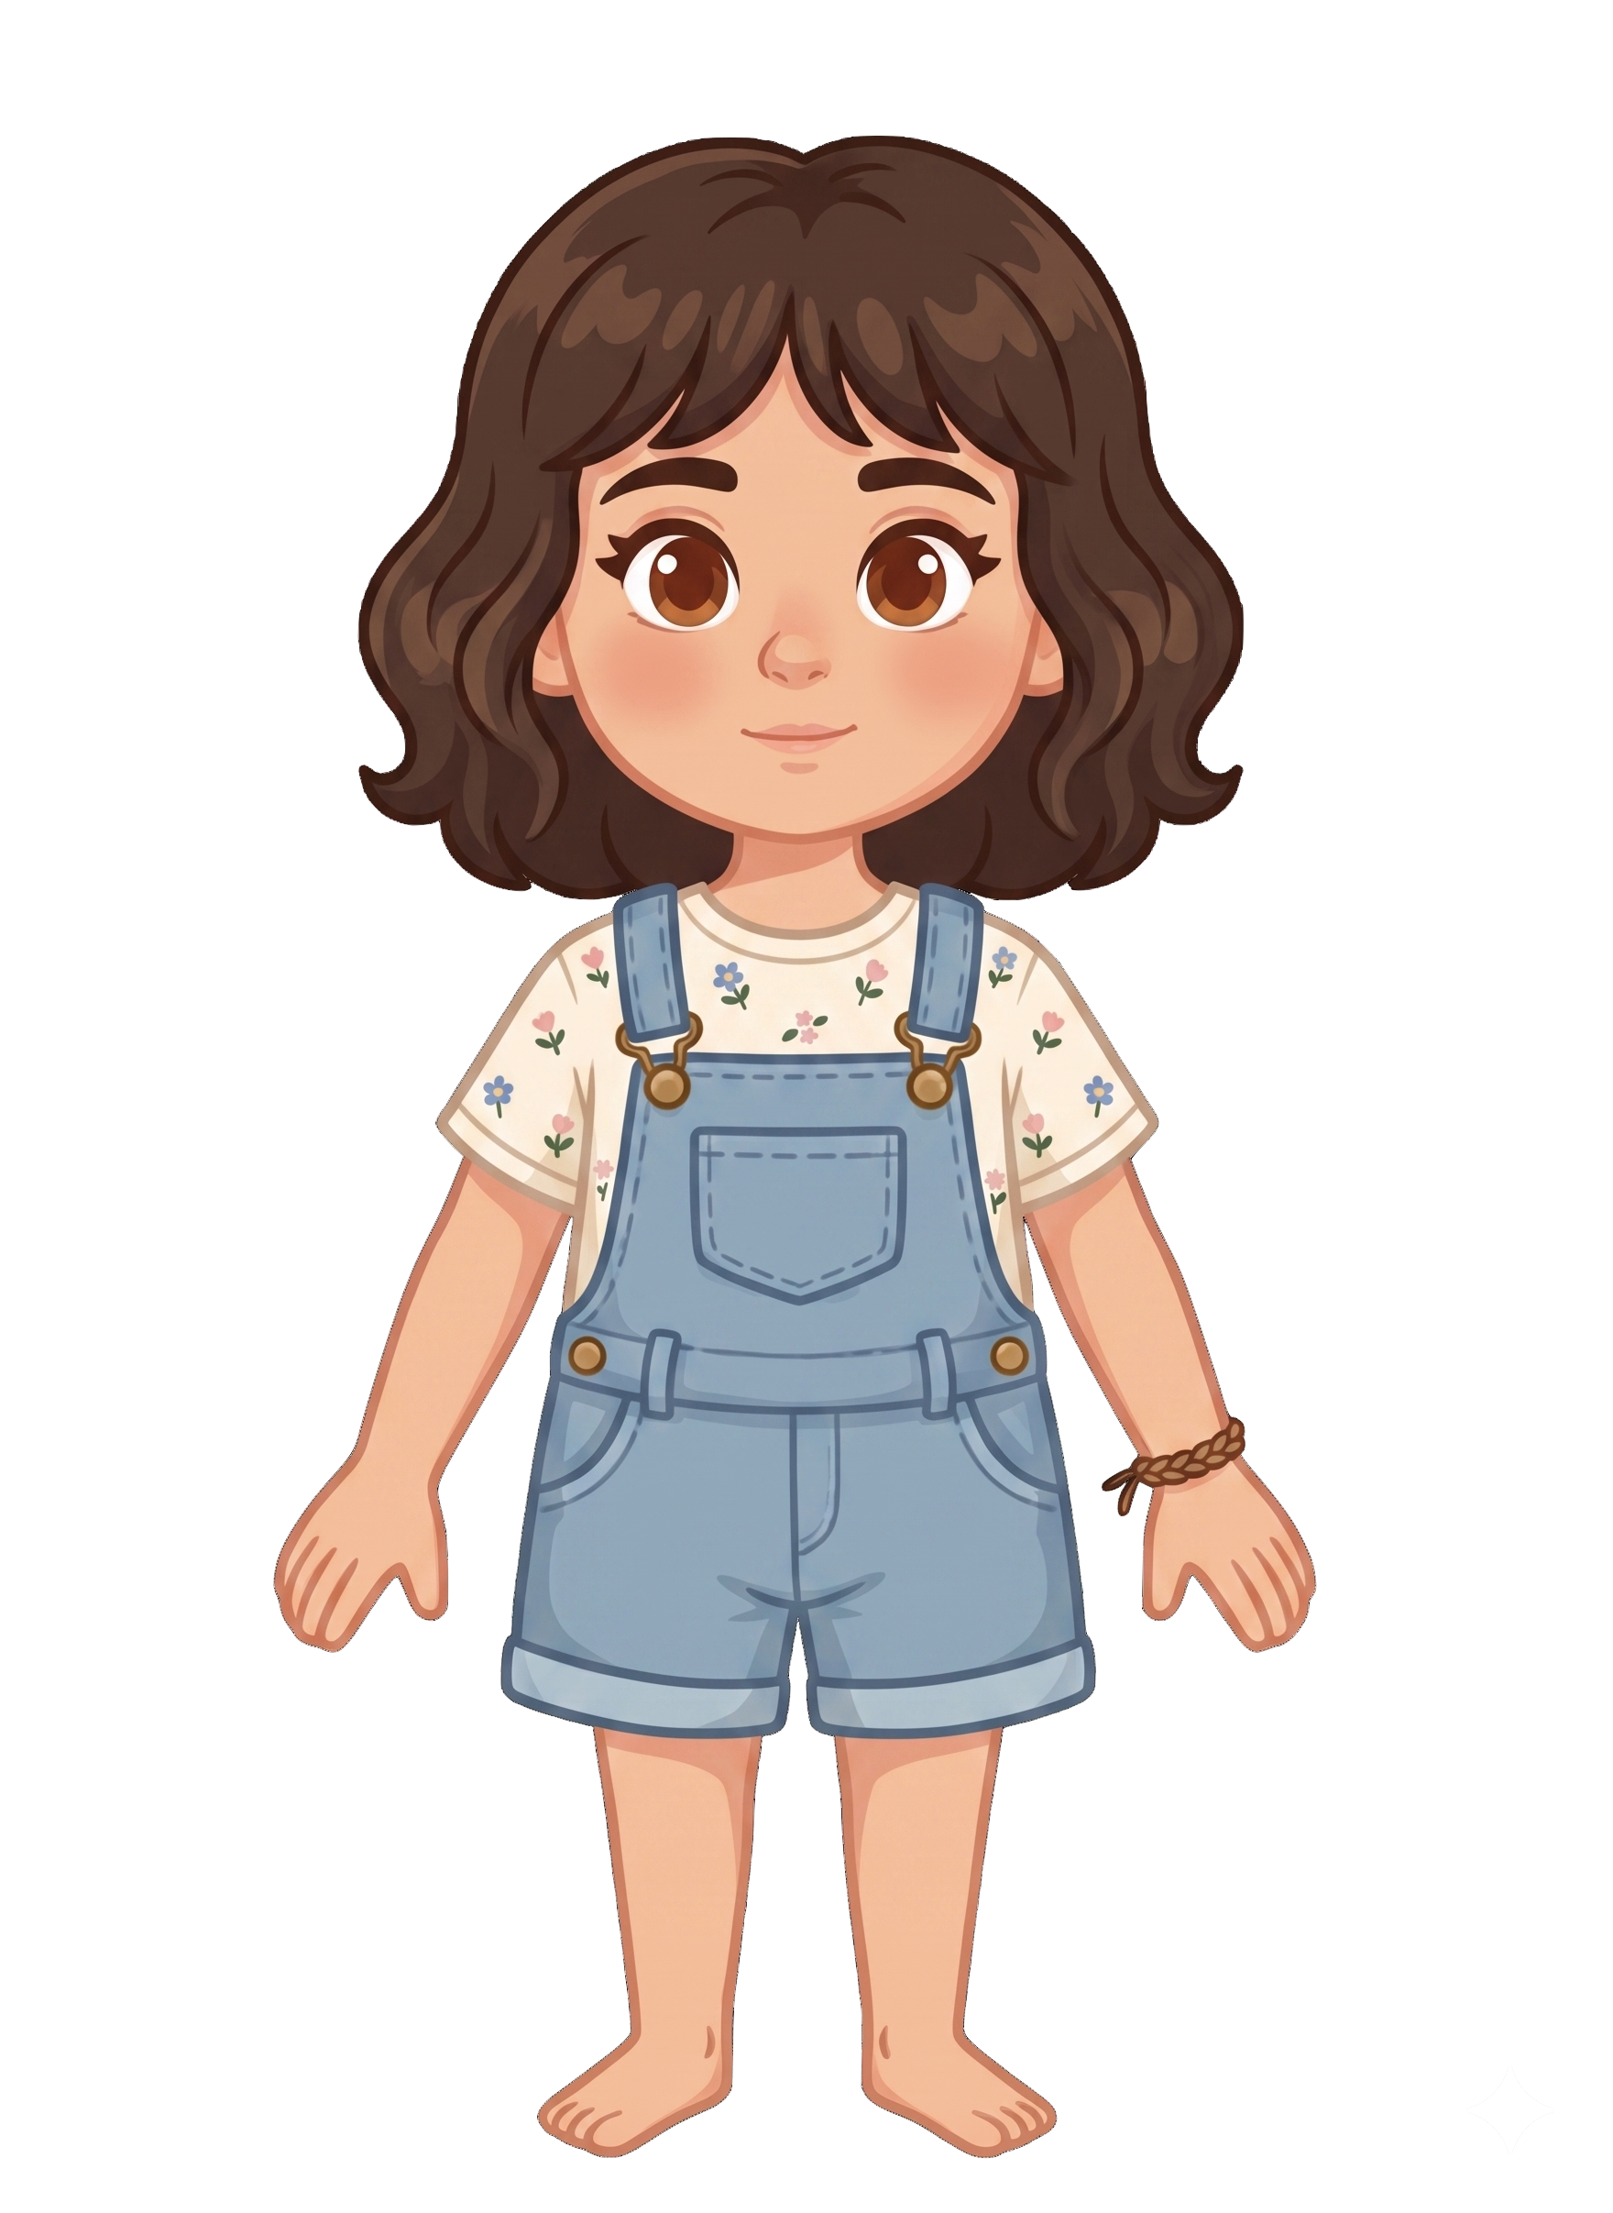
This is Katie.

Slide 2


Katie has 2 cookies.

Slide 3
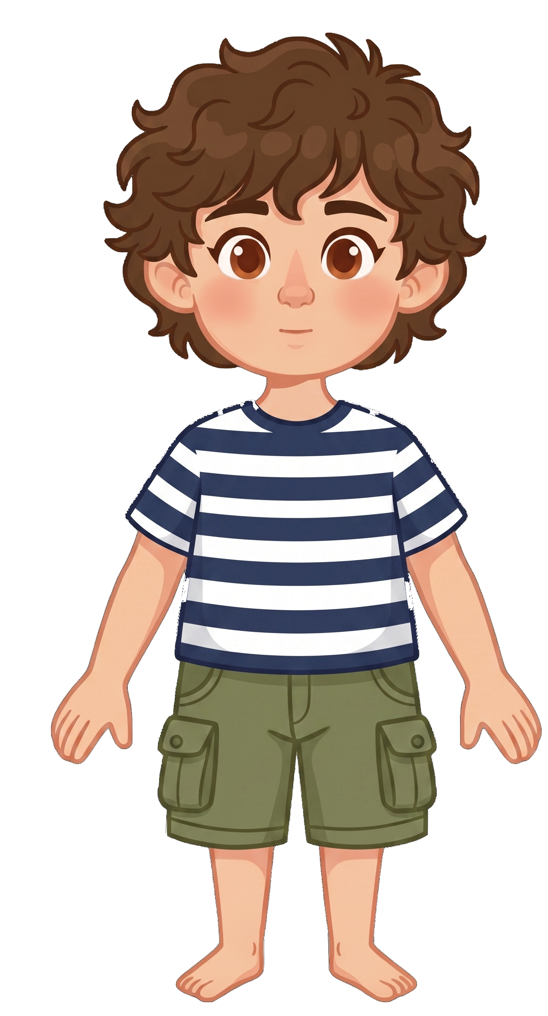
This is Tony.

Slide 4
Tony has 8 cookies.

Slide 5
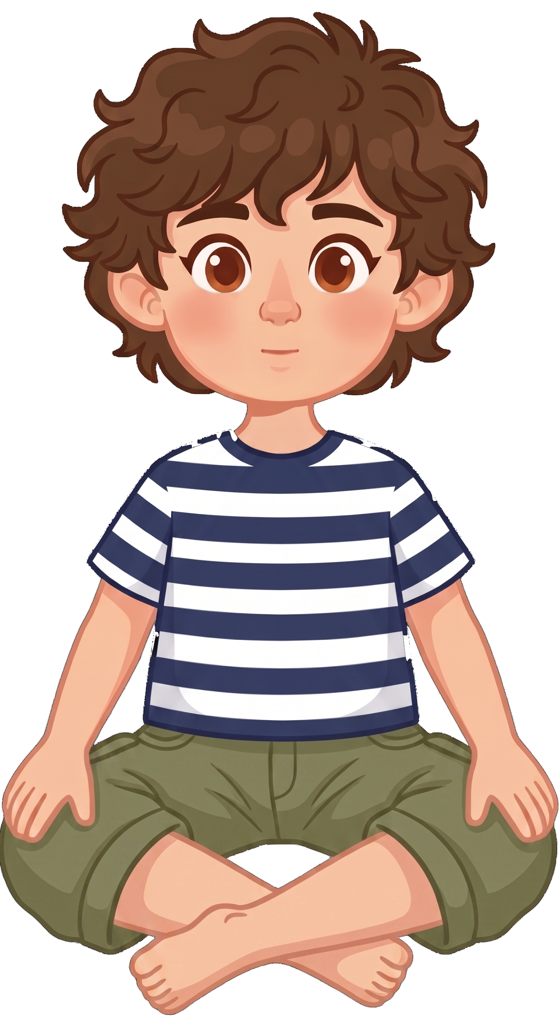
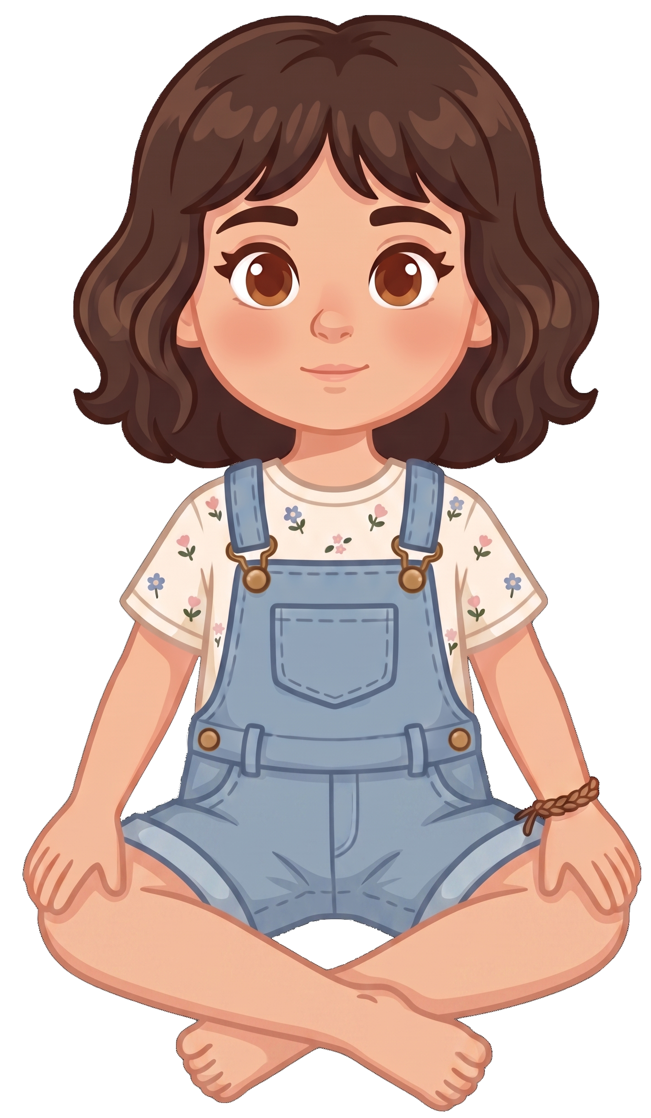
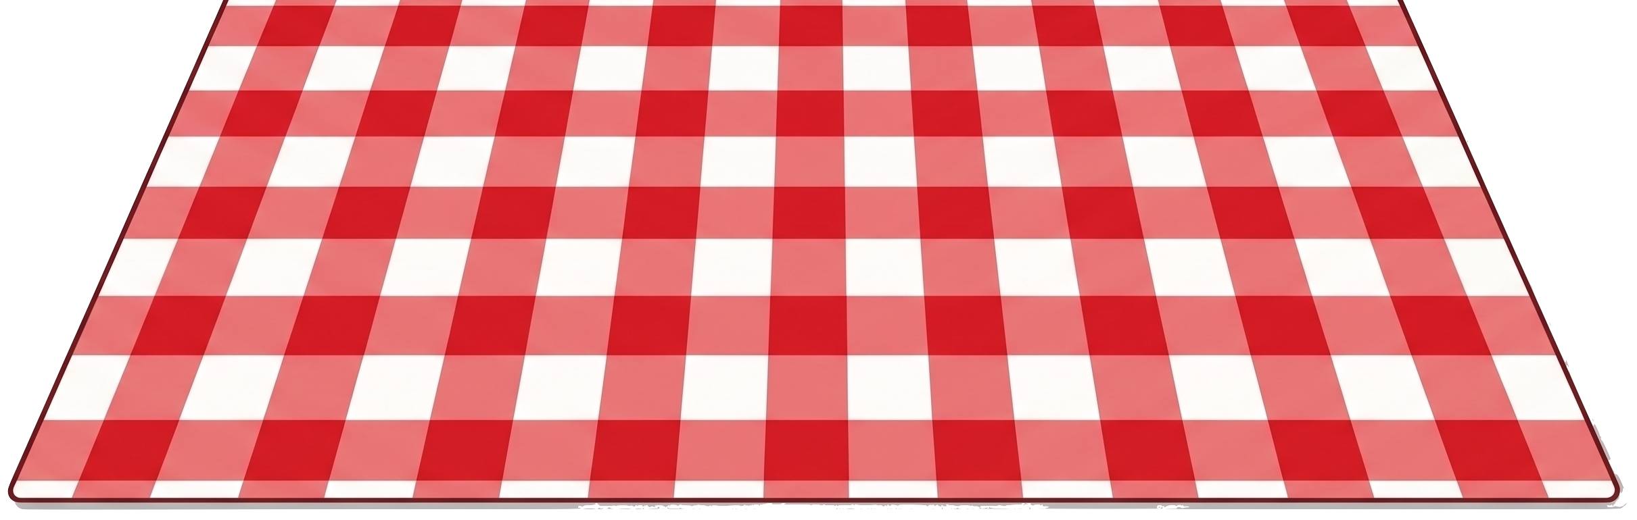
Katie and Tony are having a picnic.

Slide 6
Katie tells Tony, “I know the wind could blow my cookies away.”

Slide 7
Katie tells Tony, “I’m not okay with that.”

Slide 8

Oh no! A gust of wind blows.

Slide 9
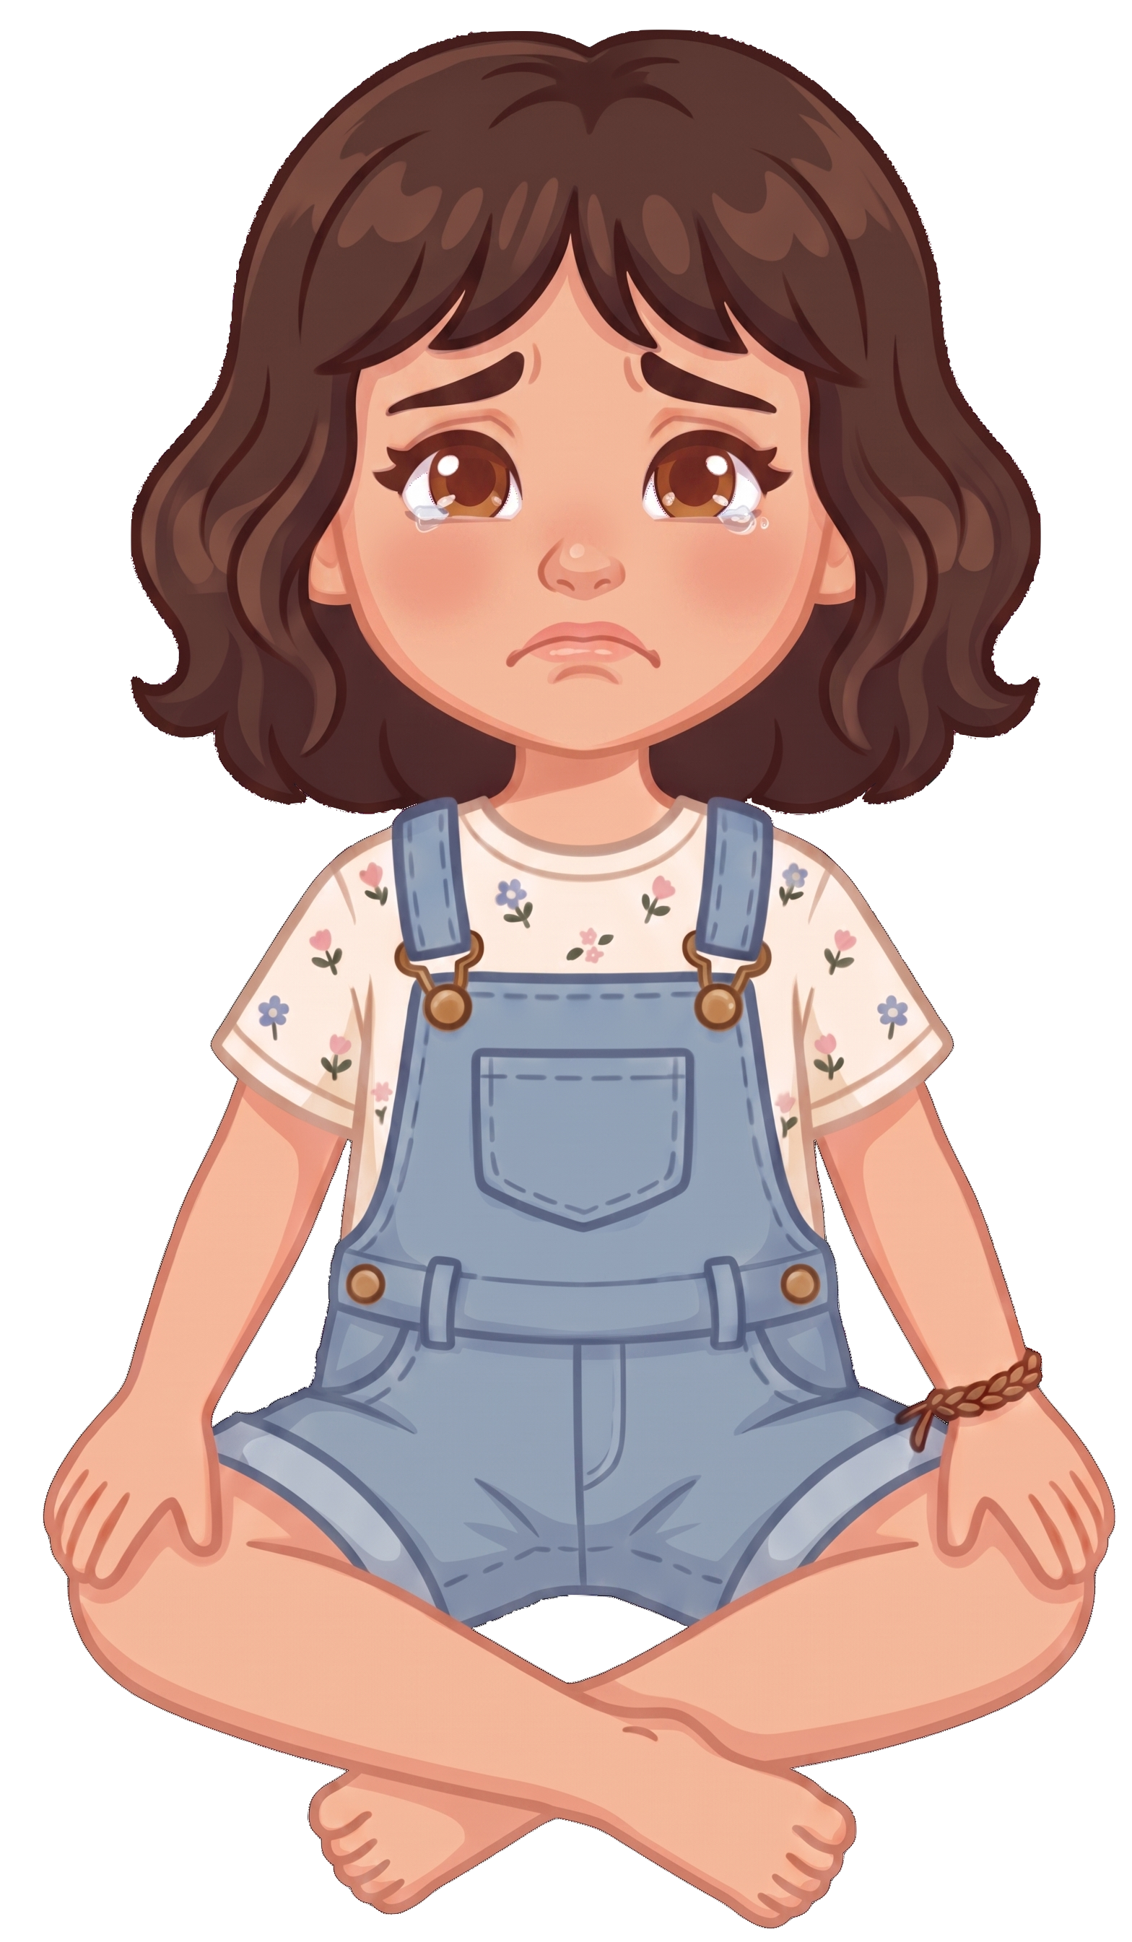
2 of Katie’s cookies blow away!

Slide 10

Tony still has 8 cookies. Katie now has 0 cookies.

