Slide 1
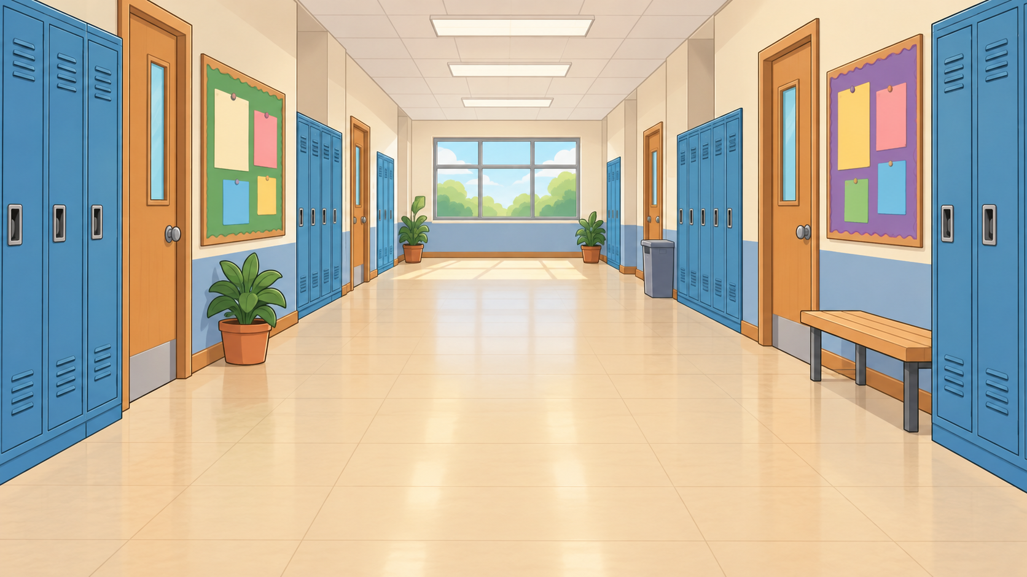
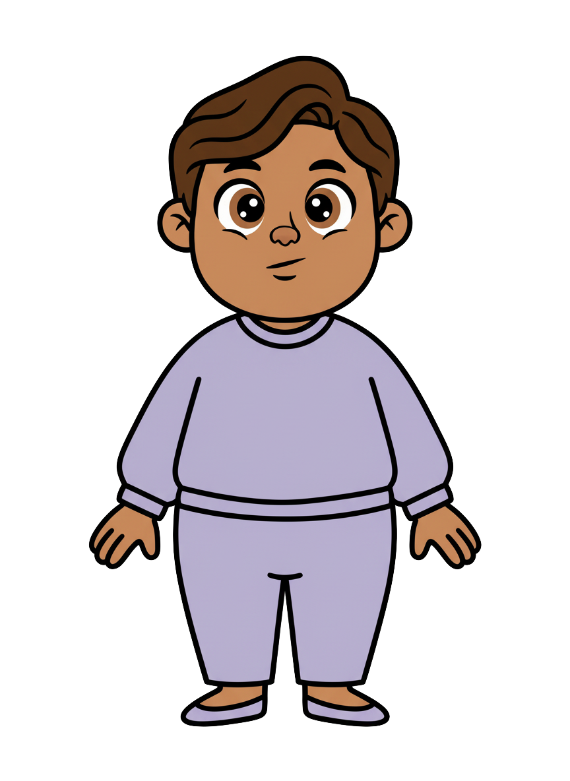
This is Milo.

Slide 2


Milo has 8 cookies.

Slide 3
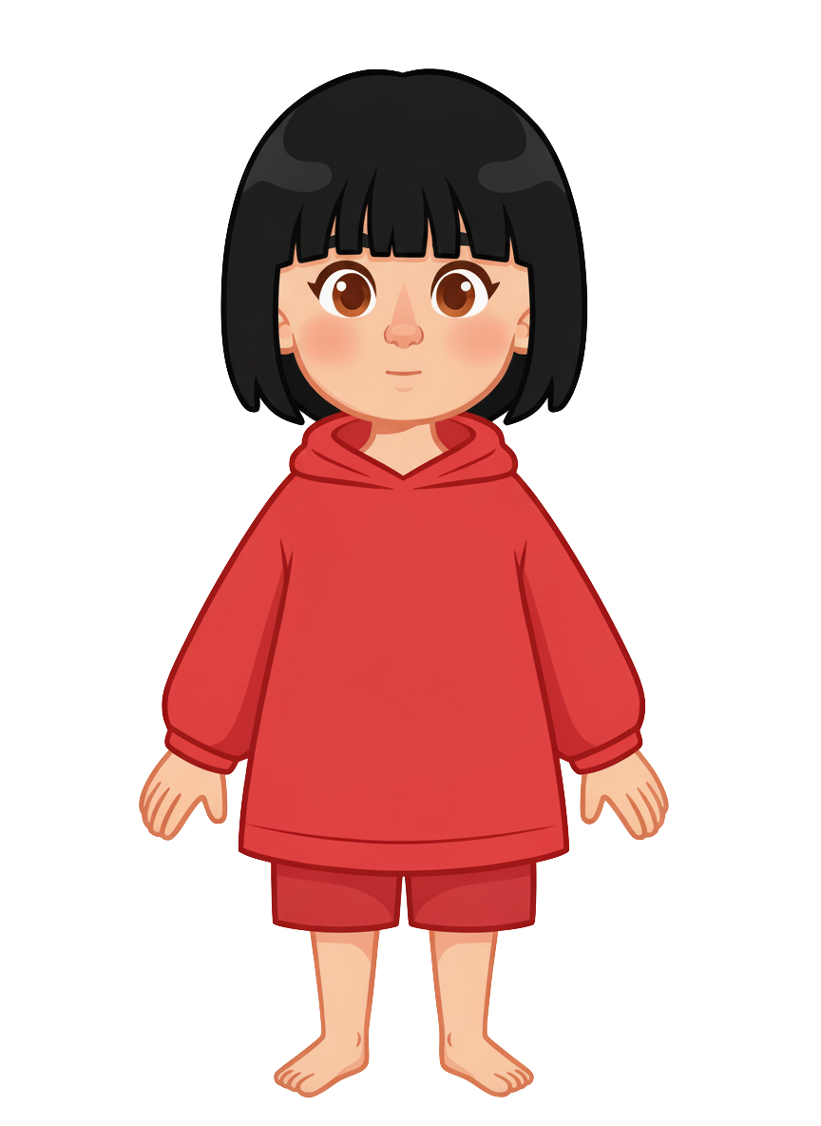
This is Sasha.

Slide 4
Sasha has 2 cookies.

Slide 5
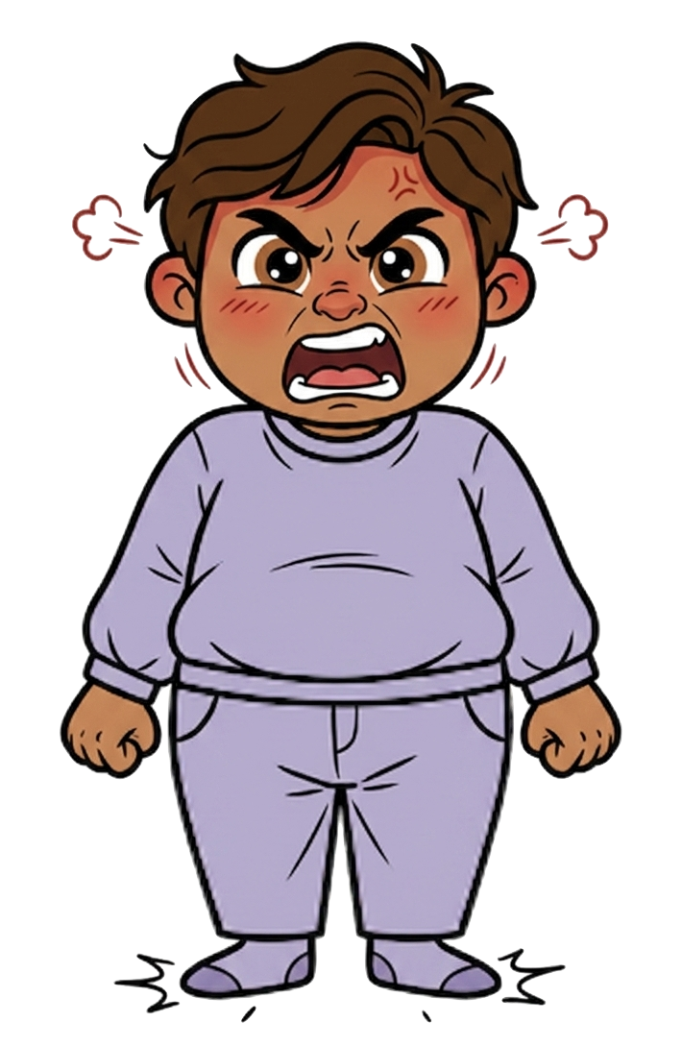
Milo is angry.

Slide 6
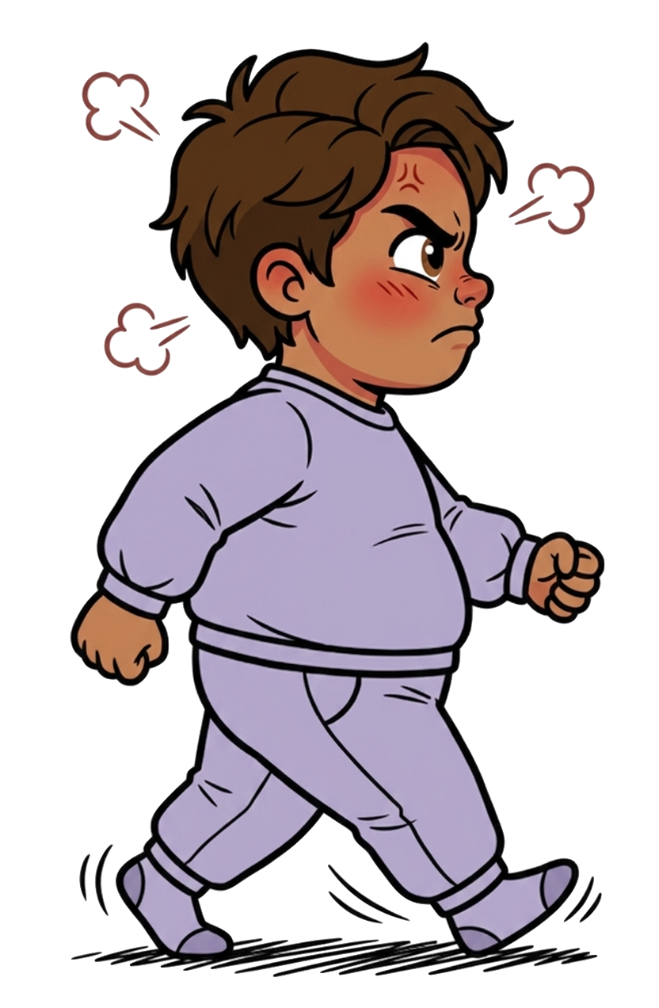
He walks over.

Slide 7
Sasha tells Milo, “I know you’re going to knock my cookies onto the ground.”

Slide 8
Sasha tells Milo, “I’m not okay with that.”

Slide 9
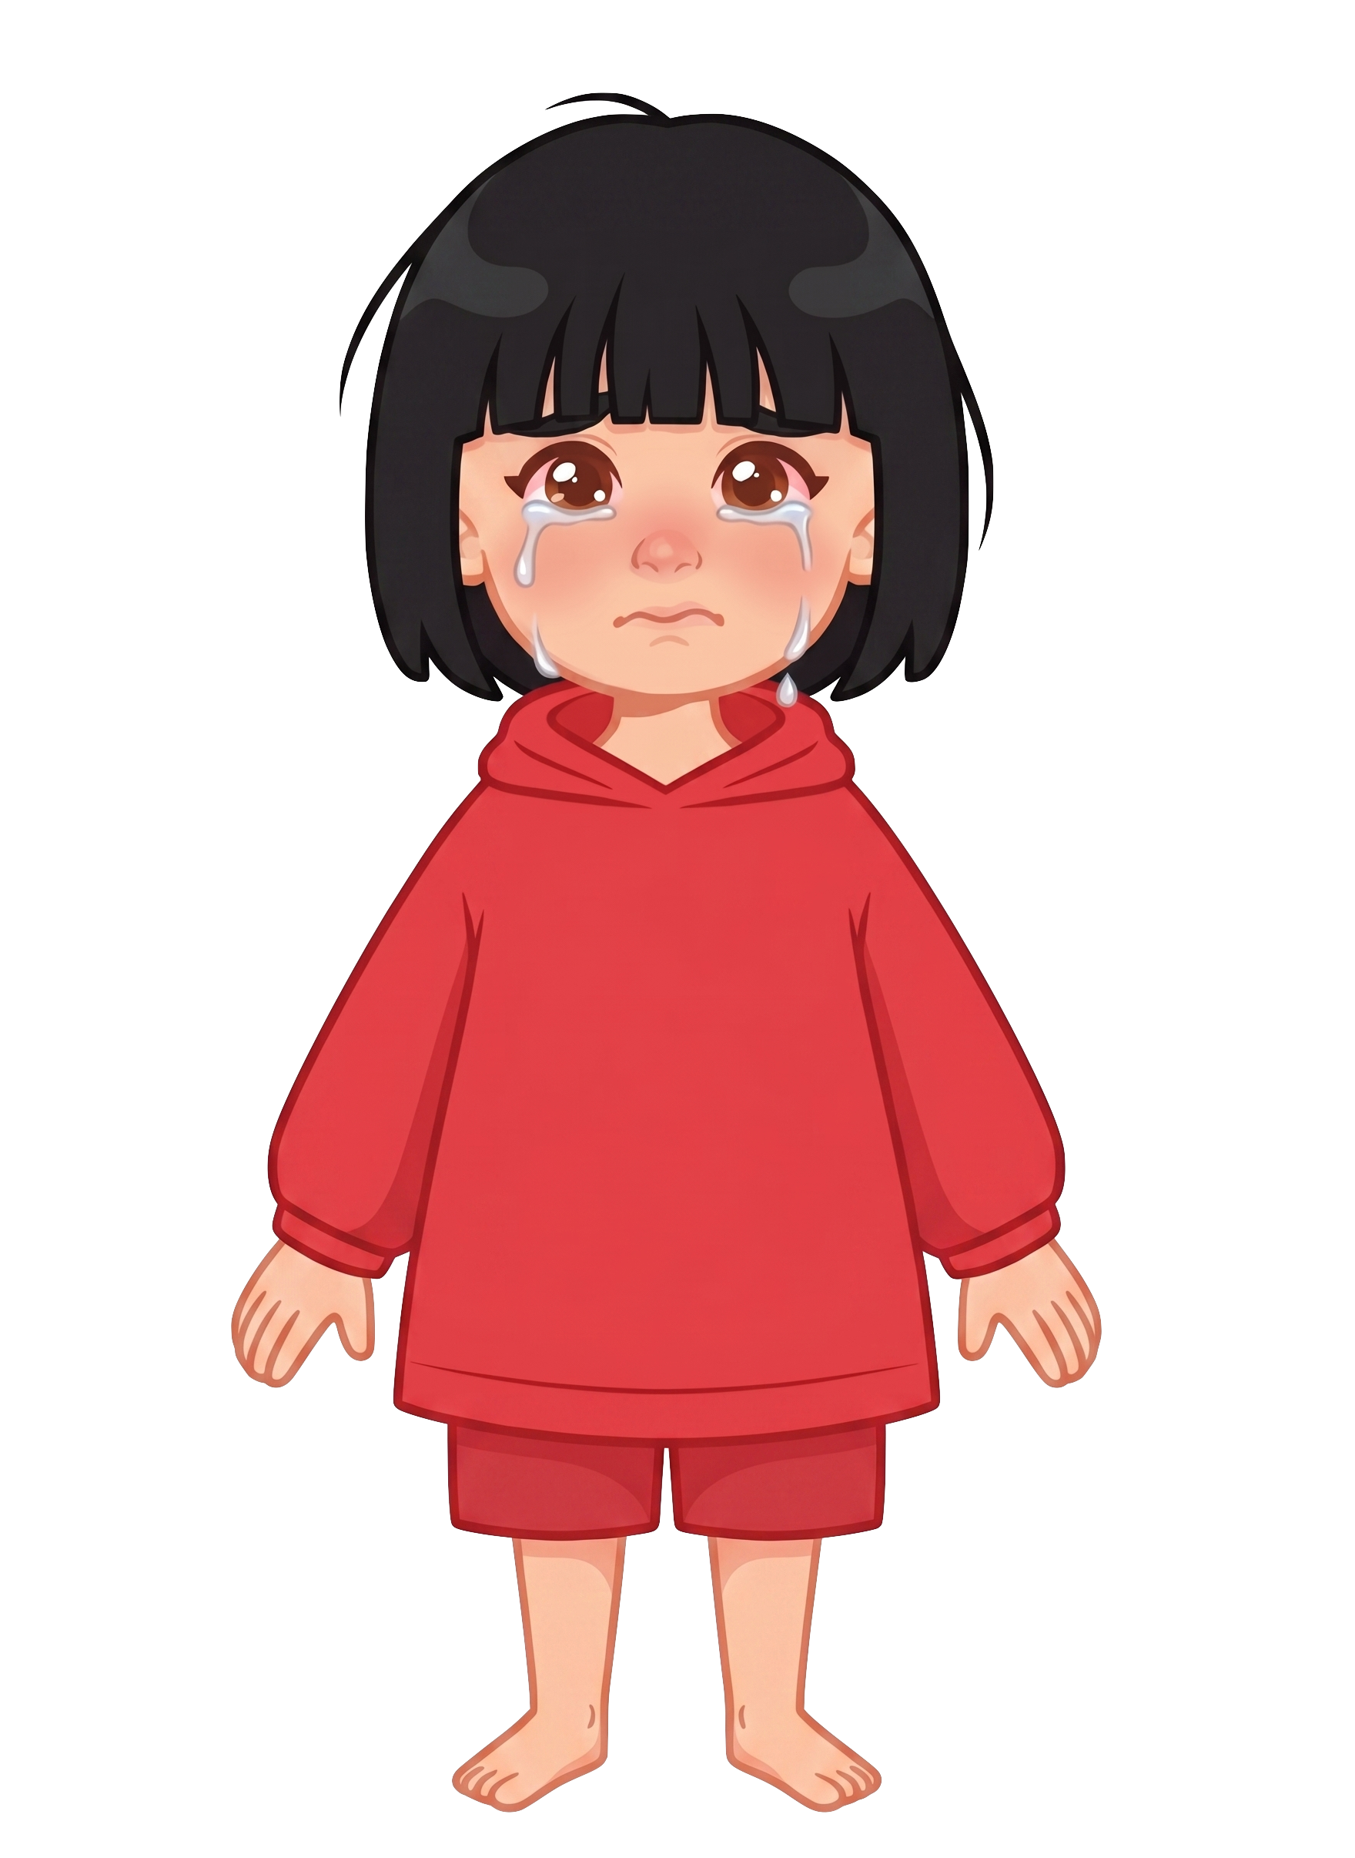
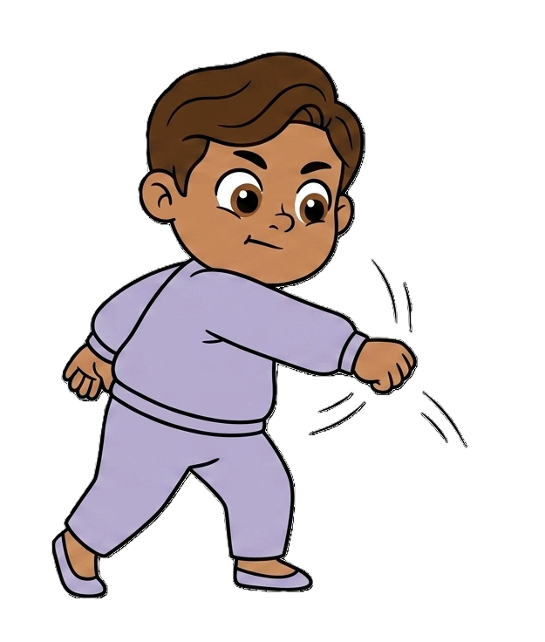
Milo hits 2 of Sasha’s cookies!

Slide 10

Milo still has 8 cookies. Sasha now has 0 cookies.

