Slide 1
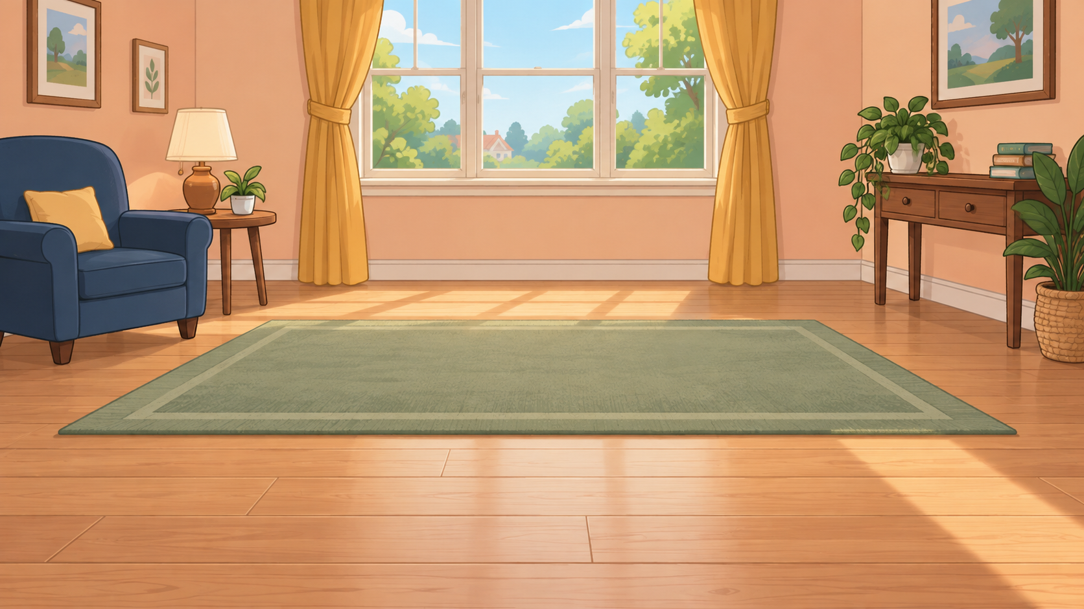
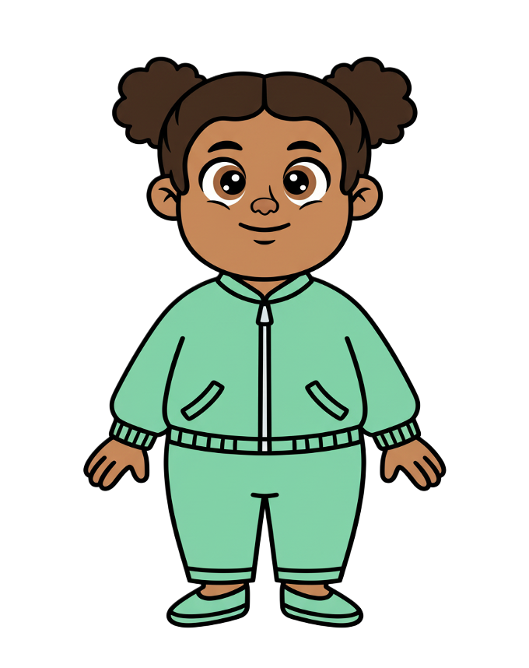
This is Zoe.

Slide 2


Zoe has 8 cookies.

Slide 3
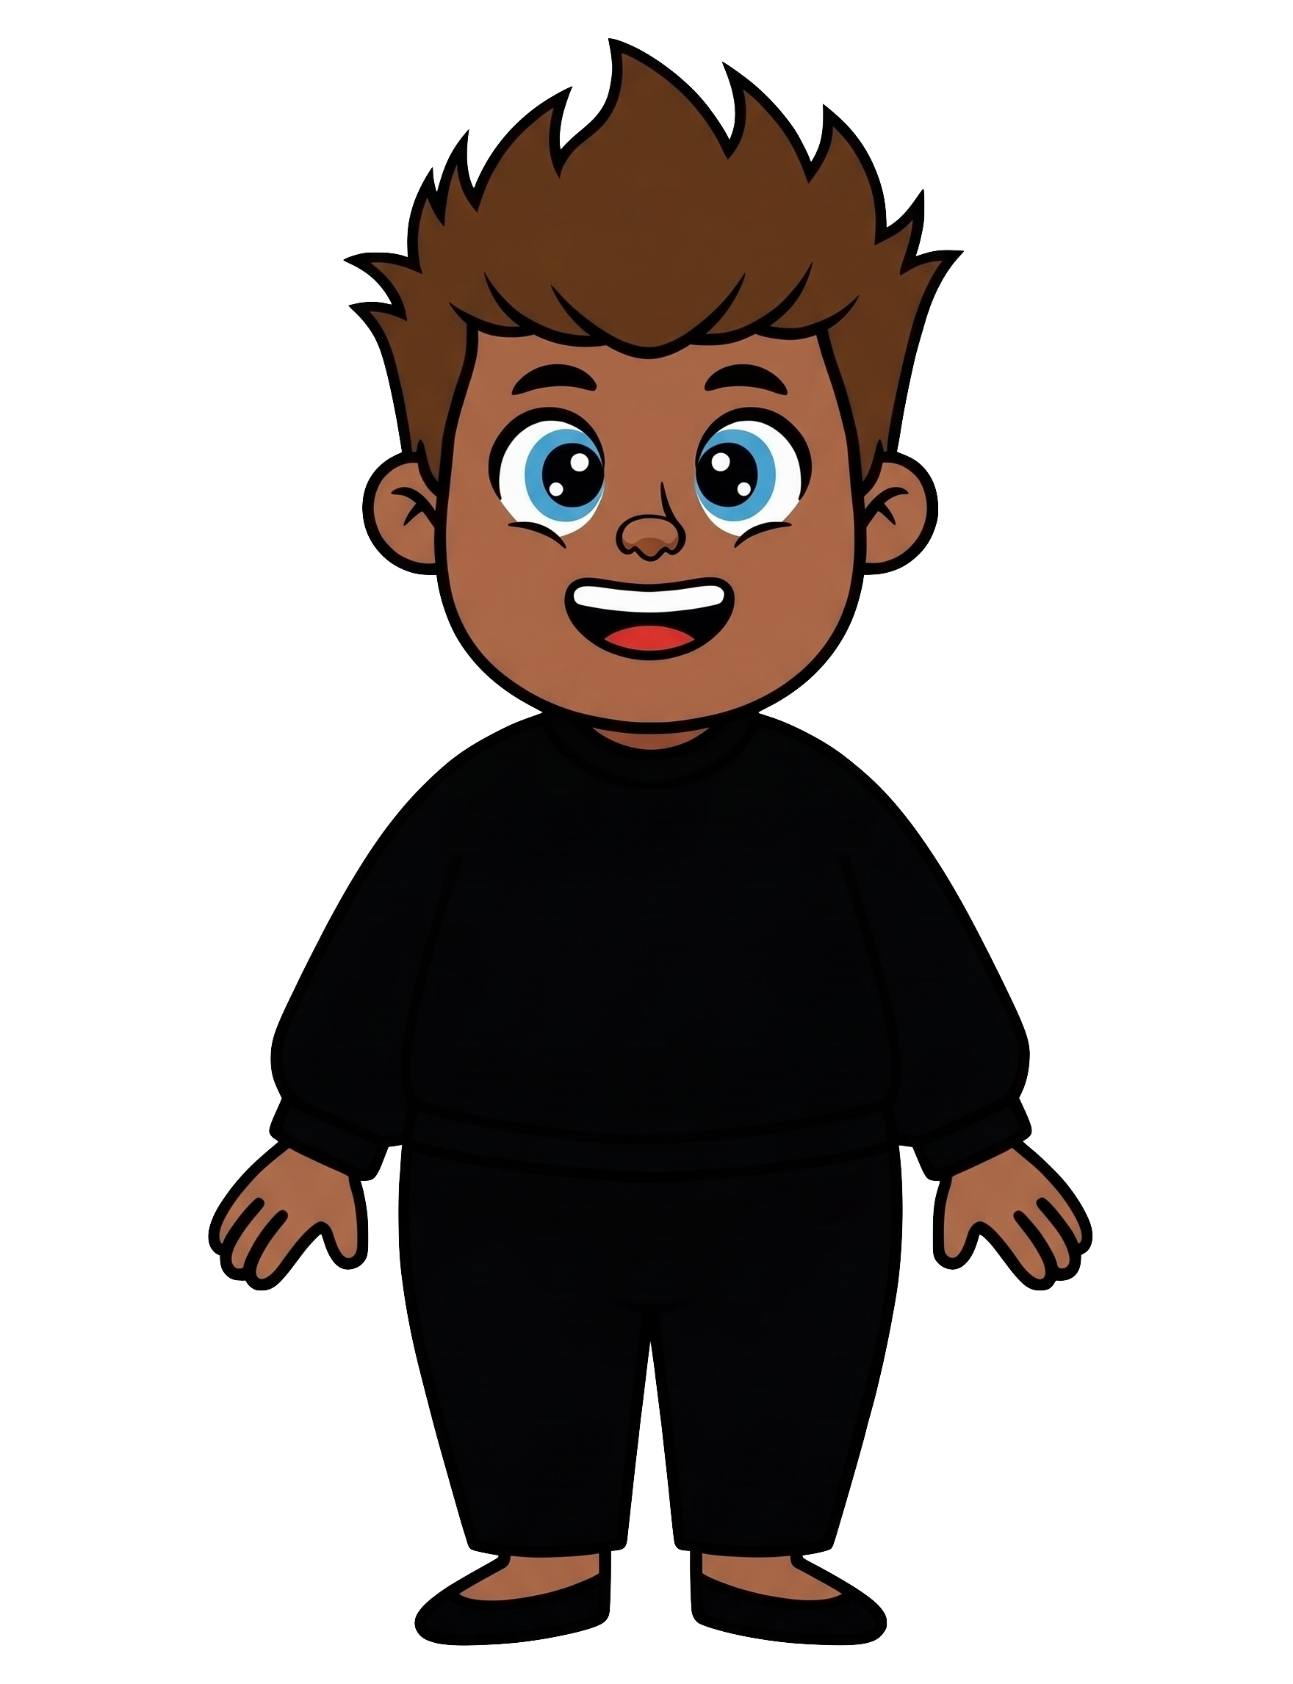
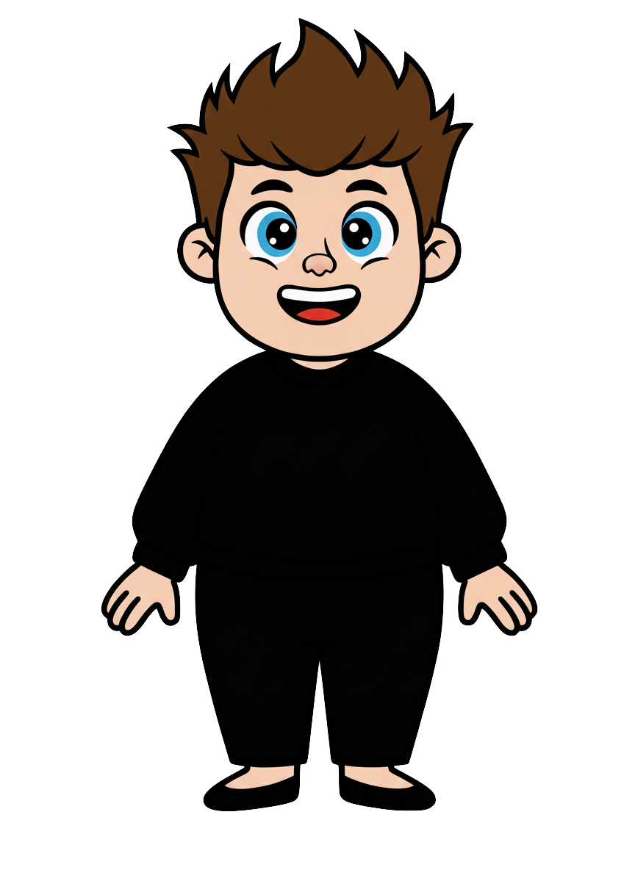
This is Rex.

Slide 4
Rex has 2 cookies.

Slide 5
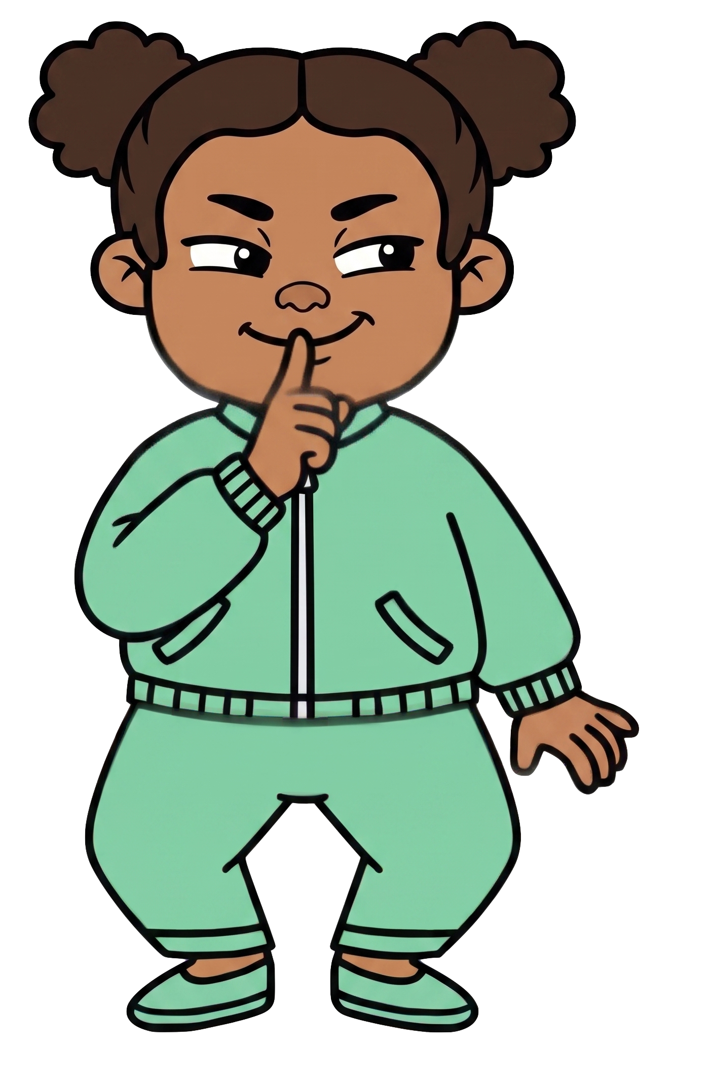
Zoe wants Rex to have fewer cookies.

Slide 6
Rex tells Zoe, “I know you’re going to throw my cookies.”

Slide 7
Rex tells Zoe, “I’m not okay with that.”

Slide 8
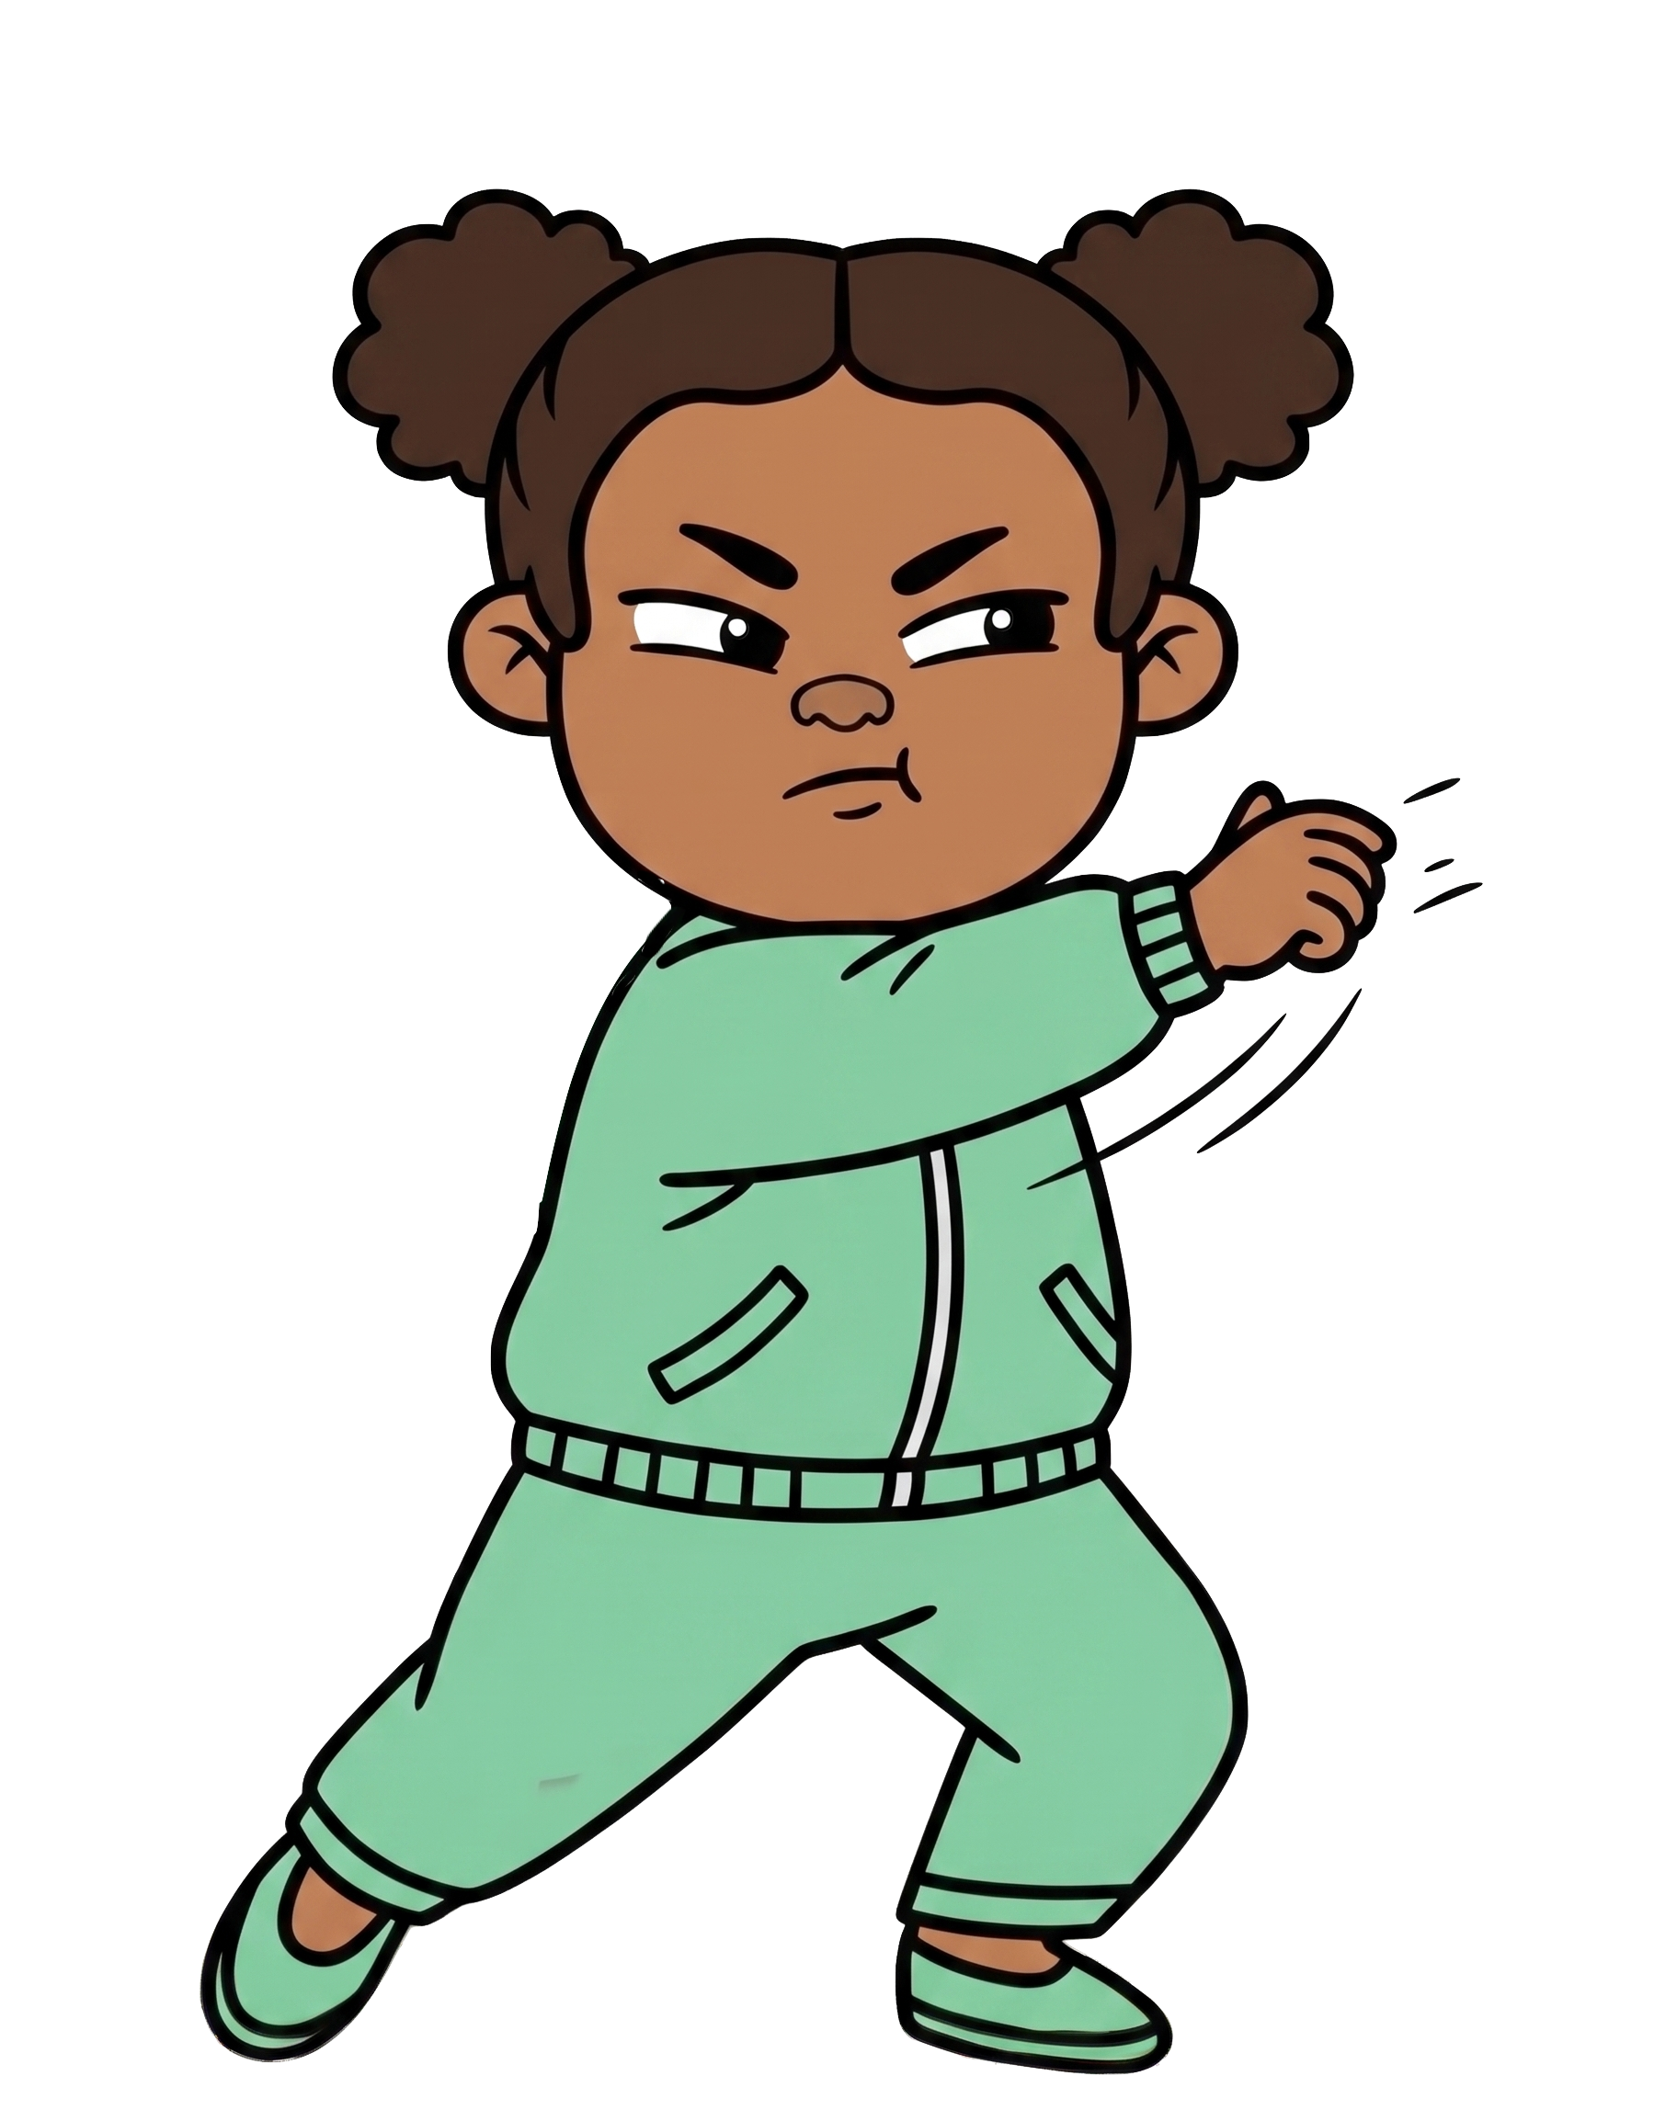

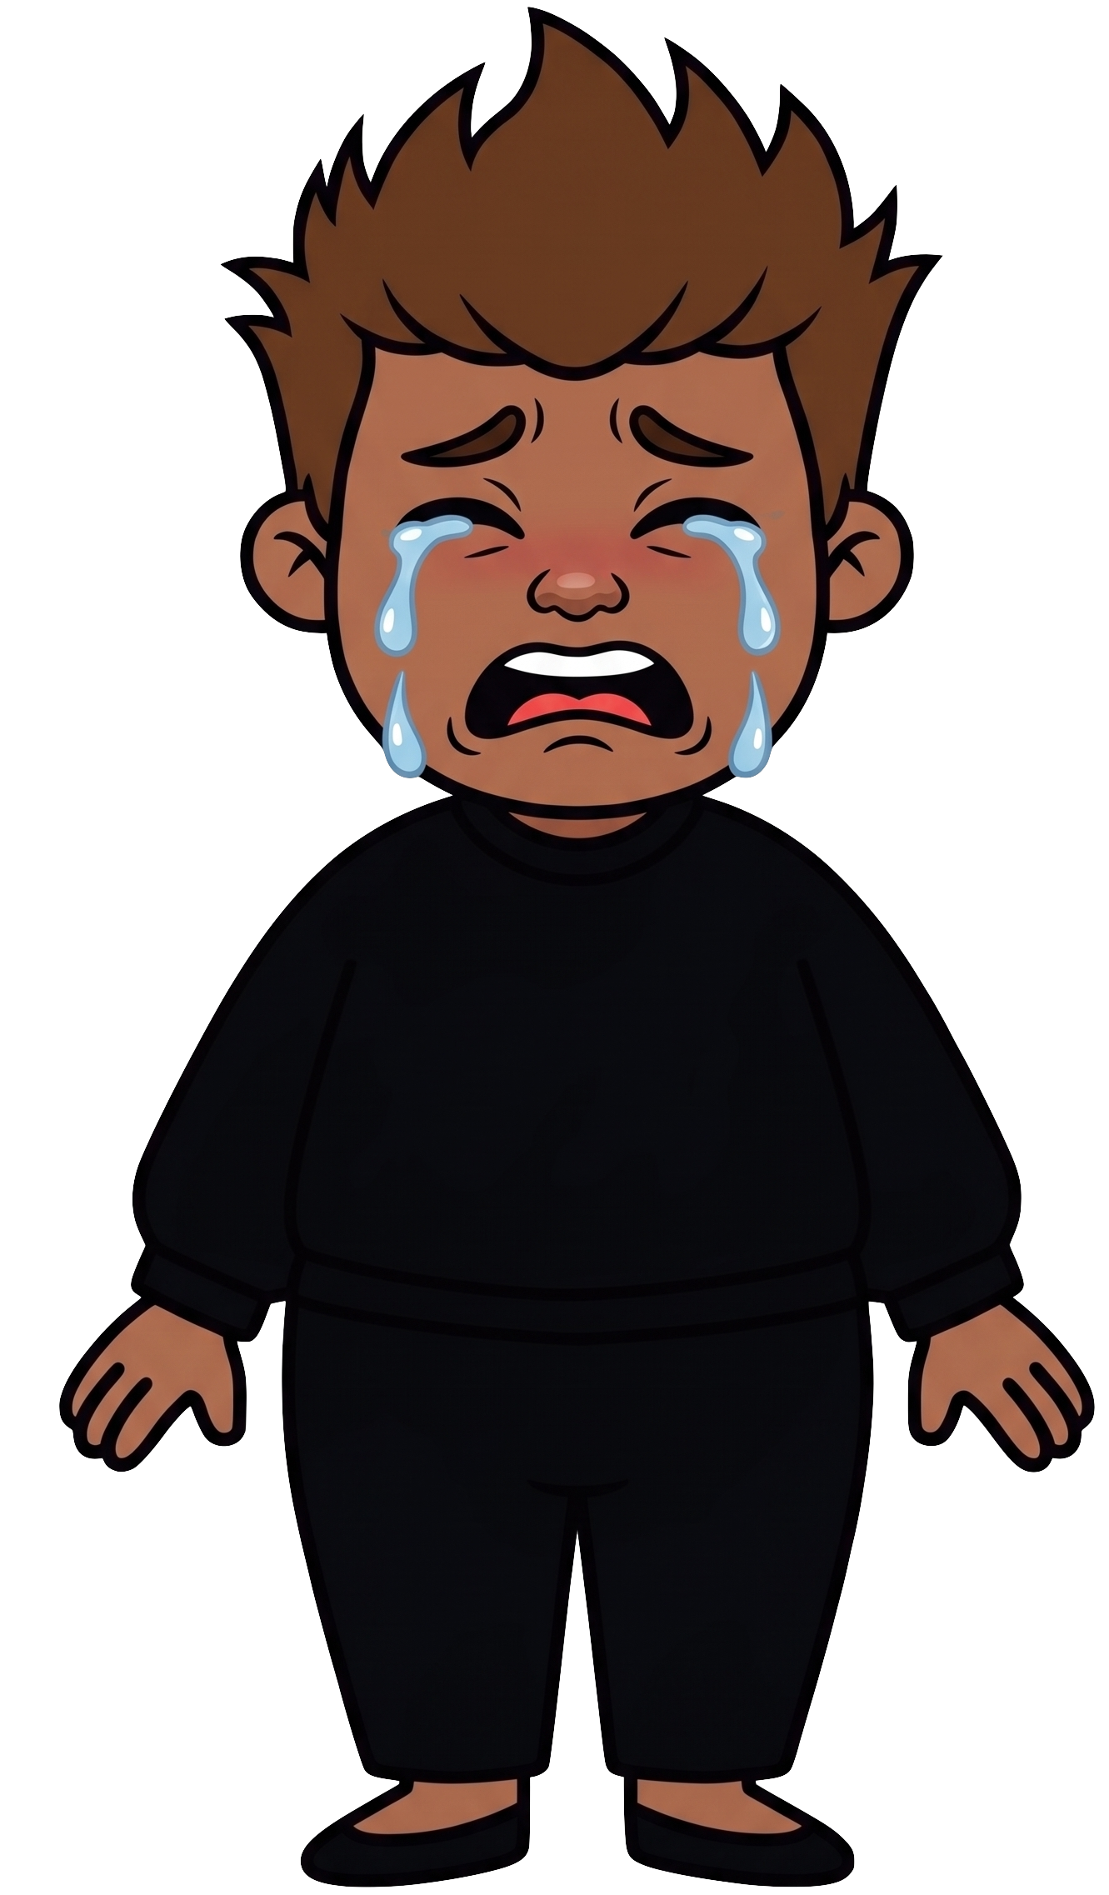
Oh no! Zoe throws 2 of Rex’s cookies!

Slide 9

Zoe still has 8 cookies. Rex now has 0 cookies.

