Slide 1

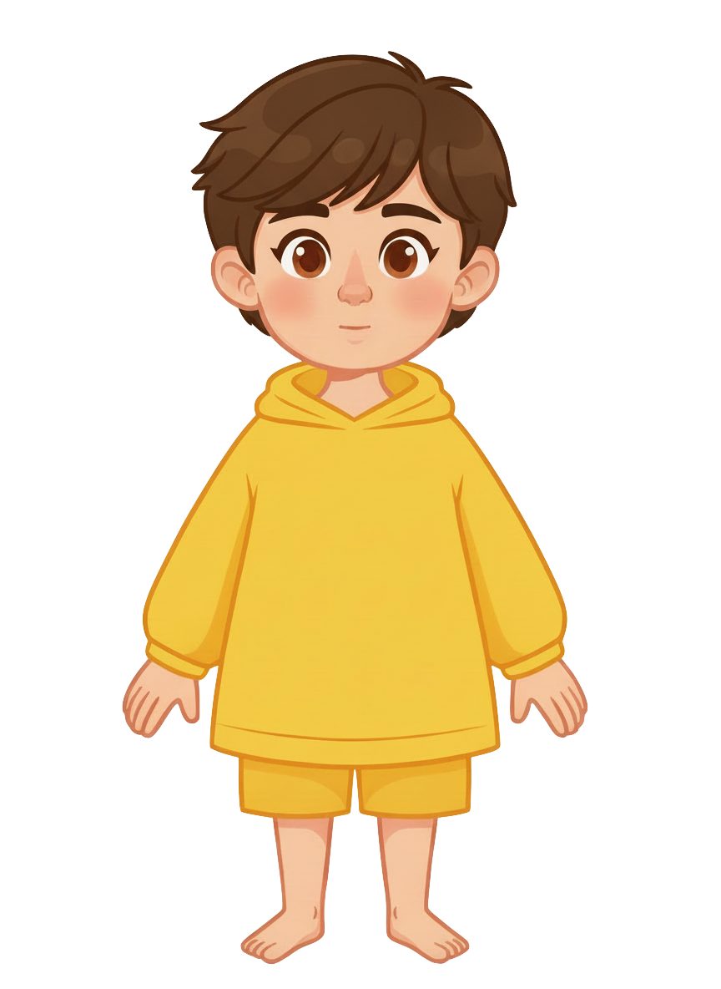
This is Sam.

Slide 2


Sam has 8 cookies.

Slide 3

Sam has an alligator.

Slide 4
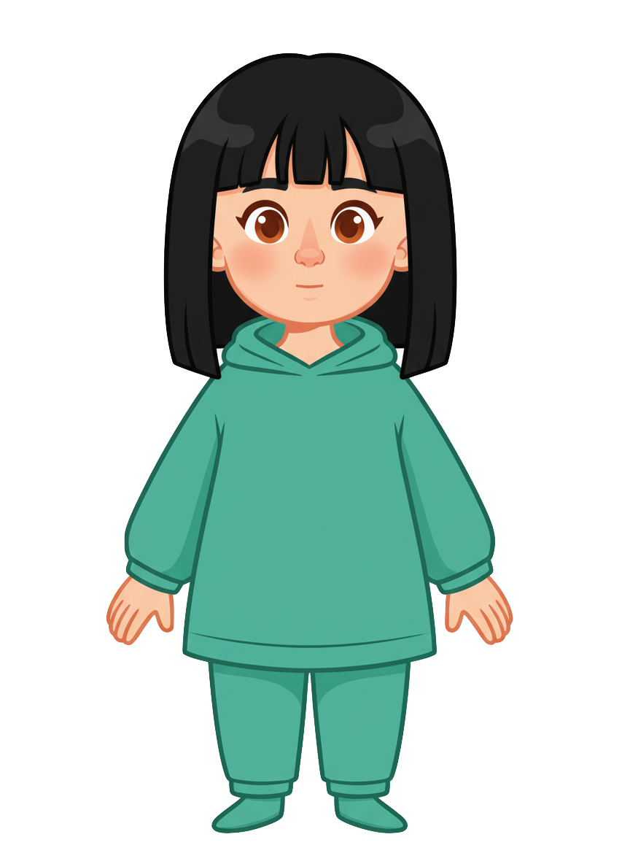
This is Ella.

Slide 5
Ella has 2 cookies.

Slide 6
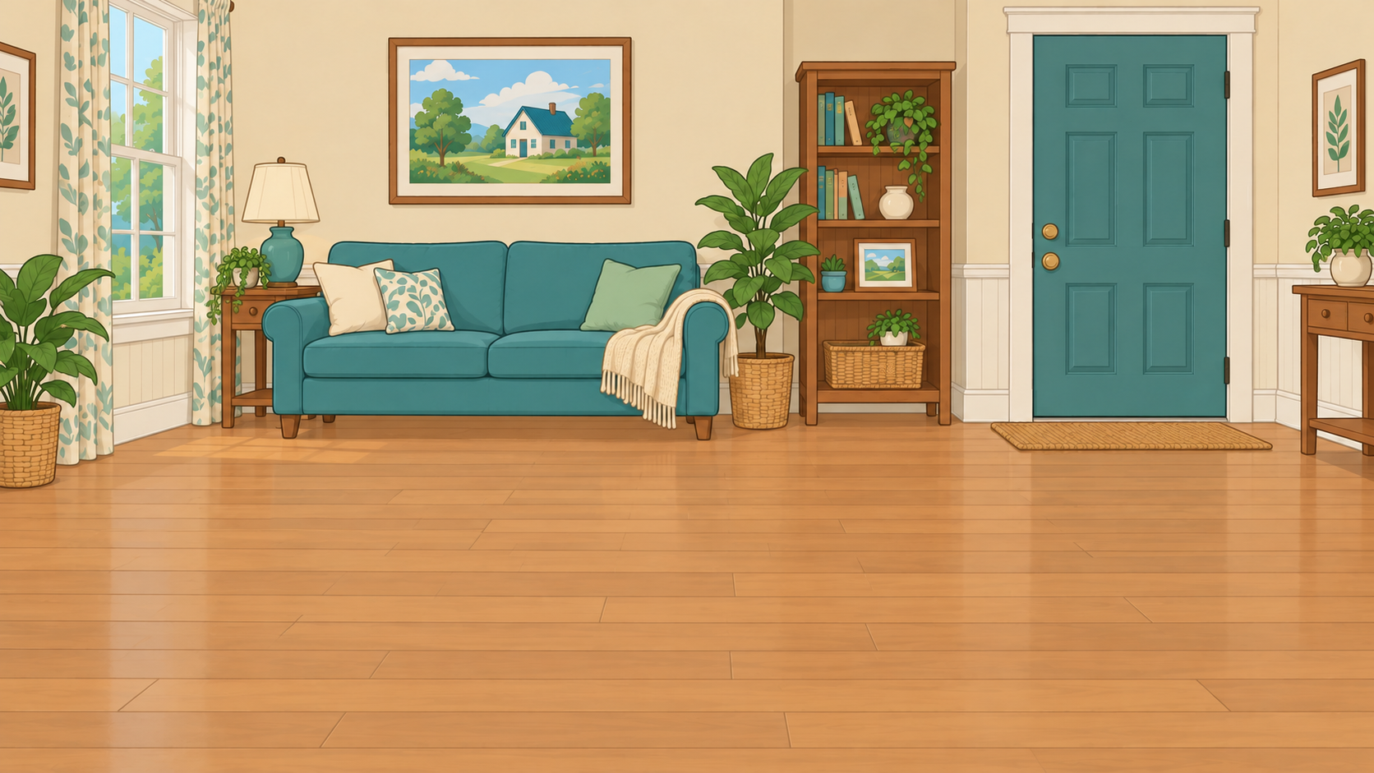
Sam puts his alligator inside the house.

Slide 7
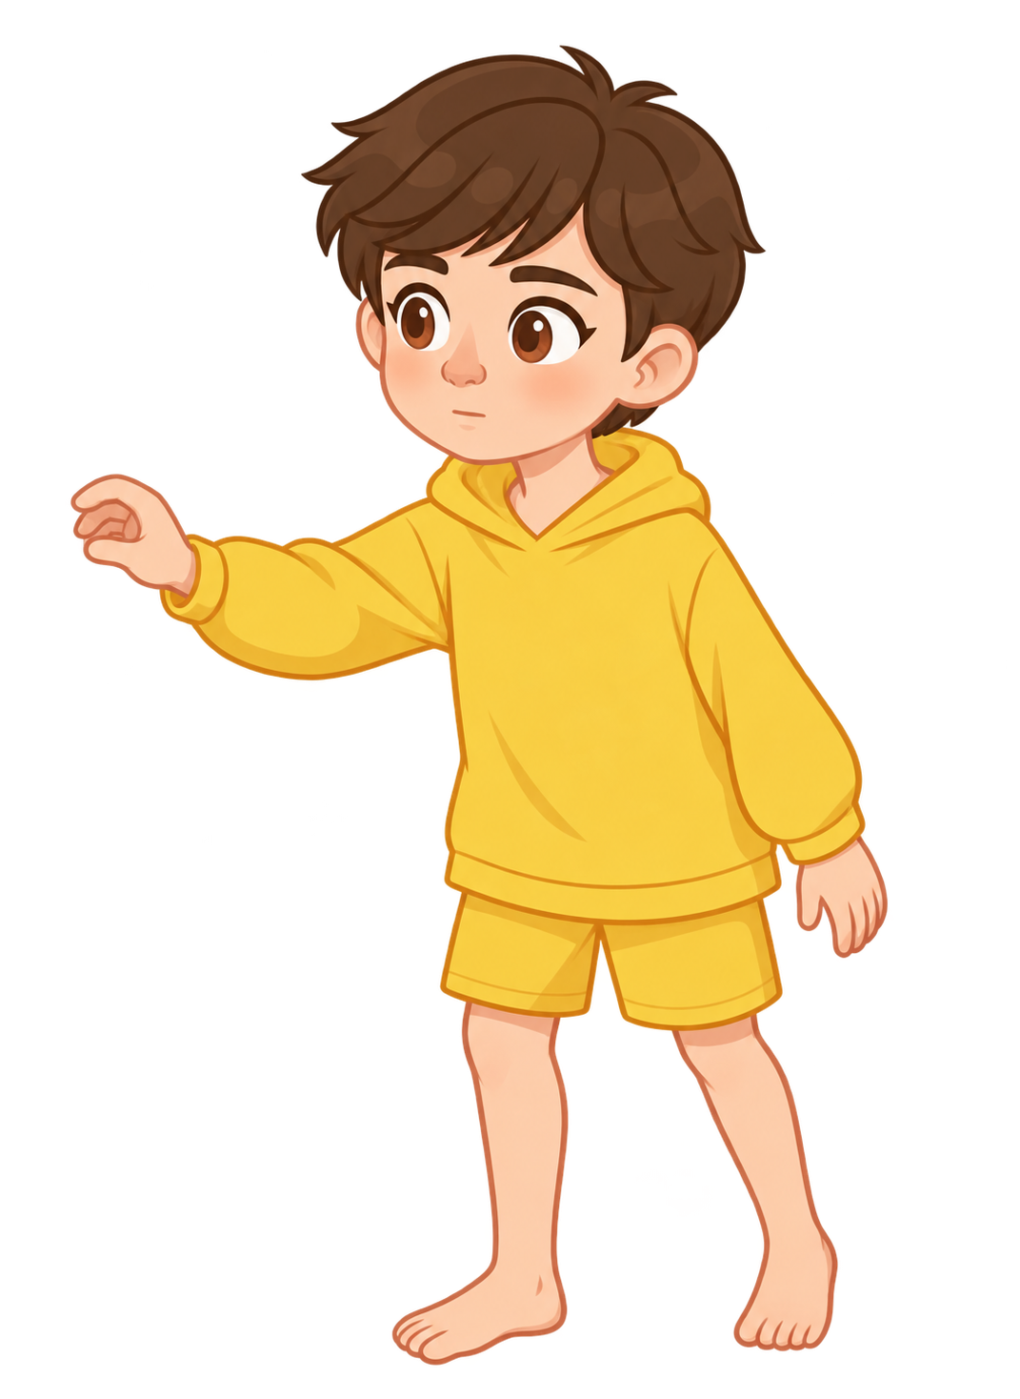
Sam locks the door and checks the lock.

Slide 8
Ella tells Sam, “I know your alligator could escape from the house and eat my cookies.”

Slide 9
Ella tells Sam, “I’m not okay with that.”

Slide 10

Oh no! The alligator breaks out of the house!

Slide 11
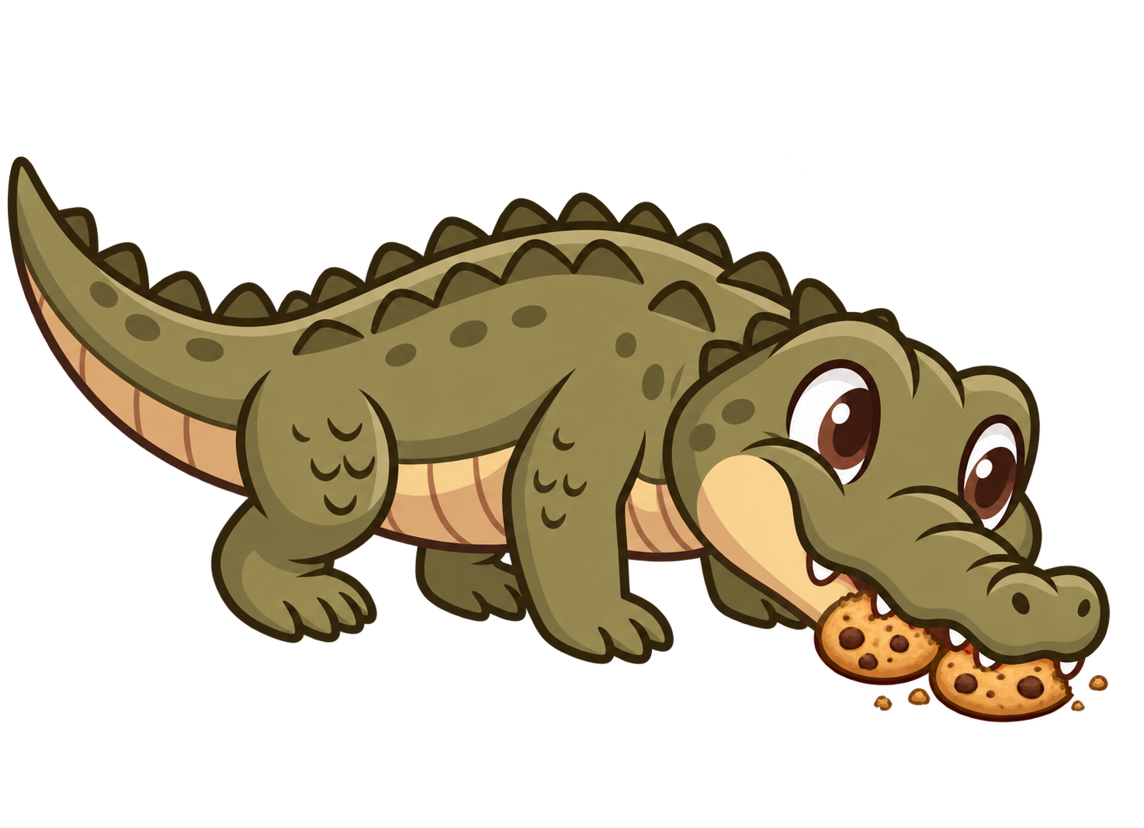
The alligator eats 2 of Ella’s cookies!

Slide 12
Sam still has 8 cookies. Ella now has 0 cookies.

