Slide 1
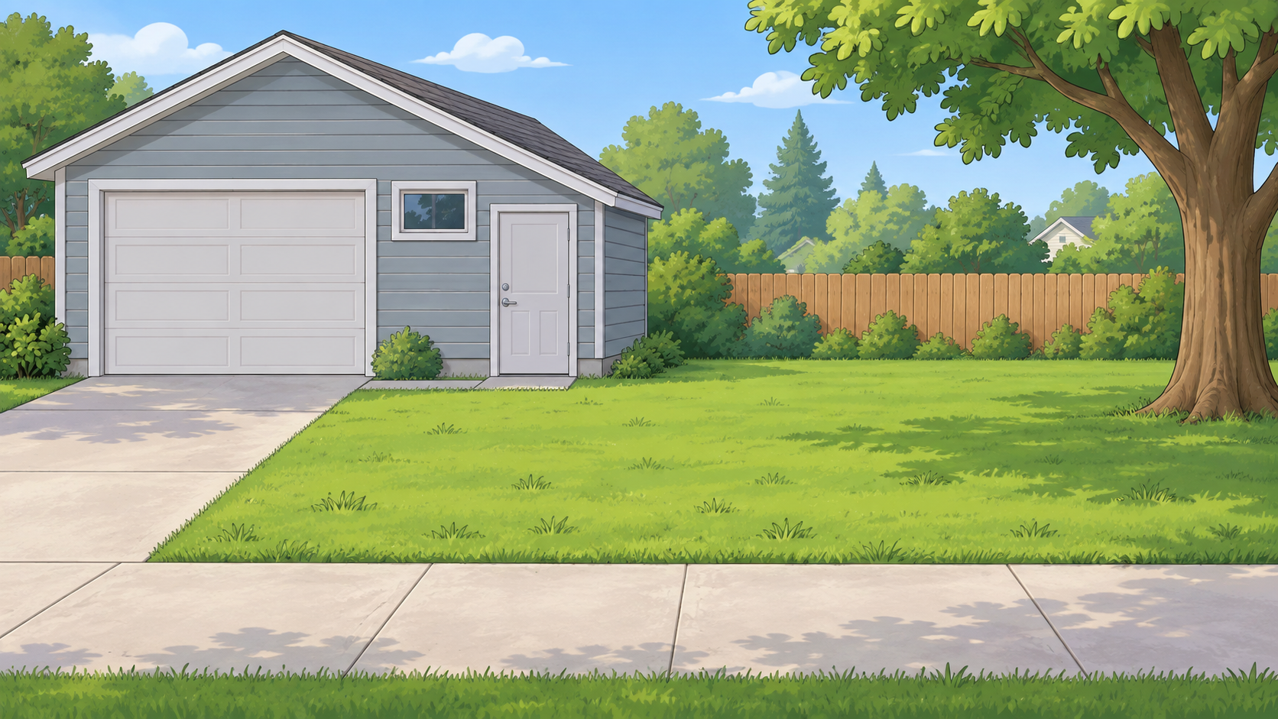
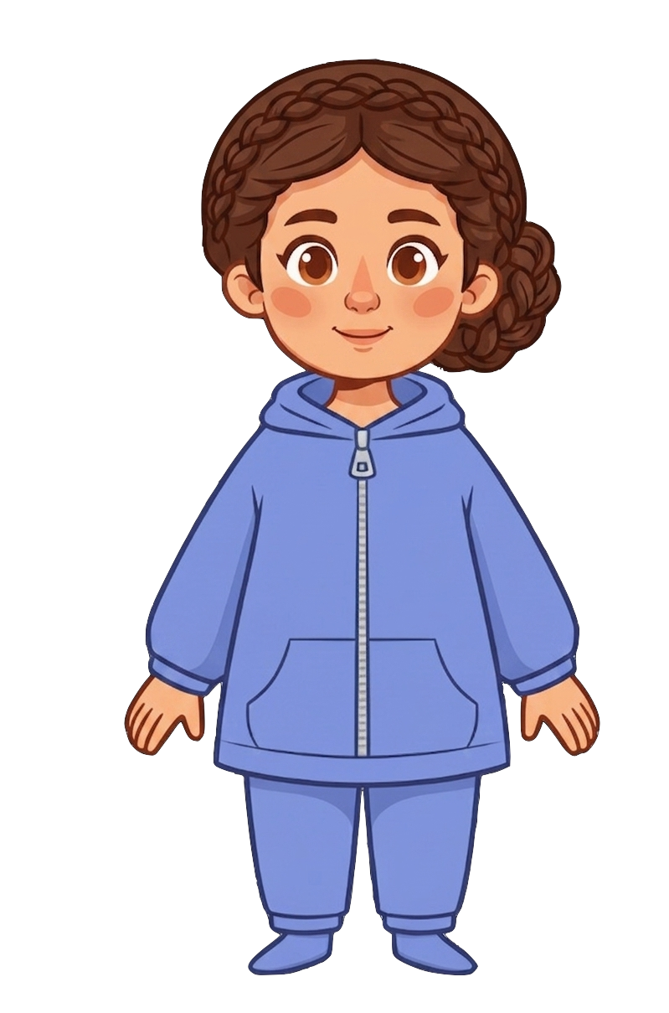
This is Catherine.

Slide 2


Catherine has 8 cookies.

Slide 3
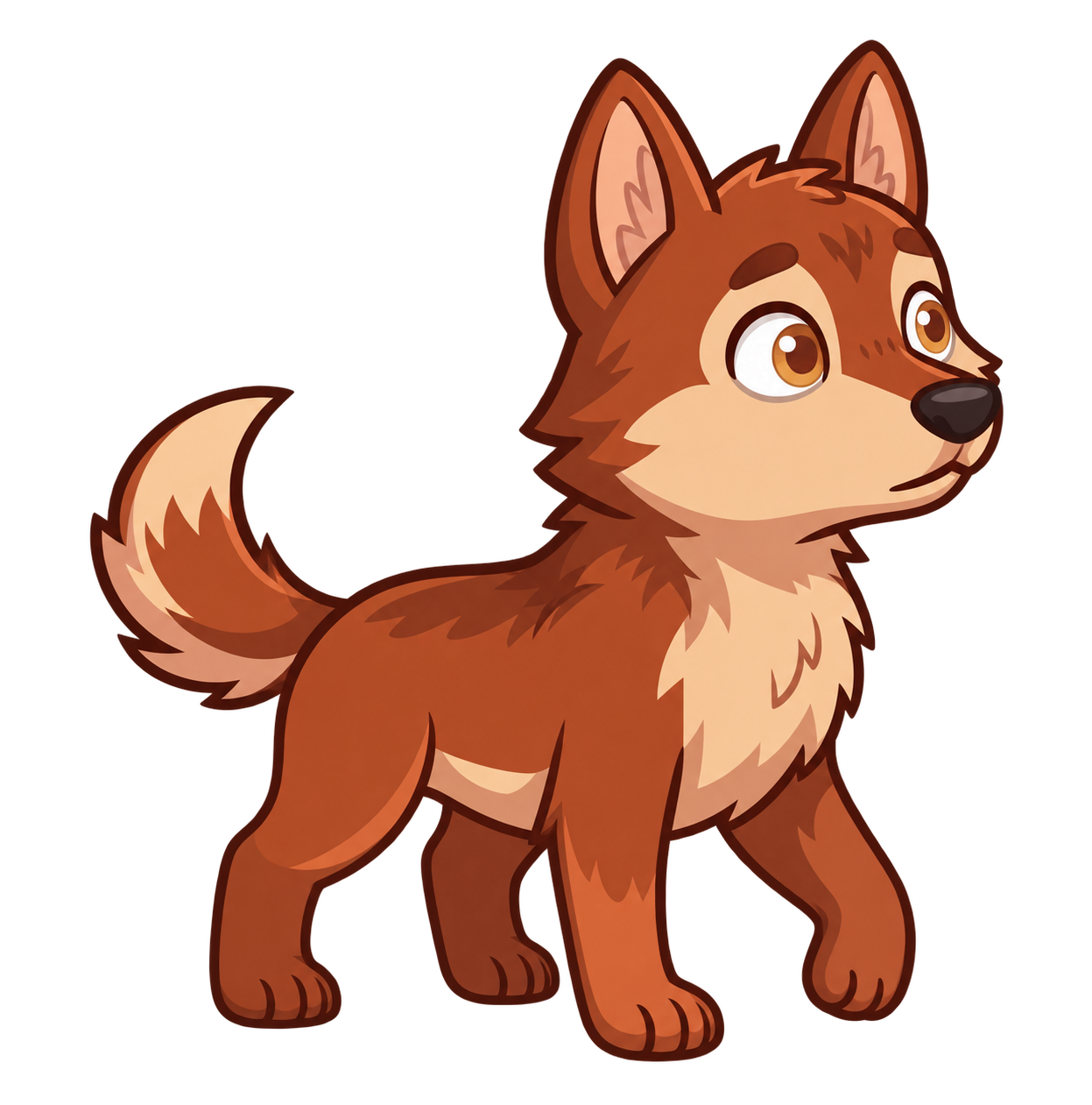
Catherine has a pet wolf.

Slide 4
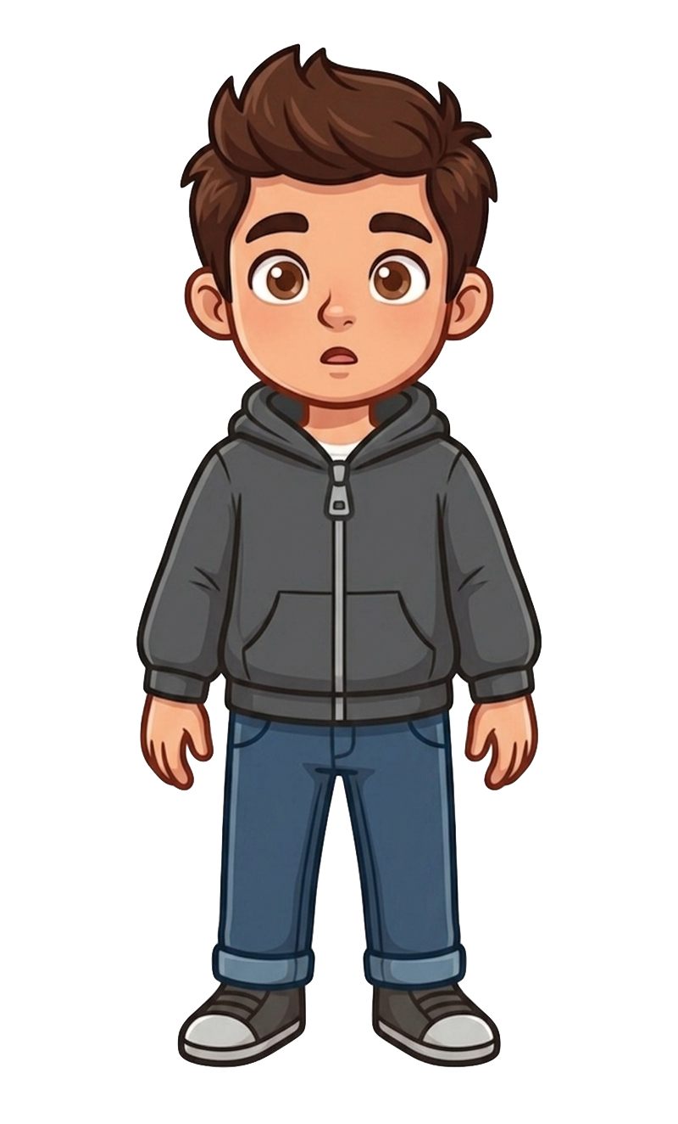
This is Andy.

Slide 5
Andy has 2 cookies.

Slide 6
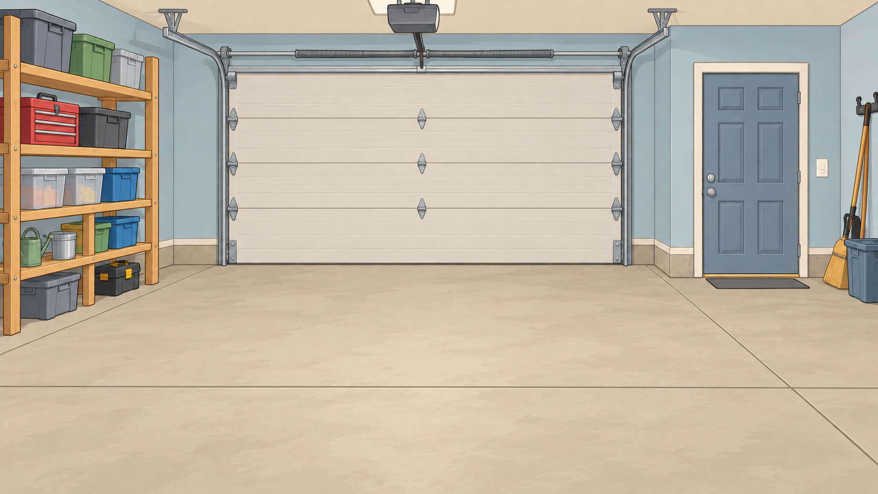
Catherine puts her wolf inside the garage.

Slide 7
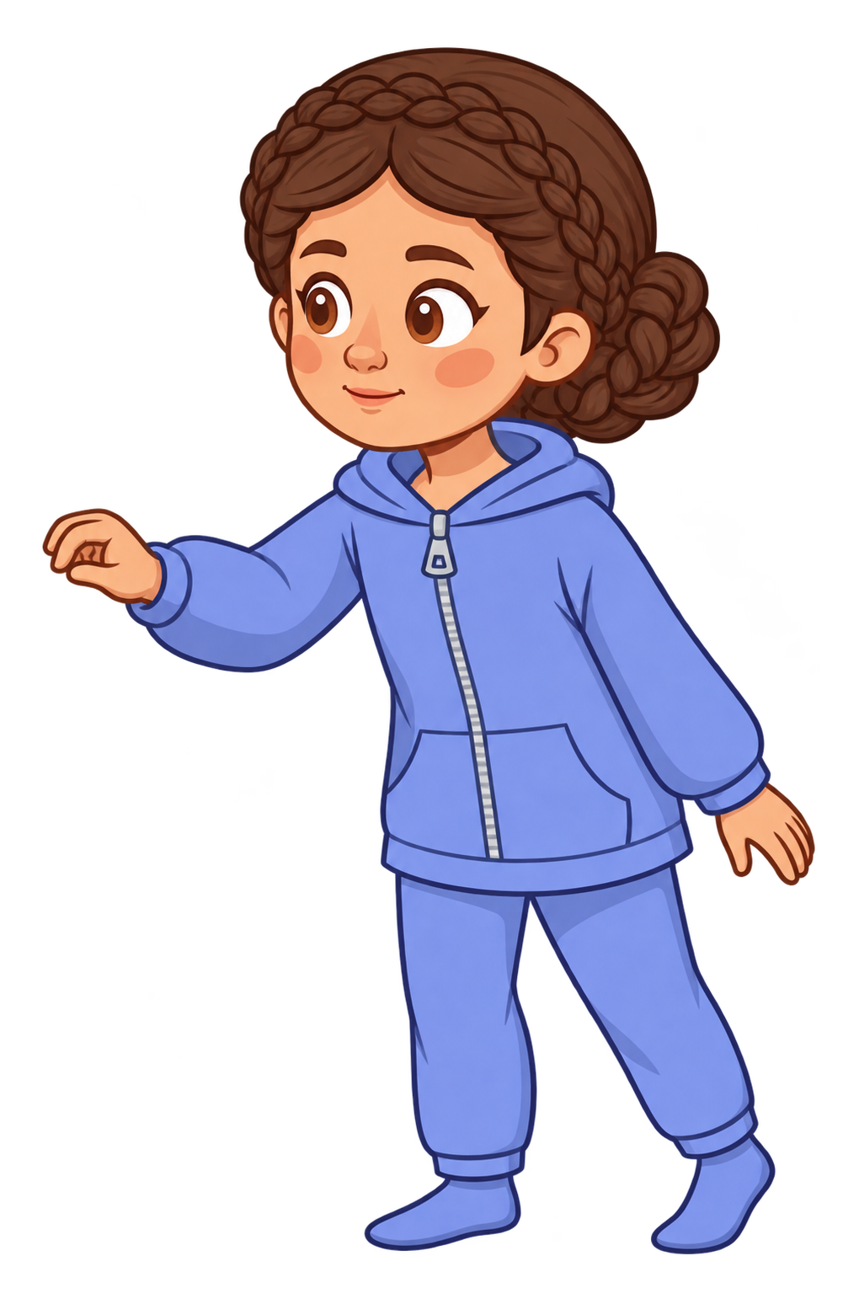
Catherine locks the door and checks the lock.

Slide 8
Andy tells Catherine, “I know your wolf could escape from the garage and eat my cookies.”

Slide 9
Andy tells Catherine, “I’m not okay with that.”

Slide 10
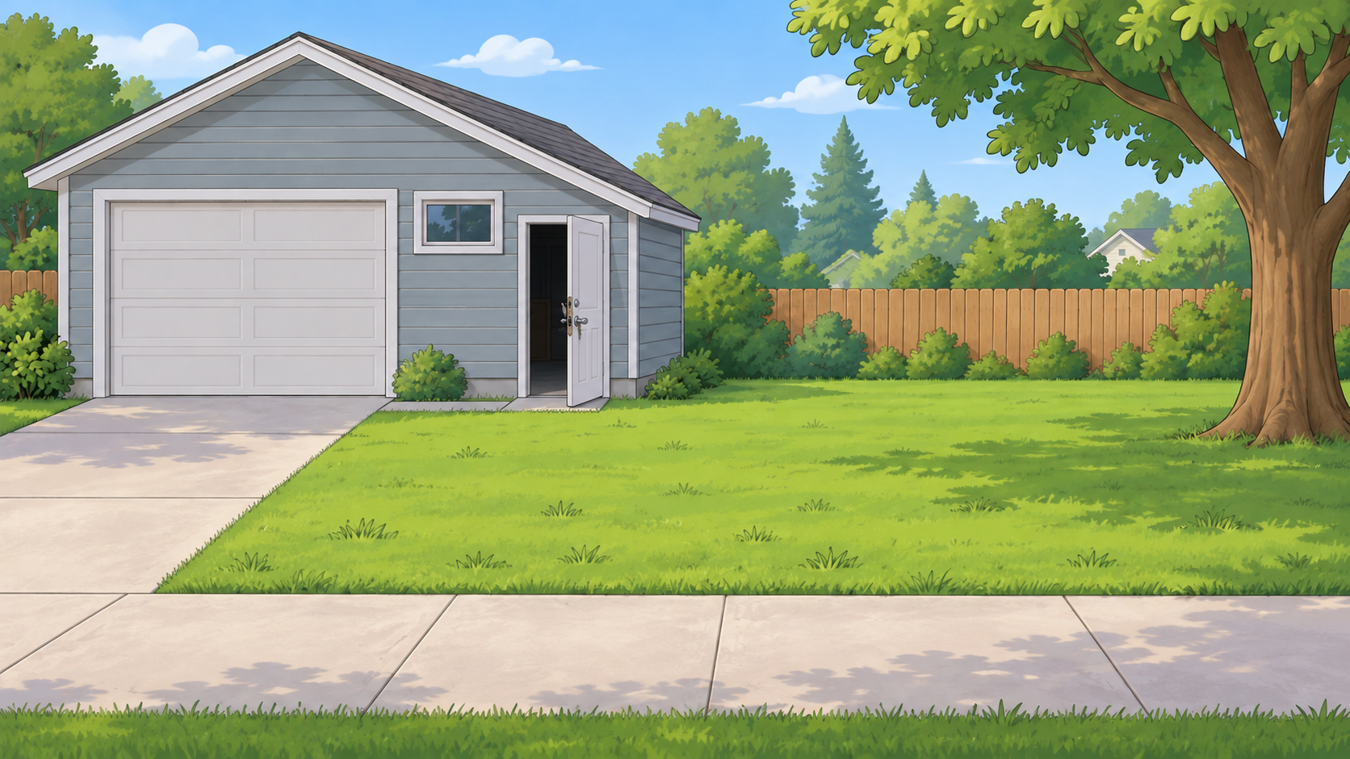
Oh no! The wolf breaks out of the garage!

Slide 11
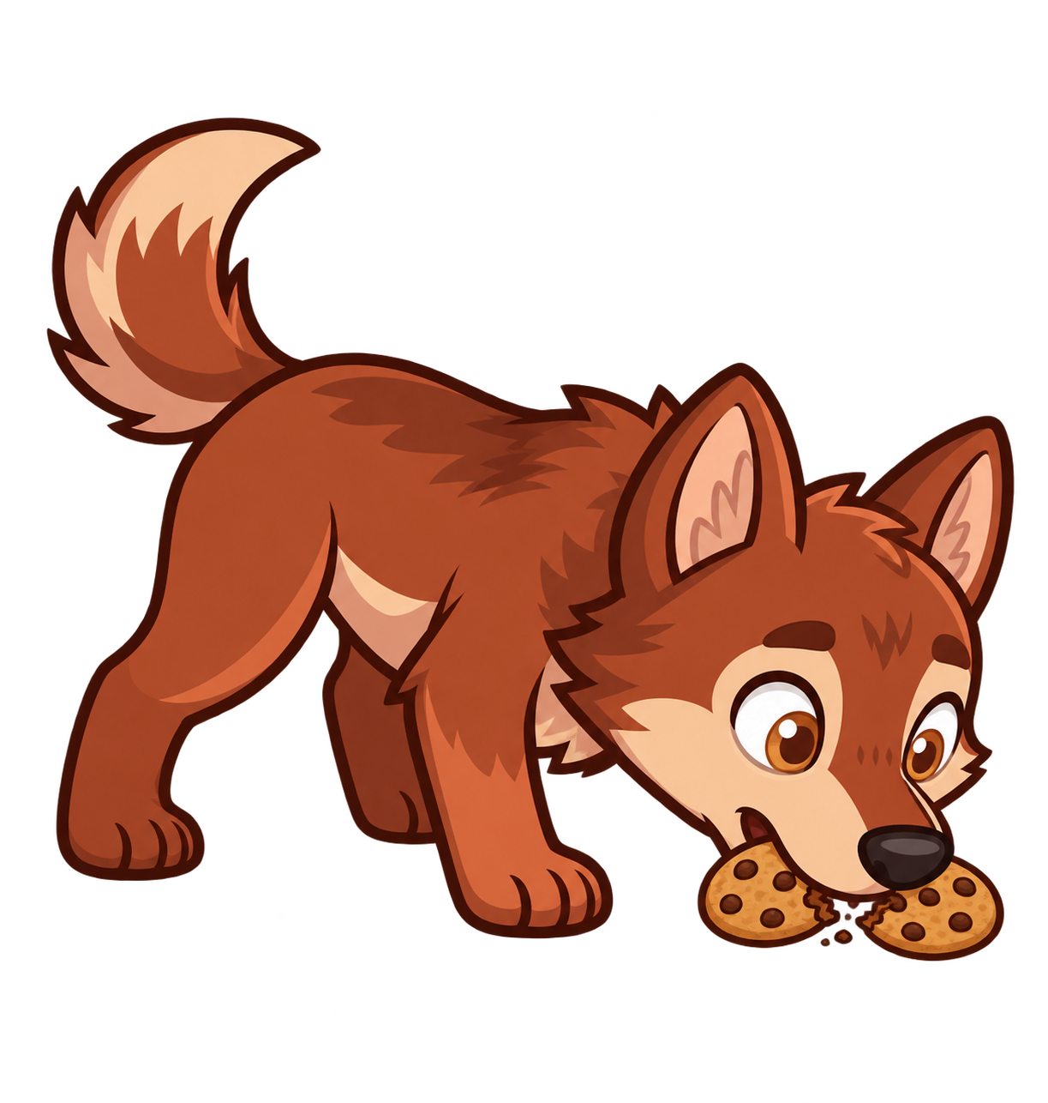
The wolf eats 2 of Andy’s cookies!

Slide 12
Catherine still has 8 cookies. Andy now has 0 cookies.

