Slide 1
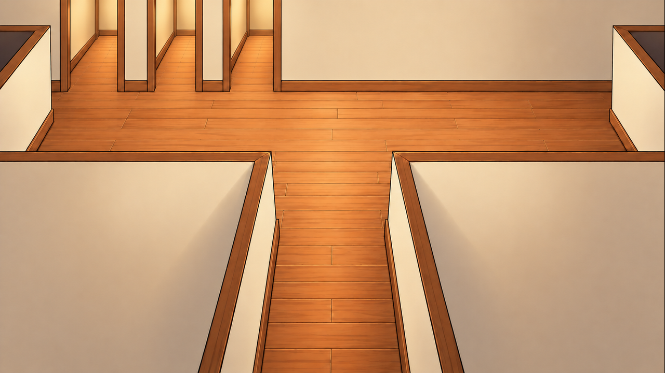
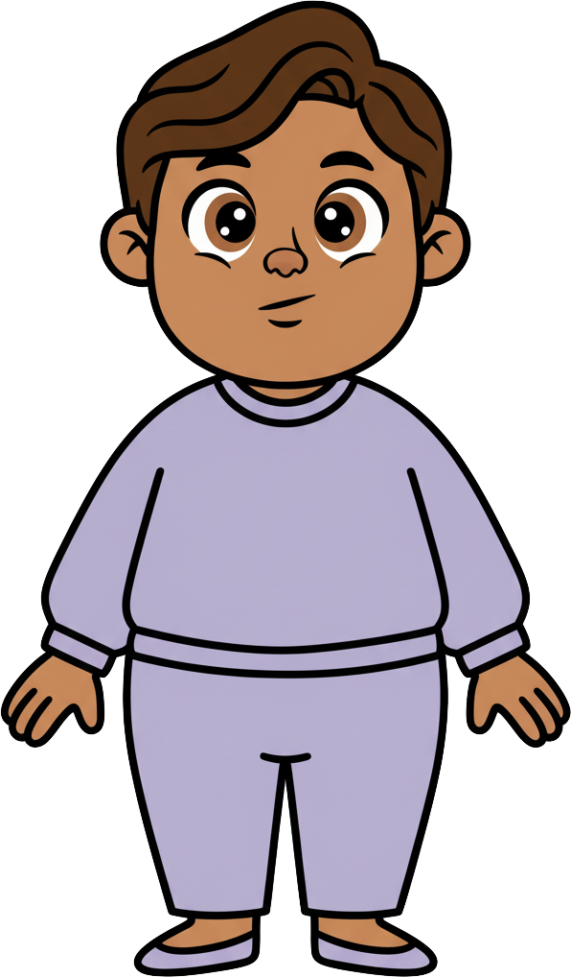
This is Milo.

Slide 2
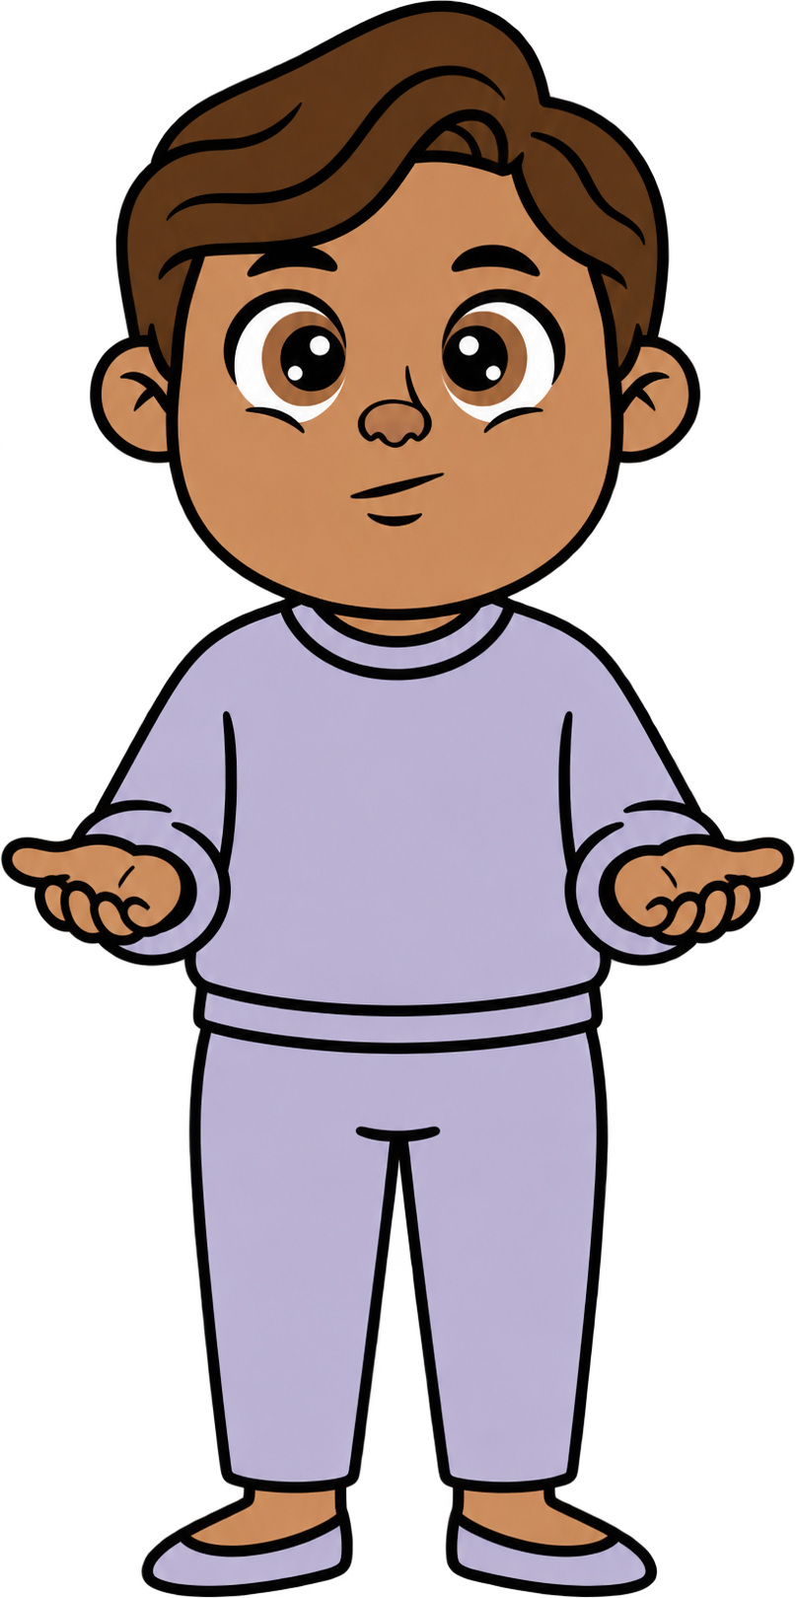


Milo has 8 cookies.

Slide 3
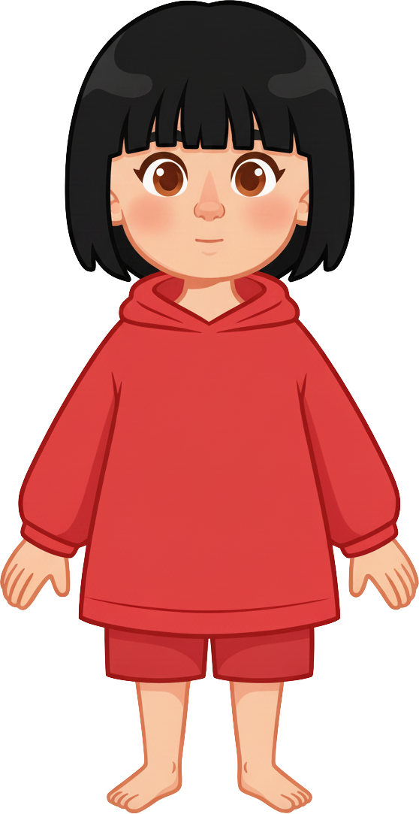
This is Sasha.

Slide 4
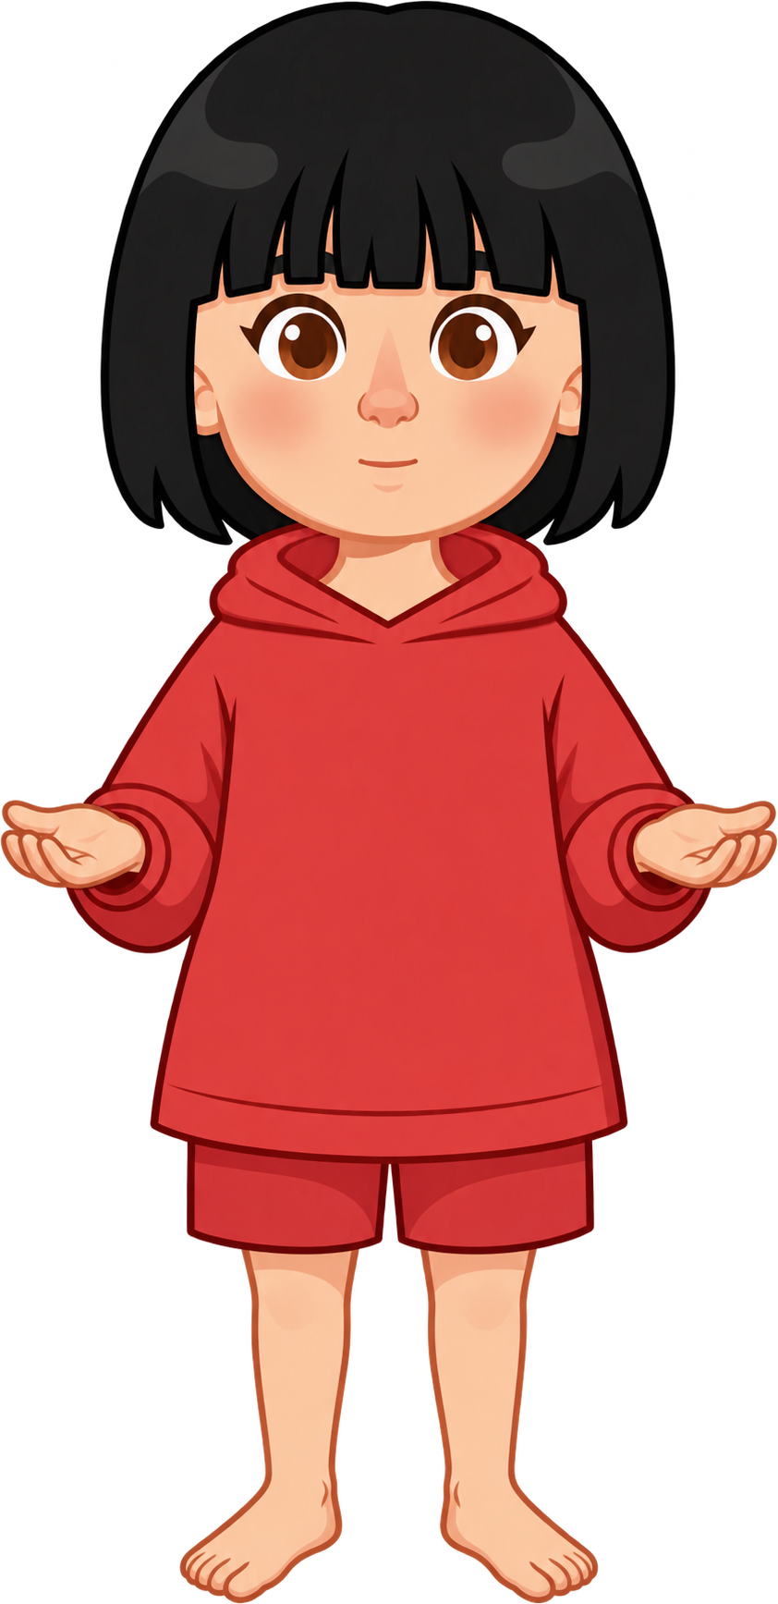
Sasha has 2 cookies.

Slide 5
Milo and Sasha are talking about school.

Slide 6
Milo knows he can get out
in five different directions.

Slide 7
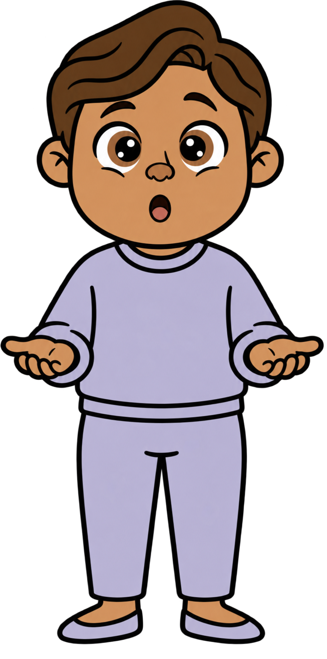
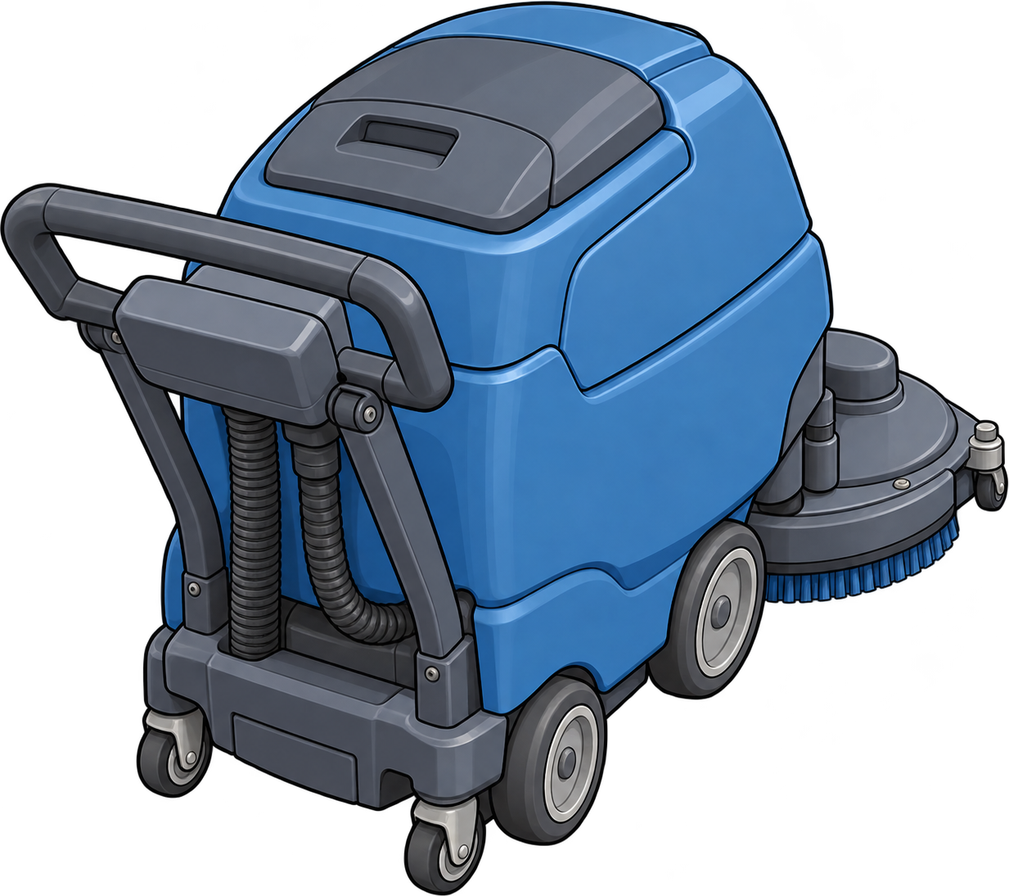
Suddenly, a heavy floor cleaner rolls toward Milo!

Slide 8
Milo can run four other ways
without running into Sasha!

Slide 9
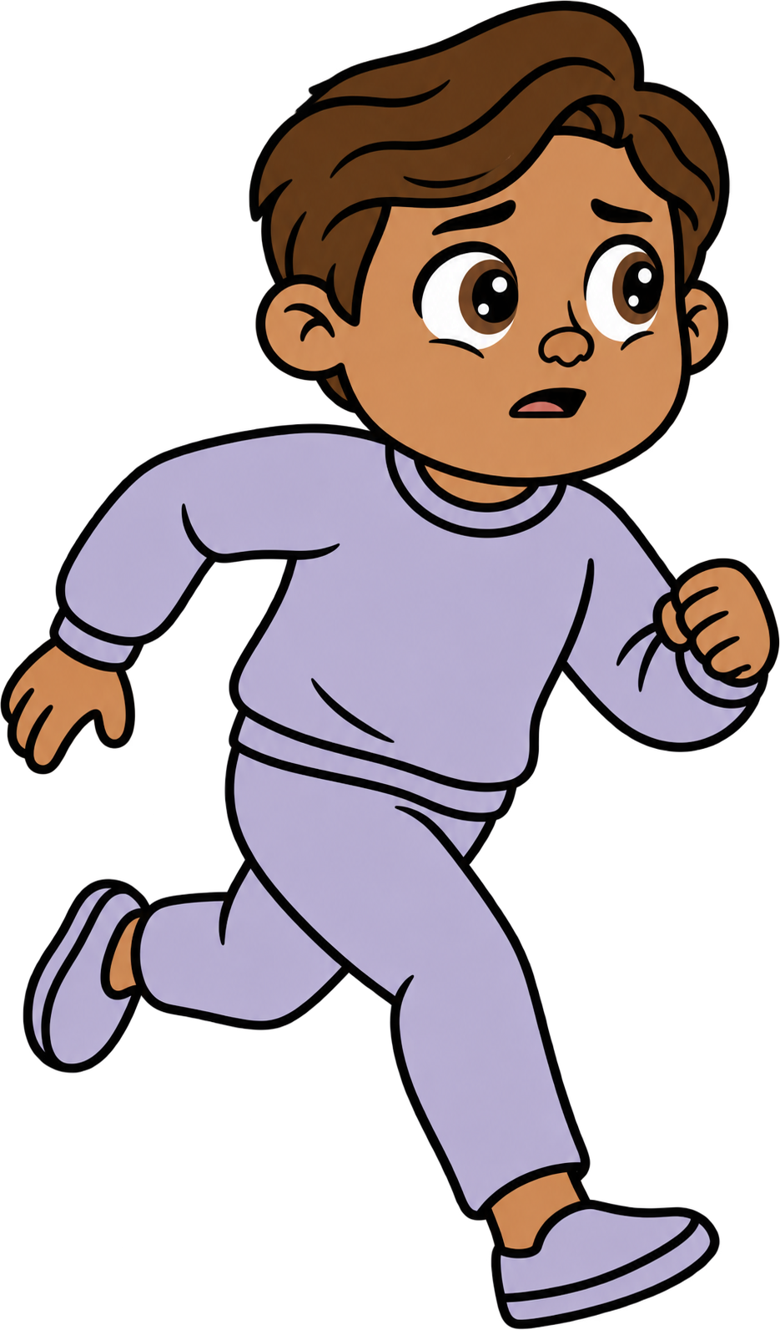
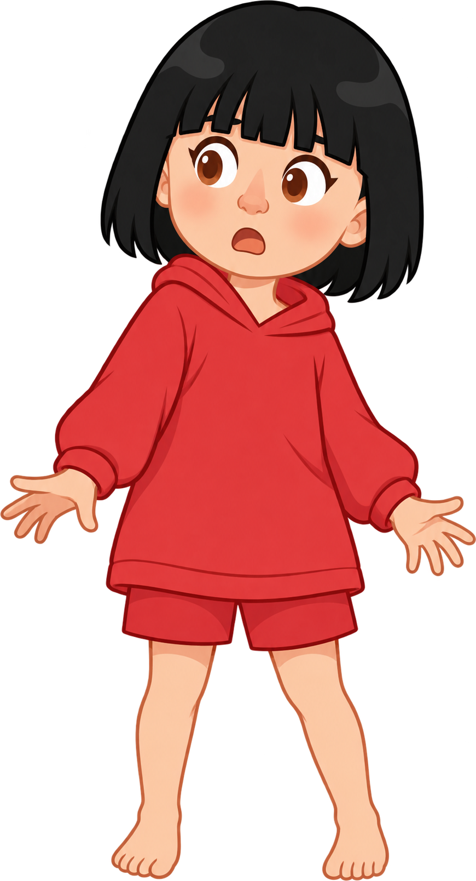
Oh no! Milo runs into Sasha!

Slide 10

2 of Sasha’s cookies fall!

Slide 11
Milo still has 8 cookies. Sasha now has 0 cookies.

