Slide 1
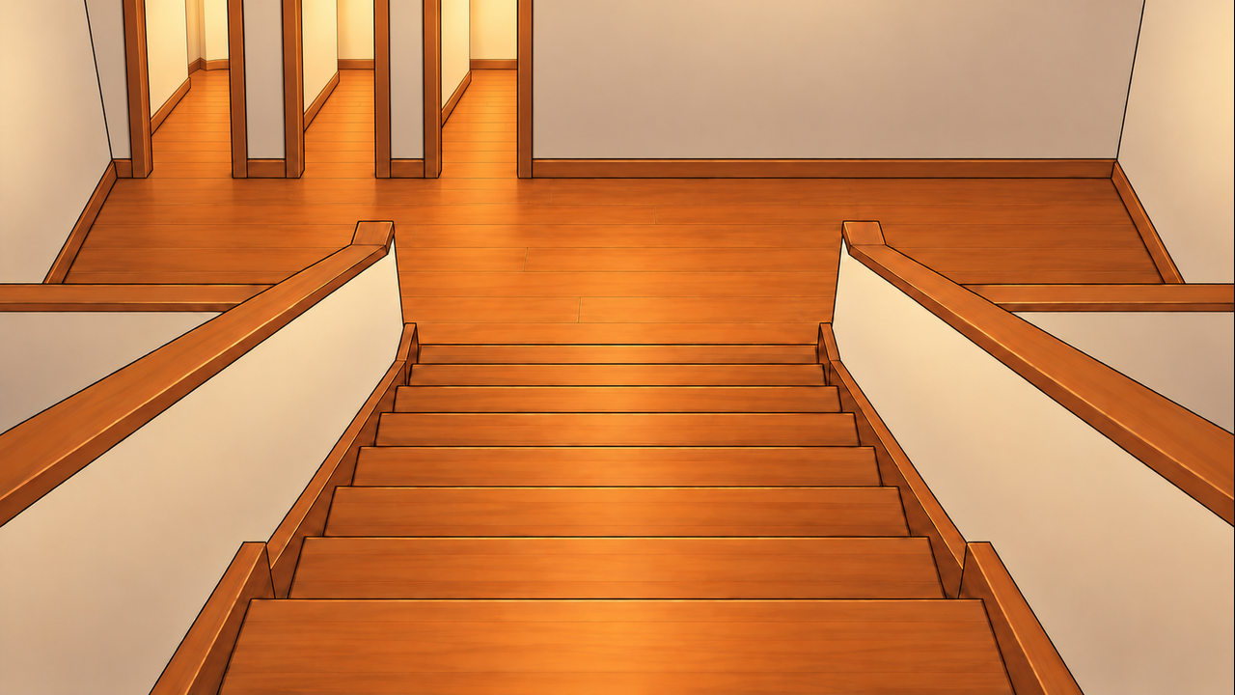
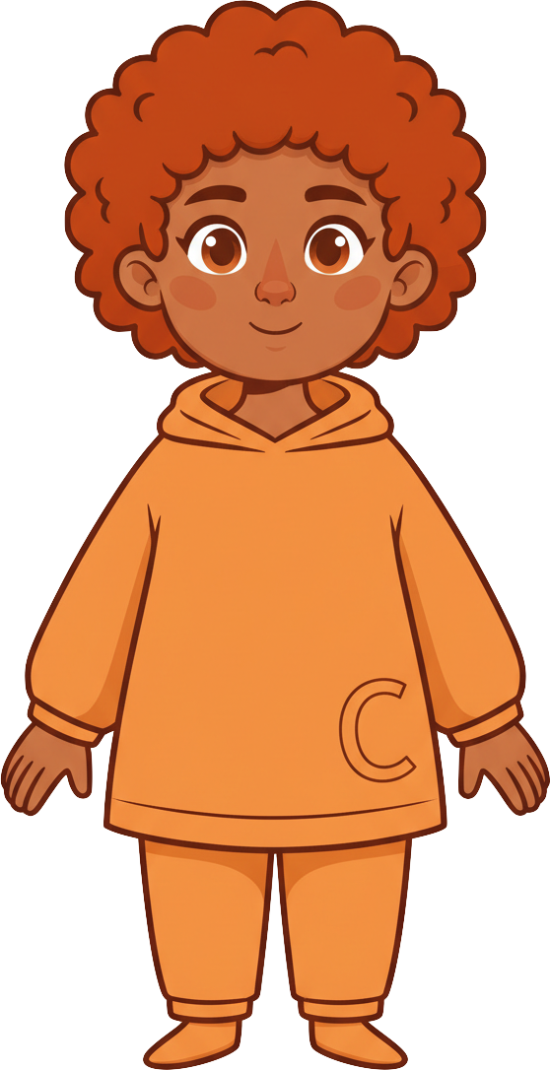
This is Finn.

Slide 2
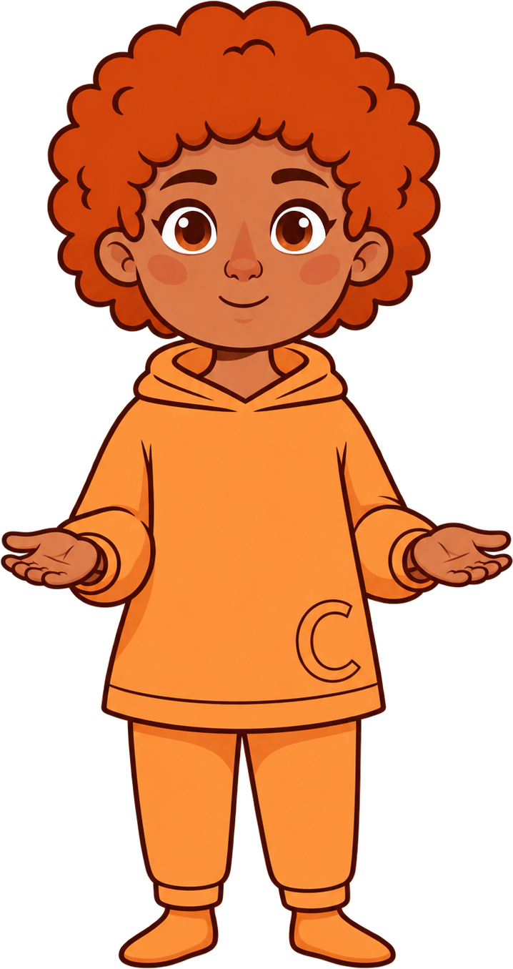


Finn has 8 cookies.

Slide 3
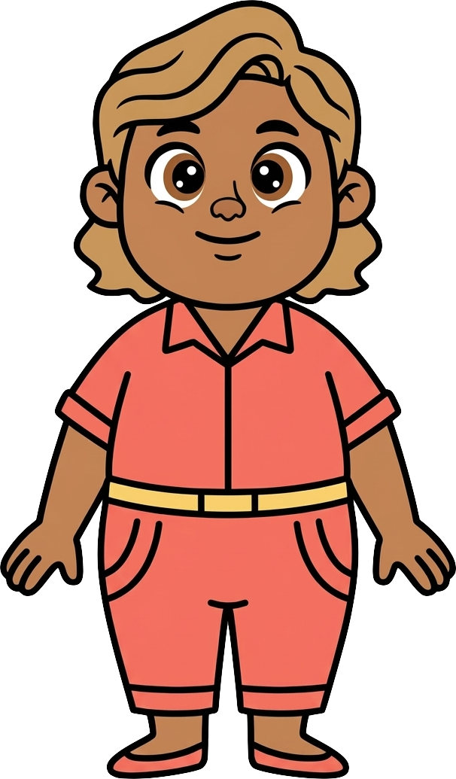
This is Cleo.

Slide 4

Cleo has 2 cookies.

Slide 5
Finn and Cleo are talking about toys.

Slide 6
Finn knows he can get out
in five different directions.

Slide 7
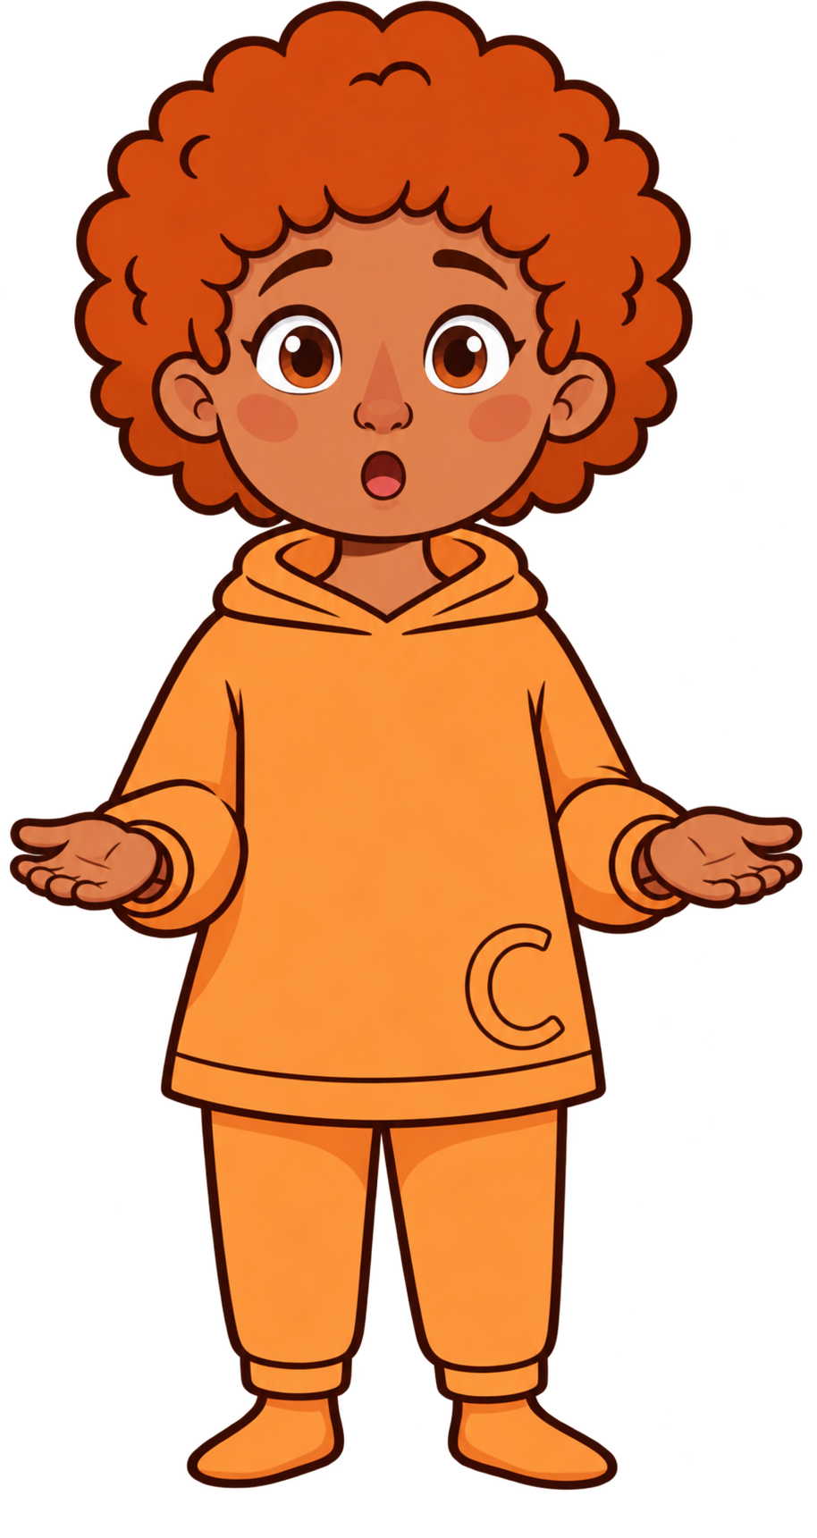

Suddenly, a heavy box falls toward Finn!

Slide 8
Finn can run four other ways
without running into Cleo!

Slide 9
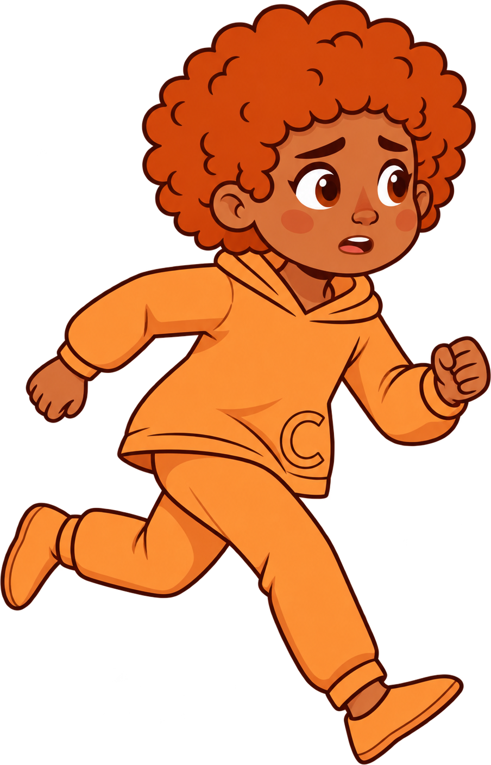
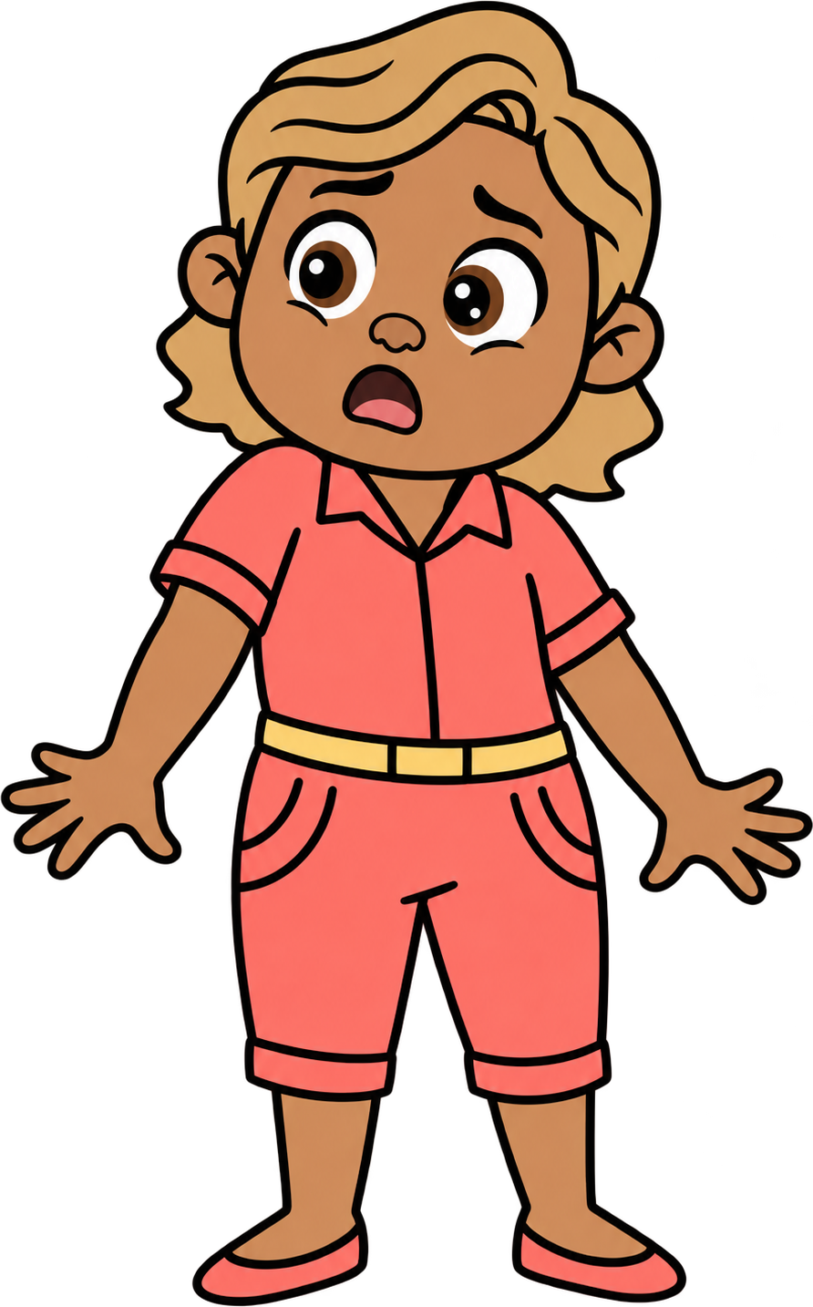
Oh no! Finn runs into Cleo.

Slide 10

2 of Cleo’s cookies fall!

Slide 11
Finn still has 8 cookies. Cleo now has 0 cookies.

