Slide 1
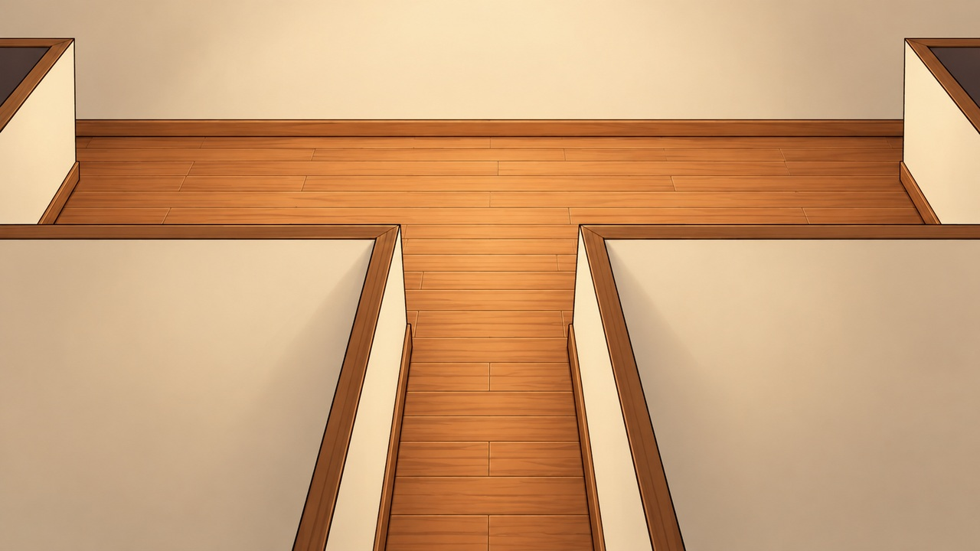
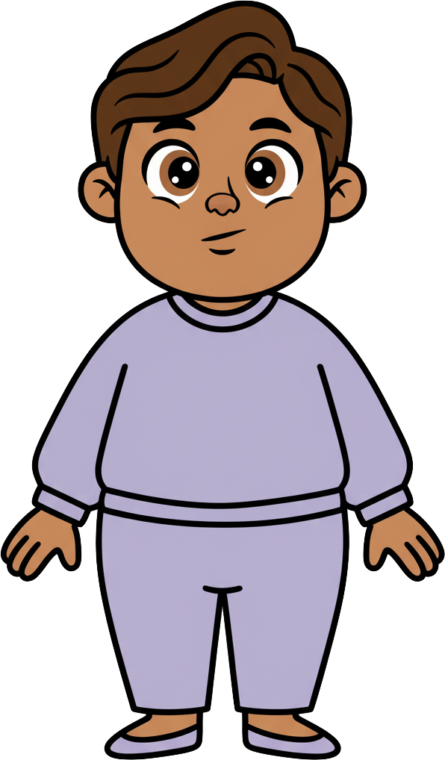
This is Milo.

Slide 2
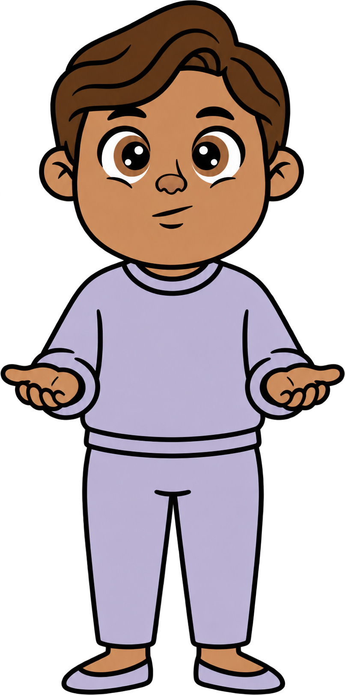


Milo has 8 cookies.

Slide 3
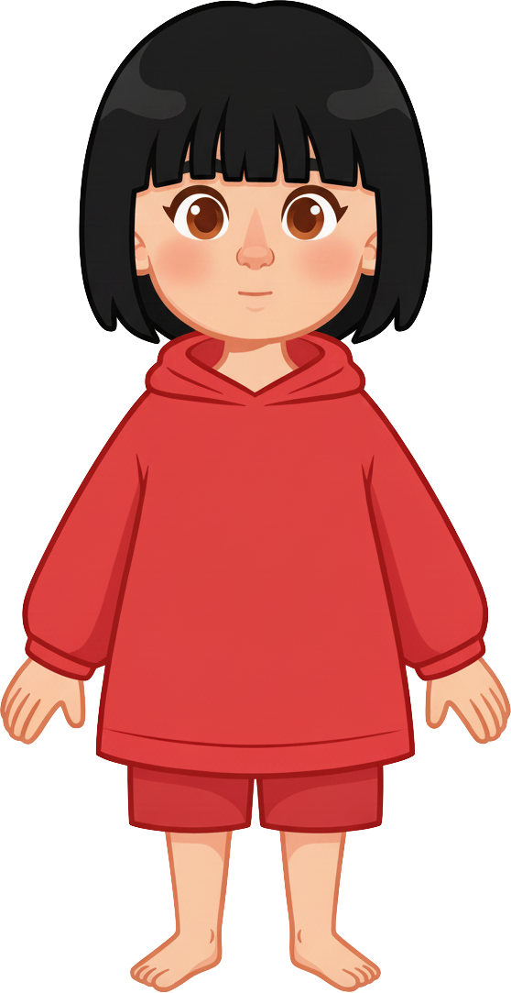
This is Sasha.

Slide 4
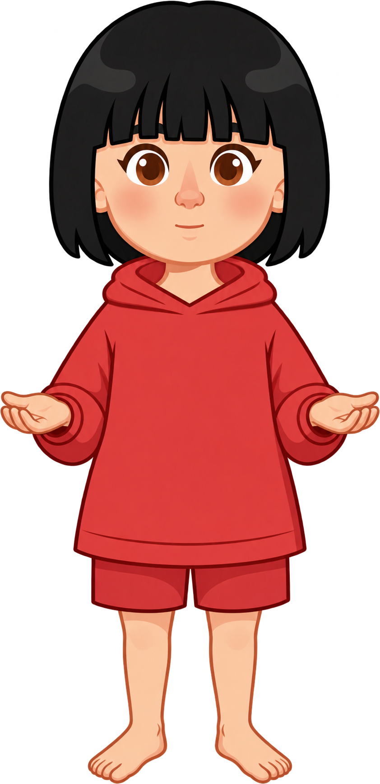
Sasha has 2 cookies.

Slide 5
Milo and Sasha are talking about school.

Slide 6
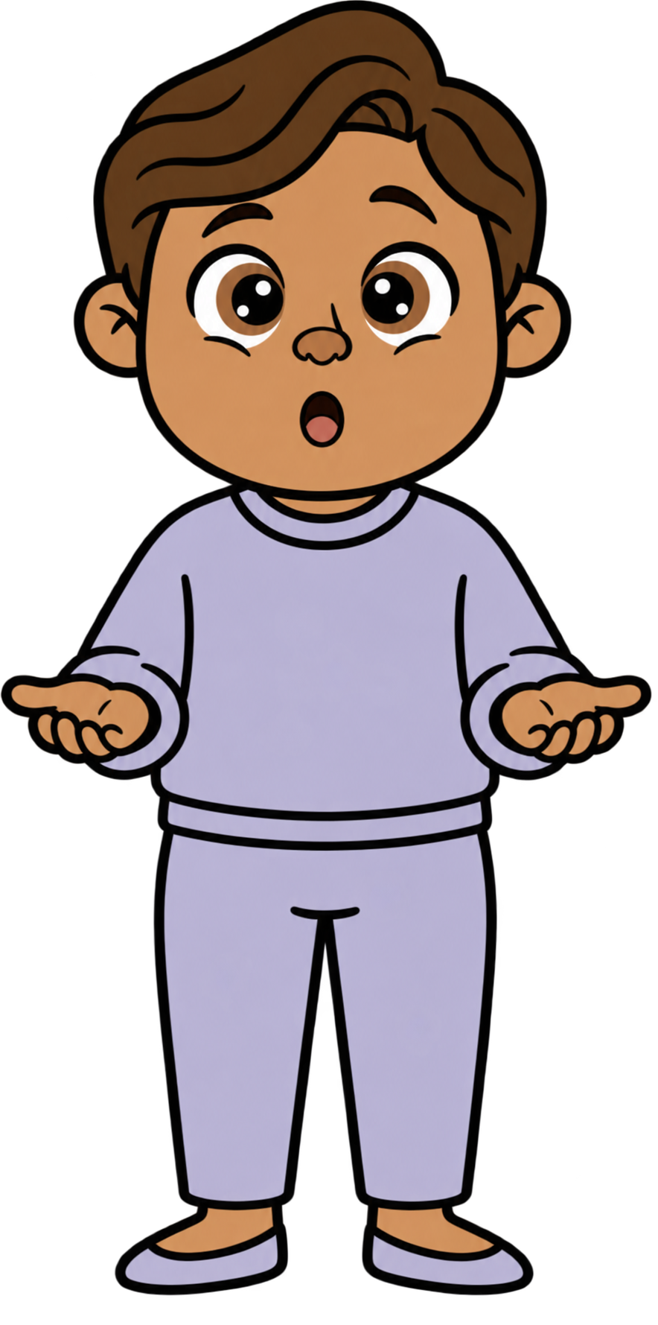
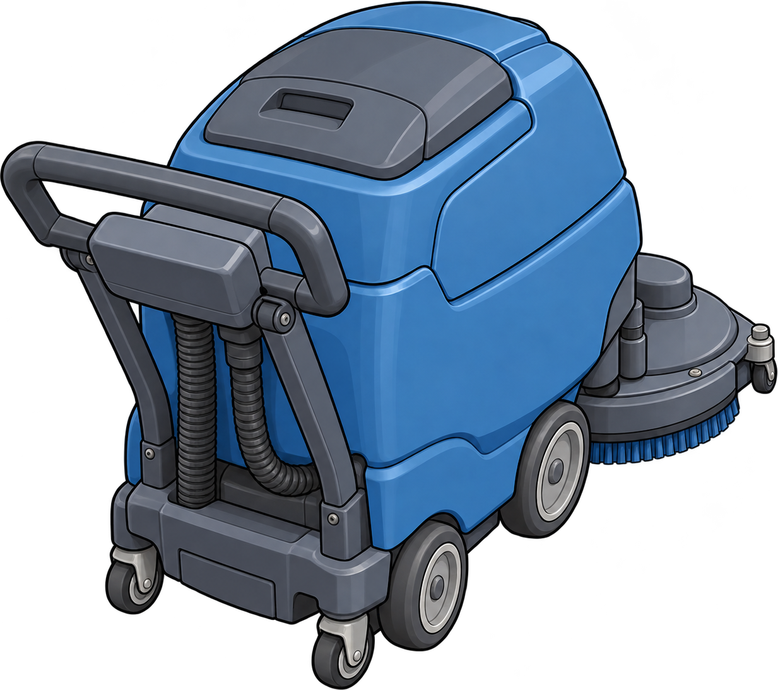
Suddenly, a heavy floor cleaner rolls toward Milo!

Slide 7
Milo has to run one way or the other!

Slide 8
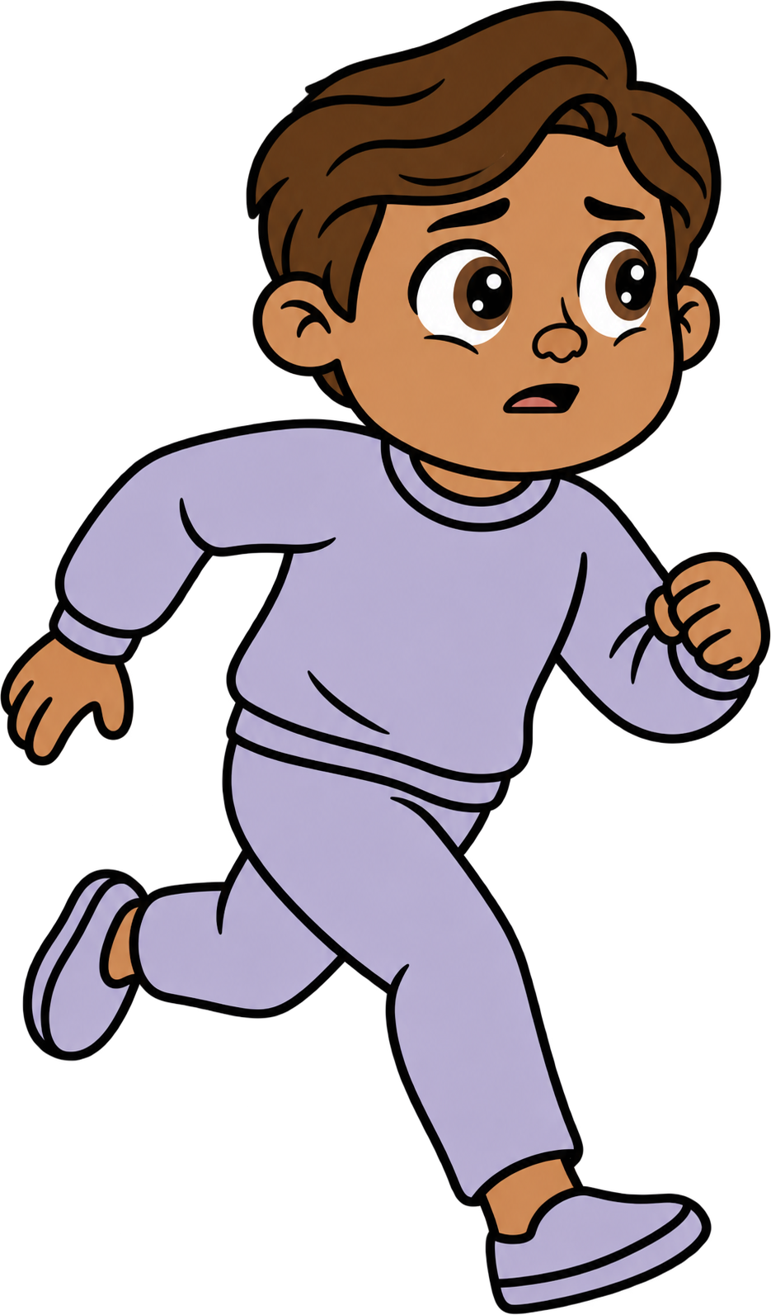
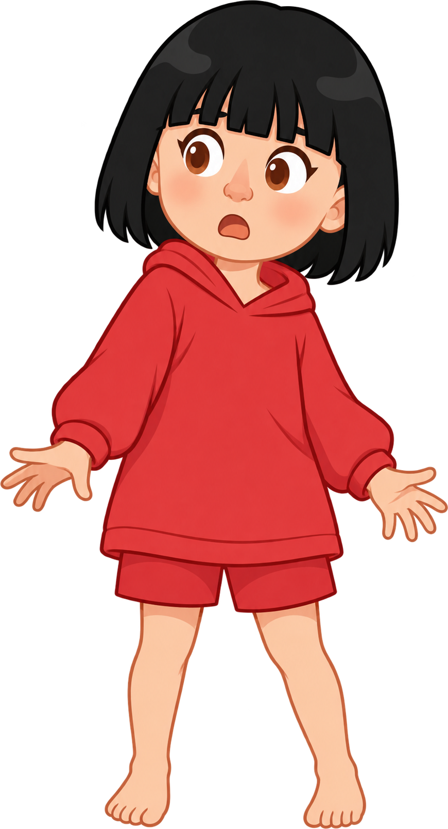
Oh no! Milo runs into Sasha!

Slide 9

2 of Sasha’s cookies fall!

Slide 10
Milo still has 8 cookies. Sasha now has 0 cookies.

