Slide 1
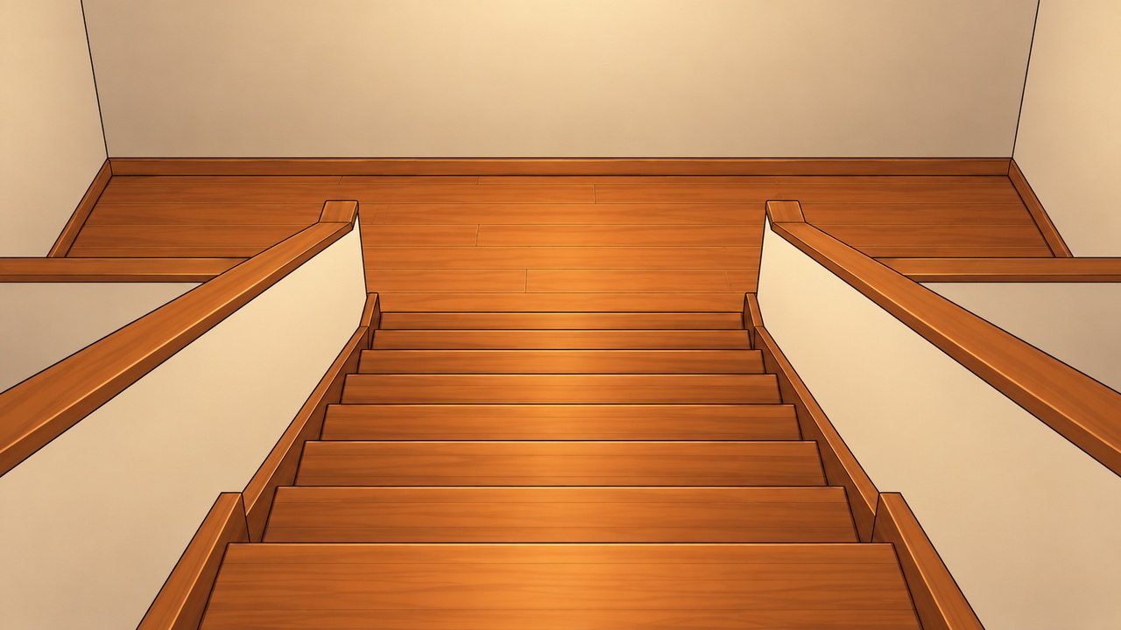
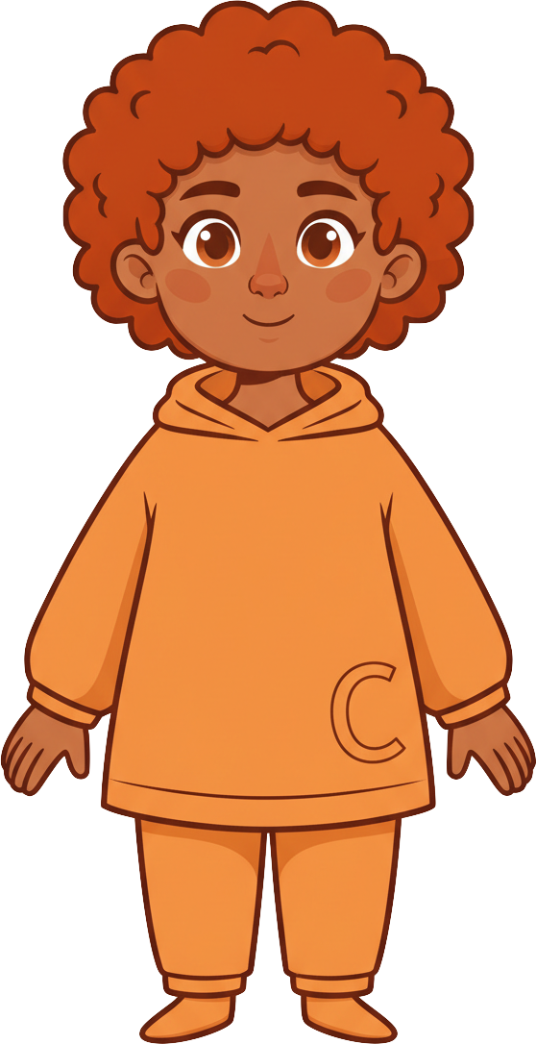
This is Finn.

Slide 2
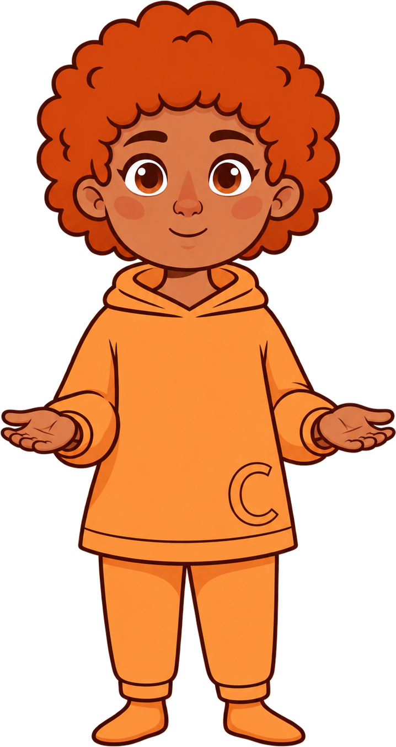


Finn has 8 cookies.

Slide 3
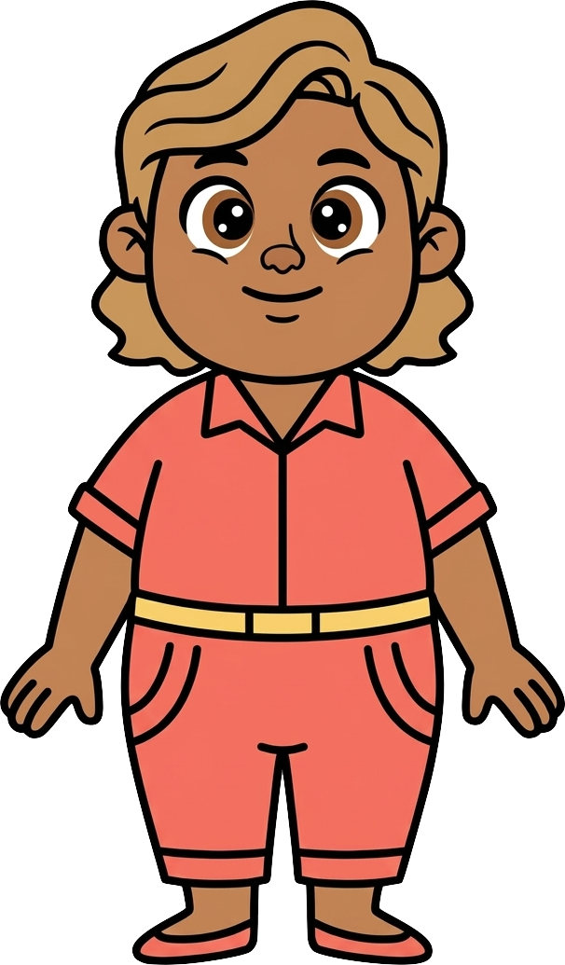
This is Cleo.

Slide 4
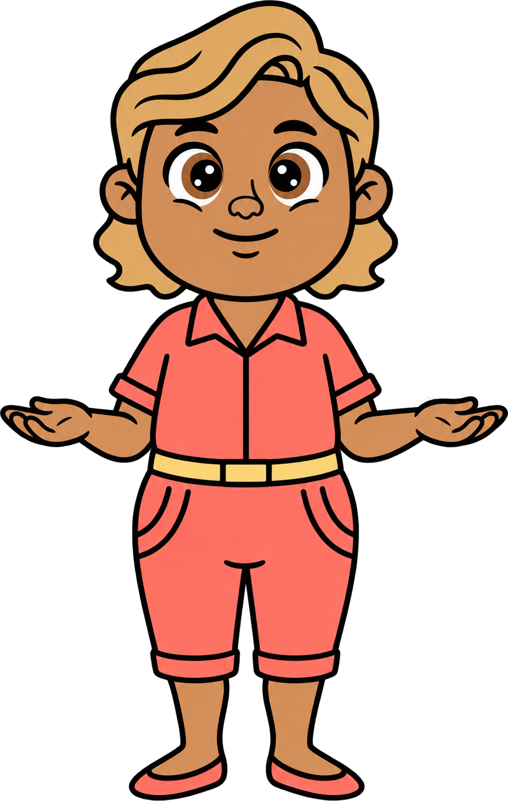
Cleo has 2 cookies.

Slide 5
Finn and Cleo are talking about toys.

Slide 6
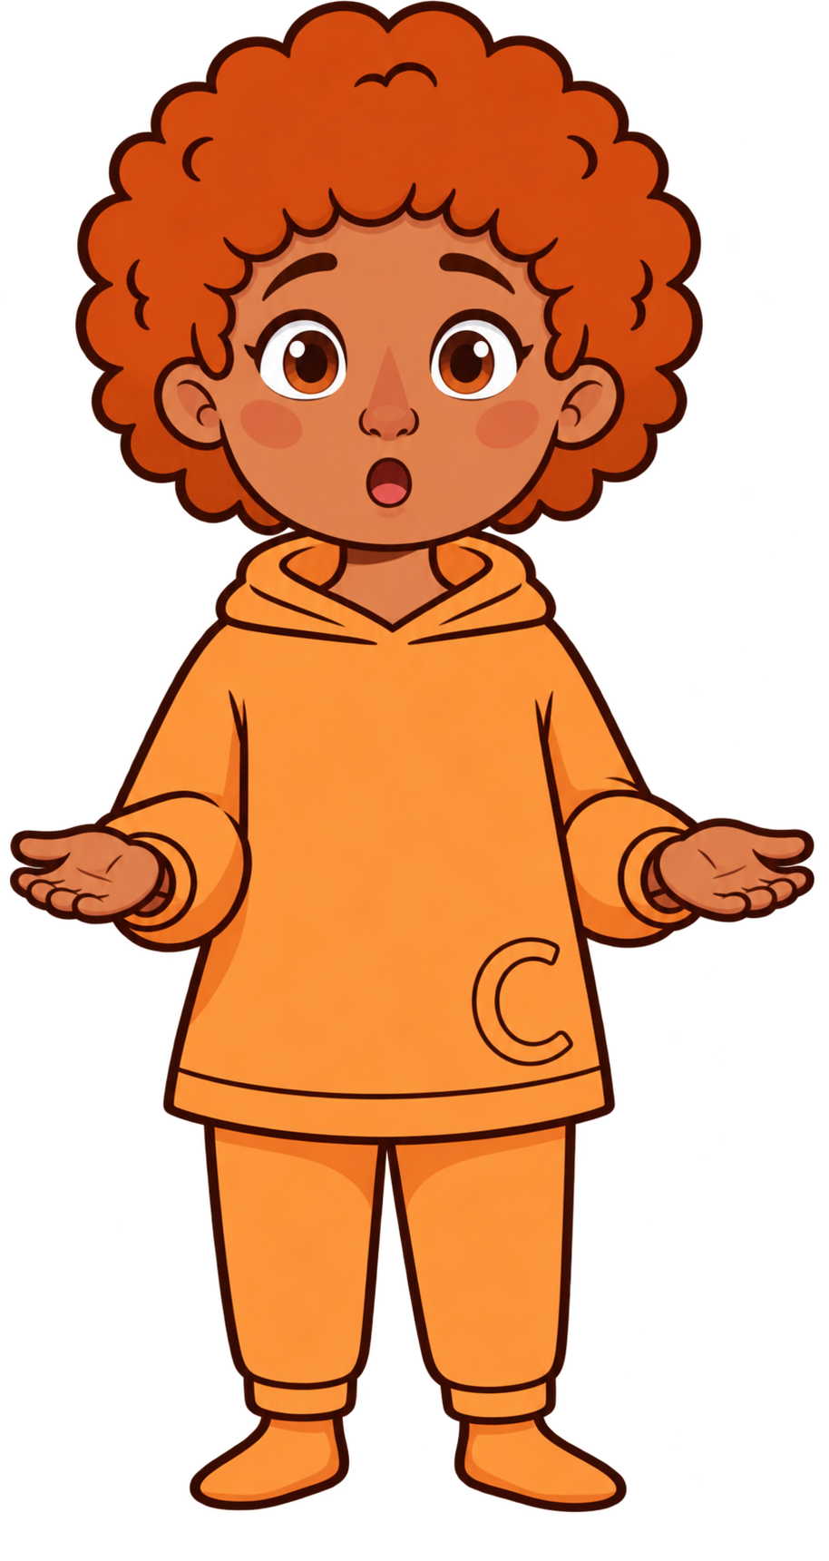
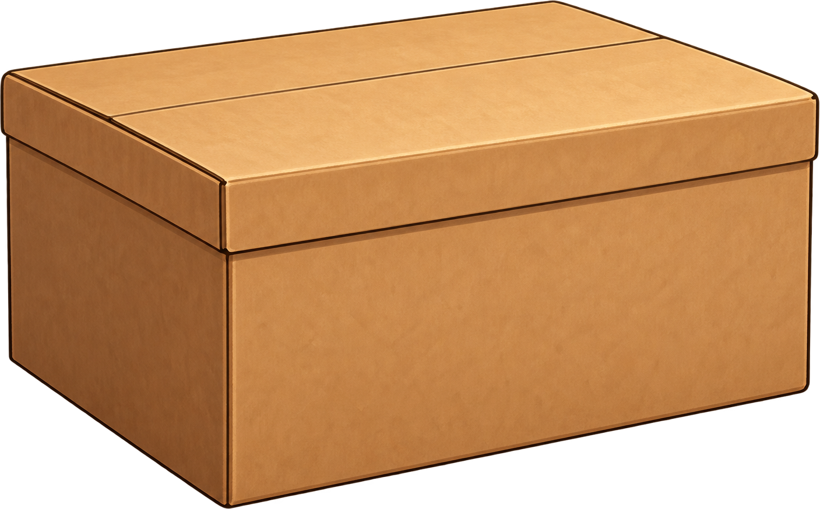
Suddenly, a heavy box falls toward Finn!

Slide 7
Finn has to run one way or the other!

Slide 8
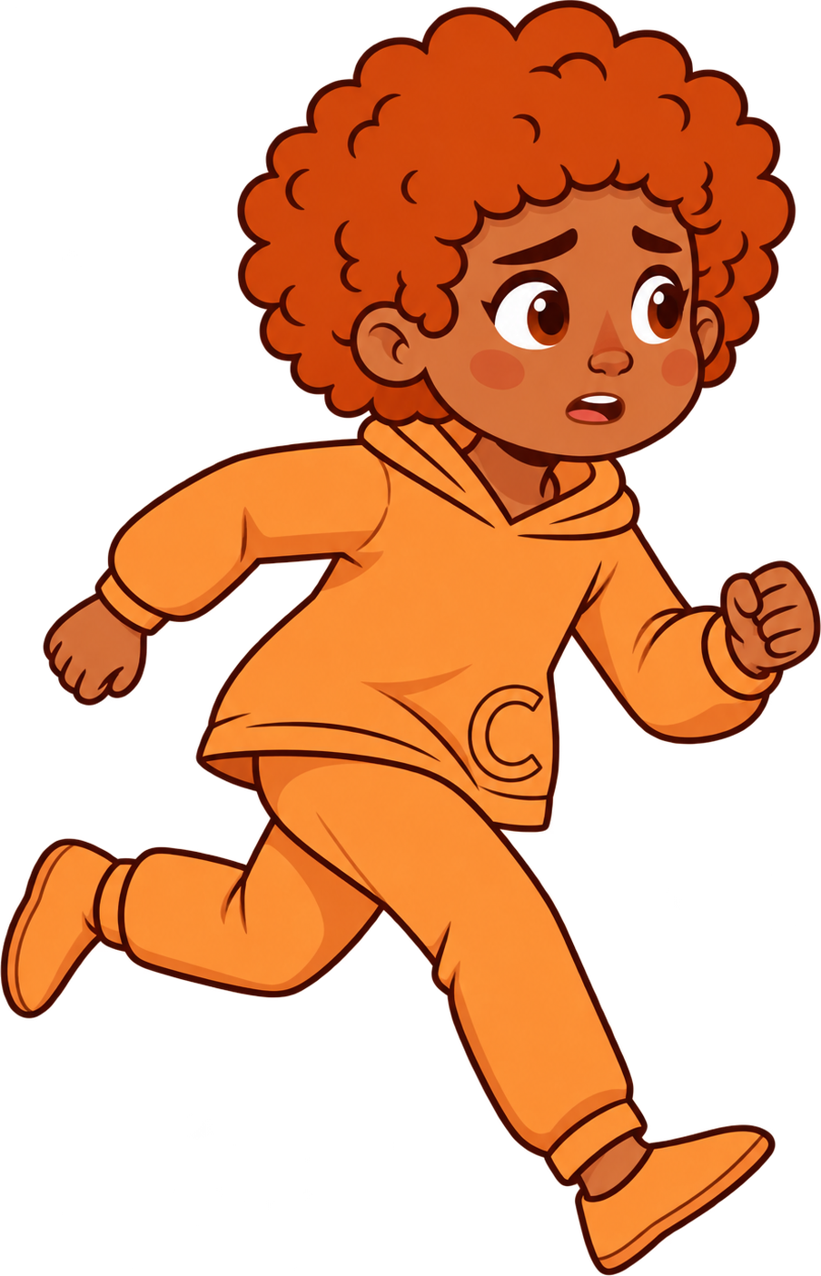
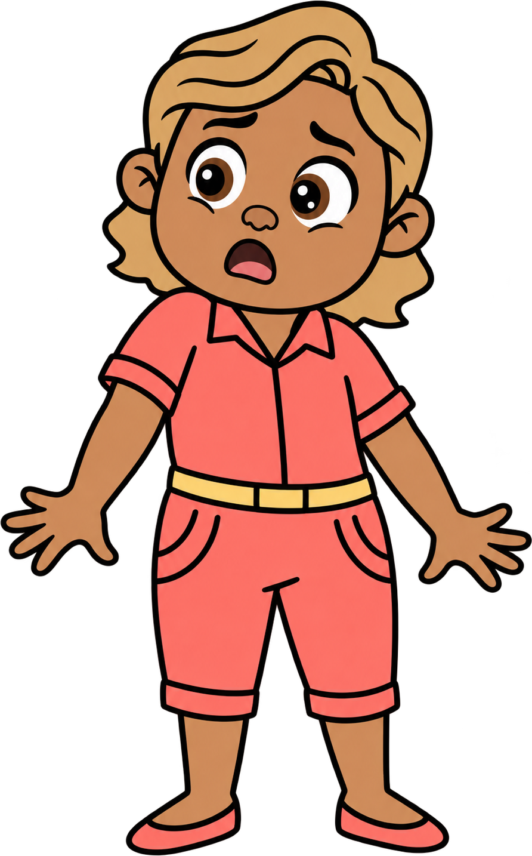
Oh no! Finn runs into Cleo.

Slide 9

2 of Cleo’s cookies fall!

Slide 10
Finn still has 8 cookies. Cleo now has 0 cookies.

