Slide 1
MeiNN: Methylation embedding interpretation neural network
Jinpu Cai , Pengcheng Xu, Yulin Gao, Ziqi Rong
Advisor: Hongyi Xin
2022/3/18

Slide 2
MeiNN
Introduction
Insight
MeiNN
Result
Method

Slide 3
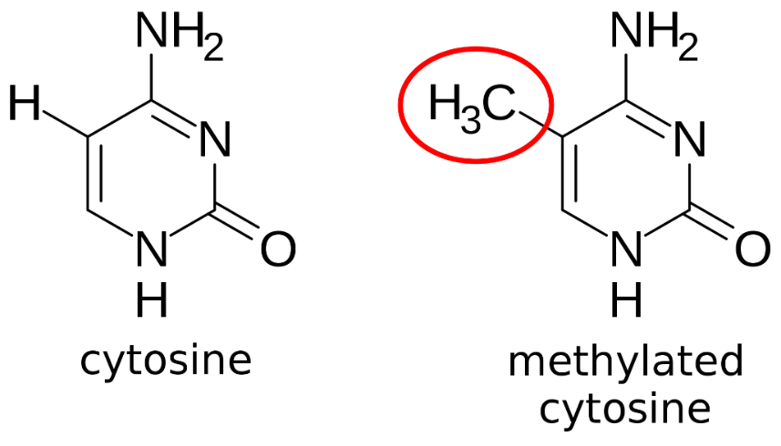
Introduction
What is Epigenetics? | CDC
DNA Methylation | What is Epigenetics?
Epigenetics of methylated modifications play an important role in biological genetic activity Many diseases, as well as heredity, have been found to be quite associated with methylated modifications
Methylated modifications are also thought to have a correlation between transcription and expression of basic functions in DNA
Associated methylation biogenesis has also been shown between the various epigenetic progress
Notes:
表观遗传是什么。甲基化修饰的表观遗传组学在生物遗传活动中起到了重要的作用 。表观遗传中，重要的是甲基化，H->CH3
很多疾病以及遗传都被发现与甲基化的修饰有着相当大的关系
而甲基化的修饰也被认为对DNA也就是基因的转录和基本功能的表达有着相关的关系，免疫，正常工作。
各个表观之间也被证明有相关的甲基化生物共性 ，疾病和疾病之间。不同疾病疾病与甲基化修饰

Slide 4
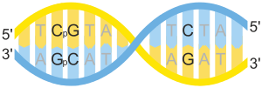
Introduction
Cytosine and Adenine methylation
Two of DNA's four bases, cytosine and adenine, can be methylated
Cytosine methylation: widespread in both eukaryotes and prokaryotes
Adenine methylation: observed in bacterial, plant and recently mammalian DNA, but with less attention
Three sequence methylation contexts: CpG, CHG, CHH
DNA methylation is almost exclusively found in CpG dinucleotides in mammals.
Notes:
四个碱基ACGT, cytosine and adenine，在目前生物很普遍，人类，哺乳动物在C很多，DNA链上有很多CGCG区域，CpG岛。位点在岛上，专家发现了甲基化区域，主要是CpG岛，450K。甲基化很重要。

Slide 5
Problem
Hard to transfer and interpret
High dimensions and few samples
Methylation-gene-pathway relationship exploration
SOTA: ReGear which has some limitations
Notes:
共性的甲基化生物特征并不能很好的找到并且很好的解释，已有的甲基化迁移模型也并不能很好的在各个任务之间去transfer ，很少有研究迁移性和解释性，特点：维度特别高，严格女书特别少，
目前的甲基化研究都是针对单任务去观测一个表观形状的特征，但是单任务的甲基化数据的特点都是高维度而少样本，因此很大程度上会过拟合。
很少有研究说 建立甲基化-基因-pathway的关系模型，从而可以对新的表型数据集进行分析
目前的SOTA：ReGear只是从线性单任务，一个数据集层面去解释甲基化与基因的关系 ，这样就很难迁移，ReGear，单任务层面迁移，methylation->gene，没有考虑pathway的信息。主要问题：不可解释不可transfer，高维，单任务

Slide 6
ReGear: Jinpu’s previous work
Hypothesis：There is a link between methylation sites/residues, and the link is thought to be gene!
Gene-level methylation
Regression
Residual data
To
Gene data
residue-1
residue-2
residue-3
residue-4

Slide 7
Insight
Methylation, gene expression and functions have correlations and can be explained in some epigenetics
Notes:
因此探寻高维空间中甲基化特征的可解释生物共性非常重要

Slide 8
MeiNN: Methylation embedding interpretation neural network
Interpretable neural network based on multitasking learning in Methylationomics
Explain methylation factor, gene and function association
Notes:
基于多任务学习的可解释的自动编码器去解释甲基化组学的表观遗传问题
高维低样本的数据集并不能很好的找到表观遗传的生物共性，因此我们建立了一个基于多任务学习，使用Autoencoder的可解释的神经网络，去揭示表观遗传和基因组，基本功能的关系。

Slide 9
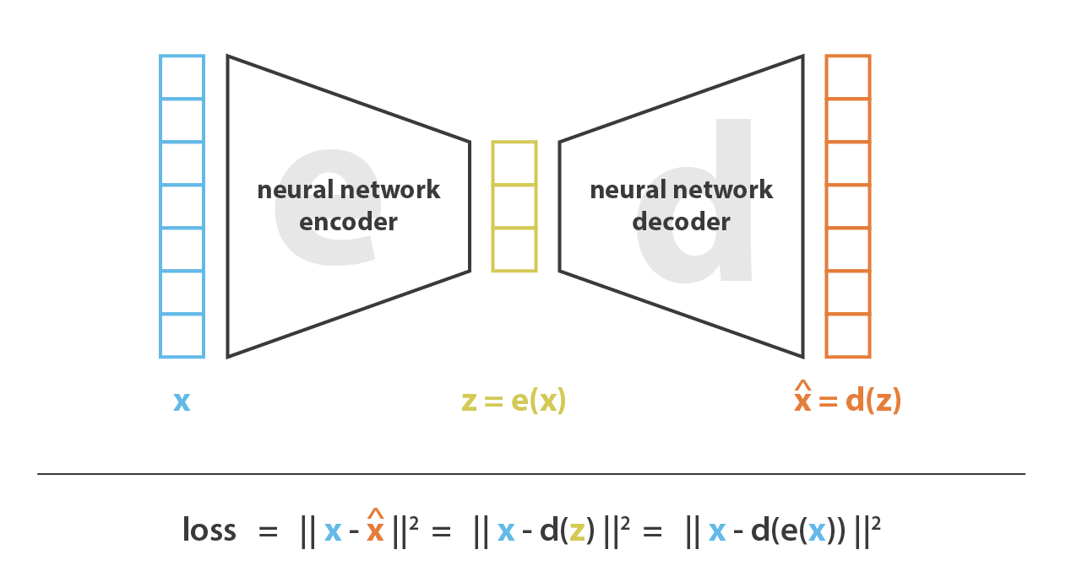
The overall structure of MeiNN (multiple dataset, multi-task learning)
Add regularization on decoder
Output
(whether has disease, more diseases from different datasets)
embedding
Residuals methylation
From different datasets
embedding

Slide 10
Result
Overview of MeiNN
MeiNN is able to detect common embedding features among multiple diseases
Interpretable Pathway-Gene-Site Feature Relational Neural Network for MeiNN
MeiNN discovered new pathways and genetic correspondences
Notes:
Result
Overview of MeiNN
MeiNN整体的结构
隐空间中各类疾病的细胞的聚类情况
多任务机器学习提高了的分类任务的准确率
MeiNN能够检测到 多疾病之间共同的embedding特征
从多疾病角度 MeiNN能够检测到各个疾病之间联合的emdding特征
MeiNN可以用没有被训练过的表型新的数据集进行解释
可解释的MeiNN的pathway-基因-位点特征关系神经网络
MeiNN的pathway 基因 位点之间的可解释特征
MeiNN发现了新的pathway和基因的对应关系
针对一些疾病，MeiNN发现了新的pathway和基因的关系，证明某些基因可能是对某些疾病的表达有着重要的关系
Method

Slide 11
Overview of MeiNN
The overall structure of MeiNN
Architecture and Training workflow
Code Implementation
Current results
Future design questions
Clustering of cells of various diseases in the latent space
Multitasking machine learning improves the accuracy of classification tasks
Notes:
MeiNN整体的结构
隐空间中各类疾病的细胞的聚类情况
多任务机器学习提高了的分类任务的准确率

Slide 12
The overall structure of MeiNN (single dataset)
The overall structure of MeiNN
Architecture and Training workflow
Code Implementation
Current results
Future design questions

Slide 13
The overall structure of MeiNN (single dataset)
Add regularization on decoder
Auto-encoder
2. Prediction Neural Network
embedding
Output
(whether has disease)
embedding
Two neural networks:
Auto-encoder
Prediction Neural Network

Slide 14
The overall structure of MeiNN (single dataset)
embedding

Slide 15
The overall structure of MeiNN (single dataset)
Add regularization on decoder
embedding

Slide 16
The overall structure of MeiNN (single dataset)
1.Autoencoder
Training and back propagation
Add regularization on decoder
embedding

Slide 17
The overall structure of MeiNN (single dataset)
Add regularization on decoder
embedding
Output
(whether has disease)
embedding
2.Prediction Neural Network
Training and back propagation

Slide 18
The overall structure of MeiNN (single dataset)
Add regularization on decoder
Single Task Done!
embedding
Output
(whether has disease)
embedding

Slide 19
The overall structure of MeiNN (multiple dataset, multi-task learning)
Add regularization on decoder
Output
(whether has disease, more diseases from different datasets)
embedding
Residuals methylation
From different datasets
embedding

Slide 20






Reconstructed input results (from AE)
The More alike, the better
Input , size= 79*100
79: num of residual
100:batch size
Reconstructed
residual methylation
(epoch 1)
Reconstructed
residual methylation
(epoch 10)
Reconstructed
residual methylation
(epoch 20)
Reconstructed
residual methylation
(epoch 50)
Reconstructed
residual methylation
(epoch 100)

Slide 21
Study on decreasing of loss
Seems that converge before epoch =100

Slide 22
Attempt on Training Autoencoder and NN together, (not workable yet)
Autoencoder reconstruction loss
embedding
Total Loss
c
Task prediction loss
embedding
Output

Slide 23
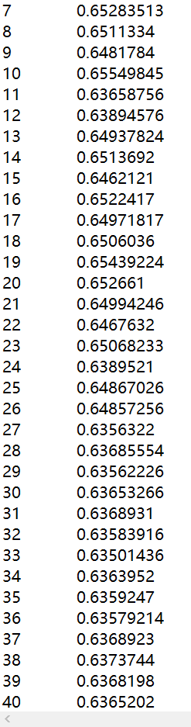
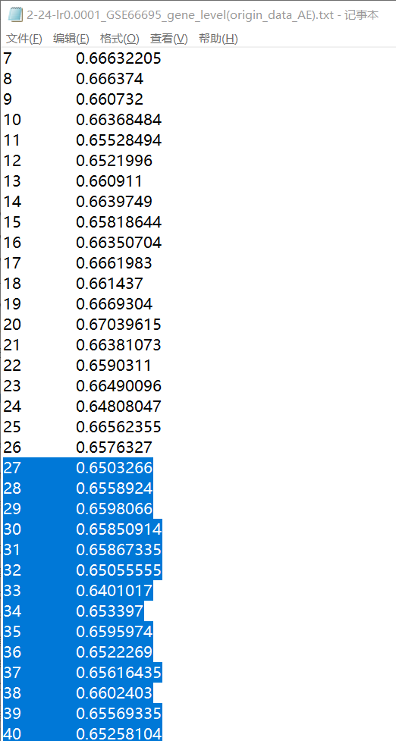
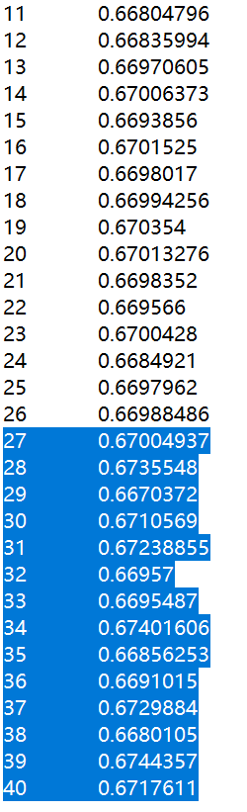
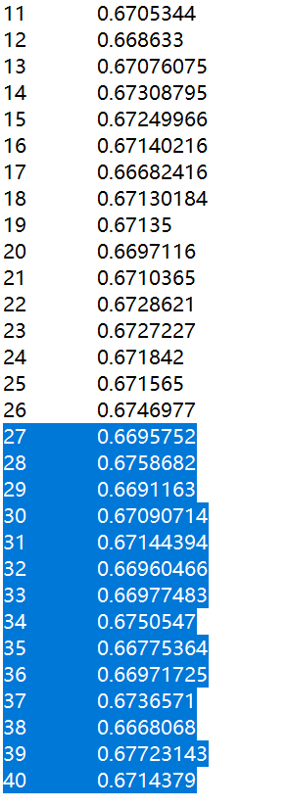
Predict results without regularization (label No.0~26 should be 1 , No.27~40 be 0)
Seems deeper network result is not necessarily better, maybe overfitting
Deeper autoencoder, and nn (B) lr=0.0001,epoch =1000
Deeper autoencoder, and nn (B)
lr=0.001,epoch =1000
Deeper autoencoder, and nn (B)
lr=0.005,epoch =1000
First try, simple network(A),
lr=0.001,epoch =100

Slide 24
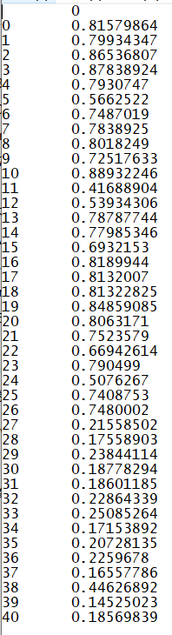
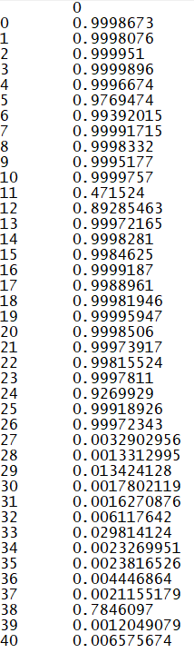
Predict results with regularization (label No.0~26 should be 1 , No.27~40 be 0)
MUCH better! because if use 0.5 as a threshold, we can tell apart 1 and 0
When epoch increases, label 1 prediction will be closer to 1, label 0 prediction will be closer to 0.
However, the accuracy doesn’t necessarily increase.
Regularized,epoch=20,
Acc=40/41
Regularized,epoch=100,
Acc=39/41

Slide 25

How will decreasing latent dimension affect accuracy?
input dimension = 809
latent dimension | 400 | 100 | 75 | 60 | 55 | 51 | 50 | 49 | 48 | 40 | 30 | 27 | 25 | 20 | 17 | 15 | 10
Accuracy | 0.95122 | 0.95122 | 0.97561 | 0.95122 | 0.97561 | 0.97561 | 0.658537 | 0.97561 | 0.658537 | 0.97561 | 0.97561 | 0.97561 | 0.658537 | 0.658537 | 0.658537 | 0.658537 | 0.658537
correct count(out of 41) | 39 | 39 | 40 | 39 | 40 | 40 | 27 | 40 | 27 | 40 | 40 | 40 | 27 | 27 | 27 | 27 | 27

Slide 26
How will decreasing latent dimension affect accuracy?
input dimension = 809
latent dimension | 400 | 100 | 75 | 60 | 55 | 51 | 50 | 49 | 48 | 40 | 30 | 27 | 25 | 20 | 17 | 15 | 10
Accuracy | 0.95122 | 0.95122 | 0.97561 | 0.95122 | 0.97561 | 0.97561 | 0.658537 | 0.97561 | 0.658537 | 0.97561 | 0.97561 | 0.97561 | 0.658537 | 0.658537 | 0.658537 | 0.658537 | 0.658537
correct count(out of 41) | 39 | 39 | 40 | 39 | 40 | 40 | 27 | 40 | 27 | 40 | 40 | 40 | 27 | 27 | 27 | 27 | 27

Slide 27
MeiNN is able to detect common embedding features among multiple diseases
From a multi-disease perspective, MeiNN is able to detect the emdding characteristics of combination between individual diseases
MeiNN can be interpreted with new datasets of phenotypes that have not been trained
Notes:
MeiNN能够检测到 多疾病之间共同的embedding特征
从多疾病角度 MeiNN能够检测到各个疾病之间联合的emdding特征
MeiNN可以用没有被训练过的表型新的数据集进行解释

Slide 28
Q&A

Slide 29
Back up

Slide 30
Future design questions
How to design the regularization
How to design number of pathway
How to design the total loss
How to design the combined training workflow(train 2 networks together)

Slide 31
How to design the regularization
regularization的设计：
被记载过参与pathway越多基因，越遵从相互的关系来正则化连接强弱。
一个都没记载的pathway，对他的研究一片空白，就不要设置太强reg。从直觉上来说。

Slide 32
How to design number of pathway
Pathway的数量：
可以设置一些冗余，比实际pathway数量更多，留有空白给未来发现。
多任务之前，先加定制的regularization，加入先验知识对网络的限制。

Slide 33
How to design the total loss
对于设置loss的建议：
一开始设置default,例如lambda=0.5，权重用于autoencoder,
剩下每个任务根据样本量来归一化/也可以每个任务一视同仁同样权重。
只要比random给weight效果更好。

Slide 34
How to design the total loss
Autoencoder reconstruction loss
embedding
Total Loss
c
Task prediction loss
embedding
Output

Slide 35
How to design the total loss
Total loss = lambda*(autoencoder reconstruction loss)+∑ (lambda_i*(task_i loss))
Lambda_i of multi task can set according to sample number, or each task has same weight, using normalization

Slide 36
How to design the combined training workflow(train 2 networks together)
关于联合训练，两个loss，梯度反向传播的comments:
如，脑embedding，肾embedding
Loss=下游任务的loss + decoder reconstruction loss
最开始先别太管下游任务。
先让decoder训练的好，然后考虑下游任务。
单独embedding，再单独multi tasking，
越是这样效果好的，用multi-task联合训练越容易成功
每个任务越不容易overfit，效果越好越容易成功。
故事是联合训练，如果单独训autoencoder会不知道下游任务的影响。

Slide 37
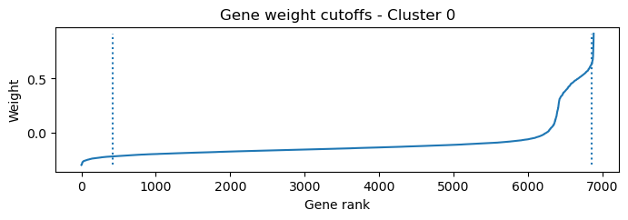
Interpretable Pathway-Gene-Site Feature Relational Neural Network for MeiNN
Interpretable features between the pathway->gene->site of MeiNN
From resVAE
Notes:
可解释的MeiNN的pathway-基因-位点特征关系神经网络
MeiNN的pathway 基因 位点之间的可解释特征

Slide 38
resVAE
Gene set inference from single-cell sequencing data using a hybrid of matrix factorization and variational autoencoders
lab-conrad/resVAE: resVAE is a restricted latent variational autoencoder that we wrote to uncover hidden structures in gene expression data, especially using single-cell RNA sequencing. In principle it can be used with any hierarchically structured data though, so feel free to play around with it. (github.com)

Slide 39
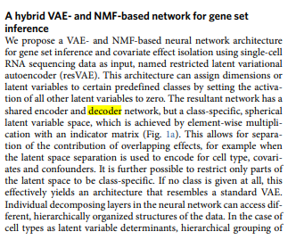
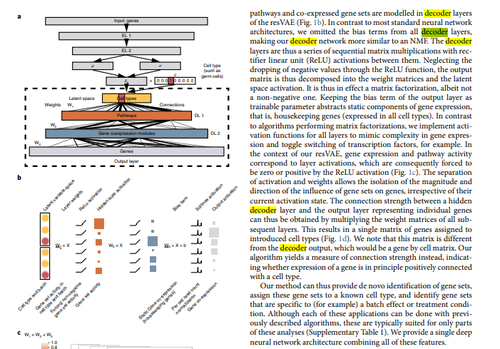
resVAE paper architecture

Slide 40
resVAE code
Runnable now
This paper possibly uses regularization to add constraints to the neuron connection strength in decoder.
But it’s a regularization(like L1, or learning rate*L1) applied to all nodes all the same. It use some get_latent_to_gene() functions to get the weight distribution of pathway->gene->sites.

Slide 41
MeiNN discovered new pathways and genetic correspondences
For some diseases, MeiNN discovered a new pathway and gene relationship, proving that certain genes may have an important relationship to the expression of certain diseases
Notes:
MeiNN发现了新的pathway和基因的对应关系
针对一些疾病，MeiNN发现了新的pathway和基因的关系，证明某些基因可能是对某些疾病的表达有着重要的关系
Method

Slide 42
Comments of Future Plan (From Prof Xin)：
1.故事：把weight讲明白，可解释性，哪个功能，网络不要随机设计，只能
一个任务先把前面的做出来，先验知识，和这个比，随机加l1，会不会更好 。起码是可解释性
2.多跑一些任务，单任务embedding连着单任务classifier。
训ae，要拿multitask，把所有数据集pool起来。 三四个四五个，看看下游classifier怎么样。
分三步走：
不限制，
正则化
有生物先验正则化
比较他们的效果区别和可解释性区别。
3． 多任务联合训练。loss粘在一块（autoencoder像输入的loss，以及下游的loss）
任务和任务之间也可以有层级hierarchial，比如都和心血管有关的任务在一个层级，等等。
4.可解释性的图怎么画，热点图，生物学已经有结论的重要function和pathway，和我们得到的可解释图能对应。

Slide 43
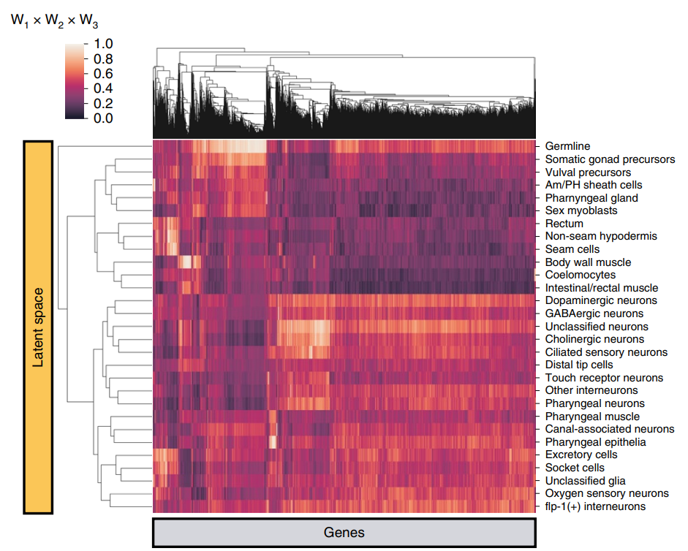
Example of explanation of the method (from resVAE paper)

Slide 44
Future Plan:
Coding:
Use resVAE’s regularization as reference. Two options to add regularization :1)rewrite ae and nn and write regularization with keras 2)continue writing with PyTorch
Add gene-site relationship to regularized network. make it runnable.
Add pathway-gene relationship to regularized network
Discover other type of loss. Like ss
Loss= MSE(input,output) + clustering Loss
Discover the weight distribution in autoencoder(whether full of zeros)
Train on large dataset, see results
Study training on multiple datasets, check accuracy.
Add multi-task neural network architecture. Tune the hyper parameter and revise model structure if needed.
Run additional experiments
Write Paper

