Slide 1
Estimate Number & position of Jiuling Based on Expectation-Maximum Algorithm
VE414 Bayesian Data Analysis
Group 11
Presented by:
Pengcheng Xu
Yiqi Sun
Yuzhou Zhai
Course Instructor:
Ailin Zhang

Slide 2
Work Division
Yuzhou Zhai
Yiqi Sun
Pengcheng Xu
Setting assumptions and workflow; Designing the poster
Data screening and visualization; Result validation
Implementataion of EM Algorithm

Slide 3
Introduction&
Assumptions

Slide 4
INTRODUCTION
Project Purpose:
Find out the estimated number and positions of Jiuling in the forest.
Project Approach:
Missing information estimation
Expectation-Maximum Algorithm
Gaussian-Mixture Model

Slide 5
Flow Chart
Raw data
Establish a matrix to store data
Clean overlapping data
Estimate the missing data
Get number and positions of Jiuling
Apply EM and Gaussian-Mixture model
Update matrix; draw cluster plot
Estimate relative position of Tayes

Slide 6
Assumptions
About Tayes:
Tayes on the ground follow joint Gaussian distributions.
Jiuling trees are treated as the sources of joint Gaussian distributions.
Number of Tayes is a constant.

Slide 7
Assumptions
About missing data:
Missing data are estimated by collected “not too far” data.
Choosing maximum values of neighboring grids as the boundary value.
About collected data:
Collected location data points will be rounded down to integers.
Adopt mean values if there are multiple samples in a grid.
For each grid, Tayes locate uniformly randomly in the grid.

Slide 8
Data Processing
Organize raw data
Estimate missing data
Re-distribute data
Visualize data

Slide 9
Raw Data
 | X | Y | Potter | Weasley | Granger | Trip | Close | Far
1 | 2.46628384419442 | 3.58211798308772 | 1 | 0 | 0 | 1 | 0 | 0
2 | 5.50833567528356 | 8.29571303014822 | 1 | 0 | 0 | 1 | 0 | 0
3 | 6.78448075699181 | 11.8513927379521 | 1 | 0 | 0 | 1 | 0 | 0
4 | 7.5504994061406 | 14.4118122862063 | 1 | 0 | 0 | 1 | 0 | 0
5 | 10.4020964298133 | 17.21807856384 | 1 | 0 | 0 | 1 | 0 | 7
 | …
24094 | 40.5305015974859 | 76.0638054903503 | 0 | 0 | 1 | 49 | 1 | 8

Slide 10
Organize Raw Data
107
…
3
2
1
 | 1 | 2 | 3 | … |  |  | 107
 | X | Y | Grid of Map | Close | Far
1 | 2.46628384419442 | 3.58211798308772 | [2, 4] | 0 | 0
2 | 5.50833567528356 | 8.29571303014822 | [6, 8] | 0 | 0
3 | 6.78448075699181 | 11.8513927379521 | [7, 12] | 0 | 0
4 | 7.5504994061406 | 14.4118122862063 | [8, 14] | 0 | 0
5 | 10.4020964298133 | 17.21807856384 | [10, 17] | 0 | 7
 | x_{i} | y_{i} | [round(x_{i}), round(y_{i})]
24094 | 40.5305015974859 | 76.0638054903503 | [41, 76] | 1 | 8
A matrix map of size 107 by 107
Round the coordinates and place each sampled “Close” and “Far” data into the matrix map.

Slide 11
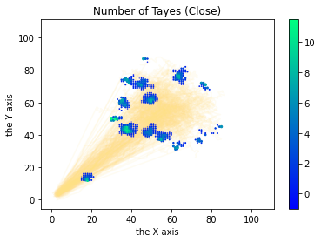
Organize Raw Data
107
…
3
2
1
 | 1 | 2 | 3 | … |  |  | 107
Number of Tayes = Average(close_{ij})
Far = Average(far_{ij})
We take the average of all data that falls into this grid since the measurement is not accurate. We choose mean as the estimator.
A matrix map of size 107 by 107

Slide 12
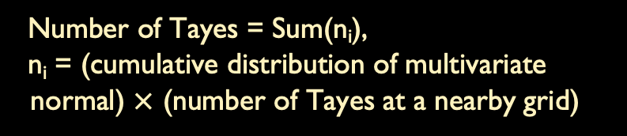
Estimate Missing Data
107
…
3
2
1
 | 1 | 2 | 3 | … |  |  | 107
Number of Tayes = Sum(n_{i}),
n_{i} = (cumulative distribution of multivariate normal) $×$ (number of Tayes at a nearby grid)
For some grids that have never been explored by the trio, we use “Far” data from surrounding grids to perform estimation.
Suppose “Far” data is distributed as multivariate (2d) normal distribution, with the intuition that it is less likely to detect a Tayes when it is farther away.
A matrix map of size 107 by 107

Slide 13
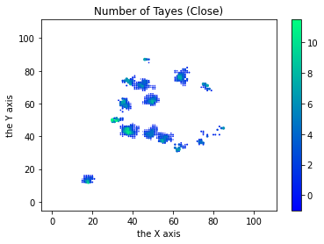
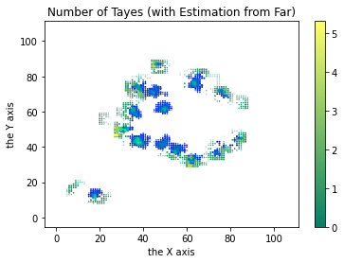
Estimate Missing Data

Slide 14
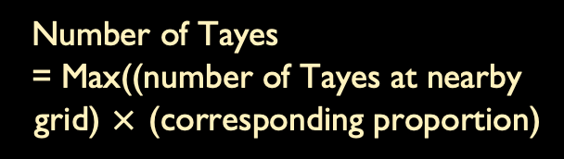
Redistribute data
Number of Tayes
= Max((number of Tayes at nearby grid) $×$ (corresponding proportion)
0 | 4 | 0
1 | 5 | 0
0 | 0 | 0
0 |  | 0 | 0 | 0
 |  | 1 | 0
0 | 1 | 1 | 0 | 0
0 | 0 | 0 | 0
0 |  | 0 |  | 0
0 | 4 | 0
1 | 5 | 0
0 | 0 | 0
Zoomed in map with value equal to the number of Tayes
Zoomed in map with value equal to the proportion of Tayes location with respect to upper-left, upper-right, lower-left and lower-right
Redistribute the number of Tayes by shifting values from grids to their upper-left corner, the process is referred to “even out” in later discussion

Slide 15
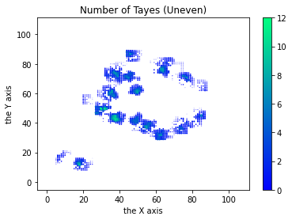

Redistribute data

Slide 16
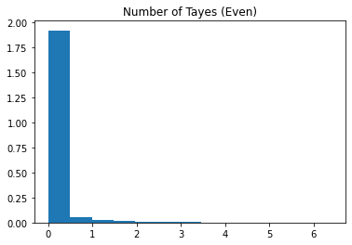
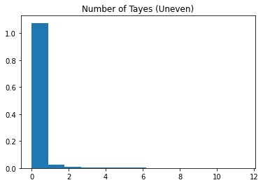
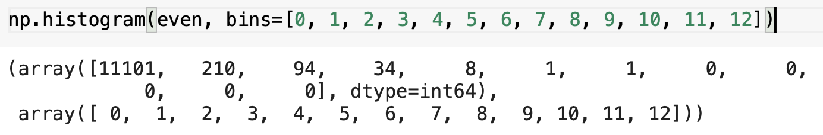
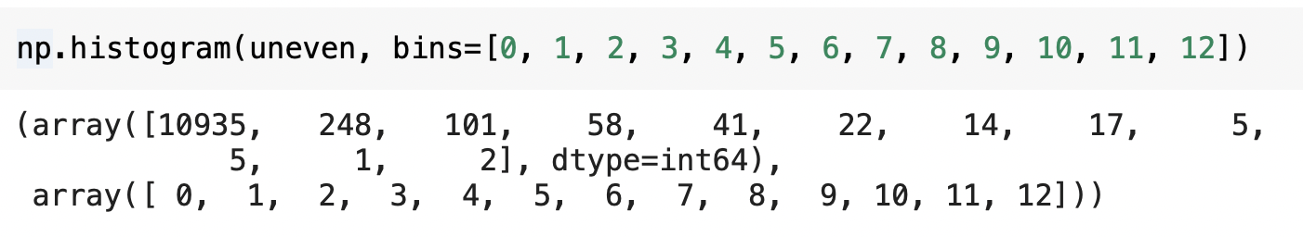
Redistribute data

Slide 17
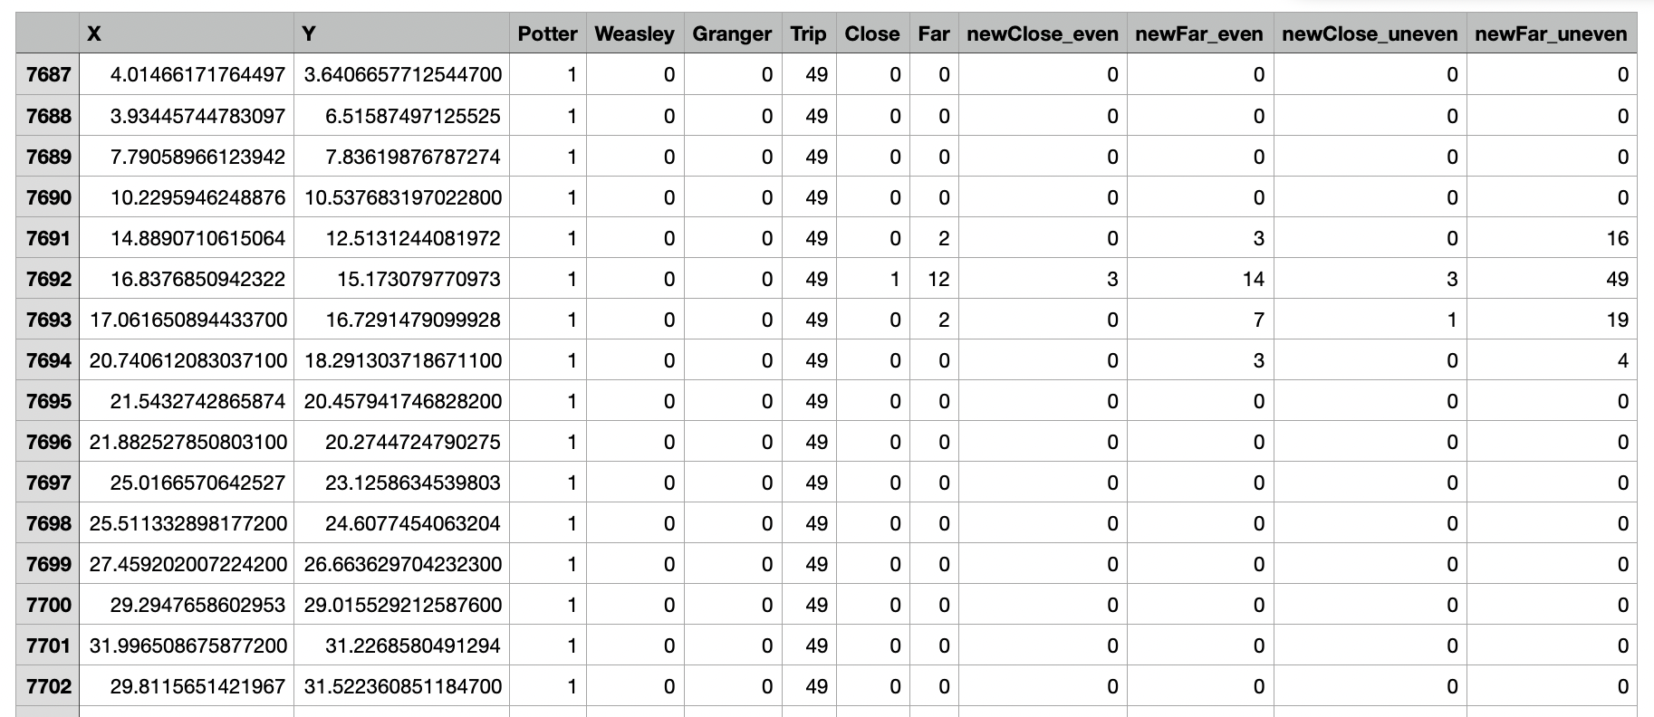
Redistribute Data
We try to estimate the value of close and far with our redistributed and tuned data as well as with the unevened data. It shows our evened data is closer to the raw data.

Slide 18
Em Algorithm

Slide 19



How many components?
The fact that GMM is a generative model gives us a natural means of determining the optimal number of components for a given dataset.
A generative model is inherently a probability distribution for the dataset, and so we can simply evaluate the likelihood of the data under the model, using cross-validation to avoid over-fitting.
Another means of correcting for over-fitting is to adjust the model likelihoods using some analytic criterion such as the Akaike information criterion (AIC) or the Bayesian information criterion (BIC).
The BIC is formally defined as
k:the number of parameters estimated by the model.
The maximized value of the likelihood function of the model M.
X: observed data.
$\hat{θ}$ : the parameter values that maximize the likelihood function
n:the number of data points in, the number of observations, or equivalently, the sample size.

Slide 20
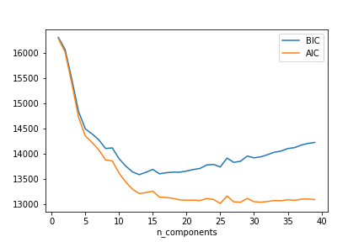
How many components?
The fact that GMM is a generative model gives us a natural means of determining the optimal number of components for a given dataset.
A generative model is inherently a probability distribution for the dataset, and so we can simply evaluate the likelihood of the data under the model, using cross-validation to avoid over-fitting.
Another means of correcting for over-fitting is to adjust the model likelihoods using some analytic criterion such as the Akaike information criterion (AIC) or the Bayesian information criterion (BIC).
BIC and AIC minimized

Slide 21
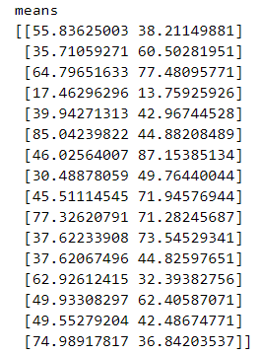
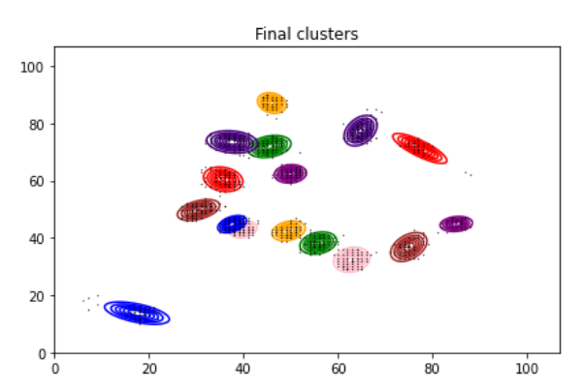
Apply E-M algorithm to cluster
(Gaussian Mixture Model)
Due to the previous analysis, we set cluster number as 16

Slide 22
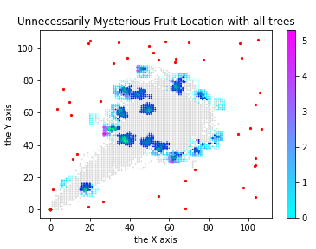
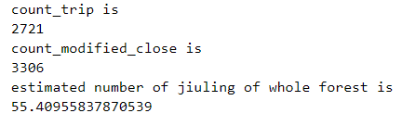
Estimate jiuling in the whole Forest
Assumption:
The position of jiuling in the forest follows a uniform distribution
We count all the grid we’ve already taken into account, it’s 3306
Then estimated number of jiuling of whole forest is 16/3306*107*107=55.40955837870539

Slide 23


What if jiuling can move?
107
…
3
2
1
 | 1 | 2 | 3 | … |  |  | 107
Each gird has a function of time, representing jiuling at every moment. F(t)
What do we need to know?
We need to know the jiuling distribution in each moment of time.
How to record?
Let one student to record one 3*3 grid at one time.
We need 107*107/9=1273 students in total.
A matrix map of size 107 by 107

Slide 24
Thank you for listening
Q&a

