Slide 1
Normalisation

Slide 2


Slide 3
Functional normalisation
450k chip has control probes
613 negative controls
186 positive controls
49 quality controls (e.g. sensitive to bisulphite conversion etc)
COMPLETELY UNRELATED TO BIOLOGY

Slide 4
Problem
Correlation between a probe and a trait can be because
Real biological relationship
Technical artifact leading to confounding
E.g. Normally a large sample is done in different batches

Slide 5
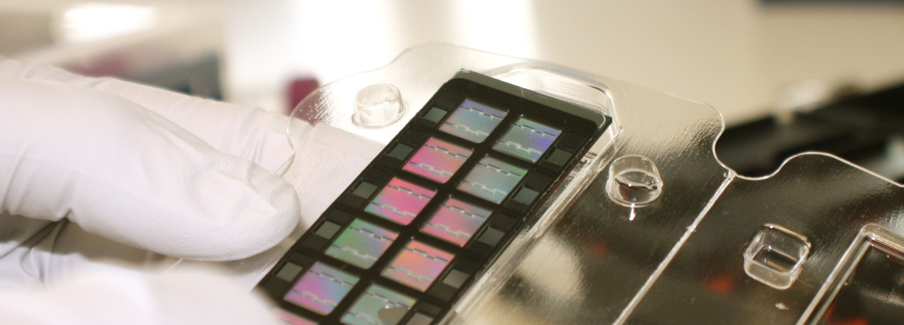
12 samples per slide 8 slides per plate

Slide 6
Normalisation packages
BMIQ
Minfi
Meffil

Slide 7
Control probes
Notes:
A – batch effects
B – Control probes capture batch effects

