Slide 1


Basic statistics (with R)
Gib Hemani
Notes:
30 mins to talk about statistics is impossible. 2 mins or 2 weeks, but not 30 mins.
I don’t want to list a bunch of facts to you for you to forget immediately.
A lot of what I’ll talk about is going to be common knowledge, but I think that if you understand the principles behind the common knowledge then you can understand the rest of statistics much more easily

Slide 2
Statistics is the collection, organisation, presentation, analysis, and interpretation of data

Slide 3
Before performing any experiment it is crucial that the outcome falls into a statistical framework “To what scientific question is this experiment the answer?” “How confident am I going to be of the result?”
Notes:
Experiment design should focus on the post-experiment statistics
What data will be necessary to answer the question fully
What are your expectations, what is the limit to what your experiment can detect?

Slide 4
Instead, we’ll talk about some concepts: - Sampling from the population - Hypothesis testing - Power and sample size - The logic behind a statistical test
This talk will have very little detail on how to perform statistical tests

Slide 5
So we have collected some data, a sample from the population
For example, we have collected the total time it took for 21590 cyclists to complete the Tour de France, of whom
12310 take steroids and 9280 are clean

Slide 6
What do the data look like?
Raw values:
Histogram of overall time:

Slide 7
Distribution of time taken
Histogram:
Normal distribution:
Notes:
Imagine we had an infinite sample size, would might the histogram look like then?

Slide 8
We can summarise our data with just two calculations: The mean The standard deviation

Slide 9
Estimation of the mean
Sample mean
Different types of averages
Mean – add up all values and divide by sample size
Median – sort all values in ascending order and take the middle value
Mode – chose the most frequent value

Slide 10
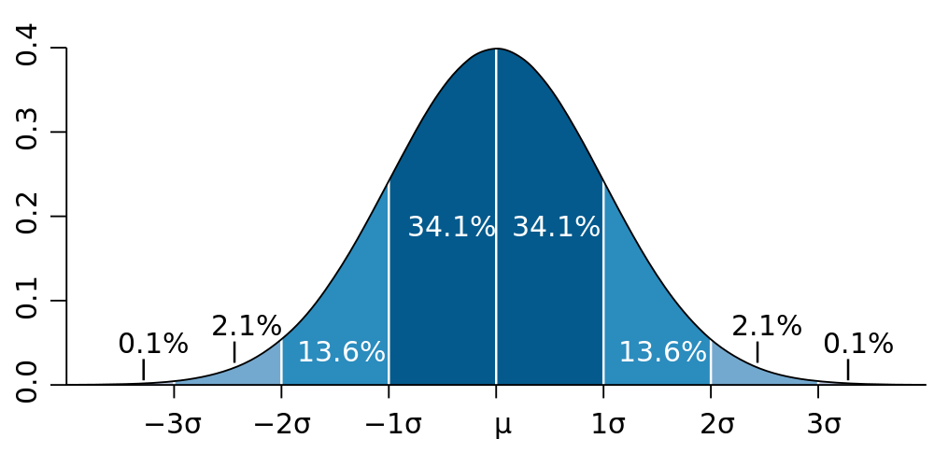
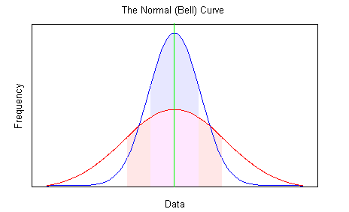
Dispersion of times
Standard deviation (σ):
How far do individuals vary from the mean?
Low standard deviation
all samples are very close to the mean
If σ = 0
every sample is equal to the mean

Slide 11
Standard error of the mean
Sample mean
How representative of the population is the sample?
We have calculated the mean from 21k individuals
What if we calculated it from
A million individuals?
20 individuals?
Let’s have a look…

Slide 12
Standard error of the mean
As we’d expect, the mean estimated from the sample is less accurate when the sample size (n) is small
Standard error = σ / √n
Notes:
Back to R

Slide 13
If we took lots of samples from the population, and calculated the mean each time, and made a histogram of those means, it would make a normal distribution.
The standard deviation of that normal distribution is the standard error of our estimate of the mean.

Slide 14
Our measurements are inherently wrong, the key is to know by how much

Slide 15
Few beans in this handful are white. Most beans in the bag are white. Probably, these beans were taken from another bag. - Anon
(aka Hypothesis testing)

Slide 16
Hypothesis testing
The null hypothesis (H₀)
This is the default position
E.g. there is no effect / no relationship
Alternative hypothesis (H₁)
The burden of evidence lies on the data to reject the null hypothesis

Slide 17
Hypothesis examples
H₀: The treatment has no effect
H₁: The treatment has an effect
H₀: The two variables are unrelated
H₁: The two variables are correlated

Slide 18
Assuming that the null hypothesis is true, what is the probability of observing a value at least as extreme as the one we observed, simply by chance?
Notes:
Remember, we are sampling from the population and all our estimates and measurements are inherently inaccurate!

Slide 19
Treatment effect
Total sample
Stratified by treatment

Slide 20
Treatment effect
Total sample
Stratified by treatment

Slide 21
H₀: Drugs have no effect on time H₁: Drugs do have an effect

Slide 22
So we can observe a difference between the mean values for the two groups
But remember – there is error in our measurements!

Slide 23
Data for our hypothesis test
Bivariate distribution
Estimating the means

Slide 24
Statistics is useful because it can formalise our observations into probabilities
Assuming that the null hypothesis is true, what is the probability of seeing this difference between the means by chance alone?

Slide 25
So, we know the difference between the means, but what is the probability of this occurring by chance?
This can be calculated if we know the sample sizes and the standard deviations of the populations

Slide 26
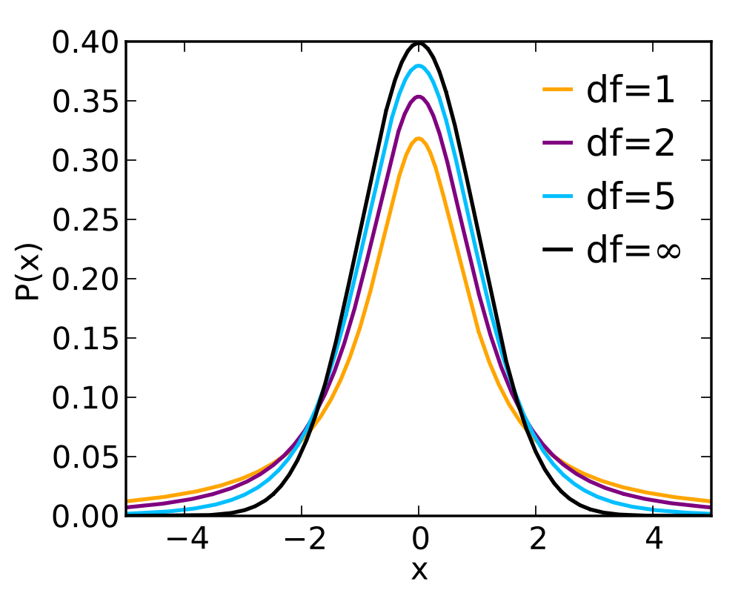

t-test
How to calculate the t-value
The distribution of t-values
For argument’s sake, let’s say our treatment had no effect on the mean, and we:
sample X₁ and X₂ lots of times and calculate t, and then
make a histogram of all the t values from these samples,
then we will get a distribution of t-values like the one on the right
t
If the t-value from our experiment is in an extreme tail such that only 5% or less of all other t-values fall there too, typically this result is often deemed significant

Slide 27
A p-value is another way of saying, if we did this experiment 100 times, and the null hypothesis were true, what proportion of times would the difference in means be this extreme?
A p-value of 0.05 literally means that we might expect to see an effect this extreme in 1 out of 20 experiments

Slide 28
So do drugs improve performance?
Sample size | Mean difference | Standard errors | t-value | P-value
10 | 0.29 | 0.41, 0.71 | 0.74 | 0.48
1000 | 0.94 | 0.03, 0.03 | 22.7 | 1e-91

Slide 29
Linear regression

Slide 30
y = a + bx + e

Slide 31
y = a + bx + e

Slide 32
y = a + bx + e
RSS = sum(e²)

Slide 33
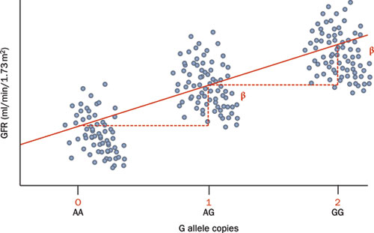
Linear regression for a SNP against a continuous outcome
Note – the points have been ‘jittered’ – they are actually all on top of each other on 0/1/2

Slide 34
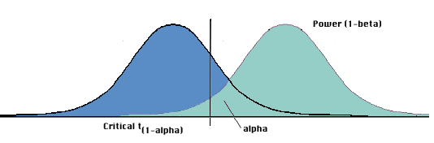
Power vs false discoveries
Distribution of t-values when H₀ is false
Distribution of t-values when H₀ is true
alpha
beta

Slide 35
Logistic regression

Slide 36
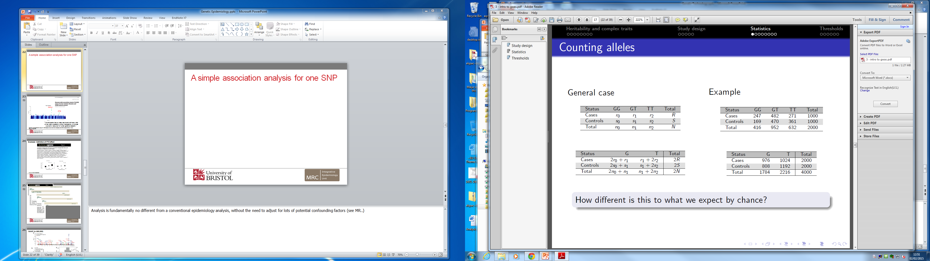
A simple association analysis for one SNP and a binary outcome
General case
Example
How different is this to what we expect by chance?
Statistical test?
Chi squared test
Odds ratio

Slide 37
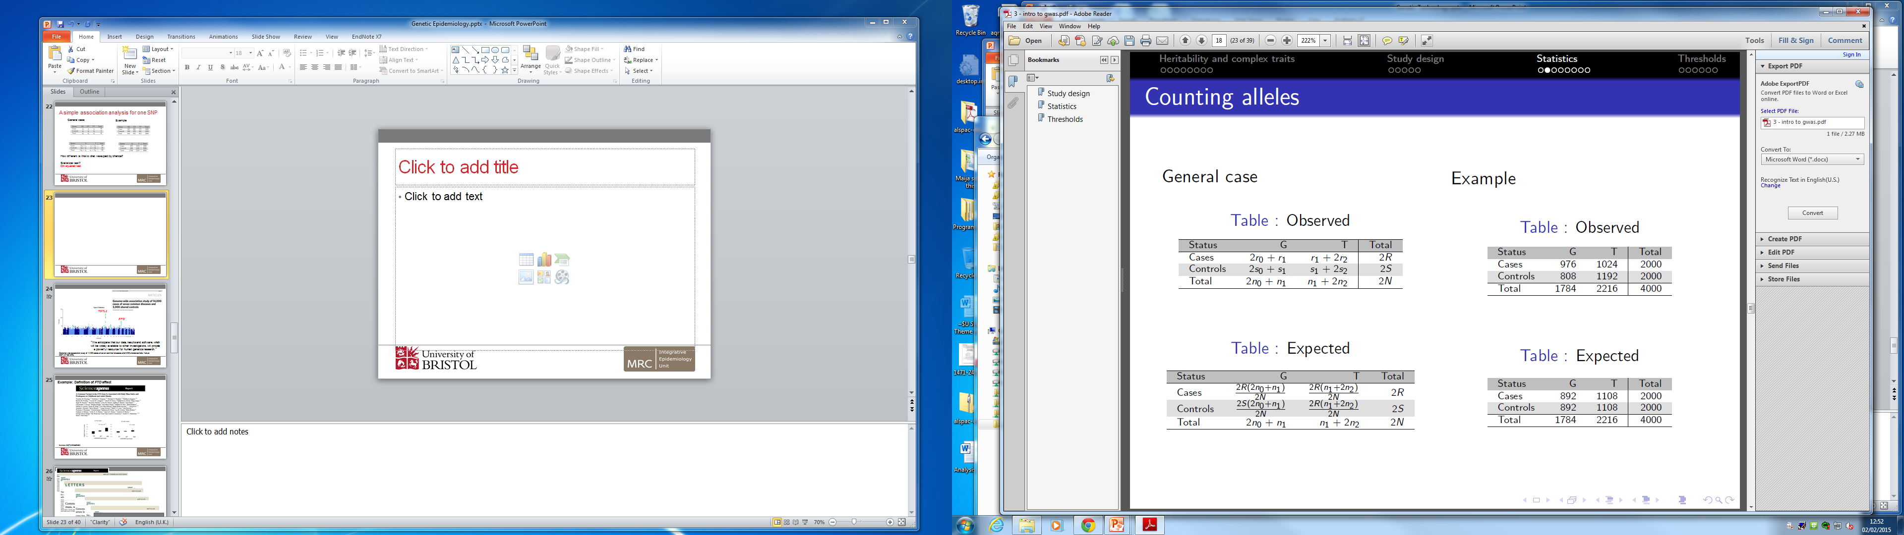
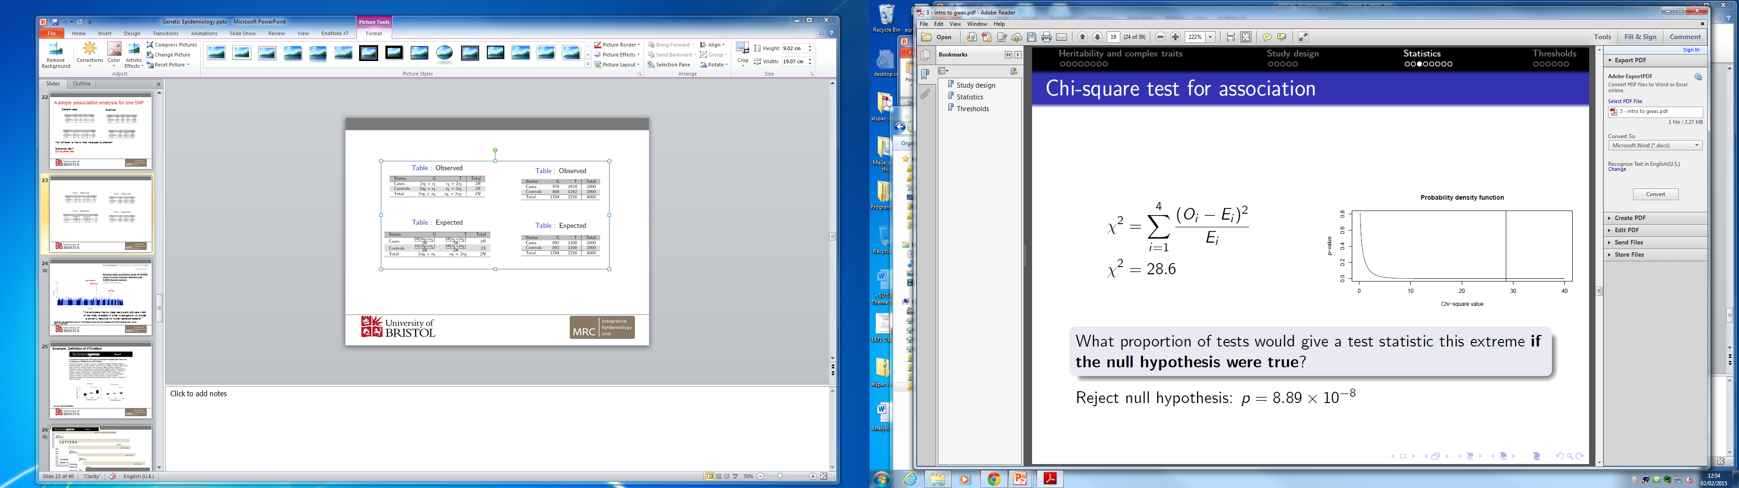

Slide 38
Odds ratio
What are the increase in odds of being a case for the G allele compared with T?
Odds ratio =
Odds of G in a case
Odds of T in a case
OR = 1; No association between genotype and disease
OR > 1; G allele increases risk of disease
OR < 1; T allele increases risk of disease
976/808 = 1.41
1024/1192

Slide 39
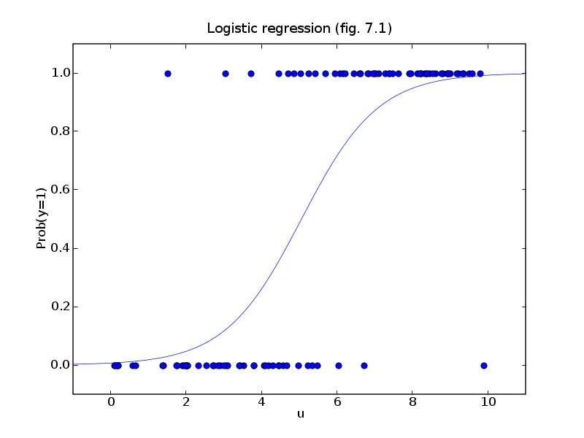
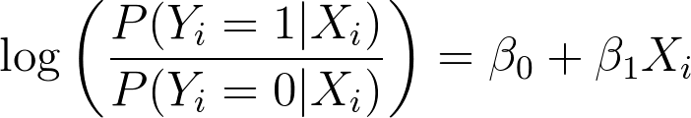
Logistic regression for complex models e.g. including covariates
Notes:
The disease phenotype is either 0 or 1
The independent variable is potentially continuous
It has an influence on the PROBABILITY of disease
The PROBABILITY of disease is estimated as a link function between the fitted values and the disease phenotype

