Slide 1


Genetic data
Gib Hemani
Notes:
Cleaning genetic data is very important, but also very boring.

Slide 2
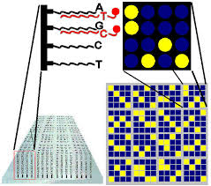
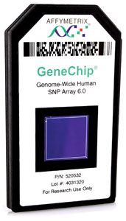
SNP chips
https://youtu.be/lVG04dAAyvY?list=PLlZbdY9YIhkN7JBqwGrOr3c-c5bW2Ott5&t=39
Notes:
Bead arrays perform hundreds of thousands (or millions) of assays
DNA is amplified and digested into small oligo nucleotides.
The bead array has many probes for each SNP, one probe for allele ‘A’ (e.g. red fluorescence) and another probe for allele ‘a’ (e.g. green fluorescence).
DNA hybridises to the corresponding probes. When it hybridises it fluoresces.
A machine measures fluorescence for each SNP

Slide 3
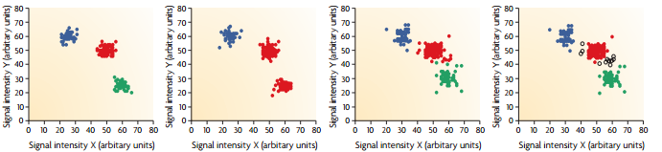
Genotype calls are probabilistic
Called as TT
Called as TG
Called as GG
Well defined genotype clusters
Error in allele calling
Overlap between clusters -> failure to call genotypes
Notes:
This is an example of signal from the fluorescence for one SNP.
Each individual is represented by one point.
The task is now to identify which cluster represents which genotype.
High Y and low X means there is much intensity from only one allele – homozygous AA
High X and low Y means there is much intensity from only one allele – homozygous aa
The middle is the heterozygote.
Notice that this is a method that depends on calling discrete genotypes from potentially quite messy continuous data.
There can be outliers that don’t obviously cluster anywhere – these individuals are set to missing.
If there are a lot of individuals set to missing for a SNP, it is potentially unreliable and we will discard that SNP entirely.

Slide 4
Storing SNPs
ID | rs1111111 | rs2222222 | rs3333333
person1 | AA | Aa | AA
person2 | Aa | aa | AA
person3 | AA | aa | AA
person4 | AA | aa | Aa
person5 | aa | aa | aa
ID | rs1111111 | rs2222222 | rs3333333
person1 | 0 | 1 | 0
person2 | 1 | 2 | 0
person3 | 0 | 2 | 0
person4 | 0 | 2 | 1
person5 | 2 | 2 | 2
Notes:
SNP data can be presented like this – rows for individuals and columns for SNPs.
Typically we will have thousands of individuals and hundreds of thousands of SNPs.
The top table shows what the genotypes are for each individual.
The bottom table shows a more convenient way of storing this information – a count of the number of ‘a’ alleles.

Slide 5
Look at genotype data

Slide 6
Allele frequencies
ID | rs1111111 | rs2222222 | rs3333333
person1 | 0 | 1 | 0
person2 | 1 | 2 | 0
person3 | 0 | 2 | 0
person4 | 0 | 2 | 1
person5 | 2 | 2 | 2
Frequency | 3 / (5 x 2) = 0.3 | 9 / (5 x 2) = 0.9 | 3 / (5 x 2) = 0.3
Minor allele freq | 0.3 | 0.1 | 0.3
Notes:
Calculating the allele frequency is simple summing up the number of ‘a’ alleles and dividing by the number of chromosomes (e.g. 2 x sample size)
The term ‘minor allele frequency’ is used as a convention – it refers to the frequency of the least common allele.

Slide 7
Calculate and plot allele frequencies

Slide 8
Quality checks
Individual missing rates (call rate)
SNP missing rates (call rate)
Allele frequencies
Hardy Weinburg equilibrium
Notes:
Just because a genotype is called for an individual doesn’t mean that it’s trustworthy…

Slide 9
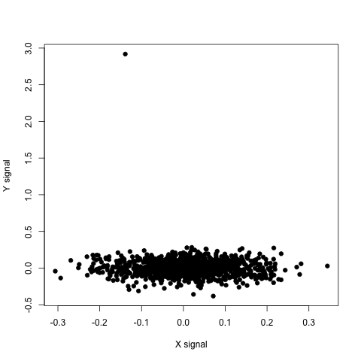
Allele frequency filtering
Notes:
If we have SNP that looks like this – lots of individuals in one cluster, and one or a few outside of that cluster.
How can we tell that these outliers are outliers, or actually heterozygotes for the minor allele?
We typically remove SNPs that are called with minor allele frequency < 1% are normally removed. Also for other reasons to be discussed later.

Slide 10
Hardy Weinberg
If we know a SNP’s allele frequency then we can calculate the expected number for each genotype:
If the Observed numbers in the clusters diverge from this, we might be suspicious that the SNP is unreliable

Slide 11
Filter on allele frequency, HWE, call rates

Slide 12
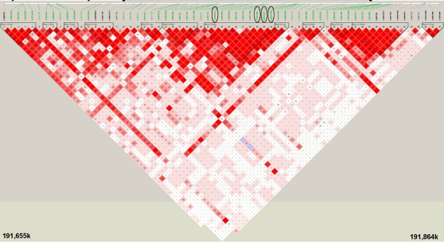
Should I be worried about discarding SNPs?
Notes:
Pros:
Avoid potentially spurious results
There is often redundancy, e.g. SNPs close together are highly correlated. Therefore, removing one SNP isn’t necessarily so bad, it’s effect might still be captured by adjacent SNPs
Cons:
1. Removing too many SNPs can remove more signal than noise.

Slide 13
Cryptic relatedness
For most analyses we want only ‘unrelated’ individuals in our sample
Relatedness CONFOUNDS genetic associations
Is a SNP associated with the trait because
A) The SNP is biologically associated
B) Relatives are more likely to have the same trait, and also more likely to share similar genotypes across the genome

Slide 14
Remove related individuals (IBS > 0.025)

Slide 15
Calculating principal components
The problem of confounding also arises if individuals are from different ethnic groups
Is a SNP associated because
A) The SNP is biologically associated
B) Individuals in one ethnic group have the same trait, and also share similar genetic composition across the genome

Slide 16
Calculate and plot principal components

