Slide 1


Introduction to next generation sequencing
Gib Hemani

Slide 2
Learning objectives
By the end of this session you should be able to:
Describe principles of genetic sequencing methodologies (past, current, future).
List potential uses of next generation sequencing technologies.
Discuss basic analysis principles and introduce the Galaxy platform.

Slide 3
How many variants are there
131,000,000 births last year
73 de novo variants for every new birth
3,000,000,000 base pairs
On average, each position is mutated 3 times per year

Slide 4
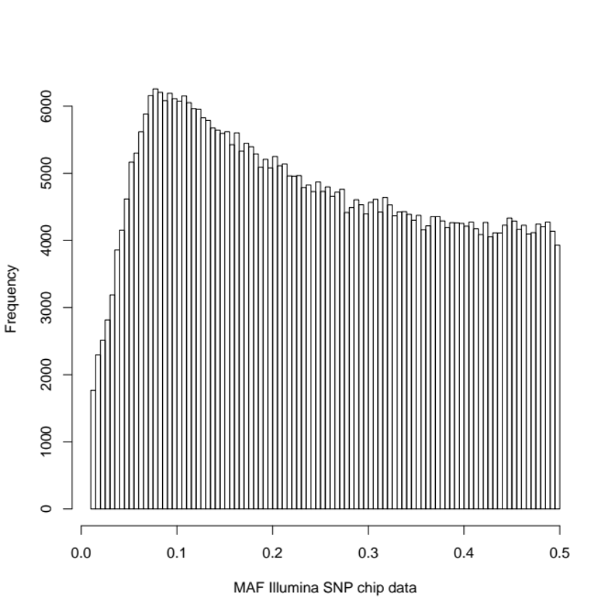
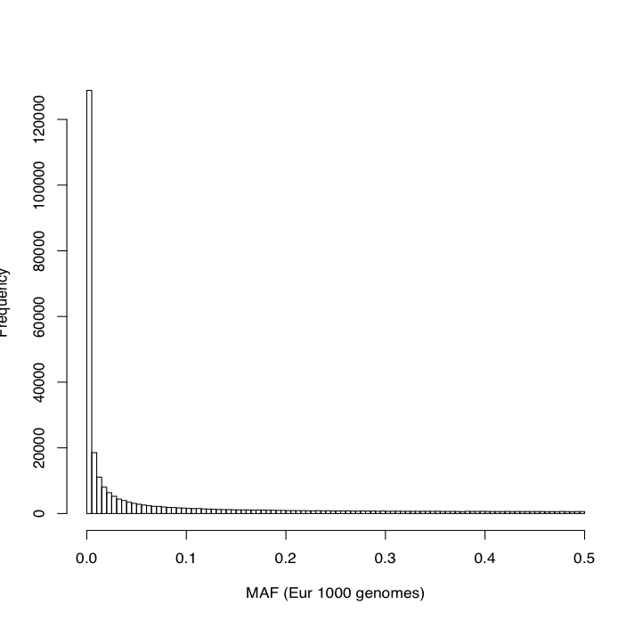
Allele frequencies
SNP chip
Sequence data

Slide 5
Why are SNP chips designed like this?
Common diseases likely caused by common variants?
Technically easier to create a SNP chip of common variants
Statistical power to detect common variant potentially better

Slide 6
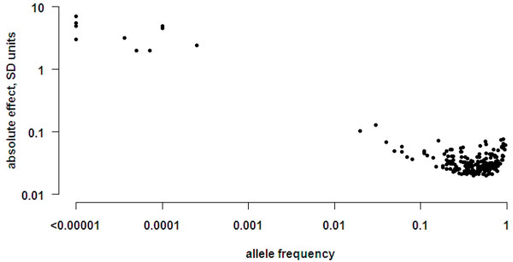
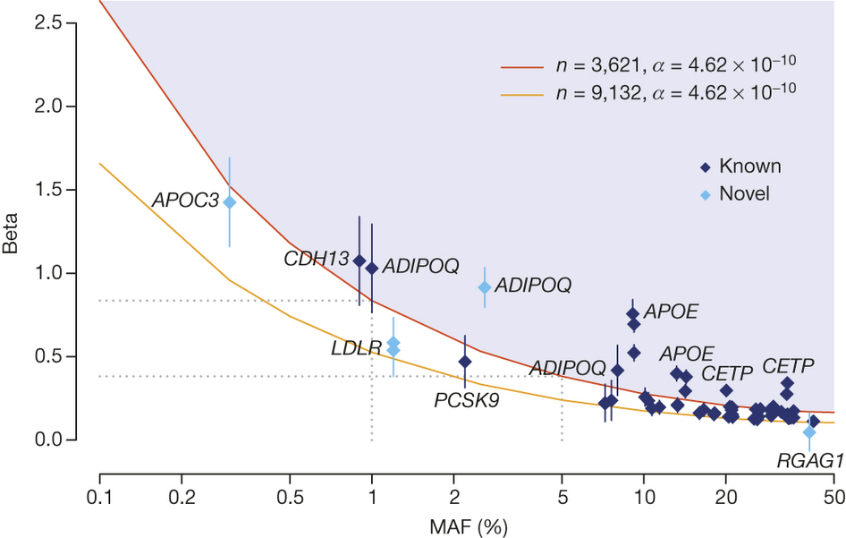
Where on the spectrum are GWAS hits?
Human height, Kemper et al 2012
Lipids, UK10K 2015

Slide 7
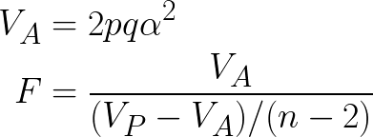
Power is related to frequency and effect size
2pq = variance of SNP
  Rare SNPs have low variance
  In order to get the same F statistic, rare variants must have much larger effect sizes
Natural selection drives large effect sizes to low frequency

Slide 8
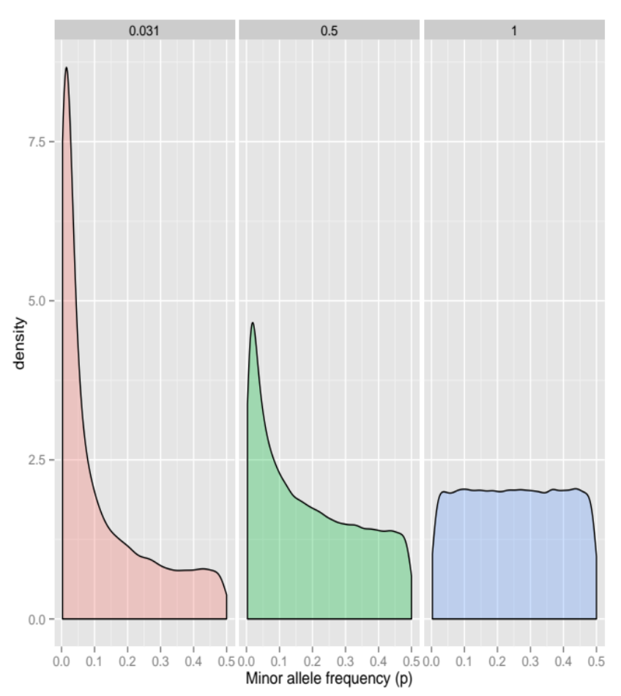
Which variants have an effect?
Beta distributed with shape parameters:
a = b = 0.031
a = b = 0.5
a = b = 1

Slide 9
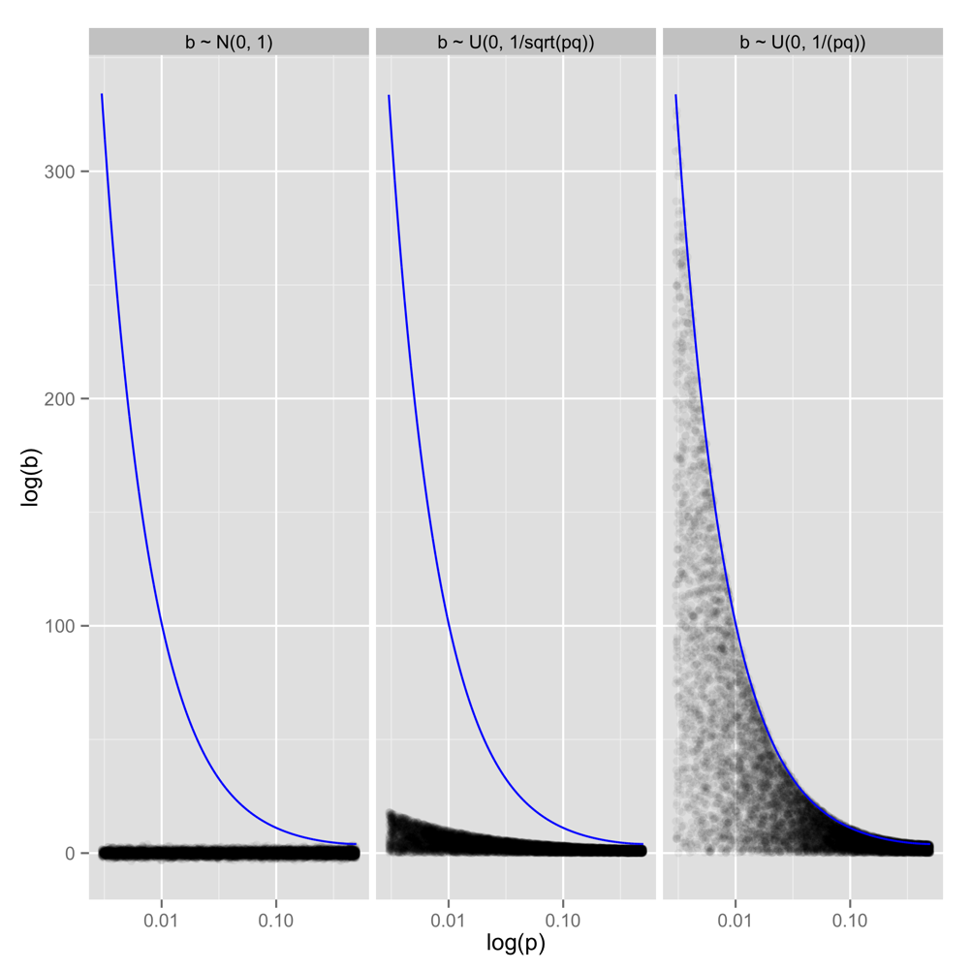
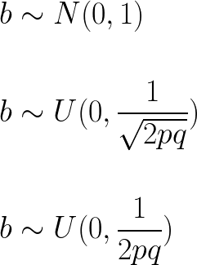
What are the effect sizes?
No relation with allele frequency
Bound by square root of power curve
Bound by power curve

Slide 10
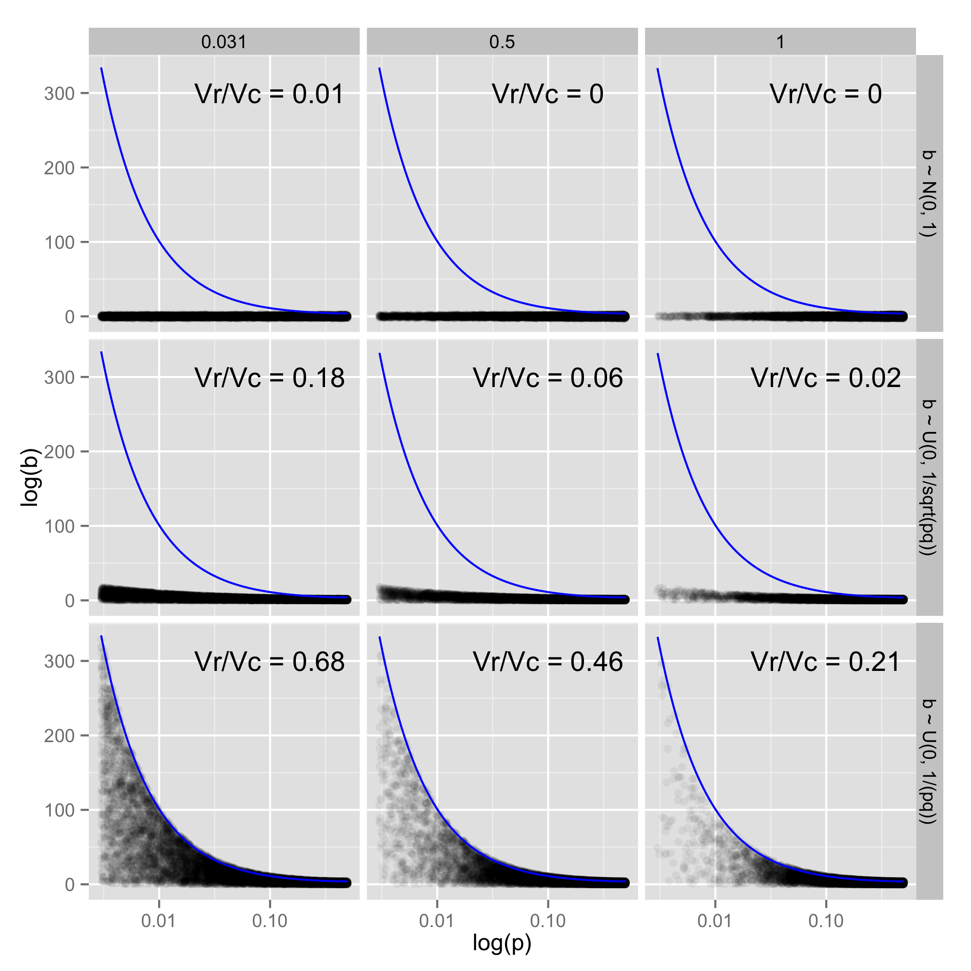
Under these scenarios…

Slide 11
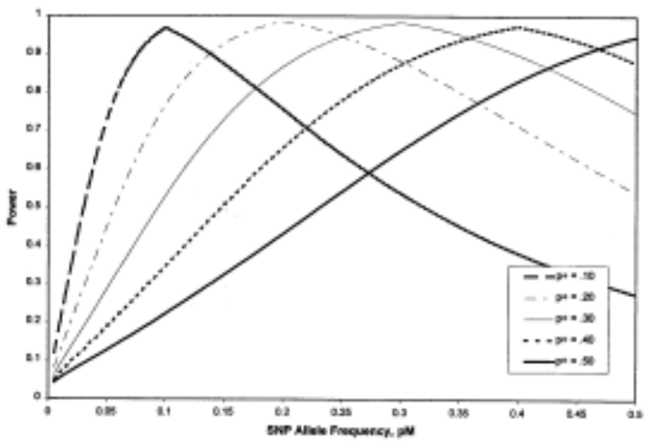
What is imputation?
Tag SNPs give us great coverage of common variants in the genome
  Probably in excess of 80% of the variation
But they are very bad at capturing rare variants
Imputation is a method for taking genotype data from SNP chips and making a probabilistic inference of what the genotypes are at the unmeasured SNPs

Slide 12
Quick summary
Rare variants are vastly more NUMEROUS than common variants
Common variants do not tag rare variants
Under certain genetic models, a substantial proportion of the missing heritability could be due to untagged rare variants
Sequence data helps identifying the causal variant

Slide 13
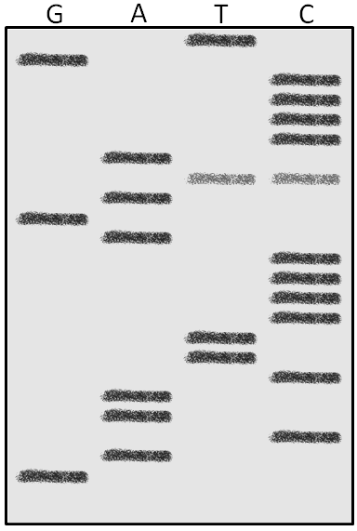
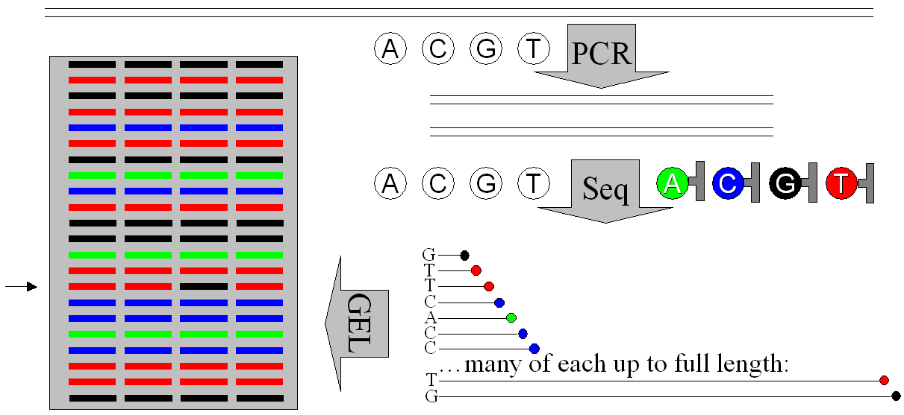
Sanger sequencing
Chain termination
Fragments distinguished by length and terminating nucleotide

Slide 14
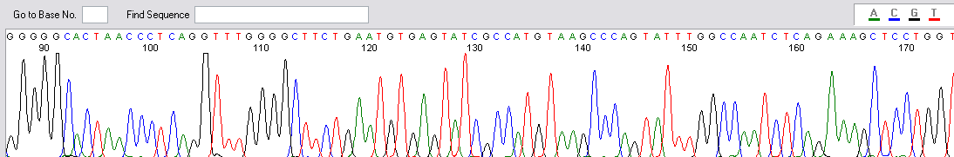
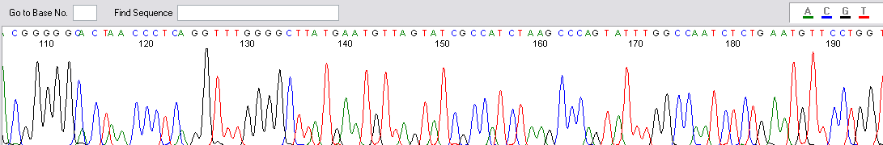
Fluorescent sequence chromatogram
Spot the difference(s)!
Also note potential importance of sequence quality – base-caller correct here, but often not!

Slide 15
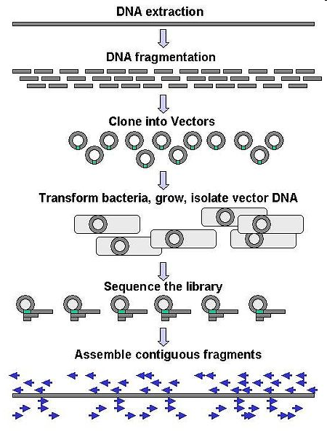
Human Genome Project: whole genome sequencing
Figure created by Abizar Lakdawalla, released into the public domain (Wikipedia)

Slide 16
Next generation sequencing
“Massively parallel”, shotgun approach
Population of sequence reads representing population of DNA molecules
  Possible to select sub-populations
Redundancy (“depth” of coverage)
Scope to multiplex samples

Slide 17
Next generation sequencing
Technology | Implementation | Max length | Reads | Cost
Chain termination* | Sanger Seq | 900bp | 96 | ££££££££
Sequencing by synthesis | Illumina | 300bp | 6 billion | £
Pyrosequencing | 454 | 300bp | 1 million | £££
Sequencing by ligation | SOLiD | 100bp | 1.4 billion | £
Ion semiconductor | Ion Torrent | 400bp | 80 million | ££
Single molecule real time | Pacific Biosciences | 40,000bp | 50,000 | £
Nanopore sequencing | Oxford Nanopore | 10,000’s bp? | 10,000’s? | ?
“Massively parallel”, shotgun approach
* Previous generation sequencing for comparison

Slide 18
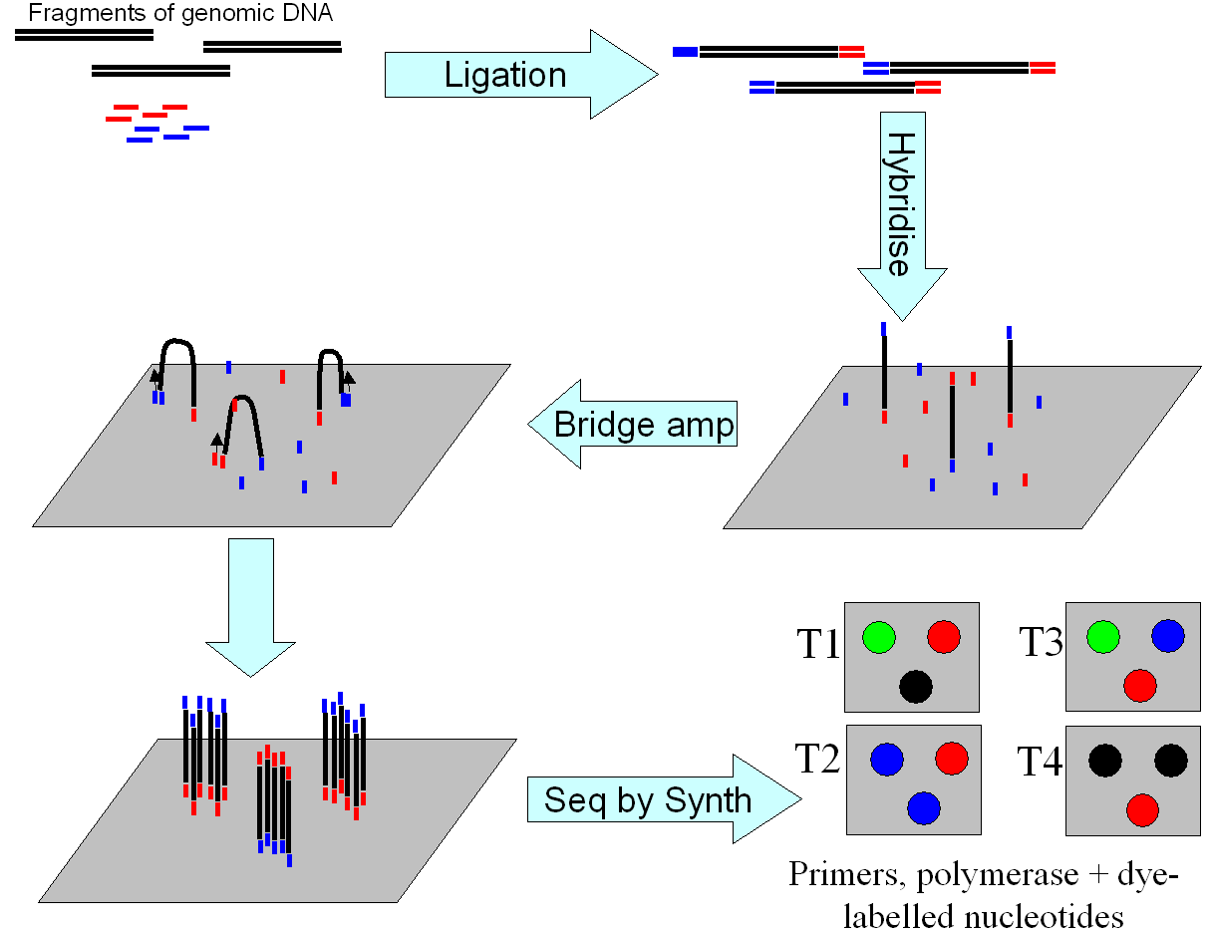
“Next generation” sequencing
Illumina/Solexa technology

Slide 19
Targetted sequencing
Sequence capture arrays – exome, gene list, specific GWAS-hit regions etc
PCR amplification – suitable for smaller scale
Pooling to maximise throughput (“barcoded” or anonymous)

Slide 20
APPLICATIONS

Slide 21
Genomics/Genetics
(Novel genome sequencing)
Identifying sequence variation

Slide 22
Epigenomics
MeDIP sequencing
Bisulphite sequencing
MicroRNA sequencing

Slide 23
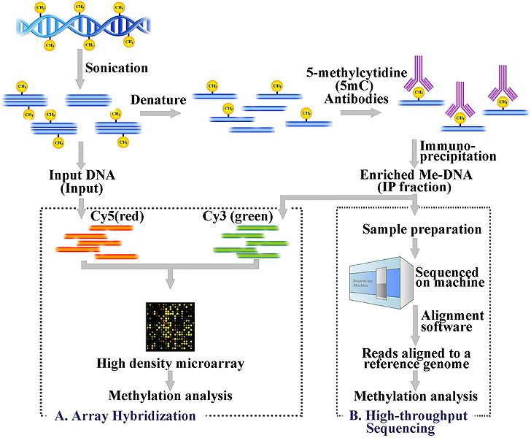
MeDIP-Sequencing
Public domain image from http://en.wikipedia.org/wiki/File:Medip-final-3.jpg

Slide 24
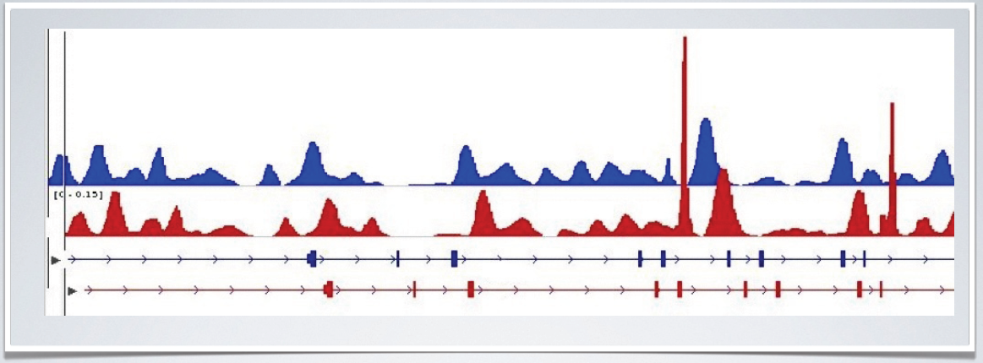
MeDIP-Sequencing
Regions rich in methylated CpG sites are captured at a higher rate
Read depth represents local methylation (although dependent on sequence context!)
Samples below differ substantially in two intronic regions
Analysis: Batman (Bayesian Tool for Methylation Analysis) and MEDIPS R package.

Slide 25
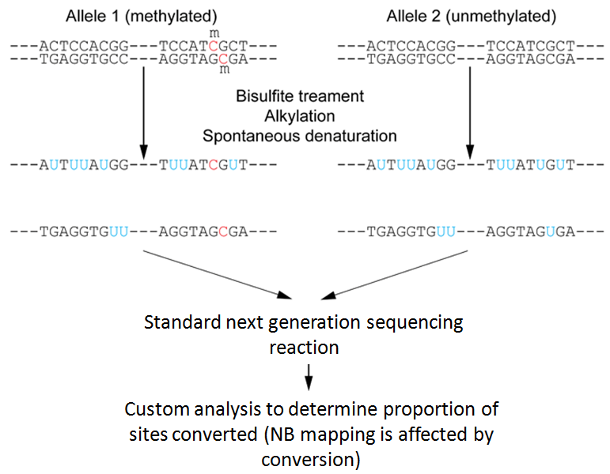
Bisulphite sequencing
ADAPTED FROM: Wikipedia: public domain image from User:Toeng

Slide 26
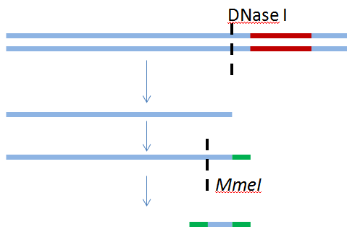
DNase-Seq and FAIRE-Seq
DNase I digestion of DNA, then sequencing of cut ends – identifies regions being actively transcribed
FAIRE-Seq – use of formaldehyde cross-linking to detect closed chromatin. Non-cross-linked DNA is separated and sequenced

Slide 27
Other selective approaches
MAINE-Seq – identify regions of closed chromatin
(MNase-mediated purification of mononucleosomes to extract histone-bound DNA sequencing)
ChIP-Seq - identify where transcription factors bind using antibody to TF on nuclear DNA
(Chromatin Immunoprecipitation sequencing)
Sono-Seq – like ChIP-Seq, but with no immunoprecipitation. Shows regions near open chromatin of expressed genes
CLIP-Seq – cross-linking immunoprecipitation for RNA/protein interaction
ChiRP-Seq – regions of genome bound by a specific RNA (Chromatin Isolation by RNA purification)

Slide 28
RNA-Seq
Digital gene expression analysis supported by some tools (eg CLC Workbench, SeqMan NGen)
Because many overlapping duplicates represent each gene, counting number of duplicates and comparing between genes gives relative expression
Relative allelic expression can be calculated where polymorphisms exist within the analyed sequence
Additional benefit of alternative splicing information

Slide 29
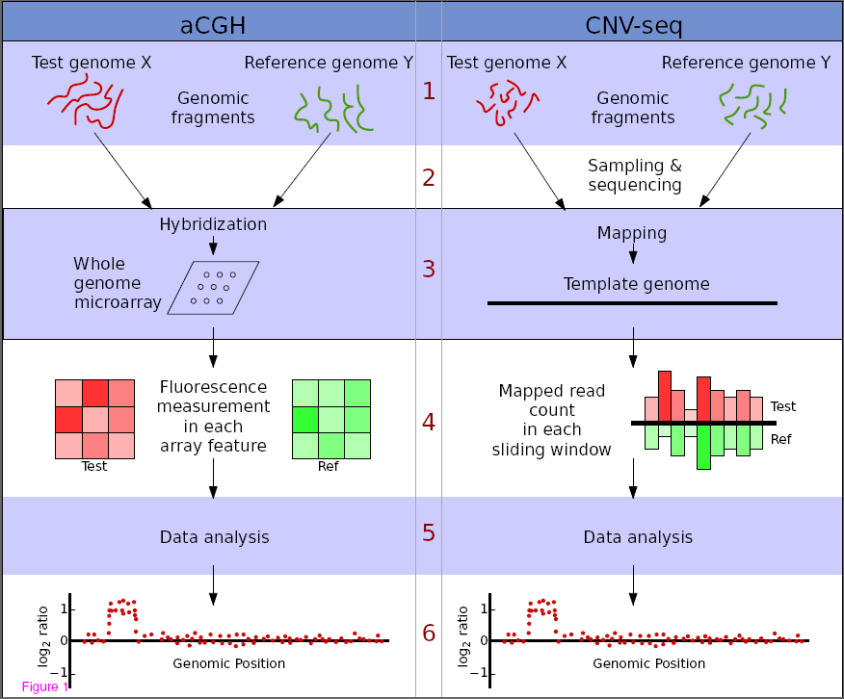
Copy number variation
Some tools – eg “CNV-seq”, an R package
Amplification stage of NGS may lead to biased representation of some regions
Many short sequences, counting number of replicates of each – direct “digital” measurement
Chao Xie and Martti T Tammi. CNV-seq, a new method to detect copy number variation using high-throughput sequencing. BMC Bioinformatics 2009, 10:80doi:10.1186/1471-2105-10-80

Slide 30
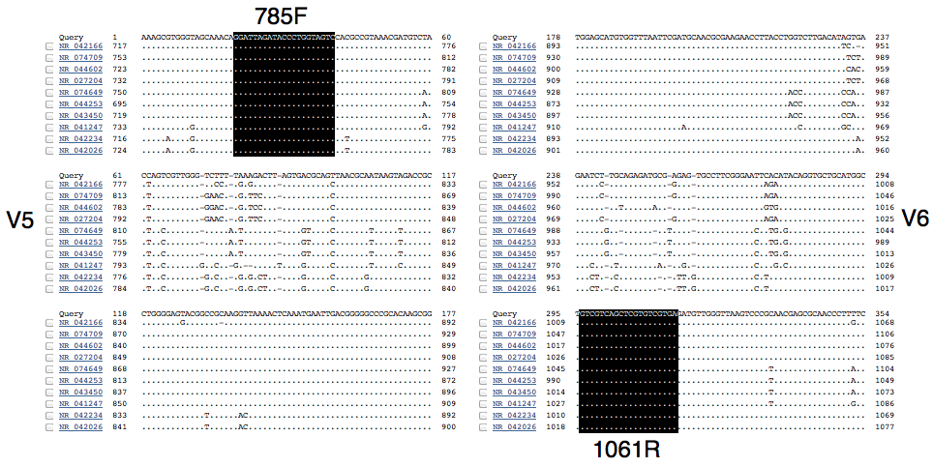
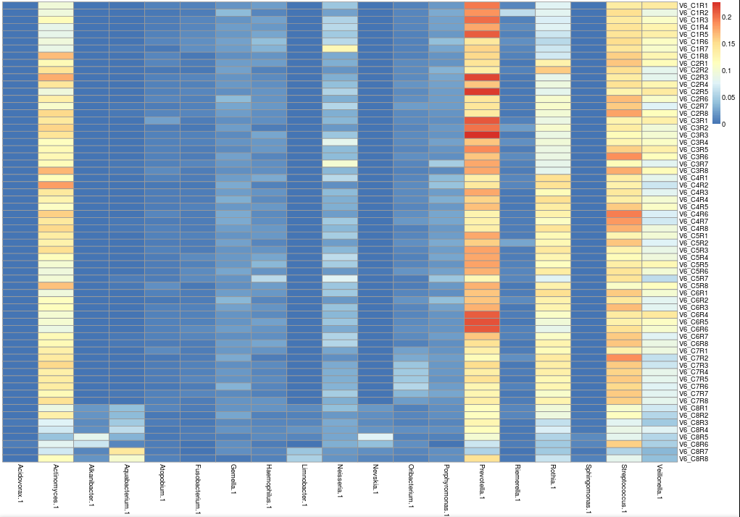
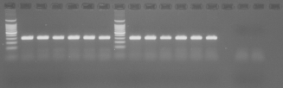
Microbiome
Meta-genomics – whole genome
16S ribosomal DNA sequencing

Slide 31
Analysis

Slide 32
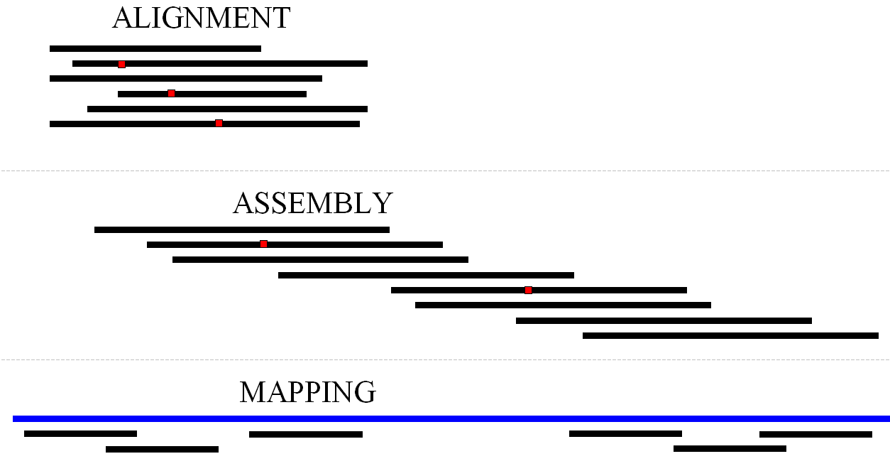
Putting sequence together
Alignment:
  Pairwise (compare two similar sequences)
  Multiple (compare several similar sequences)
Searching (find best match sequence)
Assembly (build a sequence from fragments)
Mapping (map sequence fragments to a reference genome). Often = short reads assembly

Slide 33
Sequence mapping/short read assembly
BWA (Burrows-Wheeler Aligner)
BOWTIE
DNAStar/Lasergene
Swift for primary data
SSAHA for fast alignment and ssahaSNP for SNP detection (Sanger)
SOAP from the Beijing Genomics Inst (incl Nature Protocol)
Geospiza's GeneSifter
CLCbio's Genomics Workbench
HuRef individual genome browser
Mosaik aligner, sort and assembler
Illumina's Genome Studio
RMAP - Solexa analysis
SHRiMP - short read mapping package
Edena short reads assembler
SHARCGS short reads assembler
SSAKE short reads assembler
VCAKE short reads assembler
VELVET short reads assembler
…and many others
Most programs Unix/Linux-based, command line
NGS systems come with proprietary (possibly more user-friendly) software
BWA and BOWTIE available through Web-based “Galaxy”

Slide 34
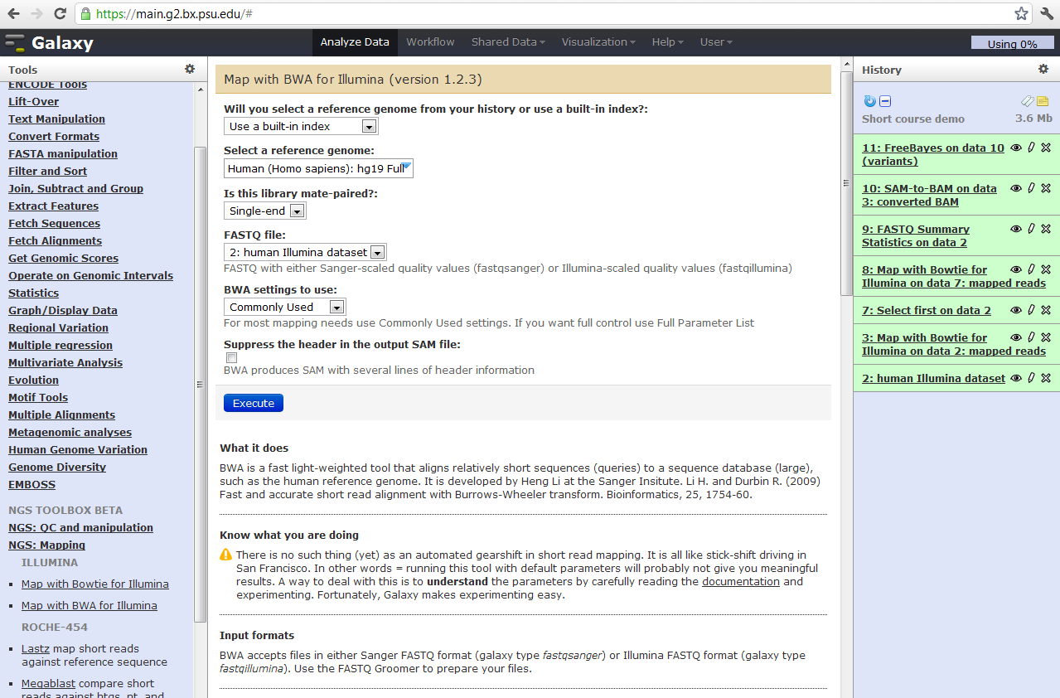
Galaxy – online seq analysis toolkit
http://main.g2.bx.psu.edu/ (and now on UoB BlueCrystal, http://galaxy.acrc.bris.ac.uk/)

Slide 35
NGS toolboxes
SAMtools http://samtools.sourceforge.net/
  SAM/BAM conversion, viewing, sorting, merging, indexing, pileup.
PICARD http://picard.sourceforge.net/
  A range of command-line utilities for manipulation, QC and metrics of SAM files.
VCFtools http://vcftools.sourceforge.net/
  Validating, comparing, merging, annotating, intersecting/subsetting.
GATK http://www.broadinstitute.org/gsa/wiki/index.php/Home_Page
  Tools and an API for working with NGS data. Quality score recalibration, SNP/variant calling, read coverage evaluation.

Slide 36
Analyzing differences
Use of differences between reads and quality scores to identify potential polymorphisms
Quality score (Phred quality or Solexa quality) indicates the probability that a particular base call is wrong
Software:
  GATK Unified Genotyper
  VarScan
  And others...
Sanger FASTQ format
(slightly different from Solexa,
despite sequence names)
@slxa_0023_1_0001_2745
CCCAGCGCGCCCGGCGGCCCGCCCCC
+slxa_0023_1_0001_2745
???????????????%+???.??7??
@slxa_0023_1_0001_2746
CCTCGGTTTCCCCGGAGCGTTCCCCC
+slxa_0023_1_0001_2746
????????70?????'$?????9???
@slxa_0023_1_0001_2747
CCGAAACGGCAAANCAAGGATATTGG
+slxa_0023_1_0001_2747
?????????????"??+?????????
@slxa_0023_1_0001_2748
CCCTGCGCCGGGCACCTCCCGCCCCG
+slxa_0023_1_0001_2748
?????????+???&???3??8???*%

Slide 37
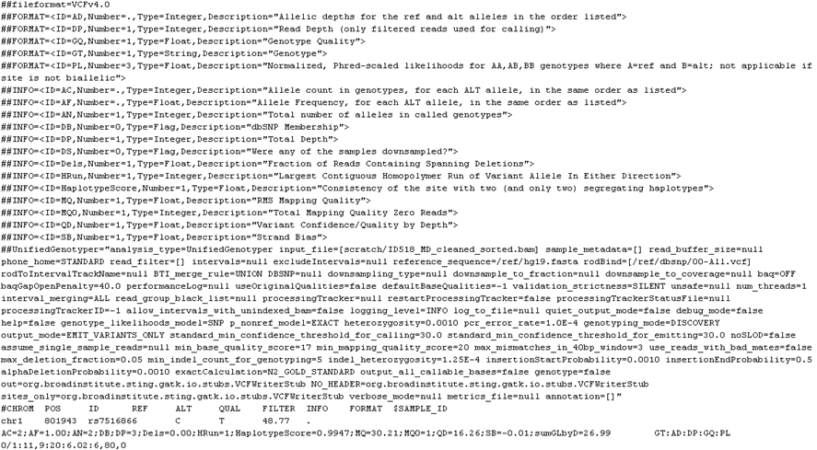
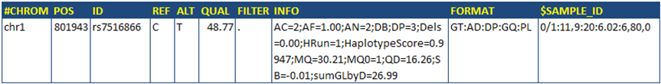
VCF – variant call format
(Below is output of GATK Unified Genotyper from Broad Institute)

Slide 38
Annotation
Annotation of variants with gene name, amino acid changes etc.
Genome build very important
Typically VCF as input
Software: Annovar, VEP, SeattleSeq, SNPEff and others
Annovar example:
synonymous SNV NPHP4:NM_015102:exon15:c.G1926A:p.E642E, chr1 5965381 5965381 C T het 114.53 16 35.72 7.16 rs12120967 0/1:11,5:15:Heterozygote:99:145,0,325

Slide 39
Approximate costs
Illumina 2 x 110bp single lane on a flow-cell (generating approx 4.5Gb data) may cost in the region of £2k-£2.5k incl library prep
(Warning: this is a very rough estimate! Costs change rapidly and are related to project size!)
The human genome is ~3Gb in length, so expensive for high density coverage (eg 20x-40x).
Human exome sequencing much more affordable – typical costs are around £600-£800 per exome

Slide 40
NGS in genetic epidemiology

Slide 41
Major initiatives
UK10K
4k whole genomes, 6k exomes (data completed, EGA)
1000 Genomes
target 2.5k people from 25 populations (phase 1, 1092)
Genomics England
target 100k genomes
NHLBI exome variant server
~6k exomes

Slide 42
Publicly available data
1000 genomes project
International consortium sequencing human genomes. VCF files and raw data downloadable.
http://www.1000genomes.org/ and Nature 467:1061–1073
NHLBI sequencing project
But no raw sequence data available to download: http://evs.gs.washington.edu/EVS/
Personal genome project (Harvard University) – open access
http://www.personalgenomes.org/ and http://www.personalgenomes.org.uk/
Illumina’s demo data - A handful of genomes
http://www.illumina.com/HumanGenome/
Complete Genomics demo data – 69 Genomes data
http://www.completegenomics.com/public-data/69-Genomes/
Others
  Other human dataset availability seems likely to be limited, esp. since public GWAS data were withdrawn in 2008 due to privacy issues
  Other organisms: many available online – potentially useful to gain familiarity with software – eg www.sanger.ac.uk/Projects/S_typhi/

Slide 43
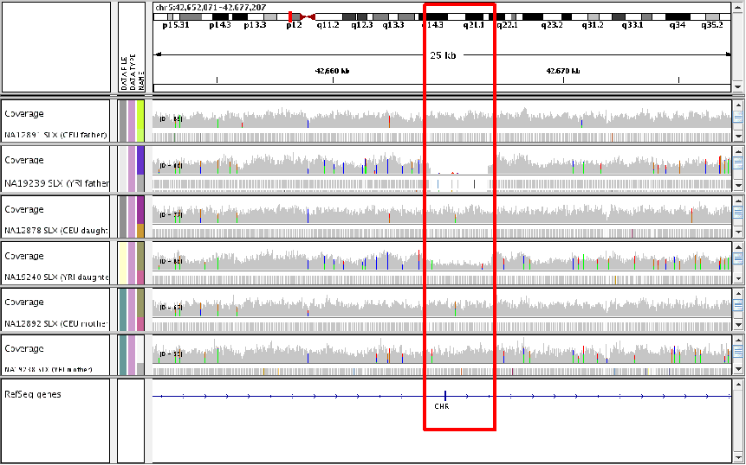
1000 genomes project
Viewer: IGV (Integrative Genomics Viewer, Broad Institute)

Slide 44
Sources of information and NGS providers
SEQanswers: an online forum – extremely useful for NGS information
http://seqanswers.com
University of Bristol NGS service (Illumina MiSeq and NextSeq)
http://www.bristol.ac.uk/biology/research/transcriptomics/
University of Exeter NGS service (Illumina HiSeq 2500, MiSeq and PacBio (SMRT) RSII platform) http://biosciences.exeter.ac.uk/facilities/sequencing/illumina/
Other providers: http://seqanswers.com/wiki/Next_Gen_Sequencing_Service_Provider
Illumina: http://www.illumina.com
454: http://www.454.com
PACBIO: http://www.pacb.com
Ion Torrent: https://www.thermofisher.com/

Slide 45
Summary
Sequence data becoming increasingly relevant in genetic epidemiology and molecular epidemiology
  Reading sequence
  Counting DNA molecules
A range of platforms and applications
A wide diversity of analysis tools, often computationally intensive
Rapidly evolving field
  Software, Hardware, Chemistry, Cost!

