Slide 2
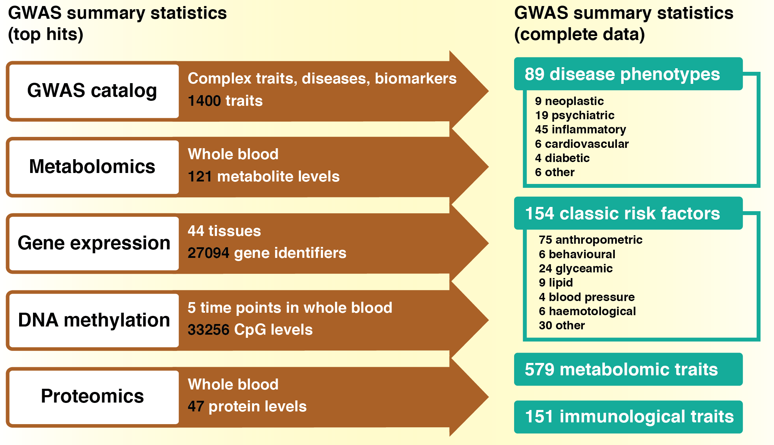

Slide 3
Exposure
Only top hits required
Outcome
Complete summary data
GWAS catalog
Complex traits, diseases, biomarkers
3889 traits
Metabolomics
Whole blood
121 metabolite levels
Gene expression
DNA methylation
Proteomics
MR-Base database
Other
44 tissues
27094 gene identifiers
5 time points in whole blood
33256 CpG levels
Whole blood
47 protein levels
Automated clumping
User-provided data
1733 datasets
144 complex diseases
266 complex traits
neoplastic
psychiatric
inflammatory
cardiovascular
diabetic
other
anthropometric
behavioural
glycaemic
lipid
blood pressure
haemotological
other
575 metabolite levels
151 immunological traits
597 UK Biobank phenotypes
User-provided results
MRInstruments R package
MR-Base database

