Slide 2
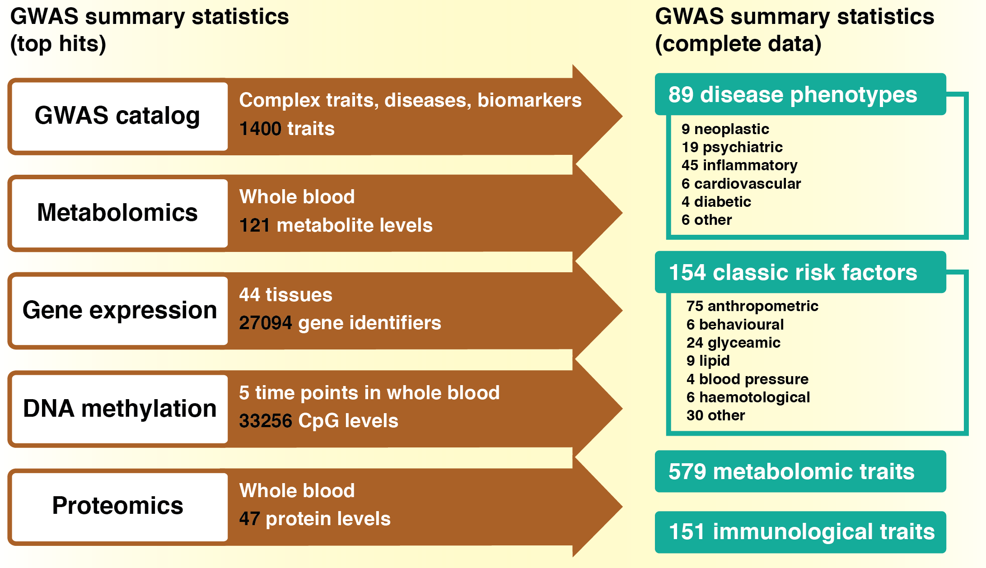

Slide 3
Exposure
Only top hits required
Outcome
Complete summary data
GWAS catalog
Complex traits, diseases, biomarkers
1628 traits
Metabolomics
Whole blood
121 metabolite levels
Gene expression
DNA methylation
Proteomics
MR-Base database
Other
44 tissues
27094 gene identifiers
5 time points in whole blood
33256 CpG levels
Whole blood
47 protein levels
Automated clumping
User-provided data
1674 datasets
123 complex diseases
219 complex traits
15 neoplastic
20 psychiatric
50 inflammatory
11 cardiovascular
5 diabetic
22 other
91 anthropometric
5 behavioural
24 glycaemic
9 lipid
4 blood pressure
8 haemotological
61 other
575 metabolite levels
151 immunological traits
606 UK Biobank phenotypes
User-provided results
17 education
MRInstruments R package
MR-Base database

