Slide 2
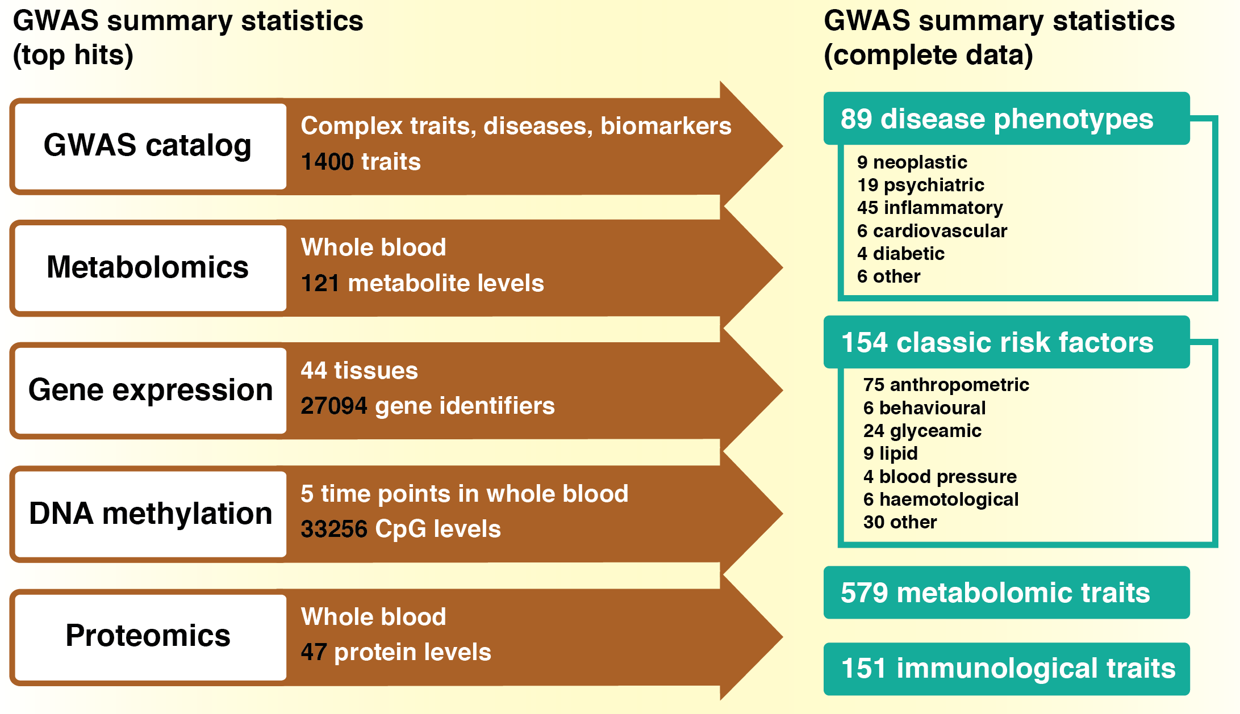

Slide 3
Exposure
Only top hits required
Outcome
Complete summary data
GWAS catalog
Complex traits, diseases, biomarkers
1628 traits
Metabolomics
Whole blood
121 metabolite levels
Gene expression
DNA methylation
Proteomics
MR-Base database
Other
44 tissues
27094 gene identifiers
5 time points in whole blood
33256 CpG levels
Whole blood
47 protein levels
Automated clumping
User-provided data
1566 datasets
89 complex diseases
154 complex traits
9 neoplastic
19 psychiatric
45 inflammatory
6 cardiovascular
4 diabetic
6 other
75 anthropometric
6 behavioural
24 glycaemic
9 lipid
4 blood pressure
6 haemotological
30 other
575 metabolite levels
151 immunological traits
597 UK Biobank phenotypes
User-provided results
MRInstruments R package
MR-Base database

