Slide 1
Sensitivity analysis
Gibran Hemani

Slide 2
Intended learning outcomes
Recall the assumptions of mediation analysis
Describe approaches for accounting for unmeasured confounding
Describe approaches for accounting for measurement error

Slide 3
Outline
Recap of assumptions
Unmeasured confounders for the total effect
Unmeasured confounders for the controlled direct effect
Unmeasured confounders for the natural direct and indirect effects
Measurement error

Slide 4
Note
As discussed already – estimating CDE / NDE / NIE should be done controlling for known confounders.
The diagrams etc here do not show known confounders for the sake of simplicity

Slide 5
Recap of assumptions

Slide 6
Assumptions in mediation analyses
1. No unmeasured confounding for X-Y association
2. No unmeasured confounding for M-Y association
3. No unmeasured confounding for X-M association
4. No (un)measured confounders for M-Y association that have been influenced by X (i.e. no intermediate confounding)

Slide 7
X
M
Y
Assumption 3
Assumption 2
U3
U2
U1
Assumption 1

Slide 8
X
M
Y
Assumption 4
U2
This is hard to deal with using regression, requires structural models. See chapter 5 of Explanation in Causal Inference (VanderWeele)

Slide 9
Estimating total effect with unmeasured confounding

Slide 10
Total effects
X
Y
U1

Slide 11
We can’t measure the confounder, so what can we do?
Choose some (sensible) parameters
For u1->x
For u1->y
Obtain “corrected” effect estimates
What would we have obtained had U1 been controlled for?
Do these parameters explain the total effect?

Slide 12
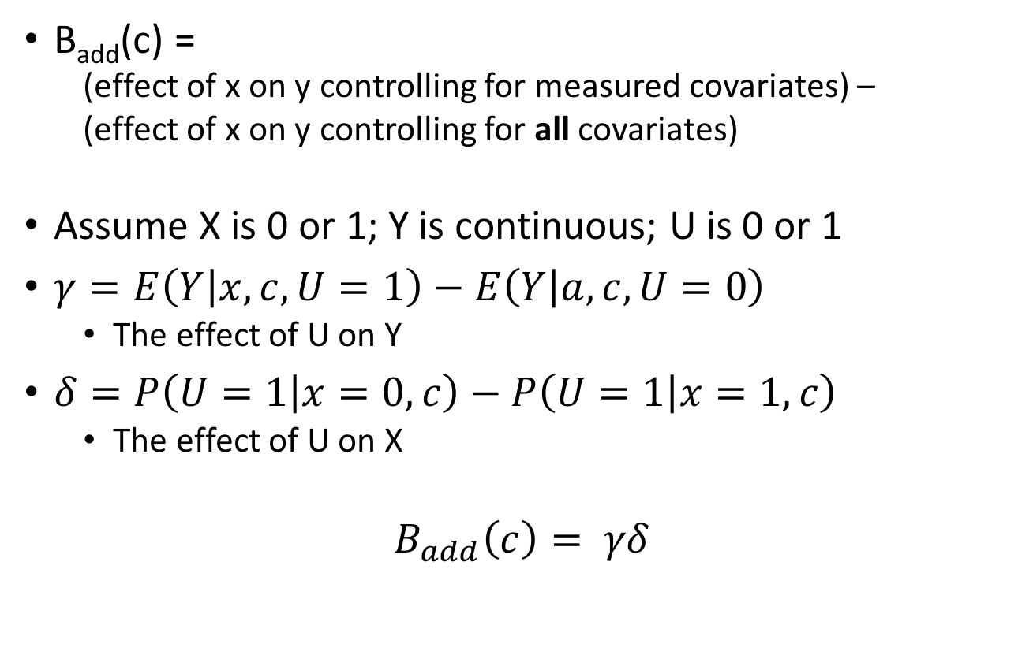
Calculating the bias factor
B_{add}(c) =
(effect of x on y controlling for measured covariates) –
(effect of x on y controlling for all covariates)
Assume X is 0 or 1; Y is continuous; U is 0 or 1
$γ=E\left(Y | x,c, U=1\right)−E\left(Y | a,c, U=0\right)$
The effect of U on Y
$δ=P\left(U=1 | x=0,c\right)−P\left(U=1 | x=1,c\right)$
The effect of U on X
$$B_{add}\left(c\right)= γδ$$

Slide 13
Using the bias factor
Estimate of B(xy) = 1.5 (CI=1.0-2.0)
We think
Effect of U1 on X is 0.7
Effect of U1 on Y is 1.2
B_{add}(c) = 0.7 * 1.2 = 0.84
B(xy) adjusted for confounders would be 1.5 – 0.84 = 0.66
With confidence intervals
1.0 – 0.84 = 0.16
2.0 – 0.84 = 1.16

Slide 14
Example
Effect of exposure,
controlling for measured covariates,
-4.77 (CI -7.96 to -1.58)
Phenobarbital
in utero
Intelligence
0.3 (assumption)
Parent intelligence
Reinisch et al 1995

Slide 15
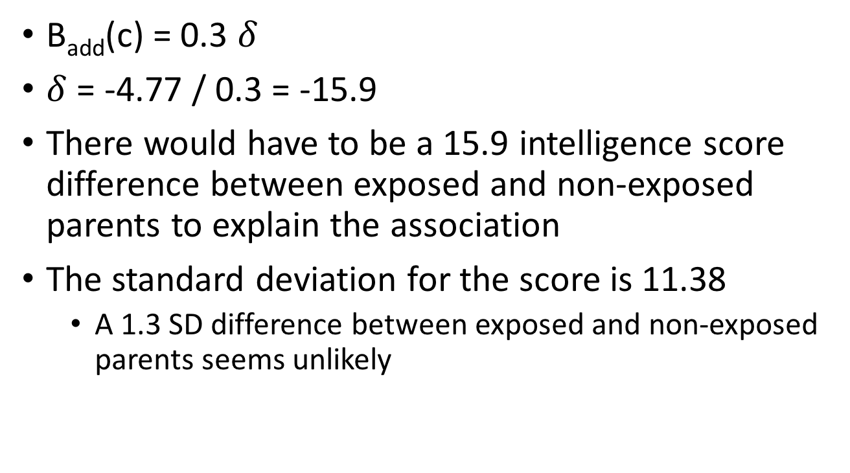
Example
B_{add}(c) = 0.3 $δ$
$δ$ = -4.77 / 0.3 = -15.9
There would have to be a 15.9 intelligence score difference between exposed and non-exposed parents to explain the association
The standard deviation for the score is 11.38
A 1.3 SD difference between exposed and non-exposed parents seems unlikely

Slide 16
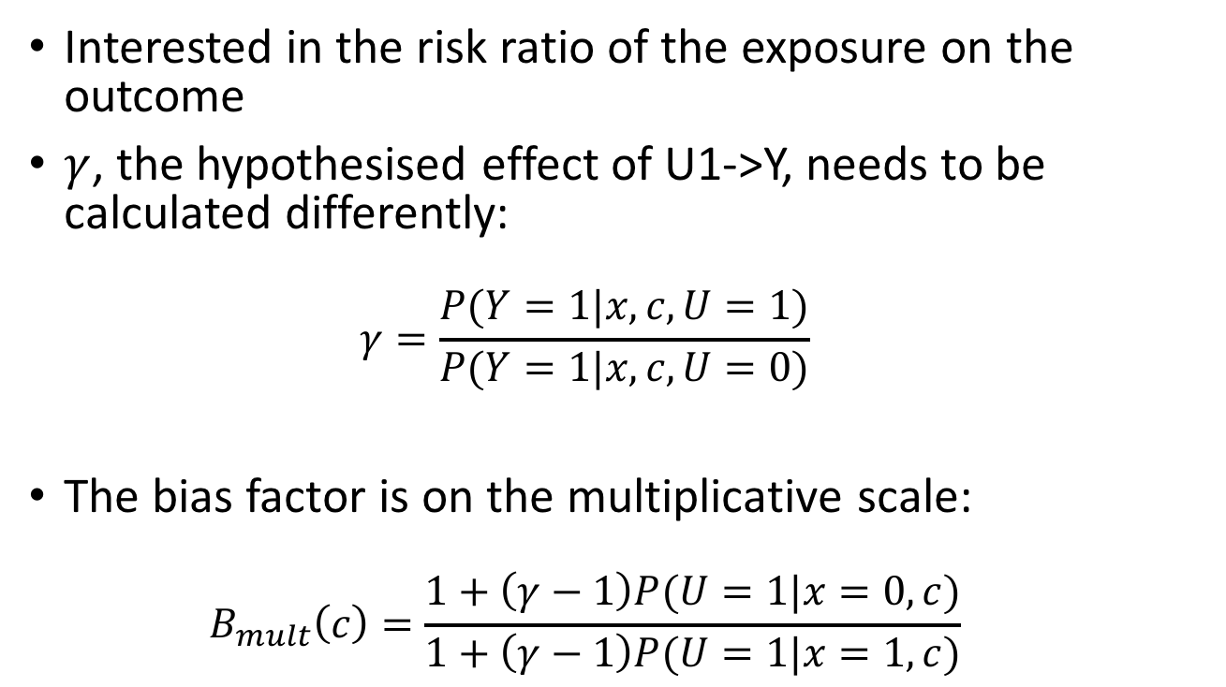
Unmeasured confounding of total effects on a binary outcome
Interested in the risk ratio of the exposure on the outcome
$γ$, the hypothesised effect of U1->Y, needs to be calculated differently:
$$γ=\frac{P(Y=1|x,c, U=1)}{P(Y=1|x,c, U=0)}$$
The bias factor is on the multiplicative scale:
$$B_{mult}\left(c\right)=\frac{1+\left(γ−1\right)P(U=1|x=0,c)}{1+\left(γ−1\right)P(U=1|x=1,c)}$$

Slide 17
How to choose parameters?
What parameters would be required to explain away the effect? Are these parameters feasible?
Create a table of wide range of possible parameters, so that the reader can see if the values that they think are sensible can explain away the effect
Use knowledge of measured confounders - which confounders, when omitted from the model, induce the largest change in the estimate? Choose these parameters for the unmeasured confounder.
If the unmeasured confounder is known (but not measured) then look through literature for reported effects on the exposure and outcome.

Slide 18
Estimating controlled direct effect with unmeasured confounding

Slide 19
CDE
X
M
Y
U2
CDE(m) = Y(1,M(m)) - Y(0,M(m))
Remember CDE(m) depends on value of m
For the following sensitivity analysis it may be important to perform for different values of m

Slide 20
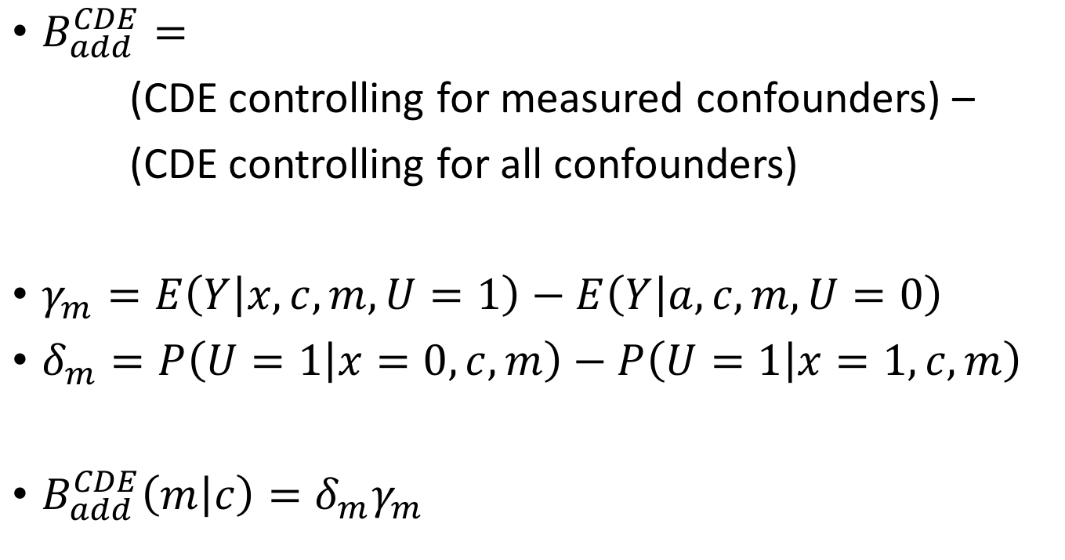
Bias factor for continuous outcome
$B_{add}^{CDE}=$
(CDE controlling for measured confounders) –
(CDE controlling for all confounders)
$γ_{m}=E\left(Y | x,c,m, U=1\right)−E\left(Y | a,c,m, U=0\right)$
$δ_{m}=P\left(U=1 | x=0,c,m\right)−P\left(U=1 | x=1,c,m\right)$
$B_{add}^{CDE}\left(m | c\right)=δ_{m}γ_{m}$

Slide 21
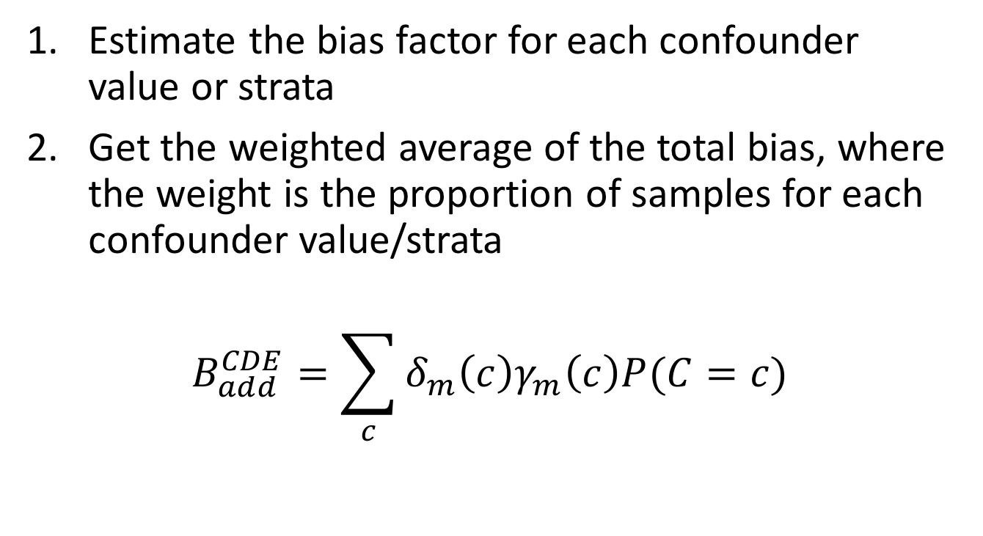
Different biases for different confounder values?
Estimate the bias factor for each confounder value or strata
Get the weighted average of the total bias, where the weight is the proportion of samples for each confounder value/strata
$$B_{add}^{CDE}=\sum_{c}{δ_{m}\left(c\right)γ_{m}\left(c\right)P(C=c)}$$

Slide 22
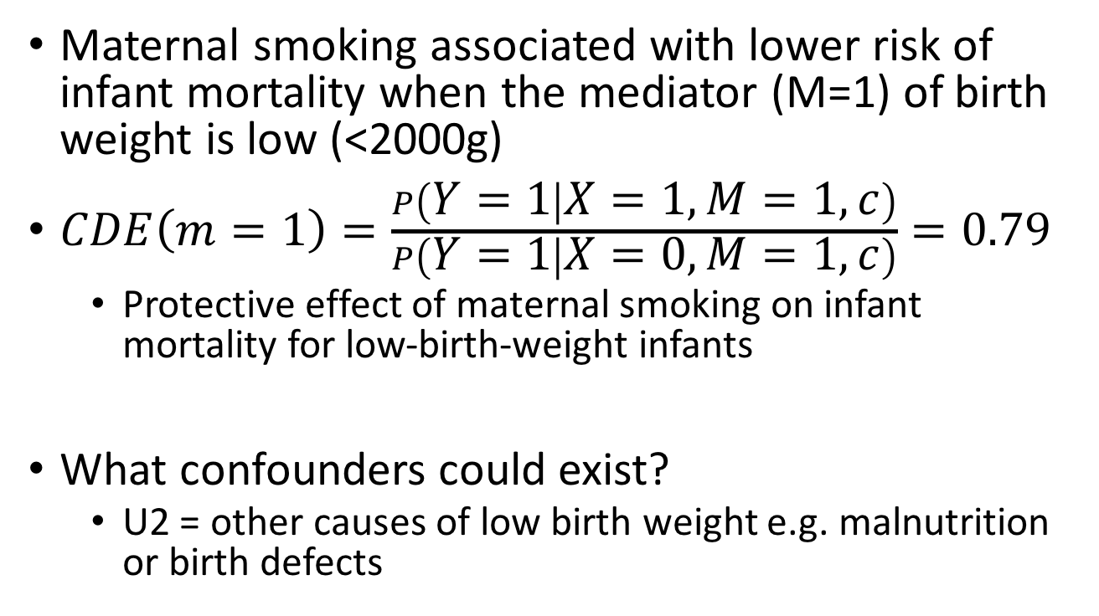
Example CDE for binary outcome – Birth weight paradox
Maternal smoking associated with lower risk of infant mortality when the mediator (M=1) of birth weight is low (<2000g)
$CDE\left(m=1\right)=\frac{P\left(Y=1 | X=1,M=1,c\right)}{P\left(Y=1 | X=0,M=1,c\right)}=0.79$
Protective effect of maternal smoking on infant mortality for low-birth-weight infants
What confounders could exist?
U2 = other causes of low birth weight e.g. malnutrition or birth defects

Slide 23
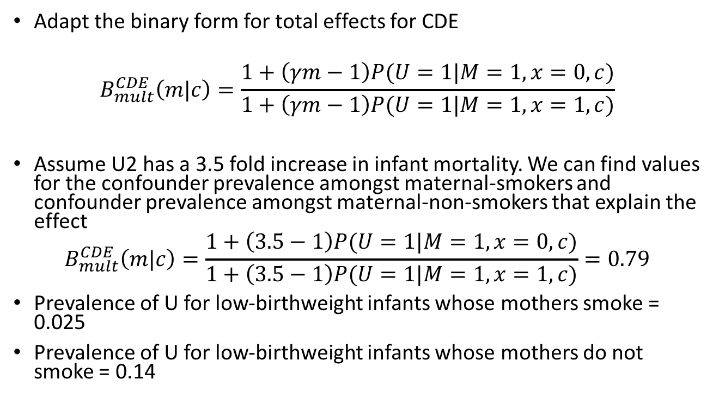
Example – Birth weight paradox
Adapt the binary form for total effects for CDE
$$B_{mult}^{CDE}\left(m|c\right)=\frac{1+\left(γm−1\right)P(U=1|M=1,x=0,c)}{1+\left(γm−1\right)P(U=1|M=1,x=1,c)}$$
Assume U2 has a 3.5 fold increase in infant mortality. We can find values for the confounder prevalence amongst maternal-smokers and confounder prevalence amongst maternal-non-smokers that explain the effect
$$B_{mult}^{CDE}\left(m|c\right)=\frac{1+\left(3.5−1\right)P(U=1|M=1,x=0,c)}{1+\left(3.5−1\right)P(U=1|M=1,x=1,c)}=0.79$$
Prevalence of U for low-birthweight infants whose mothers smoke = 0.025
Prevalence of U for low-birthweight infants whose mothers do not smoke = 0.14

Slide 24
Example – Birth weight paradox
Assume U2 has a 3.5 fold increase in infant mortality

Slide 25
Estimating natural effects with unmeasured confounding

Slide 26
Natural effects - reminder
Natural direct effect: how much the outcome would change when treatment moves from 0 to 1 if the mediator took whatever form when when treatment = 0
Natural indirect effect: how much the outcome would change if treatment set at 0 but mediator changes from level it would have had for treatment = 0 to treatment = 1
the effect of the treatment on the outcome due to changing mediator
TOTAL EFFECT (TE) = NDE + NIE

Slide 27


Mediator-outcome confounding
NIE
NDE
TRUE
MODEL
Total effect
NIE
NDE
With unmeasured
confounding
Total effect
Total effect stays the same but bias arises in the relative contribution of direct and indirect effects.
We can use the negation of the sensitivity analysis for CDE approach. E.g.
$$B_{add}^{NIE}\left(m | c\right)={−δ}_{m}γ_{m}$$
$$B_{add}^{NDE}\left(m | c\right)=δ_{m}γ_{m}$$

Slide 28
Example – influence of lead on cognitive function mediated by brain volume
Caffo et al 2008
Mine workers
Exposure is peak tibia lead exposure
Mediator is white matter brain volume
Outcome is cognitive test scores
Several measured confounders
Direct effect of X on Y obtained from:
Y = bX + M + C; b = -3.79 (CI -7.4 to -0.18)
Indirect effect of mediator on outcome was -1.21
Total effect = -5 test score / 1µg/g lead exposure

Slide 29
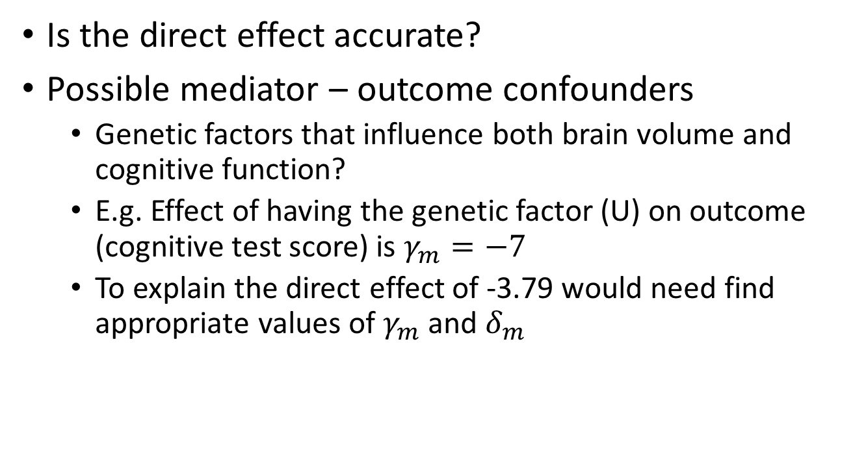
Example – influence of lead on cognitive function mediated by brain volume
Is the direct effect accurate?
Possible mediator – outcome confounders
Genetic factors that influence both brain volume and cognitive function?
E.g. Effect of having the genetic factor (U) on outcome (cognitive test score) is $γ_{m}=−7$
To explain the direct effect of -3.79 would need find appropriate values of $γ_{m}$ and $δ_{m}$

Slide 30
Plot all possible values of $γ_{m}={−3.97/δ}_{m}$
Any unmeasured confounding parameters this side of the curve will lead to a change in the sign of the estimate of the direct effect

Slide 31
Measurement error

Slide 32
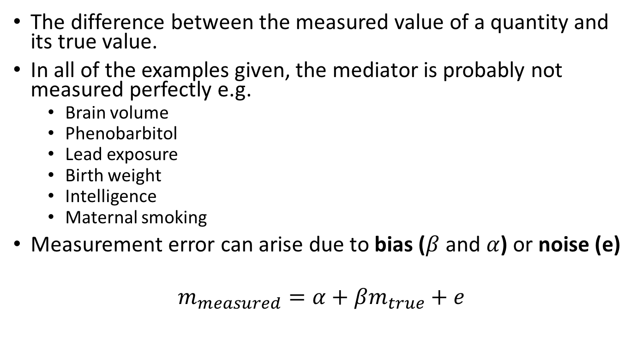
Measurement error
The difference between the measured value of a quantity and its true value.
In all of the examples given, the mediator is probably not measured perfectly e.g.
Brain volume
Phenobarbitol
Lead exposure
Birth weight
Intelligence
Maternal smoking
Measurement error can arise due to bias ($β$ and $α$) or noise (e)
$$m_{measured}=α+βm_{true}+e$$

Slide 33
Measurement error
In this case the noise is the most important aspect
Here we will consider only non-differential measurement error
The noise term is independent of the exposure and the outcome
If this isn’t true then things get very tricky

Slide 34
The influence of measurement error in the mediator
Effect of exposure on mediator
Effect of mediator on outcome
Reduced power but no bias
Bias

Slide 35
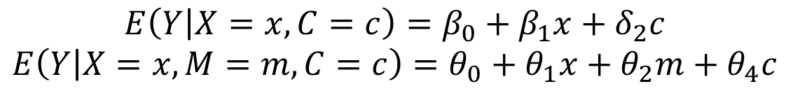
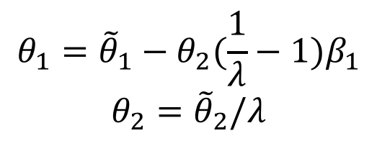

Correcting for measurement error
The influence of measurement error on bias depends on the proportion of the variance in the mediator that is due to the error term
$λ=\frac{var\left(true x\right)}{var\left(error\right)+var(true x)}$
Estimate of the direct and indirect effects
$$E\left(Y | X=x, C=c\right)=β_{0}+β_{1}x+δ_{2}c$$
$$E\left(Y | X=x, M=m, C=c\right)=θ_{0}+θ_{1}x+θ_{2}m+θ_{4}c$$
$${θ_{1}=\tilde{θ}}_{1}−θ_{2}(\frac{1}{λ}−1)β_{1}$$
$${θ_{2}=\tilde{θ}}_{2}/λ$$
Adjusting the estimates for measurement error

Slide 36
Summary
Measurement error and unmeasured confounders introduce biases for which we don’t necessarily have information
The simplest way to overcome these issues is to perform sensitivity analysis
Sensitivity analysis entails considering what would happen to our conclusions for hypothesised values of measurement error or confounding

