Slide 1



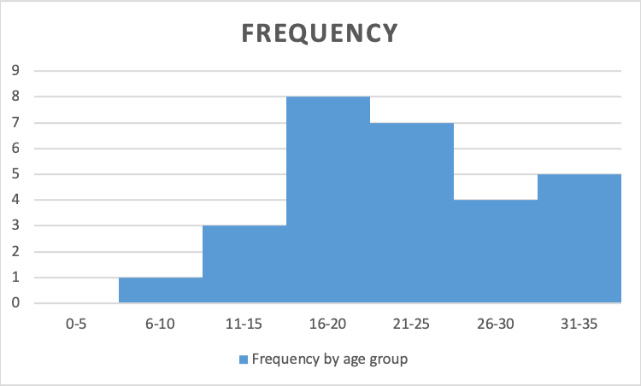
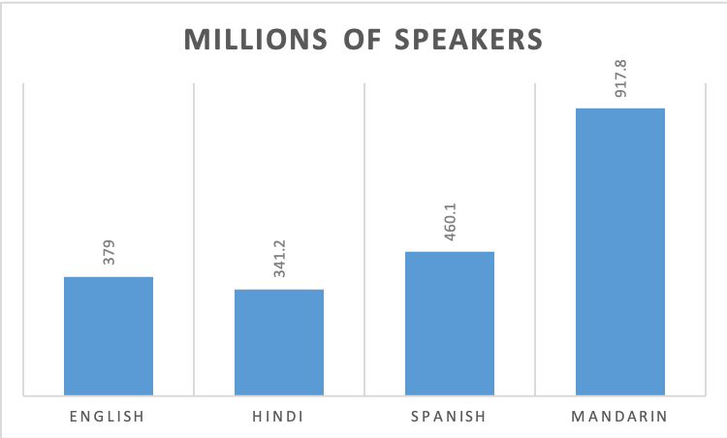
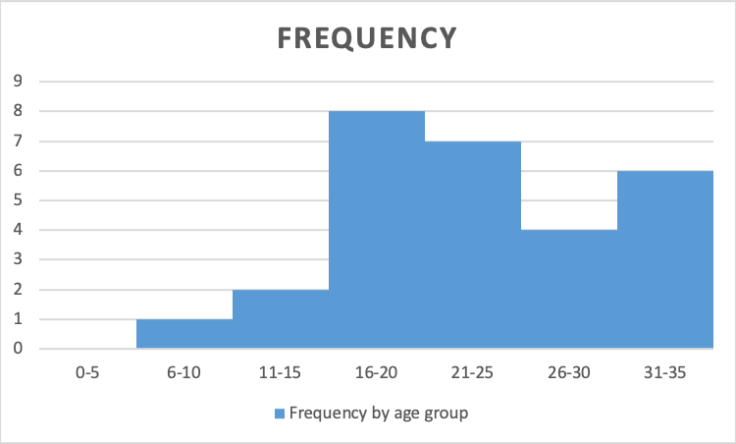
Explorable data visualisations
Roly Perera | Tomas Petricek | James Cheney
rperera@turing.ac.uk | t.petricek@kent.ac.uk | j.cheney@inf.ed.ac.uk
The Alan Turing Institute | University of Kent & The Alan Turing Institute | University of Edinburgh
Project goals
Help data scientists using interactive notebooks:
understand data analyses by connecting parts of visualisations to data they depend on
explore consequences of changes to models or data in order to test hypotheses
debug causes of unexpected outcomes
Future: exploring changes
Analyses involving aggregate properties such as binning or averaging often have many dependencies:
let data = [[yes, 18], [no, 12], [yes, 34], ...] let bins = [5, 10, 15, 20, 25, 30, 35] data ▷ groupBy bins ▷ histogram
Generalise prior techniques to associate changes in data or analyses to changes in visualisations:
let data = [[yes, 18], [no, 12], [yes, 34], ...] let bins = [5, 10, 15, 20, 25, 30, 35] data ▷ groupBy bins ▷ histogram
1
select data or code of interest
Current: exploring dependencies
Adapt program slicing techiques for dependency tracking to the data visualisation domain:
let data = [[English, 379.0], [Hindi, 341.2], ...] let invalid = -1 data ▷ filter ((lang, n) => n <> invalid) ▷ barChart
2
forward dependencies are highlighted
2
backward dependencies are highlighted
1
select visual elements of interest
32
1
modify data
or code
Lattice-theoretic foundation
Our approach to data provenance is based on Galois connections and analyses dependencies in both directions:
2
changes to chart are highlighted or animated
Model & Data
what do I contribute to?
View
what contributes to me?
Connections to explore
probabilistic programming
incremental computation

