Slide 1

Exploratory Testing Foundations
Maaret Pyhäjärvi
v. 2.2 (2022-12-14)
Exploratory Testing Foundations by Maaret Pyhäjärvi is licensed under CC BY 4.0
Notes:
Exploratory Testing Foundations by Maaret Pyhäjärvi is licensed under CC BY 4.0. To view a copy of this license, visit http://creativecommons.org/licenses/by/4.0/
Notes for each slide on this course are available with CC BY 4.0 at https://dev.to/maaretp/exploratory-testing-foundations-4lb3 (v. 1.0 with Robot Framework).
The slides, notes and added explanation is included in a LeanPub book Contemporary Exploratory Testing you can download from https://leanpub.com/ExploratoryTesting. The book is ©Maaret Pyhäjärvi.

Slide 2
Optimizing the value of testing

Slide 3
Learning
Test Design (ideas)
Test Execution (information)

Slide 4
Exploratory Testing the Verb
Doing Testing
INPUT
OUTPUT

Slide 5
Doing Testing
INPUT
OUTPUT
Input
Tester
Domain knowledge
Requirements and specifications
Testing knowledge Miscellaneous knowledge

Slide 6
Doing Testing
INPUT
OUTPUT
Output
Better tester
Coverage
Information incl. defects and change requests
Documentation: Strategy
Documentation: Tests

Slide 7
Course Outline
Chapter 1: Test target and our options for exploring
Chapter 2: Self-management basics on setting yourself constraints
Chapter 3: The moment of first impression
Chapter 4: Recognizing and learning a domain
Chapter 5: Recognizing functionality
Chapter 6: Recognizing data
Chapter 7: Recognizing application and execution environment
Chapter 8: Documenting in a mindmap
Chapter 9: pytest the very basics
Chapter 10: Documenting as skeleton test automation
Chapter 11: Playwright library and CSS selectors on web pages
Chapter 12: Documenting as executable test automation
Chapter 13: Why this is not about any specific tool
Chapter 14: Use of time
Chapter 15: Coverage
Chapter 16: Test Strategy
Chapter 17: Full results and reproducing from customer feedback
Chapter 18: Closing remarks

Slide 8
Course Outline
Section 1: Options for Exploring
Section II: Control through Choices
Section III: Documenting (with Automation)
Extending with Function, Data,
Environment and Domain
Section IV: Use of time and coverage
1
3
2
4-13
14-17

Slide 9
Test Target and Our Options for Exploring
Chapter 1

Slide 10
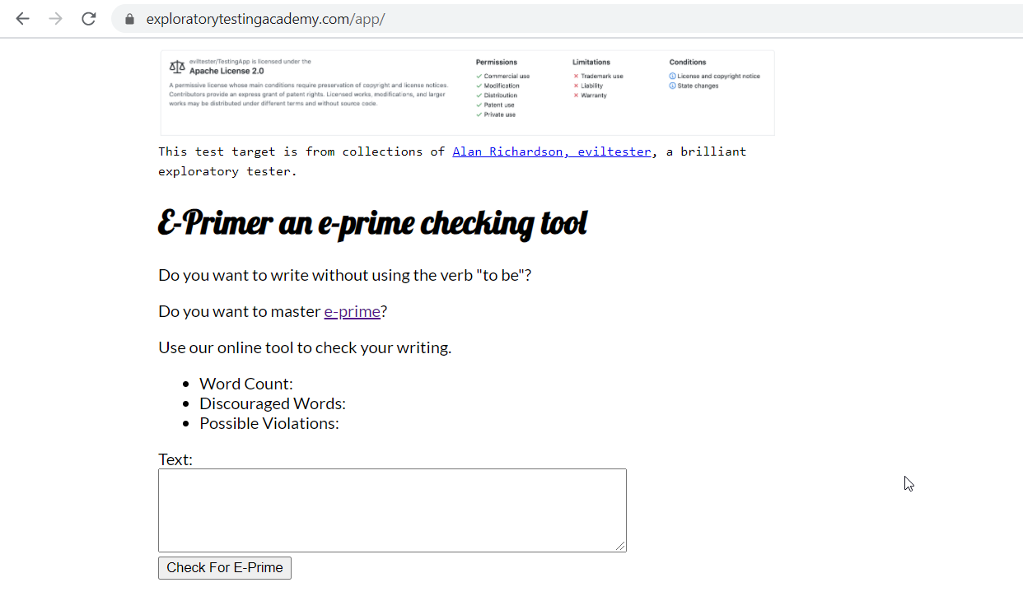

Slide 11
Stop-and-Think: Options for Exploring
What would you do first, and soon after you get started?
List all things that come to your mind about how you could test this. What would you start from? What you would not do?

Slide 12
Options for Exploring
Research the Domain
Use test target with a constraint

Slide 13
Self-management Basics on Setting Yourself Constraints
Chapter 2

Slide 14
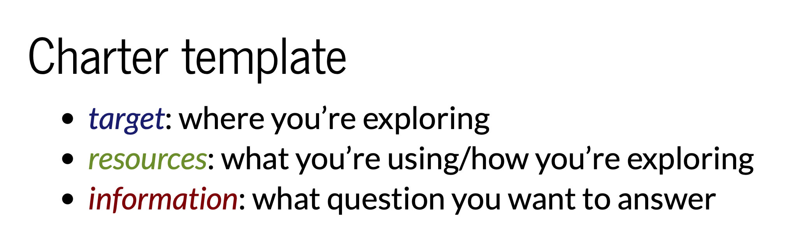
Charters
Elizabeth Zagroba’s concise template adapted from Elizabeth Hendrickson’s template

Slide 15
Choose Your Own Constraint
Deliberately excluding perspectives!
Never Be Bored!

Slide 16
Explore with Intent
Mission
Charter
INTENT
Other Charters
Details
LEARNINGS

Slide 17
Stop-and-Think: Charters, Constraints, Intent
You’re approaching the moment of first impression. How do you want to frame your moment of first impression?

Slide 18
The Moment of First Impression
Chapter 3

Slide 19
Options Expire
Capture First Impression
Borrow someone else’s First Impression
Timing of feedback changes reaction to it!

Slide 20
Let’s Test
https://www.exploratorytestingacademy.com/app/
https://eviltester.github.io/TestingApp/apps/eprimer/eprimer.html

Slide 21
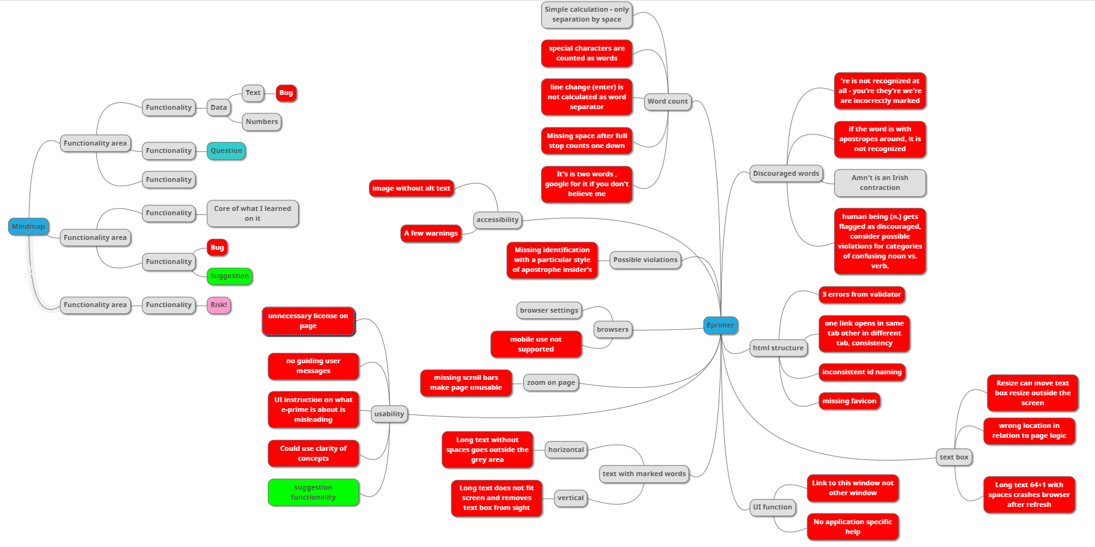
Example: Test Results, Red is Bug
Notes:
Long text moves button outside user's access as vertical scroll is disabled
Two words separated by line feed are counted as one
Space is considered only separator for words and special characters are counted as words
The possible violation's category takes possessives and leaves for human assessment and would probably be expected to be something to create programmatic rules on
You're / we're / They're contractions not recognised as violations of e-prime
Possible violations does not handle typesetter's apostrophe, only typewriter's apostrophe in calculation
Human being is noun but recognised as violation
Two part words (like people's last names) in possessive form are not recognised as possible violations
Contractions for word count (I'm) count as two words as per general googleable rules of how word counting works
Images missing alt text necessary for accessibility
Accessibility warnings on contrast
Mobile use not supported
Zoom renders page unusable due to missing scroll bars
UI instructions for user are unclear
Long texts without spaces go outside the grey area reserved for displaying the texts
Choosing which links are to overload this app and which open new browser window are inconsistent
Resizing the input text field can move it outside view so that it cannot be resized back
Site is missing favicon and security.txt - both common conventions for web applications
html validator identifies 3 errors
id naming is inconsistent, some are camel case, others not
if word is in single quotes, it is not properly recognised as eprime.
text box location in UI is not where user would expect it to be as per the logic of how web pages are usually operating

Slide 22
Bugs are Conversation Starters
Bug is anything that might bug a user.
You start conversations about defects and change requests.

Slide 23
Recognizing and Learning a Domain
Chapter 4

Slide 24
Conference Reference Inference

Slide 25
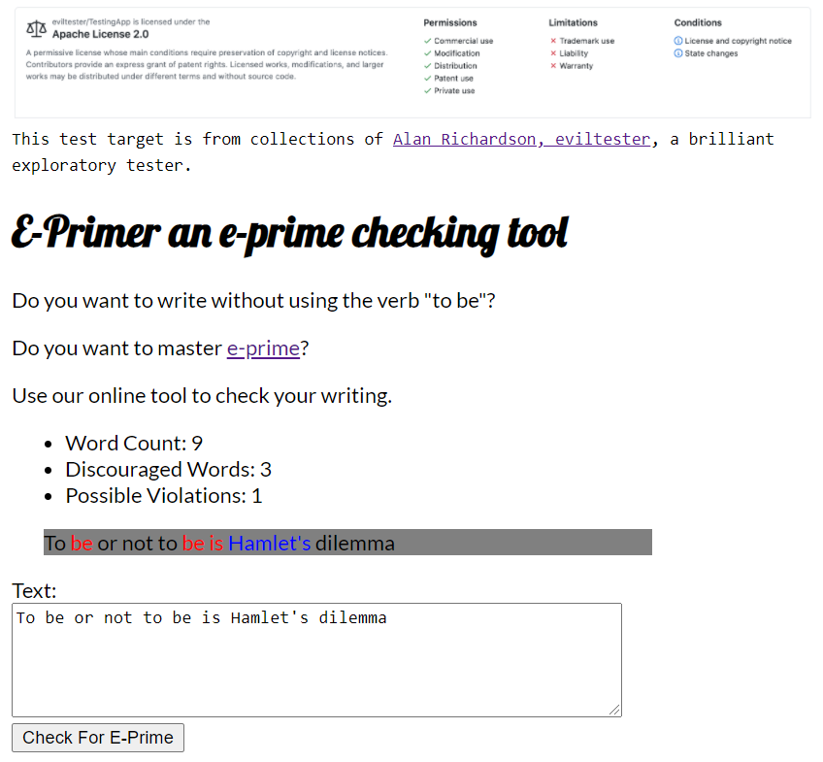

Slide 26
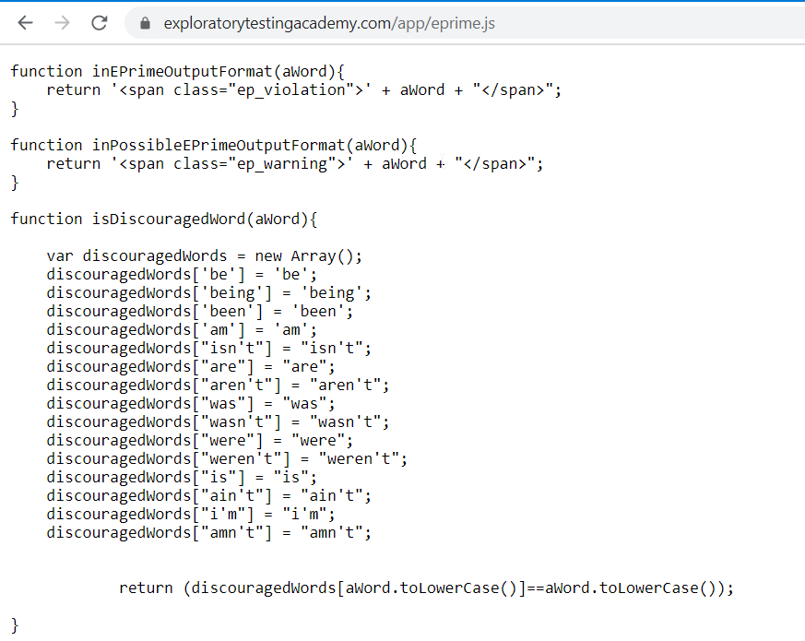

Slide 27
Let’s Test
https://www.exploratorytestingacademy.com/app/
https://eviltester.github.io/TestingApp/apps/eprimer/eprimer.html

Slide 28
Learning of Domain of E-Primer
Core Idea | Writing English language avoiding verb “be” in all its forms
Why? | Someone claims it had benefits, intellectual challenge
Examples | Used in sentences Listed examples
Sample texts | The Bible!

Slide 29
Recognizing Functionality
Chapter 5

Slide 30
Naming of Function
Functions in Code
Expected Features
Visible Features

Slide 31
Let’s Test
https://www.exploratorytestingacademy.com/app/
https://eviltester.github.io/TestingApp/apps/eprimer/eprimer.html

Slide 32
Learning of Function of E-Primer
Input | Text field and button
Output | Three numbers, text area
Containers | Resizable text field, resizable browser window, page
Presentation | Fonts, text and element sizes, order of functions
Browser | Settings, zoom
Algorithm | Recognizing eprime

Slide 33
Recognizing Data
Chapter 6

Slide 34
Data or Variables
Data
Function

Slide 35
Versatile Data
Lifecycle of Data: Create, Read, Update, Delete
Known problematic inputs: GitHub Naughty Strings
https://github.com/minimaxir/big-list-of-naughty-strings/blob/master/blns.txt

Slide 36
Let’s Test
https://www.exploratorytestingacademy.com/app/
https://eviltester.github.io/TestingApp/apps/eprimer/eprimer.html

Slide 37
Learning of Data of E-Primer
Word delimiter | Space, wordcount breaks with characters and line change
Types of apostrophes | Typesetter / typewriter
Long text | Copied / tool generated
Valid eprime | Recognizing right as right
Eprime violations | Recognizing wrong as wrong

Slide 38
Recognizing Application and Execution Environment
Chapter 7

Slide 39
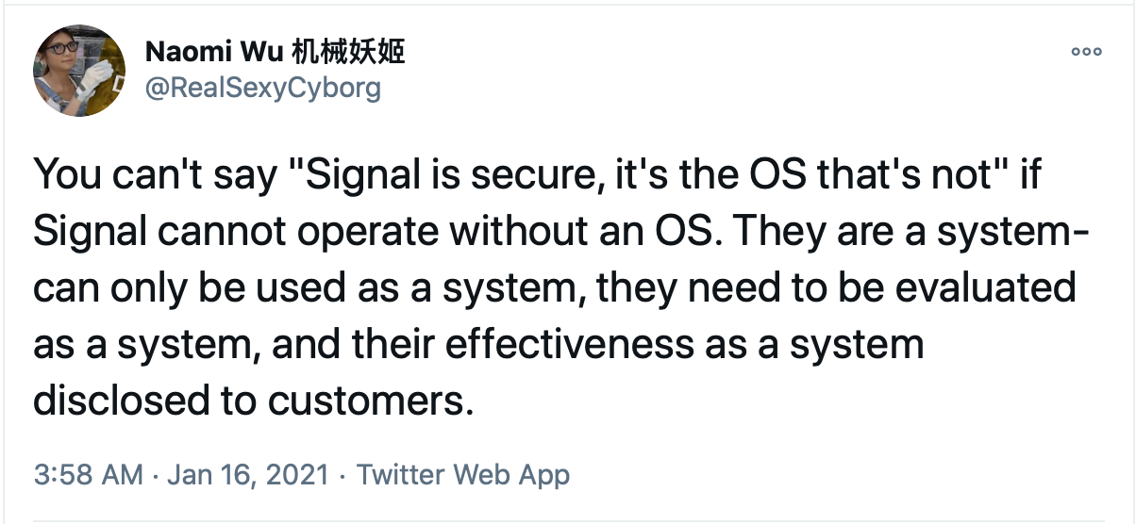
What You Coded is a Bad Constraint

Slide 40
Execution Environment
Different browsers: web and mobile
Browser functionality and add-ons
HTML standard compatibility
Accessibility standard compatibility

Slide 41
Let’s Test
https://www.exploratorytestingacademy.com/app/
https://eviltester.github.io/TestingApp/apps/eprimer/eprimer.html

Slide 42
Learning of Application and Execution Environment of E-Primer
Browser | Chrome, Brave, …
Screen size | Web, Mobile
Browser Settings | Zoom, Security, …
Add-ons | BugMagnet
Validators | HTML, Accessibility, …

Slide 43
Documenting in a Mindmap
Chapter 8

Slide 44
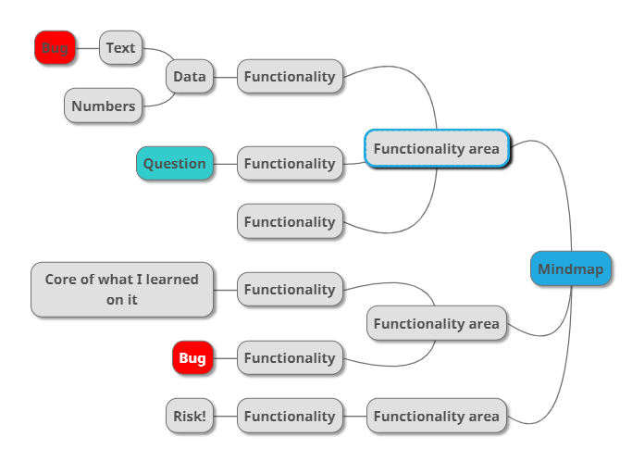
Mindmap

Slide 45
R eplicate I solate M azimize G eneralize E xternalize N eutral tone
Bug Reports
Cem Kaner. Bug Reporting Heuristic.

Slide 46
Let’s Test
https://www.exploratorytestingacademy.com/app/
https://eviltester.github.io/TestingApp/apps/eprimer/eprimer.html

Slide 47
Mindmapping as Future Reference
Notetaking in the moment
Restructure as you learn
Documentation for the future
General purpose mindmaps

Slide 48
pytest the Very Basics
Chapter 9

Slide 49
pytest
Popular test runner for python language
Used both for unit tests and orchestrated tests
Integrates with libraries in python ecosystem

Slide 50
Documenting as Skeleton Test Automation
Chapter 10

Slide 51
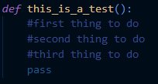
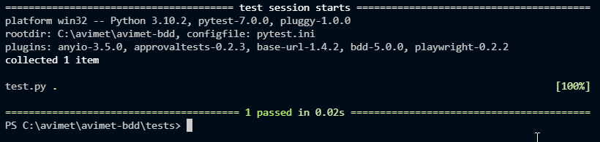
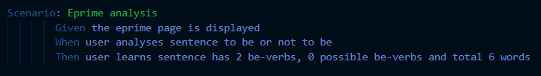
Document in Context of Code
* Runnable with pytest-bdd

Slide 52
Let’s Test
https://www.exploratorytestingacademy.com/app/
https://eviltester.github.io/TestingApp/apps/eprimer/eprimer.html

Slide 53
Skeleton Test Automation
Stepwise Test Cases as Automation Placeholders
Like test cases but version controlled as code
Handoff to a task that is decomposing testing differently

Slide 54
Playwright Library and css selectors on Web Page
Chapter 11

Slide 55

Playwright Library
Browser driver by Microsoft
Speed – Reliability – Visibility
Automatic waits

Slide 56
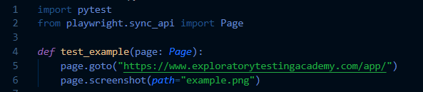
Library / Methods
https://playwright.dev/python/docs/intro

Slide 57
css selectors
css=
#id
.class
tag
[attribute='value']
[part_of_attribute_value_contains*='value']

Slide 58
Documenting as Executable Test Automation
Chapter 12

Slide 59
Let’s Test
https://www.exploratorytestingacademy.com/app/
https://eviltester.github.io/TestingApp/apps/eprimer/eprimer.html

Slide 60
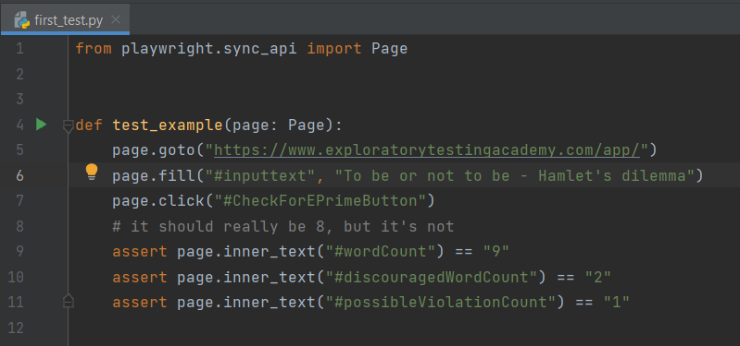

Slide 61
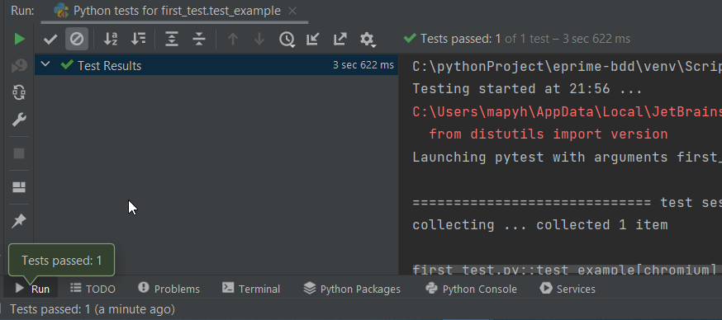

Slide 62
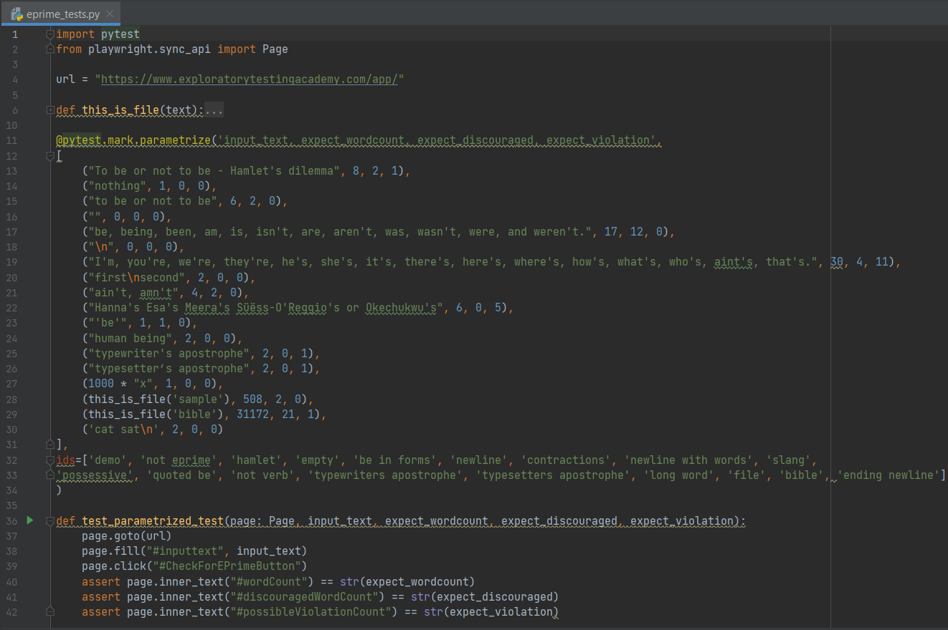
18 tests,
3 browsers

Slide 63
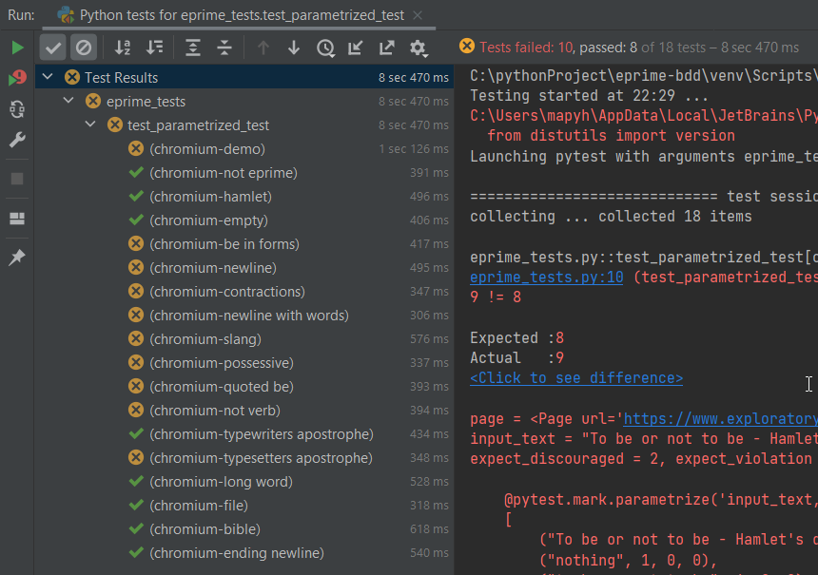
10 bugs

Slide 64
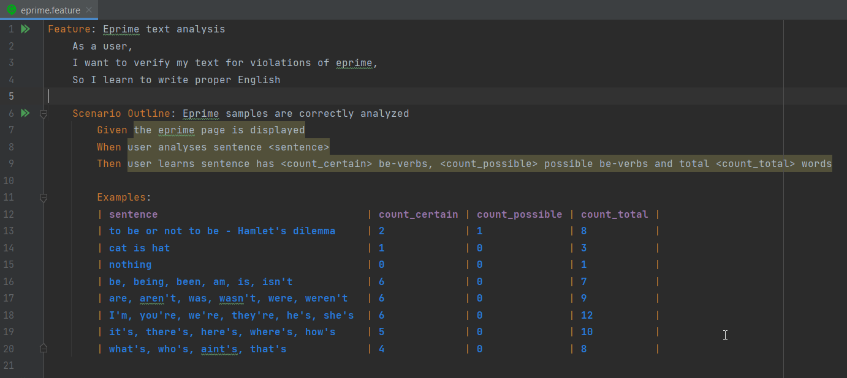
Requires pytest-bdd + refactoring to step-methods

Slide 65
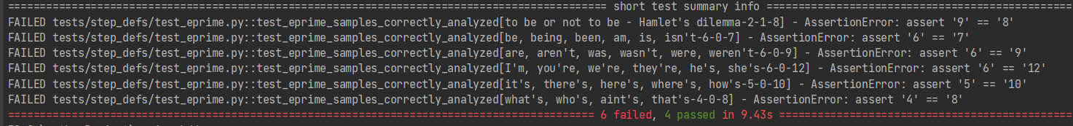

Slide 66
Documenting as Executable Test Automation
Throwaway automation?
Single line
See it fail
First test
Same test but variables
Same test but templates
Failing test with a bug
Spec to tests
Guess the values that are likely to fail
Multiple browsers
Runs in CI

Slide 67
Why This is not about Any Specific Tool
Chapter 13

Slide 68
Documentation as a Constraint
A Balancing Act between Now and Future
Never be bored is not possible without automation

Slide 69
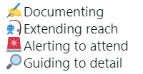
Automation in Frame of Exploratory Testing

Slide 70
Moving Focus
Learning
Attended
Learning
Learning
Learning
Unattended

Slide 71
Stop-and-Think: Test Automation as Documentation
How would the testing you did before this have been different if you were to start with this?

Slide 72
Use of Time
Chapter 14

Slide 73
Test, Bug, Setup
Software with little bugs is faster to test
Setup is configuring, learning and documenting
Test grows coverage

Slide 74
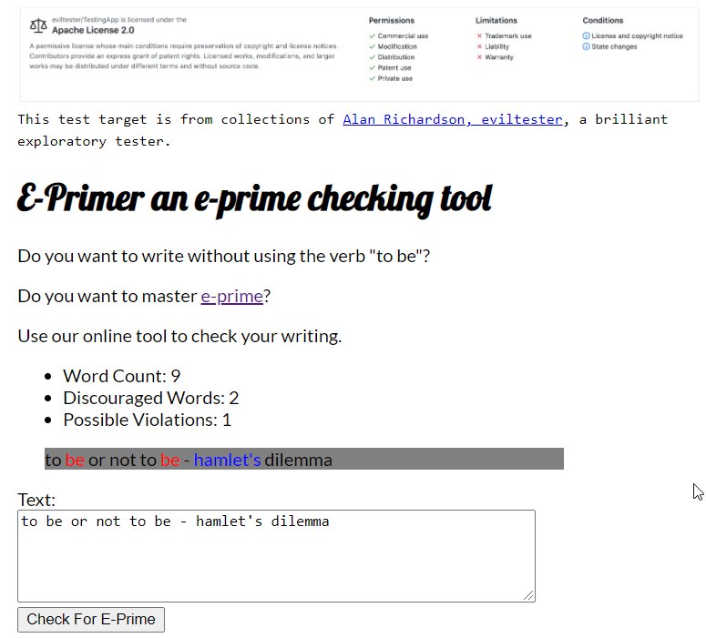
Test Cases trap
Bug trap
Algorithm trap
Data trap

Slide 75
Stop-and-Think: Time and Traps
Where did your time go on testing of the application?

Slide 76
Coverage
Chapter 15

Slide 77
Setting the Stage for Testing
WHAT WHEN WHO HOW WHY
We target these…
…to find these…
B
business
PM
project (time)
T
testing (time)
Test ideas
Serious
U
user
Coverage?
…to tell if there’s more and what level we know things.
Coverage
REQUIREMENTS RISKS (of relevant bugs) CODE ENVIRONMENTS

Slide 78
Risk Coverage
Coverage of relevant bugs
Effectiveness – results of overall strategy facilitate experience of quality for stakeholders

Slide 79
Stop-and-Think: Coverage of Today’s Testing
Would the testing you thought of have missed any of the bugs we have seen?
What did we not test?

Slide 80
Test Strategy
Chapter 16

Slide 81
Ideas that Guide Test Design
Specific to Application Under Test
Risks to ways of testing for them

Slide 82
Let’s Test
https://www.exploratorytestingacademy.com/app/
https://eviltester.github.io/TestingApp/apps/eprimer/eprimer.html

Slide 83
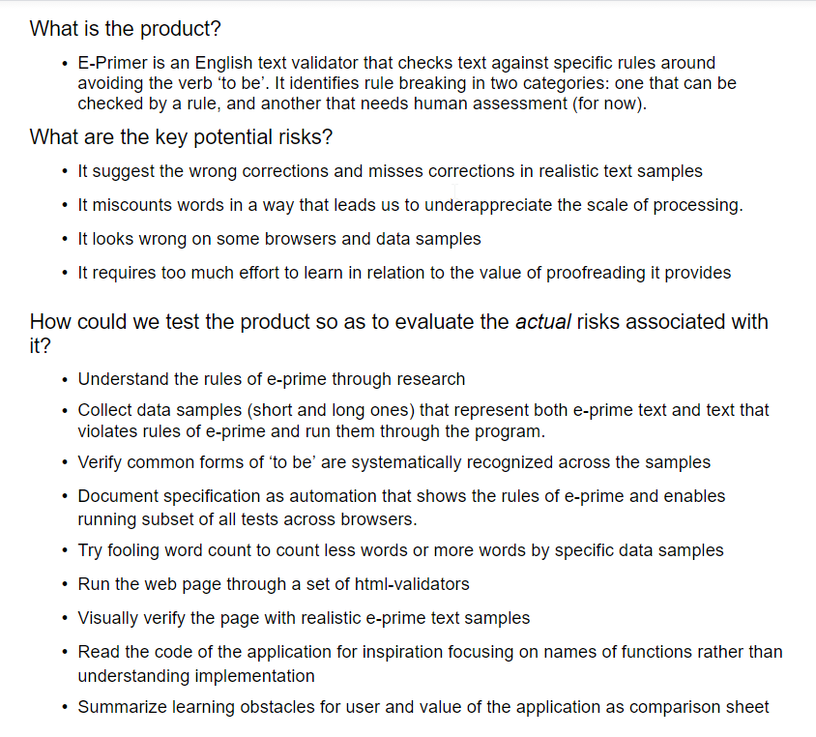
Test Strategy for E-Primer
Notes:
What is the product:
E-primer is English text validator that checks texts against specific rules around avoiding verb 'to be'. It identifies rule-breaking in two categories: one that can be checked by a rule and one that needs human assessment.
What are key potential risks:
It suggests the wrong corrections and misses corrections in realistic samples
It miscounts words in a way that leads us to underappreciated the scale of processing done
It looks wrong in some browsers and data samples
It requires too much effort to learn in relation to the value of proofreading it provides
How could we test the product in order to evaluate the actual risks associated with it?
Understand the rules of e-prime through research
Collect data samples (short/long) that represent both text in eprime and violations of eprime. Run them through the program.
Document the core rules with automation and test core rules on multiple browsers
Try fooling counting to count less or more with specific examples
Run page on html validators and accessibility validators
Visually verify with realistic data samples
Read the code / investigate implementation for tech and implementation specific impacts
Summarise learning obstacles and value for user

Slide 84
Full results and reproducing from customer feedback
Chapter 17

Slide 85
Invisible ink
Customers will tell you of some of the things you missed
Observing customers (incl. telemetry) will tell you of some of the things you missed
Limited reporting capability

Slide 86
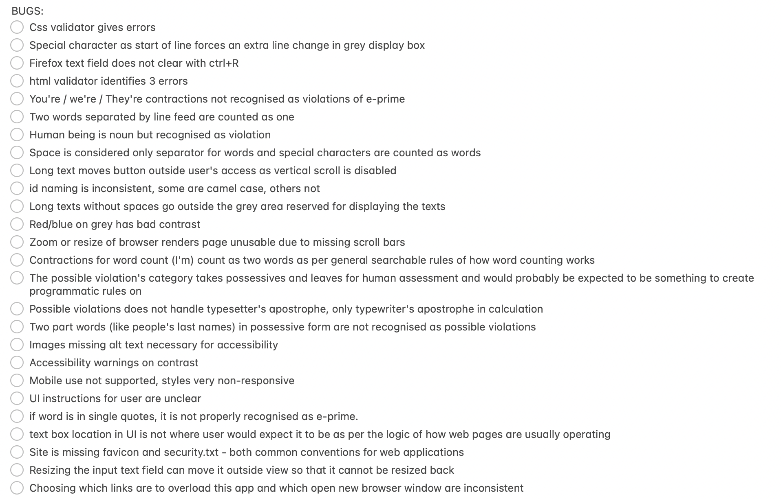
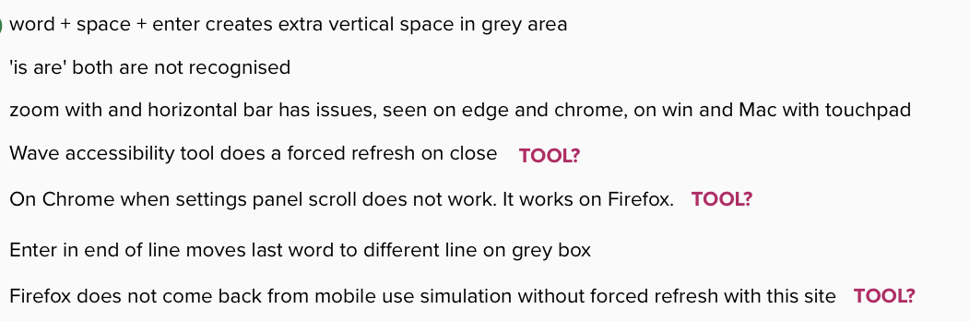


Slide 87
Let’s Test
https://www.exploratorytestingacademy.com/app/
https://eviltester.github.io/TestingApp/apps/eprimer/eprimer.html

Slide 88
Finding (more of some) relevant Conversation Starters
You will never find all bugs.
Target finding only things that matter. Learn what matters.
Seeing and not reporting is better than not seeing problems.

Slide 89
Closing Remarks
Chapter 18

Slide 90
Course Outline
Chapter 1: Test target and our options for exploring
Chapter 2: Self-management basics on setting yourself constraints
Chapter 3: The moment of first impression
Chapter 4: Recognizing and learning a domain
Chapter 5: Recognizing functionality
Chapter 6: Recognizing data
Chapter 7: Recognizing application and execution environment
Chapter 8: Documenting in a mindmap
Chapter 9: pytest the very basics
Chapter 10: Documenting as skeleton test automation
Chapter 11: Playwright library and CSS selectors on web pages
Chapter 12: Documenting as executable test automation
Chapter 13: Why this is not about any specific tool
Chapter 14: Use of time
Chapter 15: Coverage
Chapter 16: Test strategy
Chapter 17: Full results and reproducing from customer feedback
Chapter 17: Closing remarks

Slide 91







Maaret Pyhäjärvi (from Finland)
MIATPP Most Influential Agile Testing Professional Person
https://exploratorytestingacademy.com
2020
2016
2019, 2020, 2021
Email: maaret@iki.fi
Twitter: @maaretp Web: maaretp.com
Blog: visible-quality.blogspot.fi
(please connect with me through Twitter or LinkedIn)
Ohjelmistotestaus ry
#PayToSpeak #TechVoices #EnsembleTesting #EnsembleProgramming #StrongStylePairing #ExploratoryTesting #TestAutomation
#ModernAgile
#AwesomeTesters
https://techvoices.org

