Slide 1

Exploratory Testing Foundations
Maaret Pyhäjärvi
v. 2.2 (2022-12-14)
Exploratory Testing Foundations by Maaret Pyhäjärvi is licensed under CC BY 4.0
Notes:
Exploratory Testing Foundations by Maaret Pyhäjärvi is licensed under CC BY 4.0. To view a copy of this license, visit http://creativecommons.org/licenses/by/4.0/
Notes for each slide on this course are available with CC BY 4.0 at https://dev.to/maaretp/exploratory-testing-foundations-4lb3 (v. 1.0 with Robot Framework).
The slides, notes and added explanation is included in a LeanPub book Contemporary Exploratory Testing you can download from https://leanpub.com/ExploratoryTesting. The book is ©Maaret Pyhäjärvi.
v. 2.2: add chapter on full results and reproducing customer issues

Slide 2
Optimizing the value of testing

Slide 3
Learning
Test Design (ideas)
Test Execution (information)

Slide 4
Exploratory Testing the Verb
Doing Testing
INPUT
OUTPUT

Slide 5
Doing Testing
INPUT
OUTPUT
Input
Tester
Domain knowledge
Requirements and specifications
Testing knowledge Miscellaneous knowledge

Slide 6
Doing Testing
INPUT
OUTPUT
Output
Better tester
Coverage
Information incl. defects and change requests
Documentation: Strategy
Documentation: Tests

Slide 7
Course Outline
Chapter 1: Test target and our options for exploring
Chapter 2: Self-management basics on setting yourself constraints
Chapter 3: The moment of first impression
Chapter 4: Recognizing and learning a domain
Chapter 5: Recognizing functionality
Chapter 6: Recognizing data
Chapter 7: Recognizing application and execution environment
Chapter 8: Documenting in a mindmap
Chapter 9: Robot framework the very basics
Chapter 10: Documenting as skeleton test automation
Chapter 11: Robot framework browser library and CSS selectors on web pages
Chapter 12: Documenting as executable test automation
Chapter 13: Why this is not about Robot Framework
Chapter 14: Use of time
Chapter 15: Coverage
Chapter 16: Test Strategy
Chapter 17: Full results and reproducing from customer feedback
Chapter 18: Closing remarks

Slide 8
Course Outline
Section 1: Options for Exploring
Section II: Control through Choices
Section III: Documenting (with Automation)
Extending with Function, Data,
Environment and Domain
Section IV: Use of time and coverage
1
3
2
4-13
14-17

Slide 9
Test Target and Our Options for Exploring
Chapter 1

Slide 10
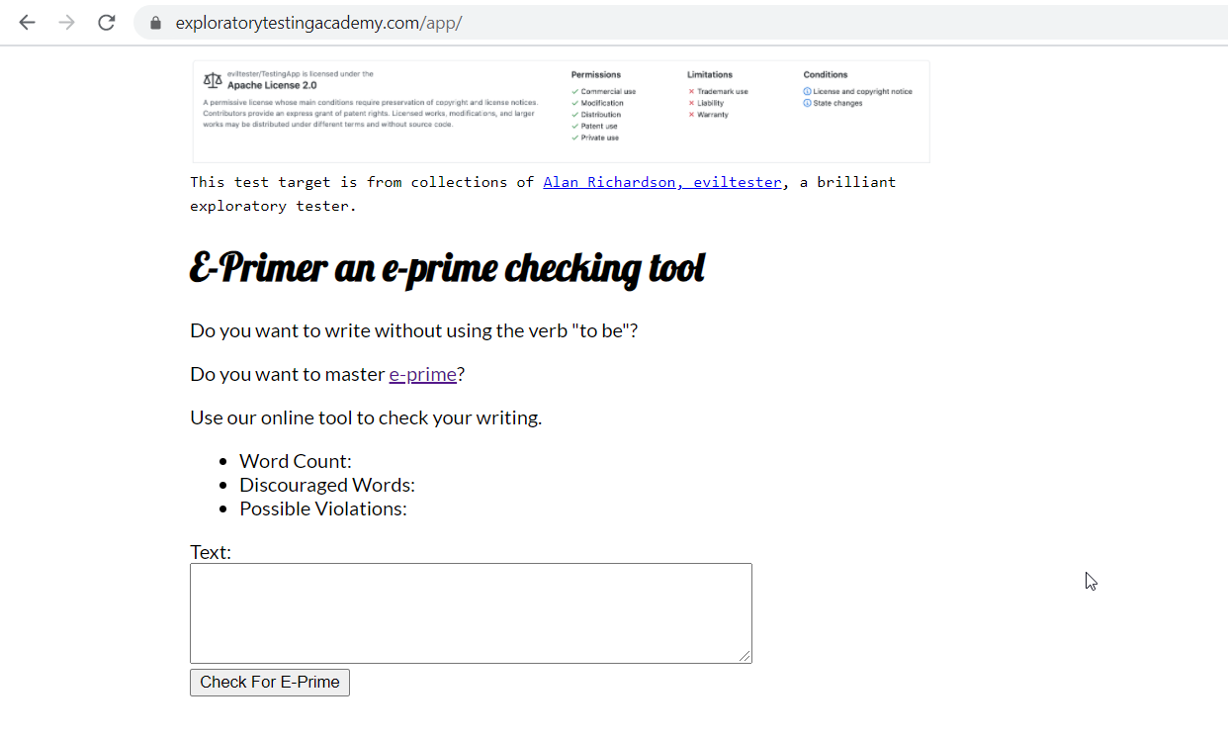

Slide 11
Stop-and-Think: Options for Exploring
What would you do first, and soon after you get started?
List all things that come to your mind about how you could test this. What would you start from? What you would not do?

Slide 12
Options for Exploring
Research the Domain
Use test target with a constraint

Slide 13
Self-management Basics on Setting Yourself Constraints
Chapter 2

Slide 14
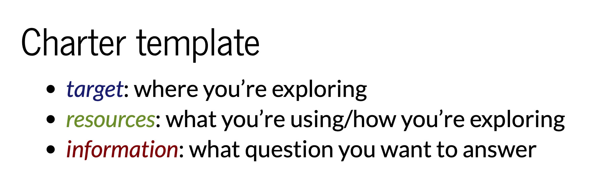
Charters
Elizabeth Zagroba’s concise template adapted from Elizabeth Hendrickson’s template

Slide 15
Choose Your Own Constraint
Deliberately excluding perspectives!
Never Be Bored!

Slide 16
Explore with Intent
Mission
Charter
INTENT
Other Charters
Details
LEARNINGS

Slide 17
Stop-and-Think: Charters, Constraints, Intent
You’re approaching the moment of first impression. How do you want to frame your moment of first impression?

Slide 18
The Moment of First Impression
Chapter 3

Slide 19
Options Expire
Capture First Impression
Borrow someone else’s First Impression
Timing of feedback changes reaction to it!

Slide 20
Let’s Test
https://www.exploratorytestingacademy.com/app/
https://eviltester.github.io/TestingApp/apps/eprimer/eprimer.html

Slide 21
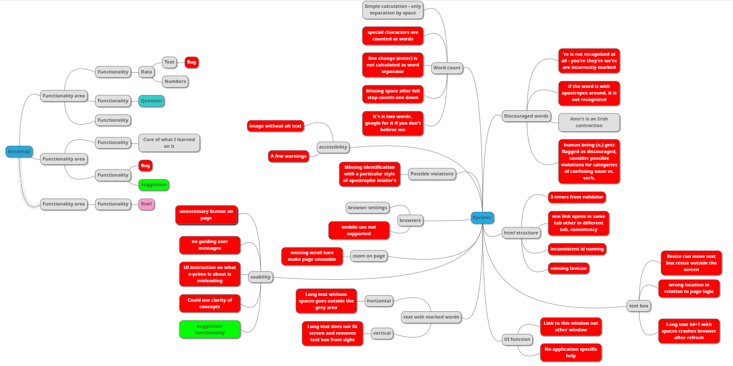
Example: Test Results, Red is Bug

Slide 22
Bugs are Conversation Starters
Bug is anything that might bug a user.
You start conversations about defects and change requests.

Slide 23
Recognizing and Learning a Domain
Chapter 4

Slide 24
Conference Reference Inference

Slide 25
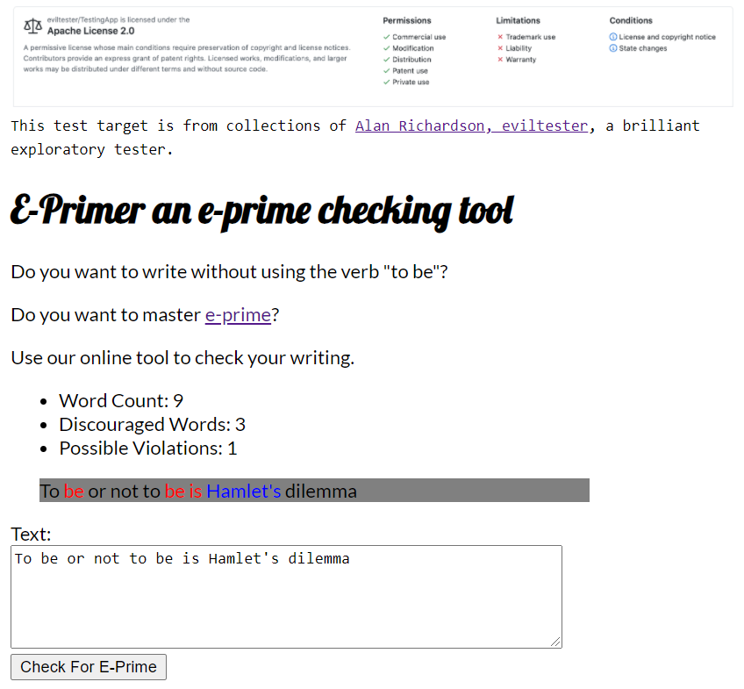

Slide 26
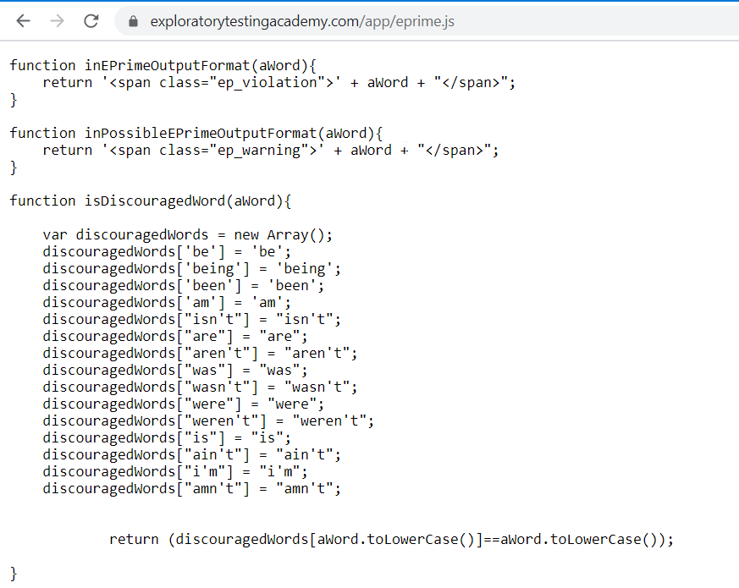

Slide 27
Let’s Test
https://www.exploratorytestingacademy.com/app/
https://eviltester.github.io/TestingApp/apps/eprimer/eprimer.html

Slide 28
Learning of Domain of E-Primer
Core Idea | Writing English language avoiding verb “be” in all its forms
Why? | Someone claims it had benefits, intellectual challenge
Examples | Used in sentences Listed examples
Sample texts | The Bible!

Slide 29
Recognizing Functionality
Chapter 5

Slide 30
Naming of Function
Functions in Code
Expected Features
Visible Features

Slide 31
Let’s Test
https://www.exploratorytestingacademy.com/app/
https://eviltester.github.io/TestingApp/apps/eprimer/eprimer.html

Slide 32
Learning of Function of E-Primer
Input | Text field and button
Output | Three numbers, text area
Containers | Resizable text field, resizable browser window, page
Presentation | Fonts, text and element sizes, order of functions
Browser | Settings, zoom
Algorithm | Recognizing eprime

Slide 33
Recognizing Data
Chapter 6

Slide 34
Data or Variables
Data
Function

Slide 35
Versatile Data
Lifecycle of Data: Create, Read, Update, Delete
Known problematic inputs: GitHub Naughty Strings
https://github.com/minimaxir/big-list-of-naughty-strings/blob/master/blns.txt

Slide 36
Let’s Test
https://www.exploratorytestingacademy.com/app/
https://eviltester.github.io/TestingApp/apps/eprimer/eprimer.html

Slide 37
Learning of Data of E-Primer
Word delimiter | Space, wordcount breaks with characters and line change
Types of apostrophes | Typesetter / typewriter
Long text | Copied / tool generated
Valid eprime | Recognizing right as right
Eprime violations | Recognizing wrong as wrong

Slide 38
Recognizing Application and Execution Environment
Chapter 7

Slide 39
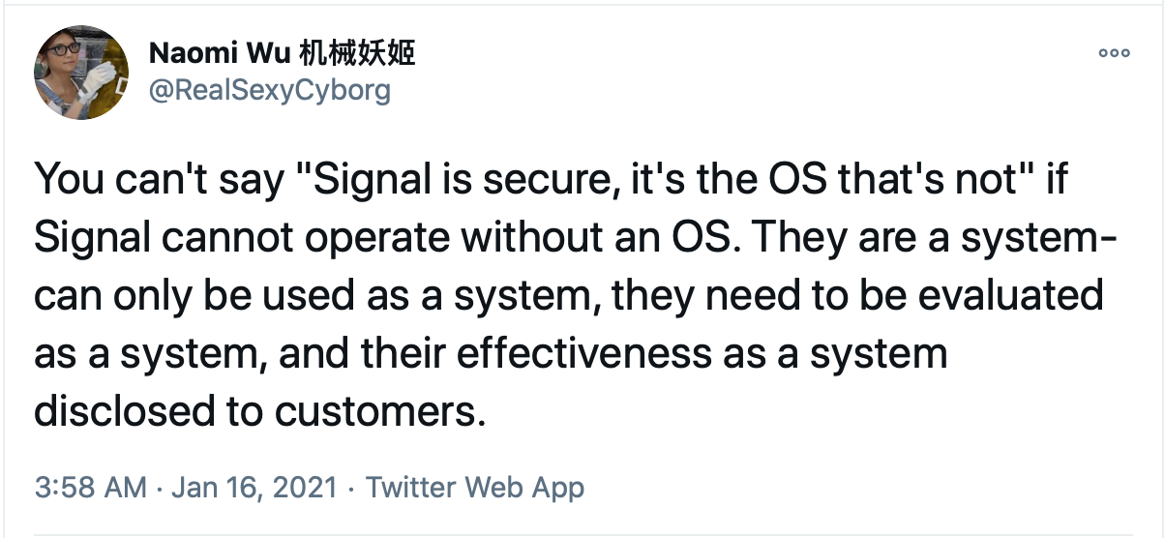
What You Coded is a Bad Constraint

Slide 40
Execution Environment
Different browsers: web and mobile
Browser functionality and add-ons
HTML standard compatibility
Accessibility standard compatibility

Slide 41
Let’s Test
https://www.exploratorytestingacademy.com/app/
https://eviltester.github.io/TestingApp/apps/eprimer/eprimer.html

Slide 42
Learning of Application and Execution Environment of E-Primer
Browser | Chrome, Brave, …
Screen size | Web, Mobile
Browser Settings | Zoom, Security, …
Add-ons | BugMagnet
Validators | HTML, Accessibility, …

Slide 43
Documenting in a Mindmap
Chapter 8

Slide 44
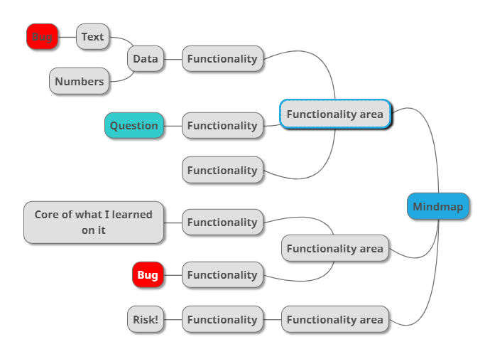
Mindmap

Slide 45
R eplicate I solate M azimize G eneralize E xternalize N eutral tone
Bug Reports
Cem Kaner. Bug Reporting Heuristic.

Slide 46
Let’s Test
https://www.exploratorytestingacademy.com/app/
https://eviltester.github.io/TestingApp/apps/eprimer/eprimer.html

Slide 47
Mindmapping as Future Reference
Notetaking in the moment
Restructure as you learn
Documentation for the future
General purpose mindmaps

Slide 48
Robot Framework the Very Basics
Chapter 9

Slide 49
Robot Framework
Custom-made language
Built-in reporting
Ecosystem of keyword libraries

Slide 50
Documenting as Skeleton Test Automation
Chapter 10

Slide 51
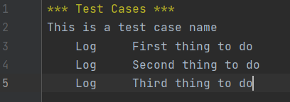
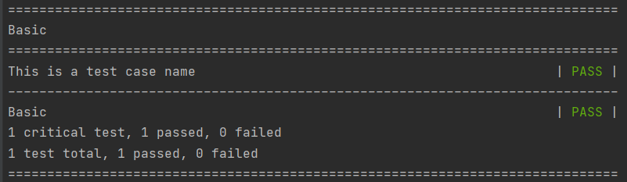
Log

Slide 52
Let’s Test
https://www.exploratorytestingacademy.com/app/
https://eviltester.github.io/TestingApp/apps/eprimer/eprimer.html

Slide 53
Skeleton Test Automation
Stepwise Test Cases as Automation Placeholders
Like test cases but version controlled as code
Handoff to a task that is decomposing testing differently

Slide 54
Robot Framework Browser Library and css selectors on Web Page
Chapter 11

Slide 55

Browser Library
Playwright inside
Speed – Reliability – Visibility
Automatic waits

Slide 56
css selectors
css=
#id
.class
tag
[attribute='value']
[part_of_attribute_value_contains*='value']

Slide 57
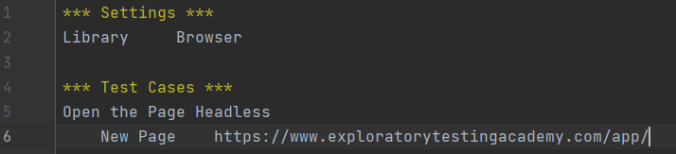
Keywords
https://marketsquare.github.io/robotframework-browser/Browser.html

Slide 58
Documenting as Executable Test Automation
Chapter 12

Slide 59
Let’s Test
https://www.exploratorytestingacademy.com/app/
https://eviltester.github.io/TestingApp/apps/eprimer/eprimer.html

Slide 60
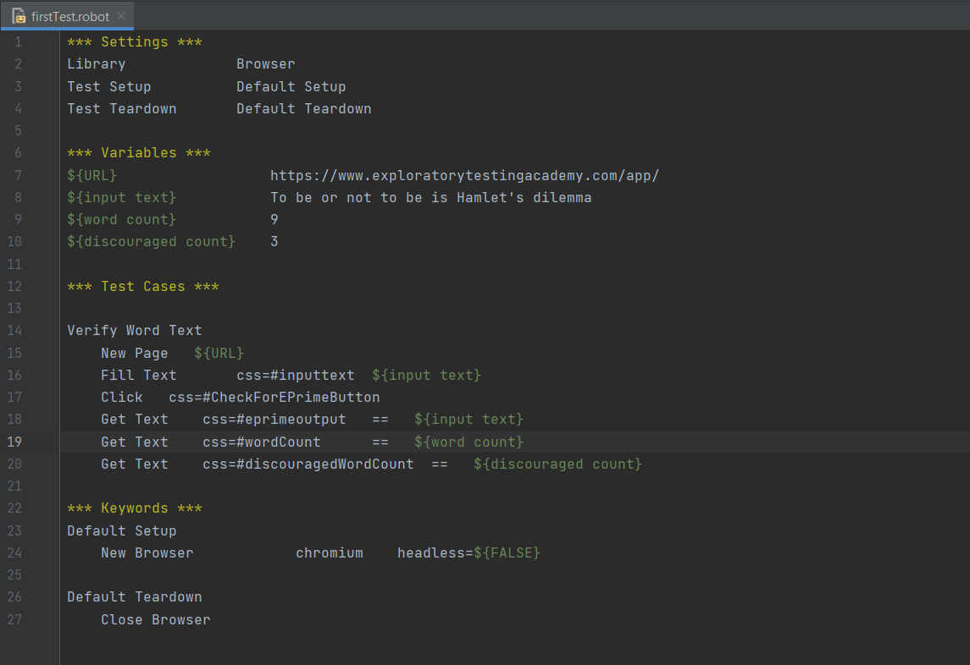
Notes:
Write one line at time – learn after line
Leave variables for refactoring – make it work first; hardcode removal is a discipline but it may be premature
Make it work and then make it better
Perfect is the enemy of good.

Slide 61
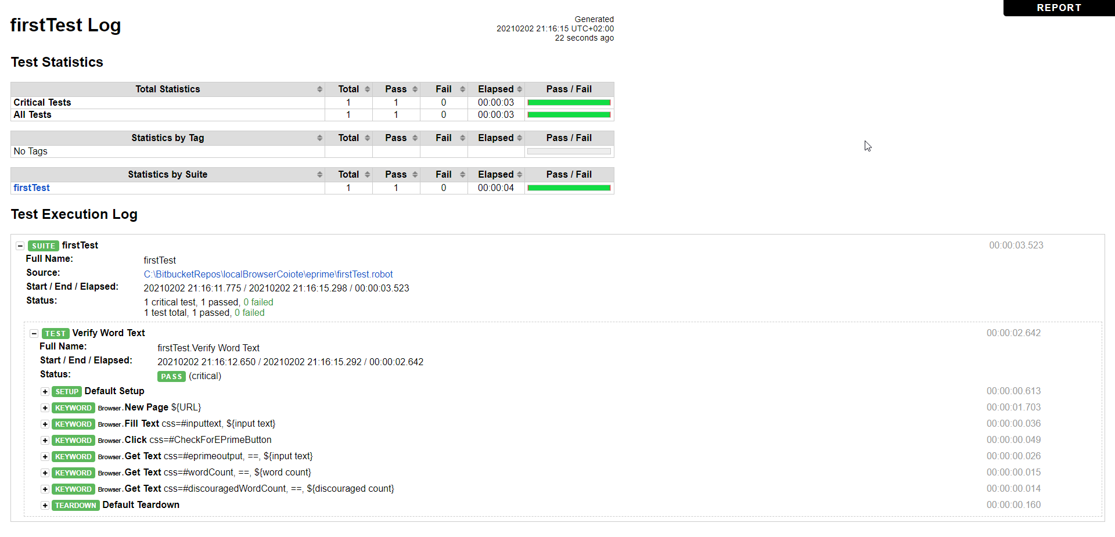

Slide 62
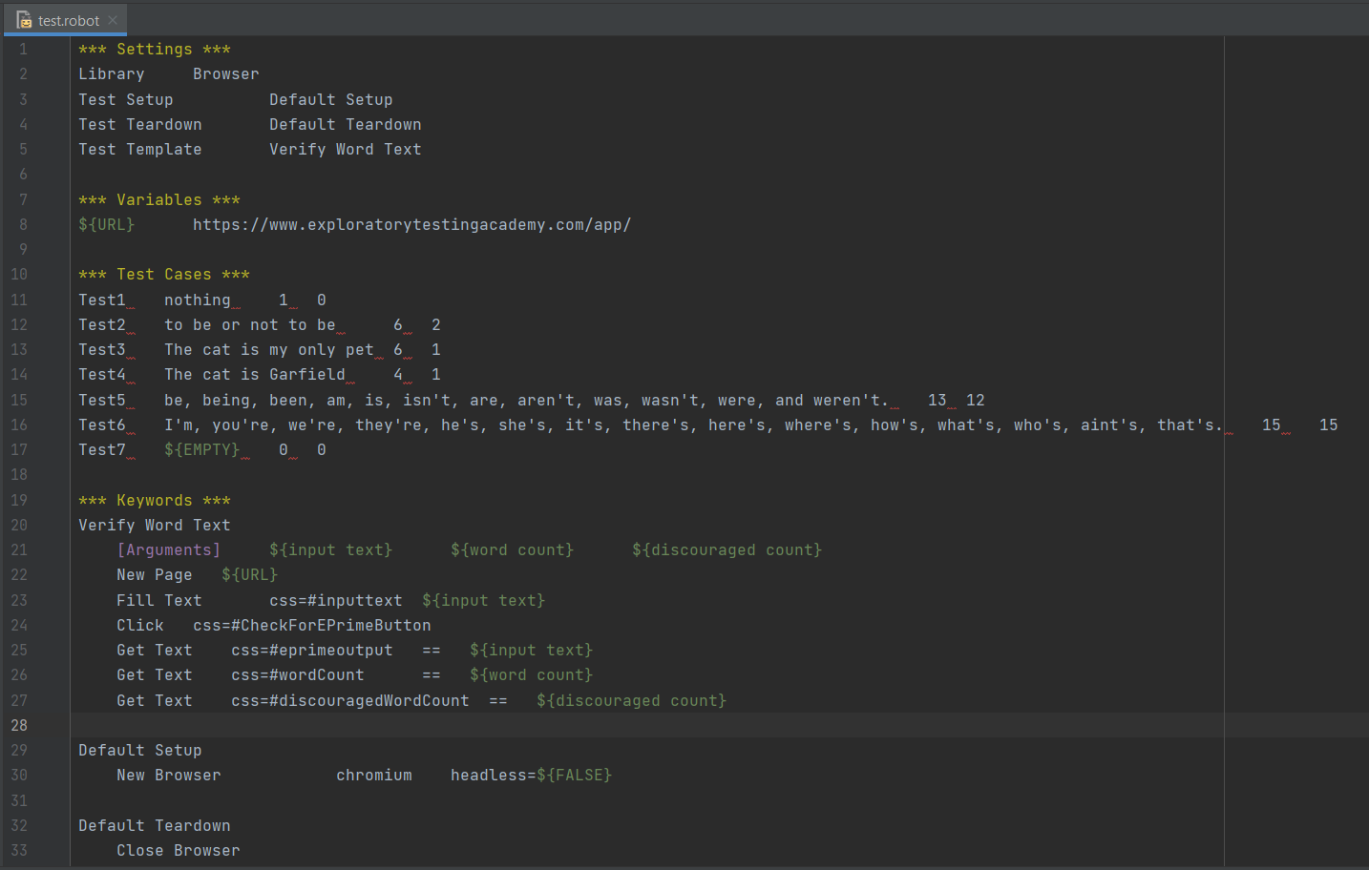

Slide 63
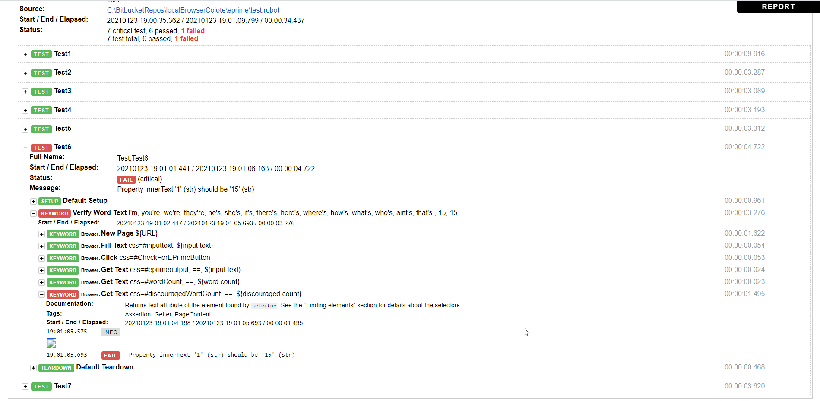

Slide 64
Documenting as Executable Test Automation
Throwaway automation?
Single line
See it fail
First test
Same test but variables
Same test but templates
Failing test with a bug
Spec to tests
Guess the values that are likely to fail
Multiple browsers
Runs in CI

Slide 65
Why This is not about Robot Framework
Chapter 13

Slide 66
Documentation as a Constraint
A Balancing Act between Now and Future
Never be bored is not possible without automation

Slide 67
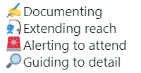
Automation in Frame of Exploratory Testing

Slide 68
Moving Focus
Learning
Attended
Learning
Learning
Learning
Unattended

Slide 69
Stop-and-Think: Robot Framework Browser
How would the testing you did before this have been different if you were to start with this?

Slide 70
Use of Time
Chapter 14

Slide 71
Test, Bug, Setup
Software with little bugs is faster to test
Setup is configuring, learning and documenting
Test grows coverage

Slide 72
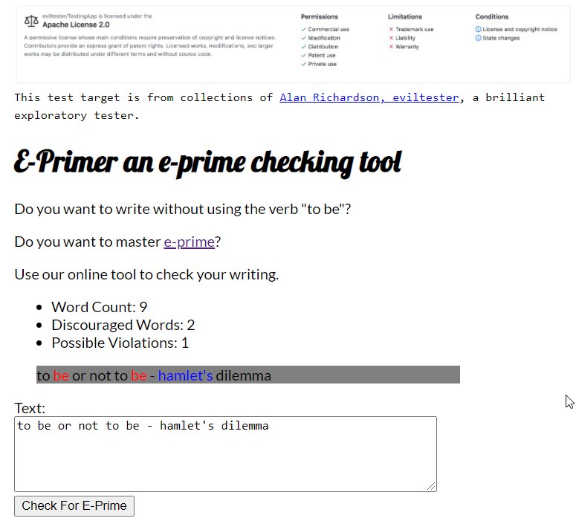
Test Cases trap
Bug trap
Algorithm trap
Data trap

Slide 73
Stop-and-Think: Time and Traps
Where did your time go on testing of the application?

Slide 74
Coverage
Chapter 15

Slide 75
Setting the Stage for Testing
WHAT WHEN WHO HOW WHY
We target these…
…to find these…
B
business
PM
project (time)
T
testing (time)
Test ideas
Serious
U
user
Coverage?
…to tell if there’s more and what level we know things.
Coverage
REQUIREMENTS RISKS (of relevant bugs) CODE ENVIRONMENTS

Slide 76
Risk Coverage
Coverage of relevant bugs
Effectiveness – results of overall strategy facilitate experience of quality for stakeholders

Slide 77
Stop-and-Think: Coverage of Today’s Testing
Would the testing you thought of have missed any of the bugs we have seen?
What did we not test?

Slide 78
Test Strategy
Chapter 16

Slide 79
Ideas that Guide Test Design
Specific to Application Under Test
Risks to ways of testing for them

Slide 80
Let’s Test
https://www.exploratorytestingacademy.com/app/
https://eviltester.github.io/TestingApp/apps/eprimer/eprimer.html

Slide 81
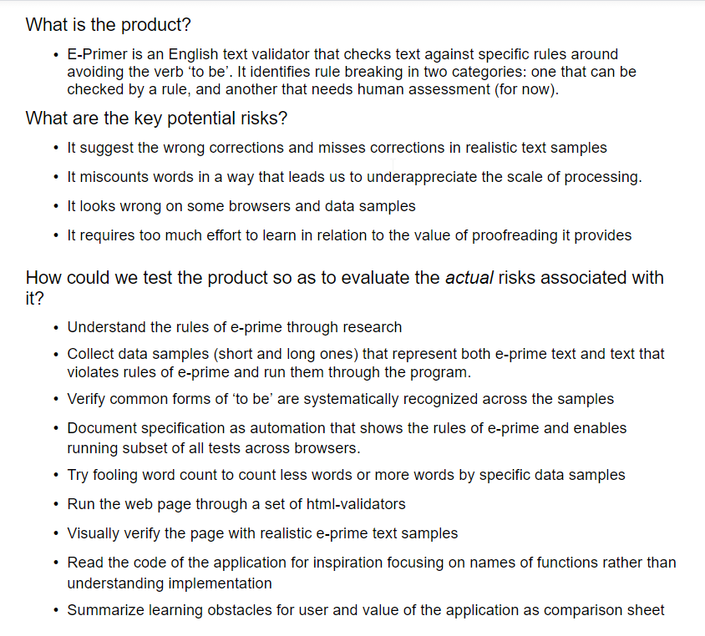
Test Strategy for E-Primer

Slide 82
Full results and reproducing from customer feedback
Chapter 17

Slide 83
Invisible ink
Customers will tell you of some of the things you missed
Observing customers (incl. telemetry) will tell you of some of the things you missed
Limited reporting capability

Slide 84
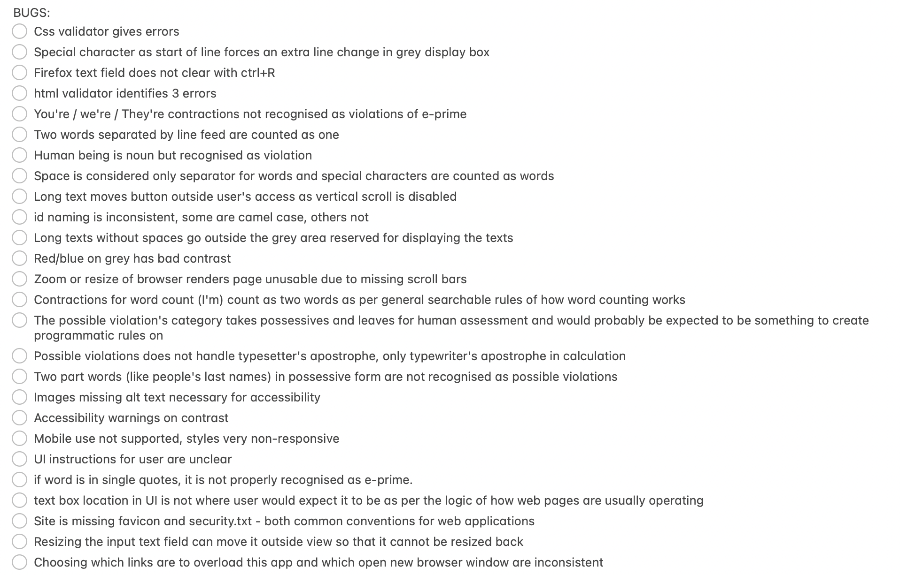
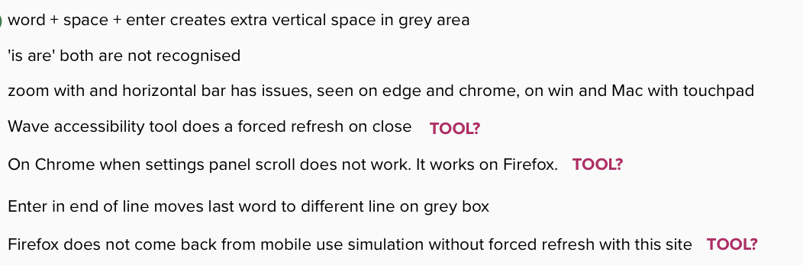


Slide 85
Let’s Test
https://www.exploratorytestingacademy.com/app/
https://eviltester.github.io/TestingApp/apps/eprimer/eprimer.html

Slide 86
Finding (more of some) relevant Conversation Starters
You will never find all bugs.
Target finding only things that matter. Learn what matters.
Seeing and not reporting is better than not seeing problems.

Slide 87
Closing Remarks
Chapter 18

Slide 88
Course Outline
Chapter 1: Test target and our options for exploring
Chapter 2: Self-management basics on setting yourself constraints
Chapter 3: The moment of first impression
Chapter 4: Recognizing and learning a domain
Chapter 5: Recognizing functionality
Chapter 6: Recognizing data
Chapter 7: Recognizing application and execution environment
Chapter 8: Documenting in a mindmap
Chapter 9: Robot framework the very basics
Chapter 10: Documenting as skeleton test automation
Chapter 11: Robot framework browser library and CSS selectors on web pages
Chapter 12: Documenting as executable test automation
Chapter 13: Why this is not about Robot Framework
Chapter 14: Use of time
Chapter 15: Coverage
Chapter 16: Test Strategy
Chapter 17: Full results and reproducing from customer feedback
Chapter 18: Closing remarks

Slide 89







Maaret Pyhäjärvi (from Finland)
MIATPP Most Influential Agile Testing Professional Person
https://exploratorytestingacademy.com
2020
2016
2019, 2020, 2021
Email: maaret@iki.fi
Twitter: @maaretp Web: maaretp.com
Blog: visible-quality.blogspot.fi
(please connect with me through Twitter or LinkedIn)
Ohjelmistotestaus ry
#PayToSpeak #TechVoices #EnsembleTesting #EnsembleProgramming #StrongStylePairing #ExploratoryTesting #TestAutomation
#ModernAgile
#AwesomeTesters
https://techvoices.org

