Slide 1

Byte July 2023

Slide 2
Limitations of JavaScript
Lack of Static Typing
Missing Compile-Time Error Checking
Limited IDE Support
Undefined Behavior and Null References
Lack of Modularization Features
Difficulty in Scaling and Maintenance

Slide 3
“
TypeScript lets you write JavaScript the way you really want to.
TypeScript is a typed superset of JavaScript that compiles to plain JavaScript.

Slide 4

Overview
Syntax based on ECMAScript proposals
TypeScript is first and foremost a superset of JavaScript
Any regular JavaScript is valid TypeScript Code

Slide 5
Installation
Install Node LTS version - https://nodejs.org/en/
Install / Update Visual Studio Code to Latest Release - https://code.visualstudio.com/
Extensions of VS Code
AutoFileName
vscode-icons
JavaScript (ES6) code snippets
After all Extensions are installed
File Menu -> Preferences -> File Icon Theme -> Select VScode Icons

Slide 6
JAVA / CS
TS
JAVAC / CSC
TSC
Byte Code / MSIL
JavaScript
JavaScript
JIT Compiler (JVM / CLR)
JavaScript Runtime
JavaScript Runtime
Native
Native
Native
O.S.
O.S.
O.S.

Slide 7
How to install typescript?
Global Installation
npm install -g typescript
OR
npm i -g typescript
Check the TypeScript Compiler version installed
tsc -v
Compile a TypeScript File to JavaScript output
tsc <full path of ts file> e.g. tsc demo3.ts
tsc <full path of ts file> -t es2015 e.g. tsc demo3.ts -t es2015
Local Installation
npm install --save-dev typescript
OR
npm i -D typescript

Slide 8
Local Installation – New Project
Create a new folder
Open the folder path in terminal window
npm init -y
Change the package.json file as required & add the compile script
npm i -D typescript@4.8.4
Check the TypeScript Compiler version installed
npx tsc -v

Slide 9
.ts files
.ts files
Will be compiled by
Will be compiled by
Automate .ts
to .js file
Creation
Run tsc in
Watch mode
tsc
tsc
Convert to
Convert to
.js files
.js files
Refer in
Refer in
.html page
.html page
Open in
Open in
BROWSER
BROWSER

Slide 10
Local Installation – New Project
Create a new folder (TSDemos)
Open the folder path in terminal window
npm init -y
Changed the package.json file as required
npm i -D typescript@4.8.3
Create and configure tsconfig.json
Create a file 1_first-demo.ts in root folder
To run the compiler in watch mode, use the following command
npm run compile

Slide 11
Using the Shared Application
Download & extract TSDemos.zip file
Open the folder in VS Code
Open Terminal window on the folder path and run the following command
npm install
4. To run the compiler in watch mode, use the following command
npm run compile

Slide 12
Target - ECMASCRIPT Versions
ES3
ES5
ECMASCRIPT 2015
ECMASCRIPT 2016
ECMASCRIPT 2017
ECMASCRIPT 2018
ECMASCRIPT 2019
ECMASCRIPT 2020
ECMASCRIPT 2021
ECMASCRIPT 2022
ECMASCRIPT 2023

Slide 13
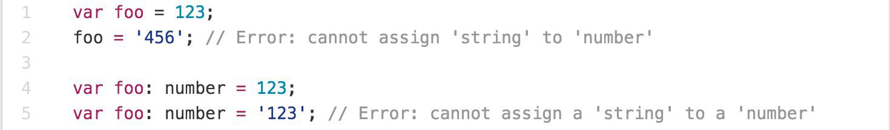
Main Goals of TypeScript
Provide an optional type system for JavaScript.
Provide planned features from future JavaScript editions to current JavaScript engines
Modular Development

Slide 14
TypeScript Features
Data Types Supported
Optional Static Type Annotation
Classes
Interface
Modules
Arrow Expressions
Type Assertions
Ambient Declarations
Source File Dependencies

Slide 15
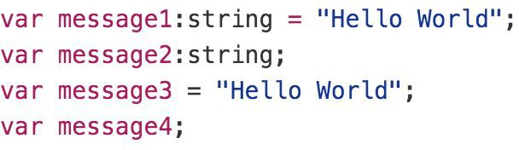
Type Inference
TypeScript tries to infer types
Four ways to variable declaration -
Type and Value in one statement
Type but no Value then Value will be undefined
Value but on Type then the it will be of Any type but maybe be inferred based on its value.
Neither Value nor Type then Type will be Any and Value will be undefined.

Slide 16
Data Types
Any
Never
Unknown
Primitive
Number
Boolean
String
Void
Null
Undefined
Array
Tuple
Enum

Slide 17
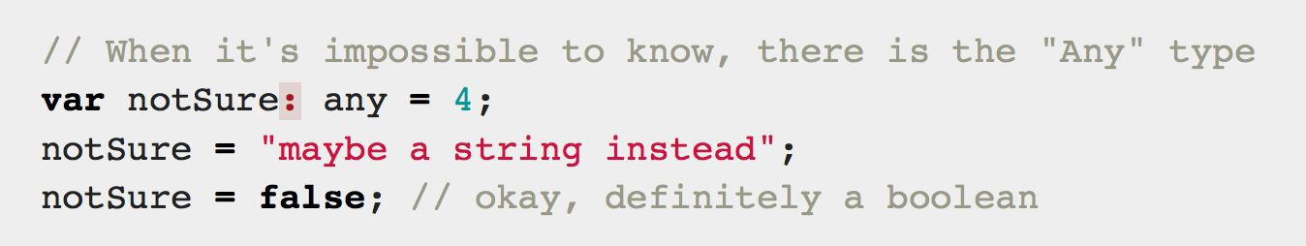
Any
Any is used when it’s impossible to determine the type

Slide 18
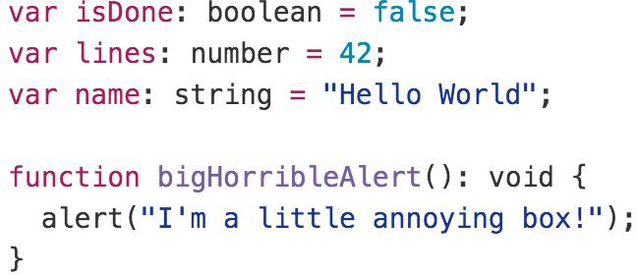
Primitive
Doesn’t have separate integers and float/double type. These all are floating point values and get the type ‘number’
boolean - true/false value
string - both single/double quote can be used
No separate char type
void - is used in function type returning nothing
null and undefined - functions as usual

Slide 19
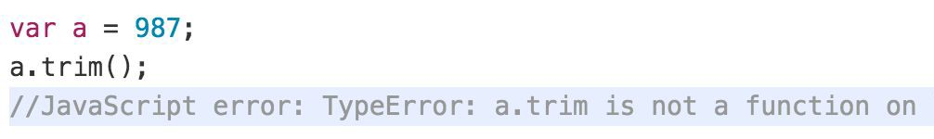
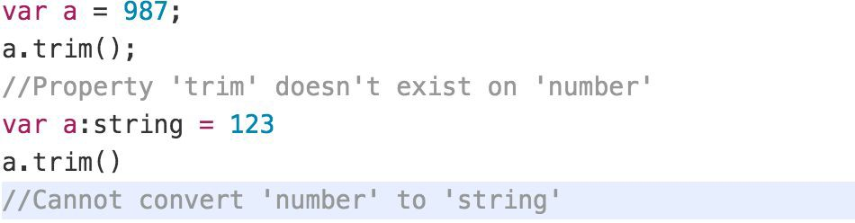
Type Annotations/Checking
JavaScript
TypeScript

Slide 20
Type Assertion
TypeScript's type assertion are purely, you telling the compiler that you know about the types better than it does, and that it should not second guess you.
Type assertion is a mechanism which tells the compiler about the type of a variable.
Type assertion is explicitly telling the compiler that we want to treat the entity as a different type.

Slide 21
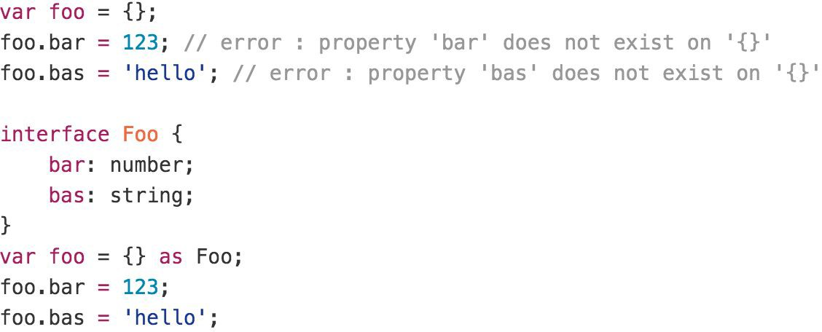
Type Assertion Example

Slide 22
Type Guards / Union Types
Type Guards allow you to narrow down the type of a variable within a conditional block.
Union types are a powerful way to express a value that can be one of the several types.
Two or more data types are combined using the pipe symbol (|) to denote a Union Type. In other words, a union type is written as a sequence of types separated by vertical bars.

Slide 23
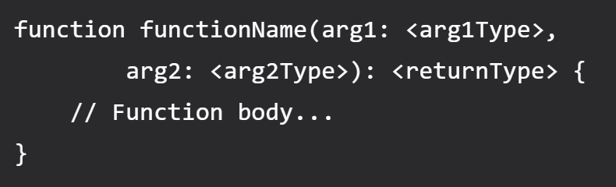
Functions
Writing a function in TypeScript is like writing them in JavaScript but with added parameters and return type.
Note that any JavaScript function is a perfectly valid TypeScript function. However, we can do better by adding type.
TypeScript function syntax (with two arguments)

Slide 24
Function Parameters
Function Parameters are required, and you cannot pass extra arguments to a function
Function Parameters are also type safe, if you don't use any type explicitly
Adding an optional parameter is super simple, just add ? to the end of the argument name.
For default argument suffix it with an equal sign and default value (TS compiler will automatically deduce the type for default argument based on provided value).

Slide 25
Lambda Expression
Implicit return
No braces for single expression
Part of ES6 termed as Arrow Functions
Lexically scoped this
You don't need to keep typing function
It lexically captures the meaning of arguments

Slide 26
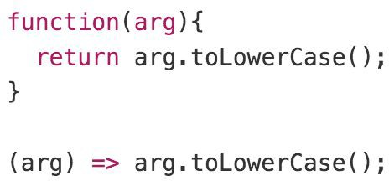
Lambda Example

Slide 27
Rest Parameter (…args)
A rest parameter allows you a function to accept zero or more arguments of the specified type.
In TypeScript, rest parameters follow these rules:
A function has only one rest parameter.
The rest parameter appears last in the parameter list.
The type of the rest parameter is an array type.
To declare a rest parameter, you prefix the parameter name with three dots and use the array type as the type annotation:

Slide 28
Rest vs Spread
Rest and spread are two related features in TypeScript that allow developers to work with arrays and objects more easily.
Rest Parameters
Rest parameters allow you to represent an indefinite number of arguments as an array.
You can use the rest parameter syntax (...) to indicate that a function should accept any number of arguments.
Spread Syntax
Spread syntax allows you to "spread" the elements of an array or object into another array or object.
You can use the spread syntax (...) to expand an array into its individual elements, or to merge two or more objects into a new object.

Slide 29
Shallow Copy
emp2
emp1
id: 1
ename: “Manish”
address:
id: 1
ename: “Manish”
address:
city: “Mumbai”

Slide 30
Deep Copy
emp2
emp1
id: 1
ename: “Manish”
address:
id: 1
ename: “Manish”
address:
city: “Mumbai”
city: “Pune”

Slide 31
Arrays
The use of variables to store values poses the following limitations −
Variables are scalar in nature. In other words, a variable declaration can only contain a single at a time. This means that to store n values in a program n variable declarations will be needed. Hence, the use of variables is not feasible when one needs to store a larger collection of values.
Variables in a program are allocated memory in random order, thereby making it difficult to retrieve/read the values in the order of their declaration.
TypeScript introduces the concept of arrays to tackle the same.
An array is a homogenous collection of values.
An array is a collection of values of the same data type.
It is a user defined type.

Slide 32
Features of an Array
An array declaration allocates sequential memory blocks.
Arrays are static. This means that an array once initialized cannot be resized.
Each memory block represents an array element.
Array elements are identified by a unique integer called as the subscript / index of the element.
Like variables, arrays too, should be declared before they are used. Use the var keyword to declare an array.
Array initialization refers to populating the array elements.
Array element values can be updated or modified but cannot be deleted.

Slide 33
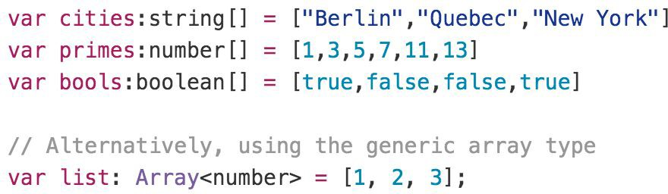
Array

Slide 34
Tuple
As we know array consists value of Homogeneous types but sometimes, we need to store a collection of a different type value in a single variable. Then we will go with Tuples.
Tuples are just like structure in C programming and can also be passed as parameters in a function call.
To denote a multi-dimensional coordinate system the term used is tuple in abstract mathematics.
JavaScript doesn’t have tuples as data types, but in typescript Tuple's facility is available.
Tuple values are individually called items. Tuples are index based. This means that items in a tuple can be accessed using their corresponding numeric index.

Slide 35
Enum
Enums or enumerations are a new data type supported in TypeScript. Most object-oriented languages like Java and C# use Enums. This is now available in TypeScript too.
In simple words, Enums allow us to declare a set of named constants i.e., a collection of related values that can be numeric or string values.
Using Enum, we can make it easier to document intent, or create a set of distinct cases.
There are three types of Enums:
Numeric Enum
String Enum
Heterogeneous Enum

Slide 36
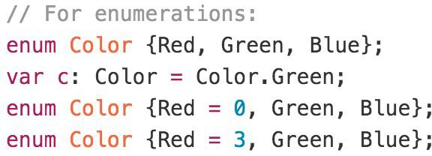
Enum
By default, Enums begin numbering their members starting at 0. You can change this by manually setting the value of one its members.

Slide 37
TypeScript Interface
Interface is a structure that defines the contract in your application.
Declared using interface keyword
Like other TypeScript features its design time features i.e., no extra code would be emitted to resultant JavaScript file
TypeScript compiler uses interface for type checking. This is also known as "duck typing" or "structural subtyping".
Errors being shown when interface signature and implementation doesn’t match.

Slide 38
TypeScript Class
In object-oriented programming languages like Java and C#, classes are the fundamental entities used to create reusable components.
TypeScript introduced classes to avail the benefit of object-oriented techniques like encapsulation and abstraction.
The class in TypeScript is compiled to plain JavaScript functions by the TypeScript compiler to work across platforms and browsers.
The concept of 'Encapsulation' is used to make class members public or private i.e., a class can control the visibility of its members. This is done using access modifiers.
There are three types of access modifiers in TypeScript:
public (Default)
private
protected.

Slide 39
TypeScript Class
A class can have the following features
Instance methods/members
Single constructor with Default/Optional parameter
Optional and Required Members in Strict Mode
Parameter Members
Static methods/members
Readonly Members
Can implement interfaces
Inheritance

Slide 40
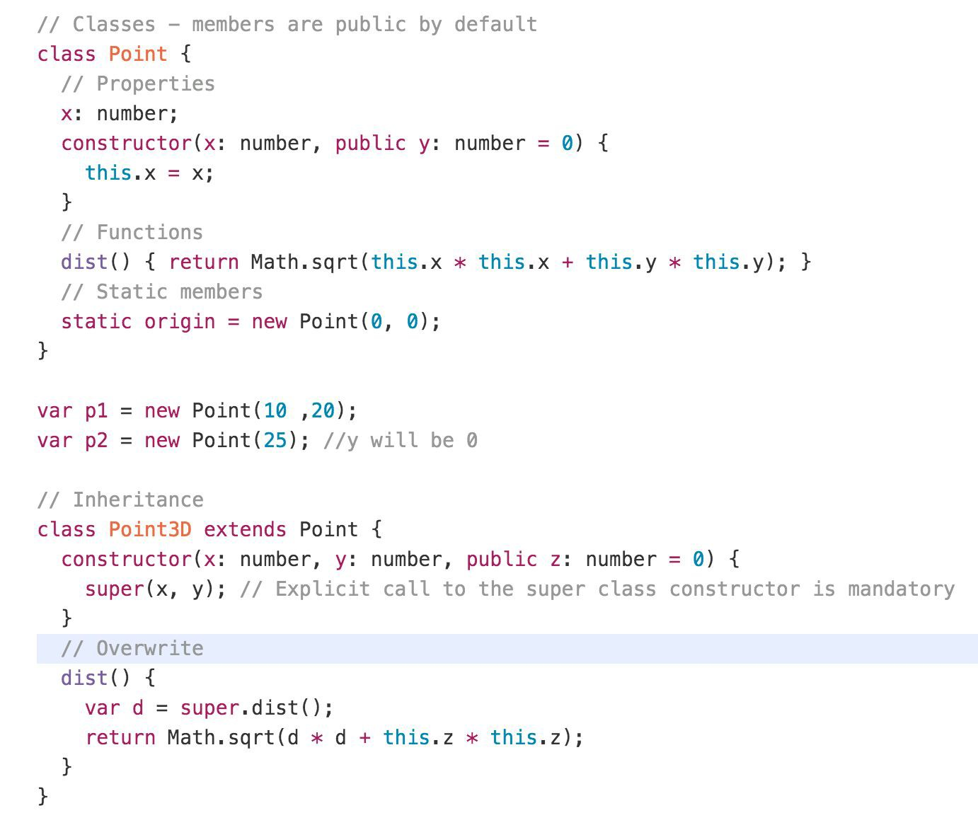
Class Example

Slide 41
Static
The static keyword defines a static method or property for a class, or a class static initialization block.
Neither static methods nor static properties can be called on instances of the class. Instead, they're called on the class itself.
Static methods are often utility functions, such as functions to create or clone objects, whereas static properties are useful for caches, fixed-configuration, or any other data you don't need to be replicated across instances.

Slide 42
Use cases for Static
Utility functions:
Static methods can be used to define utility functions that are related to a class but don't require an instance to be created. For example, a Math class could have a static method Math.random() that generates a random number.
Configuration:
Static properties can be used to store configuration values that apply to all instances of a class. For example, a Database class could have a static property Database.maxConnections that specifies the maximum number of connections allowed to the database.
Singleton pattern:
The static keyword can be used to implement the Singleton pattern, where a class has only one instance that is shared across the entire application.
Factory methods:
Static methods can be used as factory methods to create instances of a class. For example, a Person class could have a static method Person.create(name: string, age: number) that creates a new instance of the Person class with the specified name and age.

Slide 43
Readonly
The readonly keyword is used to indicate that a property or variable should not be modified after it has been initialized.
When a property is marked as readonly, it can only be set once either in its declaration or in the constructor of the class.
Similarly, when a variable is marked as readonly, it can only be assigned a value once.
Using “readonly” can help prevent accidental modifications to properties or variables, making code more robust and less error-prone.

Slide 44
Use cases for Readonly
Immutable data structures:
By marking properties as readonly, you can create immutable data structures that cannot be modified once they are initialized. This can help to prevent bugs that can be caused by unintended modifications to data.
Public API:
When creating a public API for a library or module, marking properties as readonly can help to ensure that users of the API do not accidentally modify values that are not intended to be changed.
Thread safety:
When multiple threads are accessing the same data, marking properties as readonly can help to prevent race conditions and ensure thread safety.
Performance optimization:
Marking properties as readonly can help the TypeScript compiler to optimize code, as it knows that these values will not change at runtime.

Slide 45
Generics
When writing programs, one of the most important aspects is to build reusable components. This ensures that the program is flexible as well as scalable in the long-term.
Generics offer a way to create reusable components. Generics provide a way to make components work with any data type and not restrict to one data type.
So, components can be called or used with a variety of data types, without loosing type safety and intellisense.
Generic Type can be used with
Functions
Class
Interface

Slide 46
Generic Constraints
As mentioned earlier, the generic type allows any data type. However, we can restrict it to certain types using constraints.
A constraint is specified after the generic type in the angle brackets.
Constraints can be applied using:
extends
Type Parameters
Class Types
keyof

Slide 47
Iterators
Iterables
An object is deemed iterable if it has an implementation for the Symbol.iterator property.
Some built-in types like Array, Map, Set, String, Int32Array, Uint32Array, etc. have their Symbol.iterator property already implemented.
Symbol.iterator function on an object is responsible for returning the list of values to iterate on.
for..of, loops over an iterable object, invoking the Symbol.iterator property on the object.

Slide 48
Generators
In TypeScript, generators provide a new way to work with functions and iterators. Generators provide an easier way to implement iterators.
Using a generator,
you can stop the execution of a function from anywhere inside the function
and continue executing code from a halted position
To create a generator, you need to first define a generator function with function* symbol.
You can pause the execution of a generator function without executing the whole function body by using yield keyword.
The yield expression returns a value. However, unlike the return statement, it doesn't terminate the program. That's why you can continue executing code from the last yielded position.

Slide 49
Uses of Generators
Generators let us write cleaner code while writing asynchronous tasks.
Generators provide an easier way to implement iterators.
Generators execute its code only when required.
Generators are memory efficient.

Slide 50
Decorators
Decorators provide a way to add both annotations and a meta-programming syntax.
A Decorator is a special kind of declaration that can be attached to a class declaration, method, accessor, property, or parameter.
Decorators use the form @expression, where expression must evaluate to a function that will be called at runtime with information about the decorated declaration.
Decorators are just a clean syntax for wrapping a piece of code with a function

Slide 51
Inheritance
TypeScript is an object-oriented programming language that supports inheritance.
Inheritance is a mechanism that allows one class to inherit the properties and methods of another class.
In TypeScript, inheritance is achieved using the extends keyword.
When a class extends another class, it inherits all the properties and methods of the base class.
The subclass can also add its own properties and methods, and override or extend the behavior of the inherited methods.

Slide 52
Namespaces
The namespace is used for logical grouping of functionalities. A namespace can include interfaces, classes, functions and variables to support a single or a group of related functionalities.
A namespace can be created using the namespace keyword followed by the namespace name.
By default, namespace components cannot be used in other modules or namespaces.
You must export each component to make it accessible outside, using the export keyword
The generated JavaScript code for the namespace uses the IIFE pattern to stop polluting the global scope.

Slide 53
Modules
A module is just a file. One typescript file is one module. As simple as that.
A module may contain a class or a library of functions for a specific purpose.
Modules can load each other and use special directives export and import to interchange functionality, call functions of one module from another one:
export keyword labels variables and functions that should be accessible from outside the current module.
import allows the import of functionality from other modules.

Slide 54
Namespace vs Module
Namespace | Module
Must use the namespace keyword and the export keyword to expose namespace components. | Uses the export keyword to expose module functionalities.
Used for logical grouping of functionalities with local scoping. | Used to organize the code in separate files and not pollute the global scope.
To use it, it must be included using triple slash reference syntax e.g. ///<reference path="path to namespace file" />. | Must import it first in order to use it elsewhere.
Compile using the --outFile command. | Compile using the --module command.
Must export functions and classes to be able to access it outside the namespace. | All the exports in a module are accessible outside the module.
Namespaces cannot declare their dependencies. | Modules can declare their dependencies.
No need of module loader. Include the .js file of a namespace using the <script> tag in the HTML page. | Must include the module loader API which was specified at the time of compilation e.g. CommonJS, require.js etc.

Slide 55
What is Application Build?
In the context of software development, "build" refers to the process of converting source code into an executable or deployable form.
The build process is an essential part of the software development lifecycle, and it typically occurs after the development phase when the source code is ready for deployment or testing.
The primary goal of the build process is to transform the source code into a usable form that can be executed or deployed in a target environment.
It involves various tasks such as compiling code, bundling assets, optimizing resources, running tests, and generating artifacts that can be used for deployment or distribution.

Slide 56
How will you Build - Build Workflow
A build workflow, also known as a build process or build pipeline, refers to the series of steps and processes involved in transforming source code into a deployable and optimized version of a software project.
It encompasses tasks such as compiling, bundling, testing, optimizing, and preparing the code for production or deployment.
Creating build workflows involves defining the sequence of tasks and processes required to build, test, and optimize your project.
The specific workflow will vary depending on your project's requirements.

Slide 57
Task Runners
Task runners, automate repetitive tasks and workflows in the development process.
They provide a way to define and execute a series of tasks, such as compiling code, concatenating files, minifying assets, running tests, and more.
Commonly used Task Runners:
Grunt
Gulp

Slide 58
Use a Task Runner (e.g., Gulp or Grunt)
Your project primarily involves automating development tasks and workflows, such as compiling code, running tests, optimizing assets, and copying files.
You have a relatively simple project with a small number of build-related tasks.
Your build process requires flexibility in defining custom workflows and tasks.
Dependency management and package installation are an important part of your build process.
You have an existing familiarity and expertise with a particular task runner.

Slide 59
Module Bundlers
Module bundling, on the other hand, involves the process of combining multiple modules and their dependencies into a single file or a set of files, often referred to as bundles.
The goal of module bundling is to optimize the size and performance of the application by reducing the number of separate HTTP requests required to load the code.
The bundler resolves dependencies, applies transformations through loaders (e.g., transpiling, minification), and creates a bundle that can be efficiently delivered to the browser.
Bundling is commonly used to package JavaScript, CSS, images, and other assets together, reducing the network overhead and improving the performance of the application.

Slide 60
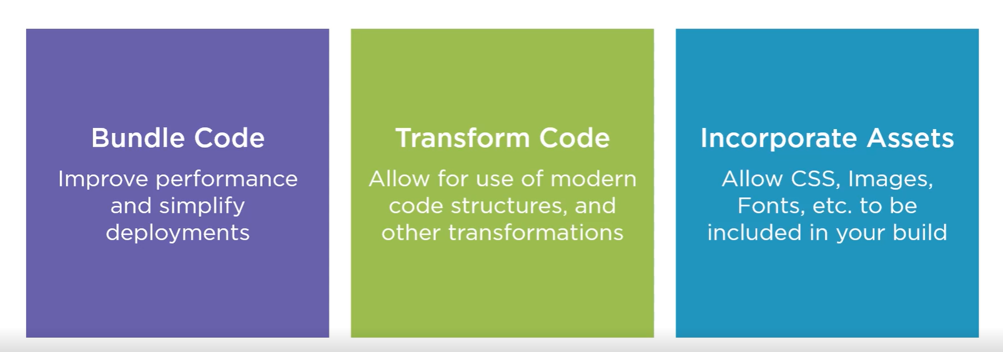
The Purpose of Bundlers

Slide 61
Module Bundlers
Some of the commonly used Module Bundlers are:
Webpack
Rollup
Parcel
Browserify

Slide 62
Use a Bundler
Your project involves module bundling, dependency management, and code optimization.
Code splitting, lazy loading, or other advanced code optimization techniques are required.
You need to bundle and optimize assets such as JavaScript, CSS, images, and other resources.
Tree shaking (removing unused code) or transpiling code to a specific target environment is necessary.
You want to leverage a rich ecosystem of plugins and loaders specific to bundlers.
You require advanced optimizations for production builds, including minification and compression.

Slide 63
Using Both
You can utilize the task runner to automate general development tasks, such as running tests or copying files
While leverage the bundler to handle module bundling, code optimization, and asset management.
By combining the strengths of both tools, you can create a comprehensive build process that meets the specific needs of your project.
For simpler projects, one tool might suffice.

Slide 64
Webpack
Webpack is a popular module bundler for JavaScript applications.
It is widely used in modern web development workflows to manage and bundle various assets, such as JavaScript files, CSS stylesheets, images, and more.
Webpack takes your project's dependencies, processes them through loaders and plugins, and creates optimized bundles that can be served to the browser.

Slide 65
How Webpack Executes?
Webpack executes in a multi-step process that involves analyzing dependencies, transforming code, and generating bundled output.
The steps involved in Webpack's execution process:
Entry Point Resolution
Dependency Graph Creation
Module Loading and Transformation
Code Splitting
Module Resolution
Bundling and Output Generation
Output Files
Notes:
Entry Point Resolution: Webpack starts the execution by identifying the entry point(s) of your application. The entry point is typically a JavaScript file that serves as the starting point for building the dependency graph.
Dependency Graph Creation: Webpack analyzes the dependencies of the entry point and recursively traverses the dependency tree. It identifies all the modules and their dependencies by parsing import and require statements in the source code. This process forms the basis of the dependency graph.
Module Loading and Transformation: Webpack uses loaders to handle different file types and apply transformations. Loaders are configured in the Webpack configuration file and are responsible for transforming modules into valid JavaScript code. For example, Babel loader can be used to transpile ES6+ code into backward-compatible JavaScript.
Code Splitting: Webpack supports code splitting, which allows for dividing the codebase into smaller chunks. Code splitting can be configured manually or through dynamic imports. It allows portions of the code to be loaded on-demand, reducing the initial bundle size and improving performance.
Module Resolution: Webpack resolves module dependencies by searching for the requested modules in various locations, such as the project's node_modules directory or specified paths. It follows the resolve configuration in the Webpack configuration file to determine how modules should be resolved.
Bundling and Output Generation: Once Webpack has resolved all the dependencies and transformed the code, it creates a bundled output. The bundling process combines all the modules and their dependencies into one or more output bundles. Webpack applies optimizations like minification, tree shaking, scope hoisting, and asset management based on the specified configuration.
Output Files: Webpack generates output files based on the specified configuration. These files typically include JavaScript bundles, CSS files, and any other assets used in the application. The output files are ready for deployment and can be included in your HTML file(s) to run the application.

Slide 66
Configuring Webpack
The configuration steps for Webpack involve setting up the necessary configuration file to define how Webpack should behave and process your project's source code.
Here are the main steps for configuring Webpack:
Create a Configuration File
Entry Points
Output Configuration
Loaders
Plugins
Resolve Configuration
Optimization Settings
Development vs. Production Mode
Additional Customizations

Slide 67
.ts files
Will be compiled by
tsc
Convert to
.js files
Refer in
.html page
Open in
BROWSER

Slide 68
Client-Side Build
TypeScript (s)
.ts
TSC
Build & Deploy your
Project on Local Server
Manual Configuration
Node JS
Webpack
TypeScript Config.
Build your project
Browser Compatible Files
(Multiple Files)
WEBPACK-DEV-
SERVER
WEBPACK
CLI
Bundling
BROWSER
WEBPACK
Single File / Set of Files
Local
HTTP Server
HTML PAGE
Deploy
Inject

Slide 69
Angular 15

Slide 70
BROWSER
SERVER
HTTP + URL
NAVIGATION
HTML PAGES
CSS
HTML + CSS
HTTP + URL
HTML + CSS
Page
Reload!

Slide 71
BROWSER
SERVER
HTTP + URL
NAVIGATION
HTML + CSS
Server PAGES
CSS
HTTP + URL
ASP
ASP .NET
JSP
PHP
Ruby
Express JS
HTML + CSS
Page
Reload!
DB

Slide 72
BROWSER
SERVER
HTTP + URL
NAVIGATION
Server PAGES
CSS
HTML + CSS + JS
AJAX - HTTP + URL
JS
PARTIAL HTML
Partial
Page
Reload!
<table>
<thead>
<tr>
<th>ID</th>
</tr>
</thead>
<tbody>
<tr>
<td>1</td>
</tr>
</tbody>
</table>
ID
1

Slide 73
SERVER
SINGLE PAGE APPLICATION – Cross Domain
SERVER PAGES
CSS
BROWSER
HTTP + URL
NAVIGATION
JS
HTML + CSS + JS
ASP
ASP .NET
JSP
PHP
Ruby
ASP .NET MVC
Spring MVC
Ruby On Rails
Laravel
<table>
<thead>
<tr>
<th>ID</th>
</tr>
</thead>
<tbody>
<tr>
<td>1</td>
</tr>
</tbody>
</table>
ID
1
SERVER
AJAX - HTTP + URL
RESTful API
ASP .NET Web API
JWS
Express JS
Python
DB
JSON to HTML on Client Side
JSON
{
“id”:1
}
Vanilla JS, jQuery, KO, BB, Ext JS,
NG JS, NG 2 & above, React, Vue

Slide 74
Single Page Application Pros - CSR
Quick Loading Time
Seamless User Experience
Ease in Building Feature-rich Apps
Uses Less Bandwidth

Slide 75
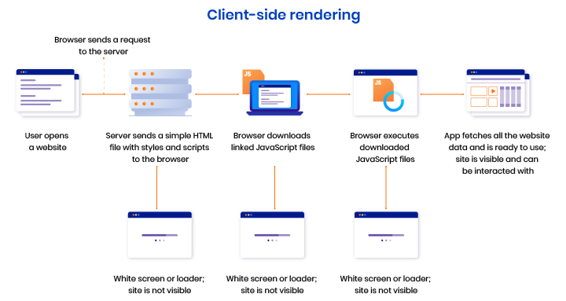

Slide 76
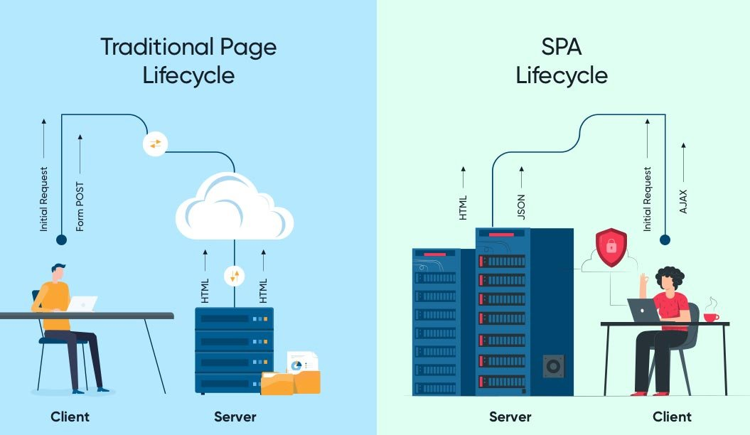

Slide 77
Single Page Application Cons (Purely CSR)
Doesn’t Perform Well With SEO
One of the metrics that search engines use is the number of pages a website has. However, since SPAs only load a single page, it serves as a disadvantage when ranking on search engines
Uses a Lot of Browser Resources
SPAs require many resources from the web browser since the browser is doing most of the tasks for the SPAs.
Security Issues
As compared to multi-page apps, SPAs are more prone to cross-site scripting attacks.

Slide 78
Component vs Traditional Approach
HTML and CSS
HTML and CSS
0
+
-
0
+
-
domHandler
domHandler
Counter
{
count: 0,
next: function() { this.count +=1; } ,
prev: function() { this.count -=1; }
}
Counter
{
count: 0,
next: function() { this.count +=10; } ,
prev: function() { this.count -=10; }
}
<Counter />
<Counter interval=“10”/>

Slide 79
Installation
Latest Version of Node JS (LTS v 16) - https://nodejs.org/en/
Latest version of Visual Studio Code - https://code.visualstudio.com/
Visual Studio Code Extensions
AutoFileName
vscode-icons
Angular Snippets (Version 16)
Angular Language Service
IntelliSense for CSS class names in HTML
CSS Formatter
After Installing the extensions, select the following in VS Code
File Menu -> Preferences -> Theme -> File Icon Theme -> VSCode Icons
Chrome Extension
Angular DevTools – Offered by Angular Team - https://chrome.google.com/webstore/detail/angular-devtools/ienfalfjdbdpebioblfackkekamfmbnh?hl=en

Slide 80
ANGULAR CLIENT-SIDE BUILD
TypeScript (s)
.ts
ng
Auto Configuration
Angular CLI
Build & Deploy your
Project on Local Server
ng serve
TSC
Build your project
ng build
Browser Compatible Files
(Multiple Files)
WEBPACK-DEV-
SERVER
WEBPACK
CLI
Bundling
BROWSER
WEBPACK
Single File / Set of Files
Local
HTTP Server
HTML PAGE
Deploy
Inject

Slide 81
Angular CLI
The Angular CLI is a command-line interface tool that you use to initialize, develop, scaffold, and maintain Angular applications directly from a command shell.
Installing Angular CLI
Open terminal window on any path and execute the following command
npm install --global @angular/cli@15
OR
npm install -g @angular/cli@15
OR
npm i -g @angular/cli@15

Slide 82
Angular CLI (Commands)
ng add | ng help
ng analytics | ng lint
ng build | ng new
ng config | ng run
ng deploy | ng serve
ng doc | ng test
ng e2e | ng update
ng extract-i18n | ng version
ng generate

Slide 83
Terminologies
Angular Workspace
A workspace is a collection of different projects. The ng new command creates a new workspace.
Angular Projects
Angular Library
A library is a collection of components, services, directives etc. that can be shared across different Angular projects.
A library can be packaged and published
Angular Application
An application is a collection of components, services, directives etc. that can be served as an output.
An application can be built and deployed.

Slide 84
Creating Application
Single Project in Single Workspace
ng new <app-name>
Run the Application
ng serve – This command will run the project in development
ng build – This command will create the production build
ng test – This command will run the jasmine tests

Slide 85
Creating Application
Multiple Projects in Single Workspace
ng new multi-apps --create-application=“false”
cd multi-apps
ng generate application app-one
ng generate application app-two
ng generate library my-lib
Run the Application
ng serve --project=app-one – This command will run the application project in development named app-one
Only project of type application will be served

Slide 86
ng generate
Generates and/or modifies files based on a schematic.
ng generate <schematic> [options]
ng g <schematic> [options]
https://angular.io/cli/generate
Schematic
app-shell | directive | interface | resolver
application | enum | library | service
class | guard | module | service-worker
component | interceptor | pipe | web-worker

Slide 87
What is Angular schematic?
A schematic is a command-line tool provided by the Angular CLI (Command Line Interface) that helps developers generate code and modify project files based on predefined templates.
It automates repetitive tasks and provides a consistent way to create components, modules, services, and other Angular artifacts.
The Angular CLI includes a set of built-in schematics that can be used to generate different parts of an Angular application.
Developers can create their own custom schematics to generate code specific to their project requirements.

Slide 88
MODULE
COMPONENT
VIEW (UI) *
Template / Template URL
STYLE (Inline/CSS)
Style / Style URL
DATA
State (Inside)
Properties (Outside)
BEHAVIOUR (Methods)

Slide 89
Composite UI
APP COMPONENT
ADVERTISEMENT
COMPONENT
NAV COMPONENT + CSS
SIDE NAV COMPONENT
+ CSS
LIST COMPONENT
+ CSS
DETAILS COMPONENT
+ CSS
STATUS COMPONENT + CSS

Slide 90
Steps to run the application
Download and Extract the zip file / Fork the Repo
Open the extracted folder in Visual Studio Code
Open the terminal window on the folder path and run
npm install
Once the installation completes, run
ng serve – Starts the Development Server on port 3000 and opens the default browser on http://localhost:3000

Slide 91
Modules
Angular applications are modular and Angular has its own modularity system called NgModules.
NgModules are containers for a cohesive block of code dedicated to an application domain, a workflow, or a closely related set of capabilities.
They can contain components, service providers, and other code files whose scope is defined by the containing NgModule.
They can import functionality that is exported from other NgModules, and export selected functionality for use by other NgModules.

Slide 92
Component
Components are the most basic UI building block of an Angular app. An Angular app contains a tree of Angular components.
Angular components are a subset of directives, always associated with a template.
A component must belong to an NgModule, for it to be available to another component or application.

Slide 93
Angular Packages
@angular/core: Critical runtime parts of the framework needed by every application. Includes all metadata decorators, Component, Directive, dependency injection, and the component lifecycle hooks.
@angular/common: The commonly needed services, pipes, and directives provided by the Angular team.
@angular/compiler: Angular Template Compiler. It understands templates and can convert them to code that makes the application run and render. Typically, you don’t interact with the compiler directly; rather, you use it indirectly via platform-browser-dynamic when JIT compiling in the browser.
@angular/platform-browser: Everything DOM and browser related, especially the pieces that help render into the DOM. This package also includes the bootstrapModuleFactory() method for bootstrapping applications for production builds that pre-compile with AOT.
@angular/platform-browser-dynamic: Includes Providers and methods to compile and run the app on the client using the JIT compiler.
@angular/forms: Support for both template-driven and reactive forms.
@angular/animations: Angular animations library makes it easy to define and apply animation effects such as page and list transitions. Read about it in the Animations guide.
@angular/router: The router module navigates among your app components/pages when the browser URL changes

Slide 94
RUNTIME
Vendor (Rxjs, Angular Packages)
Polyfills (Zone.js) - NgZone
MODULE
COMPONENT

Slide 95
Adding Bootstrap & Icons
Install Bootstrap and Bootstrap Icons
npm i bootstrap bootstrap-icons
Include the CSS and JS files in angular.json
styles: [
"node_modules/bootstrap/dist/css/bootstrap.css",
"node_modules/bootstrap-icons/font/bootstrap-icons.css",
]
scripts: [
"node_modules/bootstrap/dist/js/bootstrap.js"
]

Slide 96
Assignment
Create and Render the following Components in your application:
Component One
Hello from Component One (text-success)
Component Two
Hello from Component Two (text-primary)

Slide 97
Angular Providers
The Angular Provider is an instruction (or recipe) that describes how an object for a certain token is created.
The Angular Providers is an array of such instructions (Provider). Each provider is uniquely identified by a token (or DI Token ) in the Providers Array.

Slide 98
More on Modules – Multi Modules
Every Angular application has at least one NgModule class, the root module, which is conventionally named AppModule and resides in a file named app.module.ts. You launch your application by bootstrapping the root NgModule.
While a small application might have only one NgModule, most applications have many more feature modules.
Modules in angular are a great way to share and reuse code across your application.

Slide 99
Why use modules in Angular?
Develop a particular piece of functionality independently from the others
Manage teams more easily by enabling each development team to work on a separate feature
Explicitly define the list of modules that the current one requires to function
Deploy features gradually
Build scalable applications
Write tests easily
Enable Lazy Loading

Slide 100
More on Modules – Multi Modules
Components, Directives, Pipes
Services
Declares
Provides
Other Modules
Angular Module
Other Modules
Imports
Exports

Slide 101
Types of Module
We can break our application into following modules:
Root module
The root module is the main module in an Angular application. It is generated by the Angular CLI as AppModule and bootstrapped when the application starts.
Every other Angular module depends either directly or indirectly on the root module. Only one root module can exist in an Angular application.
Core module
The core module usually contains components that are used once in an Angular application, such as a navigation bar, loader, footer, etc.
Shared module
A shared module is made up of directives, pipes, and components that can be reused in feature modules.
Feature modules
Feature modules house the main features of your Angular application.
If you’re building an ecommerce application, for example, you might have specific sets of functionalities, such as orders, products, cart, customers, etc.

Slide 102
View Encapsulation
In Angular, component CSS styles are encapsulated into the component's view and don't affect the rest of the application.
Angular comes with view encapsulation built in, which enables us to use Shadow DOM or even emulate it.
What is Shadow DOM?
Shadow DOM is part of the Web Components standard and enables DOM tree and style encapsulation.
It basically means that Shadow DOM allows us to hide DOM logic behind other elements.
It enables us to apply scoped styles to elements without them bleeding out to the outer world.

Slide 103
View Encapsulation
Emulated
No Shadow DOM
Style Encapsulation
ShadowDom
Enable Shadow DOM
Style Encapsulation
None
No Shadow DOM
No Style Encapsulation
Value: 0
Value: 1
Value: 2

Slide 104
Data Binding
Data binding is the core concept of Angular and used to define the communication between a component and the DOM.
It is a technique to link your data to your view layer.
In simple words, you can say that data binding is a communication between your typescript code of your component and your template which user sees.
Data binding automatically keeps your page up-to-date based on your application's state.

Slide 105
Types of Data binding
Angular provides three categories of data binding according to the direction of data flow:
From the source to view
From view to source
In a two-way sequence of view to source to view

Slide 106
Data Binding (Flow of Data)
SOURCE
Component Class
Data Members
Properties
TARGET
Component Template
Element Properties
Element Attributes
Component Properties
Interpolation {{dName}}
One Way Binding
Property and Attribute Binding
[propertyName] or bind-propertyName
[attr.AttributeName]
One Way To Source Binding
Event Binding
(eventName) or on-eventName
Two Way Binding
[(ngModel)] or bindon-ngModel

Slide 107
$event
$event object is a special variable that is used to capture and access event data in event bindings.
When an event occurs, such as a button click or input change, Angular provides the event data as part of the event binding.
The $event variable allows you to access this event data within the event handler method.
By using the $event object, you can access event-specific data and perform actions based on that data within your event handlers.
The specific properties available in the $event object depend on the type of event being triggered.

Slide 108
ngModel
ngModel is a directive in Angular that facilitates two-way data binding between the model (data) and the view (UI) in forms.
It is primarily used with form controls such as <input>, <select>, and <textarea> elements.
By using ngModel on an input element, you can bind the value of that input to a property in the component's data model.
When the user interacts with the input (e.g., enters text or selects an option), the value is automatically updated in the component's data model.
Similarly, if the value in the data model changes programmatically, the corresponding input element in the UI is automatically updated.
ngModel requires the FormsModule or ReactiveFormsModule to be imported in the Angular module where the component is declared.

Slide 109
How Browser Renders a Web Page?
DOM
HTML Parser
DOM Tree
Layout
HTML
Attachment
Render Tree
Painting
Display
CSS
CSS Parser
Style Rules (CSSOM)

Slide 110
Problems, when we change DOM
The DOM is the representation of the HTML structure of a web page in the browser's memory.
When changes are made to the UI, such as updating text or adding/removing elements, the DOM needs to be updated to reflect those changes.
Traditional approaches involve fully re-rendering the entire DOM tree, even if only a small portion of the UI has changed.
This can be inefficient and lead to performance bottlenecks, especially when dealing with large or complex UIs.

Slide 111
Solution
Angular Ivy is a new Angular renderer, which is radically different from anything we have seen in mainstream frameworks, because it uses incremental DOM.
Incremental DOM takes a different approach. Instead of re-rendering the entire DOM, it performs targeted updates only to the specific parts of the UI that have changed.
The key idea is:
Every component gets compiled into a series of instructions. These instructions create DOM trees and update them in-place when the data changes.

Slide 112
How UI updates?
Angular employs a concept called "change detection"
Change detection in Angular is the process of detecting and updating the user interface (UI) when there are changes to the underlying data or state of an Angular application.
Angular uses a mechanism called Zone.js for enabling change detection.
Angular runs change detection in cycles. During a change detection cycle, Angular checks the component's bindings, including property bindings, event bindings, and child component bindings.
It compares the current values with the previous values and updates the UI accordingly. If any changes are detected, Angular propagates those changes through the component tree.
By triggering change detection, Angular keeps the UI in sync with the underlying data and ensures a responsive and up-to-date user interface.

Slide 113
When does change detection happen?
Initialization: Angular performs an initial change detection when a component is created to set up the component and its associated view.
Event Binding: Change detection is triggered when an event occurs and is bound to a component, such as a button click or input change.
Property Binding: Angular detects changes when the value of a bound property changes within the component.
Input Binding: Change detection is triggered when the value of an input property changes, typically from a parent component to a child component.
Timer-based operations: Angular's change detection is triggered after timer-based operations, such as setTimeout or setInterval, complete their execution.
Asynchronous operations: Angular's change detection is aware of asynchronous operations, like HTTP requests or Promises, and triggers change detection when these operations complete.
Manual triggering: Change detection can be manually triggered using the ChangeDetectorRef service's detectChanges() method. This is useful for updating the UI explicitly in specific cases.

Slide 114
Zone
Application state change can be caused by:
Events – User events click, change, input, submit
XMLHttpRequests – When fetching data from a remote service
Timers – setTimeout(), setInterval()
Angular takes advantage of Zones (NgZone)
Zone monkey-patches global asynchronous operations such as setTimeout() and addEventListener(), which is why Angular can easily find out, when to update the DOM.

Slide 115
When Angular needs to update the HTML?
Typically, updates occur for one of the following reasons:
Component initialization: When bootstrapping an Angular application, Angular loads the bootstrap component and triggers the ApplicationRef.tick() to call change detection and View Rendering
Event listener: The DOM event listener can update the data in an Angular component and trigger change detection.
HTTP Data Request. You can also get data from a server through an HTTP request.
MacroTasks, such as setTimeout() or setInterval(). You can also update the data in the callback function of a macroTask such as setTimeout()
MicroTasks, such as Promise.then(). Other asynchronous APIs return a Promise object (such as fetch), so the then() callback function can also update the data.
Other async operations. In addition to addEventListener(), setTimeout() and Promise.then(), there are other operations that can update the data asynchronously. E.g., WebSocket.onmessage()

Slide 116
Directives
Directives are classes that add additional behavior to elements in your Angular applications.
The different types of Angular directives are as follows:
Components—directives with a template. This type of directive is the most common directive type.
Attribute directives—directives that change the appearance or behavior of an element, component, or another directive. E.g., NgClass, NgStyle, NgModel
Structural directives—directives that change the DOM layout by adding and removing DOM elements. E.g., NgIf, NgFor, NgSwitch

Slide 117
Renderer 2
In Angular, Renderer2 is a utility class provided by the platform browser module (@angular/platform-browser).
It allows you to interact with the browser’s DOM directly
It provids a safe and platform-agnostic way to manipulate elements, attributes, and styles.
The Renderer2 class serves as a wrapper around the browser's native DOM manipulation methods.
It abstracts away the direct access to the DOM and provides a set of methods that ensure compatibility across different platforms.

Slide 118
Lifecycle hooks
Lifecycle hooks in Angular are methods that allow you to tap into various stages of a component’s or directive’s lifecycle.
They provide a way to perform certain actions or execute code at specific points in the component's or directive’s lifecycle, such as before it is created, after it is initialized, or before it is destroyed.
By implementing the lifecycle hooks in your component or directives, allows you to manage initialization, data updates, view changes, and cleanup operations effectively.

Slide 119
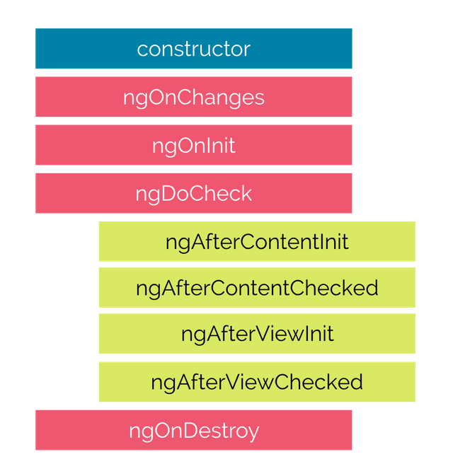
Life Cycle Hooks

Slide 120

Hooks for the Component
constructor : This is invoked when Angular creates a component or directive by calling new on the class.
ngOnChanges : Invoked every time, there is a change in one of the input properties of the component.
ngOnInit : Invoked when given component has been initialized. This hook is only called once after the first ngOnChanges
ngDoCheck : Invoked when the change detector of the given component is invoked. It allows us to implement our own change detection algorithm for the given component.
ngAfterContentInit : Invoked after Angular performs any content projection into the component’s
ngAfterContentChecked : Invoked each time the content of the given component has been checked by the change detection mechanism of Angular.
ngAfterViewInit : Invoked when the component’s view has been fully initialized.
ngAfterViewChecked : Invoked each time the view of the given component has been checked by the change detection mechanism of Angular
ngOnDestroy : This method will be invoked just before Angular destroys the component. Use this hook to unsubscribe observables and detach event handlers to avoid memory leaks.

Slide 121
$event
$event object is a special variable that is used to capture and access event data in event bindings.
When an event occurs, such as a button click or input change, Angular provides the event data as part of the event binding.
The $event variable allows you to access this event data within the event handler method.
By using the $event object, you can access event-specific data and perform actions based on that data within your event handlers.
The specific properties available in the $event object depend on the type of event being triggered.

Slide 122
ngModel
ngModel is a directive in Angular that facilitates two-way data binding between the model (data) and the view (UI) in forms.
It is primarily used with form controls such as <input>, <select>, and <textarea> elements.
By using ngModel on an input element, you can bind the value of that input to a property in the component's data model.
When the user interacts with the input (e.g., enters text or selects an option), the value is automatically updated in the component's data model.
Similarly, if the value in the data model changes programmatically, the corresponding input element in the UI is automatically updated.
ngModel requires the FormsModule or ReactiveFormsModule to be imported in the Angular module where the component is declared.

Slide 123
How Browser Renders a Web Page?
DOM
HTML Parser
DOM Tree
Layout
HTML
Attachment
Render Tree
Painting
Display
CSS
CSS Parser
Style Rules (CSSOM)

Slide 124
Problems, when we change DOM
The DOM is the representation of the HTML structure of a web page in the browser's memory.
When changes are made to the UI, such as updating text or adding/removing elements, the DOM needs to be updated to reflect those changes.
Traditional approaches involve fully re-rendering the entire DOM tree, even if only a small portion of the UI has changed.
This can be inefficient and lead to performance bottlenecks, especially when dealing with large or complex UIs.

Slide 125
Solution
Angular Ivy is a new Angular renderer, which is radically different from anything we have seen in mainstream frameworks, because it uses incremental DOM.
Incremental DOM takes a different approach. Instead of re-rendering the entire DOM, it performs targeted updates only to the specific parts of the UI that have changed.
The key idea is:
Every component gets compiled into a series of instructions. These instructions create DOM trees and update them in-place when the data changes.

Slide 126
How UI updates?
Angular employs a concept called "change detection"
Change detection in Angular is the process of detecting and updating the user interface (UI) when there are changes to the underlying data or state of an Angular application.
Angular uses a mechanism called Zone.js for enabling change detection.
Angular runs change detection in cycles. During a change detection cycle, Angular checks the component's bindings, including property bindings, event bindings, and child component bindings.
It compares the current values with the previous values and updates the UI accordingly. If any changes are detected, Angular propagates those changes through the component tree.
By triggering change detection, Angular keeps the UI in sync with the underlying data and ensures a responsive and up-to-date user interface.

Slide 127
When does change detection happen?
Initialization: Angular performs an initial change detection when a component is created to set up the component and its associated view.
Event Binding: Change detection is triggered when an event occurs and is bound to a component, such as a button click or input change.
Property Binding: Angular detects changes when the value of a bound property changes within the component.
Input Binding: Change detection is triggered when the value of an input property changes, typically from a parent component to a child component.
Timer-based operations: Angular's change detection is triggered after timer-based operations, such as setTimeout or setInterval, complete their execution.
Asynchronous operations: Angular's change detection is aware of asynchronous operations, like HTTP requests or Promises, and triggers change detection when these operations complete.
Manual triggering: Change detection can be manually triggered using the ChangeDetectorRef service's detectChanges() method. This is useful for updating the UI explicitly in specific cases.

Slide 128
Zone
Application state change can be caused by:
Events – User events click, change, input, submit
XMLHttpRequests – When fetching data from a remote service
Timers – setTimeout(), setInterval()
Angular takes advantage of Zones (NgZone)
Zone monkey-patches global asynchronous operations such as setTimeout() and addEventListener(), which is why Angular can easily find out, when to update the DOM.

Slide 129
When Angular needs to update the HTML?
Typically, updates occur for one of the following reasons:
Component initialization: When bootstrapping an Angular application, Angular loads the bootstrap component and triggers the ApplicationRef.tick() to call change detection and View Rendering
Event listener: The DOM event listener can update the data in an Angular component and trigger change detection.
HTTP Data Request. You can also get data from a server through an HTTP request.
MacroTasks, such as setTimeout() or setInterval(). You can also update the data in the callback function of a macroTask such as setTimeout()
MicroTasks, such as Promise.then(). Other asynchronous APIs return a Promise object (such as fetch), so the then() callback function can also update the data.
Other async operations. In addition to addEventListener(), setTimeout() and Promise.then(), there are other operations that can update the data asynchronously. E.g., WebSocket.onmessage()

Slide 130
Directives
Directives are classes that add additional behavior to elements in your Angular applications.
The different types of Angular directives are as follows:
Components—directives with a template. This type of directive is the most common directive type.
Attribute directives—directives that change the appearance or behavior of an element, component, or another directive. E.g., NgClass, NgStyle, NgModel
Structural directives—directives that change the DOM layout by adding and removing DOM elements. E.g., NgIf, NgFor, NgSwitch

Slide 131
Renderer 2
In Angular, Renderer2 is a utility class provided by the platform browser module (@angular/platform-browser).
It allows you to interact with the browser’s DOM directly
It provids a safe and platform-agnostic way to manipulate elements, attributes, and styles.
The Renderer2 class serves as a wrapper around the browser's native DOM manipulation methods.
It abstracts away the direct access to the DOM and provides a set of methods that ensure compatibility across different platforms.

Slide 132
Lifecycle hooks
Lifecycle hooks in Angular are methods that allow you to tap into various stages of a component’s or directive’s lifecycle.
They provide a way to perform certain actions or execute code at specific points in the component's or directive’s lifecycle, such as before it is created, after it is initialized, or before it is destroyed.
By implementing the lifecycle hooks in your component or directives, allows you to manage initialization, data updates, view changes, and cleanup operations effectively.

Slide 133
Life Cycle Hooks

Slide 134
Hooks for the Component
constructor : This is invoked when Angular creates a component or directive by calling new on the class.
ngOnChanges : Invoked every time, there is a change in one of the input properties of the component.
ngOnInit : Invoked when given component has been initialized. This hook is only called once after the first ngOnChanges
ngDoCheck : Invoked when the change detector of the given component is invoked. It allows us to implement our own change detection algorithm for the given component.
ngAfterContentInit : Invoked after Angular performs any content projection into the component’s
ngAfterContentChecked : Invoked each time the content of the given component has been checked by the change detection mechanism of Angular.
ngAfterViewInit : Invoked when the component’s view has been fully initialized.
ngAfterViewChecked : Invoked each time the view of the given component has been checked by the change detection mechanism of Angular
ngOnDestroy : This method will be invoked just before Angular destroys the component. Use this hook to unsubscribe observables and detach event handlers to avoid memory leaks.

Slide 135
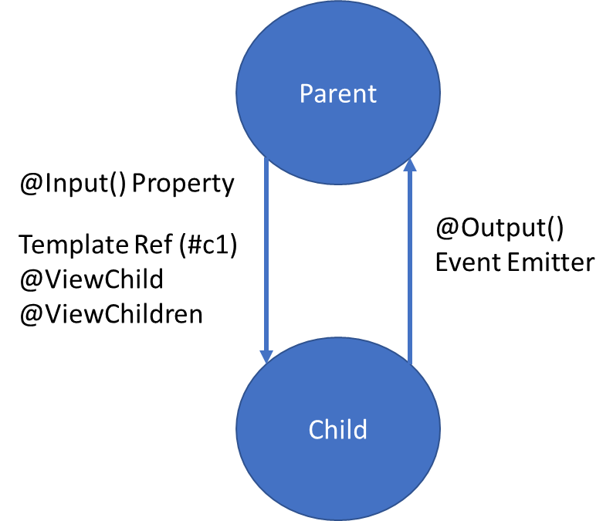
Parent Child Communication
Property Binding:
With property binding, the parent component can bind a property value to an input property of the child component. This allows the parent to pass data to the child component.
ViewChild, ViewChildren and Template Reference Variable:
The parent component can access the child component's properties and methods using ViewChild and a template reference variable.
Event and Output:
The child component can emit events that the parent component can listen to. This allows the child component to notify the parent about an action or state change.

Slide 136
Event Emitter
EventEmitter is a class provided by the @angular/core package that allows components to emit custom events.
It serves as a mechanism for communication between components, enabling the exchange of data or triggering actions based on user interactions or other application events.
It is typically used in conjunction with the @Output decorator to create custom event emitters within Angular components.
It facilitates communication in a unidirectional manner, where the child component emits events that the parent component can listen to and respond to.

Slide 137
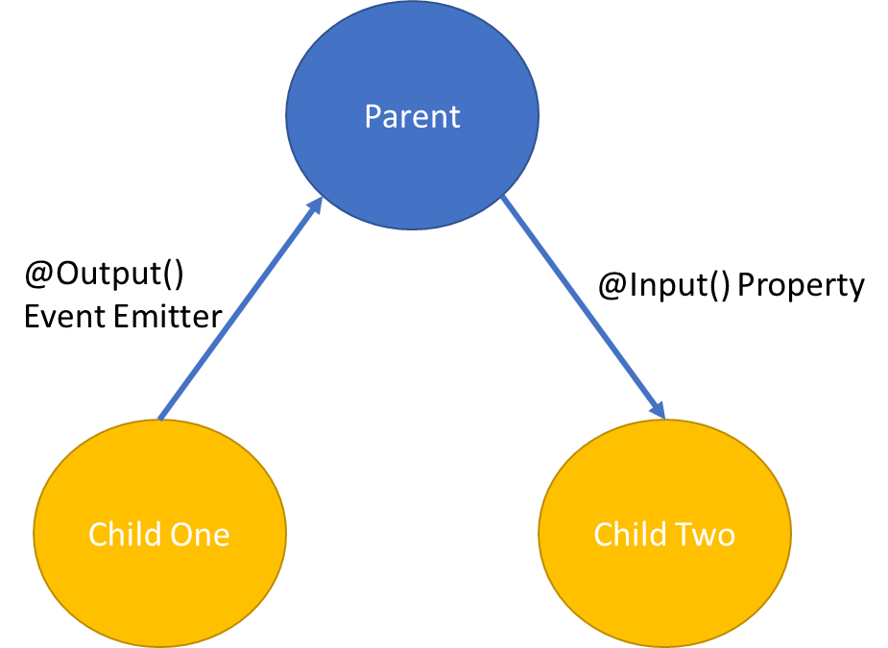
Sibling Communication
Using a Common Parent Component:
Sibling components can communicate with each other indirectly through a shared parent component.
The parent component acts as a mediator and facilitates data exchange between the siblings using property bindings and event bindings.
Using a Shared Service:
Sibling components can communicate directly with each other using a shared service.
The service acts as a central communication hub and allows siblings to share data and trigger actions.
S
E
R
V
I
C
E
Component One
Component Two

Slide 138
Pipes
Angular provides built-in pipes for typical data transformations, including transformations for internationalization (i18n), which use locale information to format data.
The following are commonly used built-in pipes for data formatting:
DatePipe: Formats a date value according to locale rules.
UpperCasePipe: Transforms text to all upper case.
LowerCasePipe: Transforms text to all lower case.
CurrencyPipe: Transforms a number to a currency string, formatted according to locale rules.
DecimalPipe: Transforms a number into a string with a decimal point, formatted according to locale rules.
PercentPipe: Transforms a number to a percentage string, formatted according to locale rules.

Slide 139
Forms
Reactive forms provide direct, explicit access to the underlying forms object model. Compared to template-driven forms, they are more robust: they're more scalable, reusable, and testable. If forms are a key part of your application, or you're already using reactive patterns for building your application, use reactive forms.
Template-driven forms rely on directives in the template to create and manipulate the underlying object model. They are useful for adding a simple form to an app, such as an email list signup form. They're easy to add to an app, but they don't scale as well as reactive forms. If you have very basic form requirements and logic that can be managed solely in the template, template-driven forms could be a good fit.

Slide 140
Key Differences
 | REACTIVE | TEMPLATE-DRIVEN
Setup of form model | Explicit, created in component class | Implicit, created by directives
Data model | Structured and immutable | Unstructured and mutable
Predictability | Synchronous | Asynchronous
Form validation | Functions | Directives

Slide 141
Form Builder
Creates an AbstractControl from a user-specified configuration.
The FormBuilder provides syntactic sugar that shortens creating instances of a FormControl, FormGroup, or FormArray.
It reduces the amount of boilerplate needed to build complex forms.

Slide 142
Built in Validators
min
max
required
requiredTrue
email
minLength
maxLength
pattern
nullValidator
compose
composeAsync

Slide 143
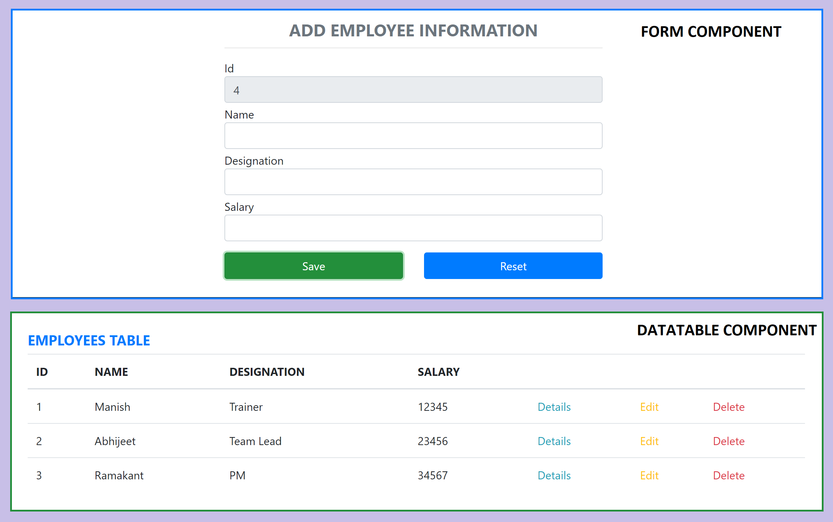
Assignment

Slide 144
Assignment
Complete the CRUD assignment as per the screenshot shared in the previous slide, use array to keep the data.
Create form-component and data-table-component as sibling components.
Id should be auto generated after every insert, update and delete
When we click details or edit, data will be displayed in Form Component.
In Details, Form should display data but will be disabled for editing.
On delete, ask for confirmation, before delete

Slide 145
Promise
The Promise object represents the eventual completion (or failure) of an asynchronous operation, and its resulting value.
It allows you to associate handlers with an asynchronous action's eventual success value or failure reason.
This lets asynchronous methods return values like synchronous methods: instead of immediately returning the final value, the asynchronous method returns a promise to supply the value at some point in the future.

Slide 146
RxJS
Reactive Extensions Library for JavaScript
RxJS is a library for reactive programming using Observables, to make it easier to compose asynchronous or callback-based code.
RxJS is a library for composing asynchronous and event-based programs by using observable sequences.
It provides one core type, the Observable, satellite types (Observer, Schedulers, Subjects) and operators inspired by Array#extras (map, filter, reduce, every, etc) to allow handling asynchronous events as collections.

Slide 147
Promise Vs Observable
Promise | Observables
Emit Single Value | Emit Multiple Values, over a period of time (Stream of Data)
Not Lazy | Lazy, observables will not execute unless we subscribe to it
Cannot be cancelled | Can be cancelled by using unsubscribe
Does not provide any operators | Observables provide a lot of built in operators i.e. map, forEach, filter, reduce, retry

Slide 148
Concepts in RxJS
Observable: represents the idea of an invokable collection of future values or events.
Observer: is a collection of callbacks that knows how to listen to values delivered by the Observable.
Subscription: represents the execution of an Observable, is primarily useful for cancelling the execution.
Operators: are pure functions that enable a functional programming style of dealing with collections with operations like map, filter, concat, reduce, etc.
Subject: is equivalent to an EventEmitter, and the only way of multicasting a value or event to multiple Observers.
Schedulers: are centralized dispatchers to control concurrency, allowing us to coordinate when computation happens on e.g. setTimeout or requestAnimationFrame or others.

Slide 149
Subject
A Subject is a special type of Observable that allows values to be multi-casted to many Observers.
A Subject is like an Observable but can multicast to many Observers.
Subjects are like EventEmitters: they maintain a registry of many listeners. Every Subject is an Observable and an Observer.
You can subscribe to a Subject and you can call next to feed values as well as error and complete.

Slide 150
Subject Type Variations to consider
Subject - a subscriber will only get published values that were emitted after the subscription.
BehaviorSubject - the last value is cached. A subscriber will get the latest value upon initial subscription. The semantics for this subject is to represent a value that changes over time.
ReplaySubject - it can cache up to a specified number of emissions if buffer Size is provided / else it is Infinity (Cache all published values). Any subscribers will get all the cached values upon subscription.

Slide 151
RxJS Operators
An operator is a pure function that takes in observable as input and the output is also an observable.
To work with operators, we need a pipe() method.
There are operators for different purposes, and they may be categorized as: creation, transformation, filtering, joining, multicasting, error handling, utility, etc.

Slide 152
Creation Operators
ajax
bindCallback
bindNodeCallback
defer
empty
from
fromEvent
fromEventPattern
generate
interval
of
range
throwError
timer
iif

Slide 153
Join Creation Operators
combineLatest
concat
forkJoin
merge
partition
race
zip
combineAll
concatAll
exhaust
mergeAll
startWith
withLatestFrom

Slide 154
Transformation Operators
buffer
bufferCount
bufferTime
bufferToggle
bufferWhen
concatMap
concatMapTo
exhaust
exhaustMap
expand
groupBy
map
mapTo
mergeMap
mergeMapTo
mergeScan

Slide 155
Transformation Operators
pairwise
partition
pluck
scan
switchMap
switchMapTo
window
windowCount
windowTime
windowToggle
windowWhen

Slide 156
Filtering Operators
audit
auditTime
debounce
debounceTime
distinct
distinctKey
distinctUntilChanged
distinctUntilKeyChanged
elementAt
filter
first
ignoreElements
last

Slide 157
Filtering Operators
sample
sampleTime
single
skip
skipLast
skipUntil
skipWhile
take
takeLast
takeUntil
takeWhile
throttle
throttleTime

Slide 158
Misc
Multicasting Operators
multicast
publish
publishBehavior
publishLast
publishReplay
share
Error Handling Operators
catchError
retry
retryWhen

Slide 159
Misc
Utility Operators
tap
delay
delayWhen
dematerialize
materialize
observeOn
subscribeOn
timeInterval
timestamp
timeout
timeoutWith
toArray

Slide 160
Misc
Conditional and Boolean Operators
defaultIfEmpty
every
find
findIndex
isEmpty
Mathematical and Aggregate Operators
count
max
min
reduce

Slide 161
RxJS Learning
https://rxjs.dev/
https://rxmarbles.com/

Slide 162
Services
Components shouldn't fetch or save data directly and they certainly shouldn't knowingly present fake data.
They should focus on presenting data and delegate data access to a service.
Instead of creating the service with the new keyword, you'll rely on Angular dependency injection to inject it into the Component’s constructor.
Services are a great way to share information among classes that don't know each other.

Slide 163
Dependency Injection (DI)
DI is wired into the Angular framework and used everywhere to provide new components with the services or other things they need.
Components consume services; that is, you can inject a service into a component, giving the component access to that service class.
The injector is the main mechanism. Angular creates an application-wide injector for you during the bootstrap process, and additional injectors as needed. You don't have to create injectors.
An injector creates dependencies and maintains a container of dependency instances that it reuses if possible.
A provider is an object that tells an injector how to obtain or create a dependency.
For any dependency that you need in your app, you must register a provider with the application's injector, so that the injector can use the provider to create new instances.

Slide 164
What is a Provider?
A provider in Angular acts like an instruction for the Dependency Injection system, which directs on how to get a value for a particular dependency.
These Dependencies are the services that we create and provide to Angular application module(s).
It helps the injector in, How to create/find the Dependency for a token.

Slide 165
Angular Providers
Providers are used to registering classes, functions, or values as dependencies using Angular’s Dependency Injection (DI) system.
Each Provider is located using a token.
Three types of token registration are available:
Type Token
String Token
Injection Token
Four ways can be used to create the dependency:
useClass : Class Provider
useValue: Value Provider
useFactory: Factory Provider
useExisting: Class as Alias Provider

Slide 166
Dependency Injection (DI)
Angular creates a hierarchical dependency injection system. It creates a hierarchical tree of Injectors.
Each Injector gets their own copy of Angular Providers.
Together these two form the core of the Angular dependency injection framework.
Angular Creates not one but two injector trees. Module Injector tree & Element Injector tree.
Module Injector tree is for Modules (@NgModule). For Root Module & for every Lazy Loaded Module.
Element Injector tree is for DOM Elements like Components & Directives.

Slide 167
Module Injector Tree
Angular creates the ModuleInjector for the services to be provided at Module Levels.
We register the Module level services in two ways
Using The Providers Metadata of the @NgModule()
Using the @Injectable() Decorator with providedIn : root in the service itself
Angular Creates the Module Injector tree when the Application starts.
At the top of the Module Injector tree, Angular creates an instance of Null Injector.
Under Null Injector Angular creates an instance of PlatformInjector.

Slide 168
Module Injector Tree
Null Injector
Platform Injector
RootModule Injector
Eager Module 1
Eager Module 2
Eager Module 3

Slide 169
Null Injector
The Null Injector always throws an error unless we decorate the dependency with the Optional decorator.
Optional Decorators
@Self
@SkipSelf
@Optional

Slide 170
Platform injector
The platformBrowserDynamic() method creates an injector configured by a PlatformModule, which contains platform-specific dependencies.
This allows multiple applications to share a platform configuration.
Platform Injector usually includes built-in providers like DomSanitize etc.

Slide 171
Element Injector
Angular creates the Element Injector tree for the services to be provided at the element level like Components & Directives.
Angular creates the Element Injector tree when the application starts.
The Injector instance of the Root Component becomes the root Injector for the Element Injector tree. It gets the Providers from the provider’s property of the Root Component.
The Root Component acts as a parent to every element we create. Each of those elements can contain child elements creating a tree of elements. The Angular creates an Injector for each of these elements creating a tree of Injectors.
Each Injector gets the list of Providers from the @Directive() or @Component(). If the Providers array is empty, then Angular creates an empty Injector.
The Angular will destroy the Injector when Angular destroys the element.

Slide 172
Element Injector Tree
Root Component
Parent Component A
Child Component C
Parent Component B
Child Component A
Child Component B
Grand Child Component

Slide 173
Dependency Resolution
When a component asks for Dependency, the DI Framework resolves it in two phases.
First phase
It starts to look for the Dependency in the current component’s ElementInjector.
If it does not provide the Dependency, it will look in the Parent Components ElementInjector.
The Request bubbles up until it finds an injector that provides the service or reaches the root ElementInjector.
Second phase - If ElementInjector does not satisfy the request
Angular looks for the Dependency in the ModuleInjector hierarchy.
If Angular still doesn’t find the provider, it throws an error.

Slide 174
Communicating with backend services using HTTP
Most front-end applications need to communicate with a server over the HTTP protocol, to download or upload data and access other back-end services.
Angular provides a client HTTP API for Angular applications, the HttpClient service class in @angular/common/http.
The HTTP client service offers the following major features.
The ability to request typed response objects.
Streamlined error handling.
Testability features.
Request and response interception.

Slide 175
Commonly used HTTP Client Methods
get(url: string, options?: {params?: HttpParams; headers?: HttpHeaders; responseType?: 'json'; withCredentials?: boolean;}): Observable<any>
Sends an HTTP GET request to the specified URL and returns the response as an observable.
post(url: string, body: any, options?: {headers?: HttpHeaders; observe?: 'body'; responseType?: 'json'; withCredentials?: boolean;}): Observable<any>
Sends an HTTP POST request to the specified URL with the provided body and returns the response as an observable.
put(url: string, body: any, options?: {headers?: HttpHeaders; observe?: 'body'; responseType?: 'json'; withCredentials?: boolean;}): Observable<any>
Sends an HTTP PUT request to the specified URL with the provided body and returns the response as an observable.
delete(url: string, options?: {headers?: HttpHeaders; observe?: 'body'; responseType?: 'json'; withCredentials?: boolean;}): Observable<any>
Sends an HTTP DELETE request to the specified URL and returns the response as an observable.
patch(url: string, body: any, options?: {headers?: HttpHeaders; observe?: 'body'; responseType?: 'json'; withCredentials?: boolean;}): Observable<any>
Sends an HTTP PATCH request to the specified URL with the provided body and returns the response as an observable.

Slide 176
Routing
Routing is the process of determining how an application responds to a specific URL or path requested by the user.
In the context of web development, routing allows for navigation between different views or pages within a single-page application (SPA) without requiring a full page reload.
In Angular, routing is a core feature provided by the Angular Router module.
The Angular Router enables developers to define routes, associate them with specific components, and handle navigation between those components based on the URL.

Slide 177
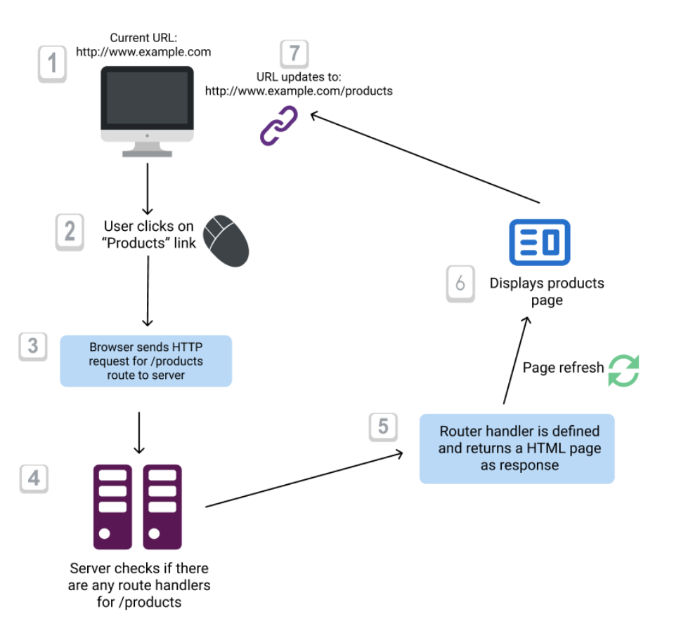
Conventional Routing

Slide 178
Angular Router
Angular Router is a module provided by Angular that enables client-side routing in Angular applications.
It allows you to define routes, associate them with components, and handle navigation between different views or components based on the application's URL.
Angular Router provides a powerful and flexible routing mechanism that helps create dynamic and responsive web applications.

Slide 179
Key Features
Route Configuration:
Angular Router allows you to define routes and associate them with specific components in a route configuration file.
Router Outlet:
The <router-outlet> serves as a placeholder in the application's template where the content of the routed components is rendered.
Links and Navigation:
Angular provides the routerLink directive to create links within templates, enabling navigation to different routes.
Route Parameters:
Route parameters allow you to include dynamic values in the URL paths, making it easy to capture and use dynamic data within components.

Slide 180
Key Features
Guards:
Route guards protect routes and control access based on conditions, such as authentication or authorization.
Lazy Loading:
Angular Router supports lazy loading, enabling modules and their components to be loaded on-demand, improving application performance.
Nested Routes:
Angular Router allows you to define child routes within parent routes, facilitating complex application layouts and component organization.

Slide 181
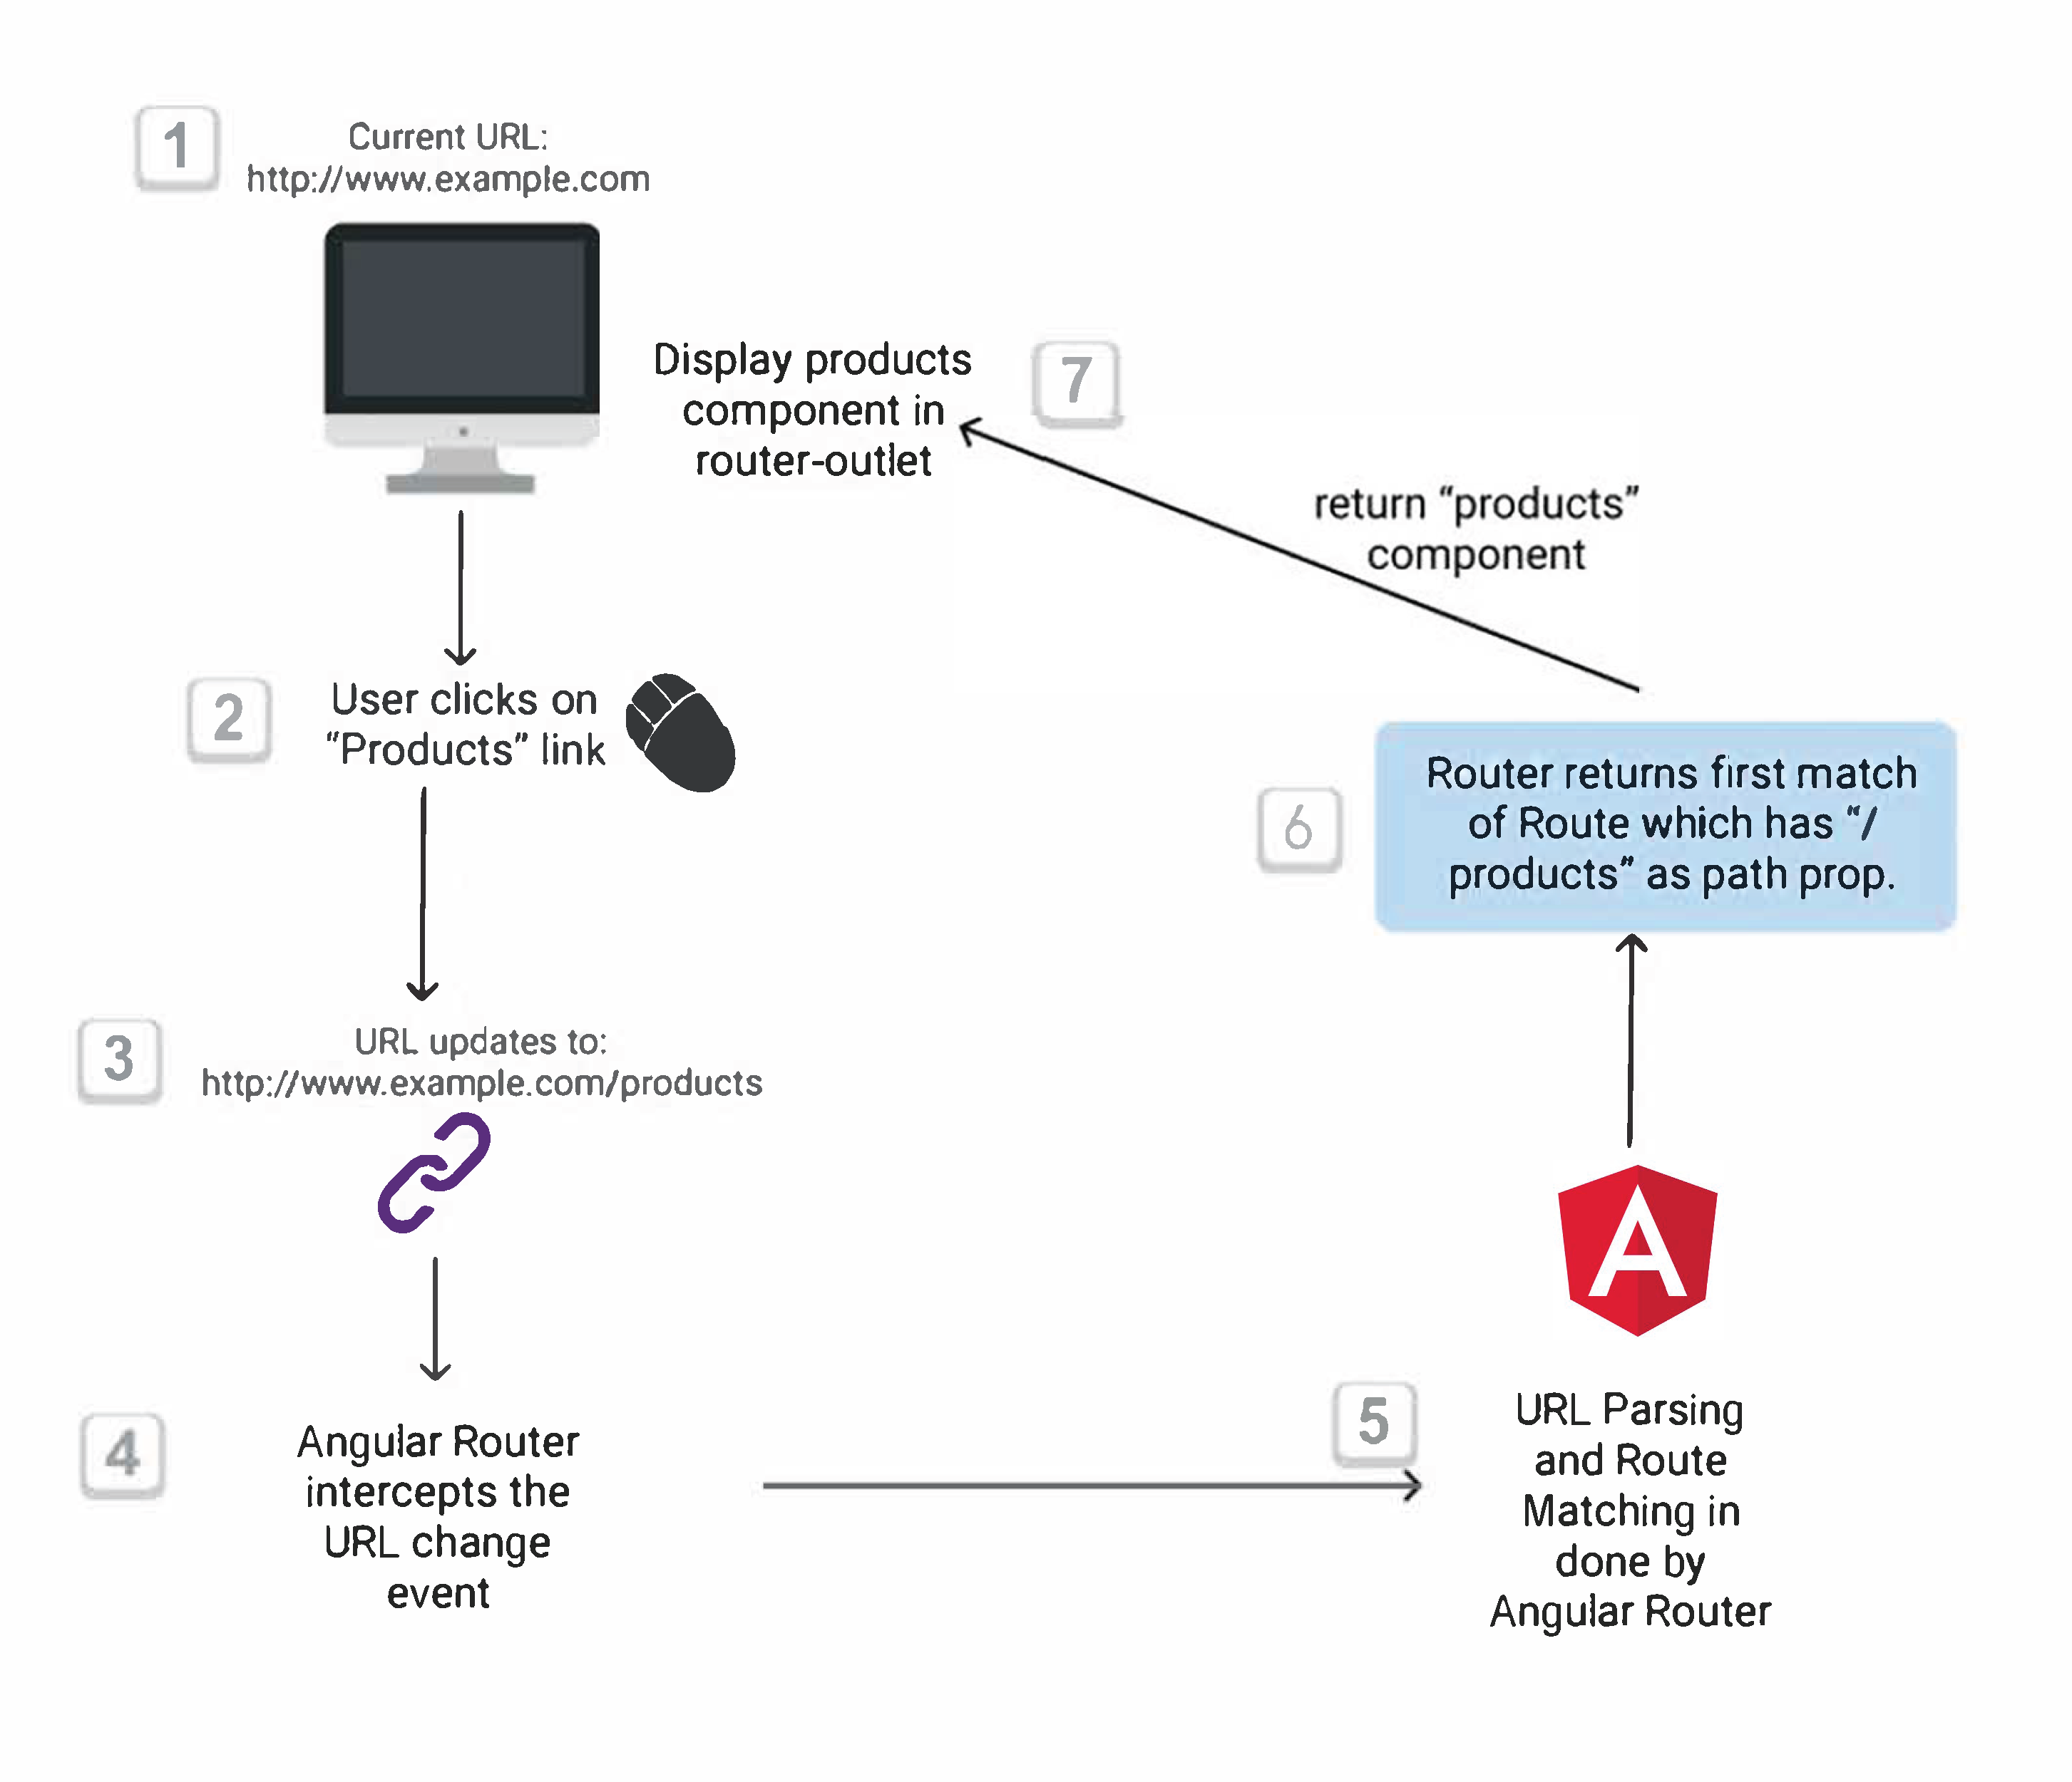
Angular Routing

Slide 182
After Navigation, What Router does?
URL Parsing:
Angular Router parses the URL and extracts information such as the URL path, query parameters, and fragment identifiers. It matches this information against the defined routes to determine the appropriate component to be displayed.
Route Matching:
Angular Router matches the parsed URL against the defined routes in the route configuration. It follows a specific order of precedence to find the best route match:
Exact Path Match: Angular Router checks for an exact match of the requested URL path against the defined paths in the route configuration.
Route Parameters: If no exact path match is found, Angular Router looks for routes with route parameters. It checks if the parameterized route pattern matches the requested URL path and extracts the parameter values.
Wildcard Route: If no exact path match or parameterized route match is found, Angular Router looks for a wildcard route (often denoted as **). The wildcard route acts as a fallback option when no other route matches.
Route Activation:
Once the route is matched, Angular Router activates the corresponding component and renders it in the designated <router-outlet> placeholder in the application's template.
Route Guards:
Angular Router can also invoke route guards before activating a route. Route guards are used to protect routes, control access, or perform additional checks.

Slide 183
NODE SERVER
BROWSER
HTTP + URL (localhost:3000)
NAVIGATION
Angular Application
User clicks on Admin Link, component calls the API in ngOnInit(), modifies the state and displays the data
HTML Page + JS (Angular App)
NODE SERVER
EXPRESS JS
Web API
AJAX – localhost:8000/api/users
Database
JSON

Slide 184
Route Guards
Use route guards to prevent users from navigating to parts of an application without authorization.
CanActivate
Checks to see if a user can visit a route.
CanActivateChild
Checks to see if a user can visit a routes children.
CanDeactivate
Checks to see if a user can exit a route.
CanLoad
Checks to see if a user can route to a module that is lazy loaded.
CanMatch
Checks to see if a user can visit a route and whether we can lazily load.
Resolve
Performs route data retrieval before route activation.
Class-based Route guards are deprecated in favor of functional guards. We should use Functional Syntax to create Guards

Slide 185
Use cases of Route Guard
Checking if the user is authenticated: This is one of the most common use cases for route guards. Before navigating to a route, the guard will check if the user is authenticated. If they're not, the guard can redirect them to a login page.
Checking if the user is authorized: A guard can check if a user has the necessary permissions to access a route. For example, you might want to restrict certain pages to administrators.
Preventing navigation away from a page: As in the example I gave previously, a guard can prevent the user from navigating away from a page. This is useful for pages with unsaved changes, for example.
Pre-loading data: Using the Resolve interface, a guard can pre-load data before navigating to a route. This can be useful for routes that require specific data to be loaded.
Controlling child routes: With a CanActivateChild guard, you can control access to child routes.

Slide 186
NODE SERVER
BROWSER
HTTP + URL (localhost:3000)
NAVIGATION
Angular Application
User clicks on Admin Link, execute a code to verify token or authentication status, if unauthenticated, redirect the request to Login Component
HTML Page + JS (Angular App)
HTTP + URL (AJAX) + Username & Password
NODE SERVER
EXPRESS JS
Web API
JSON with Token
{“token”:”___”}
Send Username, Password to server, who will verify and return a token, the received token will be stored in Session Storage of the browser
AJAX – localhost:8000/api/users + Token
Send the same token to access data from the server
Database
JSON
Added by TokenInterceptor Service

Slide 187
Secure Application using Route Guards
When user clicks the Admin Link, we need to verify that we have a token in session storage, and if the token in not there in the session storage, redirect the request to login component. (CanActivateAdminGuard)
CanActivateAdminGuard uses Authenticator Service, getToken() to get the token.
If token is undefined, the request is redirected to Login Component
If token is available, the request is allowed for Admin Component.
Logging and Token Management (Authenticator Service)
On Login Component, user must give username and password, which will be sent to Node API Server
If the username & password is correct, in the response token will come from the Server
Received token will be stored in the session storage of the browser.
Reading and Attaching Token (TokenInterceptor Service)
Whenever the AJAX request is made for api, tokenInterceptor, intercepts and attaches token in the request header.
It uses authenticator service to read the token from session storage.

Slide 188
Lazy Loading
Lazy loading is a technique used in Angular to improve the performance of your application by loading certain modules or components only when they are needed, rather than loading everything upfront.
It is particularly useful for larger applications with multiple feature modules, as it helps reduce the initial load time and saves bandwidth.

Slide 189
How to implement?
To implement lazy loading in Angular, you typically follow these steps:
Create Feature Modules: Identify the parts of your application that can be separated into feature modules. These could be sections of your app that are not required on the initial page load.
Configure Routing: Set up the Angular routing to define routes for each feature module you want to load lazily. In the main routing configuration, the route for a lazy-loaded module should use the loadChildren property, which specifies the path to the module file.
Create the Feature Module: For each feature you want to lazy load, create a separate module file using the Angular CLI or manually. This module should import the components and services specific to that feature.
Build and Serve the Application: When you build and serve the application, Angular will automatically generate separate bundles for the lazy-loaded modules. These bundles are only loaded when the user navigates to the respective routes.

Slide 190
PWA
Progressive Web Apps (PWAs) are web apps built and enhanced with modern APIs to deliver enhanced capabilities, reliability, and installability while reaching anyone, anywhere, on any device, all with a single codebase.
A Progressive Web App (PWA) is a web app that uses progressive enhancement to provide users with a more reliable experience, uses new capabilities to provide a more integrated experience, and can be installed.
It's a web app, it can reach anyone, anywhere, on any device, all with a single codebase.

Slide 191
PWA looks like any other app
It has an icon on the home screen, app launcher, launchpad, or start menu.
It appears when you search for apps on the device.
It opens in a standalone window, wholly separated from a browser's user interface.
It has access to higher levels of integration with the OS, for example, URL handling or title bar customization.
It works offline.

Slide 192
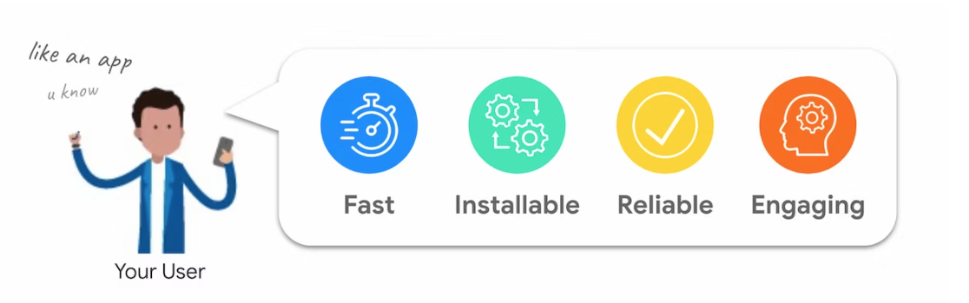
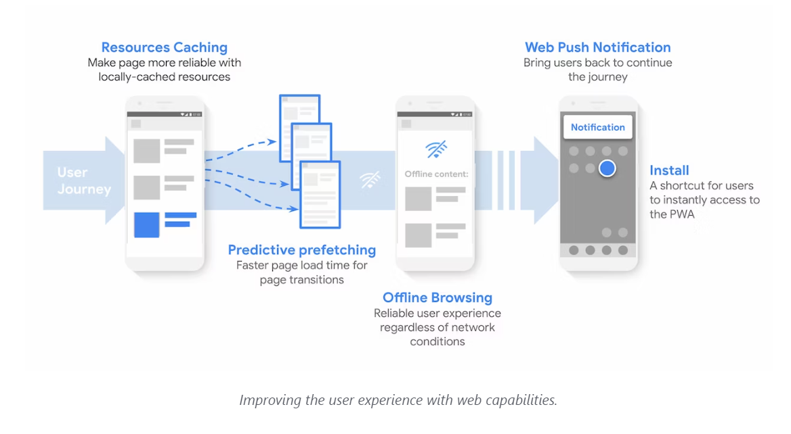

Slide 193
PWA & Devices
A Progressive Web App is installable with offline capabilities using the following browsers and app stores:
iOS and iPadOS
Safari (since iOS 11.3), AppStore (since iOS/iPadOS 14, with some limitations), mobile configuration for enterprise distribution.
Android
Firefox, Google Chrome, Samsung Internet, Microsoft Edge, Opera, Brave, Huawei Browser, Baidu, UCWeb, Play Store (from version 72 with Google Chrome installed, or browsers compatible with TWA), Galaxy Store, Managed Play iframe for enterprise distribution.
Some other small devices support PWAs, such as game consoles (Xbox with Microsoft Store) or XR devices (Microsoft Hololens, plans for Facebook's Oculus).

Slide 194
Core Requirements
Responsive Design
Connectivity Independence
App-Like Experience
Offline Support
Fast Loading
Push Notifications
Secure
Discoverable
Installable
Linkable
Fresh Content

Slide 195
Base requirement for building great PWAs
You need to design and code for the constraints of the web using a couple of principles:
Use mobile as a focusing constraint. Make sure each view of your design focuses only on the essential content and interactions.
Emphasize content and core functionality in the design process.
Progressively enhance when needed. Start by building a component's core content and functionality with the most straightforward, most widely available tools. Make it accessible. Then, test for advanced features you'd like to use and enhance your component with them.
Offer a fast and good user experience focused on user-centric web performance metrics, get real user metrics, and push performance for all your users, no matter their network connection, input type, CPU, or GPU power.

Slide 196
Further Learning on PWA
https://web.dev/learn/pwa/

Slide 197
Contact Me
Manish Sharma | Gmail
Manish Sharma | WhatsApp
Manish Sharma | Facebook
Manish Sharma | LinkedIn

