Slide 1

GIT

Slide 2
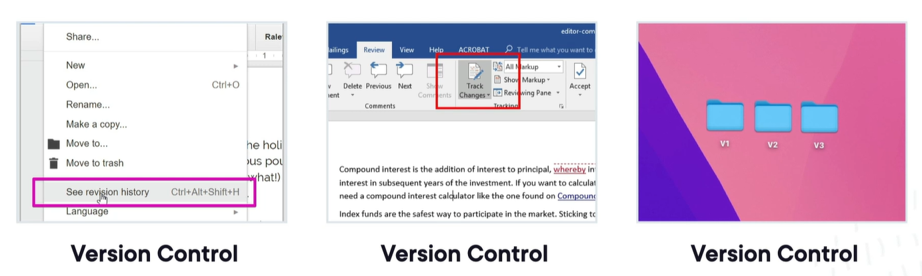
Types of Version Control - Local

Slide 3
Local version control systems (LVCS)
Lack of collaboration
Limited backup and recovery
Difficulty in sharing code
No centralized history and management
Limited scalability
Absence of fine-grained access control
Inefficient handling of concurrent edits
Notes:
Local version control systems (LVCS) are simple version control systems that are typically file-based and run on a developer's local machine. While they provide some benefits, they also have several drawbacks:
1. Lack of collaboration: LVCS does not support collaboration among multiple developers. It is designed for individual use and does not offer features for sharing code, merging changes, or managing concurrent edits by different team members.
2. Limited backup and recovery: LVCS typically lacks built-in mechanisms for remote backup and recovery. If the local machine experiences a hardware failure or data loss, the entire version history may be irretrievable.
3. Difficulty in sharing code: Sharing code with others can be cumbersome in LVCS. Since the repository is local, it requires manual transfer of files through external means such as email, USB drives, or shared network drives. This can lead to version conflicts, inconsistencies, and difficulties in tracking changes.
4. No centralized history and management: Unlike centralized or distributed version control systems, LVCS lacks a centralized history and management interface. It becomes challenging to track changes, compare versions, and manage branches effectively.
5. Limited scalability: LVCS is not designed to handle large-scale projects with numerous files and complex dependencies. As the project grows in size, maintaining version control becomes more difficult, and managing different branches and revisions can become cumbersome.
6. Absence of fine-grained access control: LVCS typically lacks sophisticated access control mechanisms. It may not provide granular permission settings, user authentication, or role-based access control, which are essential for larger teams or projects with sensitive code.
7. Inefficient handling of concurrent edits: Since LVCS lacks features for merging and resolving conflicts in a collaborative manner, it can be challenging to handle concurrent edits made by different individuals. This increases the risk of overwriting changes or losing modifications during the manual merging process.
It's important to note that these drawbacks primarily apply to simple local version control systems. More advanced version control systems, such as distributed version control systems, address many of these limitations by providing enhanced collaboration, backup capabilities, and centralized management features.

Slide 4
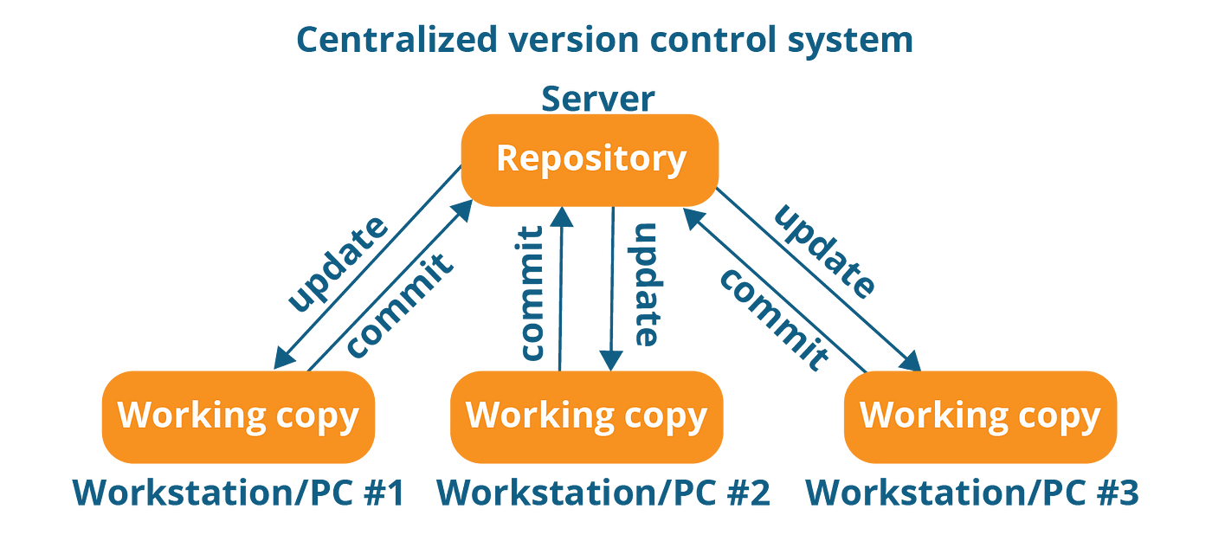
Centralized Version Control System (CVCS)

Slide 5
Limitations of CVCS
Single point of failure
Limited offline capabilities
Slower performance
Branching and merging challenges
Dependency on a centralized authority
Limited flexibility for experimentation
Difficulty in handling large projects
Notes:
Centralized version control systems (CVCS) have been widely used for managing source code and collaborating on software development projects. However, they do have some drawbacks compared to distributed version control systems (DVCS). Here are a few drawbacks of CVCS:
1. Single point of failure: In a CVCS, there is typically a central server that stores the entire history and tracks changes made by developers. If this central server goes down or becomes inaccessible, it can severely impact the ability of developers to collaborate and access the codebase.
2. Limited offline capabilities: CVCS systems heavily rely on the central server for most operations. If a developer needs to work offline or doesn't have access to the central server, they may have limited capabilities to perform version control operations or even access the code history.
3. Slower performance: Since most operations in a CVCS involve communicating with the central server, performance can be affected by network latency and server load. Activities such as committing changes, updating the codebase, or browsing the history may take longer compared to a DVCS where these operations can be performed locally.
4. Branching and merging challenges: In CVCS, branching and merging can be more complex and error-prone, especially when multiple developers are working on the same branch. The process usually involves locking files or sections of code, which can lead to conflicts and delays.
5. Dependency on a centralized authority: CVCS systems typically require a centralized authority to manage access control, permissions, and branching strategies. This can limit the autonomy and flexibility of individual developers or teams, as they have to rely on the central authority for making decisions and managing the repository.
6. Limited flexibility for experimentation: With CVCS, developers may hesitate to create experimental branches or try out new ideas due to the potential impact on the shared codebase and the need to synchronize changes with the central server. This can hinder creativity and innovation within the development team.
7. Difficulty in handling large projects: As a project grows in size and complexity, the centralized nature of CVCS can pose challenges. The central server needs to handle increased traffic and storage requirements, and operations can become slower and more cumbersome.
It's worth noting that these drawbacks may vary depending on the specific CVCS system being used and the development workflow in place.

Slide 6
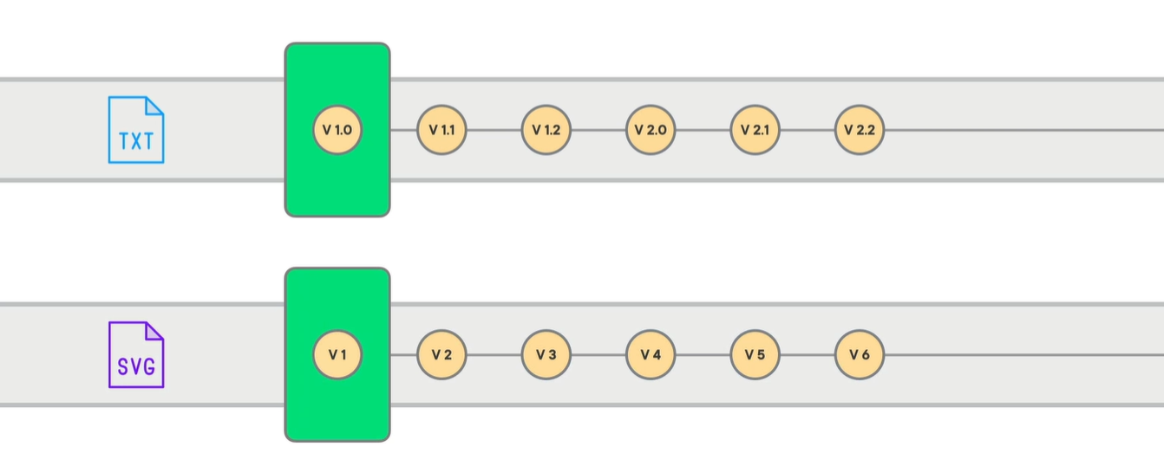
GIT
Git is a free and open-source distributed version control system designed to handle everything from small to very large projects with speed and efficiency.

Slide 7
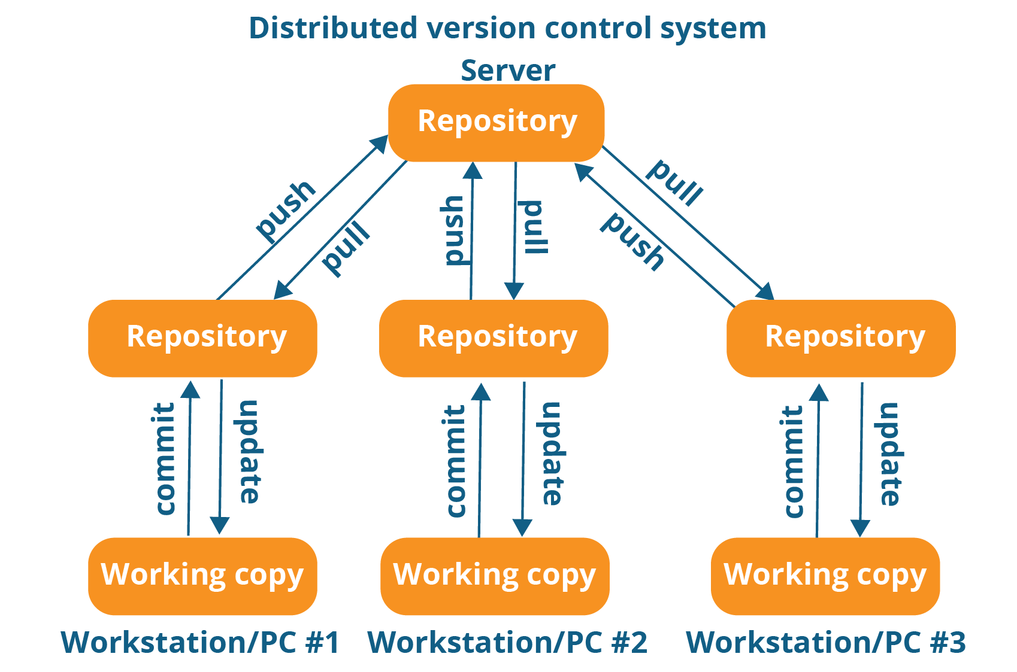
Distributed Version Control System (DVCS)
Notes:
Distributed version control systems (DVCS) offer several benefits over centralized version control systems. Here are the key advantages of DVCS:
1. Offline work: DVCS allows developers to work offline, as they have a complete copy of the repository on their local machines. They can commit changes, create branches, and access the full history without requiring a network connection. This flexibility is particularly useful in situations where internet access is limited or unreliable.
2. Enhanced collaboration: DVCS enables seamless collaboration among distributed teams. Each team member has a complete local copy of the repository, allowing them to work independently and make commits. Branches and changes can be easily shared and merged, enabling concurrent work and efficient collaboration even across geographically dispersed locations.
3. Faster performance: With DVCS, most operations are performed locally, resulting in faster performance compared to centralized systems. Tasks such as committing changes, branching, and switching between branches are quick since they are executed locally without relying on network communication or server load.
4. Improved branching and merging: DVCS systems excel in branching and merging operations. Branching is lightweight and creating branches for experimentation or isolating features is effortless. Merging changes from different branches is usually easier and less error-prone, thanks to advanced merge algorithms and tools provided by DVCS.
5. Robust version history and integrity: Each developer in a DVCS maintains a complete copy of the repository, including the full version history. This redundancy ensures that the history is preserved even if a central server or remote repository becomes inaccessible or corrupted. It enhances data integrity and provides a safety net against data loss.
6. Flexibility and autonomy: DVCS gives developers more autonomy and flexibility in managing their workflow. They can commit changes, create branches, and experiment with different features independently, without relying on a central authority. This autonomy fosters innovation, creativity, and individual productivity.
7. Multiple remote repositories: DVCS allows developers to work with multiple remote repositories. They can push changes to different repositories, facilitating collaboration with various teams, organizations, or open-source projects. This flexibility is beneficial for distributed development and contributing to multiple projects simultaneously.
8. Easy branching and forking: DVCS makes branching and forking of repositories effortless. It encourages developers to create branches freely for different features or bug fixes without worrying about disrupting the main codebase. Forking allows developers to create independent copies of a repository, making it easier to contribute to open-source projects or create custom versions.
Overall, distributed version control systems provide greater flexibility, enhanced collaboration capabilities, improved performance, and robust version history, making them a preferred choice for many developers and teams.

Slide 8
Benefits of DVCS
Offline work
Enhanced collaboration
Faster performance
Improved branching and merging
Robust version history and integrity
Flexibility and autonomy
Multiple remote repositories
Easy branching and forking

Slide 9
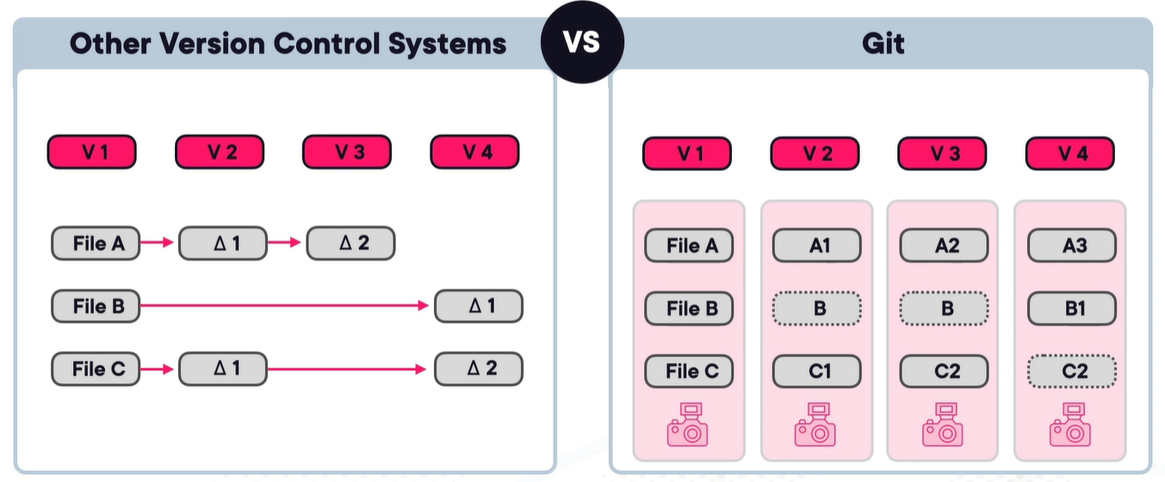
Git Stores Versions as Snapshots Not Diffs

Slide 10
GIT Characteristics - Snapshots
A snapshot refers to the state of the entire repository at a specific point in time. Instead of storing individual file changes or differences between versions, Git captures the complete content of the files in the repository, creating a snapshot of the project.
Git uses a data structure called a commit to represent a snapshot. A commit in Git contains metadata such as the author, timestamp, and a unique identifier (SHA-1 hash) along with the content of the files at the time of the commit.
When you make changes to your Git repository, Git creates a new commit that represents the updated snapshot. This commit includes all the changes you made to the files, whether it's modifying existing files, adding new ones, or deleting them.

Slide 11
GIT Characteristics – Enhanced for Local Dev
Since each developer has a local copy of the repository, Git enables offline work.
Developers can continue making commits, creating branches, and reviewing the project history without needing an internet connection.
Git's local nature means that it maintains a detailed history of commits, branches, and changes within the repository on the developer's machine.
Developers can easily share their local changes and collaborate with others by pushing their commits to remote repositories or by sharing branches.

Slide 12
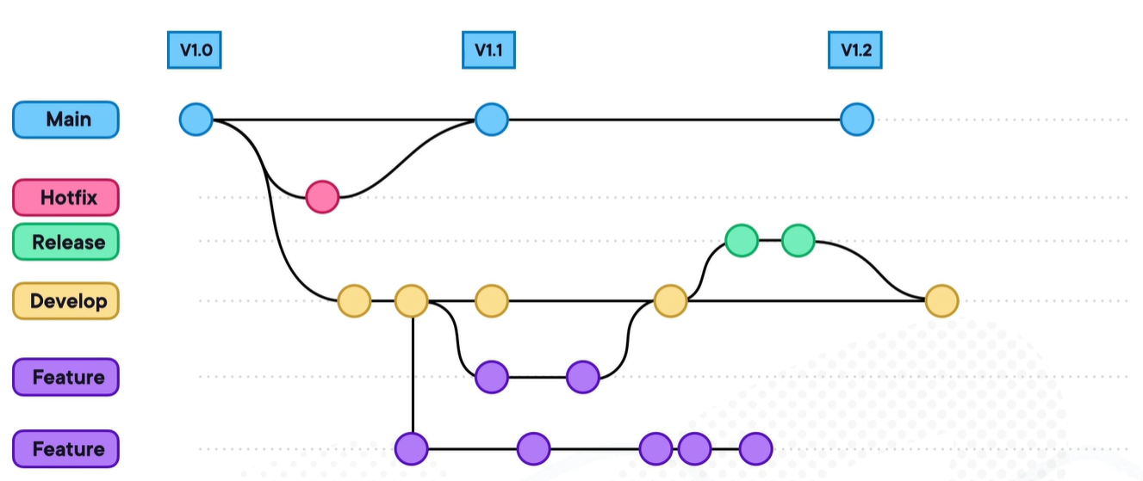
GIT Characteristics – Designed for Non-linear Development
Notes:
Git is specifically designed to support non-linear development workflows. It provides a range of features and capabilities that make it well-suited for branching and merging, enabling developers to work on multiple parallel lines of development simultaneously.

Slide 13
Different Statuses of Your Files
Untracked files
Tracked files
Unmodified files
Modified files
Staged files
Deleted files
Committed files
Ignored files
Notes:
git rm –cached <filename> (to remove git but not delete)
Git rm <filename> (to remote got and delete)
In Git, the file status refers to the current state of files within a repository. Git tracks and manages changes to files by categorizing them into different statuses. These statuses indicate whether a file has been modified, added, deleted, or ignored. Here are the main file statuses in Git:
1. Untracked: Untracked files are files that Git is not currently aware of. These files are not being tracked by Git, and they do not appear in the repository's history. Untracked files can be new files that have been added to the working directory but have not yet been staged or committed.
2. Modified: Modified files are files that have been changed since the last commit. Git detects modifications by comparing the current state of files to their previous committed versions. Modified files are candidates for staging and subsequent commit.
3. Staged: Staged files are modified files that have been marked for inclusion in the next commit. Once a file is staged, it is prepared to be part of the next snapshot of the repository. Staging allows you to selectively choose which changes to include in a commit.
4. Committed: Committed files are files that have been successfully stored in the Git repository. They are part of the version history and are associated with a specific commit. Committed files represent stable versions of the project and cannot be further modified unless new commits are made.
5. Deleted: Deleted files refer to files that have been deleted from the working directory. Git detects the deletion and records it as a change in the repository. Deleted files can be restored if needed by checking out an earlier commit that still includes the file.
6. Ignored: Ignored files are files that Git has been instructed to ignore and exclude from version control. Ignored files are typically specified in a .gitignore file, and Git will not track changes or include them in any operations.
Git provides various commands and tools to view and manage the file status. The "git status" command is commonly used to see the current status of files in the working directory and the repository. It provides an overview of which files are modified, staged, deleted, or untracked.
Understanding the file status in Git is crucial for managing and tracking changes effectively, selectively staging files for commits, and ensuring that the repository accurately represents the desired state of the project.

Slide 14
GIT Repository
A Git repository, also known as a Git repo, is a directory or folder that contains all the files, directories, and version history of a project.
It serves as a central storage location for a Git project, allowing developers to track changes, collaborate, and manage the source code and related files.
When a repository is initialized with Git, it creates a hidden directory called ".git" at the root of the project.
This ".git" directory stores all the necessary information and metadata to manage version control.

Slide 15
Components of GIT Repository
Working directory: The directory on a developer's local machine where project files are stored.
Staging area (Index): An intermediate step where changes are selectively chosen to be included in the next commit.
Commit history: A chronological record of all commits made in the repository, representing snapshots of the project at specific points in time.
Remote repositories: Copies of the repository hosted on remote servers, enabling collaboration and sharing of code among team members.

Slide 16
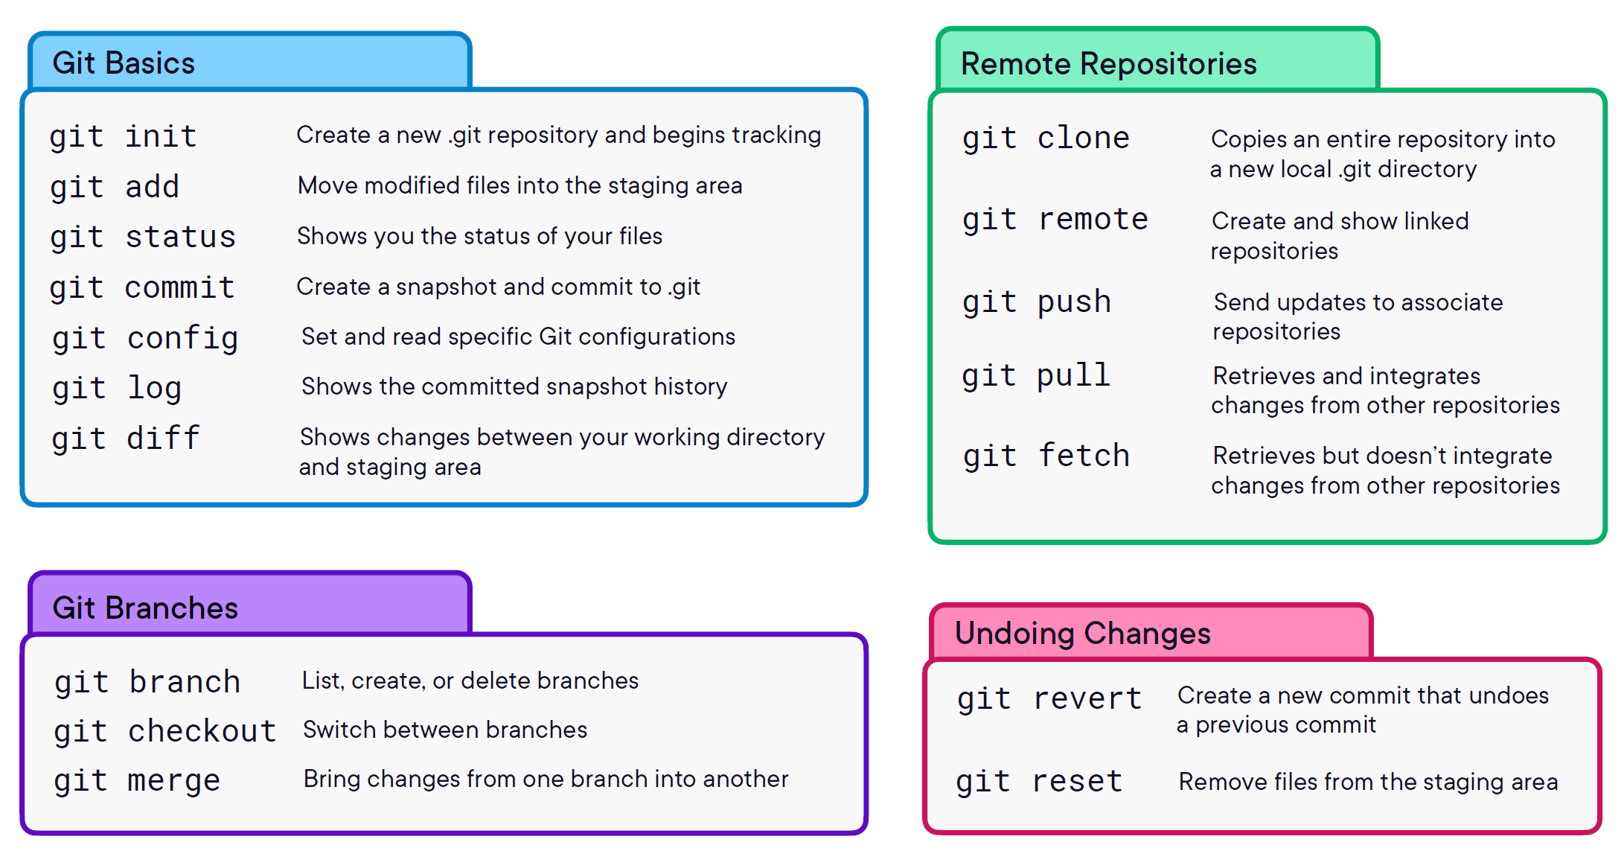

Slide 17
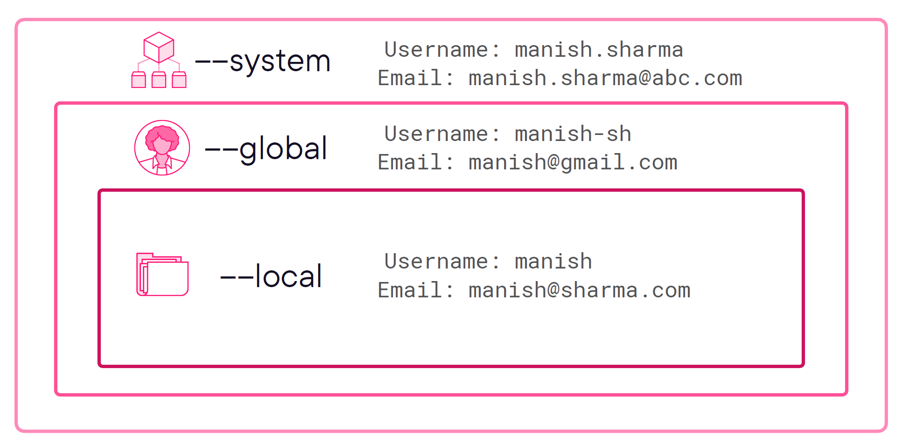
GIT Configuration Levels

Slide 18
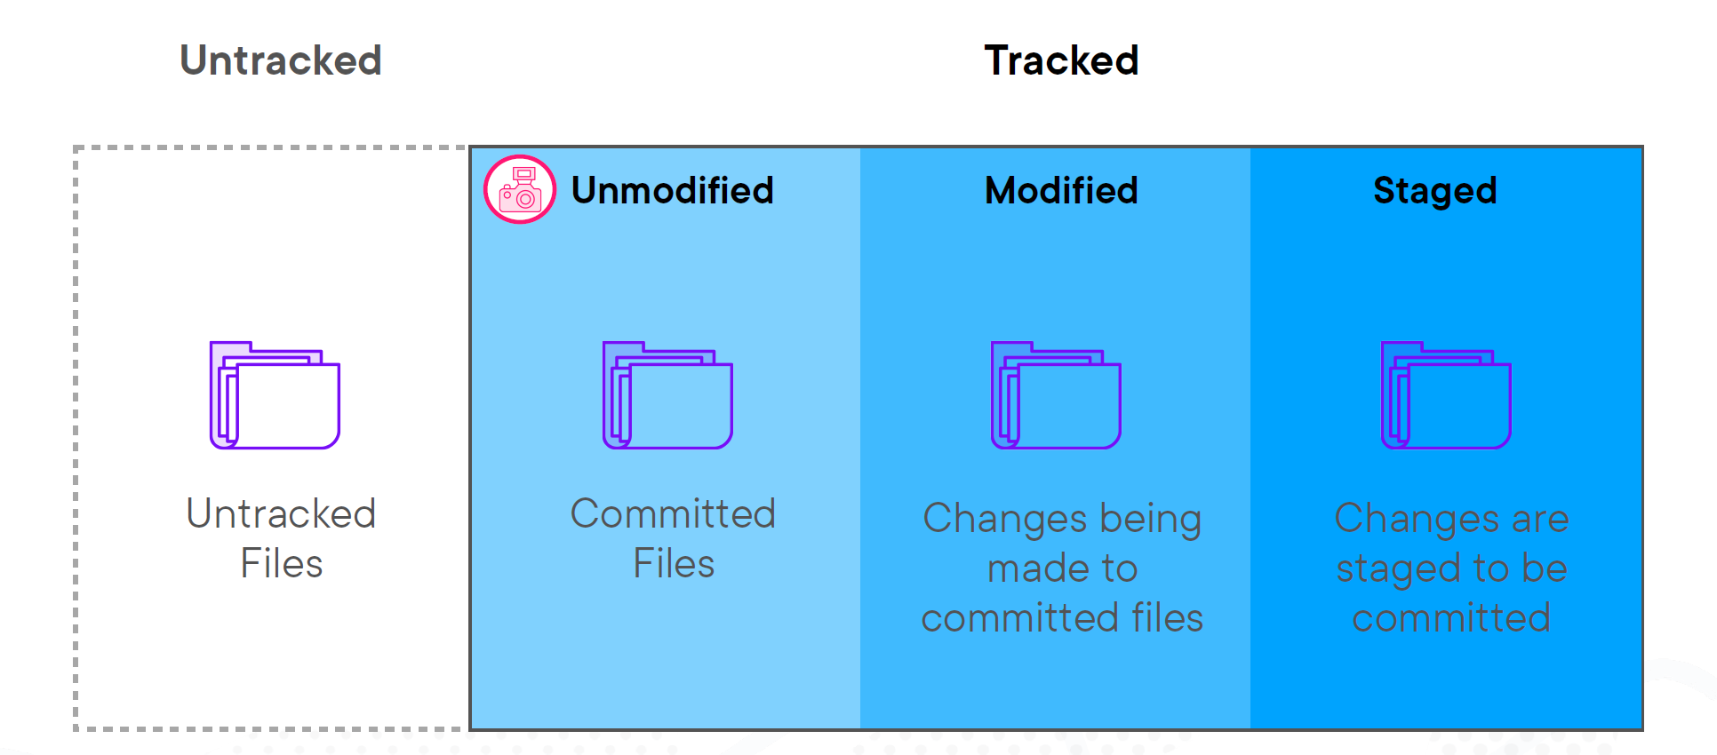
File Status

Slide 19
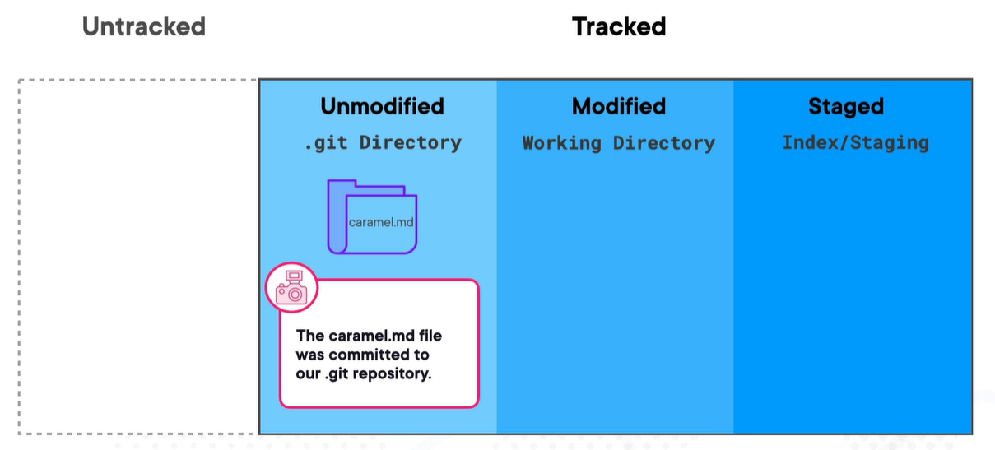
Different Directories of Git - Unchanged

Slide 20
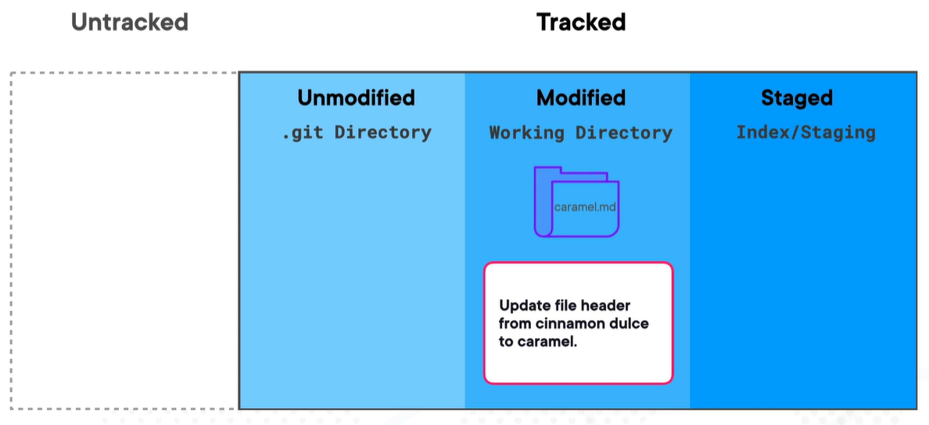
Different Directories of Git – After Change

Slide 21
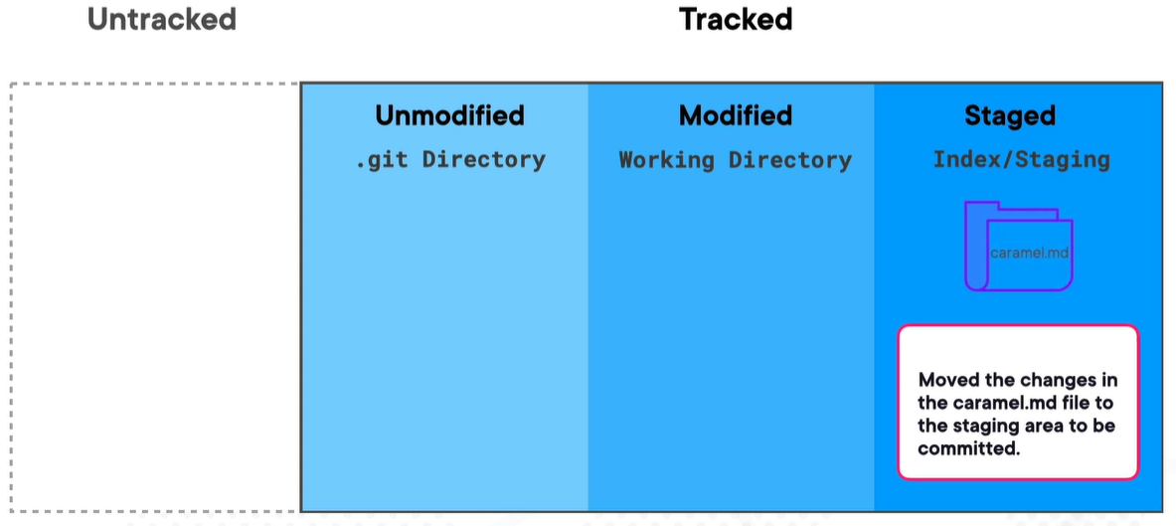
Different Directories of Git – After Add

Slide 22
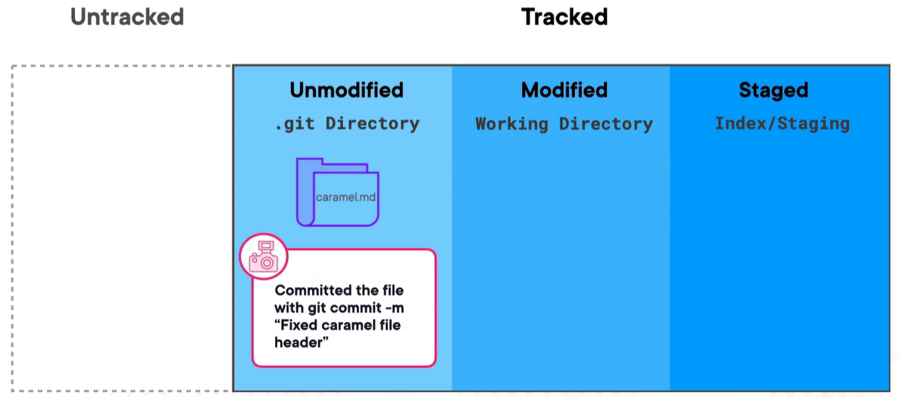
Different Directories of Git – After Commit

Slide 23
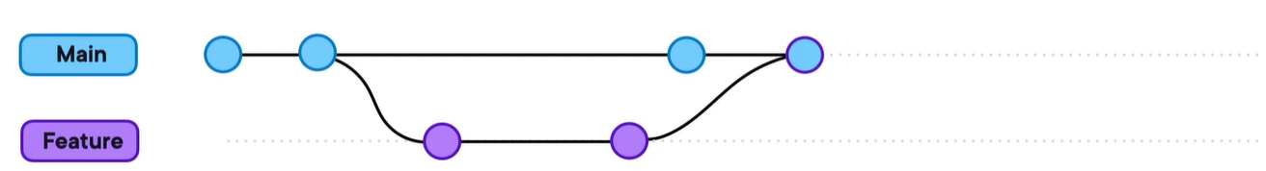
Merge Branch

Slide 24
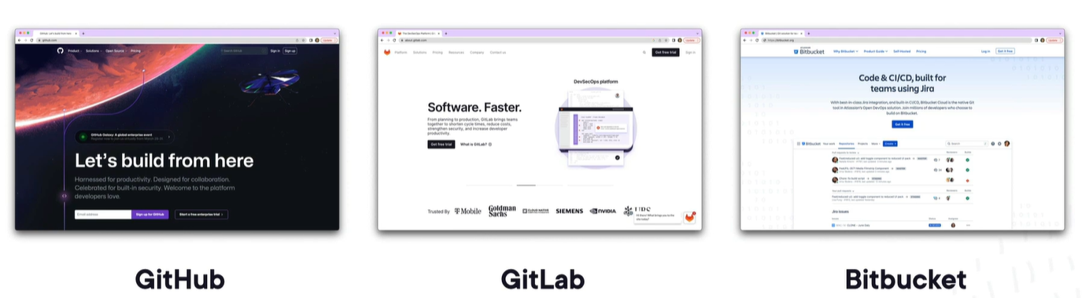
Code Hosting Platforms

Slide 25
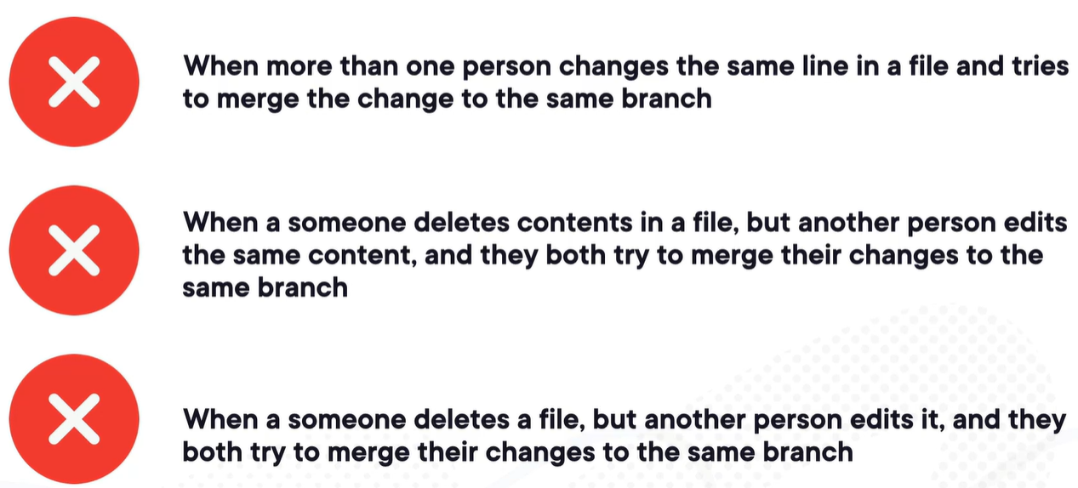
Merge Conflicts Situations

Slide 26
Preventive Measures for Merge Conflicts
Keep Branches Small and Focused
Pull Regularly
Communicate and Coordinate
Review Changes Before Merging
Use Branching Strategies
Regularly Test and Build
Resolve Conflicts Locally
Use Git Tools and Practices
Notes:
While it's not always possible to completely prevent merge conflicts in Git, there are several best practices and strategies that can help minimize the occurrence of conflicts. Here are some tips to help reduce the likelihood of merge conflicts:
1. Keep Branches Small and Focused: Break down your work into smaller, focused branches. Each branch should have a specific purpose or feature, making it easier to understand and merge changes without conflicts.
2. Pull Regularly: Pull or fetch updates from the remote repository frequently to stay up-to-date with the latest changes made by other team members. This helps identify potential conflicts early and gives you an opportunity to resolve them before they compound.
3. Communicate and Coordinate: If you're working collaboratively with others, communicate and coordinate your changes to minimize conflicting modifications. Discussing your plans and syncing up with teammates can help avoid overlapping changes and reduce the chances of conflicts.
4. Review Changes Before Merging: Before merging a branch, review the changes carefully. This helps identify potential conflicts or inconsistencies early on. You can also leverage tools like pull requests for code review, which allow for discussion and feedback before merging.
5. Use Branching Strategies: Adopt branching strategies like Git flow that promote isolation of features and releases. This can help segregate changes and reduce the likelihood of conflicts when merging branches.
6. Regularly Test and Build: Run tests and build your code regularly to identify issues or conflicts early. Automated testing and continuous integration practices can catch conflicts and errors before they impact the main codebase.
7. Resolve Conflicts Locally: If conflicts do arise during a merge, resolve them locally. Take the time to carefully review and understand the conflicting changes, make appropriate modifications, and ensure the merged result is correct and functional.
8. Use Git Tools and Practices: Familiarize yourself with Git's merging strategies, such as rebasing or merging with specific options (e.g., `--no-ff`), to tailor the merge process to your specific needs. Additionally, leverage Git's tooling, such as merge tools or visual diff tools, to assist in resolving conflicts.
While these practices can help minimize merge conflicts, it's important to remember that conflicts may still occur, especially in complex or rapidly changing codebases. The key is to proactively manage conflicts, communicate effectively with your team, and ensure proper testing and review processes are in place to handle them efficiently.

Slide 27
Modify Commit History
Limit Modifications to Unpushed Commits
Communicate with the Team, if you want to modify pushed commits
Backup the Original History
Use Interactive Rebase
Keep the Changes Logical
Preserve Commit Messages
Be Mindful of Branches and Merge Points
Test and Validate Changes
Document the Modifications
Notes:
When modifying the commit history in Git, it's essential to follow best practices to ensure a smooth and coherent history. Here are some recommended best practices to consider when making modifications:
1. Limit Modifications to Unpushed Commits: It's generally best to avoid modifying commits that have already been pushed and shared with others. Modifying shared commits can lead to conflicts and confusion among team members. Instead, focus on making modifications to commits that have not yet been pushed.
2. Communicate with the Team: If you need to modify shared commits, communicate with your team members to ensure everyone is aware of the changes. Collaborate and coordinate to minimize disruptions and conflicts resulting from modified history.
3. Backup the Original History: Before making significant modifications, create a backup or create a separate branch to preserve the original commit history. This allows you to revert back to the original state if needed.
4. Use Interactive Rebase: When rewriting commit history, use interactive rebase (`git rebase -i`) to carefully select and modify the commits. It provides a granular and controlled approach to modifying the commit history.
5. Keep the Changes Logical: Ensure that the modifications you make maintain a logical flow of the commit history. Strive to create a coherent and understandable narrative of the project's development.
6. Preserve Commit Messages: When modifying commits, try to preserve the original intent and meaning of the commit messages. Clear and descriptive commit messages help in understanding the changes made in each commit.
7. Be Mindful of Branches and Merge Points: Consider the impact of modifying commits that are part of multiple branches or have been merged with other branches. Modifying such commits may affect the integrity of the branch structure and cause confusion.
8. Test and Validate Changes: After modifying the commit history, thoroughly test the changes to ensure that the project remains in a functional and stable state. Validate that the modified history works as expected and doesn't introduce any regressions.
9. Document the Modifications: Document the modifications made to the commit history, especially if they impact shared branches or have a significant impact on the project's development. This helps in maintaining transparency and allows others to understand the changes made.
Remember, modifying the commit history should be done cautiously and with clear communication to minimize any negative impact on collaboration and project continuity.

Slide 28
Modifying the Most Recent Commit
If you want to make small changes or corrections to the most recent commit, such as updating the commit message or adding missed changes, you can use the git commit --amend command.
This command opens an editor where you can make the necessary modifications. After saving the changes, Git will create a new commit with a new commit ID, replacing the previous commit.

Slide 29
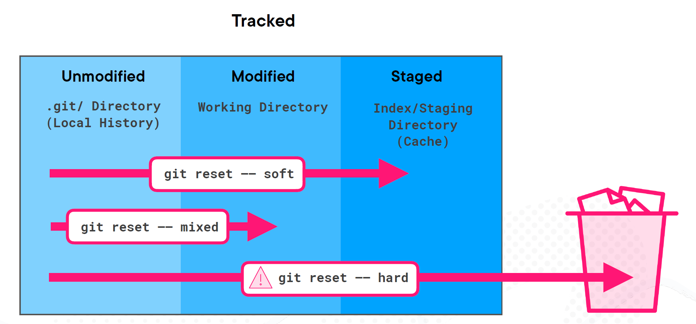
Git Reset

Slide 30
Revert Hard Reset (Reflog & Cherry-pick)
Works only on local
Available only for 90 days

Slide 31
Git workflow
A Git workflow is a set of guidelines and practices that dictate how teams and individuals collaborate using Git version control.
It defines the steps, branching strategies, and code review processes that developers follow to manage the development and integration of code in a project.
Some popular Git workflows include:
Centralized Workflow
Feature Branch Workflow
GitFlow
GitHub Flow
GitLab Flow
Forking Workflow
Notes:
Centralized Workflow:
Uses a single central repository where all developers push their changes.
Developers clone the central repository, make changes, and push them to the central repository for review and integration.
Suitable for small teams or simple projects where strict access controls and complex branching models are unnecessary.
Feature Branch Workflow:
Each new feature or bug fix is developed in a separate branch, called a feature branch.
Feature branches are created from the main branch (e.g., master or develop) and merged back when the work is completed and reviewed.
Promotes parallel development and isolation of changes, making it easier to manage code review and release features separately.
GitFlow:
Uses a structured branching model with specific branch types (e.g., feature, develop, release, hotfix).
Developers follow a predefined workflow for creating and merging branches, promoting release management and code stabilization.
Suitable for larger projects with scheduled releases and multiple development tracks.
GitHub Flow:
Similar to the Feature Branch Workflow but focused on continuous integration and continuous deployment (CI/CD) practices.
Encourages smaller, more frequent releases and encourages code review through pull requests.
Ideal for projects that continuously deploy new changes to production.
GitLab Flow:
Similar to GitHub Flow but emphasizes code review and collaboration using GitLab's merge request features.
Allows for more control over the review and approval process before merging changes.
Forking Workflow:
Commonly used in open-source projects.
Contributors fork the main repository, create feature branches in their forks, and submit pull requests to the main repository for review and merging.

Slide 32
Contact Me
Manish Sharma | Gmail
Manish Sharma | WhatsApp
Manish Sharma | Facebook
Manish Sharma | LinkedIn

