Slide 1

Node JS

Slide 2
What is Node.js?
Node.js® is a JavaScript runtime built on Chrome's V8 JavaScript engine.
As an asynchronous event-driven JavaScript runtime
Node.js is designed to build scalable network applications.

Slide 3
What is Node.js?
Node.js is
open-source
cross-platform
back-end JavaScript runtime environment
runs on the V8 engine
executes JavaScript code outside a web browser.
Node.js lets developers use JavaScript for server-side scripting.
Node.js represents a "JavaScript everywhere" paradigm
Unifying web-application development around a single programming language.

Slide 4
Installation
Install Node LTS version - https://nodejs.org/en/
Install / Update Visual Studio Code to Latest Release - https://code.visualstudio.com/
Extensions of VS Code
AutoFileName
vscode-icons
JavaScript (ES6) code snippets
Node.js Modules Intellisense
After all Extensions are installed
File Menu -> Preferences -> Theme -> File Icon Theme -> Select VScode Icons

Slide 5
NVM
NVM stands for Node Version Manager.
It is a command-line tool that allows you to manage and switch between multiple installations of Node.js on your development machine.
NVM provides an easy way to install, manage, and switch between different versions of Node.js without interfering with each other.
NVM for Windows:
https://github.com/coreybutler/nvm-windows

Slide 6
Key features and benefits of using NVM
Multiple Node.js Versions: NVM allows you to install and maintain multiple versions of Node.js on your system. This is particularly useful when working on projects that require specific versions of Node.js due to compatibility or project dependencies.
Easy Version Switching: With NVM, you can easily switch between different installed versions of Node.js using a simple command. This allows you to test your applications with different Node.js versions or use the specific version required for a particular project.
Global and Local Package Management: NVM manages both global and local packages for each Node.js version. Global packages are shared across different projects, while local packages are specific to each project. NVM ensures that the correct set of packages is available when switching between Node.js versions.
Simple Installation and Updates: NVM itself is easy to install and configure. It provides a script or package that you can run to set up NVM on your system. Additionally, NVM can be updated to the latest version easily using its built-in update command.
Cross-Platform Compatibility: NVM is available for various operating systems, including Linux, macOS, and Windows. It allows developers to use the same set of commands and workflows across different platforms for managing Node.js versions.

Slide 7
Modules
In Node.js, the module object represents the current module (file).
It provides information about the current module (file), including its filename, exports, and other metadata.
The module object is specific to each module (file) and allows you to control the module's behavior, expose functionalities, and interact with other modules in your Node.js application.
Module in Node.js is a simple or complex functionality organized in single or multiple JavaScript files which can be reused throughout the Node.js application.
Each module in Node.js has its own context, so it cannot interfere with other modules or pollute global scope. Also, each module can be placed in a separate .js file under a separate folder.
Node.js implements CommonJS modules standard.
CommonJS is a group of volunteers who define JavaScript standards for web server, desktop, and console application.

Slide 8
Types of Modules
Core Modules (Built-in Modules)
Global Modules (Objects)
Local Modules (User Defined Modules)
External Modules (Third Party Modules)

Slide 9
Node Global Objects
Node.js Global Objects are those objects which are present in all modules.
Global Objects can be used directly in the application which is available without importing any module.
Global objects have been added keeping in mind that these are some basic requirements and one can require these anytime, so it is better to keep them global rather than to add specific modules for these objects.
Some of the Node.js Global Objects:
Buffer Class
console
process
setImmediate
setTimeout

Slide 10
Do we have to compile code?
Node.js supports executing JavaScript code directly, including the latest ECMAScript features supported by the Node.js version you're using.
Node.js uses the V8 JavaScript engine, developed by Google, which also powers the Chrome browser.
V8 is designed to execute JavaScript code efficiently, and it supports many modern ES features, including arrow functions, template literals, destructuring assignment, async/await, and more.
You can write your JavaScript code using ES6 (ES2015) and newer syntax in Node.js without any additional compilation step. Node.js will interpret and execute the code directly.

Slide 11
When must we compile code?
There might be cases where you want to use certain language features or modules that are not yet natively supported by the Node.js version you are using.
In those scenarios, you might choose to use a transpiler, such as Babel, to convert your code to an older version of JavaScript that is supported by the Node.js runtime.

Slide 12
NODE EXE (NODE PROCESS)
node app.js
V8 Engine
Node JS API’s
Application
(JavaScript)
app.js
NATIVE CODE
O. S.

Slide 13
NODE APIs
V8 Engine
API’s
Libuv
(Asynchronous I/O)
Developer Uses the NODE APIs in JavaScript Language

Slide 14
What is the use of require function?
In Node.js, the require function is used to import modules and load external JavaScript files into your Node.js application.
It allows you to access functionality defined in other modules and use it in your current module.
require(), can be used for:
Loading Core Modules
Loading External Modules
Loading Local Modules
Note
Starting from Node.js version 14 and above, you can also use the import and export syntax, which is part of the ECMAScript Modules (ESM) standard.
The require function is still widely used, especially in existing Node.js codebases and when working with CommonJS modules.

Slide 15
What is global object in Node JS?
In Node.js, the global object represents the global scope, similar to the window object in browsers.
It provides access to various globally available objects, functions, and variables throughout your Node.js application.
It's generally recommended to avoid relying heavily on the global object and using global variables in Node.js.
Global variables can introduce issues related to namespace clashes, maintainability, and code readability.
It's best to adopt modular programming practices, use proper encapsulation, and explicitly import and export functionality between modules using require and module.exports or the newer import and export syntax

Slide 16
require(Path)
Module Loader will search for a file on the path specified
Y
N
Load and cache the file on the memory
Module Loader will search for a folder on the path specified
Y
N
Search inside folder, file with the name ‘package.json’
Error Loading Module
Y
N
N
In ‘package.json’, read ‘main’ key
Search inside folder, file with the name ‘index.js’
N
Y
Y
Search file mentioned in ‘main’
N
Load and cache the file on the memory
Y
Load and cache the file on the memory
NODE JS Module Resolution

Slide 17
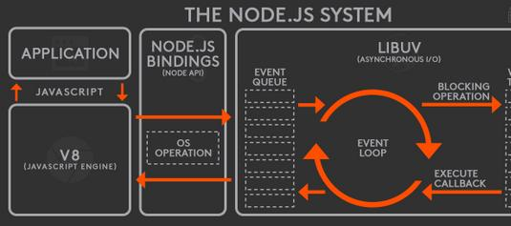
Node JS Architecture

Slide 18
Working of Node.js
Node.js runs on chrome v8 engine which converts JavaScript code into machine code, it is highly scalable, lightweight, fast, and data-intensive.
To operate I/O operations or requests node.js use the concept of threads. Thread is a sequence of instructions that the server needs to perform.
Node.js is an event loop single-threaded language.
Node.js basically works on two concept
Non-blocking I/O (Libuv)
Asynchronous

Slide 19
Event Loop
The event loop contains a single thread and is responsible for handling easy tasks like executing callbacks and network I/O.
All the applications code that is inside callback functions will run in the event loop.
EventLoop is the heart of node.js. When we start our node application the event loop starts running right away. Most of the work is done in the event loop.
Nodejs use event-driven-architecture.
Events are emitted.
Event loop picks them up.
Callbacks are called.

Slide 20
Event Queue
As soon as the request is sent the thread places the request into a queue. It is known as an event queue.
The process like app receiving HTTP request or server or a timer will emit event as soon as they are done with the work and event loop will pick up these events and call the callback functions that are associated with each event and response is sent to the client.
The event loop is an indefinite loop that continuously receives the request and processes them.
It checks the queue and waits for the incoming request indefinitely.

Slide 21
Thread Pool
Though node.js is single-threaded it internally maintains a thread pool.
When non-blocking requests are accepted there are processed in an event loop
While accepting blocking requests Node JS
Checks for available threads in a thread pool
Assigns a thread to the client’s request which is then processed and send back to the event loop
Response is sent to the respective client.

Slide 22
Non-blocking I/O
Non-blocking I/O means working with multiple requests without blocking the thread for a single request.
I/O basically interacts with external systems such as files, databases.
Node.js is not used for CPU-intensive work means for calculations, video processing because a single thread cannot handle the CPU works.

Slide 23
Asynchronous
Asynchronous is executing a callback function.
The moment we get the response from the other server or database it will execute a callback function.
Callback functions are called as soon as some work is finished and this is because the node.js uses an event-driven architecture.
The single thread doesn’t work with the request instead it sends the request to another system which resolves the request and it is accessible for another request.

Slide 24
Libuv
To implement the concept of the system to handle the request node.js uses the concept of Libuv.
Libuv is an open-source library built-in C. It has a strong focus on asynchronous and I/O, this gives node access to the underlying computer operating system, file system, and networking.
Libuv implements two extremely important features of node.js
Event loop
Thread pool

Slide 25
Built In Modules
Module | Description
assert | Provides a set of assertion tests
buffer | To handle binary data
child_process | To run a child process
cluster | To split a single Node process into multiple processes
crypto | To handle OpenSSL cryptographic functions
dgram | Provides implementation of UDP datagram sockets
dns | To do DNS lookups and name resolution functions
events | To create and handle events
fs | To handle the file system
http | To make Node.js act as an HTTP server
https | To make Node.js act as an HTTPS server.

Slide 26
Built In Modules Continued
Module | Description
net | To create servers and clients
os | Provides information about the operation system
path | To handle file paths
querystring | To handle URL query strings
readline | To handle readable streams one line at the time
stream | To handle streaming data
string_decoder | To decode buffer objects into strings
timers | To execute a function after a given number of milliseconds
tls | To implement TLS and SSL protocols
tty | Provides classes used by a text terminal
url | To parse URL strings

Slide 27
Built In Modules Continued
Module | Description
util | To access utility functions
v8 | To access information about V8 (the JavaScript engine)
vm | To compile JavaScript code in a virtual machine
zlib | To compress or decompress files

Slide 28
readline Module
The readline module is a built-in module in Node.js that provides an interface for reading input from a readable stream, such as the terminal or a file.
It allows you to prompt the user for input, read input line by line, and handle user interactions in a command-line environment.
The readline module provides an instance of the Interface class, which can be created using the createInterface method.
This instance represents a Readline interface that can be used to interact with the user.

Slide 29
fs Module
With Node.js, you can programmatically manipulate files with the built-in fs module.
The name is short for “file system,” and the module contains all the functions you need to read, write, and delete files on the local machine.
This unique aspect of Node.js makes JavaScript a useful language for back-end and CLI tool programming.
The fs module supports interacting with files synchronously, asynchronously, or via streams;

Slide 30
fs Module Methods
fs.access(): check if the file exists and Node.js can access it with its permissions
fs.appendFile(): append data to a file. If the file does not exist, it's created
fs.chmod(): change the permissions of a file specified by the filename passed. Related: fs.lchmod(), fs.fchmod()
fs.chown(): change the owner and group of a file specified by the filename passed. Related: fs.fchown(), fs.lchown()
fs.close(): close a file descriptor
fs.copyFile(): copies a file
fs.createReadStream(): create a readable file stream
fs.createWriteStream(): create a writable file stream
fs.link(): create a new hard link to a file
fs.mkdir(): create a new folder

Slide 31
fs Module Methods
fs.mkdtemp(): create a temporary directory
fs.open(): set the file mode
fs.readdir(): read the contents of a directory
fs.readFile(): read the content of a file. Related: fs.read()
fs.readlink(): read the value of a symbolic link
fs.realpath(): resolve relative file path pointers (., ..) to the full path
fs.rename(): rename a file or folder
fs.rmdir(): remove a folder
fs.stat(): returns the status of the file identified by the filename passed. Related: fs.fstat(), fs.lstat()
fs.symlink(): create a new symbolic link to a file

Slide 32
fs Module Methods
fs.truncate(): truncate to the specified length the file identified by the filename passed. Related: fs.ftruncate()
fs.unlink(): remove a file or a symbolic link
fs.unwatchFile(): stop watching for changes on a file
fs.utimes(): change the timestamp of the file identified by the filename passed. Related: fs.futimes()
fs.watchFile(): start watching for changes on a file. Related: fs.watch()
fs.writeFile(): write data to a file. Related: fs.write()

Slide 33
What is Event-driven?
Event-driven architectures build on a common pattern in software development known as publish-subscribe or observer pattern.
In an event-driven architecture there are at least two actors: the subject and the observer.
Is JavaScript language Event Driven?
No
Can we create custom events in JavaScript?
No
If you want to create custom events, we can use
document.createEvent() – HTML Programming
Event Emitter – Node JS

Slide 34
Events
Node.js core API is built around an idiomatic asynchronous event-driven architecture in which objects called "emitters" emit named events that cause Function objects "listeners" to be called.
All objects that emit events are instances of the EventEmitter class.
These objects expose an eventEmitter.on() function that allows one or more functions to be attached to named events.
When the EventEmitter object emits an event, all the functions attached to that specific event are called synchronously.

Slide 35
Streams
A stream is an abstract interface for working with streaming data in Node.js.
Streams are a core concept that allows efficient handling of data, especially when dealing with large amounts of data or when data is received or sent over time.
Streams provide an abstraction for reading from or writing to a source of data in a continuous and chunked manner.

Slide 36
Benefits of using Streams
Memory efficiency: Streams allow data to be processed in chunks rather than loading the entire dataset into memory, making them memory-efficient when working with large files or data streams.
Performance: Streams enable data to be processed or transmitted in chunks, reducing latency and improving overall performance.
Modularity: The use of streams promotes modularity in Node.js applications. Different streams can be connected or piped together to create complex data processing workflows.
Event-driven nature: Streams are based on event-driven programming, where events are emitted as data becomes available, is written, or errors occur. This makes it easy to handle and react to different stream events.

Slide 37
Types of Streams
Readable streams:
Readable streams are sources of data that can be consumed. They allow you to read data from various sources, such as files, network sockets, or HTTP responses.
Readable streams emit events like data (when new data is available), end (when all data has been read), and error (when an error occurs).
Examples of readable streams in Node.js include fs.createReadStream for reading files and http.IncomingMessage for handling HTTP requests.
Writable streams:
Writable streams are destinations where data can be written. They provide an interface for writing data to different targets, such as files, network sockets, or HTTP requests.
Writable streams have methods like write to write data and end to indicate the end of data writing. Writable streams emit events like drain (when the underlying buffer becomes empty) and error (when an error occurs).
Examples of writable streams in Node.js include fs.createWriteStream for writing files and http.ServerResponse for sending HTTP responses.

Slide 38
Types of Streams
Duplex streams:
Duplex streams represent streams that are both readable and writable. They allow bidirectional communication, where data can be both written to and read from the stream.
Examples of duplex streams in Node.js include network sockets and TLS/SSL sockets.
Transform streams:
Transform streams are a special type of duplex streams that allow for data modification during the read and write process. They can be used to transform data as it passes through the stream.
Transform streams are commonly used for tasks like compression, encryption, or parsing.
Examples of transform streams in Node.js include zlib.createGzip for compressing data and crypto.createCipher for encrypting data.

Slide 39
pipe()
The pipe() method is a powerful mechanism that allows you to easily transfer data from a readable stream to a writable stream.
It simplifies the process of consuming data from a readable stream and writing it to a writable stream without manually managing the flow of data.
The pipe() method is available on readable streams and takes a writable stream as its argument.
It establishes a connection between the two streams, allowing data to flow from the readable stream to the writable stream.

Slide 40
ReadStream
HTTP responses, on the client
HTTP requests, on the server
fs read streams
zlib streams
crypto streams
TCP sockets
Child process stdout and stderr
process.stdin

Slide 41
WriteStream
HTTP requests, on the client
HTTP responses, on the server
fs read streams
zlib streams
crypto streams
TCP sockets
Child process stdin
process.stdout and stderr

Slide 42
BankAccount Class
withdraw(amount)
deposit(amount)
Create BankAccount class with withdraw, deposit and other methods if needed.
Withdraw should show error if amount to be withdrawn is greater than balance
in account
Show message after withdraw and deposit call, showing current balance
Send a SMS after withdraw or deposit is called using send() of SMS utility
Send an Email after withdraw or deposit is called using send() Email utility
Follow SOLID principals of writing code
SMS Class
send(msg)
EMAIL Class
send(msg)
WhatsApp Class
send(msg)

Slide 43
HTTP Module
The HTTP core module is a key module to Node.js networking.
To use the HTTP server in node, we need to require the HTTP module. The HTTP module creates an HTTP server that listens to server ports and gives a response back to the client.
To make requests via the HTTP module http.request() method is used.

Slide 44
Node HTTP Server
Browser
http://localhost:3000
HTML

Slide 45
Node Used as API Gateway
Http + URL
www.abc.com
Browser
Node Server
As
API Gateway
Service A
Http + URL
www.pqr.com
Service B
Http + URL
localhost:3000
Http + URL
www.xyz.com
REACT APP
Service C
Http + URL
www.aaa.com
Service D

Slide 46
What is npm?
npm is the world's largest Software Registry.
The registry contains over 800,000 code packages.
Open-source developers use npm to share software.
Many organizations also use npm to manage private development.
You can download all npm public software packages without any registration or logon.
npm consists of three distinct components:
the website: Use the website to discover packages, set up profiles, and manage other aspects of your npm experience.
the Command Line Interface (CLI): The CLI runs from a terminal, and is how most developers interact with npm
the registry: The registry is a large public database of JavaScript software and the meta-information surrounding it.

Slide 47
npm cli
Local Installation
Production Packages
npm install --save <package_name>
npm install <package_name>
npm i <package_name>
Development Packages
npm install --save-dev <package_name>
npm install --dev <package_name>
npm i -D <package_name>
Local Un-installation
Production Packages
npm uninstall --save <package_name>
npm un <package_name>
Developement Packages
npm uninstall --save-dev <package_name>
npm un -D <package_name>

Slide 48
Steps to run the application
Download and Extract the zip file.
Open the extracted folder in Visual Studio Code
Open the terminal window on the folder path and run
npm install
OR
npm i
After the installation completes, run
node app.js

Slide 49
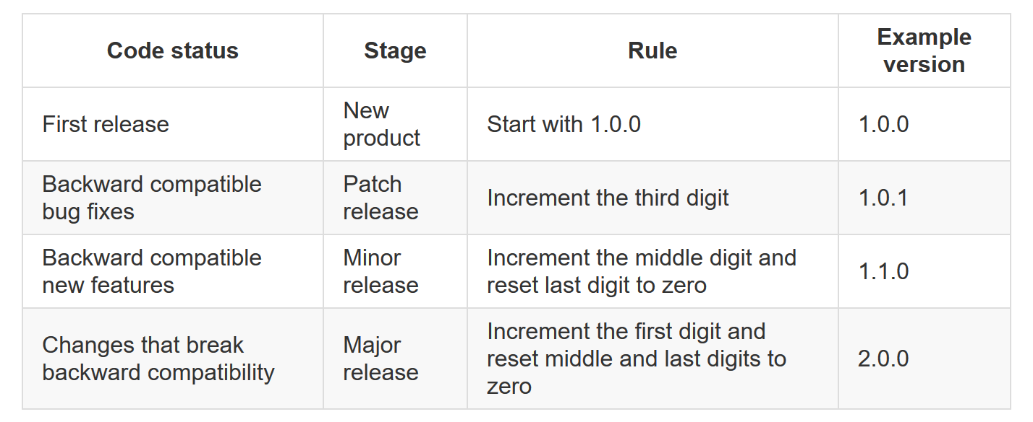

Slide 50
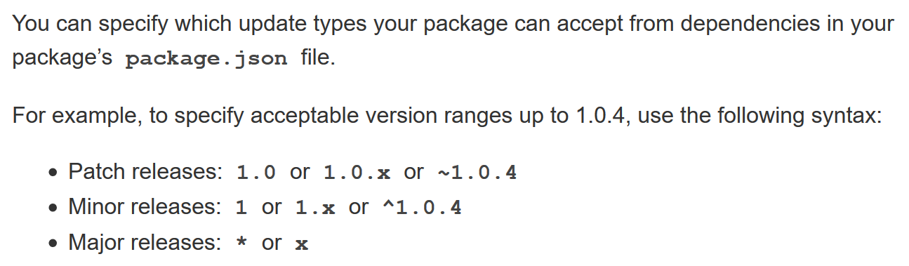

Slide 51
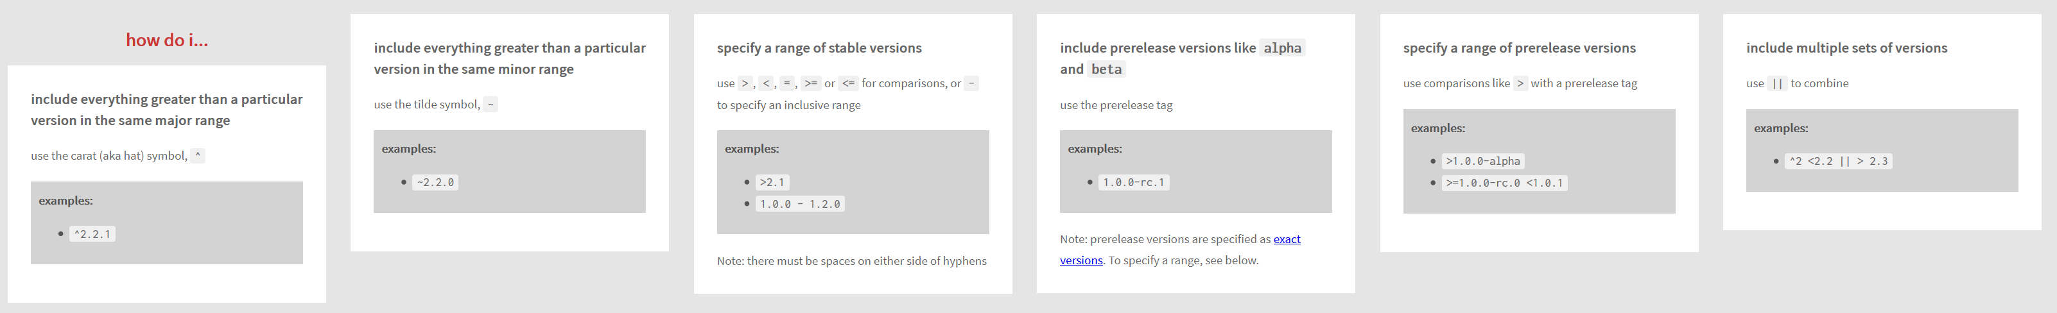

Slide 52
npm cli
Global Installation
npm install -g <package_name>
npm i -g <package_name>
Global Un-installation
npm uninstall -g <package_name>
npm un -g <package_name>
List all Global Packages installed
npm list -g --depth=0

Slide 53
Update Package Versions
npm-check-updates - npm (npmjs.com)

Slide 54
WebSocket
WebSocket is a computer communications protocol, providing full-duplex communication channels over a single TCP connection.
The WebSocket protocol was standardized by the IETF as RFC 6455 in 2011
The WebSocket API in Web IDL is being standardized by the W3C.
WebSocket uses HTTP as the initial transport mechanism but keeps the TCP connection alive after the HTTP response is received so that it can be used for sending messages between client and server.

Slide 55
NODE SERVER
BROWSER
HTTP + URL
HTML + JS
I want WebSocket Communication (WS Request)
Should have a code to accept and acknowledge the WebSocket Request
WebSocket Handshake
Acknowledgement

Slide 56
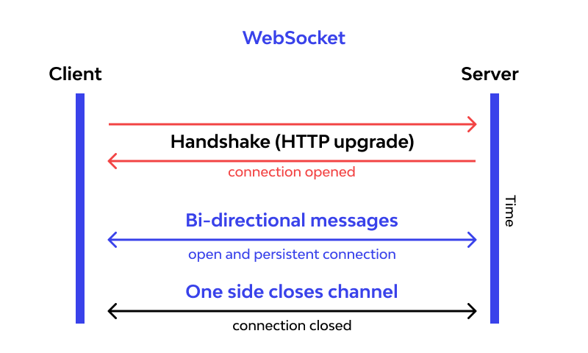

Slide 57
Express JS
Fast, unopinionated, minimalist web framework for Node.js
Express is a minimal and flexible Node.js web application framework that provides a robust set of features for web and mobile applications.
With a myriad of HTTP utility methods and middleware at your disposal, creating a robust API is quick and easy.

Slide 58
BROWSER
SERVER
HTTP + URL
NAVIGATION
HTML PAGES
CSS
HTML + CSS

Slide 59
BROWSER
SERVER
HTTP + URL
NAVIGATION
HTML + CSS
Server PAGES
CSS
Express JS + Template Engine
DB

Slide 60
Template Engines
A template engine enables you to use static template files in your application.
At runtime, the template engine replaces variables in a template file with actual values and transforms the template into an HTML file sent to the client.
This approach makes it easier to design dynamic HTML pages.

Slide 61
Template Engines
There are multiple template engines that work “out-of-the-box” with Express, some examples are:
Pug: Haml-inspired template engine (formerly Jade).
Haml.js: Haml implementation.
EJS: Embedded JavaScript template engine.
hbs: Adapter for Handlebars.js, an extension of Mustache.js template engine.
All out-of-the-box Template Engines

Slide 62
Express and Middleware
Express is a routing and middleware web framework that has minimal functionality of its own.
An Express application is essentially a series of middleware function calls.
Middleware is a subset of chained function called by the Express app before the user-defined handler is invoked.
Middleware functions have full access to the request and response objects and the next middleware function in the application’s request-response cycle.
Middleware functions can perform the following tasks:
Execute any code.
Make changes to the request and the response objects.
End the request-response cycle.
Call the next middleware function in the stack.

Slide 63
Request Processing Pipeline
REQUEST
RESPONSE
Middleware (Logging, Authentication, Authorization e.t.c.)

Slide 64
Types of middleware
An Express application can use the following types of middleware:
Application-level middleware
Router-level middleware
Error-handling middleware
Built-in middleware
Third-party middleware

Slide 65
Catching Errors
Errors that occur in synchronous code inside route handlers and middleware require no extra work. If synchronous code throws an error, then Express will catch and process it.
For errors returned from asynchronous functions invoked by route handlers and middleware, you must pass them to the next() function, where Express will catch and process them.
a try...catch block to catch's errors in the asynchronous code and pass them to Express. If the try...catch block were omitted, Express would not catch the error since it is not part of the synchronous handler code.
Use promises to avoid the overhead of the try...catch block or when using functions that return promises.

Slide 66
Implementation – Not following MVC
HTTP
Request
Router
Views
HTTP
Response
Data Access
Database

Slide 67
MVC
MVC is an acronym for Model-View-Controller. It is a design pattern for software projects.
It is used majorly by Node developers and by C#, Ruby, PHP framework users too.
In MVC pattern, application and its development are divided into three interconnected parts.
The advantage of this is it helps in focusing on a specific part of the application name, the ways information is presented to and accepted from, the user.
It helps in allowing for efficient code reuse and the parallel development of the application.

Slide 68
MVC
Model:
Model represents the structure of data, the format and the constraints with which it is stored.
It maintains the data of the application. Essentially, it is the database part of the application.
View:
View is what is presented to the user. Views utilize the Model and present data in a form in which the user wants.
A user can also be allowed to make changes to the data presented to the user.
They consist of static and dynamic pages which are rendered or sent to the user when the user requests them.
Controller:
Controller controls the requests of the user and then generates appropriate response which is fed to the viewer.
Typically, the user interacts with the View, which in turn generates the appropriate request, this request will be handled by a controller.

Slide 69
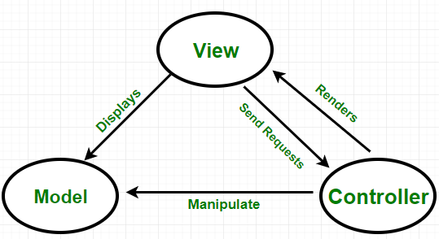

Slide 70
MVC Implementation
HTTP
Request
Router
HTTP
Response
Forward request to
appropriate controller
Controller
Views
Read/write data
Models
Database

Slide 71
Express Generator
Express Generator is a command-line tool for scaffolding out Express web applications quickly.
It generates the basic directory structure and files needed to get started with an Express application, including routes, views, and middleware.

Slide 72
Using Express Generator – Method 1
npm i -g express-generator (Only once)
express --view=pug 1_express-app
cd 1_express-app
ncu -u
npm i
npm i -D nodemon
Change the start script in package.json file, to use nodemon
npm start

Slide 73
Using Express Generator – Method 2
npx express-generator --view=pug 1_express-app
cd 1_express-app
ncu -u (npm i -g npm-check-updates)
npm i
npm i -D nodemon
Change the start script in package.json file, to use nodemon
npm start

Slide 74
Assignment (Use Product Assignment Code)
Create a CRUD application to work with employee data using express generator.
Write code to persist the data in JSON file (employees.json)
Use Promise based implementation.
Employee Schema
id – number
name – string
designation – string
salary – number

Slide 75
MongoDB
MongoDB is a popular open-source, document-oriented NoSQL database that stores data in flexible, JSON-like documents with dynamic schemas.
Unlike traditional relational databases, which use tables to store data, MongoDB stores data in collections of JSON-like documents, which can have varying structures and fields.
MongoDB is designed to be highly scalable, allowing you to easily scale your database horizontally by adding more servers to a cluster. It also supports a wide range of use cases, including web applications, mobile apps, content management systems, and more.
MongoDB uses a query language similar to SQL called the MongoDB Query Language (MQL), which allows you to perform complex queries on your data using a simple syntax. It also provides a powerful aggregation framework that allows you to perform advanced data analysis and transformation.
MongoDB is widely used in modern web development, particularly in the MEAN (MongoDB, Express.js, AngularJS, Node.js) and MERN (MongoDB, Express.js, React.js, Node.js) stacks.

Slide 76
Create a database on MongoDB Atlas
Follow these steps:
Sign up for a MongoDB Atlas account at https://www.mongodb.com/cloud/atlas/register
Once you're signed up, log in to your MongoDB Atlas account.
Click on the "Build a New Cluster" button and follow the prompts to create a new cluster. You'll need to select a cloud provider, region, and tier for your cluster, as well as specify a cluster name and other settings.
Once your cluster is created, click on the "Connect" button to connect to your cluster.
You'll be presented with several options for connecting to your cluster. Choose "Connect your application" to get the connection string you'll need to connect to your cluster from your Node.js application.

Slide 77
What is Mongoose?
Mongoose is an Object-Document Mapping (ODM) library for Node.js and MongoDB.
It provides a straightforward way to interact with MongoDB databases by abstracting away the complexities of working directly with the MongoDB driver.
It provides a higher level of abstraction, making it easier to work with MongoDB and enabling you to build scalable and maintainable applications.
To use Mongoose in your Node.js application, you need to install it via npm (npm install mongoose) and then require it in your code.

Slide 78
Key features and functionalities of Mongoose
Schema-Based Modeling: Mongoose allows you to define schemas to represent the structure, data types, and validation rules of your MongoDB documents. Schemas provide a clear structure for your data and enable you to enforce data integrity.
Data Validation: Mongoose provides built-in data validation capabilities. You can define validation rules for each field in your schema, ensuring that the data stored in the database meets the specified criteria.
Query Building: Mongoose simplifies the process of building MongoDB queries. It provides a rich set of query-building methods and helpers, allowing you to perform complex database operations using a more intuitive and expressive syntax.
Middleware: Mongoose supports middleware functions that allow you to define pre and post hooks for various database operations such as saving, updating, and removing documents. Middleware functions provide a way to add custom logic and perform actions before or after specific database operations.

Slide 79
Key features and functionalities of Mongoose
Model-Based Approach: With Mongoose, you define models based on your schemas. Models represent a collection in your MongoDB database and provide an interface for creating, querying, updating, and deleting documents. Models encapsulate the business logic of your application and simplify database operations.
Population and References: Mongoose supports population, which allows you to automatically resolve references between documents. You can define relationships between collections using references or subdocuments and use population to retrieve related data easily.
Middleware for Express.js: Mongoose integrates well with Express.js and provides middleware functions that simplify handling database operations in your Express.js routes.

Slide 80
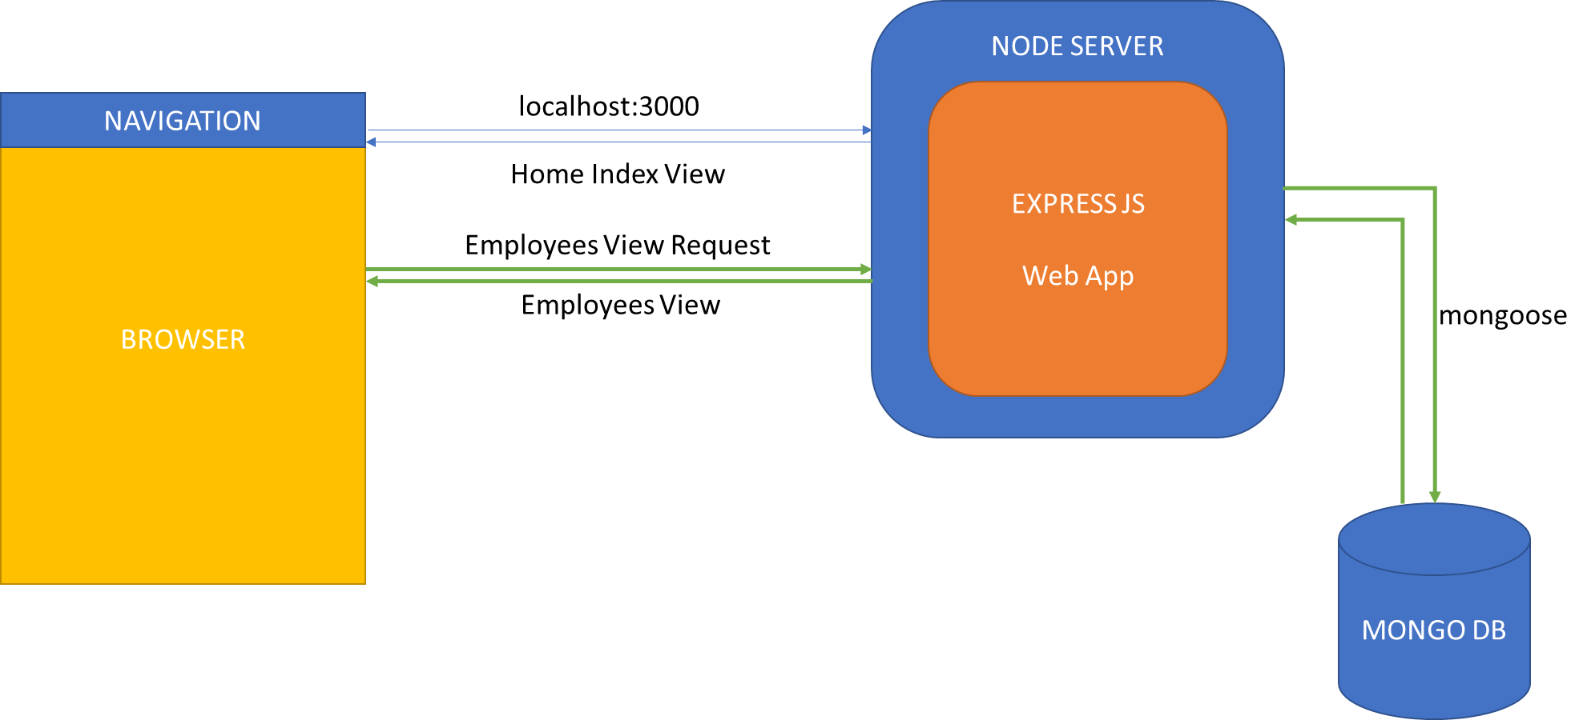
CRUD Application

Slide 81
What is Passport JS?
Passport is a popular authentication middleware for Node.js that allows developers to add user authentication to their web applications.
Passport provides a simple and modular way to authenticate users with a variety of different authentication mechanisms.
Passport uses a strategy-based approach, where each authentication mechanism is implemented as a separate strategy.
A strategy is essentially a module that contains the logic for authenticating a user with a specific authentication mechanism.
Passport comes with many built-in strategies, and developers can also create custom strategies to support any authentication mechanism that is not supported out-of-the-box.
Overall, Passport simplifies the process of adding authentication to Node.js web applications by providing a unified interface to a variety of authentication mechanisms, making it easier for developers to focus on building their applications rather than worrying about the underlying authentication logic.

Slide 82
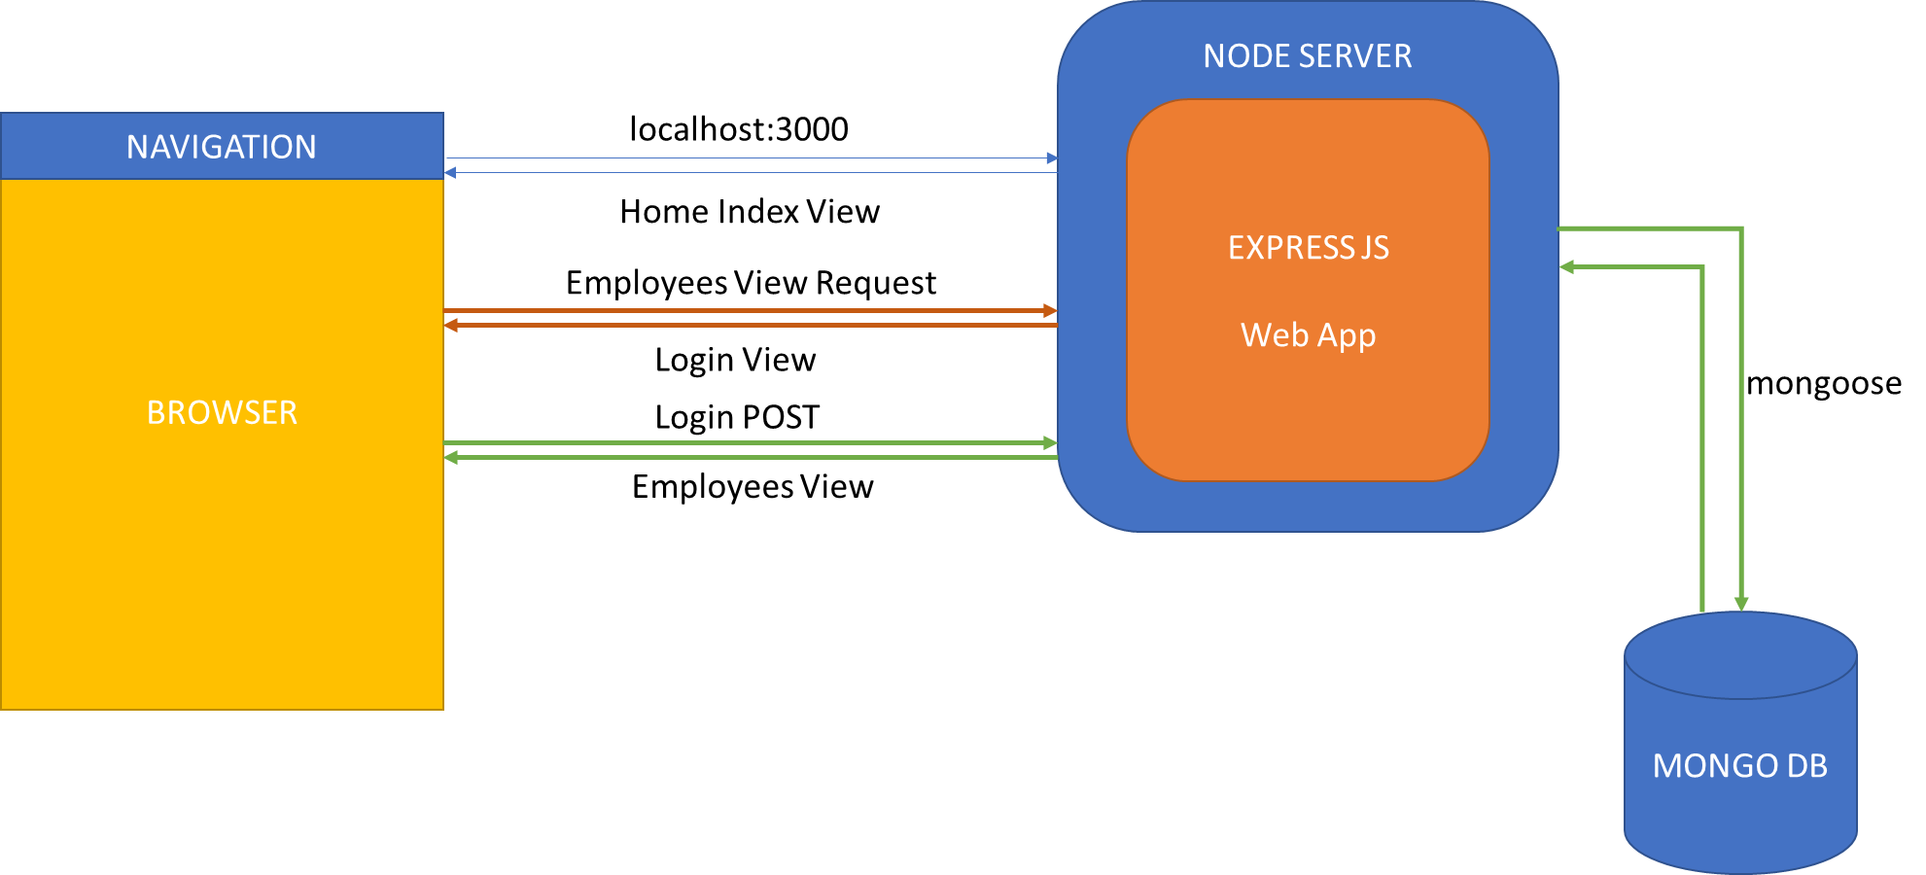
CRUD Application Secured

Slide 83
Assignments
Implement WebSocket using ws & socket.io packages
https://www.npmjs.com/package/ws
https://www.npmjs.com/package/socket.io
Revise and do the exercises which we covered in last 3 days of our session.
Create a Secured CRUD application using
Mongoose
Sequelize - https://sequelize.org/docs/v6/getting-started/
Passport JS using Google oAuth
https://www.passportjs.org/packages/passport-google-oauth/

Slide 84
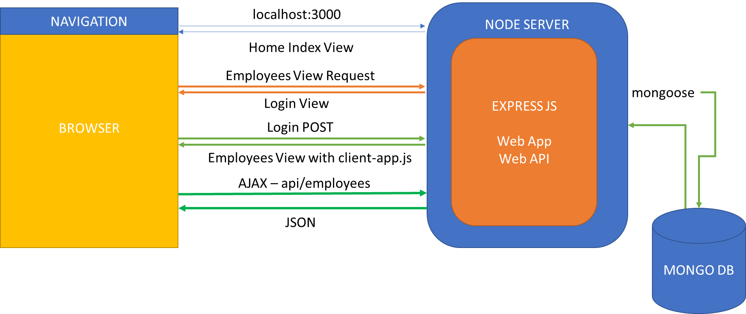
CRUD Application With API (In Domain)

Slide 85
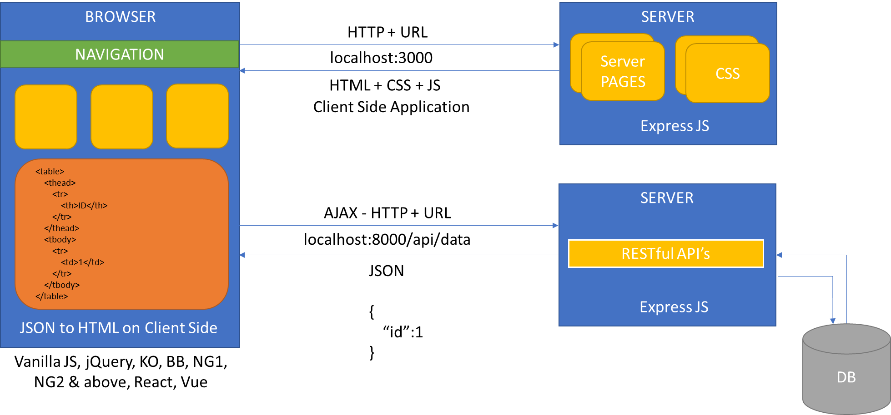
CRUD Application With API (Cross Domain)

Slide 86
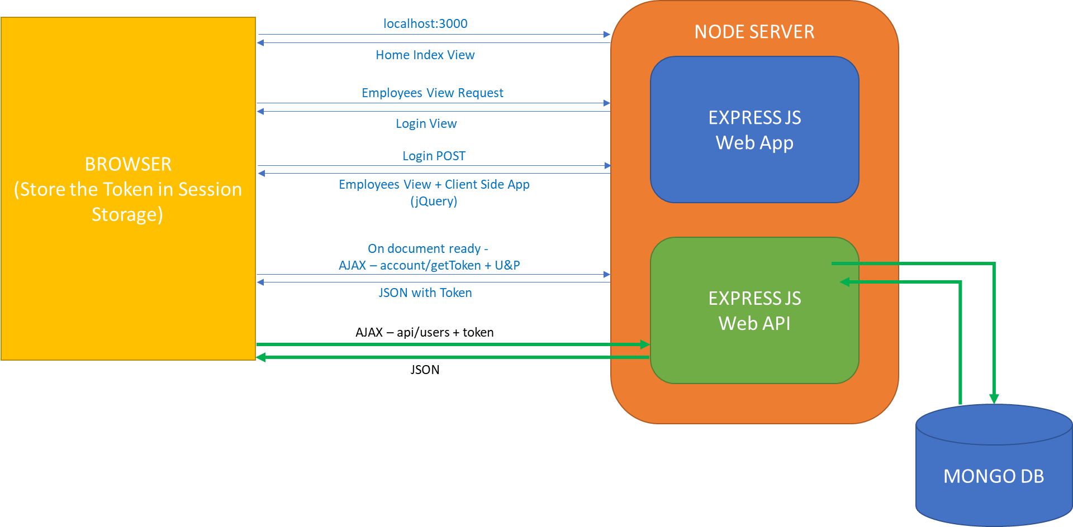
CRUD with API Secured

Slide 87
What is PM2?
PM2 (Process Manager 2) is a production-ready process manager for Node.js applications.
It is designed to simplify the deployment, monitoring, and management of Node.js processes in a production environment.
PM2 provides a set of features that enhance the stability and scalability of Node.js applications.

Slide 88
Key features of PM2
Process management: PM2 can manage multiple Node.js processes, allowing you to easily start, stop, restart, and monitor them. It provides a unified interface to manage all your Node.js applications or microservices.
Automatic restarts: PM2 can automatically restart crashed or stopped processes, ensuring high availability of your applications. It can monitor the health of your application and take appropriate actions if any process encounters an error or stops unexpectedly.
Load balancing: PM2 supports built-in load balancing mechanisms that distribute incoming requests across multiple instances of your application. This helps improve the performance and scalability of your Node.js applications by leveraging the available system resources effectively.

Slide 89
Key features of PM2
Logging and log management: PM2 collects and manages logs from your Node.js processes, allowing you to easily access and monitor application logs. It provides features like log rotation, log streaming, and log aggregation to simplify log management.
Monitoring and performance metrics: PM2 provides a web-based dashboard that displays real-time monitoring and performance metrics of your Node.js processes. You can monitor CPU and memory usage, response times, and other important metrics to gain insights into the health and performance of your applications.
Process clustering: PM2 can spawn multiple instances of your application across available CPU cores, maximizing the utilization of system resources and enabling better performance and concurrency.
Zero-downtime deployments: PM2 supports seamless zero-downtime deployments by enabling you to reload or update your application without interrupting the ongoing requests or causing any downtime for your users.

Slide 90
Contact Me
Manish Sharma | Gmail
Manish Sharma | WhatsApp
Manish Sharma | Facebook
Manish Sharma | LinkedIn

