Slide 1
Learn the Chef basics
Chef helps you express your infrastructure policy – how your software is delivered and maintained on your servers – as code. When infrastructure is code, it becomes more maintainable, versionable, testable, and collaborative.
After completing this section, you should be able to:
describe what happens when Chef runs.
write Chef code that defines a basic policy.
apply that policy to a server.
Remember, for learning purposes, you'll start by managing a server directly. To do that, you'll install Chef Workstation on your instance. Chef Workstation provides tools that enable you to manage your servers remotely from your workstation. But it also provides tools that allow you to configure a machine directly.

Slide 2
Connect to AWS EC2
Access your AWS account and Launch an Ubuntu 18.04 instance
Connect to your Ubuntu instance
To connect from VS Code PowerShell terminal
ssh -i "/path/to/private/key" username@host
convert your private key
Open PuTTYgen, Under Type of key to generate, choose RSA.
Choose Load and Select .pem file specified while launching instance, Choose OK.
Choose Save private key, Specify the same name as .pem file but with (.ppk) ext.
connect to your instance using PuTTY
Start PuTTY , In the Category pane, choose Session
In the Host Name box, , enter user_name@public_dns_name
Ensure that the Port value is 22 (SSH).
In the Category pane -> Connection ->SSH, and then choose Auth.
Browse the .ppk file that you generated for your key pair and choose Open

Slide 3
Connect to SFTP using Visual Code
CTRL + SHIFT + P -> SFTP Confi -> Enter below Code
{
"name": "EC2ChefWorkStation",
"remotePath": "/home/ubuntu",
"host": "ec2-13-52-61-229.us-west-1.compute.amazonaws.com",
"username": "ubuntu",
"port": 22,
"secure": true,
"protocol": "sftp",
"uploadOnSave": true,
"passive": false,
"debug": true,
"privateKeyPath": "C:\\Users\\soham\\.ssh\\west1.pem",
"generatedFiles": {
"uploadOnSave": false,
"extensionsToInclude": [],
"path": ""
}
}

Slide 4
Install Chef Workstation on EC2
From your SSH connection, first update the apt cache and then install curl.
sudo apt-get update
sudo apt-get -y install curl
Run this to install Chef Workstation.
curl https://omnitruck.chef.io/install.sh | sudo bash -s -- -P chef-workstation -c stable -v 0.2.41
chef -v (Verify the chef workstation installation)
Install Git (https://git-scm.com/downloads)
git --version
Verify your SSH client
ssh

Slide 5
Recipe
A Chef recipe is a file that groups related resources, such as everything needed to configure a web server, database server, or a load balancer. A Recipe is a file that holds one or more resources.
A Chef resource describes one part of the System, such as a file, a template, or a package.
Every resource in Chef has a default action, An action as the process that achieves the desired configuration state.
for example, create a file, install a package, and start a service.
When we created the file we didn't specify the :create action because :create is the default.
Chef applies resources in the order you specify.

Slide 6
Demo- First Chef Recipe
Set up your working directory
mkdir ~/chef-repo
cd ~/chef-repo
Inside ~/chef-repo directory, create a file, FirstRecipe.rb (see code file)
Run the following chef-client command to apply chef code
chef-client --local-mode FirstRecipe.rb
verify that the file
more /tmp/sample
chef-client downloads and runs the latest Chef code from the Chef server, however in this demo, we will run chef-client in local mode to apply Chef code that exists locally on your server.
let's see now what happens when you run the same chef-client command again.
This time you get a different response – the file is already up to date. This is because Chef applies the configuration only when it needs to.
Chef looks at the current configuration state and applies the action only if the current state doesn't match the desired state. This approach is called as test and repair

Slide 7
Update/Delete file content using chef
Now update the recipe FirstRecipe.rb to modify the content of sample file
file '/tmp/sample' do
content 'Good Day'
end
Run the following chef-client command to apply chef code
chef-client --local-mode FirstRecipe.rb
This time Chef applies the action because you've changed the desired state of the file.
Let’s manually change content of /tmp/sample by replacing 'Good Day ' with 'Hello World' and Run chef-client command to apply chef code
chef-client --local-mode FirstRecipe.rb
Observer Chef restored the original configuration. This is actually a really good thing because Chef ensures that the actual state of your resource matches what you specify, even if it is altered by some outside process.
Delete the Sample file
create a new file named DeleteSampleFile.rb and save the following content to it.
sudo chef-client --local-mode DeleteSampleFile.rb

Slide 8
Install and configure a package and service
Packages and services are also types of resources similar like files.
Lets manage the Apache HTTP Server package and its service.
First Let’s ensure the apt cache is up to date using recipe
You could run the apt-get update command manually when you bring up your instance. But over time, but Chef provides the apt_update resource to automate the process.
In your ~/chef-repo directory, add this code to a file named webserver.rb
apt_update 'Update the apt cache daily' do
frequency 86_400
action :periodic
end
The frequency property specifies how often to update the apt cache (in seconds.)
Here, we specify 86,400 seconds to update the cache once every 24 hours.
The _ notation is a Ruby convention that helps make numeric values more readable.
The :periodic action means that the update occurs periodically, but the :update action can be used instead of :periodic to update the apt cache each time Chef runs.

Slide 9
let's install the Apache package, apache2. Modify webserver.rb to look like this.
apt_update 'Update the apt cache daily' do
frequency 86_400
action :periodic
end
package 'apache2‘
(Note: We don't need to specify an action because :install is the default.)
Now let's first enable the Apache service when the server boots and then start the service. Modify webserver.rb to look like this.
apt_update 'Update the apt cache daily' do
frequency 86_400
action :periodic
end
package 'apache2'
service 'apache2' do
supports status: true
action [:enable, :start]
end
This code declares multiple action [:enable, :start]
Now run chef-client to apply the recipe.
sudo chef-client --local-mode webserver.rb

Slide 10
Add a HTML webpage (Ubuntu uses /var/www/html/index.html as the default home page)
Let’s configure a file resource; append one that configures the default home page, /var/www/html/index.html, to the end of webserver.rb (see code in file)
sudo chef-client --local-mode webserver.rb
Confirm your web site is running
curl localhost
Access your web server from a browser on port 80
Chef resources are applied in the order they are specified in the recipe. So here,
the apt cache is updated,
the package is installed,
then the service is configured, and
finally the home page is set.
The same idea applies to the action list [:enable, :start] for configuring the service. The service is enabled when the server boots and then it's started.
If any resource is already in the desired state, Chef simply moves on to the next one.
A recipe stops if any step fails (don't worry – Chef provides info about the error). That's why we ordered the service actions the way we did. If the service can't be enabled on boot then we don't want to start it.

Slide 11
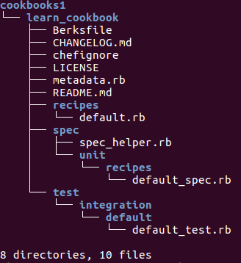
Create a cookbook
A cookbook provides structure to your recipes and enables you to more easily reference external files, such as our web server's home page. In essence, a cookbook helps you stay organized.
Let's create a cookbook to make our web server recipe easier to manage.
First, In ~/chef-repo directory, create the cookbooks directory.
mkdir cookbooks
Run the chef generate cookbook command to generate a cookbook named learn_cookbook.
chef generate cookbook cookbooks/learn_cookbook
Lets see the directory structure that command created.
tree cookbooks
run sudo apt-get install tree to install the tree utility
Note the default recipe, named default.rb.

Slide 12
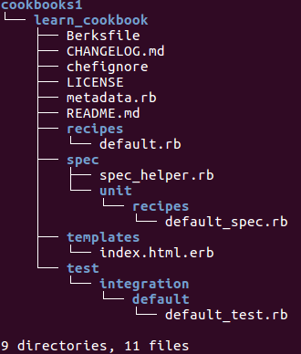
Create webpage template in cookbook
Now we'll move the home page to an external file. First, run this command to generate the HTML file for our home page
chef generate template cookbooks/learn_cookbook index.html
Observe The file index.html.erb gets created, The .erb extension means that the file can have placeholders.
Now copy the contents of the HTML file from your recipe to HTML file, index.html.erb.
<html>
<body>
<h1> Hello From Cookbook</h1>
</body>
</html>
Here, you're adding the web site content directly to your cookbook for learning purposes. In practice, With Chef, you could pull updated web content from your build server and deploy it to your web server.

Slide 13
Update the recipe to reference the HTML template (Write the default.rb, like below)
sudo nano cookbooks/learn_cookbook/recipes/default.rb
apt_update 'Update the apt cache daily' do
frequency 86_400
action :periodic
end
package 'apache2'
service 'apache2' do
supports status: true
action [:enable, :start]
end
template '/var/www/html/index.html' do
source 'index.html.erb'
end
Now run the cookbook using the chef-client command and specify what's called the run-list.
sudo chef-client --local-mode --runlist 'recipe[learn_cookbook]'
The above would install the new index.html from template.
Here you applied just one recipe, but the run-list can contain multiple recipes from multiple cookbooks.
In this example, recipe[learn_chef_apache2] is the same as specifying recipe[learn_chef_apache2::default], meaning we want to run the learn_chef_apache2 cookbook's default recipe, default.rb.

Slide 14
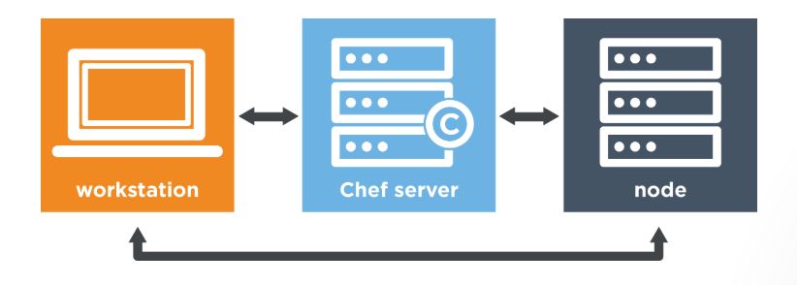
Chef Automate with AWS OpsWorks
Typically, Chef is comprised of three parts – your workstation, a Chef server, and nodes.
Workstation is the computer from which you author your cookbooks and administer your network. It's typically the machine you use everyday, be it Linux, macOS, or Windows.
Chef server acts as a central repository for your cookbooks as well as for information about every node it manages. For example, the Chef server knows a node's fully qualified domain name (FQDN) and its platform.
A node is any computer that is managed by a Chef server. Every node has the Chef client installed on it. The Chef client talks to the Chef server. A node can be any physical or virtual machine in your network.

Slide 15
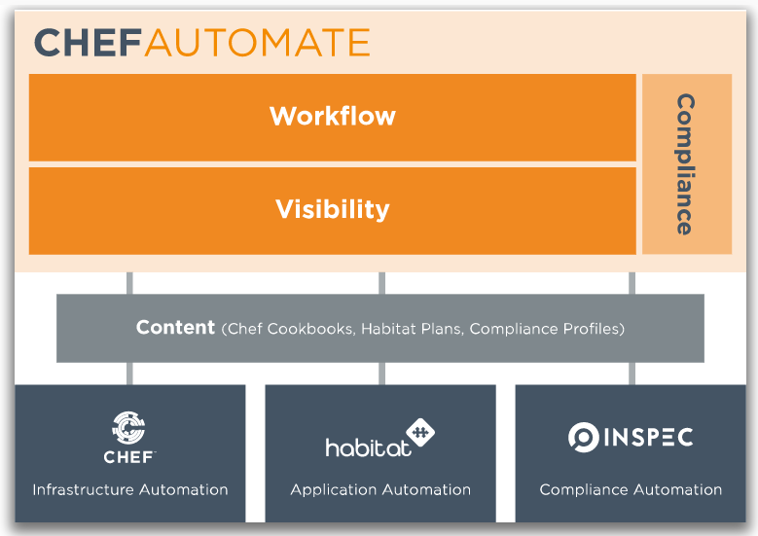
Chef Automate extends this setup by giving your operations and development teams a common platform for developing, building, testing, and deploying cookbooks, applications, and more. It enables multiple teams to work together on systems made up of many different components and services, and promotes the DevOps principles of cross-team collaboration, cooperation, and transparency.
Chef Automate provides a full-stack continuous delivery solution, which includes workflow, visibility, and compliance.

Slide 16
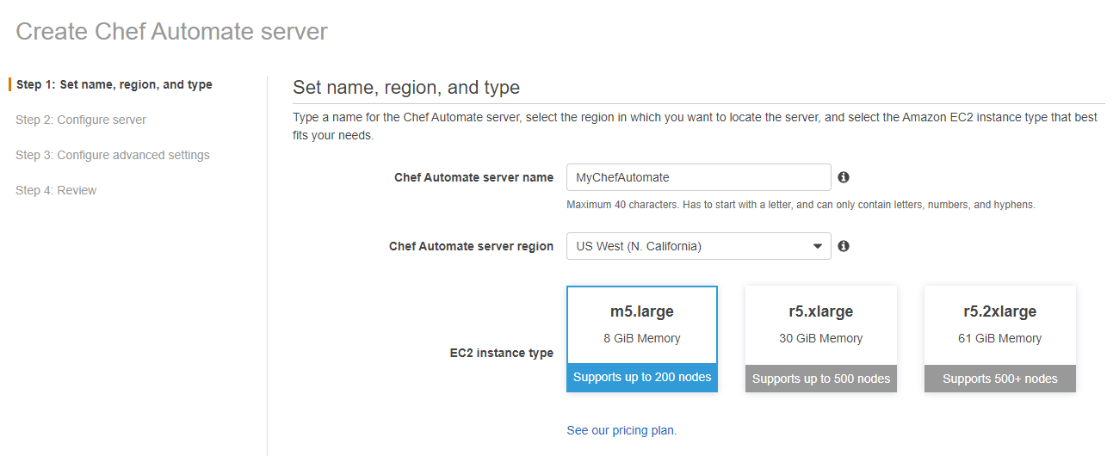
Bring up an OpsWorks for Chef Automate instance through the AWS console
process takes about 20 minutes to complete) https://docs.aws.amazon.com/opsworks/latest/userguide/gettingstarted-opscm-create.html
Download your Chef Automate login credentials and the starter kit.

Slide 17
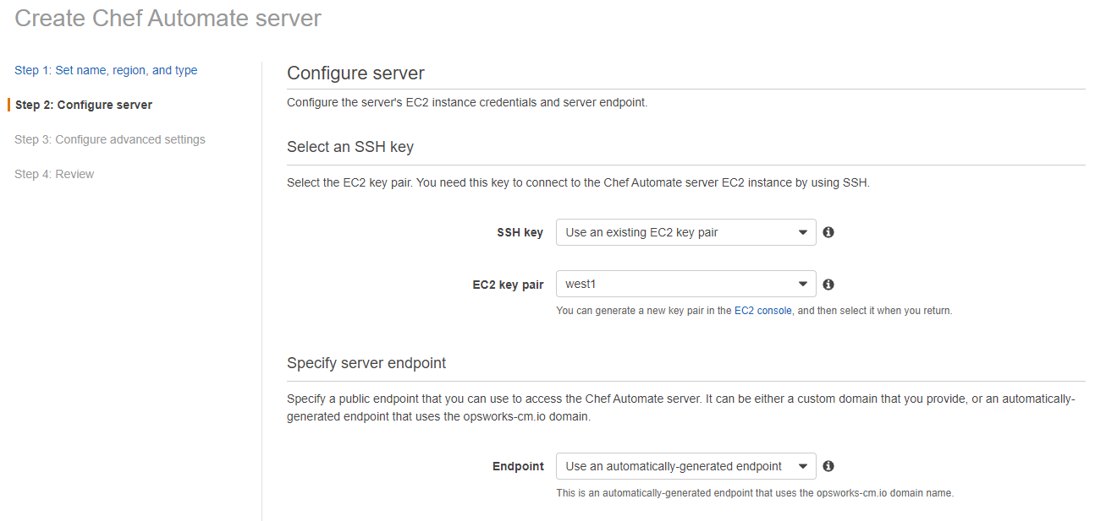

Slide 18
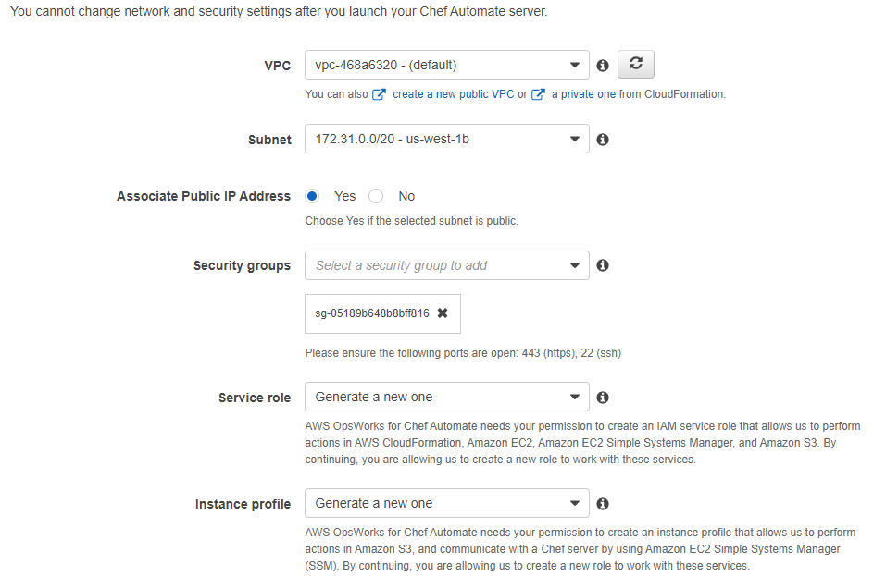

Slide 19
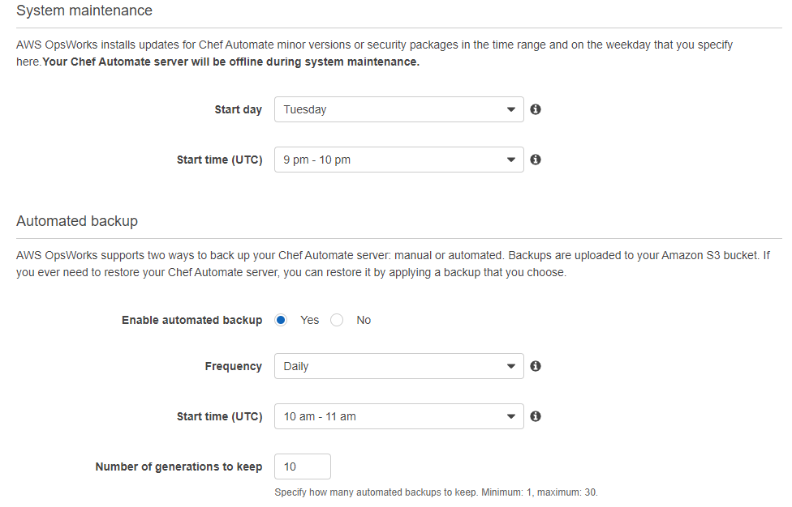
On the Review page, review your choices. When you are ready to create the server, choose Launch.
While you are waiting for AWS OpsWorks to create your Chef server, go on to Configure the Chef Server Using the Starter Kit and download the Starter Kit and the Chef Automate dashboard credentials. Do not wait until your server is online to download these items.
When OPSWORKS server creation is finished, your Chef server is available on the AWS OpsWorks for Chef Automate home page, with a status of online. And the Chef Automate dashboard is available on the server's domain, at a URL in the following format:
https://your_server_name-random.region.opsworks-cm.io

Slide 20
Set up your workstation (An EC2 instance, as your workstation as you experiment with Chef)
We can use the workstation we have created in previous module hence skip below
Otherwise to create and Install Chef Workstation (New EC2 as workstation)
wget https://packages.chef.io/files/stable/chef-workstation/0.17.5/ubuntu/18.04/chef-workstation_0.17.5-1_amd64.deb (check for download link @ https://downloads.chef.io/chef-workstation)
sudo dpkg -i chef-workstation_0.17.5-1_amd64.deb
chef -v (Verify the chef workstation installation)
Install Git (https://git-scm.com/downloads)
git --version
Verify your SSH client
ssh

Slide 21

Move the starter kit zip file to home directory of EC2 workstation node and Now Extract the starter kit to your home directory.
unzip mychefautomate_starter_kit.zip
(To Install unzip - sudo apt install unzip)
Notice that your starter kit name and Chef server domain end point name is same, So rename it.
mv mychefautomate-1ergce1d6bndf0fi/ learn-chef
tree -a ~/learn-chef
To ensure you're able to authenticate commands and validate SSL certificate with the Chef server, Run below command from your ~/learn-chef directory
cd learn-chef
knife ssl check
knife is the command-line tool that provides an interface between your workstation and the Chef server. knife enables you to upload your cookbooks to the Chef server and work with nodes, the servers that you manage.
knife requires two files to authenticate with the Chef server.
an RSA private key
Every request to the Chef server is authenticated through an RSA public key pair. The Chef server holds the public part; you hold the private part.
a knife configuration file
The configuration file is typically named knife.rb {.chef/knife.rb}. It contains information such as the Chef server's URL, the location of your RSA private key, and the default location of your cookbooks.
Both of these files are typically located in a directory named .chef. By default, every time knife runs, it looks in the current working directory for the .chef directory. If the .chef directory does not exist, knife searches up the directory tree for a .chef directory. This process is similar to how tools such as Git work.

Slide 22
Log in to the Chef Automate dashboard
Chef Automate provides a web interface where you can monitor and visualize the status of nodes. for example, https://mychefautomate-1ergce1d6bndf0fi.us-east-1.opsworks-cm.io/
Sign in using the credentials you downloaded (After loin modify password – admin123)
The Chef Automate dashboard appears. Select the Infrastructure tab.
Notice that the Nodes is initially empty. Leave your browser window open for now.
At this point, A Chef server and a Chef Automate server is set up through OpsWorks for Chef Automate and your workstation is configured to work with them.
Upload a cookbook to Chef server
Most Chef users maintain their cookbooks in a version control system such as Git.
Chef server also gives you a persistent location to store your cookbooks and information about your nodes. Chef Automate's visibility feature gives you insight into what's happening on your Chef server.
Along with source control(GIT), maintaining another copy of your cookbooks on the Chef server provides these benefits:
A central location for your cookbooks that's accessible from every node in your network.
A versioning mechanism that enables you to associate different cookbook versions among your nodes. This enables you to roll out new configuration policies only when you're ready.
The Chef server does not replace version control. Version control is where you and your team maintain your cookbooks as you develop them. Chef server is where you publish your cookbooks when you're ready to run them on your nodes.

Slide 23
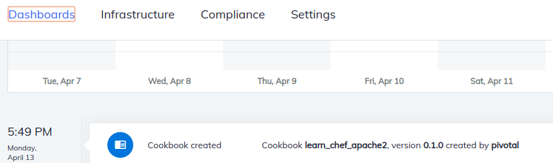
Get the cookbook from GitHub (Normally, you write cookbooks and place it in Github)
First, you need a place to store your cookbooks locally on your workstation.
Notice Your knife.rb file (cat .chef/knife.rb)
cookbook_path - [File.join(base_dir, 'cookbooks')]
Here, ~/learn-chef. cookbook_path joins base_dir with the cookbooks directory
Move to ~/learn-chef/cookbooks directory.
cd ~/learn-chef/cookbooks
Now, clone the learn_chef_apache2 cookbook from GitHub.
(content same as same as what you built in the previous module)
git clone https://github.com/learn-chef/learn_chef_apache2.git
Upload cookbook to the Chef server
Run this command from anywhere under your ~/learn-chef directory to upload the learn_chef_apache2 cookbook to your Chef server.
knife cookbook upload learn_chef_apache2
knife cookbook list (Run the knife cookbook list command to verify)
Return to the Chef Automate dashboard and refresh the page.

Slide 24
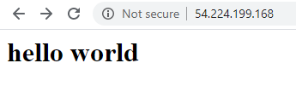
Create nodes to bootstrap
Create multiple EC2 instances with security group with port 22, 80 and 443 open.
Any computer that's managed by a Chef server is called a node, and that chef-client is the command that applies the policy defined by your cookbooks to a node.
Run the bootstrap command using key-based authentication
knife bootstrap 13.52.239.53 --ssh-user ubuntu --sudo --ssh-identity-file /home/ubuntu/.ssh/west1.pem --node-name node1-ubuntu --run-list 'recipe[learn_chef_apache2]'
knife bootstrap 13.52.239.54 --ssh-user ubuntu --sudo --ssh-identity-file /home/ubuntu/.ssh/west1.pem --node-name node2-ubuntu --run-list 'recipe[learn_chef_apache2]'
Remember to copy ssh(.pem) key file to workstation (/home/ubuntu/.ssh/west1.pem)
The --node-name argument uniquely identifies the node with the Chef server.
knife bootstrap is the command you use to bootstrap a node. Bootstrapping is a one-time process. During the bootstrap process, your node downloaded and installed chef-client, downloaded the latest cookbooks, and executed the run-list.
Verify the nodes are registered with Chef Server and visible in chef automate web page.
To verify this, run the knife node list command.
knife node list
knife node show node1-ubuntu
knife node show node2-ubuntu
Also can verify the webpage in both nodes.

Slide 25
Let’s make a change to your cookbook, upload it to the Chef server, and see the node update its configuration.
When you bootstrapped your node, the Chef server created what's called a node object which contains number of attributes that describe the node, and these attributes are saved on the Chef server.
When a recipe runs, a node object is loaded into the program. You can access these attributes from your Chef recipes.
For e.g., we want to display the server's fully qualified domain name (FQDN) in webpage. To do so, we access the fqdn attribute of the node object.
On the local workstation copy of your learn_chef_apache2 cookbook, change index.html.erb to look like this.
nano learn_chef_apache2/templates/index.html.erb
<html>
<body>
<h1>hello from <%= node['fqdn'] %></h1>
</body>
</html>
Before uploading an updated cookbook to Chef server always update your cookbook's version in metadata.rb to ensure that each version is tied to a specific set of functionality. The initial version is set to 0.1.0 bydefault.
nano learn_chef_apache2/metadata.rb (Modify to version '0.2.0')

Slide 26
Upload your cookbook to the Chef server
knife cookbook upload learn_chef_apache2
Run the cookbook on your node
knife ssh 'name:node1-ubuntu' 'sudo chef-client' --ssh-user ubuntu --ssh-identity-file ~/.ssh/west1.pem --attribute ipaddress
knife ssh 'name:node2-ubuntu' 'sudo chef-client' --ssh-user ubuntu --ssh-identity-file ~/.ssh/west1.pem --attribute ipaddress
The knife ssh command enables you to update your node's configuration when your cookbook changes.
The chef-client command pulls from Chef server the latest cookbooks from the node's run-list and applies the run-list to the node.
Also can verify the webpage in both nodes.

Slide 27
Run chef-client periodically
There are multiple ways to set up chef-client to run on a regular interval. On Linux nodes, you might use a daemon, cron job, or service.
Earlier in this module, you obtained starter code from GitHub. Chef Supermarket is also a place for the community to share cookbooks.
Chef provides a public Chef Supermarket site at https://supermarket.chef.io. You can also manage your own private Chef Supermarket server. Your Berksfile specifies that you want the chef-client cookbook and to pull cookbooks from the public Chef Supermarket server.
There are several ways to obtain cookbooks from Chef Supermarket. One way is to use the knife supermarket command. However, the chef-client cookbook has dependencies on other cookbooks and knife supermarket does not resolve these dependencies for you.
Berkshelf is a tool, comes with Chef Workstation that can retrieve the cookbooks that your cookbook depends on and can upload your cookbooks to your Chef server to helps you resolve cookbook dependencies.
Next, you need to create a configuration file that tells Berkshelf which cookbooks you want and where they're located.
From in your ~/learn-chef directory, create a file named Berksfile and add these contents.
cd learn-chef
sudo nano Berksfile (Filename is case sensitive)
source 'https://supermarket.chef.io'
cookbook 'chef-client'

Slide 28
Next, run berks install to download the chef-client cookbook and its dependencies.
berks install
Berkshelf downloads the chef-client cookbook and its dependent cookbooks to the ~/.berkshelf/cookbooks directory.
Next, you need to upload the chef-client cookbook and its dependencies to your Chef server.
Previously, you ran knife cookbook upload to upload your learn_chef_apache2 cookbook to the Chef server. Remember that the chef-client cookbook has dependencies on other cookbooks, so you need another way to upload everything.
You could run knife cookbook upload to manually upload each cookbook. An easier way is to run berks upload. Like berks install, berks upload handles dependencies for you.
Run berks upload to upload the chef-client cookbook and its dependencies to Chef server. The syntax varies slightly between Windows and other operating systems.
Linux and macOS
SSL_CERT_FILE='.chef/ca_certs/opsworks-cm-ca-2016-root.pem' berks upload
Windows
$env:SSL_CERT_FILE='.chef/ca_certs/opsworks-cm-ca-2016-root.pem'
berks upload
You may verify the location and verify certificate
ls .chef/ca_certs/
The SSL_CERT_FILE environment variable tells Berkshelf the location of your Chef server's SSL certificate, which is used to ensure that the connection is trusted.

Slide 29
In this part, you'll use a Role to update your node's run-list to use it and need to specify how often to run chef-client
How often chef-client to run, is controlled by two node attributes :
node['chef_client']['interval'] – interval specifies the number of seconds between chef-client runs. The default value is 1,800 (30 minutes).
node['chef_client']['splay'] – splay specifies a maximum random number of seconds that is added to the interval. Splay helps balance the load on the Chef server by ensuring that many chef-client runs are not occurring at the same interval. The default value is 300 (5 minutes).
By default, chef-client will run every 30—35 minutes on your node. In practice, the values you choose depend on your requirements. For learning purposes, you'll specify an interval of 5 minutes (300 seconds) and a splay of 1 minute (60 seconds), causing your node to check in every 5—6 minutes.
To update your node's run-list, you could use the knife node run_list set command. However, that does not set the appropriate node attributes. Hence to accomplish both tasks, you'll use a role. Roles enable you to focus on the function that your node performs collectively rather than each of its individual components (its run-list, node attributes, and so on).
For example, you might have a web server role, a database role, or a load balancer role. Here, you'll create a role named web to define your node's function as a web server.
Roles are stored as objects on the Chef server. To create a role, you can use the knife role create command. Another common way is to create a file (in JSON format) that describes your role and then run the knife role from file command to upload that file to the Chef server. The advantage of creating a file is that you can store that file in Git (version control system)

Slide 30
First, ensure you have a directory named ~/learn-chef/roles
mkdir ~/learn-chef/roles
nano ~/learn-chef/roles/web.json
{
"name": "web",
"description": "Web server role.",
"json_class": "Chef::Role",
"default_attributes": {
"chef_client": {
"interval": 300,
"splay": 60
}
},
"override_attributes": {
},
"chef_type": "role",
"run_list": ["recipe[chef-client::default]",
"recipe[chef-client::delete_validation]",
"recipe[learn_chef_apache2::default]"
],
"env_run_lists": {
}
}
This file defines the web role. It sets the required interval and splay attributes and also sets the run-list to contain the chef-client cookbook as well as the learn_chef_apache2 cookbook.
As a recommended practice, the run-list also contains the chef-client::delete_validation recipe. This recipe deletes the validation certificate (for example, /etc/chef/validation.pem) from your node. This certificate is used during the bootstrap process to authorize the node to connect to the Chef server, and is no longer needed.

Slide 31
Next, run the following knife role from file command to upload role to the Chef server.
knife role from file roles/web.json
knife role list (Verify knife role list to view the roles on your Chef server)
knife role show web (You can also run knife role show web to view the role's details)
The final step is to run the following knife node run_list set command to set node's run-list.
knife node run_list set node1-ubuntu "role[web]"
knife node run_list set node2-ubuntu "role[web]"
You can run the knife node show command to view your node's run-list.
knife node show node1-ubuntu --run-list
You're now ready to run chef-client on your node. Run chef-client
Like before, run the knife ssh command to trigger chef-client to run on your node. But this time replace the 'name:node1-ubuntu' with 'role:web'. If you have multiple nodes with the web role, chef-client would run on each of them.
knife ssh 'role:web' 'sudo chef-client' --ssh-user ubuntu --ssh-identity-file ~/.ssh/west1.pem --attribute ipaddress
You can see from the output that the chef-client cookbook set up chef-client as a service on your node.
Earlier, you examined your node's details in the Chef Automate web interface.
Now return to the Chef Automate dashboard, select Nodes, and then select your node.
From the details page, you'll see over time that your node runs chef-client within each 5—6 minute interval.

Slide 32
Now that chef-client is set up to run every 5—6 minutes, now's a great time to experiment with your node.
Modify home page template, index.html.erb, to practice the process.
nano cookbooks/learn_chef_apache2/templates/index.html.erb
<html>
<body>
<h1>Hey, hello from <%= node['fqdn'] %></h1>
</body>
</html>
nano cookbooks/learn_chef_apache2/metadata.rb (Modify to version '0.2.1')
Upload your cookbook to the Chef server
knife cookbook upload learn_chef_apache2
Manually log in to one node and stop the Apache service or delete the home page, /var/www/html/index.html. Refresh your browser window to see that your web server is down. Verify the chef updates everything when chef-client runs as per schedule.
Write a cookbook that configures a piece of software that you use. See if there are any cookbooks on Chef Supermarket that you can use to get started.

Slide 33
Clean up your environment
Delete the node from the Chef server
knife node delete node1-ubuntu --yes
knife client delete node2-ubuntu --yes
use caution when using the --yes argument. The --yes argument suppresses any prompts for confirmation before performing a destructive operation.
Delete your cookbook from the Chef server
knife cookbook delete learn_chef_apache2 --all --yes
If you omit the --all argument, you'll be prompted to select which version to delete.
Delete the role from the Chef server
knife role delete web --yes
Delete the RSA private key from your node
During the bootstrap process, an RSA private key is generated on your node to enable your node to make API calls to the Chef server. The default location of this key is /etc/chef/client.pem on Linux systems.
If you plan to bootstrap your node second time to practice the process, you'll need to log in to your node and delete the RSA private key file, like this.
sudo rm /etc/chef/client.pem

Slide 34
Test Kitchen with Ubuntu on AWS
Imagine your node represented a piece of your production infrastructure. How could you detect the failure before the change reached production?
You can quickly experiment with new features and test configuration changes on temporary test instances using Test Kitchen. Test Kitchen runs your infrastructure code in an isolated environment that resembles your production environment.
With Test Kitchen, you continue to write your Chef code from your workstation, but instead of uploading your code to the Chef server and applying it to a node, Test Kitchen applies your code to a temporary environment, such as a virtual machine on your workstation or a cloud or container instance.
Test Kitchen enables you to specify details about your virtual machine. For e.g., To work with EC2, this includes its AMI, instance type, security groups, and how to run Chef – including which recipes and which tests to run.
Test Kitchen is the interface to create, destroy, and run Chef on your temporary instances.

Slide 35
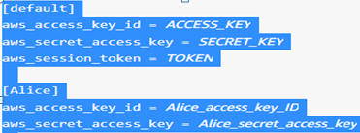
Set up your workstation
Ensure your IAM role grants permission to launch instances
Create your credentials file in below location
~/.aws/credentials (Linux/Mac) (Create .aws direcotry, If not available)
C:\Users\USERNAME\.aws\credentials (Windows)
Sample content of the file credentials.
Keep below information's ready from your AWS account
VPC - vpc-0258cf34b940cd38e
SUBNET - subnet-69b24f48
REGION - us-east-1a
Security Group - sg-0139d4f4c38cff9a7
Ubuntu AMIID - ami-07ebfd5b3428b6f4d
Keypair file - ~/.ssh/west1.pem

Slide 36
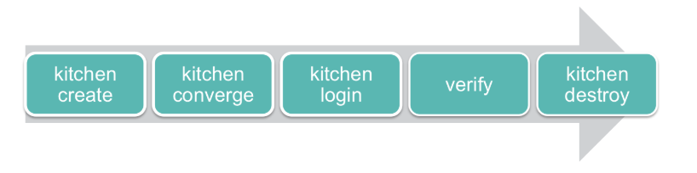
Apply a cookbook locally
In this part, you'll run through the Test Kitchen workflow to get the hang of things.
Kitchen create - In this step, Test Kitchen creates an instance of your virtual environment, for example, an Ubuntu EC2 machine.
Kitchen converge - In this step, Test Kitchen applies your cookbook to the virtual environment.
Kitchen login - In this step, Test Kitchen creates an SSH session into your virtual environment.
Verify - In this step, you manually verify that virtual environment is configured as expected.
Kitchen destroy - In this step, Test Kitchen shuts down and destroys your virtual environment.

Slide 37

Create Test Kitchen configuration file
When you use the chef generate cookbook command to create a cookbook, Chef creates a file named .kitchen.yml in the root directory of your cookbook.
.kitchen.yml defines what's needed to run Test Kitchen, including which virtualization provider to use, how to run Chef, and what platforms to run your code on.
start by modifying .kitchen.yml (see the code file .kitchen.yml)
Create the Test Kitchen instance
From the ~/learn-chef/cookbooks/learn_chef_apache2 directory, run
kitchen list
Create the instance now by running
kitchen create (Note This would create a node in AWS )
kitchen list
Verify a new instance would be created in EC2

Slide 38
Apply the learn_chef_apache2 cookbook to your Test Kitchen instance
Now run kitchen converge to apply the cookbook to the EC2 virtual machine.
kitchen converge
We use the term converge to describe the process of bringing a system closer to its desired state. When you see the word converge, think test and repair.
If you had more than one platform specified in your .kitchen.yml file, then you should specify the platform/instance you want to test your cookbook on when you run kitchen converge. For example, kitchen converge default-windows-2012r2, Otherwise, Test Kitchen would test cookbook on all platforms specified in .kitchen.yml
When the chef-client run completes successfully, Test Kitchen exits with exit code 0. Run the following to check the exit code.
echo $?
If you receive a result other than 0, fix the errors that were reported. Then run kitchen converge to apply the changes and again check the exit code.
Run kitchen list to see the latest status.
Verify that your Test Kitchen instance
kitchen exec -c 'wget -qO- localhost'
Also can go to find the ec2 instance name and run to see index.html in browser
Delete the Test Kitchen instance
kitchen destroy – This will also terminate the EC2 instance created for kitchen.
kitchen list

