Slide 1
LIFE EXPECTANCY DATA ANALYSIS
Data source: www.kaggle.com

Slide 2
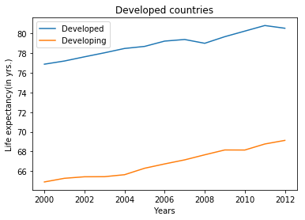
Comparison of Life Expectancy with time

Slide 3
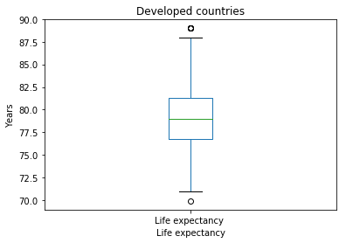
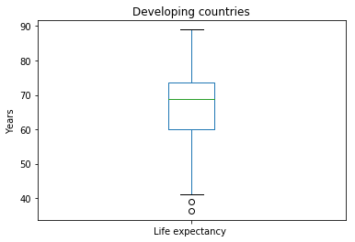
Comparison of Life Expectancy

Slide 4
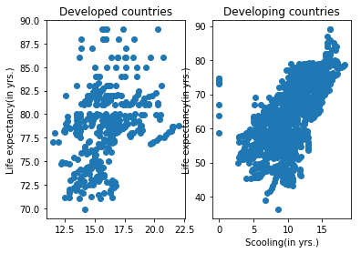
Life Expectancy v/s Schooling

Slide 5
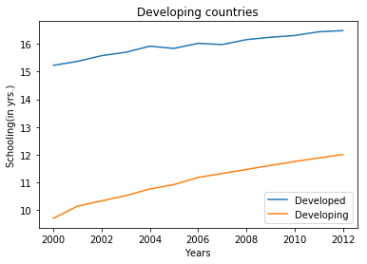
Average Schooling years

Slide 6
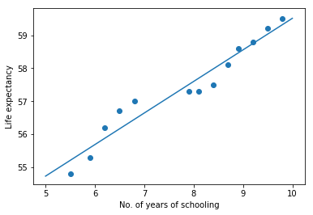
Simple Linear Regression

Slide 7
Life Expectancy Prediction
A=49.94
B=0.9573
LE=A+B*S
S=Average Schooling(2014)=10yrs.
Predicted Average Schooling=49.94+0.9576*10=59.51yrs
True value of LE=59.9yrs.

Slide 8
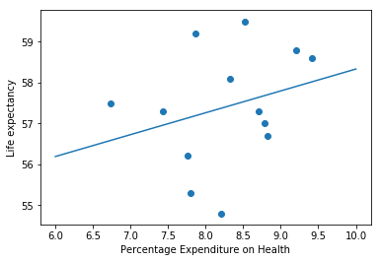
Simple Linear Regression

Slide 9
Life Expectancy Prediction
A=52.9798
B=0.5351
LE=A+B*P
P=% Expenditure(2014)=8.18
Predicted LE=52.9798+0.5351*8.18=57.35yrs.
True value of LE=59.9yrs.

