Slide 1

Priva Technologies pvt. Ltd.
EV Charger UI Workflow

Slide 2
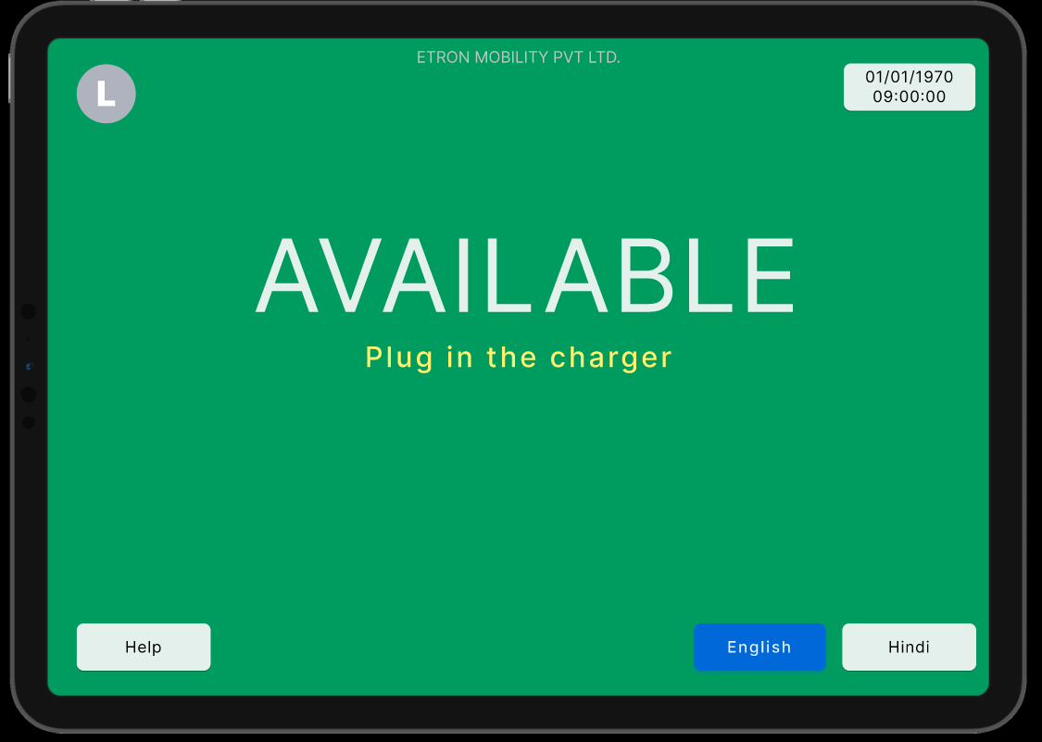
This is the first page user will interact with. If an ad. is running, user can touch on screen and this page will pop up
Our company name will be displayed as “Priva Technologies pvt. Ltd.”
Here our company logo will be displayed
Here date and time will be displayed and updated automatically
This message will be continuously blinking on the screen
Here user can select the language. “English” as default.
Instead of “Hindi” tab, “select other language” tab can be provided
User will be directed to a help page where emergency contacts or support form will be provided with an unique identification.
Only after connecting charger, user will be directed to the next page as shown on the next slide.

Slide 3
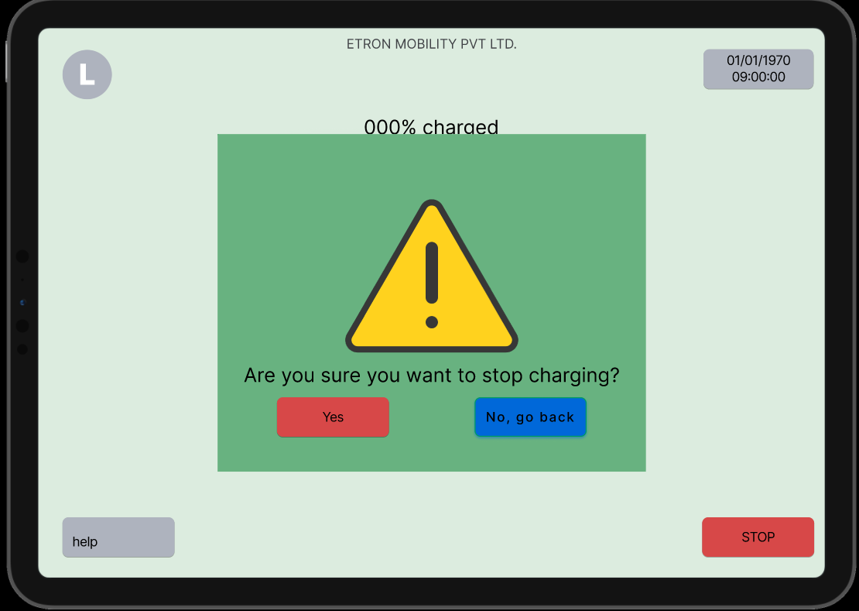
Registration page
Please let us know your customer status
New User? / First time at Priva Charger
Already registered?
Please register first time
Please login if already registered

Slide 4
If clicked on “New User” tab, user will be redirected to registration page
Please enter the following details
*
*
Name
(first name)
(last name)
*
Mobile Number
+91
*
Email ID
(someone@example.com)
(An automated generated receipt will be sent to your mobile number)
Back
Submit

Slide 5
If clicked on “Already registered tab” tab, user will be redirected to verification page
Please verify
*
Mobile Number
+91
Back
Submit
If user data is not verified, then user will be redirected to registration page

Slide 6
If clicked on “Submit” tab, and if user is verified, it will show the details of user
User details
Name
Example Example
Mobile Number
+91 xxxxxxxxxx
Email ID
someone@example.com
Charge History
A
B
C
D
Back
Proceed

Slide 7
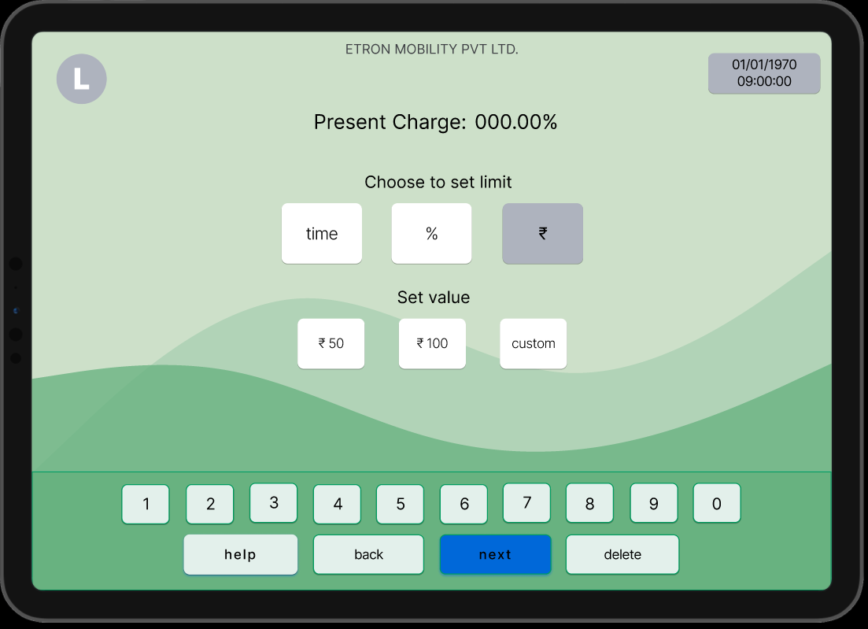
This is the third layer once the mobile number is provided
Our company name will be displayed as “Priva Technologies pvt. Ltd.”
Here date and time will be displayed and updated automatically
User can see the present status of the vehicle charge
User can choose mode of charging
User can input mobile number from this number pad (This number pad has to replaced with mobile number pad)
“next” – user will be directed to next page only if 10 digits are entered
“delete” – user can edit number if there is any mistake
“back” – user can go back or end the operation in between
User can set the value if he wants to charge in money mode
User will be directed to a help page where emergency contacts or support form will be provided with an unique identification.

Slide 8
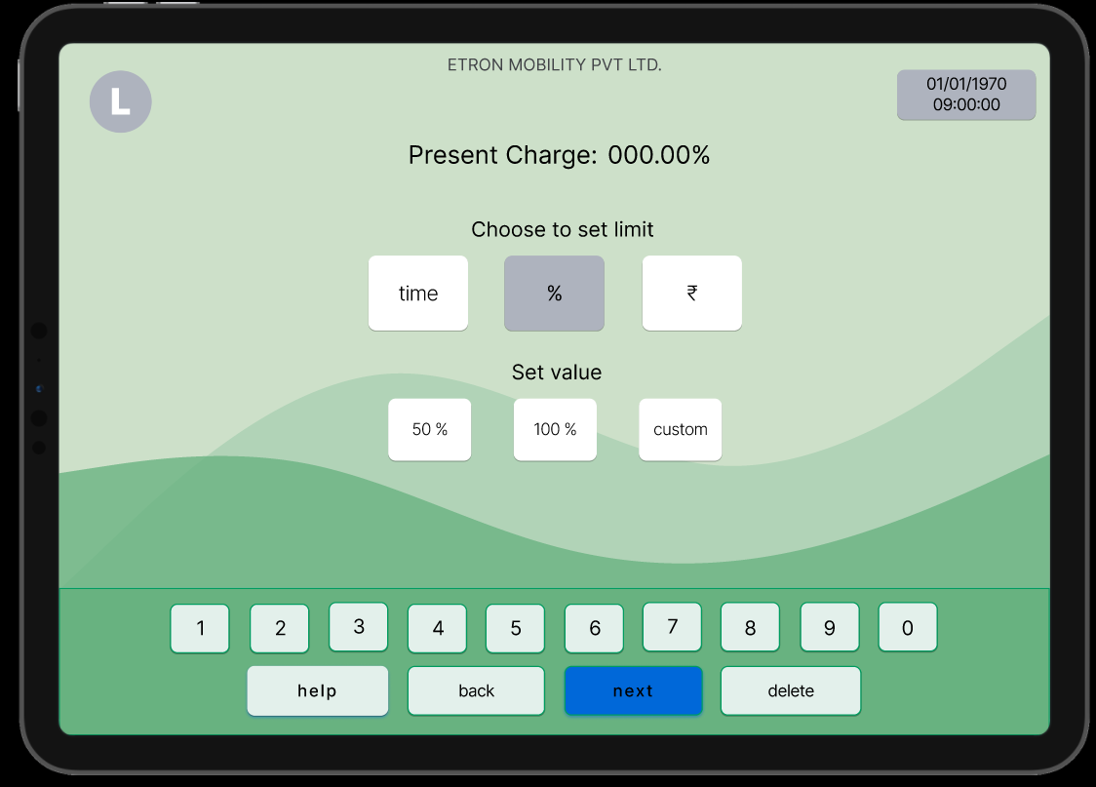
This is the third page once the mobile number is provided
Our company name will be displayed as “Priva Technologies pvt. Ltd.”
Here date and time will be displayed and updated automatically
User can see the present status of the vehicle charge
User can choose mode of charging
User can input mobile number from this number pad (This number pad has to replaced with mobile number pad)
“next” – user will be directed to next page only if 10 digits are entered
“delete” – user can edit number if there is any mistake
“back” – user can go back or end the operation in between
User can set the value if he wants to charge in percentage mode
User will be directed to a help page where emergency contacts or support form will be provided with an unique identification.

Slide 9
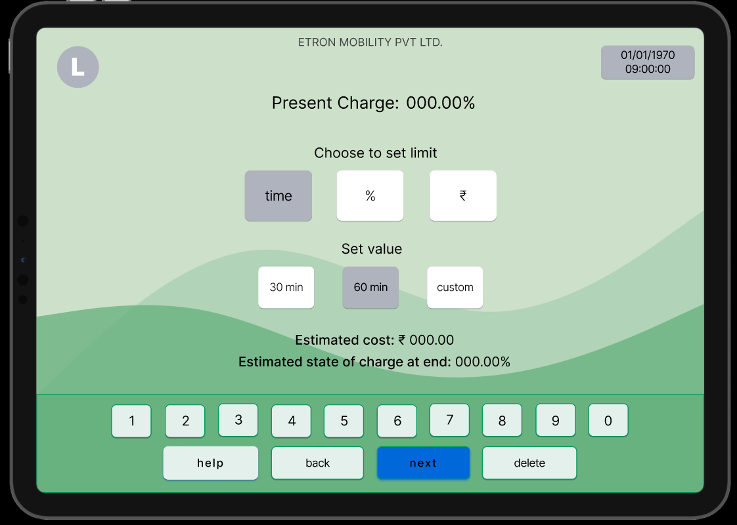
This is the third page once the mobile number is provided
Our company name will be displayed as “Priva Technologies pvt. Ltd.”
Here date and time will be displayed and updated automatically
User can see the present status of the vehicle charge
User can choose mode of charging
User can input mobile number from this number pad (This number pad has to replaced with mobile number pad)
“next” – user will be directed to next page only if 10 digits are entered
“delete” – user can edit number if there is any mistake
“back” – user can go back or end the operation in between
User can set the value if he wants to charge in time mode
User will get the knowledge of estimated bill
User will be directed to a help page where emergency contacts or support form will be provided with an unique identification.
Only after “next” case is validated and presses the tab, user will be directed to next page as shown on next slide.

Slide 10
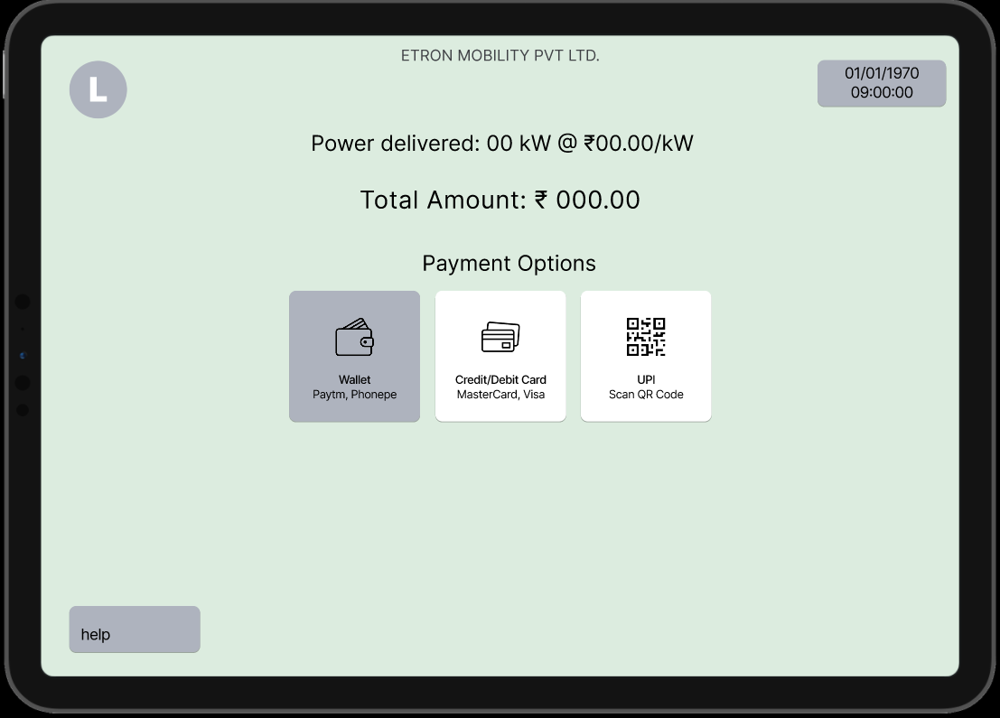
This is the fourth page once the mode / parameters of charging is selected
Our company name will be displayed as “Priva Technologies pvt. Ltd.”
Here date and time will be displayed and updated automatically
User will get to know about how much power is being delivered and at what cost
User can select mode of payment. (Here we can only keep UPI and Cash option, and also cash option can be easily added or removed from the code as it depends on our customer)
With Cash option, user can go to charger owner and hand-in the cash. Upon payment, owner has the feasibility to start the charger through his cloud access / rights.
User will be directed to a help page where emergency contacts or support form will be provided with an unique identification.
If user selects UPI, QR will pop up as shown on the next slide

Slide 11
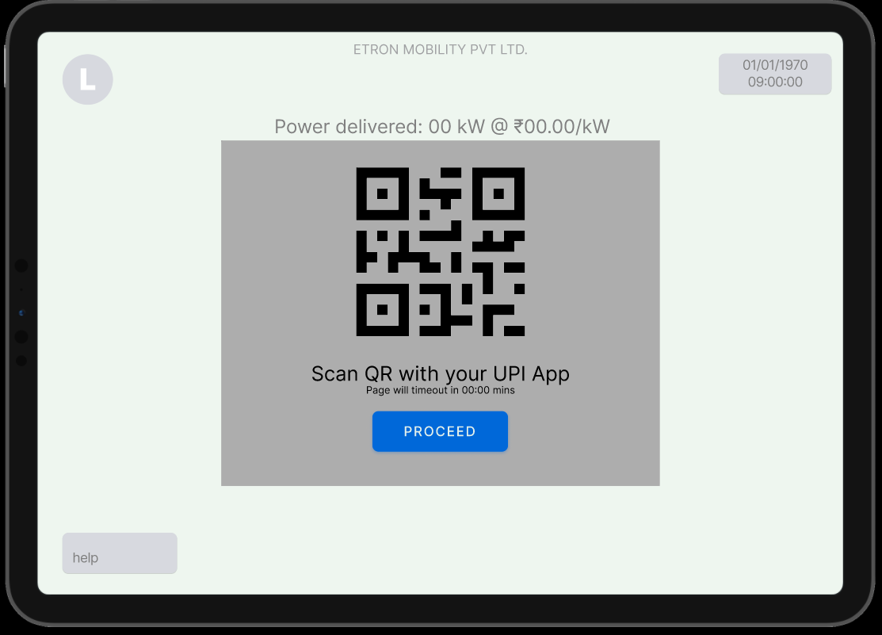
This is the fourth page once the mode / parameters of charging is selected
Our company name will be displayed as “Priva Technologies pvt. Ltd.”
Here date and time will be displayed and updated automatically
User will get to know about how much power is being delivered and at what cost
User can pay via scanning the QR code using gpay, phonepe, paytm, etc.
Here every customer of Priva will have different QR codes of their UPI
If the QR is not working and user wants to go back, he can touch elsewhere on the screen and QR will disappear
Once the payment is done, it will take user to next page and charging will be started for the set parameters
If user selects UPI, this QR will pop up. Once the payment is done, charging will be started

Slide 12
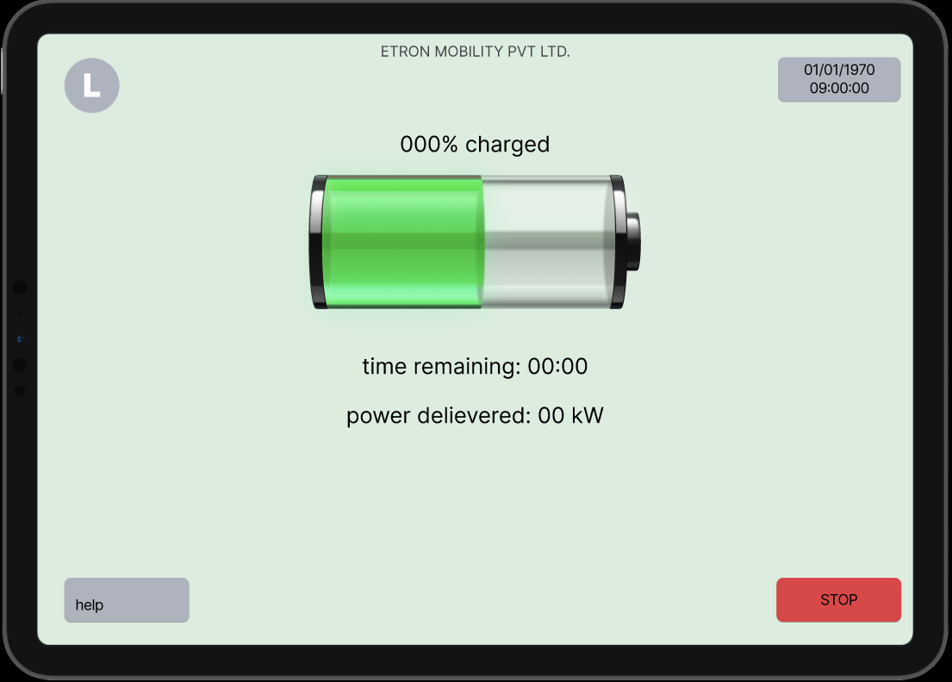
This is the fifth page once the payment is done
Our company name will be displayed as “Priva Technologies pvt. Ltd.”
Here date and time will be displayed and updated automatically
User will get to know the live status of charging while the vehicle is being charged
Graphics can be more attractive with status of the charging
If the QR is not working and user wants to go back, he can touch elsewhere on the screen and QR will disappear
User will get to know the time remaining for their set parameters of the charging
User will be directed to a help page where emergency contacts or support form will be provided with an unique identification.
*imp - User can stop the operation in between and the remaining amount will be sent back to his UPI wallet / bank
If user selects stop, a confirmation dialog box will pop up as shown on the next slide

Slide 13
This is the fifth page once the stop tab is pressed
Our company name will be displayed as “Priva Technologies pvt. Ltd.”
Here date and time will be displayed and updated automatically
User will get to know the amount of charging is completed
User will get a confirmation question dialog box to verify if user really wants to stop the charging
User will be directed to a help page where emergency contacts or support form will be provided with an unique identification.
If user selects yes, an end page will pop up. If No, charging will be in process

Slide 14
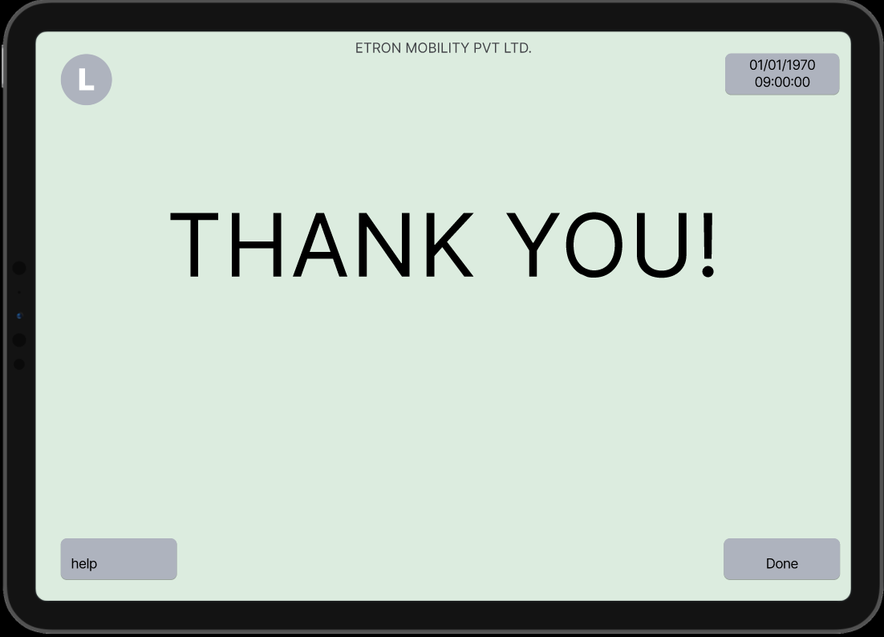
This is the sixth page once the process is stopped
Our company name will be displayed as “Priva Technologies pvt. Ltd.”
Here date and time will be displayed and updated automatically
Once the process is completed, the e-receipt will be sent to their mobile number as a text message which user has given on the page 2
User will get a “Thank you” message with receipt displayed on their screen
(This message can be modified)
Please visit us again
You have charged __ KW @__ Rs.
If process is completed, thank you message will be sent to mobile number OR if charging is topped in between or charger is removed in between charging stops, and update message will be sent to the mobile number
User will be directed to a help page where emergency contacts or support form will be provided with an unique identification.
After 5 or 10 seconds, this screen will change to an advertisement or the welcome page (page 1) and one cycle ends here
Here the process ends and redirected to the advertisement page or the welcome page

Slide 15
Notes:
Future Compatibility:
How can we share location and status of our charger with the maps so that user can find our charger?
Electricity tariff change and save should be done on cloud as it varries from location to location and customer to customer
Background should be futuristic and eye-pleasing. Language should be interactive and possibility for voice output (eg. Atm, paytm machines)
This is not the final version as we will discuss more and adopt changes

Slide 16
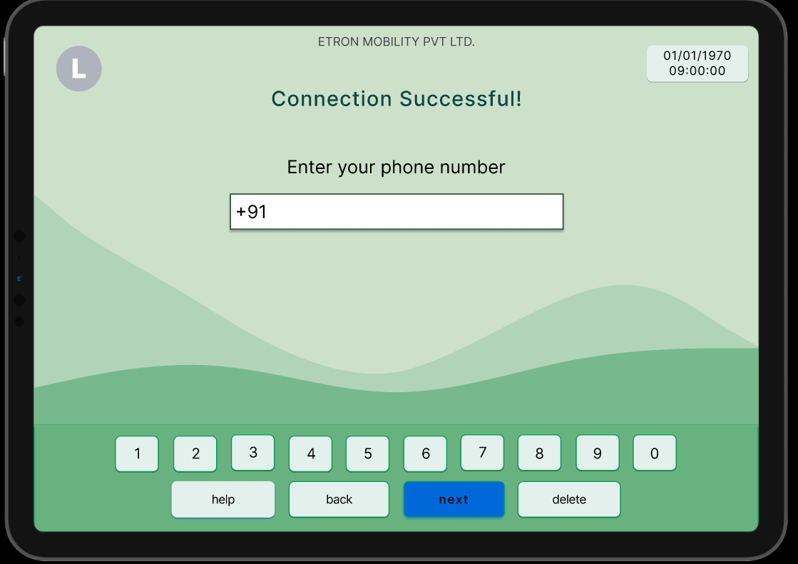
This is the second page once the connection is made successful EXTRA
Our company name will be displayed as “Priva Technologies pvt. Ltd.”
Here date and time will be displayed and updated automatically
Validation message will be displayed on the screen of successful connection.
User can see 10 digit mobile number *Mandatory
User can input mobile number from this number pad (This number pad has to replaced with mobile number pad)
“next” – user will be directed to next page only if 10 digits are entered
“delete” – user can edit number if there is any mistake
“back” – user can go back or end the operation in between
(An automated generated receipt will be sent to your mobile number)
Background can be more classy, elegant and eye-pleasing
User will be directed to a help page where emergency contacts or support form will be provided with an unique identification.
Only after “next” case is validated and presses the tab, user will be directed to next page as shown on next slide.

