Slide 1
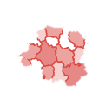

EXPL
R
PLETH
EXPL
R
PLETH

