Slide 1


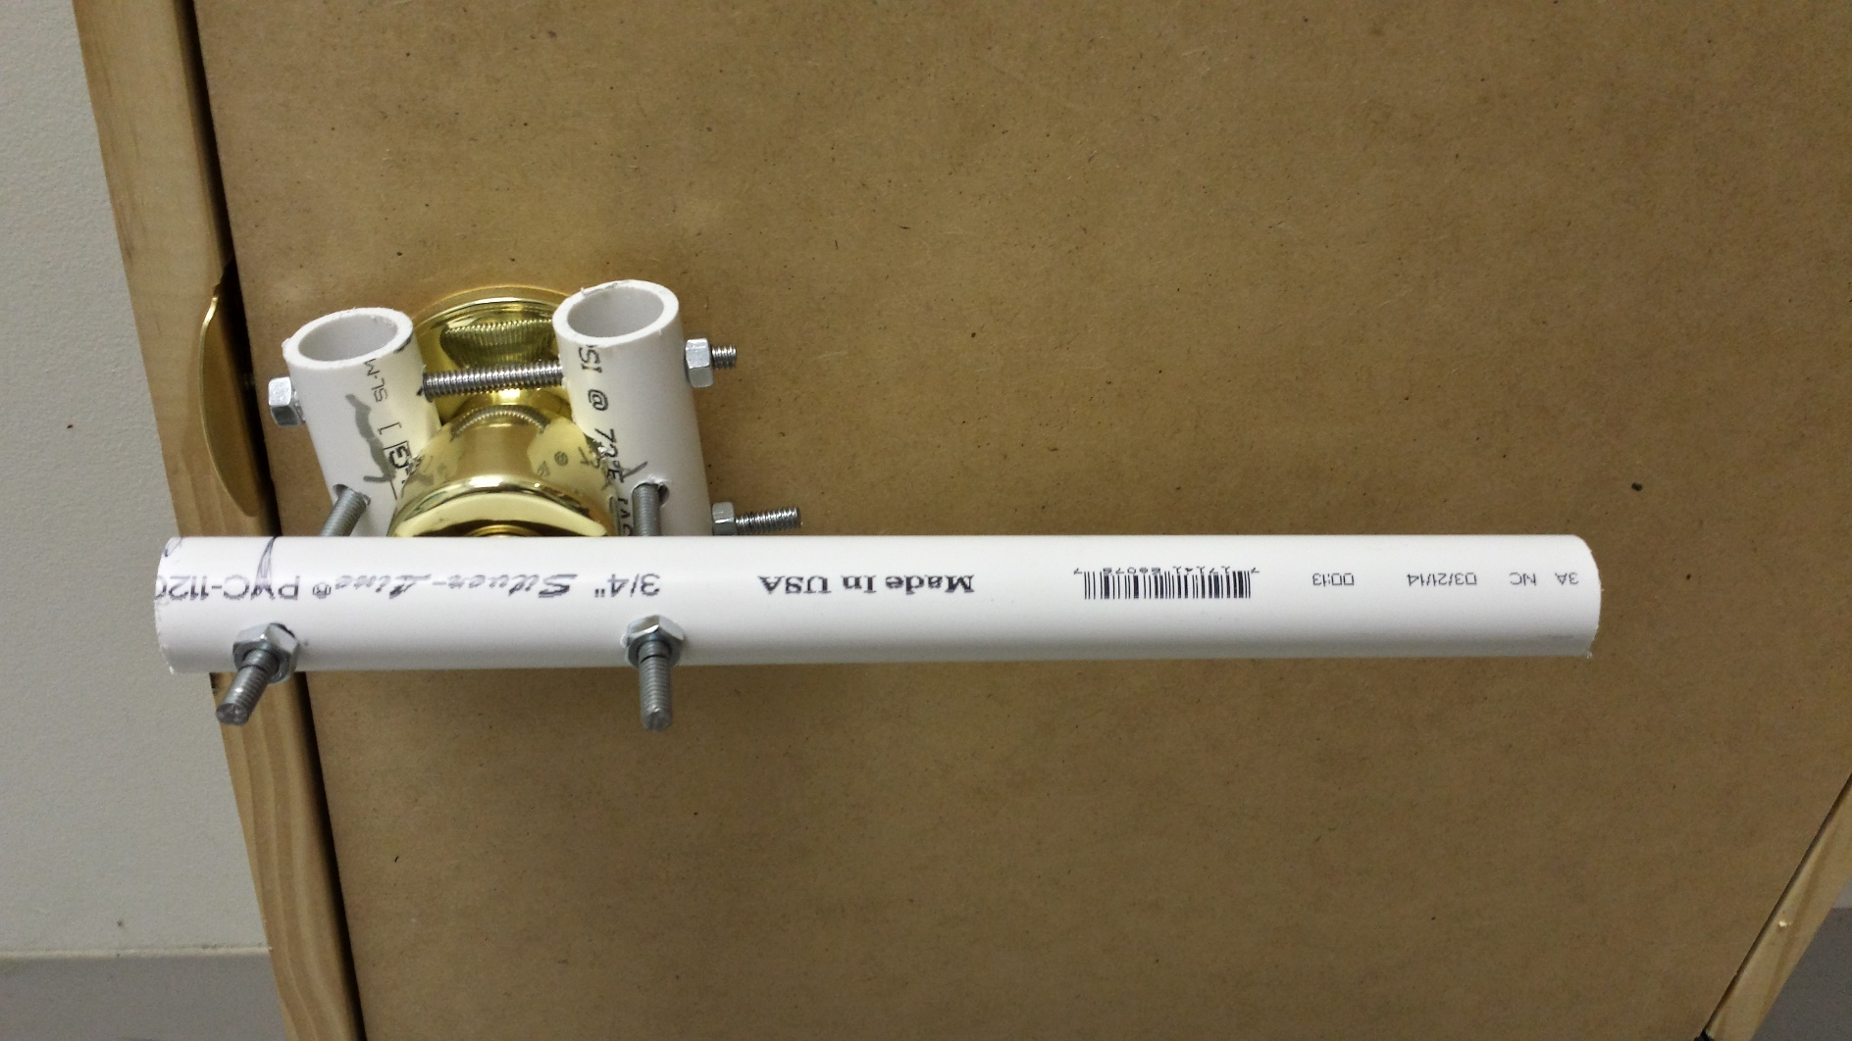
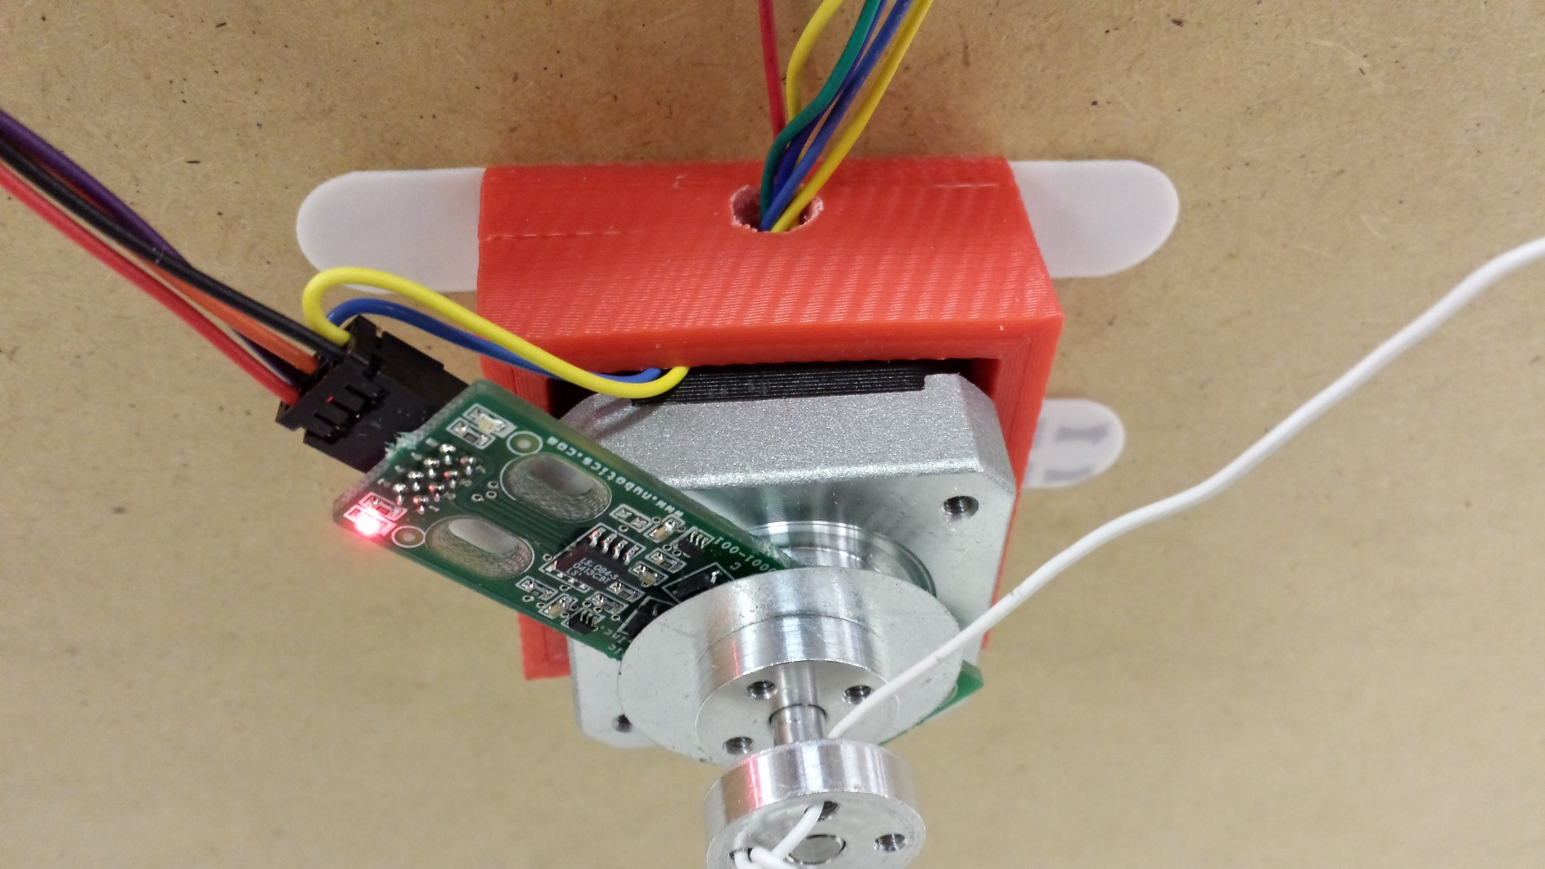
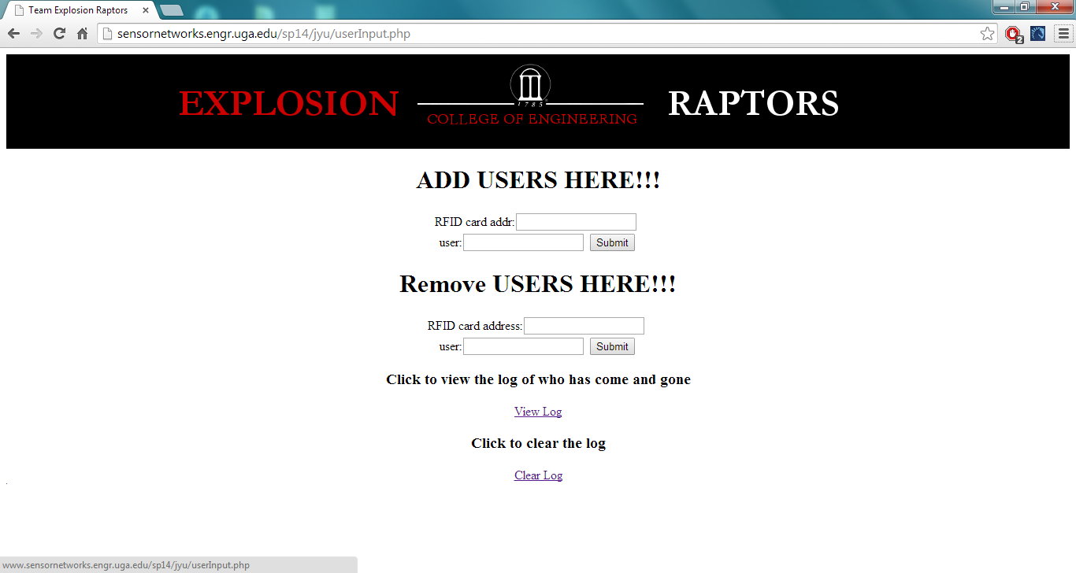
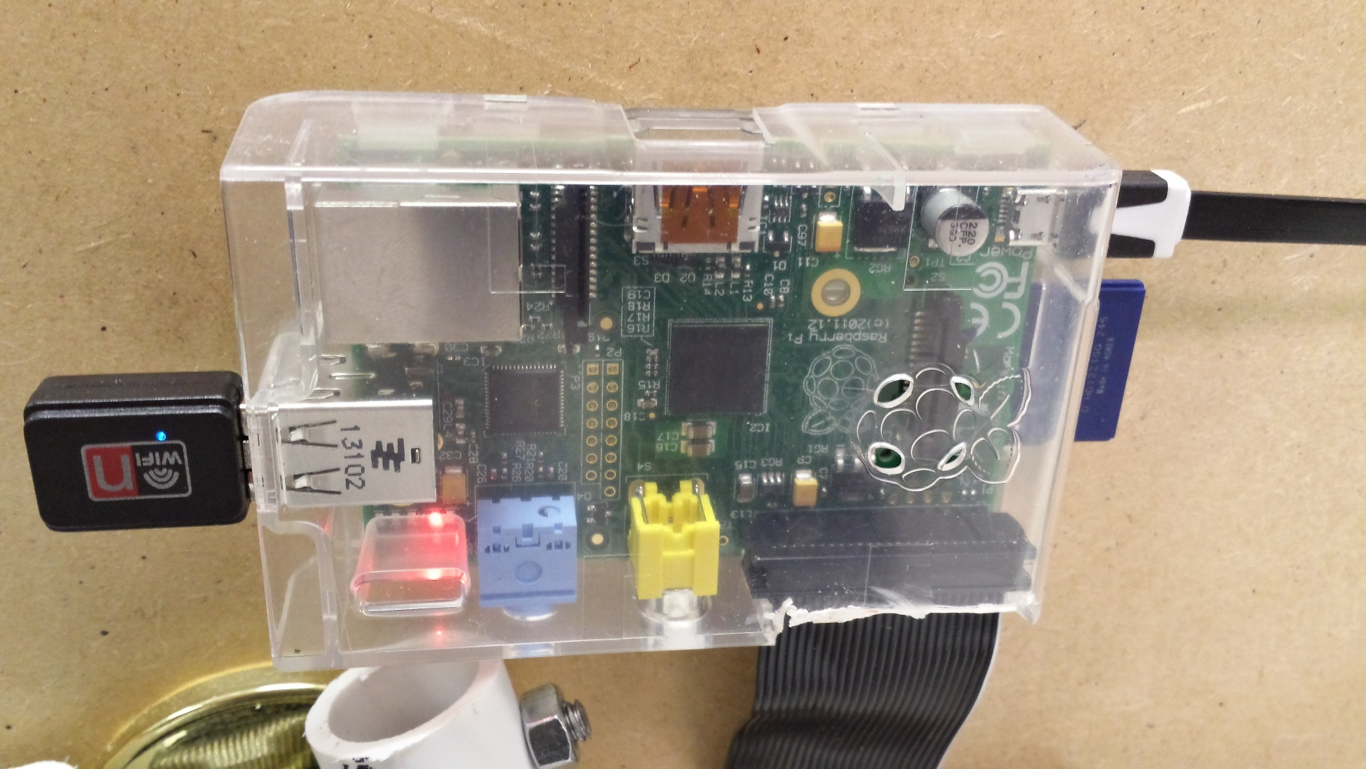
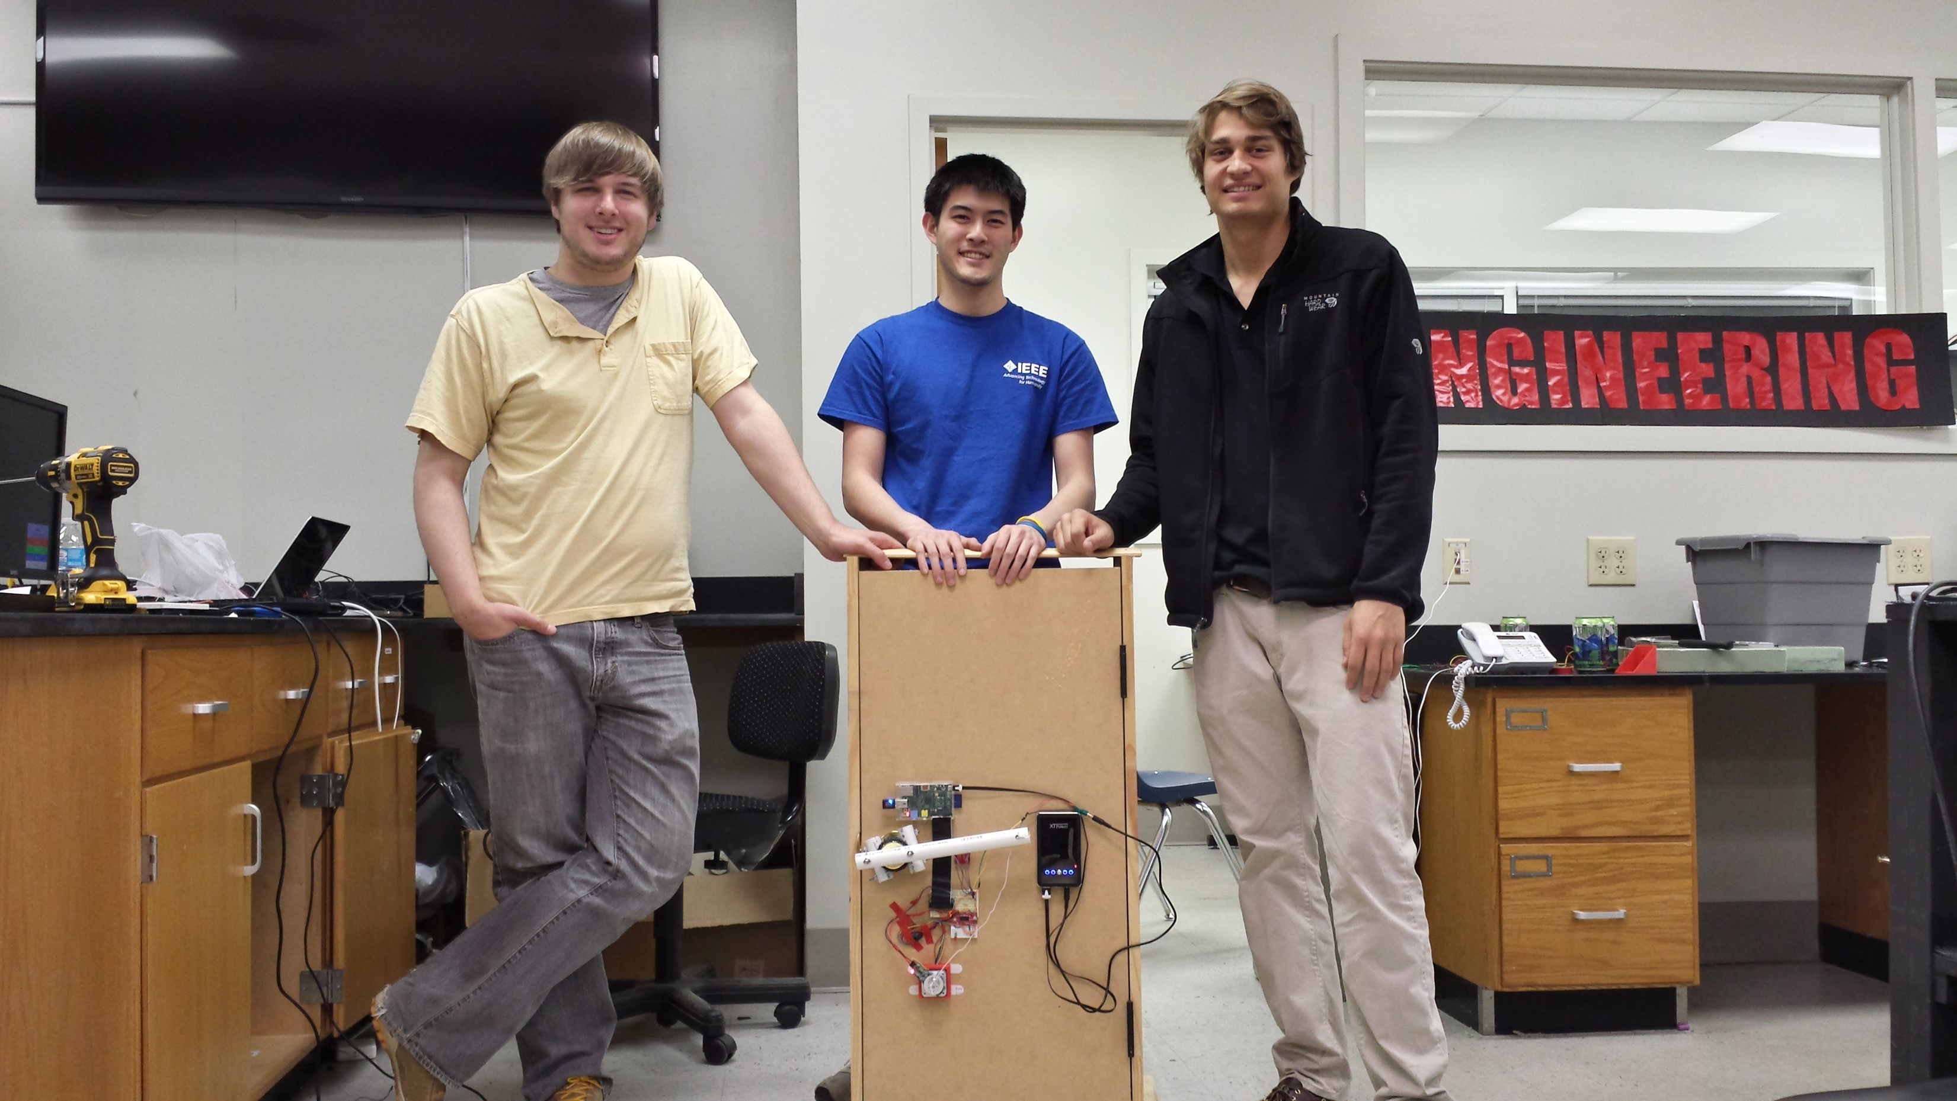
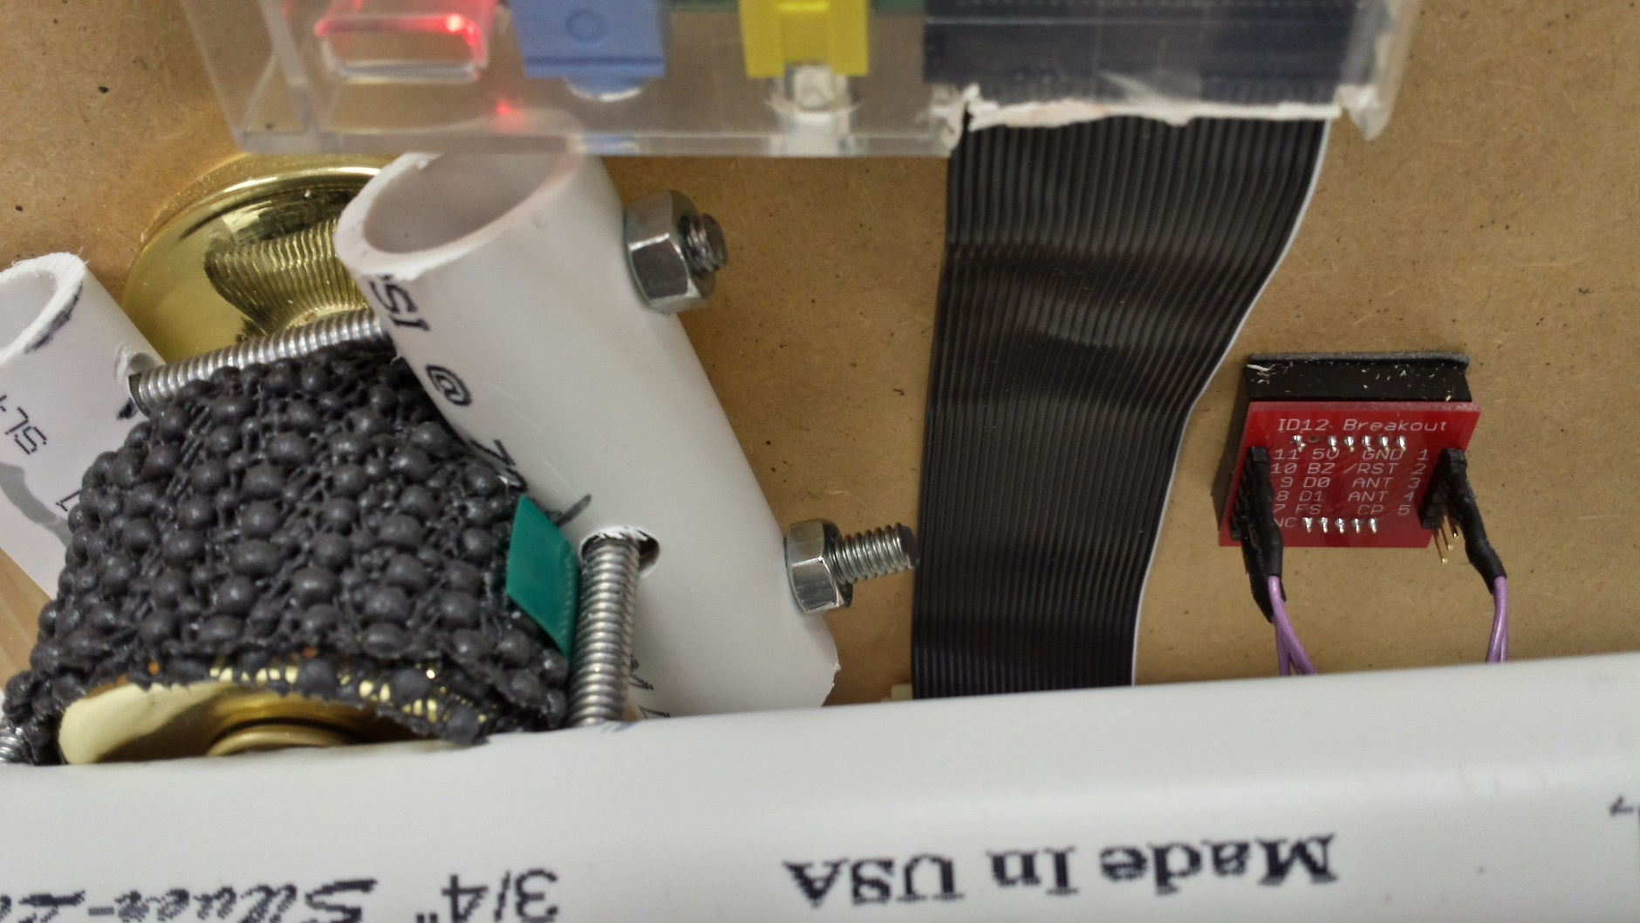
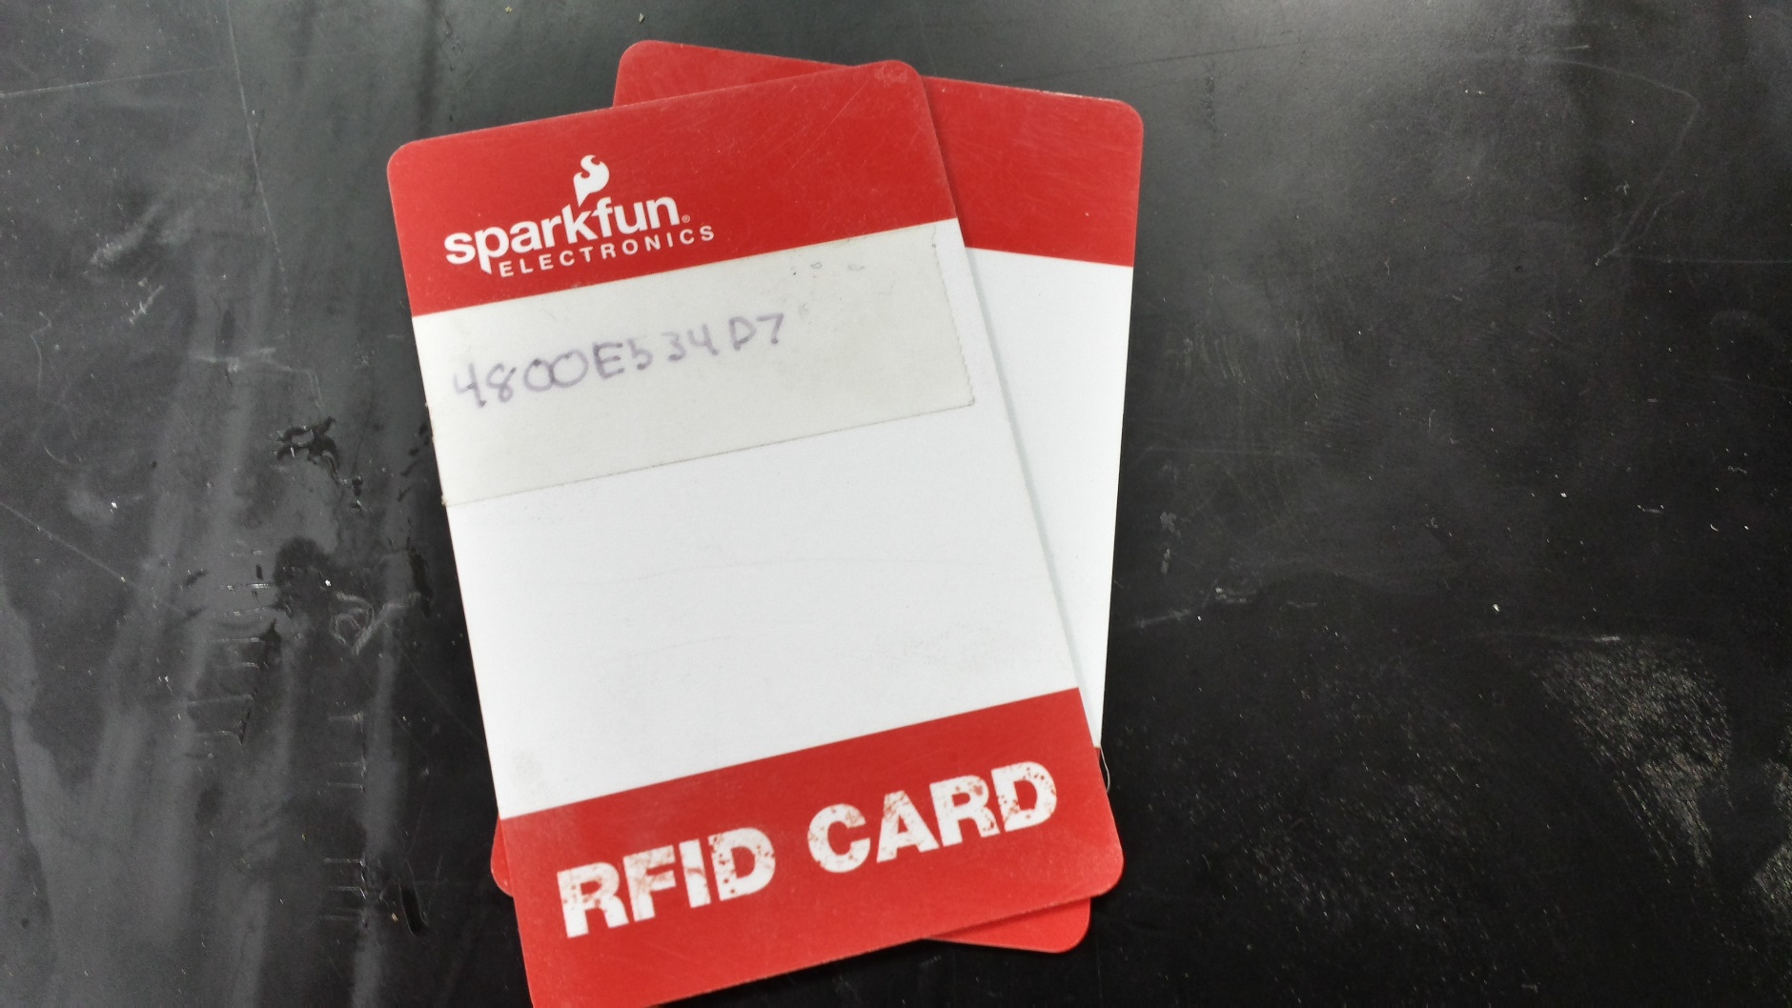
Robotic Doorman Project
Team “Explosion Raptors”: Adam Hall, Jasper Yu, Peter Wins
Mentors: Dr. Kyle Johnsen, Dr. Peter Kner
Driftmier Engineering Center, Athens, GA 30602
Problem Statement
Design Overview
Conclusion & Future Work
Our group has been tasked with creating an automated classroom access solution which attempts to strike a balance between convenience, security, and accountability for UGA students, faculty, and the University system. Our access solution will be refined to meet the needs of our stakeholders:
Students need access to classroom and lab spaces in a convenient and efficient manner to complete work;
Faculty need to monitor and control access to classrooms and lab spaces to protect equipment and projects which can be difficult or impossible to replace;
The University system demands accountability to protect its assets and ensure the well-being of its students and faculty.
Currently, the best solution to the problem of convenient access is to create door keys for the students who need them. This solution allows for the possibility of lost or stolen keys, which results in the opposite of what our shareholders desire in an access solution. Our solution will provide secure access to students and faculty at any time of day. By standardizing facility access, student access will be on-demand, faculty can control room access, and the University will save money.
To address the needs of students, several doors in the Driftmier Engineering Center were closely studied. The locking mechanism on a majority of classrooms could remain locked but be opened by rotating the doorknob inside the room. Based on this type of locking mechanism, a system to rotate the inside doorknob using a motor controller, stepper motor, and rotary encoder was devised.
After research and testing, a working prototype which scanned RFID cards, compared their key values to a database of whitelisted keys, and rotated a doorknob to allow entry to an approved user was successfully built. The prototype was presented as a proof-of-concept piece, demonstrating potential functionality and the inexpensive, off-the-shelf nature of its constituent components. The project is capable of scaling to accommodate many students across many different classrooms, as scaling only involves trivial database configuration on a controlling server.
Future work would address each of the project’s components: better hardware to ensure reliable doorknob rotation, better security to ensure both faculty and the University system can place their trust in the device and in the system as a whole, and housing consideration and development. The current project does not properly address the very real possibility of physical tampering, nor does it address the potential security problems associated with hosting a whitelist database on a remote server. Also, as this project was only intended to demonstrate functionality, future work would involve consultation with a mechanical engineer to deliver a viable housing solution. At present, the project consists of several off-the-shelf components interfaced to deliver required functionality, but this is at the expense of potential space and weight savings.
To address the needs of faculty, the project needed to incorporate security features which would allow for basic access control and accountability through key card logging. Every few minutes, the device checks a whitelist database on a remote server for approved access keys, updates its local database of whitelisted keys, and sends local access logs to the remote server for later review. A web interface on the remote server allows for manual addition/removal of whitelisted keys and for time-stamped logging.
The Team
Cost Analysis
To address the needs of the University System, an RFID access system was implemented. This approach solves one of the greatest problems of the traditional door key access system: students losing keys. When a student loses a key, the University has a decision to make: keep the compromised lock and replace the key, or replace both the lock and the key. Neither choice is ideal. By implementing a system with easily-replaceable keys, both of these traditional problems are solved.
Cost Analysis for Robotic Doorman Project
Electronics
Parts | Manufacturer | Model Number | Quantity | Unit Cost (<100) | Unit Cost (>100) | Total (<100) | Total (>100)
RFID Reader ID-12LA (125kHz) | Innovations | SEN-11827 | 1 | $29.95 | $23.96 | $29.95 | $23.96
Easydriver Motor Controller | Sparkfun/Schmalz Haus LLC | ROB-10267 | 1 | $14.95 | $11.96 | $14.95 | $11.96
Rechargeable Battery Pack | XTPower | MP-10000 | 1 | $47.90 | $47.90 | $47.90 | $47.90
Raspberry Pi Microcontroller | RS Components | Model-B Rev. 1 | 1 | $35.00 | $35.00 | $35.00 | $35.00
Hook-up Wire - (White) (22AWG) | Generic/OEM | PRT-08026 | 1 | $2.50 | $2.00 | $2.50 | $2.00
802.11b/g/n Nano USB Wifi Adapter Dongle for Raspberry Pi (Ralink RT5370) | Ralink | RT5370 | 1 | $6.18 | $6.18 | $6.18 | $6.18
LED - Basic Red 5mm | Generic/OEM | COM-09590 | 1 | $0.35 | $0.28 | $0.35 | $0.28
Wheelwatcher Quadrature Encoder | Nubotics | WW-12 | 1 | $19.95 | $19.95 | $19.95 | $19.95
Subtotal |  |  |  |  |  | $156.78 | $147.23
Mechanical
Stepper Motor with Cable | Generic/OEM | ROB-09238 | 1 | $14.95 | $11.96 | $14.95 | $11.96
Universal Aluminum Mounting Hub for 5mm Shaft, #4-40 Holes (2-Pack) | Pololu | 1203 | 1 | $7.49 | $5.62 | $7.49 | $5.62
3/4-In x 10-Ft 480 Psi Schedule 40 Pvc Pressure Pipe | Charlotte Pipe | PVC 04007 0600 | 1 | $2.19 | $2.19 | $2.19 | $2.19
1/4-in x 36-in Standard (SAE) Threaded Rod | The Hillman Group | 11009 | 1 | $1.82 | $1.82 | $1.82 | $1.82
1/4-in-20 Hot-Dipped Galvanized Standard (SAE) Hex Nut | The Hillman Group | 810503 | 4 | $0.14 | $0.14 | $0.56 | $0.56
Subtotal |  |  |  |  |  | $27.01 | $22.15
Grand Total |  |  |  |  |  | $183.79 | $169.38
From left to right: Peter Wins, Jasper Yu, Adam Hall
Acknowledgements
Special thanks to:
Victor Lee (colleague) for printing our group’s poster.
Dr. Johnsen and Dr. Kner for their invaluable help and guidance.

