Slide 1
Crypto Pitfalls
Or: Beware the MSDN sample code
Central PA Open Source Conference, 17-Oct-2015

Slide 2
Contrived Business Case
Business partners exchange some transaction securely
Secrecy in transit
Verified origin
Not changed in transit
Not using ___________

Slide 3
A Common Solution
Use AES encryption for both secrecy and integrity
AES is current standard
Won’t decrypt successfully without same encryption key both ends
Copy some example AES code from MSDN or Stack Overflow

Slide 4
Let’s Code

Slide 5
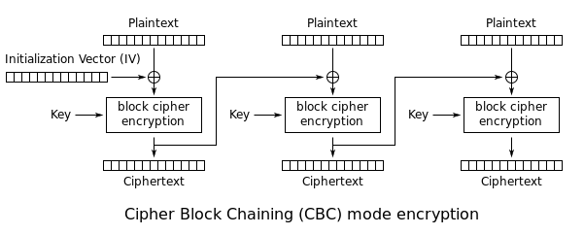
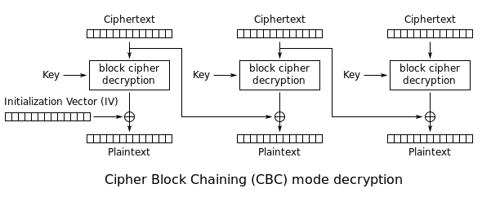
Cipher Block Chaining (CBC) Mode
Source: http://en.wikipedia.org/wiki/Block_cipher_mode_of_operation

Slide 6
The Cryptographic Doom Principle
“If you have to perform any cryptographic operation before verifying the MAC on a message you’ve received, it will somehow inevitably lead to doom.”
- Moxie Marlinspike
http://www.thoughtcrime.org/blog/the-cryptographic-doom-principle/

Slide 7
Bonus Pitfall
non-constant time comparison of the MAC

Slide 8
What should we have done?

Slide 9
Encrypt-then-Authenticate
After generating the encrypted token (with IV), run HMAC on it (with separate key) and send the hash along
Before decrypting, verify the hash
Only once we’re confident of the token’s integrity should we begin to decrypt it
Note also AES-GCM

Slide 10
Lessons Learned
Never use a static Initialization Vector
Don’t expose error status codes over the public API
Never use encryption without authentication e.g. HMAC
Do not use same key for authentication and encryption
Use cryptography with extreme caution and extra code reviews
http://www.happybearsoftware.com/you-are-dangerously-bad-at-cryptography.html
Use higher level-constructs whenever you can
JWT/JWE, OAuth2, SAML, etc

Slide 11
Further reference
There are more elegant versions of padding oracle and CBC-R code in other languages, e.g.
http://www.limited-entropy.com/po_cbc-r_and_timing/
Other explanations of this material:
CBC-R Paper - Juliano Rizzo & Thai Duong http://static.usenix.org/events/woot10/tech/full_papers/Rizzo.pdf
The Padding Oracle Attack – Why Crypto Is Terrifying http://robertheaton.com/2013/07/29/padding-oracle-attack/

Slide 12
The End
Feedback welcome:
stevepatches@gmail.com
Code & slides from this presentation:
https://github.com/explunit/crypto-pitfalls
CareEvolution is hiring:
http://letsfixhealthcare.com

