Slide 1
Data Analysis and Insights for different page Optimization & How to get more user install & Engagement from the App & Website
introduction
This dataset contains data of XYZ Inc .containing comprehensive user data spanning various regions, customer demographics, product details, and marketing campaigns . This analysis, findings and recommendations will serve as a compass guiding XYZ Inc. toward enhanced user satisfaction, increased installations, and heightened engagement.
^{In [ ]:} # loading the dataset and importing libraries
import pandas as pd import numpy as np import matplotlib.pyplot as plt import seaborn as sns import plotly.express as px
# Read multiple sheets from the same Excel file
xls = pd.ExcelFile(r'C:/Users/expon/Downloads/Data set for BA.xlsx')
^{In [ ]:} xls.sheet_names
Out[ ]:['Report Snapshot',
'User Acquisition',
'Traffic Aquisition',
'Event Report',
'Conversion Report',
'Pages & Screens Report',
'Retention Overview',
'User Engagement Overview',
'Demographics Report',
'Citiwise Report',
'Gender Report',
'User By Interest',
'User by Language',
'User By Age',
'Google Ads Report']
^{In [ ]:} print(f'This dataset has {len(xls.sheet_names)} sheets')
This dataset has 15 sheets
User installation & Engagement Performance Analysis:
Analysis on Event Report
^{In [ ]:} er = pd.read_excel(xls, 'Event Report') er.head(20)

Slide 2
Event count per
Event name Event count Total users Total revenue
user
0 | screen_view | 694729 | 23254 | 30.865870 | 0
1 | notification_receive | 125146 | 1700 | 138.896800 | 0
2 | user_engagement | 124836 | 22699 | 5.622230 | 0
3 | notification_dismiss | 70128 | 1369 | 144.000000 | 0
4 | session_start | 61163 | 23226 | 3.121357 | 0
5 | first_open | 22872 | 23059 | 0.991890 | 0
6 | app_remove | 18080 | 18030 | 4.037517 | 0
7 | Promilo113_login | 12719 | 6174 | 2.068803 | 0
8 | Promilo1116_feeds | 7942 | 1837 | 4.323353 | 0
9 | Promilo111_login | 7449 | 3517 | 2.130721 | 0
10 | Promilo111_feeds | 6240 | 1045 | 5.988484 | 0
11 | Promilo1116_my_rewards_screen | 5863 | 884 | 6.632353 | 0
12 | Promilo106_feeds | 5629 | 1146 | 4.911867 | 0
13 | Promilo113_feeds | 5495 | 1376 | 3.996364 | 0
14 | Promilo1116_login | 5315 | 2263 | 2.351770 | 0
15 | Promilo106_login | 5258 | 2232 | 2.365272 | 0
16 | Promilo1114_feeds | 5062 | 1187 | 4.264532 | 0
17 | Promilo1114_my_rewards_screen | 4774 | 509 | 9.379175 | 0
18 | Promilo111_my_rewards_screen | 4056 | 488 | 8.311475 | 0
19 | Promilo1116_storyboard | 3914 | 2464 | 1.598856 | 0
^{In [ ]:} er.infoO
<class 'pandas.core.frame.DataFrame'> RangeIndex: 379 entries, 0 to 378 Data columns (total 5 columns):
# Column Non-Null Count Dtype
0 Event name 378 non-null object
1 Event count 379 non-null int64
2 Total users 379 non-null int64
3 Event count per user 379 non-null float64
4 Total revenue 379 non-null int64
dtypes: float64(1), int64(3), object(1)
memory usage: 14.9+ KB
^{In [ ]:} #sorting the values on Total users
er=er.sort_values(by=['Total users'],ascending=False)
^{In [ ]:} er1=er.head(10)
^{In [ ]:} sns.barplot(data=er1,x='Event name',y='Total users') plt.xticks(rotation=90) plt.show()

Slide 3
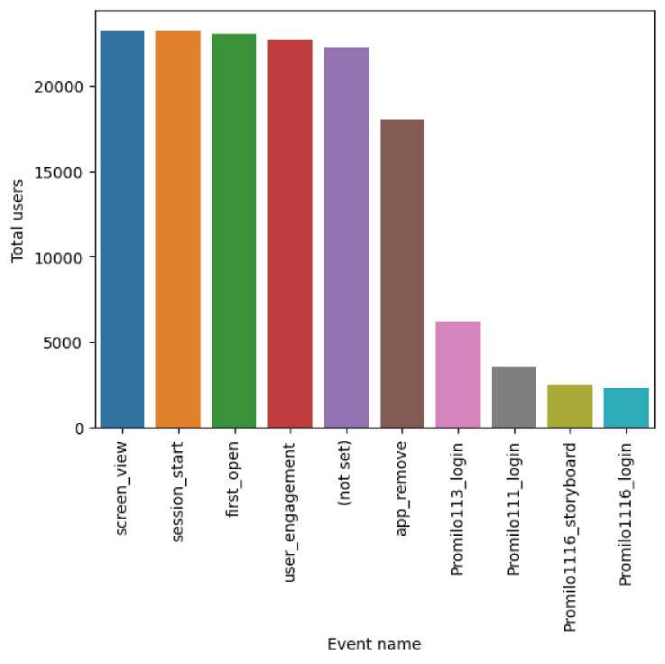
• this plot shows that most of the users who install the app atleast start a session
• There are 23254 users and 18030 users removed app which is a high number
• only 1700 users reveive notification
^{In [ ]:} # Event count per user is a parameter,where we can see which app feature is being used most
er2=er.sort_values(by=['Event count per user'],ascending=False) er2=er2.head(20)
sns.barplot(data=er2,x='Event name',y='Event count per user')
plt.xticks(rotation=90)
plt.show()

Slide 4
3 3 ,—, CD
co NI CD cn -t^ co i\)
O
Analysis on Gender Report
^{ln} [ 1- gr= pd.read_excel(xls, 'Gender Report')
3 '
3 £13 31
CQ CO
3
03 | ~a >< | ~a ><
CD | T3 | T3
O c
CO | CQ | CQ
o |  | c*
3 CD | < 03_ | < 03_
 | C | C
3 | CD | CD
03 | CO II | CO II
CO o 0>. O -i £1) CD
§1
SS
m > < < CD CD
3 3 8 ® § S
'“*■ CQ 0) CQ CD
3
CD
3
m m m
Z C O
o ^
° 9. c °
=5 C
3 3 3
CD_ CO (Q
CQ CQ CQ < 03 03 03 ^ CQ CQ CQ C CD CD CD <£
CL
CD
3 "o'
CL 3 CL CD
CL m CD 3 X CL ' £13 CO
CD O 3 O
o
03 =3
>
<
CD
3
CQ
CD
CD
3
CQ
0>
CQ
CD
3
CD
3
“ w “ o =>
a =5 ° § a A
CD
CO
03
c
</>
CO 3 CD O
03_ ³
< | 0 3
3 S"
tn ^
C cr
3
3
“ OJ OJ ⁰⁰ O -« -« 3
§1
CD
CD CD 00
b
s o o g
03
CD 3 3 3 Q. 3 3 ³
03
T1
0 (D
V) S
c c
O
o
c
3
C i
3
II
o
CD
3
CL
CD
3- O
5‘ 03 CT
85*8'
CD
V~
O
O 3
S> S
03
■P^
■O
CD
w m
0 3 «
W QJ
O CQ
= 2 CO Q.
0)
3
0)
03
ii
c5
CD
3
CL
CD
m
0
0
-« 3
0 0
0 3
CD
3
03_
CD
03
3
3
o
3
>
<
0
- 3
3 g 0 3
o m
o <
o
o
3
<
0
W
o'

Slide 5
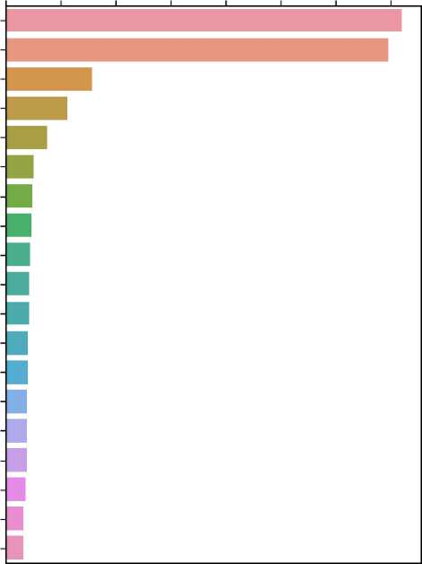
Analysis On User Demographics
Event count per user
i—■ i—■ i—■
rvj js, o> oo o ISJ -b oooooooo
notificationdismiss notification receive
screen view
Promiloll9 dashboard
Promilolll4_discovery_screen
Promiloll3_my_rewards_screen
Promilolll4_my_rewards_screen
Promiloll9_feeds
m
^ Promilolll_my_rewards_screen Promiloll9_resume_builder
Ql
3 Promilolll6_Event_error_code_800
n>
notification_foreground
Promilolll7_my_rewards_screen
Promilolll3_login
Promilolll3_feeds
Promilolll3_myProfile_mediator
Promilolll6_my_rewards_screen
Promilolll5_my_rewards_screen
Promilol06_my_meetings_screen

Slide 6
Analysis on Age Data
^{In [ ]:} uba= pd.read_excel(xls, 'User By Age') ubal =uba.drop(index=0) uba1
Out[ ]: | Age | Users | New users | Engaged sessions | Engagement rate | Engaged sessions per user | Average engagement time | Event count | Conversions | Total revenue
1 | 18¬ 24 | 4282 | 3678 | 7291 | 0.695308 | 1.702709 | 251.16300 | 309328 | 53661 | 0
2 | 25¬ 34 | 2920 | 2161 | 3749 | 0.504780 | 1.283904 | 97.24144 | 90074 | 20172 | 0
3 | 65+ | 1422 | 1081 | 1640 | 0.539829 | 1.153305 | 52.30661 | 24780 | 4891 | 0
4 | 55¬ 64 | 1403 | 979 | 1552 | 0.519411 | 1.106201 | 55.37063 | 25169 | 4823 | 0
5 | 35¬ 44 | 1202 | 785 | 1420 | 0.510424 | 1.181364 | 96.08236 | 33016 | 8111 | 0
6 | 45¬ 54 | 810 | 552 | 881 | 0.561862 | 1.087654 | 84.54321 | 18661 | 2946 | 0
^{In [ ]:} uba.info()
<class 'pandas.core.frame.DataFrame'> RangeIndex: 7 entries, 0 to 6 Data columns (total 10 columns):
# Column Non-Null Count Dtype
0 Age 7 non-null object
1 Users 7 non-null int64
2 New users 7 non-null int64
3 Engaged sessions 7 non-null int64
4 Engagement rate 7 non-null float64
5 Engaged sessions per user 7 non-null float64
6 Average engagement time 7 non-null float64
7 Event count 7 non-null int64
8 Conversions 7 non-null int64
9 Total revenue 7 non-null int64
dtypes: float64(3), int64(6), object(1) memory usage: 688.0+ bytes
^{In [ ]:} px.pie(uba1,values='Users',names='Age')
• most of the users belongs to 18-24 category
• 18-35 age group constitutes 60% of the total users
^{In [ ]:} px.pie(uba1 ,values='Average engagement time',names='Age')
• however 18-24 age group has highest average engagement time
Analysis on User Interest report
^{In [ ]:} ui= pd.read_excel(xls, 'User By Interest')
ui=ui.sort_values(by=['Users'],ascending=False) ui 1 =ui.head(30) ui 1 .head(3)
Out[ ]: | Interests | Users | New users | Engaged sessions | Engagement rate | Engaged sessions per user | Average engagement time | Event count | Conversions | Total revenue
0 | Shoppers | 10950 | 9256 | 15652 | 0.581534 | 1.429406 | 162.8347 | 490664 | 86846 | 0
1 | Media & Entertainment/Comics & Animation Fans | 10946 | 9247 | 15680 | 0.583008 | 1.432487 | 165.1772 | 491025 | 86845 | 0
2 | Technology/Mobile Enthusiasts | 10934 | 9239 | 15619 | 0.582451 | 1.428480 | 162.6945 | 489353 | 86742 | 0
^{In [ ]:} ui.info()

Slide 7

<Figure size 3000x6000 with 0 Axes>
^{ln} [ 1- sns.barplot(data=ui1 ,x='lnterests',y='Engaged sessions per user') plt.xticks(rotation=90) plt.figure(figsize=(30,60))
Shoppers -
Media & Entertainment/Comics & Animation Fans -Technology/Mobile Enthusiasts -| Food & Dining/Cooking Enthusiasts-| Sports & Fitness/Health & Fitness Buffs -| Lifestyles & Hobbies/Pet Lovers -| Media & Entertainment/Music Lovers -Media & Entertainment/TV Lovers -News & Politics/Avid News Readers -Lifestyles & Hobbies/Outdoor Enthusiasts -
Media & Entertainment/Movie Lovers Food & Dining/Cooking Enthusiasts/30 Minute Chefs Lifestyles & Hobbies/Family-Focused □ Sports & Fitness/Sports Fans
ro Lifestyles & Hobbies/Fashionistas
(j> Food & Dining/Fast Food Cravers
Cf Sports & Fitness/Sports Fans/Soccer Fans
Shoppers/Value Shoppers -Lifestyles & Hobbies/Art & Theater Aficionados Media & Entertainment/Gamers
News Si Politics/Avid News Readers/Avid Political News Readers-
Technology/Social Media Enthusiasts -Media & Entertainment/Gamers/Casual & Social Gamers -
Food & Dining/Foodies -Lifestyles & Hobbies/Business Professionals -Media & Entertainment/Gamers/Action Game Fans-Vehicles & Transportation/Auto Enthusiasts Technology/Technophiles Media Si Entertainment/Book Lovers-Home & Garden/Do-lt-Yourselfers -

Slide 8
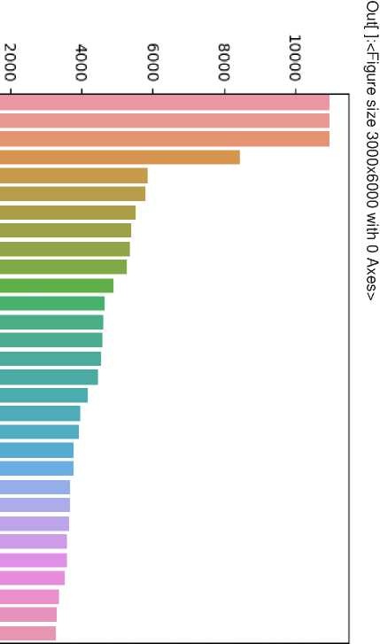
Users
■ 3 9:
0ODvlCT)Ol^WIV)
<class 'pandas.core.frame.DataFrame’> Int64lndex: 89 entries, 0 to 88 Data columns (total 10 columns):
# Column Non-Null Count Dtype
, CD "<
■D T3 W ;=+ ^ 3 x « CQ — cr c o 0) CD W "D_
- =5 "O o ® "<
m > < < CD CD
S £ 8 ® § S
CQ
0)
CQ
CD
3
CD
3
03 =3-. CO g 3 CD O 3
3 03 C <° = 3 O 3
5' 3 03 = -P^
m m m
3 3 3
CQ CQ CQ 0) 0) 0) CQ CQ CQ CD CD CD CL 3 CL
^ C 3
CD w cr
g CD CD
t— c75 CD
« sa
CD cn
c o
C/> Q) £D ~ CQ CD CD
“32
CO £
CQ
Q) Q.
=?. £D
>* .
CD
D)
II
CD --
+ 3
II
~a
CD
c
in
CD 00 CO -5 CO (O
03 3 3
co S o
g|i
3 P C_ 3 —
C_
o 5'
_K 9 03
o 2 *
0> ^
03
■P^
00 03 03 CO CO CO ^ =5
gf?
3 =3 3
ill
C
CO CD —-
P o J-¹-
cx>" x
— ^.3 3
3
CD
CD
II
C=
C/5
CD
c/5
3' O
s §f
03 O
CD
-P^

Slide 9
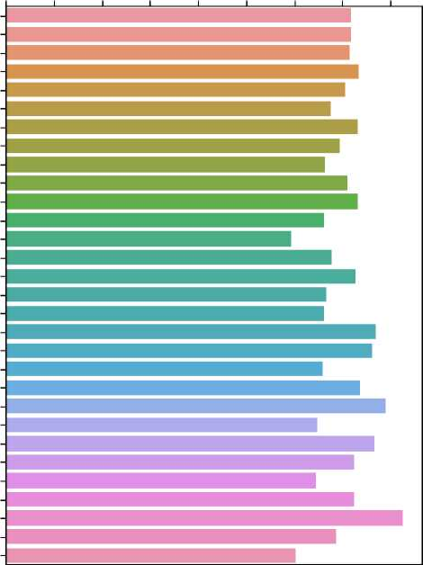
[ ]■ dr.infoQ
5" >
Interest of user has negligible effect on Engaged Sessions per user
Shoppers, Media & Entertainment/Comics & Animation Fans, Technology/Mobile Enthusiast, Food & Dining/Cooking Enthusiasts are the top most interest of the users
This can be used to get more conversions from targeted ads
A
Jl
CQ'
Engaged sessions per user
Out[ ]:<Figure size 3000x6000 with 0 Axes>
ppppOMMMH¹
CD . £D
Shoppers
okijicjibobkijicn
5
<Q §-
Q- ~ 2. CD
3 Q.
O
CD
O
o
cn CD
^ £D
Media & Entertainment/Comics & Animation Fans Technology/Mobile Enthusiasts Food Si Dining/Cooking Enthusiasts Sports Si Fitness/Health Si Fitness Buffs Lifestyles Si Hobbies/Pet Lovers Media Si Entertainment/Music Lovers Media Si Entertainment/TV Lovers News Si Politics/Avid News Readers Lifestyles Si Hobbies/Outdoor Enthusiasts Media Si Entertainment/Movie Lovers Food Si Dining/Cooking Enthusiasts/30 Minute Chefs Lifestyles Si Hobbies/Family-Focused Sports Si Fitness/Sports Fans Lifestyles Si Hobbies/Fashionistas Food Si Dining/Fast Food Cravers Sports Si Fitness/Sports Fans/Soccer Fans Shoppers/Value Shoppers Lifestyles Si Hobbies/Art Si Theater Aficionados Media Si Entertainment/Gamers News Si Politics/Avid News Readers/Avid Political News Readers
CD
X
o
CD
D
CD
3
o
CQ
£D
■o
DO
CD
■a
o
ro <D w §
w
m
ZI
CD
■a
o
CD _
W <Q
w so o <Q
³ 2 (/) Q.
m
0)
(£2
CD
-« 3
0) CD CD 3.
Technology/Social Media Enthusiasts Media Si Entertainment/Gamers/Casual Si Social Gamers
Food Si Dining/Foodies Lifestyles Si Hobbies/Business Professionals Media Si Entertainment/Gamers/Action Game Fans Vehicles Si Transportation/Auto Enthusiasts Technology/Technophiles Media Si Entertainment/Book Lovers Home Si Garden/Do-lt-Yourselfers
(£2
0)
(£2
CD
- 3
3 g
CD 3
o m
o <
o
o
o

Slide 10

o |  | 3 | > |  |  |  | 3
c |  |  | 3 0 | • | • | •
 | o | o | »< W | o | > 3 | 3 | ~a
 | =y | IT | o | 3¹ CD | CL (n | GO | X ■b
=3
O
CD ~a
o o a o 3 -
C CD 3-
3 ^ CD
CD
CO
N'
CD
03
O
O
O
X
cn
o
o
o
5000
£1) CL CL
o
o
cn
CD 0> CL
o ^{c}
CD 3 W 0 3 CD IT C W
8 E- »
^ CD CD
laf
(n co =5
India
I
CD
X
c
w
0
o CD
II
O
o
3
<
CD
United States Canada -(not set) -
o
3
CD
CQ_
c5'
a;
CD
c
in
CD
co
in
CD
ZJ
CD
TD
O
3
0)
CD
tn
V
 |  |  | ro | cn | w m 0 3 « <0 W Q)
 | ro | cn |  | o | O <0
ro |  |  | ro |  | 3 CD
cn |  | CO |  | CO | CO Q.
II
d
_{n} United Kingdom
o
Singapore -Japan Australia -Bangladesh -Germany -
3
0 ®
0 3.
m
0
<Q
0
A 3 3 g 0 3
o s s
o
o

Slide 11
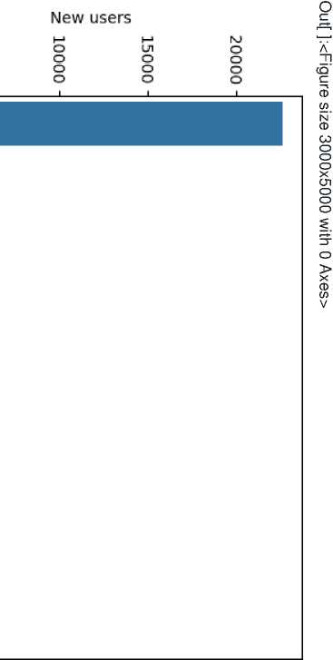
3 3
^ Q_
cjoco-Nicnai^wiv)
<class 'pandas.core.frame.DataFrame’> Rangelndex: 47 entries, 0 to 46 Data columns (total 10 columns):
# Column Non-Null Count Dtype
CD ^{v}<
■ =?
O ®
=s ^ P
m > < < CD CD
m m m
3 3 3
CQ CQ CQ £D £D £D CQ CQ CQ CD CD CD CL 3 CL
Z <Z O
CD CO O S CD C
CQ
C
x » o" Q" £o" _a
c o
C/> Q)
0)
£5 XL CQ CD CD
8 ® § S
CQ
0)
CQ
CD
3
CD
3
=!■.
^ 3
3 CD O
1* = 3 O 3
5' 3 05 = -P^
aj CL =?. £D
§ 5P
7? II
JL ^{W}
CD c/5
3 x
ii
d
o
c
3
CD
CD
CO
+ D 7T CD
ai *
-5"
^ o S
O ? §
ill
3
0>
3
CD
in
II
O
o
c
^.3 3
II
i s
3. o
5' CD JZ XL CD
£ a
C
co
CD
CD
-P^
O 3
® S
CD -P^ ■P^
o
0>
O)
■P^

Slide 12
=3
sns.barplot(data=cr2,x=Town/City',y='Engaged sessions per user')
plt.xticks(rotation=90)
plt.showQ
IV) IV) II II
q o
E° b-
CO CD
O SD
'<1
SD O
o
Bengaluru Patna Hyderabad Indore Lucknow Mysuru Chennai (not set) Coimbatore Guwahati Ahmedabad Kochi Nagpur Bhubaneswar Agra Jaipur Siliguri Pune Kolkata Imphal Ludhiana Delhi
Visakhapatnam
CT
II
CQ
0)
CQ
CD
Q.
in
CD
in
TO
CD
c
in
CD
-
n
i—r
-<
CQ
II
Madurai -Shimla -Mumbai -Panipat -j Ranchi -Chandigarh -j Jammu -
</>
CD

Slide 13
Users
3 3
^ Q_
coco--jcncn4^coho
<class 'pandas.core.frame.DataFrame’> Rangelndex: 574 entries, 0 to 573 Data columns (total 10 columns):
# Column Non-Null Count Dtype
, CD ^{v}<
o
o
o
ro
UJ
o
Q
O
o
o
o
ui
o
o
o
CTi
o
o
o
TD "O CO O
- =3 "O
O ® o C/3
m > < < CD CD
m m m
3 3 3
CQ CQ CQ 03 03 03 CQ CQ CQ CD CD CD CL =5 CL
2 c
o
o
o
;=+ ^ =3 ^
=s ^ P
in X “ II 3-^cro
c
03
o
I s-« -
8 ® § S
^ CQ 03 CQ CD
3
CD
3
Cn =r. -si =3
5. <2. "S. o)
4^
cn
b =J'
+ 03 CD 03
“s a g
I §■'< g sr i-
II o ®
cn
2 =>
m
cn
' C CT
cn
4^
3
O
3
=3
C
c
in _{rri} CD Sf, cn
cn _■ ^ -si 3 =5 ^ § o
O =5 3 3 _ C
H-Tf
0 C
1 8
i
i
i
*< 0) - - C/3
E 2^
03 CD
-P^ O
II
o
CD
03 C =
C Q. cn -■
O 3
3 eg
_* & 5
« II
O 2 *
^ T|
0) ^
03_
03
0)
4^
(D

Slide 14
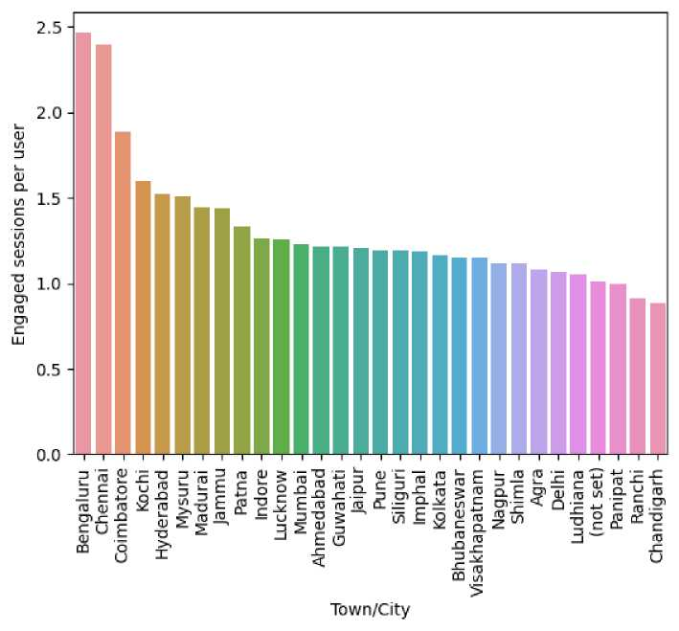
• Bangaluru has highst Engaged sessions per user
• Bangaluru ,Chennai ,Coimbatore , Kochi has Engaged sessions per user is more than 1.5 which we can consider high
• Most of the users are from Bangalore
Analysis on User by Language report
^{In [ ]:} ul= pd.read_excel(xls, 'User by Language') ul.head(5)
Out[ ]: | Language | Users | New users | Engaged sessions | Engagement rate | Engaged sessions per user | Average engagement time | Event count | Conversions | Total revenue
0 | English | 22495 | 21990 | 40639 | 0.595147 | 1.806579 | 341.36350 | 1297970 | 189946 | 0
1 | Hindi | 586 | 552 | 798 | 0.406314 | 1.361775 | 60.03413 | 13523 | 2699 | 0
2 | Marathi | 85 | 84 | 98 | 0.426087 | 1.152941 | 38.48235 | 1589 | 323 | 0
3 | Gujarati | 78 | 77 | 100 | 0.448430 | 1.282051 | 46.53846 | 1794 | 327 | 0
4 | Telugu | 43 | 42 | 56 | 0.455285 | 1.302326 | 36.65116 | 812 | 170 | 0
^{In [ ]:} ul.info()
<class 'pandas.core.frame.DataFrame'> RangeIndex: 24 entries, 0 to 23 Data columns (total 10 columns):
# Column Non-Null Count Dtype
0 Language 24 non-null object
1 Users 24 non-null int64
2 New users 24 non-null int64
3 Engaged sessions 24 non-null int64
4 Engagement rate 24 non-null float64
5 Engaged sessions per user 24 non-null float64
6 Average engagement time 24 non-null float64
7 Event count 24 non-null int64
8 Conversions 24 non-null int64
9 Total revenue 24 non-null int64
dtypes: float64(3), int64(6), object(1) memory usage: 2.0+ KB
^{In [ ]:} sns.barplot(data=ul,x='Users',y='Language')

Slide 15
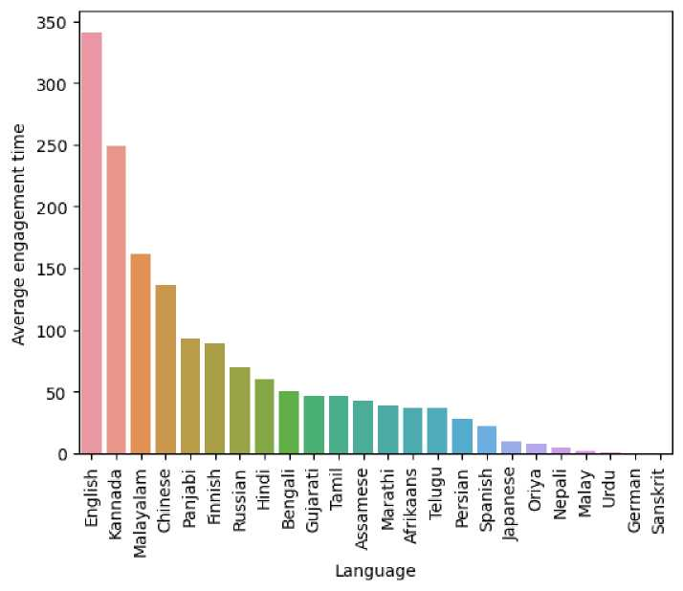
Out[ ]:<AxesSubplot:xlabel='Users', ylabel='Language'>
English -Hindi -Marathi -Gujarati -Telugu -Tamil -Malayalam -Bengali -Chinese -Kannada -Si Panjabi -
§ Persian -
o’ Spanish-
rtj Finnish -
Japanese -Oriya -Afrikaans -Assamese -German -Malay -Nepali -Russian -Urdu -Sanskrit -
-1-1-1-1—
0 5000 10000 15000 20000
Users
^{In [ ]:} # users distribution for top 5 languages ul 1 =ul.head(5)
px.pie(ul 1 ,values='Users',names='Language')
• Most of the users use English 96.6%
• 2.52% users speak Hindi
^{In [ ]:} ul2=ul.sort_values(by=['Average engagement time'],ascending=False) sns.barplot(data=ul2,x='Language',y='Average engagement time') plt.xticks(rotation=90) plt.show() •
• Average engagement time is highest for English
• language like Kannada, Malayalam ,Chinese has high Average engagement time
Analysis on User Interest report
^{In [ ]:} ui= pd.read_excel(xls, 'User By Interest')
ui=ui.sort_values(by=['Users'],ascending=False)
^{In [ ]:} ui 1 =ui.head(30)
^{In [ ]:} ui1 .head(5)

Slide 16
Marketing Campaign Analysis:
3 | C/D
o | =r
GO | o
 | ■o
O | ■O
O | CD
3 | w
3 o
3 | CD
 | CL
5' | ED'
CD | P°
CD GO | m
 | 3
O | s
3¹ | ED.
CD | 3
C | 3
(/) CD | CD 3
3
 | o
H | o
=r | 3
C/)' | o'
o | C/5
ED =3 | P°
cr CD | > 3
3 o | 3' ED
CD | o' 3
c
cn | T1
CD^ | ED
 | 3
c] | co
& | —1
CQ CD | CD O =r
CD | 3
CL | o
ED | o
CL CQ
C/3 | *<
ED
13 | o
CL | a;
O | CD⁻
13 | m
ED | 3
3 | 3¹
o | C co
r~ ED 13 | ED' co
CL | CO
3' | -
CQ | T1
"D | o o
ED CQ | CL
CD | p°
C/5 ED | o
13 | 3^
CL | 3"
C/D | CQ
 | O
ED CD | O O
CQ | 7T
o' | 3" CQ
"D ED | m
 | 3
3 | 3¹
CD | C
3 | O
=r | ED'
■o' | 0
o | CO
ED | T-c
3 | =T
CL | CD
O | O CD
o_ | 0)
ED | CD
cr
o 0) | 3¹ CD
o'
3
co
CD
«
N'
CD
05
O
O
O
X
05
O
O
O
o
Shoppers -f
Media & Entertainment/Comics & Animation Fans -Technology/Mobile Enthusiasts -Food & Dining/Cooking Enthusiasts -Sports & Fitness/Health & Fitness Buffs -| Lifestyles Si Flobbies/Pet Lovers -| Media & Entertainment/Music Lovers -Media & Entertainment/TV Lovers -| News Si Politics/Avid News Readers-| Lifestyles Si Hobbies/Outdoor Enthusiasts -J Media Si Entertainment/Movie Lovers -E Food Si Dining/Cooking Enthusiasts/30 Minute Chefs -E Lifestyles Si Flobbies/Family-Focused -I □ Sports Si Fitness/Sports Fans -E
?D Lifestyles Si Hobbies/Fashionistas -j
^ Food Si Dining/Fast Food Cravers -E
5T Sports Si Fitness/Sports Fans/Soccer Fans -E
Shoppers/Value Shoppers -E Lifestyles Si Hobbies/Art Si Theater Aficionados -E Media Si Entertainment/Gamers -| News Si Politics/Avid News Readers/Avid Political News Readers-|
Technology/Social Media Enthusiasts -| Media Si Entertainment/Gamers/Casual Si Social Gamers -
Food Si Dining/Foodies -Lifestyles Si Flobbies/Business Professionals -Media Si Entertainment/Gamers/Action Game Fans -Vehicles Si Transportation/Auto Enthusiasts -Technology/Technophiles -Media Si Entertainment/Book Lovers -Flome Si Garden/Do-lt-Yourselfers -
CD
0)
V

Slide 17
Users
ro
o
o
o
_I_
-pk
o
o
o
CTi
o
o
o
_I_
00
Q
o
o
_I_
o
o
o
o
CQ
c
O Q) 7T =* CO -Q
CD
CD
O
O
O
X
CD
O
O
O
CQ" O
cu
90
CD
aj CL =?. £1) § N u ft
ll^
CD
CD --o J-¹-
9°
o
o
> 3
3. CD
3 =
CD '
X
O
ll_
5"
CD
=■ O
W. 8 £u x:
>
X
CD
II
C=
CD
CD
c/5
« ²
5 CD
w £
cn
CD
cn
ro
CD
CD
, 3
cn |  | CD | CD | CD | CD >
cn | CD | ro | cn | ro
!_». | CD | CD | Li. | co | _n
4^ | cn | CD | -■J | co
cn | CD | 4^ | --■J | 4^ | 3 CQ
 | -■J | cn | ro | --J | <D CD
I'D | 4^ | 4^ | 4^ | 4^
cn | O | CO | CD | CD | 0 m
 | CD | CD |  | O | 0 <
CO |  | CO | O | CD | C CD
CO |  | cn | ro | CD | 3 3
—*■ | CO | CO | cn | 4^
o
o

Slide 18
Out[ ]:
 | Session Google Ads campaign | Users | Sessions | Engaged sessions | Google Ads clicks | Google Ads cost | Google Ads cost per click | Conversions | Cost per conversion | Event count | Total revenue | Return on ad spend
0 | App Installation for May -Shahid | 5429 | 10936 | 6276 | 147100 | 179175.000 | 1.218049 | 12257 | 14.618180 | 97802 | 0 | 0
1 | App Install-States-A200Inst-20Jun22 | 842 | 1655 | 968 | 28742 | 24309.130 | 0.845770 | 1794 | 13.550240 | 15311 | 0 | 0
2 | App Install-States-B100Installs-22Jun22 | 742 | 1332 | 780 | 17809 | 22374.580 | 1.256363 | 1422 | 15.734580 | 11640 | 0 | 0
3 | App Install for April -Shahid | 473 | 976 | 546 | 19302 | 20525.180 | 1.063370 | 1115 | 18.408230 | 8001 | 0 | 0
4 | Video-AppInstall-PS-Internships-11 Jul22 | 510 | 966 | 515 | 9831 | 6377.833 | 0.648747 | 1032 | 6.180071 | 10323 | 0 | 0
^{In [ ]:} ga.infoO
<class 'pandas.core.frame.DataFrame'> RangeIndex: 15 entries, 0 to 14 Data columns (total 12 columns):
# Column Non-Null Count Dtype
0
Session Google Ads campaign 15 non-null object
Users 15 non-null int64
1
Sessions
Engaged sessions Google Ads clicks Google Ads cost
15 non-null int64 15 non-null int64 15 non-null int64
15 non-null float64
2
3
4
5
Google Ads cost per click 15 non-null float64
6
Conversions Cost per conversion Event count Total revenue Return on ad spend
15 non-null int64 15 non-null float64 15 non-null int64 15 non-null int64 15 non-null int64
7
8
9
10 11
dtypes: float64(3), int64(8), object(1) memory usage: 1.5+ KB
^{In [ ]:} # creating a columns for Money Spent in each a campaign ga['money_spent']=ga['Conversions']*ga['Cost per conversion'] ga.head(5)
Out[ ]: | Session Google Ads campaign | Users | Sessions | Engaged sessions | Google Ads clicks | Google Ads cost | Google Ads cost per click | Conversions | Cost per conversion | Event count | Total revenue | Return on ad spend | money_spent
0 | App Installation for May --Shahid | 5429 | 10936 | 6276 | 147100 | 179175.000 | 1.218049 | 12257 | 14.618180 | 97802 | 0 | 0 | 179175.032260
1 | App Install-States-A200Inst-20Jun22 | 842 | 1655 | 968 | 28742 | 24309.130 | 0.845770 | 1794 | 13.550240 | 15311 | 0 | 0 | 24309.130560
2 | App Install-States-B100Installs-22Jun22 | 742 | 1332 | 780 | 17809 | 22374.580 | 1.256363 | 1422 | 15.734580 | 11640 | 0 | 0 | 22374.572760
3 | App Install for April -- Shahid | 473 | 976 | 546 | 19302 | 20525.180 | 1.063370 | 1115 | 18.408230 | 8001 | 0 | 0 | 20525.176450
4 | Video-AppInstall-PS-Internships-11Jul22 | 510 | 966 | 515 | 9831 | 6377.833 | 0.648747 | 1032 | 6.180071 | 10323 | 0 | 0 | 6377.833272
^{In [ ]:} # Creating a column to judge cost effectiveness of Campign
ga['cost_effictiveness']=ga['Cost per conversion']-sum(ga['money_spent'])/sum(ga['Conversions'])
^{In [ ]:} ga.head(5)

Slide 19
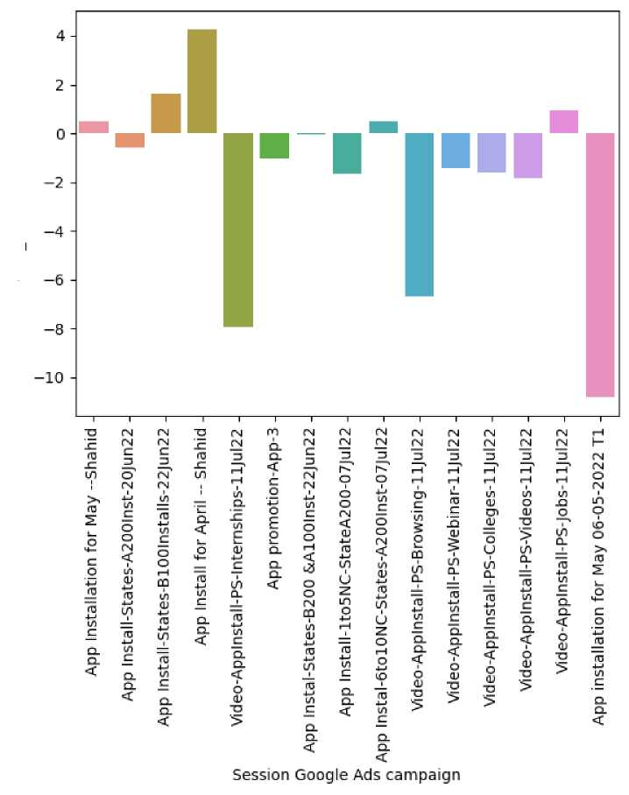

Out[ ]:
Session Google Ads campaign | Users | Sessions | Engaged sessions | Google Ads clicks | Google Ads cost | Google Ads cost per click | Conversions | Cost per conversion | Event count | Total revenue | Return on ad spend | money_spent | cost_effict
App
Installation for May -- | 5429 | 10936 | 6276 | 147100 | 179175.000 | 1.218049 | 12257 | 14.618180 | 97802 | 0 | 0 | 179175.032260 | 0
Shahid
App Install-
States- A200Inst- | 842 | 1655 | 968 | 28742 | 24309.130 | 0.845770 | 1794 | 13.550240 | 15311 | 0 | 0 | 24309.130560 | -0
20Jun22
App Install-States-B100Installs- | 742 | 1332 | 780 | 17809 | 22374.580 | 1.256363 | 1422 | 15.734580 | 11640 | 0 | 0 | 22374.572760 | 1
22Jun22
App Install for April -- | 473 | 976 | 546 | 19302 | 20525.180 | 1.063370 | 1115 | 18.408230 | 8001 | 0 | 0 | 20525.176450 | 4
Shahid
Video-
AppInstall-
PS- | 510 | 966 | 515 | 9831 | 6377.833 | 0.648747 | 1032 | 6.180071 | 10323 | 0 | 0 | 6377.833272 | -7
0
1
2
3
4
Internships-11Jul22
^{In [ ]:} sns.barplot(data=ga,x='Session Google Ads campaign',y='cost_effictiveness') plt.xticks(rotation=90) plt.show()
• The most successful campaign was >- 'App Install for April -- Shahid' in terms of cost effectiveness.
• App installation for May 06-05-2022 T1 as the least successful
• App Instal-6to10NC-States-A200Inst-07Jul22 , Video-AppInstall-PS-Browsing-11Jul22 was significantly less successful in terms of cost effectiveness
^{In [ ]:} sns.lineplot(data=ga,x='Google Ads cost',y='Conversions') plt.xticks(rotation=90) plt.show()

Slide 20
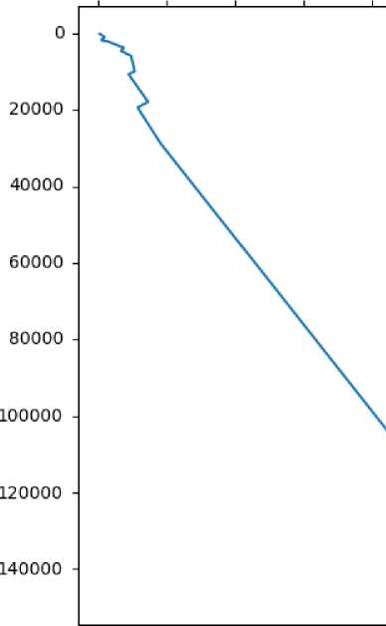
3 | >
 | 3 | •
 | fi)
& ii | < 0) to' | in £D 3 CD
"O Q. | o 3
CD | H | 3¹
£D CL | fi) | 3¹
I |  | CD
CD X o | o' | £D
 | > | 3
CD_ | -Q | o
 | c | c
x_ |  | 3
CO | </>;
 |  | (/>
H | o' | ■o CD
j3 | 3 | 3
 |  | o
o |  | 3
> |  | O
-Q |  | £D
C |  | 3
w; |  | ■O
<—*- |  | £1)
o |  | CQ
3_ |  | 3
Conversions
0)
CL
ro
o
o
o
O
o
o
CD
o
o
o
CO
o
o
o
_ W
0 CD
=r c/3
Q) W
1 g
CD ³
2!
O Q> C C ■Q ^
C
V)
0)
3
CL
Q
o
o
w
m
iTi
CD _
W <Q W Q)
o <Q
³ 2
CO Q.
CD
£D
£
>
<
0)
~ s
q CD
5 ®
p 2
^ (Q
«<g
w 3
1'S
 |  | ro |  | o | 2. m
!_». | CO | CD | Li. | o | O 3
CO | CD |  | o | --J | 3 CD
CD | ro | CD |  | CO | _{C} « W
CD | CO | CO | o | o | V) "D
CD | CO |  | ro | CO | CD CD 2
ro | o | CD | CD | CD | H' H' Q.
O
o_
o'
7T
to
0)
CL
CQ
CD
CO
O
O
3
<
CD
CD
CL
(£2
CD
, 3
o m
o <
cn X X
O
o

Slide 21
Google Ads cost
^{n} [ 1: sns.lineplot(data=ga,x='Google Ads clicks',y='Conversions') plt.xticks(rotation=90) plt.showQ
Conversions
0 - | 12000 -10000 -8000 -6000 -4000 -2000 -0- '
25000 - | \
50000 - | \
75000 - | \
100000 - | \
125000 - | \
150000 - | \
175000 -

Slide 22
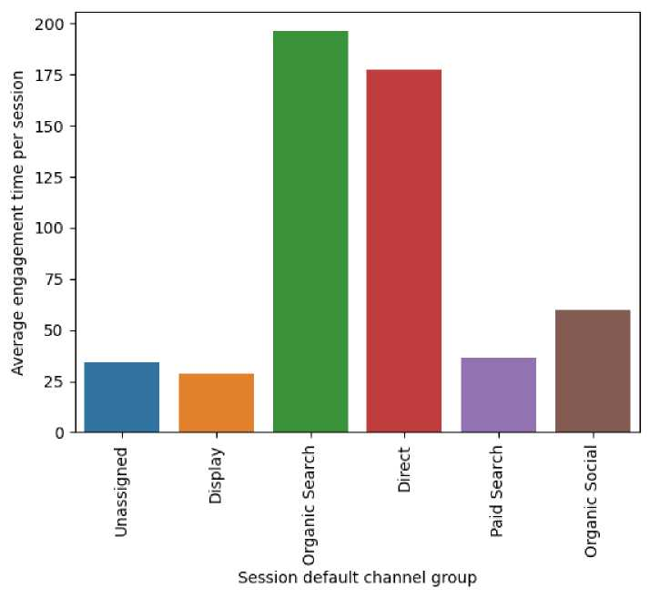
<class 'pandas.core.frame.DataFrame'>
RangeIndex: 6 entries, 0 to 5 Data columns (total 11 columns):
# Column Non-Null Count Dtype
Session default channel group 6 non-null object Users 6 non-null int64
Sessions 6 non-null int64
Engaged sessions 6 non-null int64
Average engagement time per session 6 non-null float64 Engaged sessions per user 6 non-null float64
Events per session Engagement rate Event count Conversions
6 non-null float64
6 non-null float64
6 non-null int64 6 non-null int64
10 Total revenue 6 non-null int64
dtypes: float64(4), int64(6), object(1) memory usage: 656.0+ bytes
^{In [ ]:} px.pie(ta,values='Users',names='Session default channel group')
• Display is the highest contributor for traffic aquisition followed bu organic search
• Paid search contributes only 6.53% of total traffic
• Paid search is good for aquiring new users but not for traffic aquisition
^{In [ ]:} sns.barplot(data=ta,x='Session default channel group',y='Average engagement time per session') plt.xticks(rotation=90) plt.show()
• Organic Search and Direct has more Average engagement time per session even though they have 17% and 9% traffic contribution
^{In [ ]:} sns.barplot(data=ta,y='Events per session',x='Session default channel group') plt.xticks(rotation=45) plt.show()

Slide 23
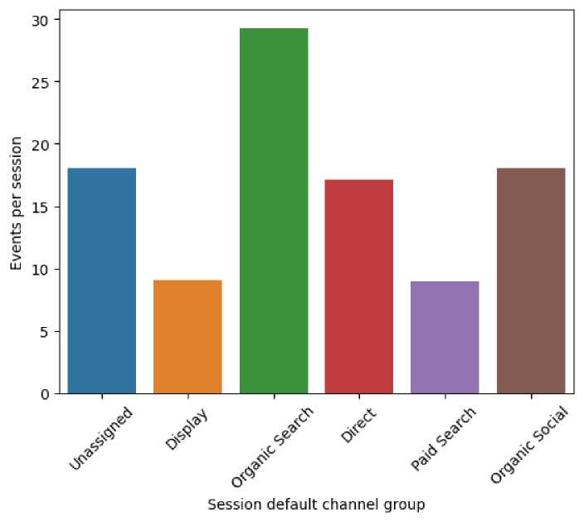
• when people organic search they explore the app more
• in case of paid and display type channel group the Events per session ,they browse less which has less possibilty for fequent user
Business Insights And Key Findings :

Slide 24
User Installation & Engagement Performance Analysis:
• Users who install the app at least start a session, which means they at least try the app.
• There are 23,254 users, and 18,030 users removed the app, which is a high number.
• Only 1,700 users receive notifications.
Analysis on Gender Report:
• Male customers are more in number than female customers.
• Despite that, the average engagement time for females is more.
Analysis on Age Data:
• Most of the users belong to the 18-24 category.
• The 18-35 age group constitutes 60% of the total users; however, the 18-24 age group has the highest average engagement time.
Analysis on User Interest Report:
• Interest of users has a negligible effect on Engaged Sessions per user.
• Shoppers, Media & Entertainment/Comics & Animation Fans, Technology/Mobile Enthusiasts, Food & Dining/Cooking Enthusiasts are the top interests of the users.
Analysis on Demographics Report:
• Most of the users are from India, and some are from the United States.
• Other countries have almost negligible users.
• Bangalore has the highest Engaged sessions per user.
• Bangalore, Chennai, Coimbatore, Kochi have Engaged sessions per user more than 1.5, which we can consider high.
• Most of the users are from Bangalore.
• Most of the users use English (96.6%).
• 2.52% of users speak Hindi.
• Average engagement time is highest for English.
• Languages like Kannada, Malayalam, Chinese have high Average engagement time.
• Shoppers, Media & Entertainment/Comics & Animation Fans, Technology/Mobile Enthusiasts, Food & Dining/Cooking Enthusiasts, these are the most common interests of the users. This can be more useful for targeted ads, Dynamic Landing Pages, and Strategic Partnerships and Collaborations.
Marketing Campaign Analysis:
• The most successful campaign was 'App Install for April -- Shahid' in terms of cost-effectiveness.
• App installation for May 06-05-2022 T1 was the least successful.
• App Install-6to10NC-States-A200Inst-07Jul22, Video-AppInstall-PS-Browsing-11Jul22 was significantly less successful in terms of cost-effectiveness.
• The ad clicks and conversions plot is linear, that means most of the consumers who click ads get converted.
• Same with the amount spent on the campaign.
• Display is the highest contributor to traffic acquisition followed by organic search.
• Paid search contributes only 6.53% of total traffic.
• Paid search is good for acquiring new users but not for traffic acquisition.
• Organic Search and Direct have more Average engagement time per session even though they have 17% and 9% traffic contribution.
Business Recommendations

Slide 25
1. User Engagement Enhancement Strategy
• Develop a notification strategy to engage users after installation. Since only a small percentage currently receives notifications, explore ways to increase this number.
• Investigate the reasons behind the high number of app removals. Conduct user feedback surveys to understand pain points and areas for improvement.
• Develop targeted retention campaigns to encourage users to revisit the app. Consider offering incentives or exclusive content to re-engage dormant users. ##### Gender Based Engagement Strategy
• Despite a higher number of male users, focus on creating content that resonates with female users. Leverage insights from the higher average engagement time for females to tailor content and features ##### Age-Group Targeting: Recognize the importance of the 18-24 age group in terms of both population and engagement time. Develop targeted engagement strategies, exclusive content, and features to cater to this demographic. ##### Targeted Advertising
• Leverage the identified top interests (Shoppers, Media & Entertainment/Comics & Animation Fans, Technology/Mobile Enthusiasts, Food & Dining/Cooking Enthusiasts) for more effective targeted advertising.
• Implement dynamic landing pages and collaborate with partners aligned with these interests to enhance user engagement. ##### Region Based Strategy
• Given the concentration of users in Bangalore, Chennai, Coimbatore, and Kochi, consider tailoring marketing efforts and content for these regions.
• Utilize the language insights to optimize content delivery and possibly introduce localized features.
2. Marketing Campaign Optimization
• Analyze the successful 'App Install for April -- Shahid' campaign to understand what worked well. Apply similar strategies to future campaigns.
• Reevaluate and optimize less successful campaigns, such as 'App Instal-6to10NC-States-A200Inst-07Jul22' and 'Video-AppInstall-PS-Browsing-11 Jul22,' to improve cost-effectiveness.
• Acknowledge the effectiveness of Display and Organic Search for traffic acquisition. Allocate resources accordingly and consider increasing investment in these channels.
• Assess the performance of Paid Search and explore ways to improve its effectiveness for both user acquisition and engagement.

