Slide 1
Apex 3
Tom Francart
Stijn Verstraeten

Slide 2
Structure
What’s new?
Introduction XML
Editing XML files
Apex experiment files for dummies
Hands on: idn and training
Conversion Apex 2 -> Apex 3
Analysis of results
Apex experiment files: advanced features
Hands on: speech in noise, aid
Bugreports - bugzilla
Questions

Slide 3
What’s new?
Flexibility
Better soundcard support
New devices (NIC2, …)
Subject selection
Multiplatform
Backward compatibility
NO forward compatibility
Experiment file in XML

Slide 4
XML: basics
Plain text (cfr. HTML)
Nomenclature:
<person> John Doe </person>
Whitespace matters!
Case sensitive
Start-tag
content
End-tag
Element
Empty element: <person/>
No whitespace!

Slide 5
XML: trees
<person>
<name>
<first_name>Jamie</first_name>
<middle_name/>
<last_name>Oliver</last_name>
</name>
<profession>Cook</profession>
<profession>Author</profession>
</person>
Thou shalt close every tag!
How do you close an empty tag?

Slide 6
XML: attributes
<person first_name=“John”
male = ‘true’ number_of_toes=“10” />
Use “ or ‘ is obliged, even for numbers
Whitespace is allowed
Attributes can be optional
attribute
value

Slide 7
XML basics – exercise
Please remind me:
<person born=“true” id=“21248”>
John Doe
</person>
Which are the XML names?

Slide 8
XML: various
“Names” can contain letters, numbers, underscore (_), hyphen (-), period (.)
Names cannot contain spaces
Names shall start with a letter
Names are case sensitive
References: certain characters must be described:
  < &lt;
  & &amp;
  > &gt;
  “ &quot;
  ‘ &apos;
Comments:
<!-- this is a comment, which is ignored -->
<char type=“less than”>
<
</char>
<char type=“less than”>
&lt;
</char>
No whitespace!

Slide 9
XML: declaration
Every document should start with a declaration. For Apex, you can copy this from an example document
<?xml version='1.0' encoding='UTF-8'?>
<apex:apex xmlns:xsi="http://www.w3.org/2001/XMLSchema-instance"
xsi:schemaLocation="http://www.kuleuven.be/exporl/Lab/Apex"
xmlns:apex="http://www.kuleuven.be/exporl/Lab/Apex"
version="1">
<!– Put your own experiment definintion here -->
</apex>
Every XML document starts with a line like this

Slide 10
XML: well-formedness
A document that complies to the previous slides (general: to the XML specification) is called well formed
A document is checked for well-formedness before any further processing is done
Further constraints can be imposed on a document, for Apex3 this is done using a schema. A document adhering to a certain schema is called valid
For an experiment file to be interpreted by Apex, it must first be well formed and valid

Slide 11
Editing XML files
XML files are plain text
Several options:
Plain text editor of your choice (eg. Notepad, Matlab editor, …)
Special XML editor, which can help you
  Write well-formed XML
  Write valid XML according to the Apex3 schema
  Eg: OxygenXML (installation: cfr wiki): demo
  Don’t use: Word, frontpage or similar

Slide 12
Structure
What’s new?
Introduction XML
Editing XML files
Apex experiment files for dummies
Hands on: idn and training
Conversion Apex 2 -> Apex 3
Analysis of results
Apex experiment files: advanced features
Hands on: speech in noise, aid
Bugreports - bugzilla
Questions

Slide 13
Terminology of a psycho-ac experiment
The experiment is started
The subject is presented with several trials. The order of the trials is determined by the psychoacoustical procedure
For every trial, the subject is presented with a screen and a stimulus
The screen is presented via the computer monitor, the stimulus via a “device”, currently a sound card or CI interface
After every answer, the corrector corrects the answer and hands the result to the procedure
The procedure determines whether the experiment is finished
The bold words are also Apex3 terminology

Slide 14
Terminology
What’s the difference between a trial and a stimulus?
What’s the relationship between a procedure and a corrector?

Slide 15
Apex experiment files for dummies
The structure of an Apex3 experiment file is defined by the Apex3 schema
General overview:
<apex:apex>
<procedure/>
<corrector/>
<screens/>
<datablocks/>
<devices/>
<filters/>
<stimuli/>
<connections>
</apex>
Is the above structure well-formed?
Is the above structure valid?

Slide 16
<devices>
More than one device can be defined. For now we define only one, a soundcard
<devices>
<device id=“mySoundcard" xsi:type="apex:wavDeviceType">
<driver>portaudio</driver>
<card>default</card>
<gain>0</gain>
<channels>2</channels>
<samplerate>44100</samplerate>
<buffersize>512</buffersize>
</device>
</devices>
How to define more than one device?
Choose yourself

Slide 17
<datablocks>
A datablock is the basic data container in Apex3. Every wav-file you want to use must be defined using a datablock
<datablocks>
<uri_prefix>file:../stimuli</uri_prefix>
<datablock id=“datablock1" >
<device>mySoundcard</device>
<description>This is the first datablock</description>
<birth>2006-01-17T00:00:00Z</birth>
<checksum>5E2854FE11</checksum>
<uri>rawdata1.wav</uri>
</datablock>
<datablock id=“datablock2" >
<device>mySoundcard</device>
<description>This is the second datablock</description>
<birth>2005-05-19T00:00:00Z</birth>
<checksum>5E2854FE11</checksum>
<uri>rawdata2.wav</uri>
</datablock>
</datablocks>
file:../stimuli/rawdata1.wav

Slide 18
Our possessions
What do we have now?
1 device, called mySoundcard
2 datablocks, called datablock1 and datablock2
In what follows, we will refer to our possessions using their ID’s.
Reminder: an ID consists of letters, numbers, hyphens, underscores and periods
Which of the following ID’s are valid?
Smurf, sMURF, 3smurf, smu2rf, _smurf,
smu_rf, smu rf, sm.urf

Slide 19
<stimuli> - part 1
A stimulus consists of one ore more datablocks, chained together
<stimuli>
<fixed_parameters/>
<stimulus id="stimulus1">
<description>Eenvoudige teststimulus</description>
<datablocks>
<datablock id="rawdata1"/>
</datablocks>
<variableParameters/>
<fixedParameters/>
</stimulus>
</stimuli>

Slide 20
<stimuli> - part 2
A more fancy example: chaining together datablocks
<stimulus id="stimulus2">
<description>This is my stimulus!</description>
<datablocks>
<sequential>
<datablock id="rawdata1"/>
<datablock id="rawdata2"/>
<simultaneous>
<datablock id="rawdata1"/>
<datablock id="rawdata2"/>
</simultaneous>
</sequential>
</datablocks>
<variableParameters/>
<fixedParameters/>
</stimulus>
Rawdata1=“a”
Rawdata2=“I”
What do we hear?

Slide 21
<screens>
<screens>
<screen id="screen1">
<gridLayout height=“1" width=“2" id="main_layout">
<button x="1" y="1" id="button1">
  <text>Knop 1</text>
  </button>
  <button x="2" y="1" id="button2">
  <text>Knop 2</text>
  </button>
</gridLayout>
<buttongroup id="buttongroup1">
<button id="button1"/>
<button id="button2"/>
</buttongroup>
<default_answer_element>buttongroup1</default_answer_element>
</screen>
</screens>

Slide 22
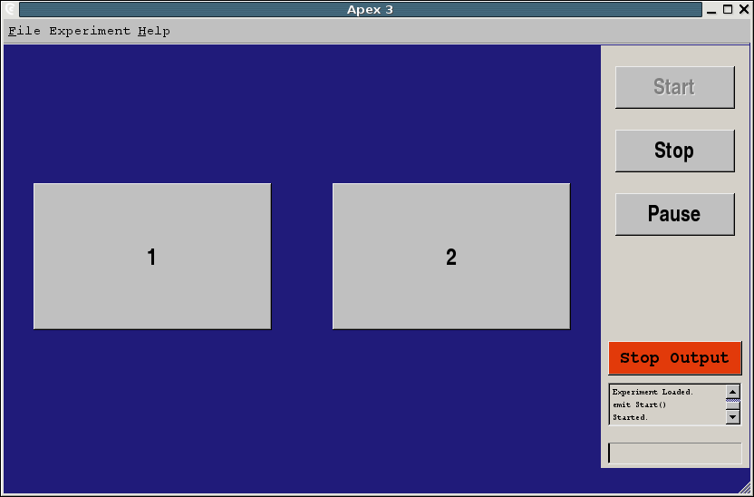
<screens>

Slide 23
<screens>
Available layout types:
  gridLayout
  arcLayout (localisation experiments)
Available elements:
  button
  textEdit
  label
  picture
All nested as deeply as you like

Slide 24
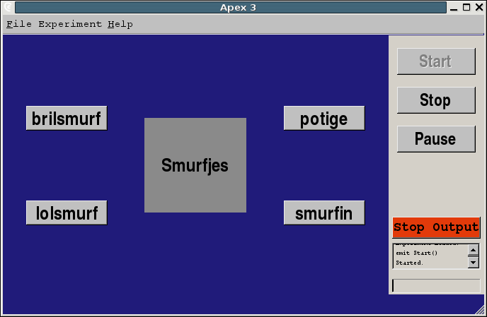
<screens> - excercise
How would you do this?

Slide 25
<screens> - solution
<screen id="screen1">
<gridLayout height="1" width="3" id="main_layout">
  <gridLayout width="1" height="2" x="1" y="1">
    <button x="1" y="1" id="button1">
    <text>brilsmurf</text>
    </button>
    <button x="1" y="2" id="button2">
    <text>lolsmurf</text>
    </button>
  </gridLayout>
  <label id="labeltje" x="2" y="1">
  <text>Smurfjes</text>
  </label>
  <gridLayout width="1" height="2" x="3" y="1">
    <button x="1" y="1" id="button4">
    <text>potige</text>
    </button>
    <button x="1" y="2" id="button5">
    <text>smurfin</text>
    </button>
  </gridLayout>
</gridLayout>

Slide 26
<procedure> - general
<procedure xsi:type="apex:trainingProcedureType">
<parameters>
…
</parameters>
<trials>
…
</trials>
</procedure>

Slide 27
<procedure> - types
Constant procedure | Every trial is presented a given number of times
Adaptive procedure | N up/M down, Levitt A user specified parameter is adapted
Training procedure | The stimulus corre-sponding to a user input is presented after the input
Multiprocedure | Multiple of the above procedures interleaved

Slide 28
<procedure> - example
<procedure xsi:type="apex:constantProcedureType">
<parameters>
<presentations>1</presentations>
<skip>0</skip>
<order>sequential</order>
</parameters>
<trials>
<trial id="trial1">
<answer>button1</answer>
<screen id="screen1"/>
<stimulus id="stimulus1"/>
</trial>
</trials>
</procedure>
Where are the
ID’s?
What will happen
from the user’s
point of view?

Slide 29
Demo: constant procedure
Define devices
Define datablocks
Define stimuli
Define screens
Define procedure
  Procedure parameters
  Trials
Give it a shot!
idn1.xml - handouts

Slide 30
Demo: training procedure
How to modify the previous?
train1.xml - cfr. handout
How to get more information?
  The schema
  OxygenXML
  Examples!
  Ask

Slide 31
Structure
What’s new?
Introduction XML
Editing XML files
Apex experiment files for dummies
Hands on: idn and training
Conversion Apex 2 -> Apex 3
Analysis of results
Apex experiment files: advanced features
Hands on: speech in noise, aid
Bugreports - bugzilla
Questions

Slide 32
Conversion from Apex2 to Apex3
For now, everything can be converted, except child mode
Scripts still experimental: check whether all parameters are translated
Perl scripts: you have to install the interpreter from
http://www.activestate.com/Products/ActivePerl/
or equivalent
See wiki for more practical info

Slide 33
Analysis of results
Later: database with results, for now: use files on disk
Results are in XML format
XML can be translated to other formats using XSLT stylesheets
What format would you like?
Example: results from idn1.xml
Example after processing with idn1.xsl:
[Stimulus/response pairs]
stimulus1 stimulus2 stimulus3 stimulus4 stimulus5 stimulus6
stimulus1 stimulus3 stimulus2 stimulus4 stimulus2 stimulus6

Slide 34
Apex experiment files: advanced features
<corrector>
<filters>
<connections>
parameters

Slide 35
<corrector>
How does Apex determine whether an answer is correct?
<corrector>
<type>isequal</type>
</corrector>
Currently supported types:
  isequal
  alternatives
  Many more to come!
Might be moved to procedure

Slide 36
<filters>
Filters
Generators
Example
<filters>
<filter xsi:type="apex:generator" id="noisegen">
<device>dev</device>
<channels>1</channels>
<type>noise</type>
<gain id="gainparam">-20.0</gain>
<frequency>0</frequency>
<phase>0</phase>
</filter>
</filters>

Slide 37
<filters> - currently available
Generator
  noise
  square
  sinus
  triangle
  singlepulse
Amplifier
Cfr examples

Slide 38
<connections>
We have:
  Datablocks
  Filters/generators
  Output devices
How are they interconnected?
  Default
  Via the <connections> element
You can define your own network of the above elements (cfr simulink, labview, …)

Slide 39
<connections> - example
<connections>
<connection>
<from>
<id>noisegen</id>
<channel>0</channel>
</from>
<to>
<id>soundcard</id>
<channel>1</channel>
</to>
</connection>
<connection>
<from>
<id>rawdata1</id>
<channel>1</channel>
</from>
<to>
<id>soundcard</id>
<channel>0</channel>
</to>
</connection>
</connections>
A special ID is defined for all datablocks: _ALL_
A <channel> can have an ID so it can be referenced as a parameter from elsewhere
Eg <channel id=“outputchannel”/>

Slide 40
Fixed stimulus parameters
Every stimulus must have the fixed parameters defined here
<stimuli>
<fixed_parameters>
<parameter id=“pitch"/>
</fixed_parameters>
<stimulus id=“stimulus1" >
<description>pitched stimulus</description>
<datablocks>
<datablock id=“datablock1" />
</datablocks>
<variableParameters/>
<fixedParameters>
<parameter id=“pitch">310</parameter>
</fixedParameters>
</stimulus>
</stimuli>

Slide 41
Fixed parameters
A fixed stimulus parameter is a property of a stimulus that cannot be changed by Apex. It is rather a description of the stimulus than a parameter that has impact somewhere else.
Fixed parameters are especially used by adaptive procedures. If a certain fixed parameter is selected to be adapted by a procedure, the stimulus to be presented will be selected using that fixed parameter
How would you design a JND in ITD experiment using fixed parameters?

Slide 42
Variable stimulus parameters
<stimuli>
<fixed_parameters/>
<stimulus id="stimulus0">
<description>Stimulus 0</description>
<datablocks>
<datablock id="datablock0"/>
</datablocks>
<variableParameters>
<parameter id=“speaker">3</parameter>
</variableParameters>
<fixedParameters/>
</stimulus>
</stimuli>

Slide 43
Variable stimulus parameters
A variable stimulus parameter, is a parameter that will be set elsewhere just before the stimulus is sent to the device.
A variable parameter should be defined elsewhere (in a filter, in a device, …: see previous slides)
Where are fixed parameters defined?
How would you set up a localization experiment in the arc using variable parameters?

Slide 44
Structure
What’s new?
Introduction XML
Editing XML files
Apex experiment files for dummies
Hands on: idn and training
Conversion Apex 2 -> Apex 3
Analysis of results
Apex experiment files: advanced features
Hands on: speech in noise, aid
Bugreports - bugzilla
Questions

Slide 45
Hands on: speech in noise
Words-noise.xml
Converted from apex2 file
Cfr handout

Slide 46
Future features
Database support for experiment results and definitions
Editor for experiment files
Matlab interface for experiment creation and processing of results
Experiment selection per subject
Automatic calibration
...
Who designs a nice logo/spash screen?

Slide 47
Bugs?
What to do if you encounter a bug?
Find out what causes the bug. Can you reproduce it?
Use our brand new bugzilla system
If you have problems with bugzilla, contact Tom by e-mail
Also for feature-requests

Slide 48
Using bugzilla
Surf to http://gilbert.med.kuleuven.be/bugzilla
If you haven’t used the system before, create a new acount using the Open a new Bugzilla account link
Otherwise log in using your e-mail address
Click the new link in the yellow box at the bottom of the page
Click on Apex 3
Fill out the required fields
Press the commit button
Everyone who has to know about the will be contacted
Automated follow-up

Slide 49
Thanks for you kind attention
Questions?

