Slide 1
SickCoin
Sweet, dude.
Just came up with that token name, brah.

Slide 2
Biz Problem
Easy and quick access to medical data
Jordan’s story about his wife’s data and issue
SOLUTION: Secure access of the medical data stored on the chain

Slide 3
Characteristics
Patient is an address
Contract is big, holds multiple procedures
Can have multiple contracts, which inherit attributes of other contracts
Allows us to build procedures onto the chain
Token is the procedure itself
Once the patient undergoes the procedure, the patient is awarded that procedure’s token

Slide 4
Characteristics Continued
Patient has a collection of tokens based on their procedures and whatever
Patient doesn’t own the contract

Slide 5
Main Users
Hospital
Doctor
Nurse
Billing
Insurance
Patient

Slide 6
General Workflow
New Patient Visit
Patient gets a check-up
Patient is diagnosed with something
Patient gets surgery
Patient gets prescription
Patient goes to new hospital

Slide 7
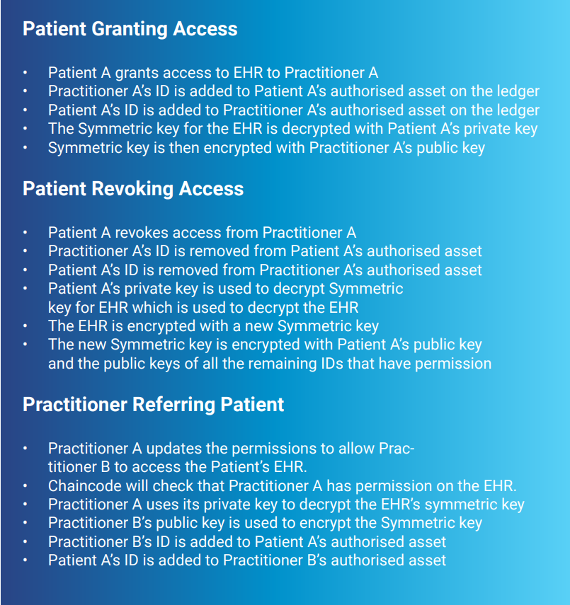
From medicalchain whitepaper

Slide 8
New Patient Visit (code idea)
pragma solidity ^0.5.0;
import "https://github.com/OpenZeppelin/openzeppelin-contracts/blob/release-v2.5.0/contracts/token/ERC20/ERC20.sol";
import "https://github.com/OpenZeppelin/openzeppelin-contracts/blob/release-v2.5.0/contracts/token/ERC20/ERC20Detailed.sol";
import "https://github.com/OpenZeppelin/openzeppelin-contracts/blob/release-v2.5.0/contracts/token/ERC20/ERC20Mintable.sol";
contract ArcadeToken is ERC20, ERC20Detailed, ERC20Mintable {
constructor ( string memory name,
string memory symbol,
uint initial_supply
)
ERC20Detailed(name,symbol,18) public {
mint(msg.sender, initial_supply);
}
}

Slide 9
Friction Points
Does the patient “own” the tokens? Is he the sole provider of access to those tokens and who can see them?
No. but neither does the hospital or the doctor
The token IDs have the attributes associated with them
The tokens are stored on the chain
Anyone with access to the chain and permissions (we set in the contract), can view the attributes of the token
Amiright? Need to look

Slide 10
Resources
https://medicalchain.com/Medicalchain-Whitepaper-EN.pdf

Slide 11
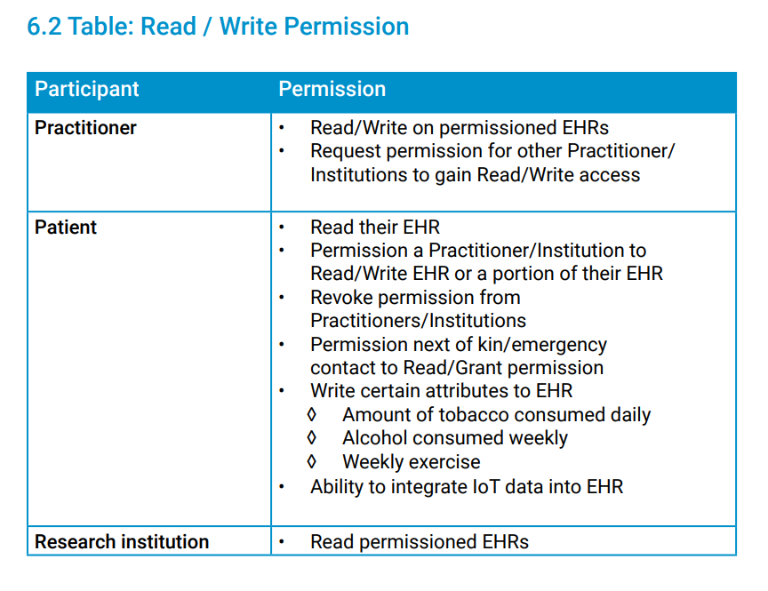
From medicalchain whitepaper

