Slide 1


Predicting the presence of flight arrival delays based on 2015 US air travel data
Vladyslav Lesiv
May 21th, 2023

Slide 2




The objective
Designing and implementing a data warehouse and ETL processes;
Data analysis and selection of methods for research;
Evaluation of methods, their comparison, and selection of the best one for predicting airline delays;

Slide 3





Presentation Plan
Determining data sources
3. Selecting data analysis and prediction methods
5. Choosing the best forecasting model
Creating a data warehouse
4. Application of methods and their effectiveness comparison

Slide 4



The main resources used:
2015 Flight Delays and Cancellations. Kaggle: https://www.kaggle.com/datasets/usdot/flight-delays
Python programming language documentation: https://docs.python.org/3/
Sklearn library: https://scikit-learn.org/stable/user_guide.html

Slide 5
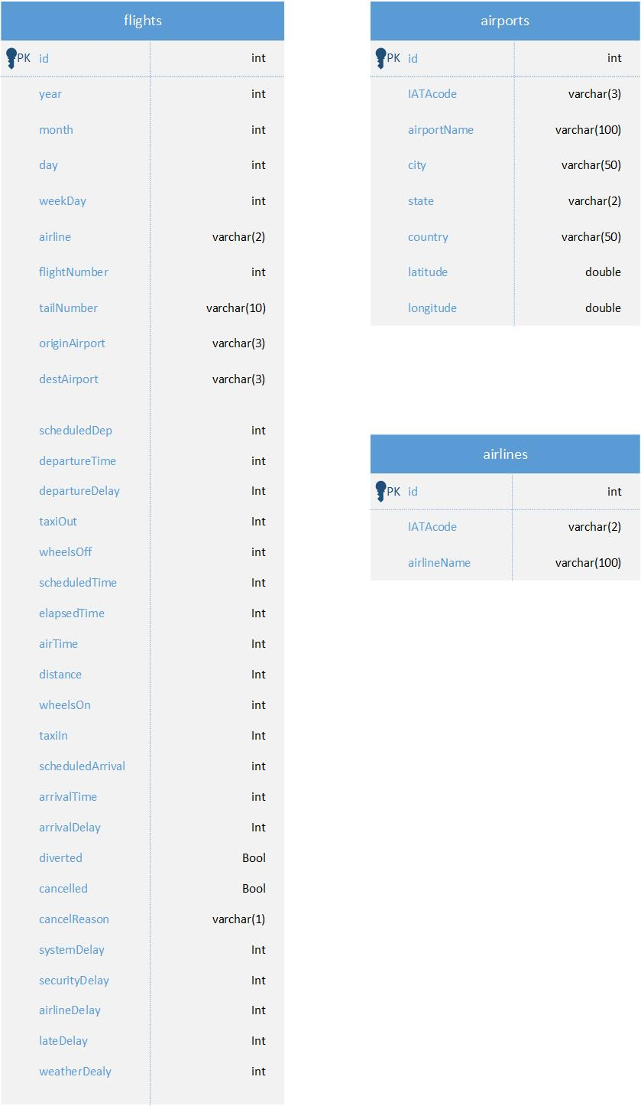
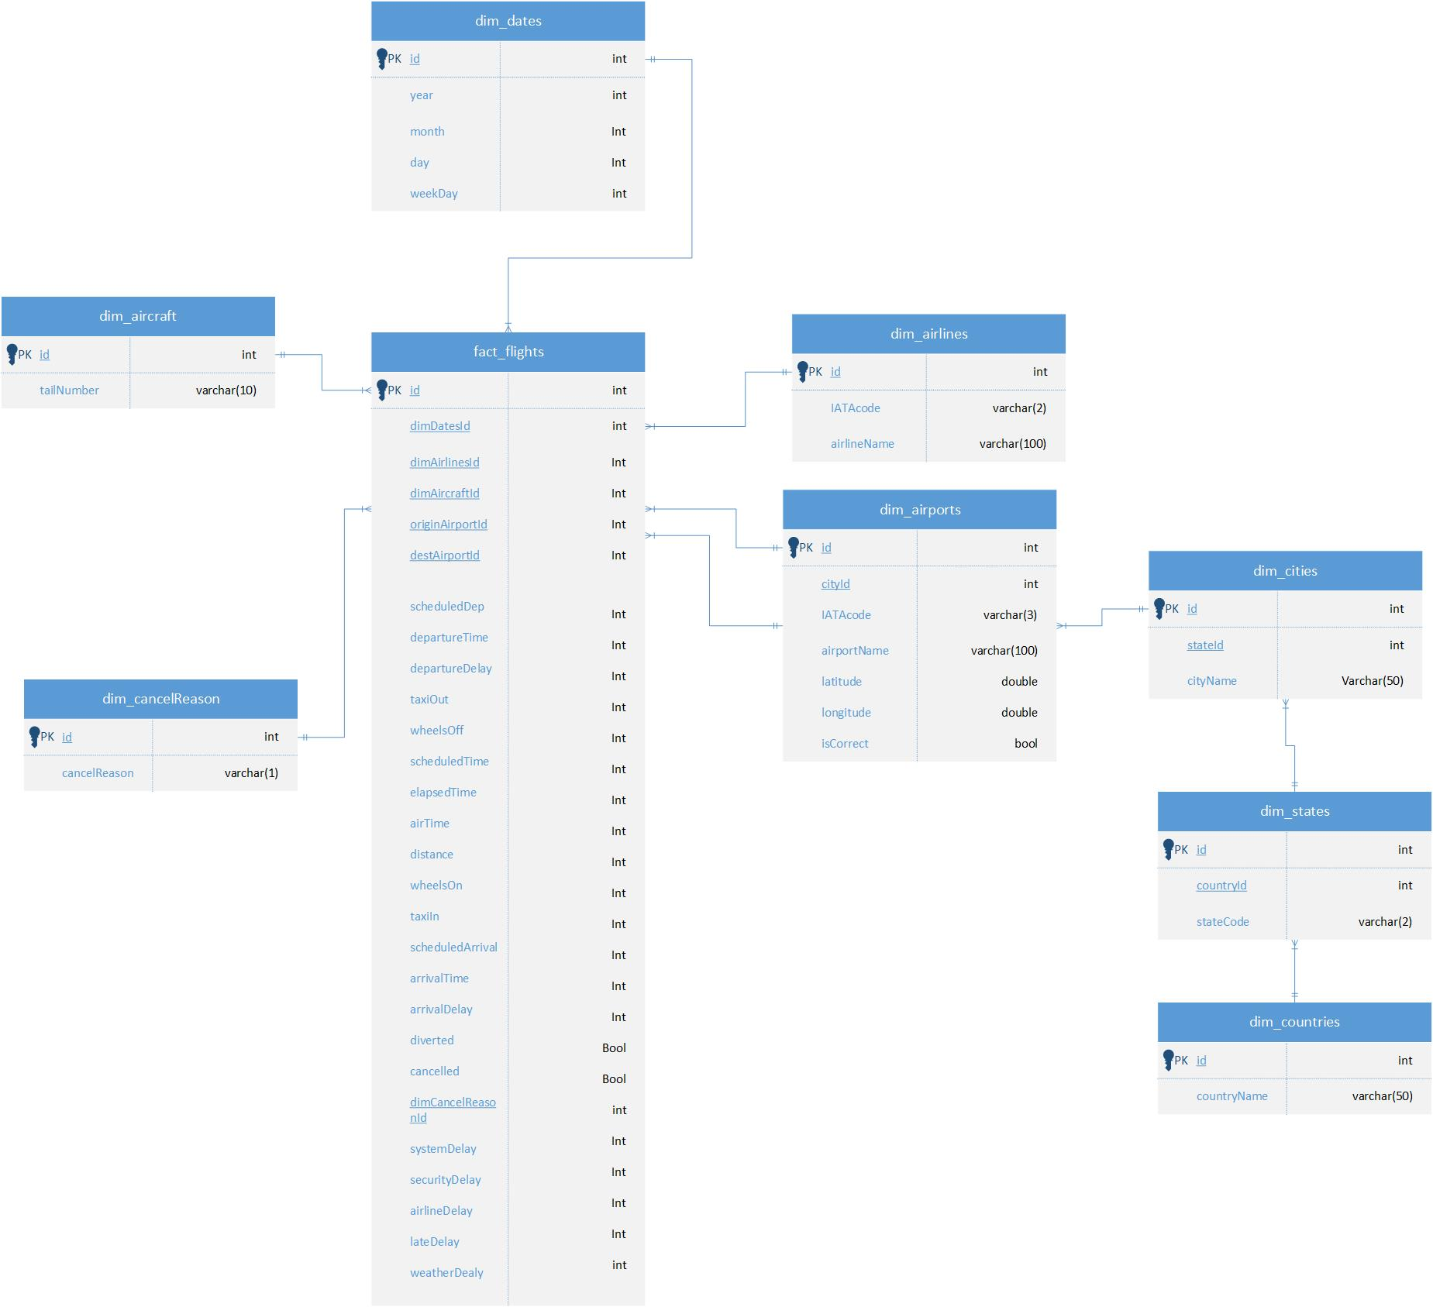
Creating a data warehouse
Initial data format, stage-zone model.
Format of the processed data, data warehouse model.

Slide 6
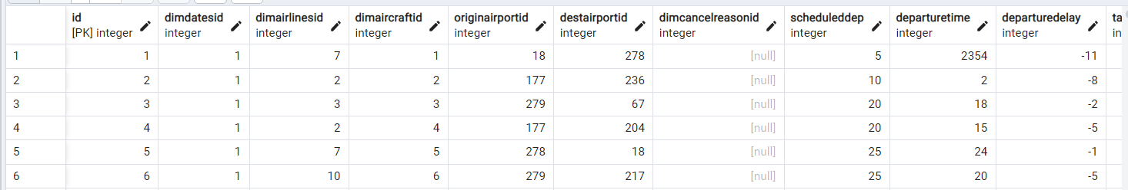
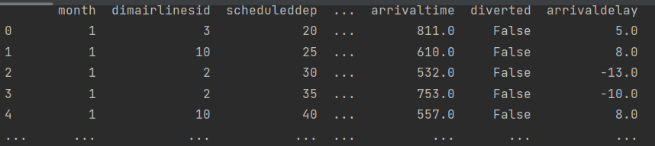
Data processing
Data from the fact table that will be used for analysis.
The same data is loaded into the Dataframe with selected factors and corrected errors.

Slide 7
Justification of the selected analysis methods
Decision Tree Classifier
Simple, easy to interpret
Has a high performance
K-Nearest Neighbors
The lazy learning algorithm
Easy to understand and implement
SVC (Support Vector Machine)
Works efficiently with data with many features
High classification accuracy
K-Means
Algorithm of learning without a teacher
Has fast convergence

Slide 8
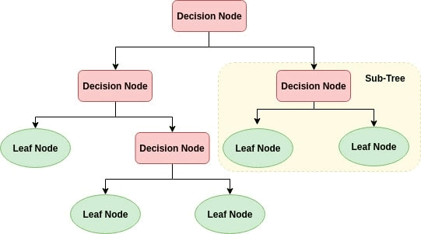
Model 1 – Decision Tree Classifier
Decision Tree Classifier creates a classification model by building a decision tree. Each node in the tree defines a test for an attribute, and each branch descending from this node corresponds to one of the possible values of the attribute.

Slide 9
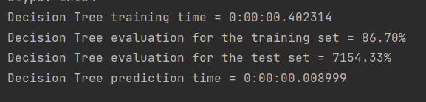
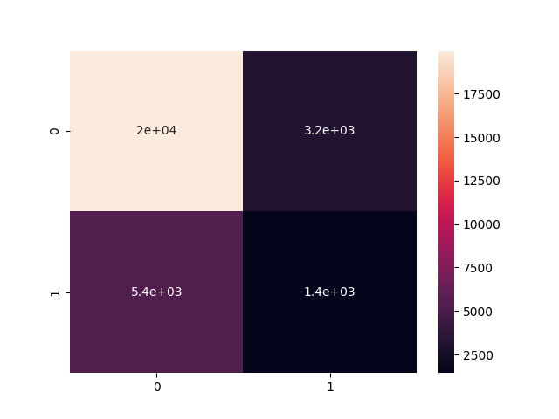
Model 1 – Results and implications.
We can see that Decision Tree quickly coped with the classification task, the time is measured in milliseconds, and the prediction scores are quite high. The score for the training set is 86.70%, and the test set is 71.54%. We can state that the model works effectively.
Inconsistency matrix for Decision Tree Classifier.

Slide 10
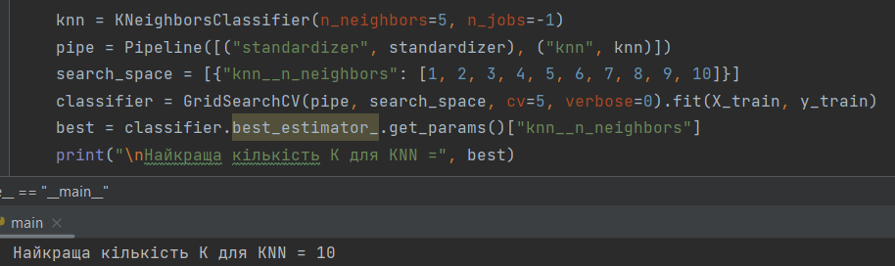

Model 2 – K-Nearest Neighbors
KNN uses a set of data examples with known class labels and classifies new examples by comparing them to their nearest neighbors. The "K" in KNN indicates the number of nearest neighbors that the algorithm uses to solve the classification.
Finding the best K.
The metric used is the Euclidean distance.

Slide 11
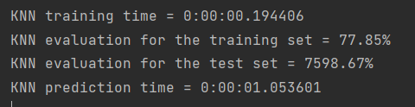
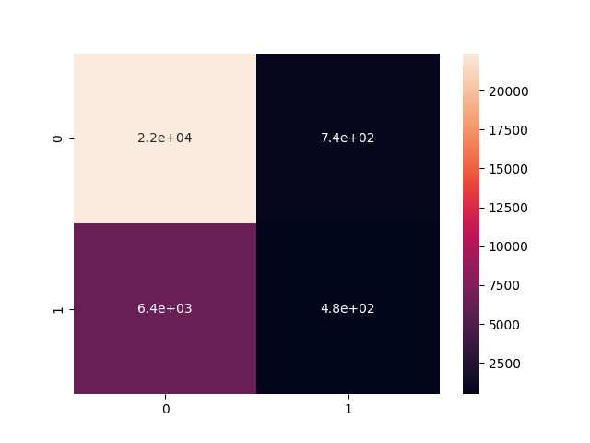
Model 2 – Results and implications.
We can see that KNN effectively coped with the classification task. The training set score is 77.85%, which is lower than that of Decision Tree, and the test set score is 75.99%, which is higher. Since the score of the test set is more important, we can say that KNN has shown a higher performance in practice.
Inconsistency matrix for K-Nearest Neighbors

Slide 12
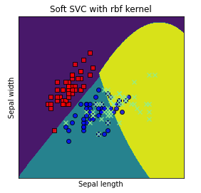
Model 3 – SVM (Support Vector Machine)
SVM with RBF (Radial Basis Function) kernel uses a nonlinear kernel function to solve nonlinear classification problems. The RBF kernel is used to transform the data into a higher-dimensional space where it becomes linearly separable. It then calculates the distance between the input samples and uses it as a measure of similarity.

Slide 13
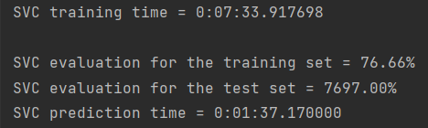

Model 3 – Results and implications.
We can see that SVC is effective in prediction. The training set score is 76.66%, which is about the same as the previous model, and the test set score is 76.97%, which is higher than the rest of the models. However, the training took as long as 7:34 minutes, which is very long, and with larger samples, the training time would be unacceptably long.
Inconsistency matrix for SVC

Slide 14
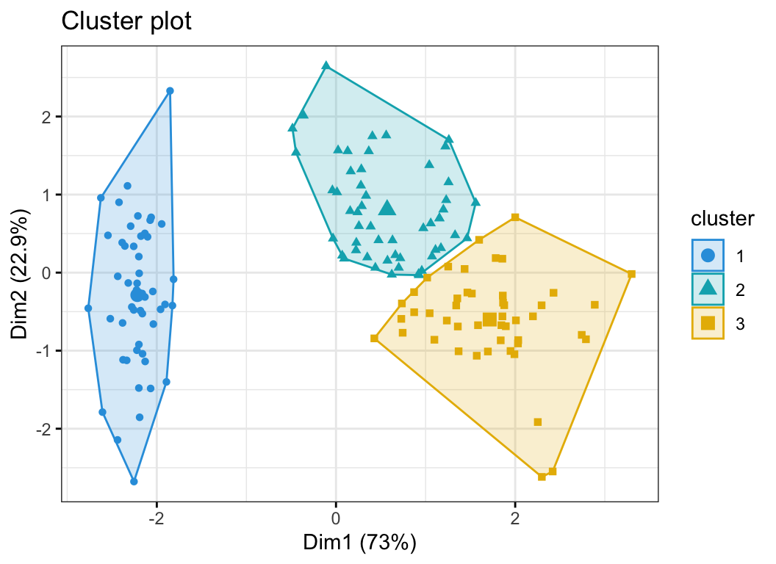
Model 4 – K-Means
The K-Means algorithm is based on the fact that each point in a cluster should be close to the center of that cluster. It works like this: first, we choose k - the number of clusters we want to find in the data. Then we initialize the centers of the clusters - centroids.
Next, the algorithm performs two parts in turn:
Assigns each point to the cluster whose centroid is closest to it.
Recalculates the position of each centroid as the average of all points in the cluster.
The steps are repeated until the centroids stop moving or the points stop moving between clusters.

Slide 15

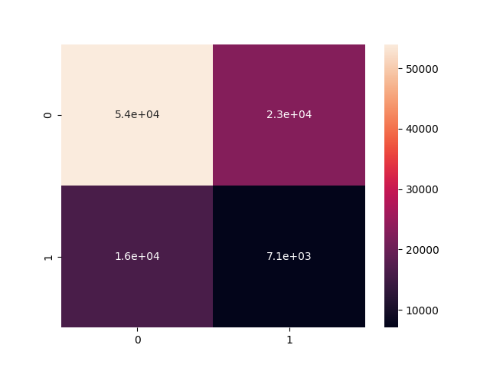
Model 4 – Results and implications.
We can see that clustering showed a result of 38.805% of correct predictions. This is a pretty good result for data with this model. The runtime is negligible, so the model works to the best of its ability.
Inconsistency matrix for K-Means

Slide 16
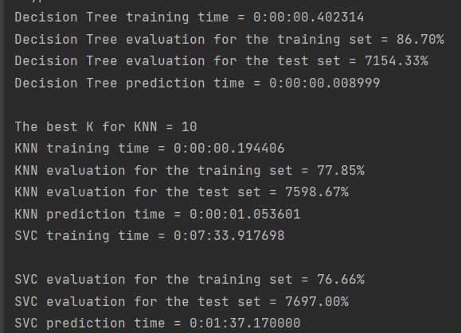
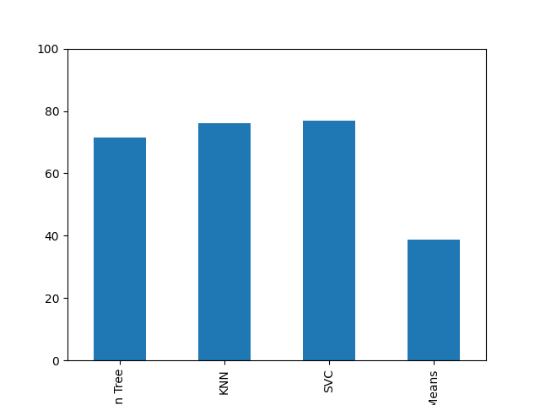

Results
Histogram of prediction results on a test sample.

Slide 17



Conclusions
Flight delays are a very serious issue that affects the economy, the well-being of individuals and society as a whole. Therefore, it is important to look for and find ways to solve this problem as soon as possible and put them into practice.
After analyzing four methods, I determined that K-Nearest Neighbors is the best model for predicting flight delays.

Slide 18


Thank you for your attention!

