Slide 1
Overview of Information Modeling Using STEP EXPRESS, EXPRESS-G, and Part 21 Models
(Excerpts and updates based on Section 1.1.1 of http://eislab.gatech.edu/pubs/seminars-etc/2002-04-shinshu-peak/)
Authors: Diego Tamburini and Russell Peak
eislab.gatech.edu
www.marc.gatech.edu
August 12, 2003
Based on Graduate Course Lectures
Georgia Tech
COA/CS/ME 6754
Excerpt Version

Slide 2
Version History and Known Caveats
Version History
~05/1997 - Diego Tamburini: Initial version
10/30/2000 - Russell Peak: Minor corrections
02/07/2001 - Russell Peak: Updates
04/22/2002 - Russell Peak: Updates including more examples
07/08/2003 - Russell Peak: Updates for excerpt version used in AP210 course (Cedar Rapids, IA)
08/12/2003 - Russell Peak: Misc. updates for AP210 course (Gaithersburg, MD)
Known Caveats
- Beware: length and end are Express keywords (better: point1, point2, length12 etc.) - also the TYPE DATE example
gives problems in some STEP processing tools
- More explanation and proper usage of INVERSE is needed (when to use INVERSE vs. aggregates)
- Include xml (p28) example for comparison

Slide 3
STEP Information Modeling Languages
Included in ISO 10303-xx series of standards
Geared towards design & engineering information systems for product life cycle
Schemas Instances
Lexical (Text) Forms: Express Part 21 (classic .stp form)
(computer-sensible) (ISO 10303-11) Part 28 (XML form) Language bindings, Express-I
Graphical Forms: Express-G
(human-sensible)

Slide 4
EXPRESS: Overview
Textual conceptual schema language.
Object-Oriented flavor.
Defined in ISO 10303-11.
Used to specify STEP integrated resources and APs.
Human-readable and computer-processable.
It is not a traditional programming language (e.g., no I/O).
It is not a data manipulation language.

Slide 5
EXPRESS Elements
Main Elements:
  Schema
  Type
  Entity
  Rule
Other Elements
  Constants
  Functions and procedures
  Executable statements
Notes:
Schema: “container” or “wrapper” of constructs
Types used to represent value domains.
Built-in: real, integer, strings, etc.
User-defined: built on top of the built-in ones.
Entities: the “meat: of EXPRESS. Things, concepts of interest.
Rules:
Local rules: uniqueness, domain
Global rules: apply to only a part of a population of entities, or to more than one population.

Slide 6
Example 1: Lines & Points
Schema
Express
Express-G
SCHEMA example1;
ENTITY point;
x : REAL;
y : REAL;
END_ENTITY;
ENTITY line;
end1 : point;
end2 : point;
END_ENTITY;
END_SCHEMA;
REAL
Primitive attributes
x
point
y
end1
line
Complex attributes
end2

Slide 7
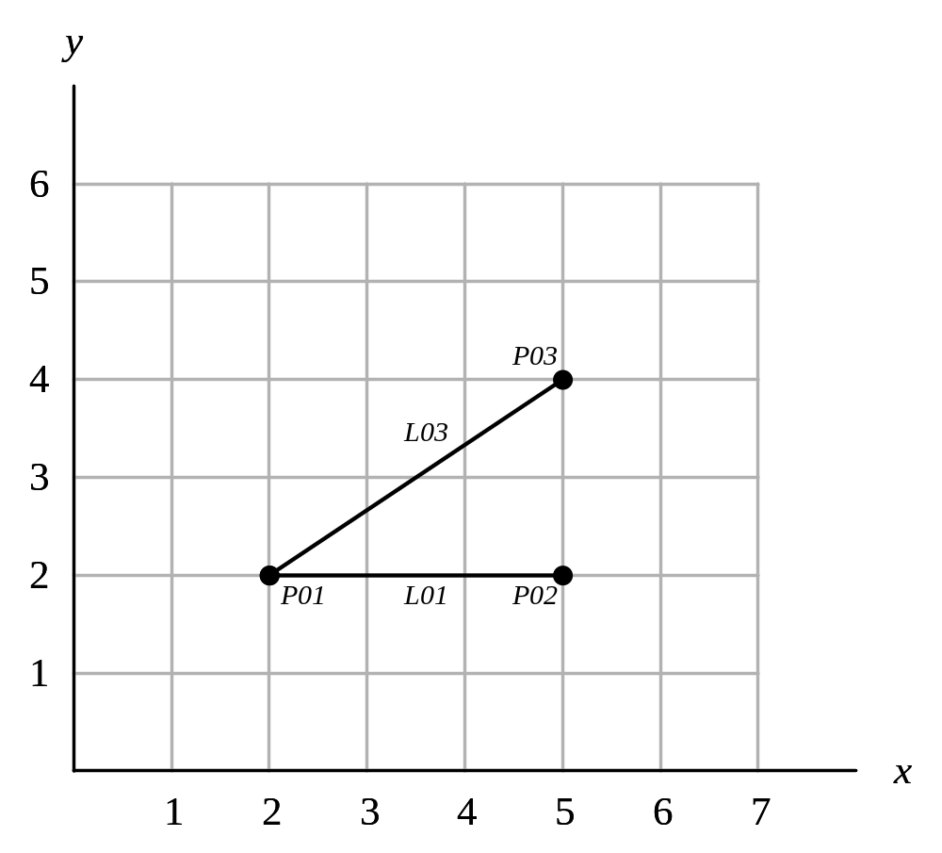
Example 1: Lines & Points (cont.)
Instances 1.a for the example1 schema
Instance Model Fragment
Part 21 format (.p21, .stp, .step)
Instance identifier (arbitrary number within a given p21 model)
Attribute values (in order as given in schema)
#10 = POINT (2.0, 2.0);
#20 = POINT (5.0, 2.0);
#30 = POINT (5.0, 4.0);
#110 = LINE (#10, #20);
#150 = LINE (#10, #30);
Reference to another instance

Slide 8
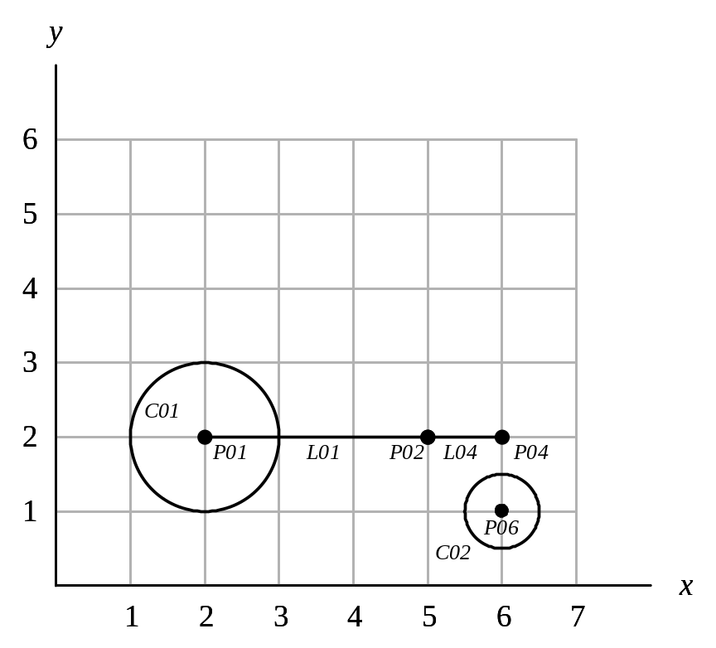
Example 2: Circles, Lines, Points
Extend the Ex 1. information model to support circles
  Modify the Express model and draw the new Express-G model
Create an instance model (Part 21 form) of this drawing:
#10 = POINT (2.0, 2.0);
…

Slide 9
Types (basic)
Simple (built-in) types:
  BINARY, BOOLEAN, INTEGER, LOGICAL, NUMBER, REAL, STRING
Collection types:
  Array (fixed size, position relevant)
  Bag (variable size, position not relevant)
  Set (like bag but without duplicates)
  List (variable size, position relevant)
Enumeration type
Select type

Slide 10
Types (user-defined )
TYPE distance = REAL;
END_TYPE;
TYPE positive_integer = INTEGER;
WHERE NotNegative : SELF >= 0;
END_TYPE;
TYPE trafficLightColor = ENUMERATION OF (Red, Amber, Green);
END_TYPE;
TYPE vehicle = SELECT( car, boat, plane );
END_TYPE;

Slide 11
Entities
ENTITY point;
x : REAL;
y : REAL;
END_ENTITY;
ENTITY line;
end1 : point;
end2 : point;
length : distance;
END_ENTITY;
ENTITY polyline;
lines : LIST[ 1 : ? ] OF line;
END_ENTITY;

Slide 12
Types vs. Entities
Type Entity
N Y - Can have instances:
Y Y - Can be used as an entity attribute

Slide 13
Entities: DERIVE and OPTIONAL
ENTITY line;
start : point;
end : point;
DERIVE
length : distance:=SQRT((end.xcoord - start.xcoord)**2
+ (end.ycoord - start.ycoord)**2);
END_ENTITY;
ENTITY person;
first_name : STRING;
last_name : STRING;
nickname : OPTIONAL STRING;
END_ENTITY;

Slide 14
ENTITIES: Local Rules
ENTITY student;
first_name : STRING;
last_name : STRING;
ssn : STRING;
UNIQUE
unique_ssn_rule : ssn;
END_ENTITY;
ENTITY unit_vector;
a,b,c : REAL;
WHERE
unit_length_rule : a**2+b**2+c**2 = 1.0;
END_ENTITY;

Slide 15
EXPRESS-G
Symbol Definitions
Simple types symbols
BOOLEAN
LOGICAL
BINARY
NUMBER
INTEGER
REAL
STRING
Type definition symbols
userDefinedType
anEnumeration
aSelect

Slide 16
EXPRESS-G
Symbol Definitions (cont.)
Entity symbol
Relationship line styles
attribute
Optional attribute
subtype-supertype

Slide 17
Subtypes/Supertypes (OneOf)
mammal
1
human
dog
cat
ENTITY mammal
ABSTRACT SUPERTYPE OF (OneOf(human,dog,cat));
weight : REAL;
END_ENTITY;
ENTITY human
SUBTYPE OF (mammal);
(* human attributes *)
END_ENTITY;
ENTITY dog
SUBTYPE OF (mammal);
(* dog attributes *)
END_ENTITY;
ENTITY cat
SUBTYPE OF (mammal);
(* cat attributes *)
END_ENTITY;

Slide 18
Example 3: Drawings, Lines, Points
Schema
Complete and compare to Example 1.
Express
Express-G
SCHEMA example2;
ENTITY drawing;
name : STRING;
elements : SET [1:?] OF shape;
END_ENTITY;
ENTITY shape;
label : STRING;
END_ENTITY;
ENTITY point SUB_TYPE OF (shape);
x : REAL;
y : REAL;
END_ENTITY;
ENTITY line SUB_TYPE OF (shape);
end1 : point;
end2 : point;
END_ENTITY;
END_SCHEMA;
Note: Another way for handling part-of relationships rather than SET as above is to use INVERSE as introduced earlier.

Slide 19
Example 3: Drawings, Lines, Points (cont.)
Instances 2.a
Instance Model Fragment
(Part 21 format)
my drawing
Inherited attribute
#10 = POINT (‘P01’, 2.0, 2.0);
#20 = POINT (‘P02’, 5.0, 2.0);
…
#100 = DRAWING (‘my drawing’,
(#10, #20, …) );
Aggregate attribute

Slide 20
Subtypes/Supertypes (AndOr)
person
student
employee
business
owner
ENTITY person
ssn : STRING;
END_ENTITY;
ENTITY student
SUBTYPE OF (person);
(*student attributes*)
END_ENTITY;
ENTITY employee
SUBTYPE OF (person);
(*employee attributes*)
END_ENTITY;
ENTITY business_owner
SUBTYPE OF (person);
(*business_owner atts*)
END_ENTITY;

Slide 21
Global Rules
RULE rule_name FOR (entity_type_1,…, entity_type_N);
(* executable statements *)
WHERE
(* some expression that returns TRUE or FALSE *)
END_RULE;
RULE max_number_of_students FOR (student);
WHERE
max_is_40 : SIZEOF(student) <= 40;
END_RULE;

Slide 22
Functions
FUNCTION days_between( d1 : date, d2 : date ) : INTEGER;
(* returns the number of days between the two
input dates. If d1 is earlier than d2, a positive
number is returned *)
END_FUNCTION;
ENTITY destroyed_part;
production_date : date;
destruction_date : date;
WHERE
dates_ok :
days_between(production_date,destruction_date) >=0;
END_ENTITY;

Slide 23
Schema
SCHEMA YourSchemaName;
[type declarations]
[entity declarations]
[rule declarations]
[functions]
END_SCHEMA;

Slide 24
EXPRESS-G
Person Example
EXPRESS
EXPRESS-G
SCHEMA example;
TYPE date = ARRAY [1:3] OF INTEGER; END_TYPE;
TYPE hair_type = ENUMERATION OF (bald,dyed,natural,wig);
END_TYPE;
ENTITY person
SUPERTYPE OF(ONEOF(female,male));
first_name, last_name : STRING;
nickname : OPTIONAL STRING;
birthdate : date;
children : SET[0:?] OF person;
hair : hair_type;
DERIVE
age : INTEGER:=years(birthdate);
INVERSE
parents : SET[0:2] OF person FOR children;
END_ENTITY;
ENTITY female
SUBTYPE OF (person);
maiden_name : OPTIONAL STRING;
END_ENTITY;
ENTITY male
SUBTYPE OF (person);
END_ENTITY;
ENTITY married;
husband : male;
wife : female;
UNIQUE
no_polyandry : husband;
no_polygamy : wife;
END_ENTITY;
FUNCTION years(aDate:date) : INTEGER;
(* returns the number of years between aDate and today *)
END_FUNCTION;
END_SCHEMA;
hair
hair_type
person
birthdate
date
first_name
A[1:3]
last_name
STRING
nickname
(DER) age
INTEGER
1
male
female
maiden_name
STRING
*wife
*husband
married

Slide 25
Part 21 Files
Person Example
SCHEMA example;
TYPE date = ARRAY [1:3] OF INTEGER; END_TYPE;
TYPE hair_type = ENUMERATION OF (bald,dyed,natural,wig);
END_TYPE;
ENTITY person
SUPERTYPE OF(ONEOF(female,male));
first_name, last_name : STRING;
nickname : OPTIONAL STRING;
birthdate : date;
children : SET[0:?] OF person;
hair : hair_type;
DERIVE
age : INTEGER:=years(birthdate);
INVERSE
parents : SET[0:2] OF person FOR children;
END_ENTITY;
ENTITY female
SUBTYPE OF (person);
maiden_name : OPTIONAL STRING;
END_ENTITY;
ENTITY male
SUBTYPE OF (person);
END_ENTITY;
ENTITY married;
husband : male;
wife : female;
UNIQUE
no_polyandry : husband;
no_polygamy : wife;
END_ENTITY;
FUNCTION years(aDate:date) : INTEGER;
(* returns the number of years between aDate and today *)
END_FUNCTION;
END_SCHEMA;
Part 21 File Fragment
(instances of data):
#10 = FEMALE( ‘Georgina’, ‘Burdell’, $, #20, (#30,#40), .DYED., ‘Jones’);
#20 = DATE((5,25,66));
#30 = PERSON(‘James’, ‘Burdell’, ‘Jimmy’, #50, ( ), .NATURAL.);
#40 = PERSON(‘Elizabeth’, ‘Burdell’, ‘Lisa’, #60, ( ), .NATURAL., $);
#50 = DATE((7,2,89));
#60 = DATE((10,29,90));
#70 = MALE( ‘George’, ‘Burdell’, $, #80, (#30,#40), .NATURAL.);
#80 = DATE((6,10,65));
#90 = MARRIED( #80, #10 );

Slide 26

STEP-Book-based Application Development Process
Overview
References:
http://eislab.gatech.edu/efwig/
http://www.lksoft.com/
End user requirements
& use cases
Develop
information model
My Express schema
LKSoft
Compiler
Optional: Use ISO standard schemas
in my schema
Develop
user interface model
My GUI XML document
Use default schema-based app generator
Create test data
& exercise use cases
My instance models
(p21 files)
User Interface
SDAI API
Repository
import/export
My STEP-Book
Application
GUI = graphical user interface
API = application programming interface
SDAI = standard data access interface (ISO 10303-22)
p21 = STEP text files (instance models) (ISO 10303-21)

Slide 27
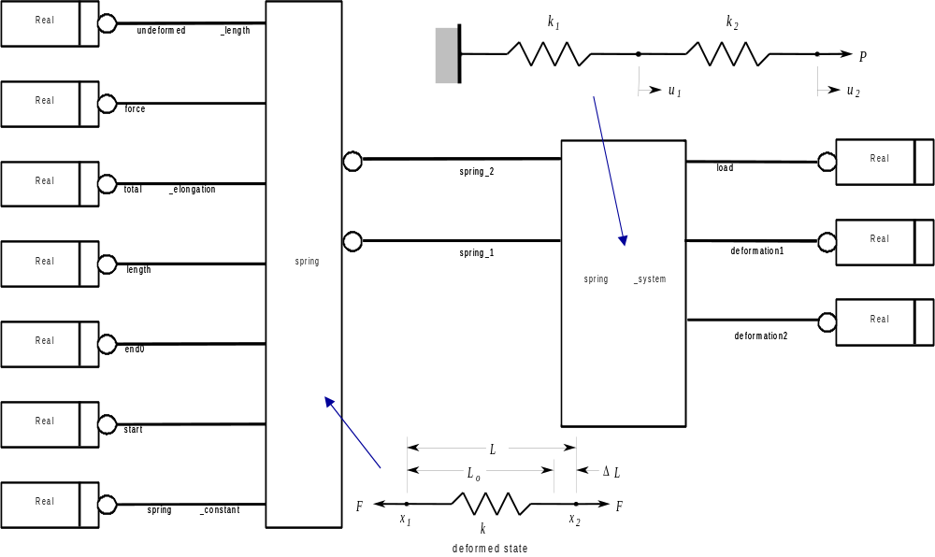
Express-G Model spring system tutorial

Slide 28
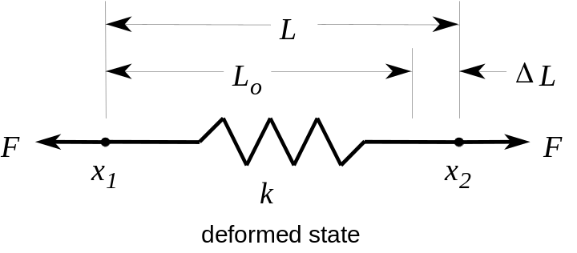
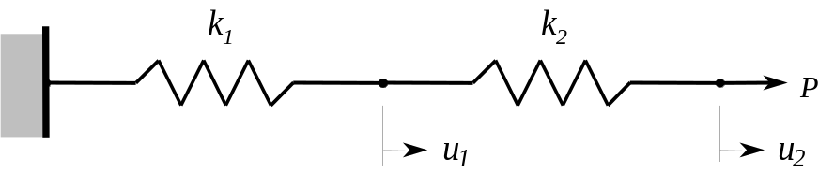
Express Model: two_spring_system.exp spring system tutorial
SCHEMA spring_systems;
ENTITY spring;
undeformed_length : REAL;
spring_constant : REAL;
start : REAL;
end0 : REAL;
length0 : REAL;
total_elongation : REAL;
force : REAL;
END_ENTITY;
ENTITY two_spring_system;
spring1 : spring;
spring2 : spring;
deformation1 : REAL;
deformation2 : REAL;
load : REAL;
END_ENTITY;
END_SCHEMA;

Slide 29
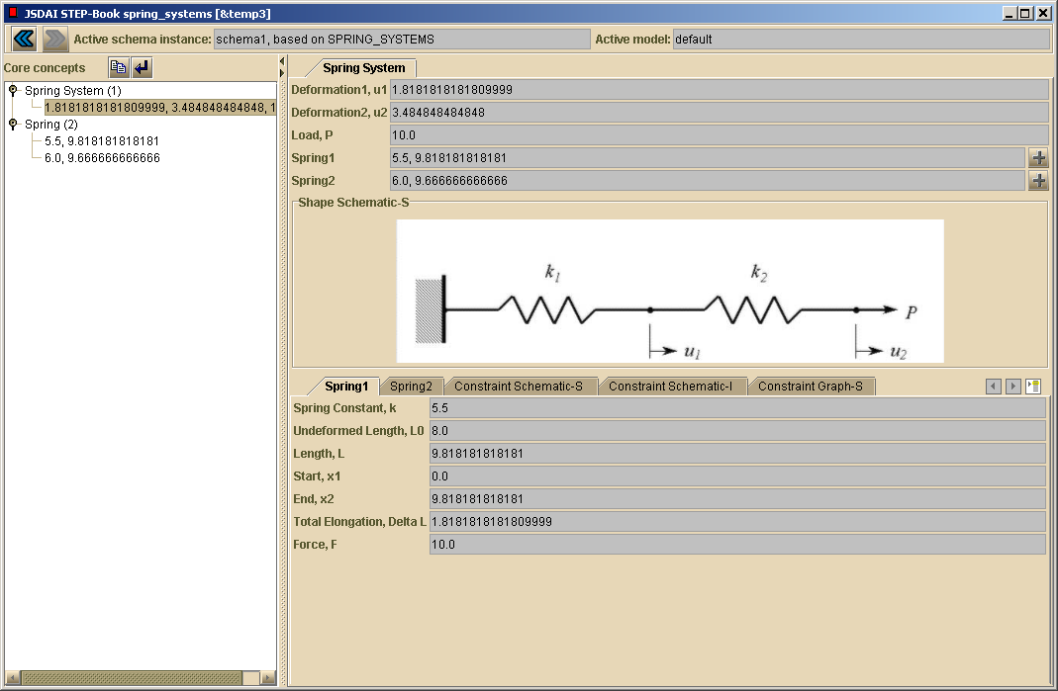
Instance Model: Part 21 and Example Application spring system tutorial
Fragment from an instance model - Part 21 (a.k.a. “STEP File” - ISO 10303-21)
#1=TWO_SPRING_SYSTEM(#2,#3,1.81,3.48,10.0);
#2=SPRING(8.0,5.5,0.0,9.81,9.81,1.81,10.0);
#3=SPRING(8.0,6.0,9.8,19.48,9.66,1.66,10.0);

Slide 30
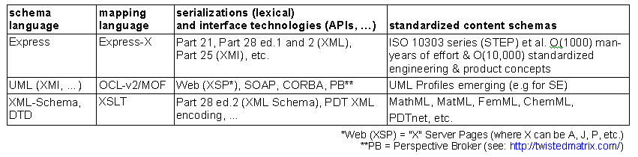
Primary Technologies for Schema-based Engineering Frameworks
Based on Engineering Framework Interest Group (EFWIG) emails from steve.waterbury@gsfc.nasa.gov
(dated July 13, 2002 wrt PGPDM directions) and David Leal (dated November 26, 2002).

Slide 31
STEP-based Information Modeling References
Web:
  ISO work site: http://www.tc184-sc4.org/
  EPM Technology: http://www.epmtech.jotne.com/
    Has online tutorials covering Express etc. in more depth
  STEP tool vendors (for tools to create and manage Express-based models)
Suggested Reading:
  Information Modeling the EXPRESS Way - Schenk & Wilson, 1994
  Developing High Quality Data Models - West & Fowler, 1996
  http://www.stepcom.ncl.ac.uk/epistle/data/mdlgdocs.htm
  Building Product Models - Eastman, 1999 (architecture/engr./construction)
    Chapter 5 overviews Express etc.
See also references in the next STEP-related lecture segment:
The Structure and Usage of the STEP Family of Standards

