Slide 1
An Introduction to
X-Analysis Integration (XAI)
Part 1:
Constrained Object (COB) Primer
Georgia Tech
Engineering Information Systems Lab
eislab.gatech.edu
Contact: Russell S. Peak
Revision: April 22, 2002
Copyright © 1993-2002 by Georgia Tech Research Corporation, Atlanta, Georgia 30332-0415 USA. All Rights Reserved.
Developed by eislab.gatech.edu. Permission to use for non-commercial purposes is hereby granted provided this notice is included.

Slide 2
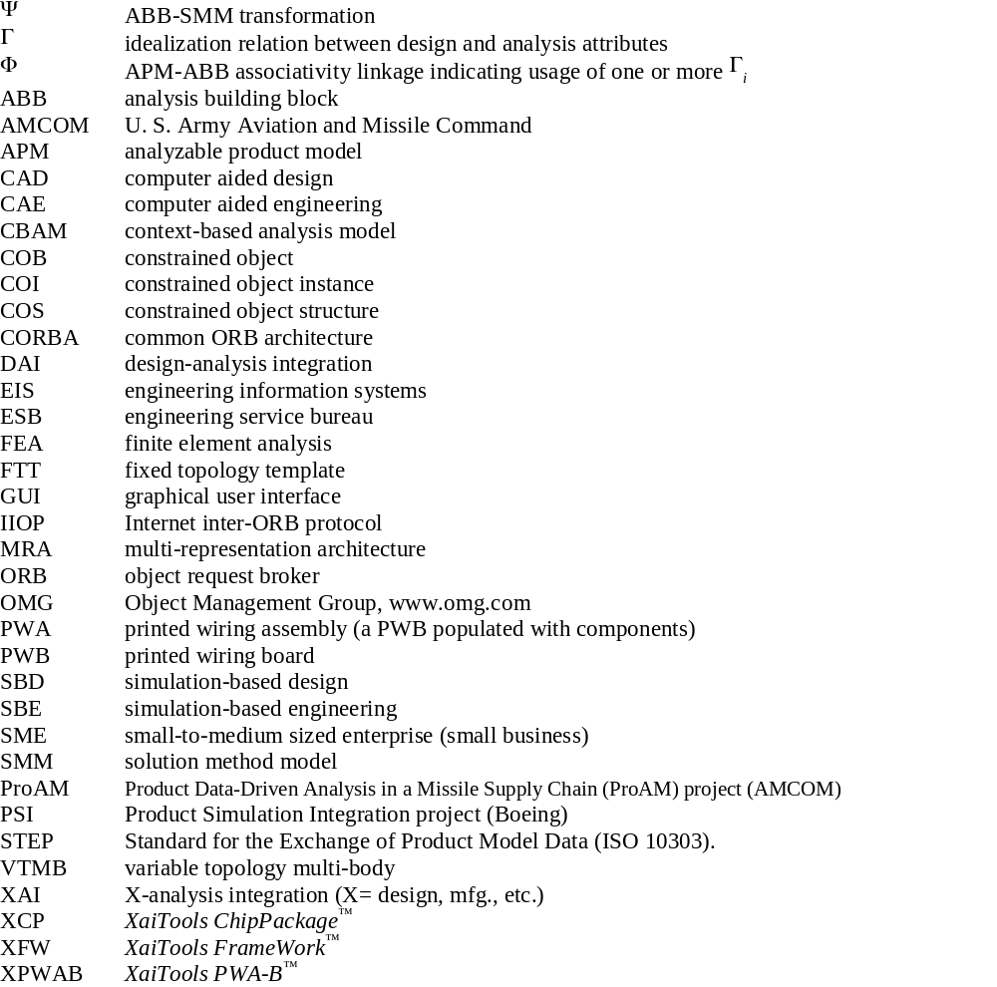
Nomenclature

Slide 3
An Introduction to X-Analysis Integration (XAI)
Short Course Outline
Part 1: Constrained Objects (COBs) Primer
  Nomenclature
Part 2: Multi-Representation Architecture (MRA) Primer
  Analysis Integration Challenges
  Overview of COB-based XAI
  Ubiquitization Methodology
Part 3: Example Applications
    Airframe Structural Analysis (Boeing)
    Circuit Board Thermomechanical Analysis
    (DoD: ProAM; JPL/NASA)
    Chip Package Thermal Analysis (Shinko)
  Summary
Part 4: Advanced Topics & Current Research

Slide 4


Information Associativity
Associativity = Relations among objects
gasoline amount & trip mileage
in record book
trip mileage
on car odometer
System X
g
m
m
System Y
mpg
System Z
trip gas mileage
in calculator
Similar to electrical circuits

Slide 5
Procedural vs. Declarative
Knowledge Representations
Procedural Representation
Traditional programming: C, C++, Java, ...
h
Declarative Representation
Math solvers: Maple, Mathematica, ...
function: area
area (b,h)
return 0.5 * b * h;
state 1
bb := 2, hh := 3;
AA := area(bb,hh);
result: AA := 3;
state 2 (value change)
hh := 9;
result: AA := 3;
state 3 (I/O change)
AA := 6;
result: hh := 9;
/* how compute hh given AA, bb ? */
b
relation: r1
r1(b,h,A): A :=: 0.5 * b * h;
state 1
f :=: new r1(bb,hh,AA) instance;
bb :=: 2, hh :=: 3, AA :=: ?;
solve f;
result: AA :=: 3
state 2 (value change)
hh :=: 9;
solve f;
result: AA :=: 9
state 3 (I/O change)
hh :=: ?, AA :=: 6;
solve f;
result: hh :=: 6
A = 1/2 bh
bb
bb
AA
AA
hh
hh
bb
AA
bb
AA
hh
hh
bb
AA
bb
AA
hh
hh

Slide 6
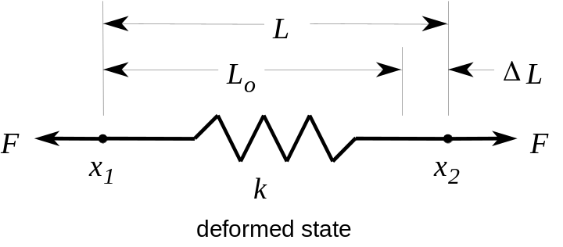
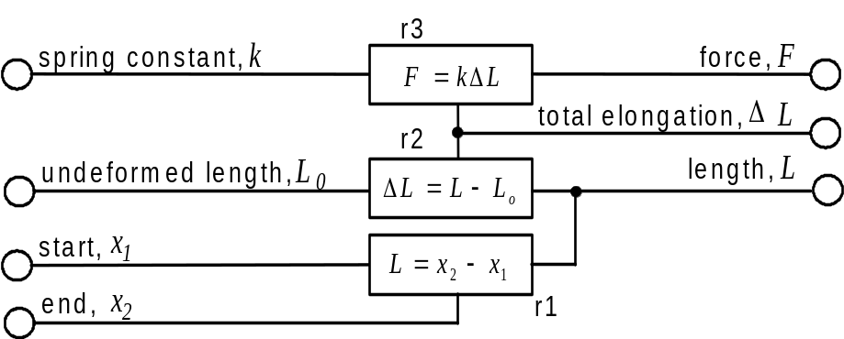
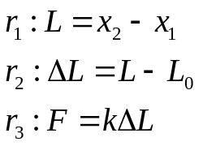
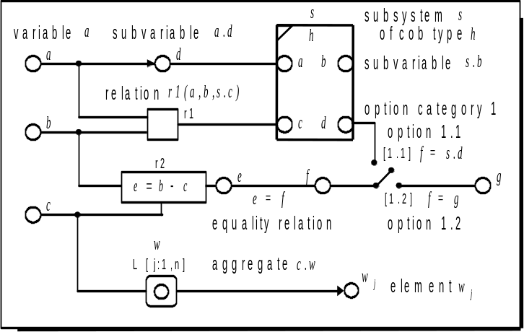
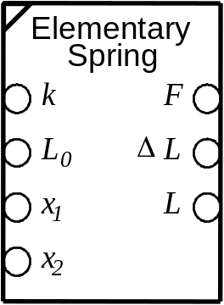
COB Structure: Graphical Forms
Tutorial: Spring Primitive
a. Shape Schematic-S
c. Constraint Schematic-S
b. Relations-S
Basic Constraint Schematic-S Notation
d. Subsystem-S
(for reuse by other COBs)

Slide 7
COB Structure: Lexical Form
Spring Primitive
Constraint Schematic-S
Lexical COB Structure (COS)
COB spring SUBTYPE_OF abb;
undeformed_length, L<sub>0</sub> : REAL;
spring_constant, k : REAL;
start, x<sub>1</sub> : REAL;
end, x<sub>2</sub> : REAL;
length, L : REAL;
total_elongation, &Delta;L : REAL;
force, F : REAL;
RELATIONS
r1 : "<length> == <end> - <start>";
r2 : "<total_elongation> == <length> - <undeformed_length>";
r3 : "<force> == <spring_constant> * <total_elongation>";
END_COB;

Slide 8
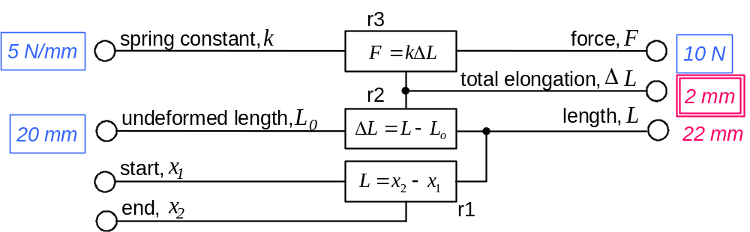
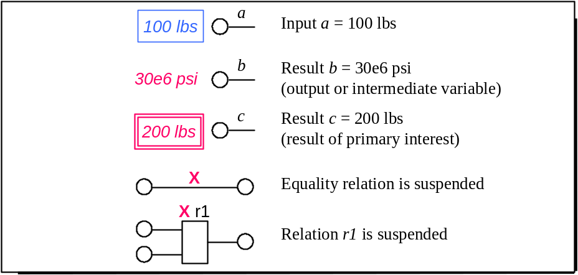
Example COB Instance
Spring Primitive
Constraint Schematic-I
Lexical COB Instance (COI)
example 1, state 1.1
state 1.0 (unsolved):
INSTANCE_OF spring;
undeformed_length : 20.0;
spring_constant : 5.0;
total_elongation : ?;
force : 10.0;
END_INSTANCE;
state 1.1 (solved):
INSTANCE_OF spring;
undeformed_length : 20.0;
spring_constant : 5.0;
start : ?;
end : ?;
length : 22.0;
total_elongation : 2.0;
force : 10.0;
END_INSTANCE;
Basic Constraint Schematic-I Notation

Slide 9
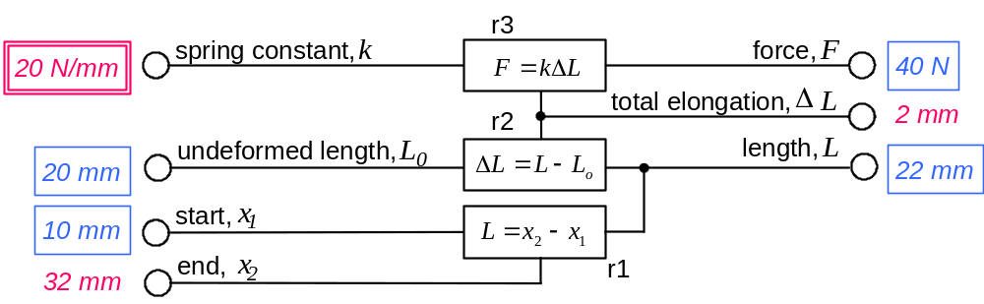
Multi-Directional I/O (non-causal)
Spring Primitive
Constraint Schematic-I
Lexical COB Instance (COI)
Design Verification
example 1, state 1.1
state 5.0 (unsolved):
INSTANCE_OF spring;
undeformed_length : 20.0;
spring_constant : ?;
start : 10.0;
length : 22.0;
force : 40.0;
END_INSTANCE;
state 5.1 (solved):
INSTANCE_OF spring;
undeformed_length : 20.0;
spring_constant : 20.0;
start : 10.0;
end : 32.0;
length : 22.0;
total_elongation : 2.0;
force : 40.0;
END_INSTANCE;
Design Synthesis
example 1, state 5.1

Slide 10
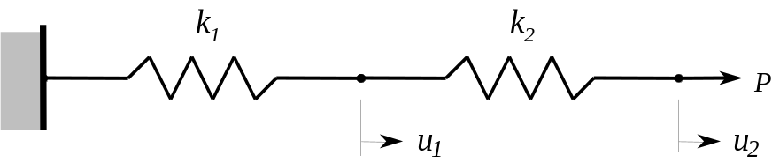
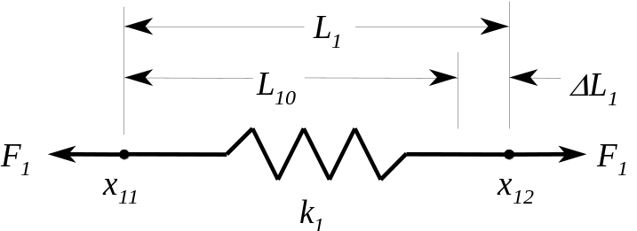

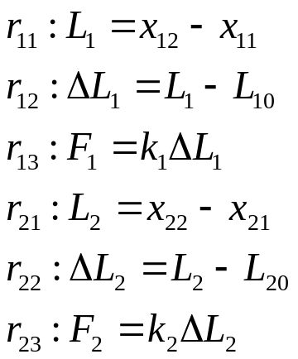
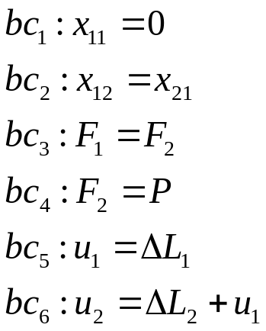
Traditional Mathematical Representation
Tutorial: Two Spring System
System Figure
Free Body Diagrams
Variables and Relations
Kinematic Relations
Boundary Conditions
Constitutive Relations

Slide 11
Constraint Graph-S
Two Spring System
bc1
bc3
P
bc4
F₁
k₁
F₂
k₂
r13
spring2
r23
x₁₁
L₁
spring1
x₂₂
L₂
r11
ΔL₁
r21
ΔL₂
r12
r22
x₁₂
x₂₁
L₁₀
bc6
L₂₀
bc5
u₁
u₂
bc2

Slide 12
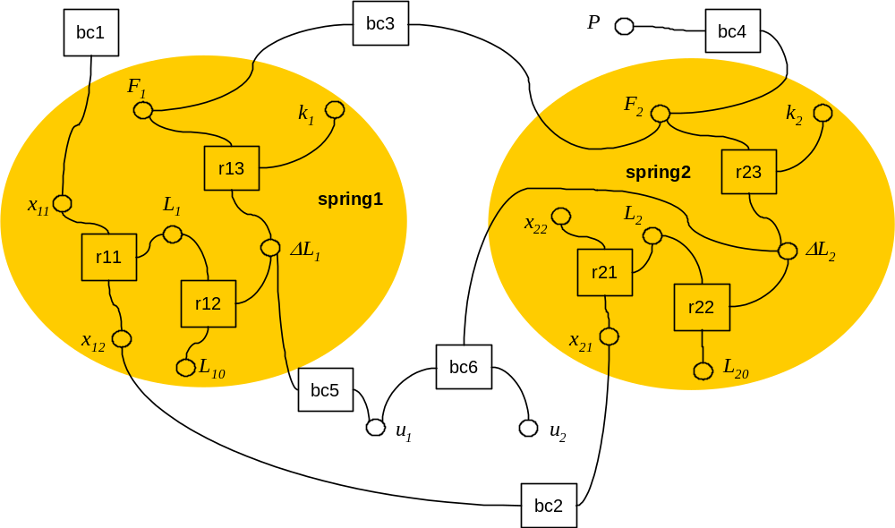
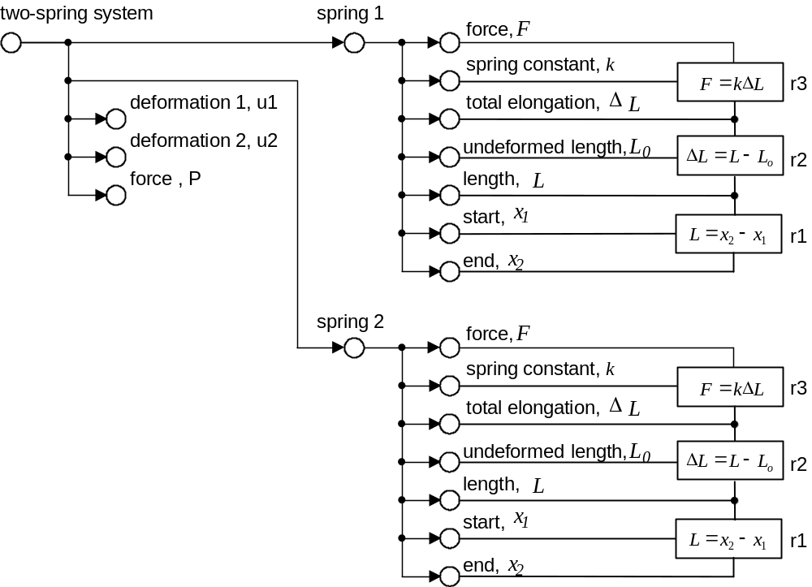
COB Representation
Extended Constraint Graph-S: Two Spring System
Constraint Graph-S
Extended Constraint Graph-S
Groups objects & relations
into parent objects
Object-oriented vs. flattened
partial
(BC relations not included)

Slide 13
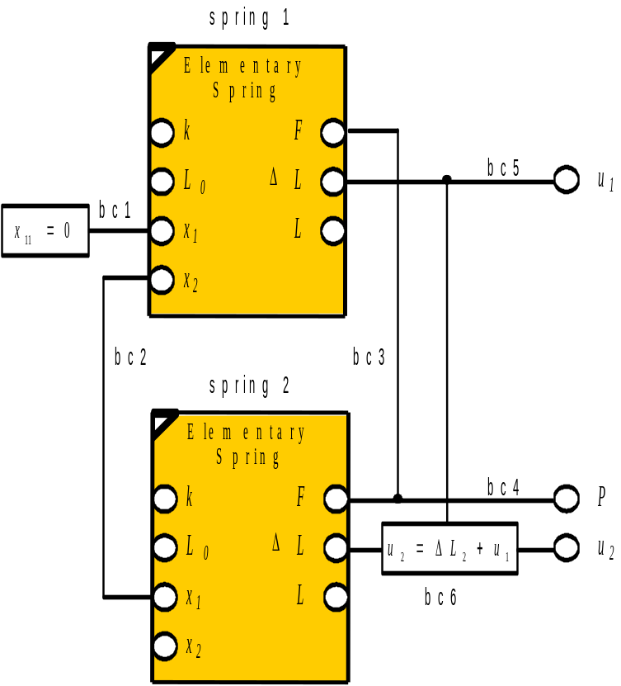
COB Representation
Constraint Schematic-S: Two Spring System
Constraint Graph-S
Constraint Schematic-S
Encapsulated form (hides details)

Slide 14
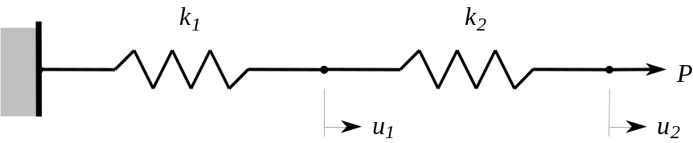
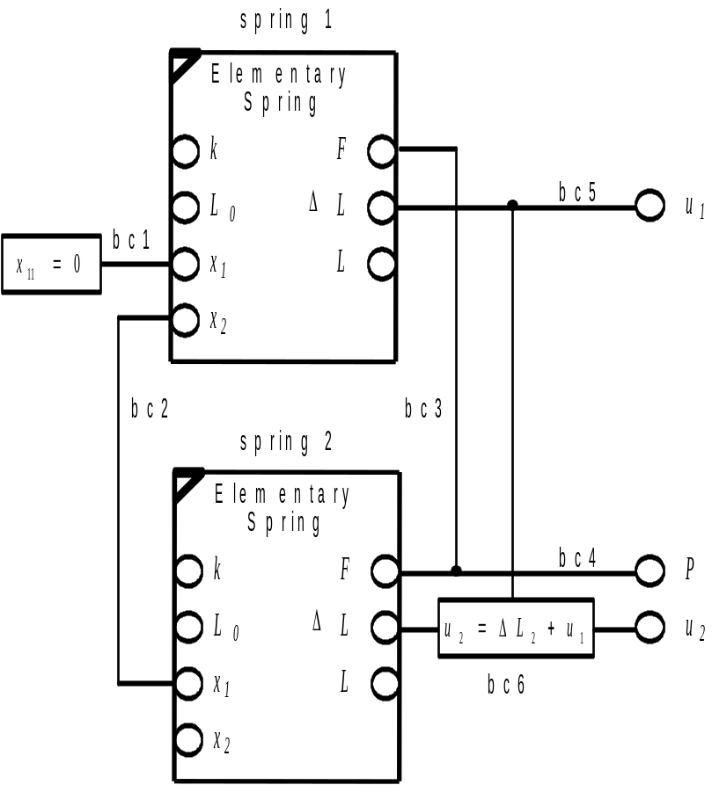
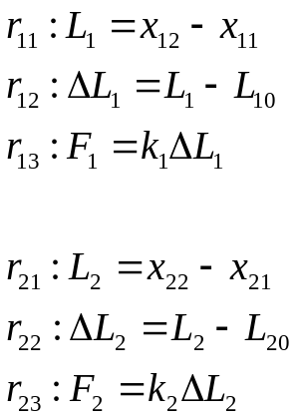
COB Constraint Schematic-S
Two Spring System
Analysis Primitives
with
Encapsulated Relations
System-Level Relations
(Boundary Conditions)

Slide 15
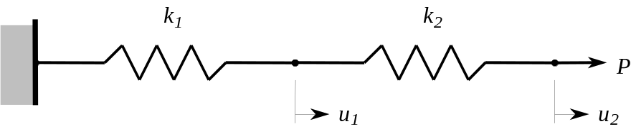
COBs as Building Blocks
Two Spring System
Constraint Schematic-S
Lexical COB Structure (COS)
COB spring_system SUBTYPE_OF analysis_system;
spring1 : spring;
spring2 : spring;
deformation1, u<sub>1</sub> : REAL;
deformation2, u<sub>2</sub> : REAL;
load, P : REAL;
RELATIONS
bc1 : "<spring1.start> == 0.0";
bc2 : "<spring1.end> == <spring2.start>";
bc3 : "<spring1.force> == <spring2.force>";
bc4 : "<spring2.force> == <load>";
bc5 : "<deformation1> == <spring1.total_elongation>";
bc6 : "<deformation2> == <spring2.total_elongation>
+ <deformation1>";
END_COB;

Slide 16
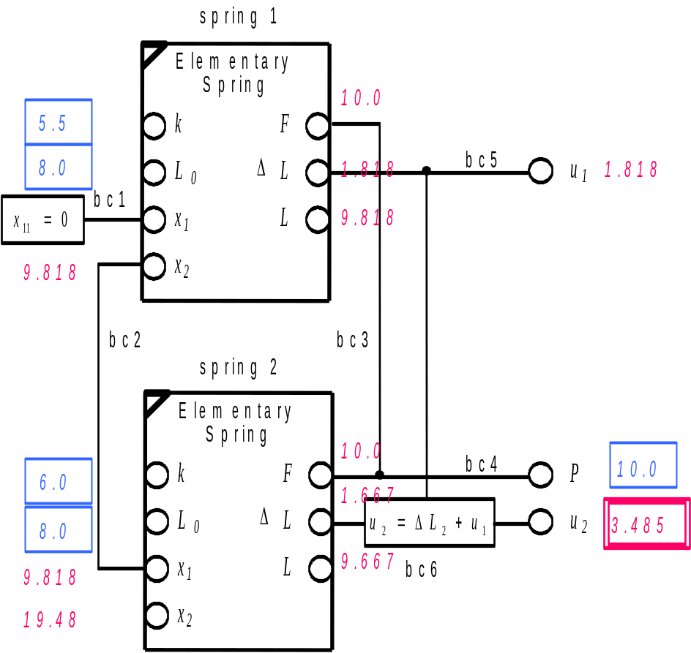
Analysis System Instance
Two Spring System
Constraint Schematic-I
Lexical COB Instance (COI)
example 2, state 1.1
state 1.0 (unsolved):
INSTANCE_OF spring_system;
spring1.undeformed_length : 8.0;
spring1.spring_constant : 5.5;
spring2.undeformed_length : 8.0;
spring2.spring_constant : 6.0;
load : 10.0;
deformation2 : ?;
END_INSTANCE;
state 1.1 (solved):
INSTANCE_OF spring_system;
spring1.undeformed_length : 8.0;
spring1.spring_constant : 5.5;
spring1.start : 0.0;
spring1.end : 9.818;
spring1.force : 10.0;
spring1.total_elongation : 1.818;
spring1.length : 9.818;
spring2.undeformed_length : 8.0;
spring2.spring_constant : 6.0;
spring2.start : 9.818;
spring2.force : 10.0;
spring2.total_elongation : 1.667;
spring2.length : 9.667;
spring2.end : 19.48;
load : 10.0;
deformation1 : 1.818;
deformation2 : 3.485;
END_INSTANCE;

Slide 17
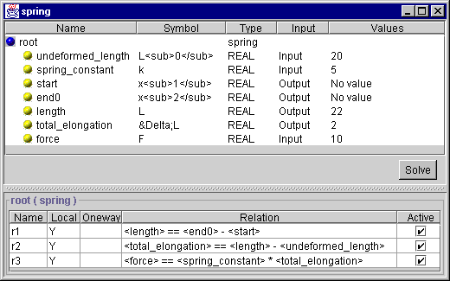
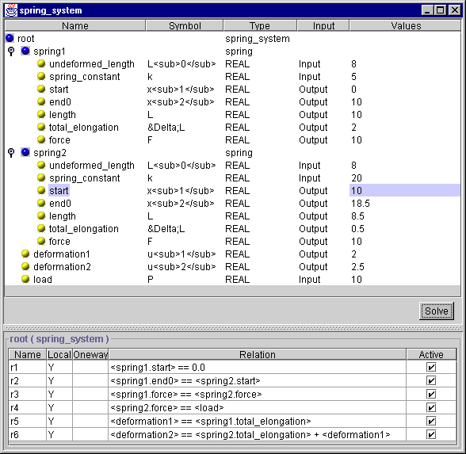
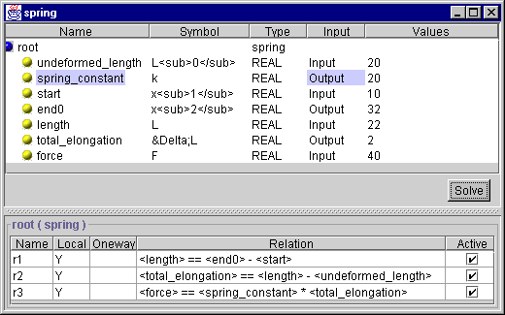
Spring Examples Implemented in XaiTools X-Analysis Integration Toolkit
spring: state 1.1 (solved)
spring system: similar to state 1.1 (solved):
spring: state 5.1 (solved)

Slide 18
Using Internet/Intranet-based Analysis Solvers
Thick Client Architecture - Engineering-Oriented ASP
Users
Engineering Service Bureau
Client PCs
Host Machines
June’99-Present:
EIS Lab
- Regular internal use
U-Engineer.com
- Demo usage:
- US (SMEs, OEMs, Gov. labs)
- Japan
Nov.’00-Present:
Electronics Co.
- Began production usage
(dept. Intranet)
Future:
Other company Intranets
and/or
U-Engineer.com
(commercial)
- Other solvers
Thick Client
CORBA Daemon
XaiTools
Iona orbixdj
CORBA IIOP
CORBA Servers
Internet
XaiTools Ansys
Solver Server
XaiTools Ansys
Solver Server
XaiTools Math.
Solver Server
XaiTools Ansys
Solver Server
FEA Solvers
Ansys
Internet/Intranet
Math Solvers
...
Mathematica
2002-04 Updates: SOAP protocol; Patran/Abaqus wrappers
ASP= application service provider

Slide 19
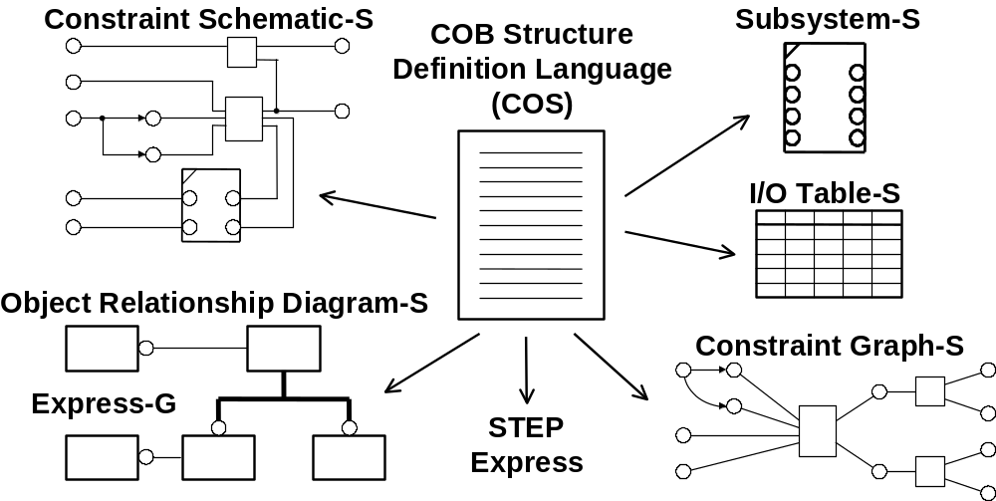
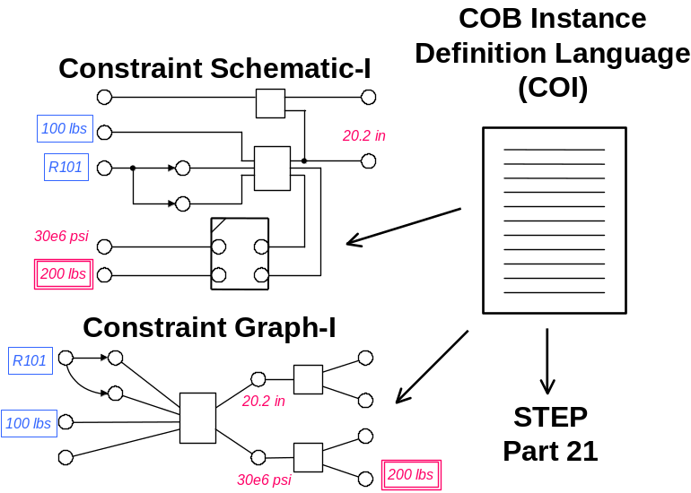
COB Modeling Languages & Views
Structure
Level
(Template)
Instance
Level

Slide 20
Basic EXPRESS-G notation
A
A is an entity (class)
Instance of A are objects
A
A is a simple type
( BOOLEAN, LOGICAL, BINARY,
NUMBER, INTEGER, REAL, STRING)
a1
A
a2
B
A has two attribute, a1 and a2, that
are both type B
A
a1
B
A has an attribute, a1, that is
a Set of 1 or ore entities of type B
S[1;?]
A
A is a supertype of B and C.
(B and C are subtype of A)
B
C
a1
B
Unofficial extensions:
A has two levels, a1 and a2.
a1 is type B. a2 is type C.
A
a2
C

Slide 21
COB Object Model View (EXPRESS-G)
Spring Systems Schema
Real
undeformed
_length
Real
force
spring_2
load
Real
Real
total
_elongation
deformation1
Real
Real
spring
spring_1
length
spring
_system
Real
Real
end0
deformation2
Real
start
Real
spring
_constant

Slide 22
Express Model: two_spring_system.exp spring systems tutorial
SCHEMA spring_systems;
ENTITY spring;
undeformed_length : REAL;
spring_constant : REAL;
start : REAL;
end0 : REAL;
length0 : REAL;
total_elongation : REAL;
force : REAL;
END_ENTITY;
ENTITY two_spring_system;
spring1 : spring;
spring2 : spring;
deformation1 : REAL;
deformation2 : REAL;
load : REAL;
END_ENTITY;
END_SCHEMA;

Slide 23
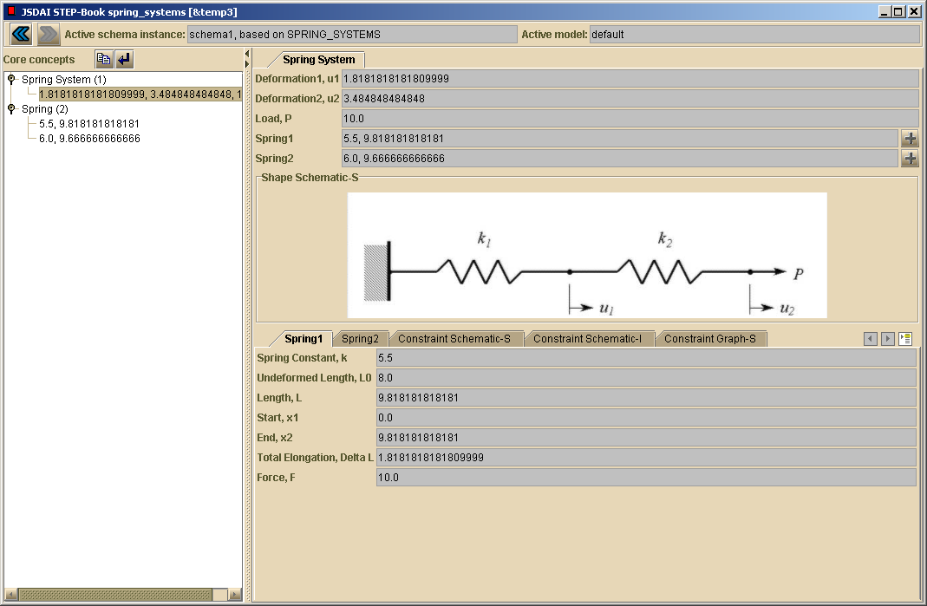
Instance Model: Part 21 and Example Application spring systems tutorial
Fragment from an instance model - Part 21 (a.k.a. “STEP File” - ISO 10303-21)
#1=TWO_SPRING_SYSTEM(#2,#3,1.81,3.48,10.0);
#2=SPRING(8.0,5.5,0.0,9.81,9.81,1.81,10.0);
#3=SPRING(8.0,6.0,9.8,19.48,9.66,1.66,10.0);

Slide 24
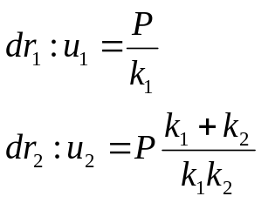
Declarative Knowledge / Derivable Behavior
Two Spring System
Derivable Behavior
⇒ No need to include explicitly (redundant)

Slide 25
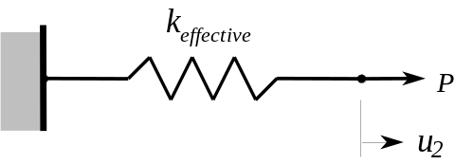
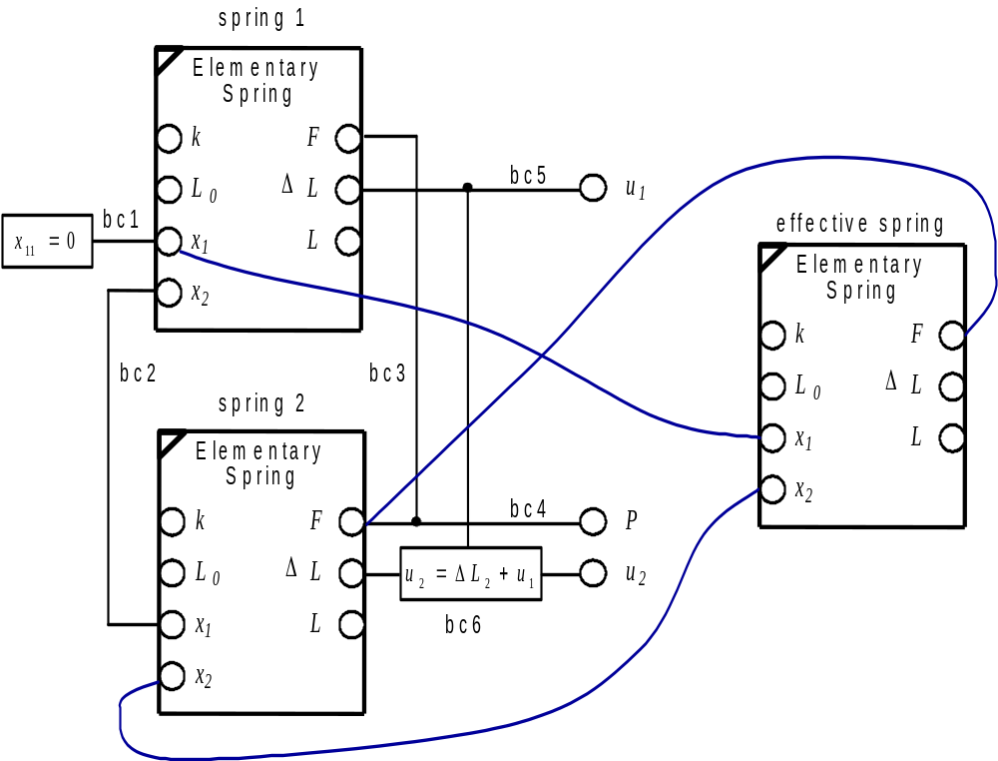
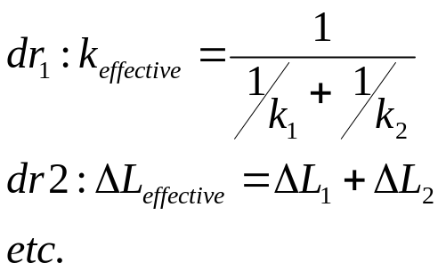
Achieving Effective System Properties via Semantically Rich COBs
Derivable System
Level Properties
⇒ No need to derive
⇒ Minimal extra work
⇒ Semantically richer
Note: A relation for effective undeformed length is also needed, as higher level semantic relations (e.g., that it is the value when F=0) are not yet supported.

Slide 26
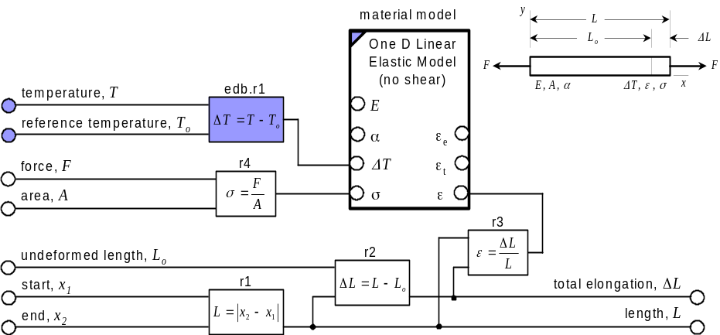
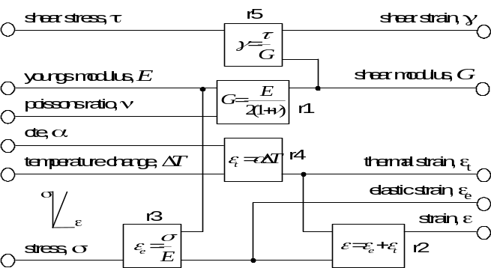
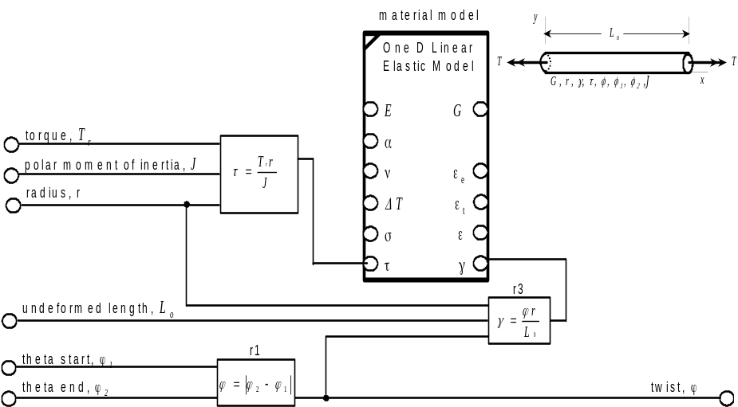
COB-based Libraries of
Analysis Building Blocks (ABBs)
Continuum ABBs
Extensional Rod
Material Model ABB
1D Linear Elastic Model
modular
re-usage
Torsional Rod

Slide 27
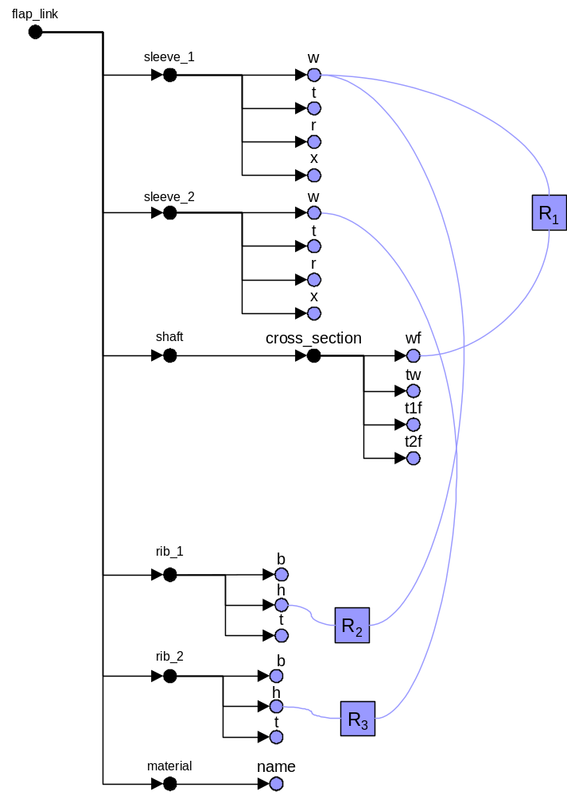
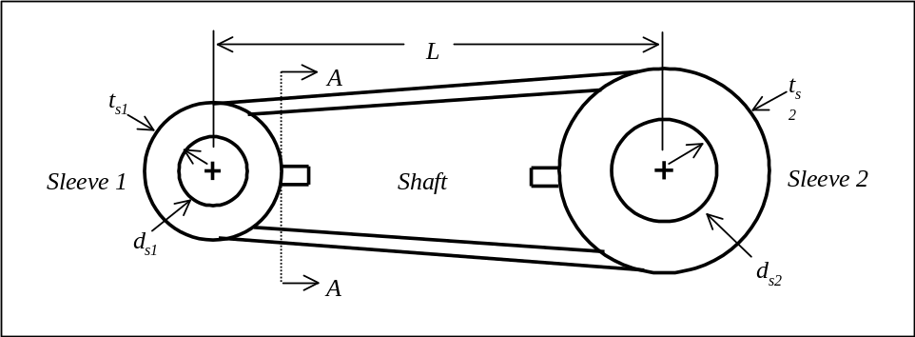
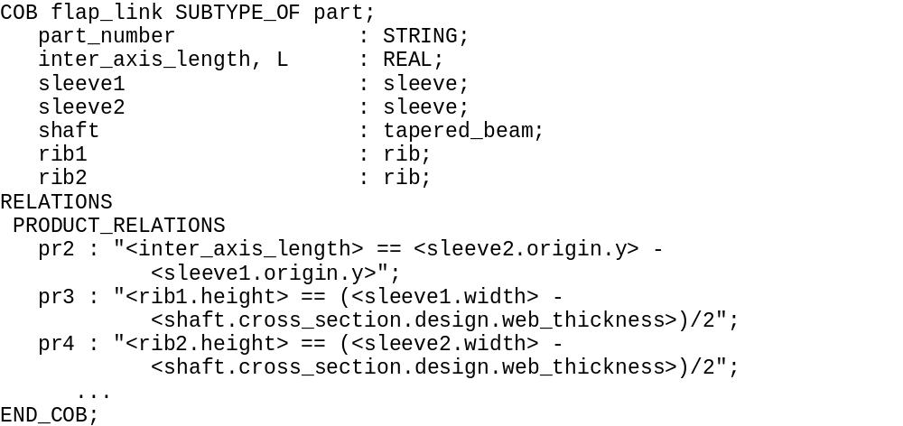
Flap Link Example
Parametric Design Description
Extended Constraint Graph
COB Structure (COS)

Slide 28
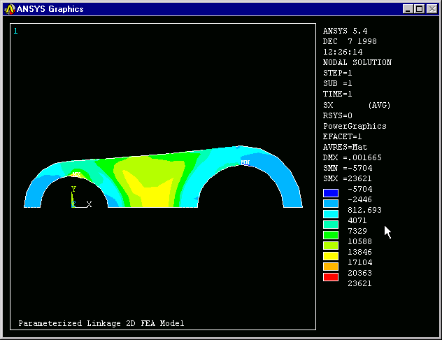
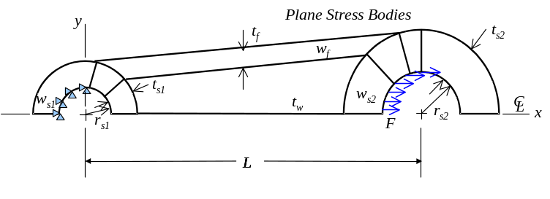
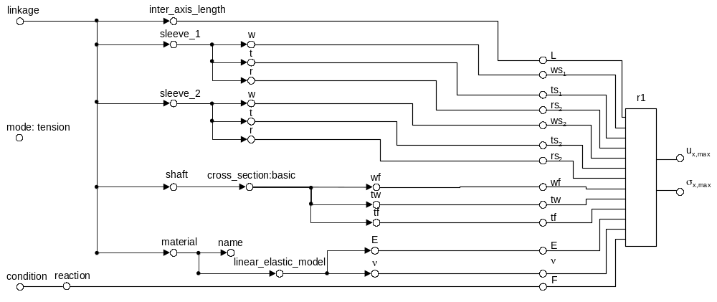
Representing External Tools as COB Relations
Parametric FEA Model
FEA Tool

Slide 29
Constrained Object (COB) Representation
Current Technical Capabilities - Generation 2
Capabilities & features:
  Various forms: computable lexical forms, graphical forms, etc.
    Enables both computer automation and human comprehension
  Sub/supertypes, basic aggregates, multi-fidelity objects
  Multi-directionality (I/O changes)
  Reuses external programs as white box relations
  Advanced associativity added to COTS frameworks & wrappers
Analysis module/template applications (XAI/MRA):
  Analysis template languages
  Product model idealizations
  Explicit associativity relations with design models & other analyses
  White box reuse of existing tools (e.g., FEA, in-house codes)
  Reusable, adaptable analysis building blocks
  Synthesis (sizing) and verification (analysis)

Slide 30
Constrained Objects (cont.)
Representation Characteristics & Advantages - Gen. 2
Overall characteristics
  Declarative knowledge representation (non-causal)
  Combining object & constraint graph techniques
  COBs = (STEP EXPRESS subset) +
  (constraint graph concepts & views)
Advantages over traditional analysis representations
  Greater solution control
  Richer semantics
  (e.g., equations wrapped in engineering context)
  Unified views of diverse capabilities (tool-independent)
  Capture of reusable knowledge
  Enhanced development of complex analysis models
Toolkit status (XaiTools v0.4)
  Basic framework, single user-oriented, file-based
See Advanced Topics
for Gen.3 Extensions

Slide 31
Convergence of Representations
Software Development
(algorithms …)
Database Techniques
(data structure, storage …)
Flow Charts
ER
OMT
EER
UML
STEP Express
Constrained Object - like
Representations
COBs, OCL, ...
Objects
Constraint graphs
Rules
Artificial Intelligence
& Knowledge-Based Techniques
(structure combined with algorithms/relations/behavior)

Slide 32


Dimensions of Associativity
Associativity = Relations among objects
r1
System Y
System X
a
a
r2
System Z
b
Operand representation: a, b
  Type: numeric, logical, string, …, general object
  Human-sensible vs. computer-sensible
    Computer-sensible:
      Flattened vs. object/feature-oriented
Relation representation: r1, r2
  Relation type:
    Math formula, geometric constraint, computable algorithm, computer system (e.g., FEA tool), arbitrary human process, ...
electrical
circuits
analogy

Slide 33
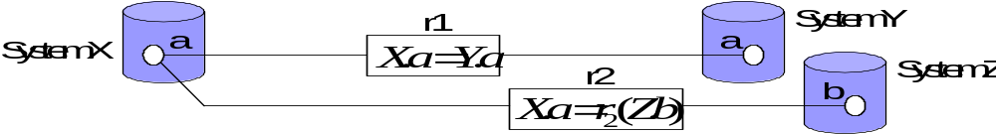
Dimensions of Associativity (cont.)
Relation representation (continued)
  Explict vs. implicit vs. unrecognized vs. unknown
  Human-sensible vs. computer-sensible
    Computer-sensible:
      Dumb string vs. smart string vs. object/feature-oriented
  Level: instance and/or template (schema, structure)
Relation directionality
  Uni-directional vs. multi-directional
  vs. iteratively multi-directional
Relation duration
  Continuous (“live”) vs. event-controlled
Relation granularity
  coarse vs. fine (macro vs. micro)
Associativity graph type
  Declarative vs. procedural
  Cyclic vs. acyclic

Slide 34
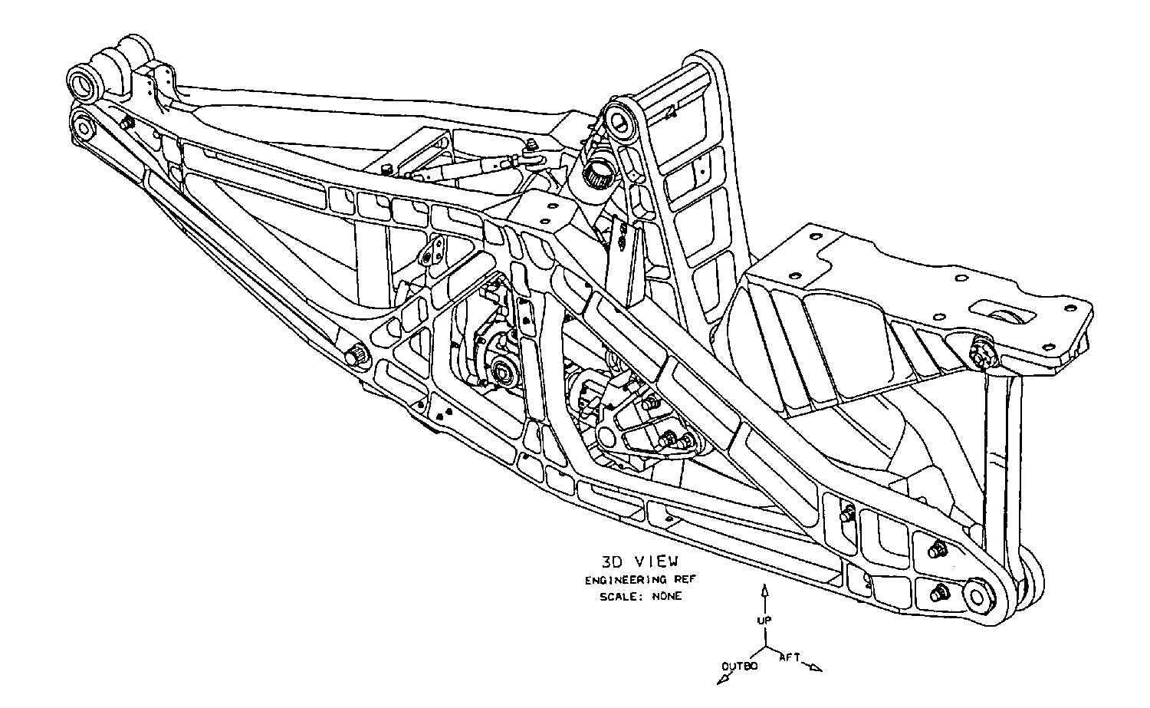
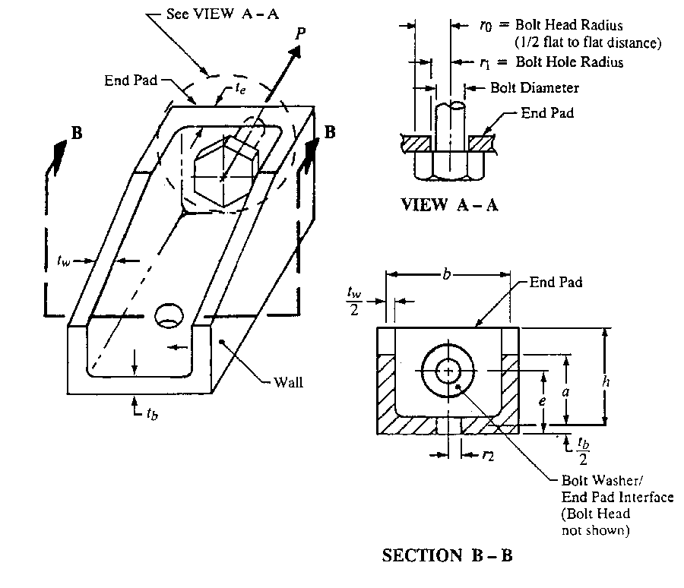
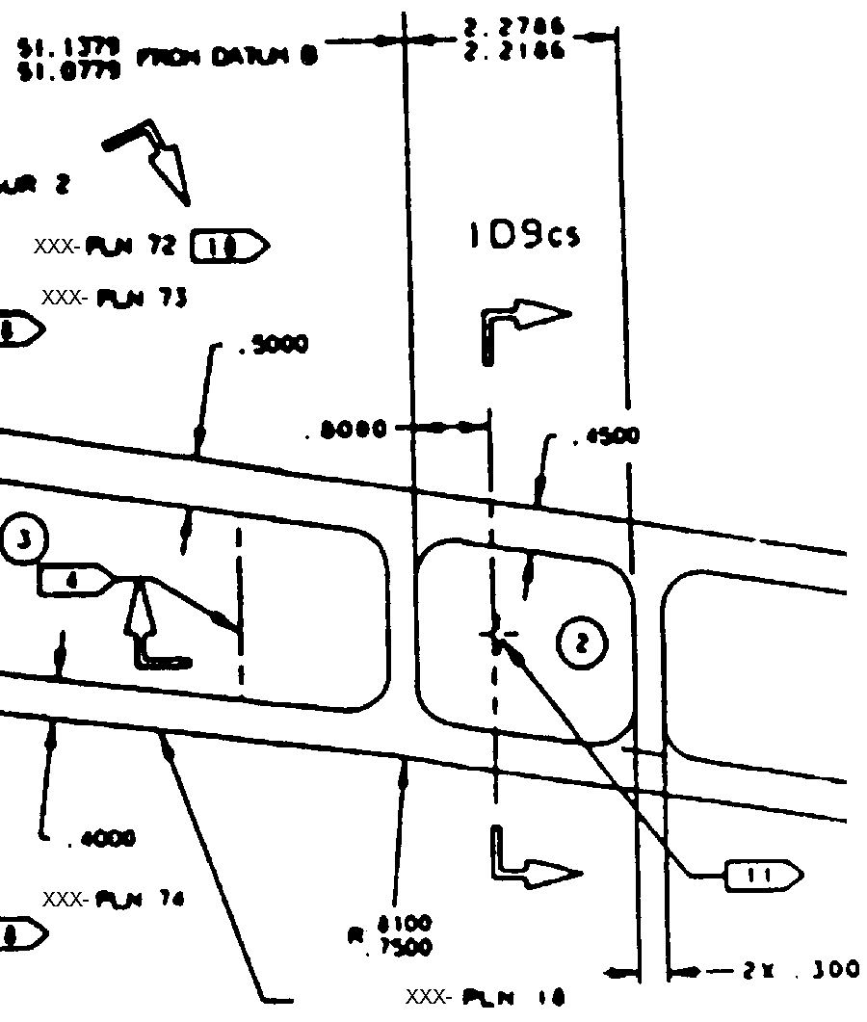
Missing Today:
Fine-Grained Design-Analysis Associativity
Detailed Design Model
Analysis Model
(with Idealized Features)
inconsistency
little
automation
No explicit
fine-grained
CAD-CAE
associativity
little
knowledge capture
Γ
K
3
=
f
(
r
,
b
,
h
)
1
idealizations
f
se
=
P
f
be
=
C
1
P
2
π
r
t
ht
2
0
e
e
Channel Fitting Analysis
“It is no secret that CAD models are driving more of today’s product development processes ... With the growing number of design tools on the market, however, the interoperability gap with downstream applications, such as finite element analysis, is a very real problem. As a result, CAD models are being re-created at unprecedented levels.” Ansys/ITI press Release, July 6 1999
http://www.ansys.com/webdocs/VisitAnsys/CorpInfo/PR/pr-060799.html

Slide 35
Constrained Object Representation
Business Benefits
COB end user : Designer
(uses COB instances & COB-based applications)
  Automation → Time savings & consistency
  More analysis → Improved designs
COB creator : Analyst
(creates templates with COB definition language)
  Modularity & reusability → Faster, consistent modeling
  Semantic richness → Increased understanding
  Knowledge capture → Enhanced corporate memory
COB application developer: Programmer
(uses COB API to create COB-based custom applications)
  Modularity & reusability → Faster, consistent application development

Slide 36
An Introduction to X-Analysis Integration (XAI)
Short Course Outline
Part 1: Constrained Objects (COBs) Primer
  Nomenclature
Part 2: Multi-Representation Architecture (MRA) Primer
  Analysis Integration Challenges
  Overview of COB-based XAI
  Ubiquitization Methodology
Part 3: Example Applications
    Airframe Structural Analysis (Boeing)
    Circuit Board Thermomechanical Analysis
    (DoD: ProAM; JPL/NASA)
    Chip Package Thermal Analysis (Shinko)
  Summary
Part 4: Advanced Topics & Current Research

Slide 37
Other Aspects from [Wilson, 2000] thesis, etc.

Slide 38
COB Meta Information Model & Protocol
Generic Nature
Generic
Metadata
Meta Information
Model
Generic
Data
cos & coi content
as java objects
Protocol
COS
COB
Structure
Definition
Data
COI
COB
Instance
Definition
Data
Specific
Structure
Data (cos)
Specific
Instance
Data (coi)
Lexical Definition Languages & Views
cos and coi
Express and Part 21
...
22.0
Example:
L
20.0
2.0
Graphical Definition Languages & Views
L
Δ
L
10.0
F
x
x
F
10.0
32.0
1
k
2
5.0
Express-G
Constraint schematics
Parameterized figures
...
Notes:
Information model is higher level mode for COS and COI
allow to describe structure object and specific instance of objects
any COBs in general
The protocol operates on any cobs for manipulation

Slide 39
Simplified COB Meta-Model (EXPRESS-G)
(page 1/2)
Late-bound representation style
set_domains
COB Domain
L[0:?]
COB Schema
source_sets
COB Source
L[0:?]
Set
set_instances
COB Domain
L[0:?]
Instance
source_sets_links
COB Source
L[0:?]
Set Link

Slide 40
Simplified COB Meta-Model
(page 2/2)
STRING
domain_name
COB Domain
COB Relation
relations
L[0:?]
COB Complex
COB Primitive
COB Aggregate
elements
Domain
Domain
Domain
L[0:?]
attributes
L[0:?]
attribute_name
STRING
COB Attribute
domain
values
COB Domain
L[0:?]
Instance
COB Complex
COB Primitive
COB Aggregate
elements
instance_of
Instance
Instance
instance_of
Instance
L[0:?]
value
REAL

Slide 41
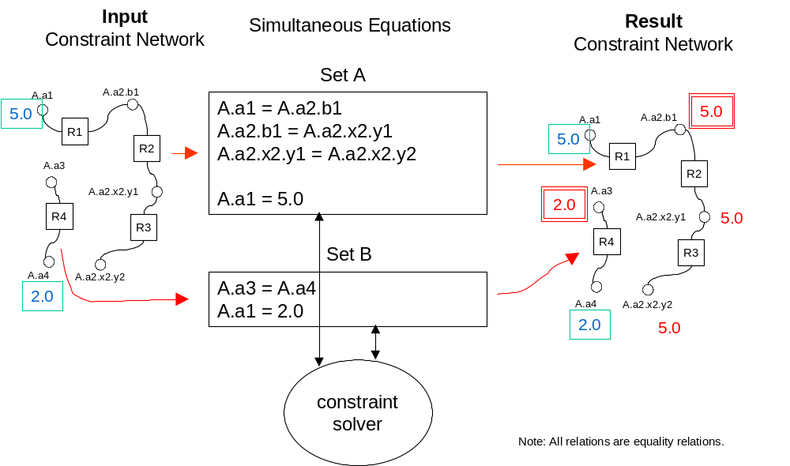
COB Constraint Processing Algorithms
“solve” algorithm: constraint graphs with only multi-directional relations
Provisional patent filed 6/2000

Slide 42
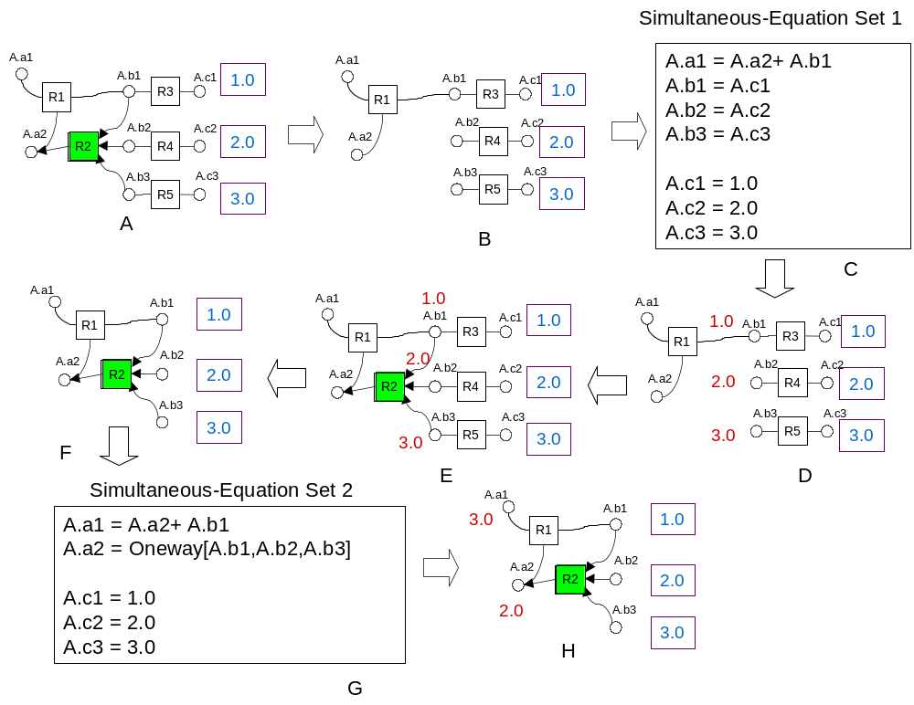
COB Constraint Processing Algorithms
“solve” algorithm: constraint graphs with 1 or more one-way relations
Provisional patent filed 6/2000

