Slide 1




Creating Gap-Filling Applications
Using STEP Express, XML, and SVG-based Smart Figures - An Avionics Example
2002 NASA-ESA Workshop on
Aerospace Product Data Exchange
ESA/ESTEC, Noordwijk (ZH), The Netherlands
April 9-12, 2002
Russell Peak, Miyako Wilson, Injoong Kim,
Nsikan Udoyen, Manas Bajaj, Greg Mocko
Giedrius Liutkus, Lothar Klein
Mike Dickerson
v3 - 2002-05-30

Slide 2
Abstract http://www.estec.esa.int/conferences/aerospace-pde-2002/
Creating Gap-Filling Applications
Using STEP Express, XML, and SVG-based Smart Figures -
An Avionics Example
Gaps often exist in the kind of knowledge captured by today's engineering design tools. So-called "dumb" notes and figures on engineering drawings and documents are evidence of such gaps. They are created for human consumption but contain little that is computer-sensible. Thus, these dumb notes and figures hamper life cycle activities that need to work with their content.
This presentation overviews how standards like STEP Express, XML, and SVG can be combined to create applications that fill such gaps. In this approach, we handle core STEP and user interface technology using an existing toolkit. We employ STEP Express for information models to form the structure for repositories and applications. These information models may be custom in-house schemas or standard schemas like STEP AP210. To create a given application, we use XML models to define the user interface. These XML models specify arrangement of user interface widgets, their behavior, and their connection to the Express-based information repositories.
To this core toolkit we are adding SVG-based figures to better depict the meaning of attributes. These figures supplement existing widgets that display CAD-oriented geometry intended for design detail. These figures capture idealized logical and quasi-geometric diagrams that are often found in engineering handbooks. Work is underway to make "smart" figures by connecting them to their associated attributes, and thus have them scale according to attribute values.
Prototype examples from the electronics domain are given, and their interaction with AP210 is discussed. Overall, this experience indicates a promising methodology for creating gap-filling tools that combine enhanced usability with information richness and standards-based infrastructure.

Slide 3
Contents
Motivation
Scalable Vector Graphics (SVG) Overview
Application Development Toolkit
with STEP Express & XML-based widgets
Example Gap-Filling Applications
  Circuit board design
  Electronic package analysis
Summary
See Related 2002 APDE Presentation:
Progress on Standards-Based Engineering Frameworks that include STEP AP210 (Avionics), PDM Schema, and AP233 (Systems)
Peak, Dickerson, Klein, Waterbury, Smith, Thurman, U'Ren, and Buchanan

Slide 4
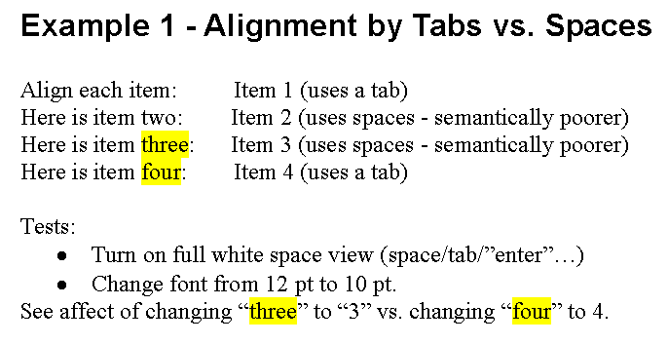
On Semantic Gaps wysiNwyg examples in MS Word
(WYSIWYG drawbacks: What You See is NOT always What You Get!)

Slide 5
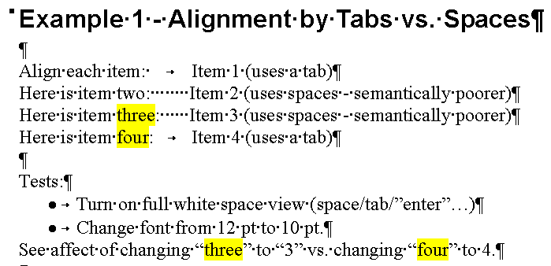
On Semantic Gaps (cont.)
Higher fidelity view of your “model” (your document)
Next slide

Slide 6
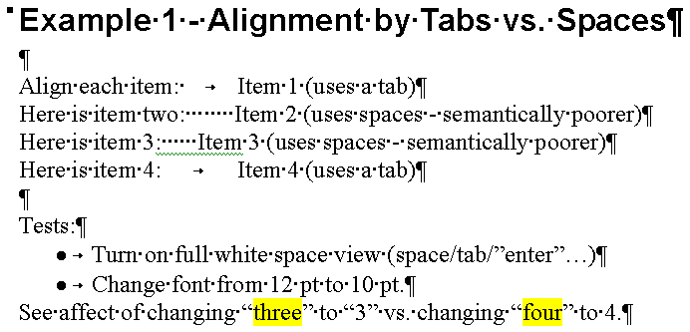
On Semantic Gaps (cont.)
Adverse effect of change on semantically poorer model content

Slide 7
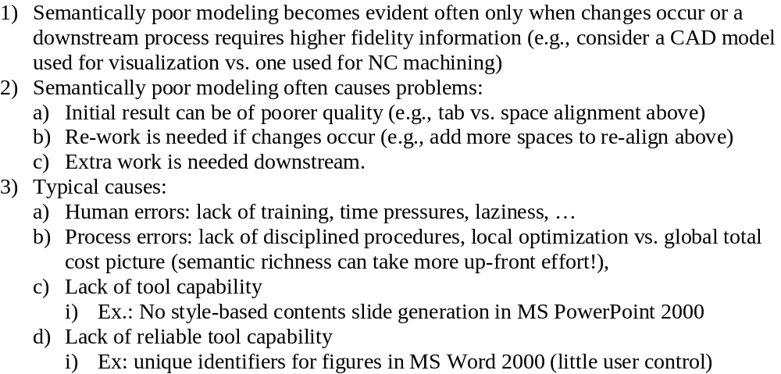
Observations about Semantic Gaps
Problems are compounded in engineering tools …

Slide 8
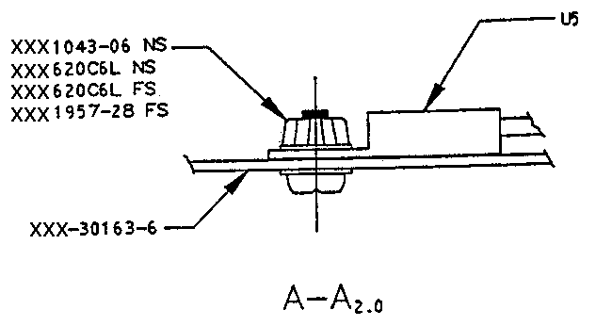
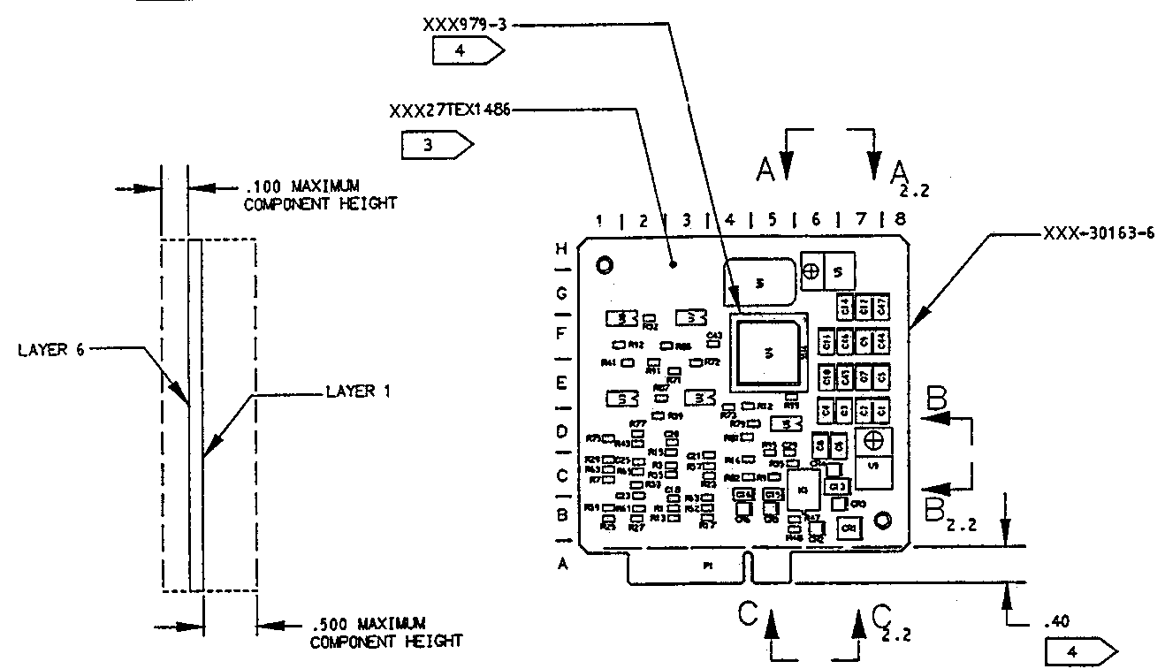
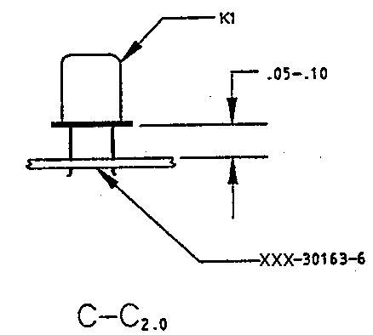
Example PWA Ancillary Information
“Dumb Figures” with Little Associativity to Underlying Information
PWA = printed wiring assembly
PWB = printed wiring board
Maximum Height
Restrictions
Conformal Coating
Restrictions
Component Assembly
Instructions
Stackup Notes

Slide 9
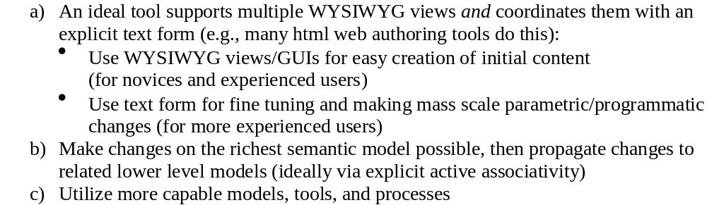
Addressing Semantic Gaps

Slide 10
Information Capture Gaps:
Content Coverage and Semantics
Existing Tools
Tool A₁
...
Tool A_{n}
Legend
Content
Coverage Gaps
“dumb” information capture
(only human-sensible,
I.e., not computer-sensible)
Product Model
Components
AP210
AP233
PDM Schema
Content
Semantic Gaps

Slide 11
Contents
Motivation
Scalable Vector Graphics (SVG) Overview
Application Development Toolkit
with STEP Express & XML-based widgets
Example Gap-Filling Applications
  Circuit board design
  Electronic package analysis
Summary

Slide 12
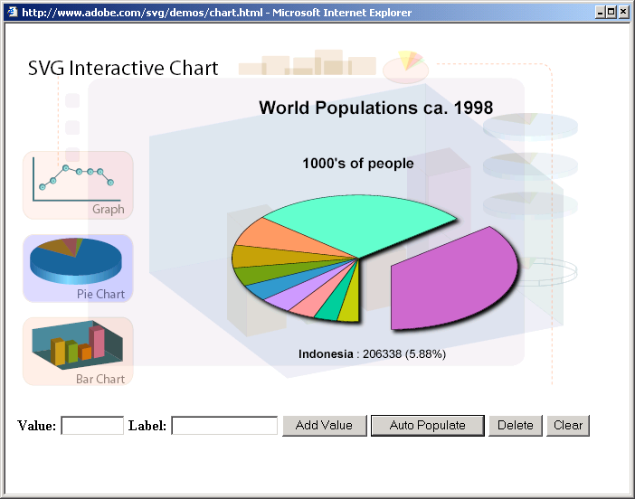
SVG Example: Interactive Pie Chart

Slide 13
What is SVG?
Scalable Vector Graphics
  W3C specification
  Graphics model representation
  XML-based development language
Role: publication graphics vs. CAD graphics
  Idealized/schematic-oriented figures
  (e.g., as in engineering textbooks and handbooks)
  Increased understanding of related definitions and data
References
  www.w3c.org
  www.adobe.com/svg

Slide 14
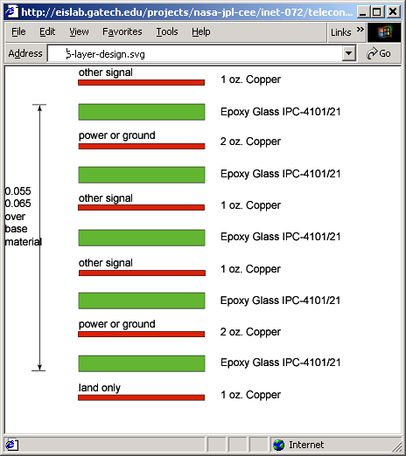
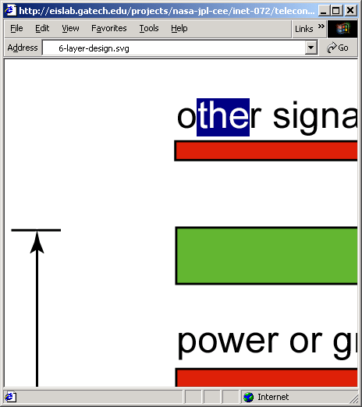
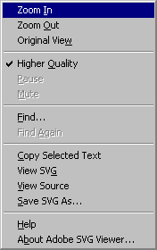
Example SVG Figures
Publication-quality vector graphics as basis for smart figures/diagrams
original scale
zoomed in, and text portion selected

Slide 15
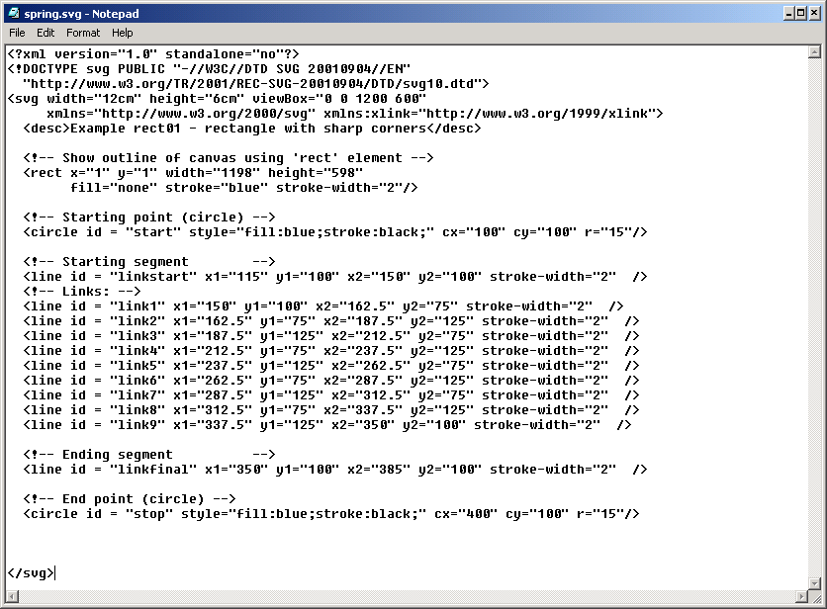

The SVG Image -
The SVG Object
The SVG DTD
SVG
XML
source:
The circle Object
(example of a primitive)
Resulting figure:

Slide 16
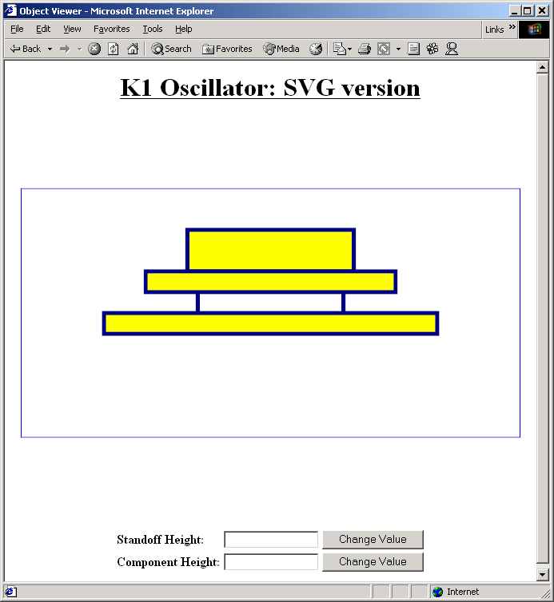
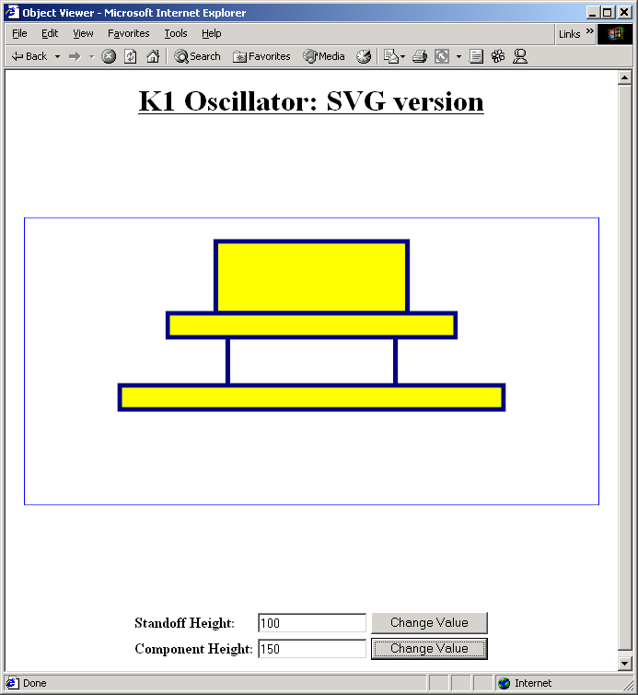
SVG-based “Smart Figures”
Linking Figures to Underlying Data - Initial Studies
Original State
Updated Values State

Slide 17
SVG Advantages and Issues
Advantages
  Vector-based, so better viewing, control, etc.
  vs. raster images
  Hooks (attribute handles) to manipulate graphical elements
Issues (investigations in-progress)
  Availability of plug-ins & tools
  Support for elements: subscripts, symbols, …

Slide 18
Contents
Motivation
Scalable Vector Graphics (SVG) Overview
Application Development Toolkit
with STEP Express & XML-based widgets
Example Gap-Filling Applications
  Circuit board design
  Electronic package analysis
Summary

Slide 19
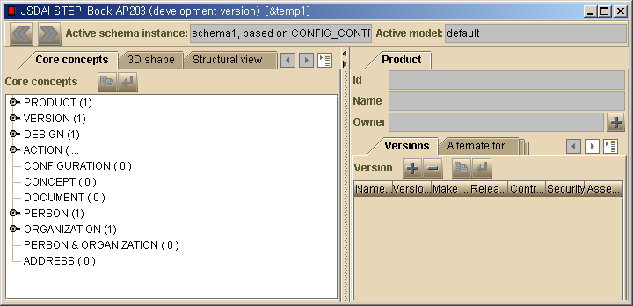
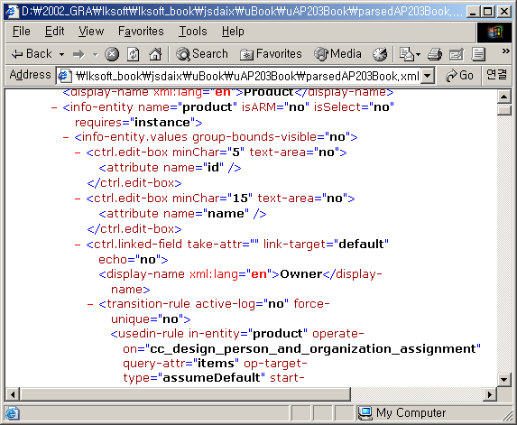
Express/XML-based GUIs in STEP-Book Applications:
AP203 Example - Edit Box Widget
LKSoft Application:
STEP-Book AP203
XML-based GUI widgets
Specify STEP Express-based info sources
(at ARM and/or AIM levels)

Slide 20
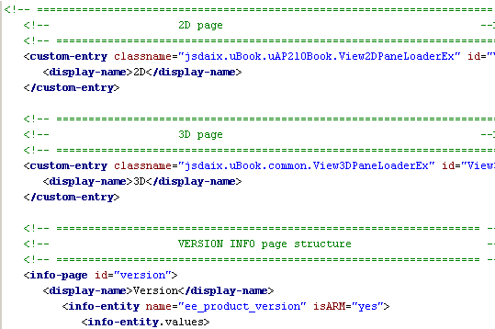
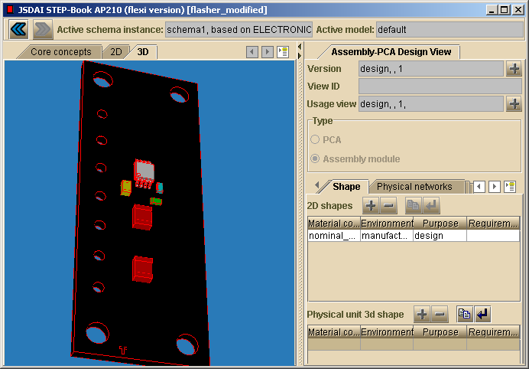
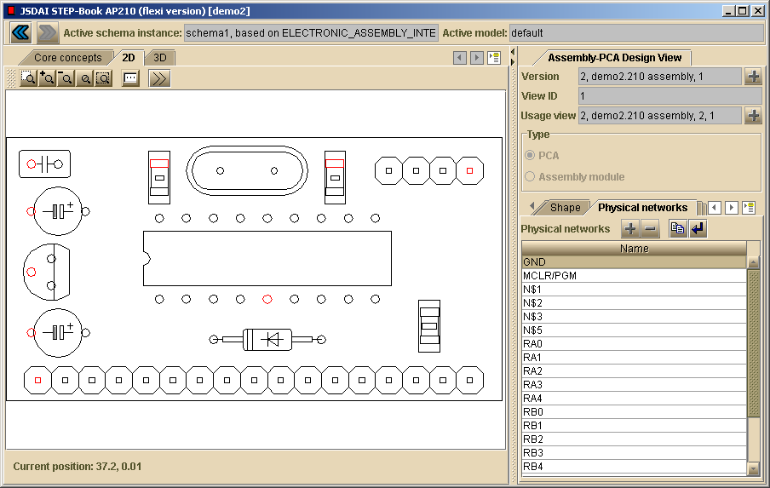
STEP-Book 2D and 3D Shape Viewer Widgets
Supports AP210 2D electronics views
Supports STEP AIC 514 (advanced B-rep), so “common”: usable for many APs
Based on Source: LKSoft 2002-04

Slide 21
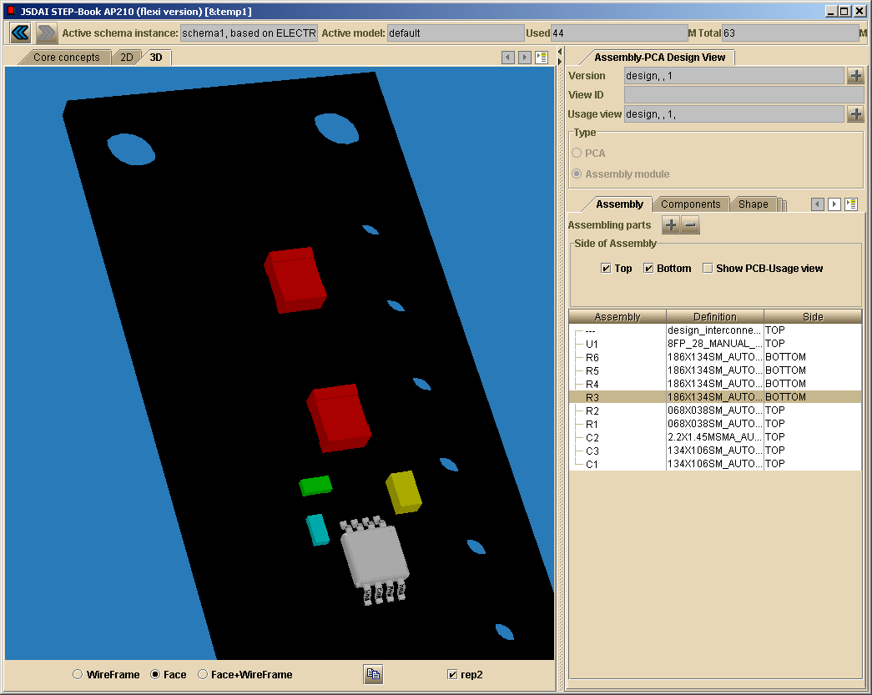
STEP-Book - 3D Widget
Supports ISO 10303-514 Advanced B-Rep Shapes (STEP AIC standard)
PCA in
STEP-Book AP210

Slide 22

STEP-Book-based Application Development Process
Overview
References:
http://eislab.gatech.edu/efwig/
http://www.lksoft.com/
End user requirements
& use cases
Develop
information model
My Express schema
LKSoft
Compiler
Optional: Use ISO standard schemas
in my schema
Develop
user interface model
My GUI XML document
Use default schema-based app generator
Create test data
& exercise use cases
My instance models
(p21 files)
User Interface
SDAI API
Repository
import/export
My STEP-Book
Application
Other Aspects Not Shown Above:
Mapping between my schema and STEP standard schemas
Use of existing STEP-Book widgets
Creation of custom widgets and/or related custom Java
Local single user vs. server-based multi-user repositories
Link with constrained objects (via XaiTools) for multi-directional computable relations
GUI = graphical user interface
API = application programming interface
SDAI = standard data access interface (ISO 10303-22)
p21 = STEP text files (instance models) (ISO 10303-21)

Slide 23
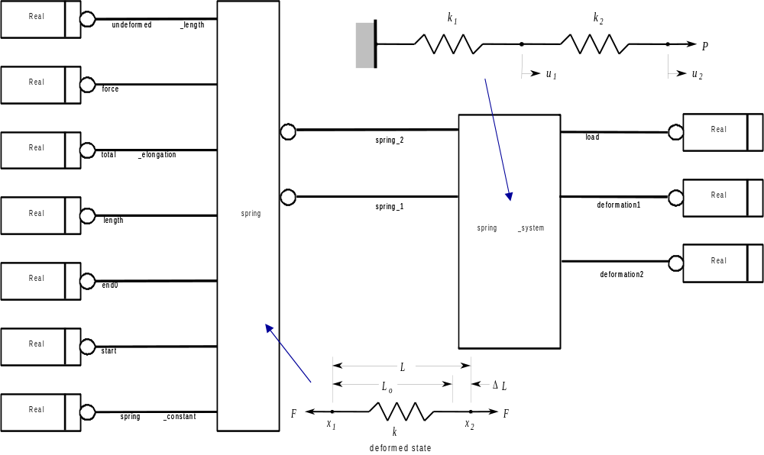
Express-G Model spring system tutorial

Slide 24
Express Model: two_spring_system.exp spring system tutorial
SCHEMA spring_systems;
ENTITY two_spring_system;
spring1 : spring;
spring2 : spring;
deformation1 : REAL;
deformation2 : REAL;
load : REAL;
END_ENTITY;
ENTITY spring;
undeformed_length : REAL;
spring_constant : REAL;
start : REAL;
end0 : REAL;
length0 : REAL;
total_elongation : REAL;
force : REAL;
END_ENTITY;
END_SCHEMA;

Slide 25
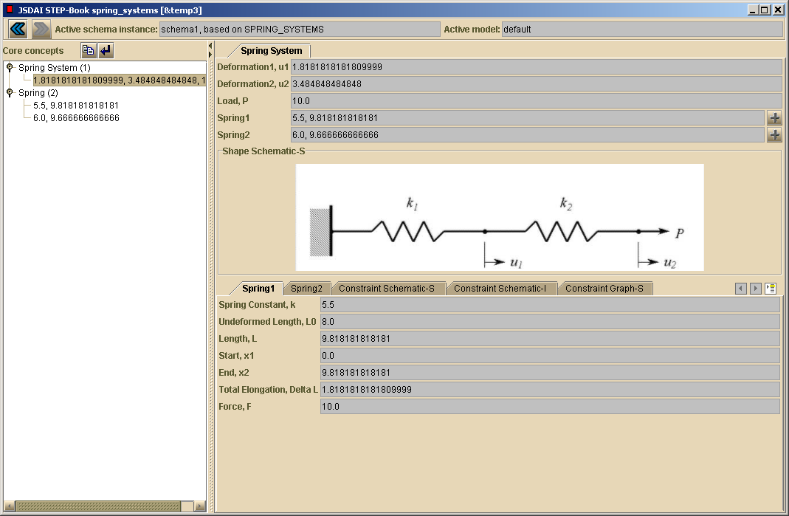
Instance Model: Part 21 and Example Application spring system tutorial
Fragment from an instance model - Part 21 (a.k.a. “STEP File” - ISO 10303-21)
#1=TWO_SPRING_SYSTEM(#2,#3,1.81,3.48,10.0);
#2=SPRING(8.0,5.5,0.0,9.81,9.81,1.81,10.0);
#3=SPRING(8.0,6.0,9.8,19.48,9.66,1.66,10.0);

Slide 26
Contents
Motivation
Scalable Vector Graphics (SVG) Overview
Application Development Toolkit
with STEP Express & XML-based widgets
Example Gap-Filling Applications
  Circuit board design
  Electronic package analysis
Summary

Slide 27
Tool-Product Model Schema Relationships in a
Standards-Based Engineering Framework
Version 1 Target for Workgroup-level Product Development
Electrical
CAD Tools
Systems Engineering
Tools
Traditional
Tools
Eagle
Doors
Mentor
Graphics
Slate
AP210
interface
Product Model
Components
AP210
AP233
PDM Schema
XaiTools
PWA-B
LKSoft, …
STEP-Book AP210,
SDAI-Edit,
STI AP210 Viewer, ...
Gap-Filling
Tools
XaiTools
PWA-B
pgpdm
LKSoft, …
PWB Stackup Tool,
…
Core
PDM Tool
Instance Browser/Editor

Slide 28
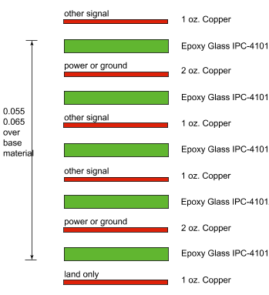
Stackup Design Tool
End User Scenario - Target 1.0 (work-in-progress)
Board Station v8
ICX
Mentor
Graphics
Mentor
Graphics
Interoperability levels:
Repository (SDAI)
File exchange
Native file(s)
ap210.exp
(IS CC24)
mg-ap210
pwb_stackup.step
Translator
v1 - OEM spec
stackup spec (OEM view)
(1)
my_pwb_model.exp
(2), (4)
Stackup
Tool
my_pwb_stackup.step
XaiTools PWA-B
stackup spec (OEM view) viewing & editing

Slide 29
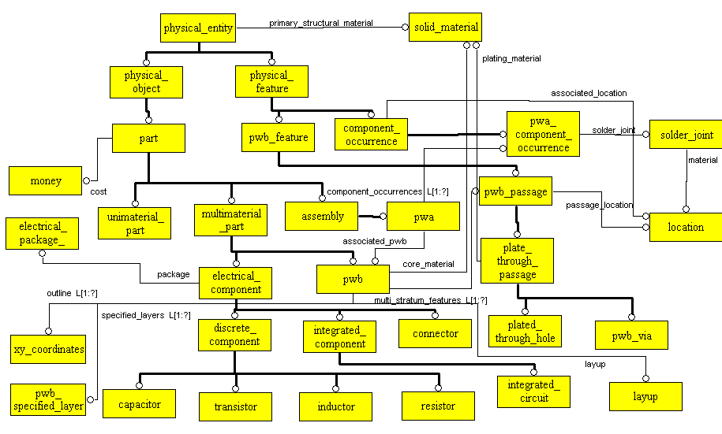
Application-Oriented
Custom Schema: git_pwa.exp
Based on TIGER/ProAM/JPL Phase 1
Focused to support stackup design, analysis, etc.
Has mapping with AP210 stackup data

Slide 30
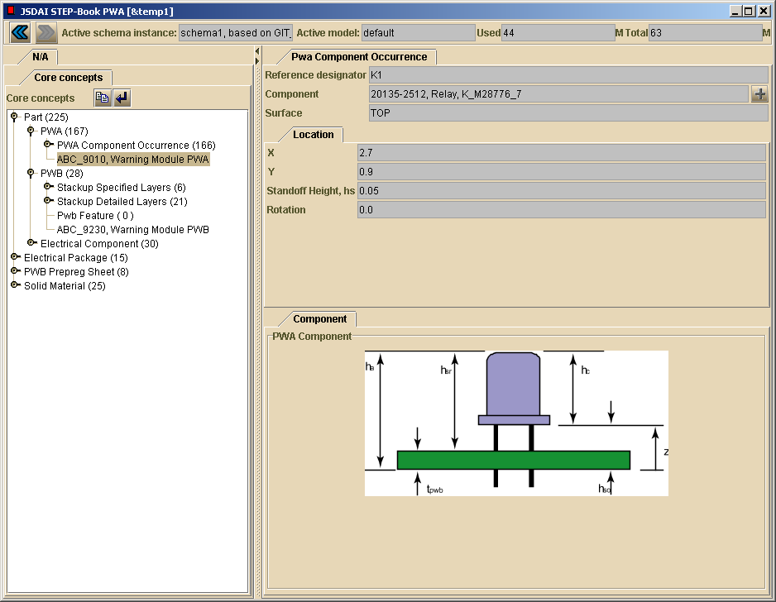
Attribute captured in computer-sensible form
Original “dumb” figure
with computer-insensible parameter: standoff height, hs
Reference figure (static SVG - first prototype). Enhances end user understanding of above attributes

Slide 31
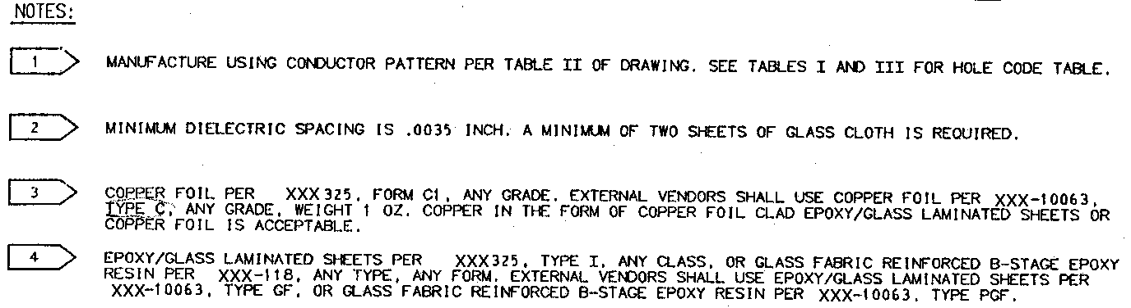
Example PWB Ancillary Information
Stackup Specs
Outline Detail
Stackup Notes

Slide 32
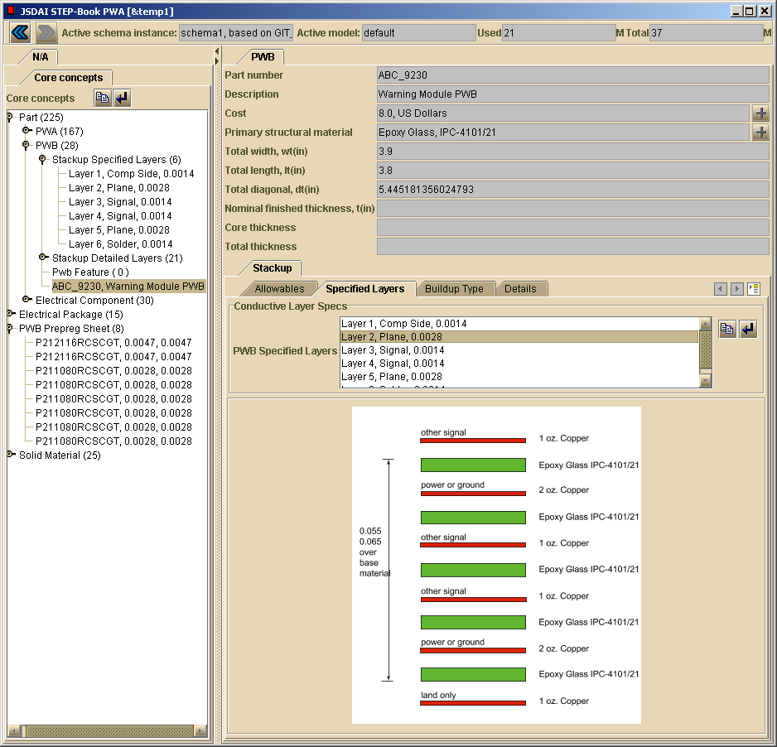
Next Gen. Gap-Filler Application
(In-Progress):
PWB Stackup Design & Analysis Tool
Attributes captured in computer-sensible form
Original manually generated
“dumb” figure
Reference figure (static SVG - first prototype). Enhances end user understanding of above attributes

Slide 33
Example Approach in JPL/NASA Effort
Typical Current Multi-PDM Architecture for Larger Organizations
(components and interfaces)
Level 1: Domain-Level PDM
Interactive WIP design collaboration: main tools
Tight Integration w/ major domain-specific CAD tools
Level 2: Workgroup-Level PDM
Interactive WIP design collaboration
Focus on inter-tool information interoperability
Oracle
MGC Board Station
MGC DMS
Basic Objects & Relations
ECAD Bound Design
ECAD- Oriented PDM
DBMS
Software and
Person-ware (manual) glue
____________
Native Files
…
Gaps:
Content coverage and semantics
Fine-grained associativity
  Even within a native file
  Esp. between attributes in monolithic native files
Dynamic interactivity vs. batch releases
Oracle
PTC Pro/Engineer 2001
PTC ProjectLink
MCAD Bound Design
MCAD- Oriented PDM
DBMS
____________
Native Files
Oracle
Level 3: Enterprise-Level PDM
Major Releases (to manufacturer, to supplier, …)
Long Term Archiving
EDS Metaphase
Plus other enterprise resources:
Document Mgt. Systems
(e.g., DocuShare), …
Enterprise PDM
DBMS
____________
Native Files

Slide 34
Example Approach in JPL/NASA Effort
Target Standards-Based Multi-PDM Architecture for Larger Organizations
(components and interfaces)
Level 1: Domain-Level PDM
Interactive WIP design collaboration: main tools
Tight Integration w/ major domain-specific CAD tools
Level 2: Workgroup-Level PDM
Interactive WIP design collaboration: gap filler tools
Focus on inter-tool information interoperability
Oracle
Type 2a
Oracle or MySQL
MGC Board Station
MGC DMS
Basic Objects & Relations
LKSoft & XaiTools
ECAD Bound Design
ECAD- Oriented PDM
DBMS
Object Manager
SDAI
____________
Native Files
…
LKSoft & XaiTools
Fine-Grained Objects &
Advanced Relations
w/ Multi-Schema
STEP-Based Models:
233, 203, 209, 210, …
Standard & Custom Templates
Oracle
Statemate, Ansys, Matlab, Materials DB, …
PTC Pro/Engineer 2001
PTC ProjectLink
Other CAD/CAE Tools
MCAD Bound Design
MCAD- Oriented PDM
DBMS
CORBA, SOAP
Type 2b
PostgreSQL
OMG PDM Enablers Protocol
(for inter-PDM/repository communication)
____________
Native Files
PGPDM
SOAP
Product Structure and Native File Manager
PDM Schema Context
OMG CAD Services Protocol
(for automatic usage
of geometry processing, …)
____________
Native Files
Oracle
Level 3: Enterprise-Level PDM
Major Releases (to manufacturer, to supplier, …)
Long Term Archiving
EDS Metaphase
Plus other enterprise resources:
Document Mgt. Systems
(e.g., DocuShare), …
Enterprise PDM
DBMS
____________
Native Files

Slide 35
Contents
Motivation
Scalable Vector Graphics (SVG) Overview
Application Development Toolkit
with STEP Express & XML-based widgets
Example Gap-Filling Applications
  Circuit board design
  Electronic package analysis
Summary

Slide 36
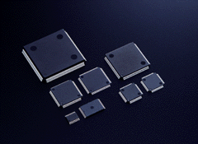
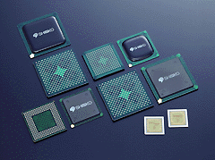
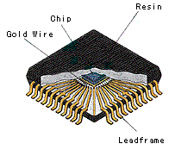
Chip Package Products
Shinko
Quad Flat Packs (QFPs)
Plastic Ball Grid Array (PBGA) Packages

Slide 37
Traditional VTMB FEA Model Creation
- Not well-supported by typical automeshing or multi-point constraint approaches
- Manually intensive model creation: 6-12 hours
FEA Model Planning Sketches - EBGA 600 Chip Package
~30 tightly packed
idealized 3D bodies
VTMB = variable topology multi-body

Slide 38
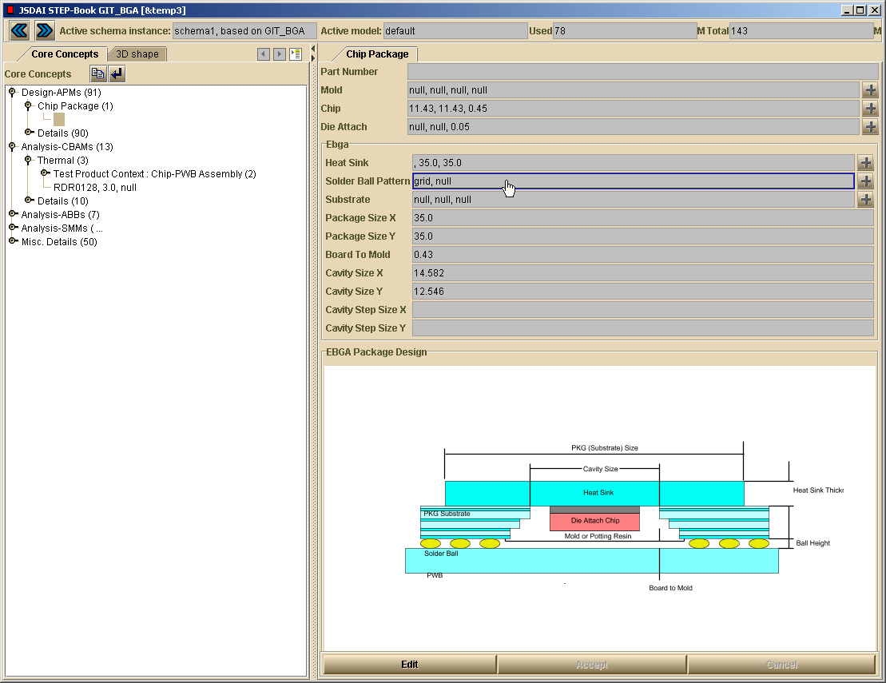
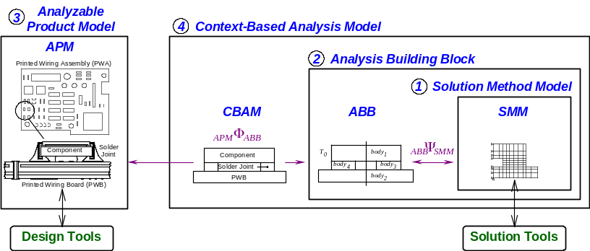
STEP-Book for BGA Thermal Analysis Templates
Ball Grid Array (BGA) Package Design Views - Initial Prototype
Implements MRA concepts for enhanced design-analysis integration: APMs, CBAMs, ABBs, SMMs
(see http://eislab.gatech.edu/ for details)
Includes SOAP-based use of commercial math and FEA solvers
Combines in-house custom schemas and ISO 10303 standard schemas (e.g., AIC 514)
5a. Click here to view Solder Ball Pattern details
3. Click here for Chip Package Design Details
4.
SVG Figure
Ctrl + Shift + Right Mouse Button to Zoom in and out
Shift + Left Mouse Button to translate
Alt + Ctrl + Right Mouse Button to rotate
Ctrl + Shift + Right Mouse Button for original image
Multi-Representation Architecture (MRA)
for CAD-CAE Interoperability

Slide 39
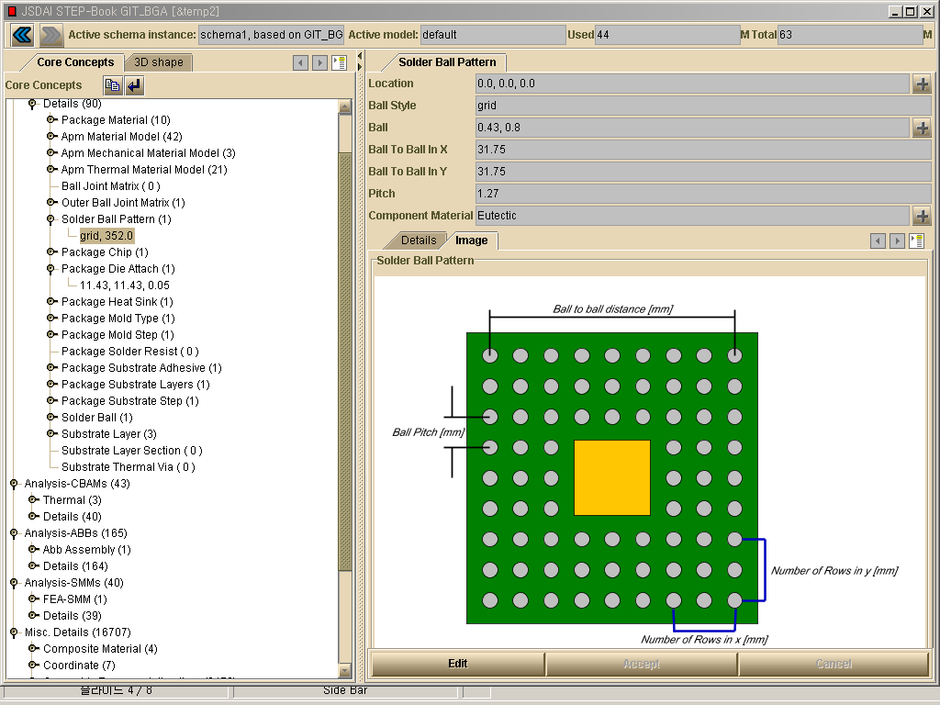
STEP-Book for BGA Thermal Analysis Templates
Package Design: Solder Ball Pattern
5b. Or Click here to activate Solder Ball Pattern details page on the right side
6. This mark indicates objects you can navigate for further details

Slide 40
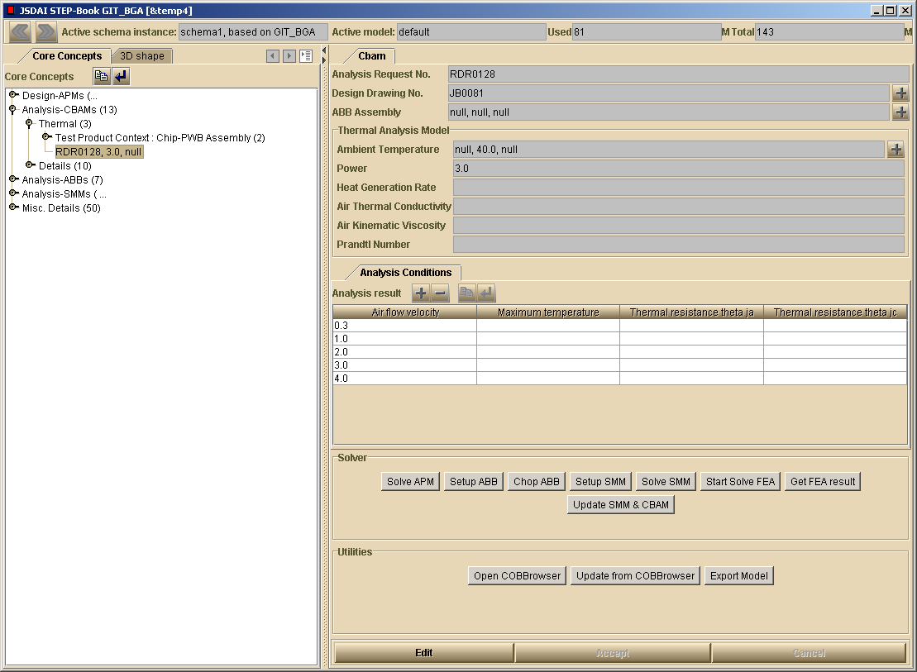
EBGA Model APM/CBAM Setup
Thermal Analysis Model (CBAM) before final setup
7. Click to view Thermal Analysis Model (CBAM)
8b. Operations to interact with the Constrained Object Browser
(Optional)
8a. Operations to set up and create MRA Models
8c. Operations to save the model as a STEP file (Usable at anytime)
9. Click to setup APM and CBAM (solve APM idealizations and CBAM boundary condition relations)

Slide 41
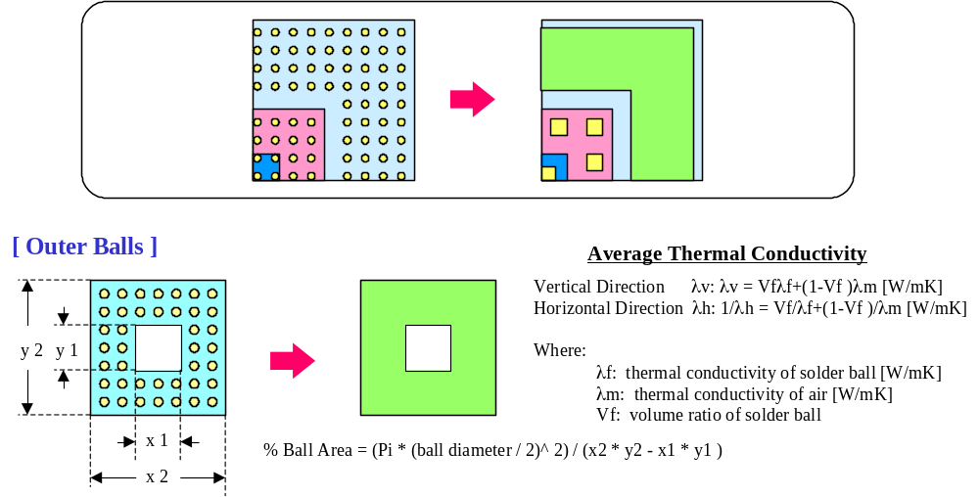
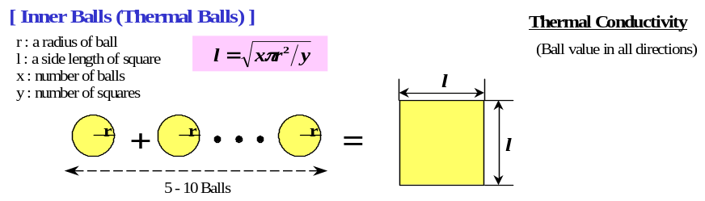
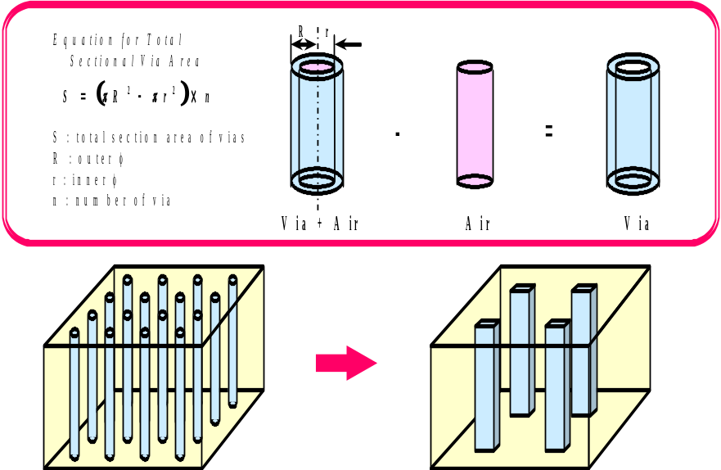
Example Chip Package Idealizations (PBGA)
Idealization for solder-joint/thermal ball
Idealization for thermal via
Courtesy of Shinko - see [Koo, 2000]

Slide 42
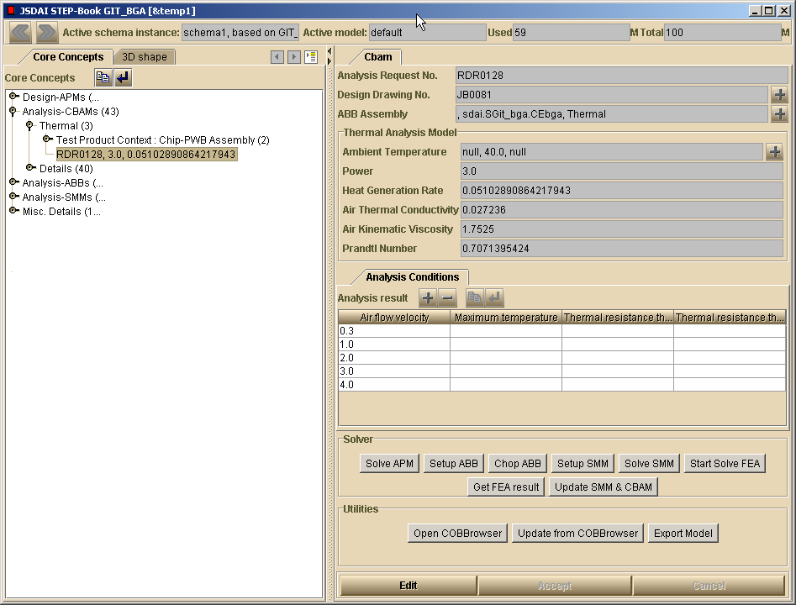
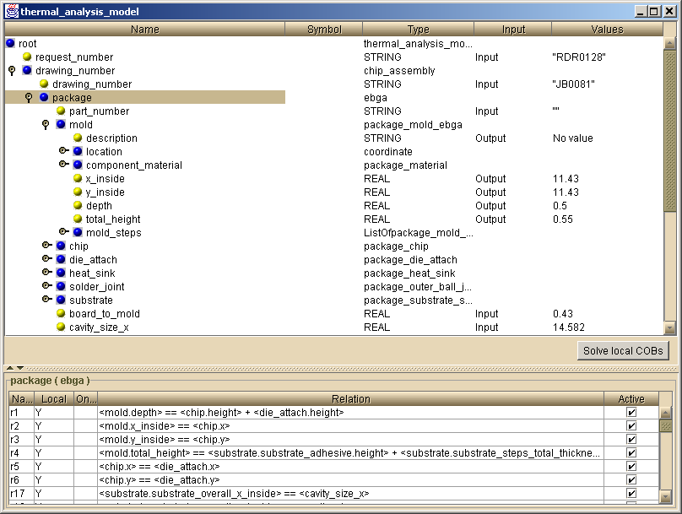
Interaction with Detailed Objects and Relations/Idealizations (APM, etc.)
Supports I/O changes for design studies - Uses server-based math solver

Slide 43
EBGA Model APM/CBAM
Thermal Analysis Model (CBAM) after final setup
10a. CBAM Inputs Details for the EBGA Thermal Analysis Model
10b. Specifying the desired results (to come after FEA solution)
10c. Click to setup ABB Assembly, Chop, and Bind for FEA solving

Slide 44
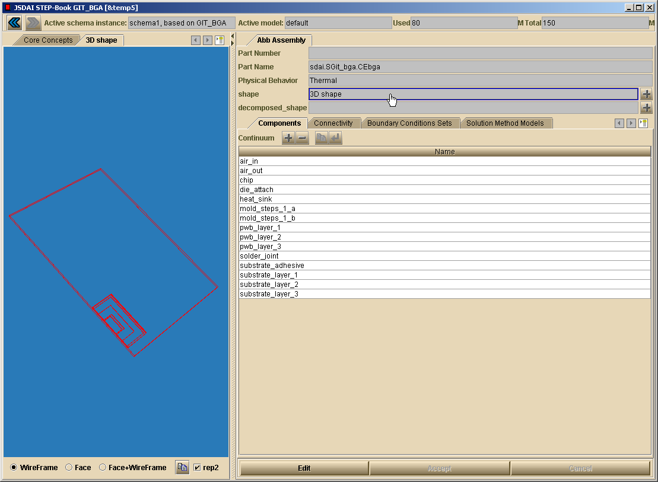
EBGA Model ABB Assembly
Continuum bodies shape representation
16. Click here to view ABB assembly continuum bodies
~15 tightly packed idealized bodies
STEP-Book Java widget supporting standardized advanced B-rep shapes (ISO 10303-514)

Slide 45
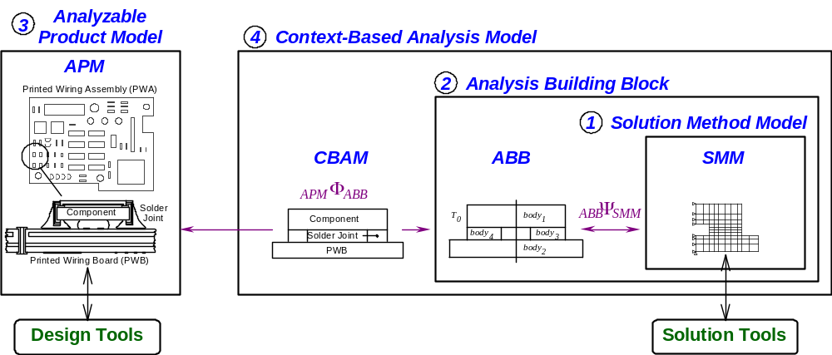
Context in MRA
Multi-Representation Architecture for Advanced Design-Analysis Integration
Composed of four representations (information models)
Provides flexible, modular mapping between design & analysis models
Creates automated, product-specific analysis modules (CBAMs)
Represents design-analysis associativity explicitly

Slide 46
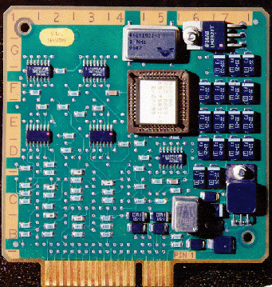
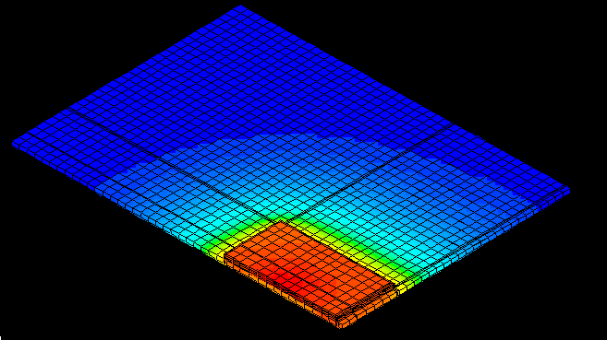
Advanced FEA Modeling Roadmap
MRA View
Design
Model A
??
Analysis
Model A
Level 0
Heterogeneous Transformation
Component
Solder
Design
Model A
Joint
Analysis
Model A
Level 1
Printed Wiring Board (PWB)
Analysis Specific Design Model
CAD
FEA
Idealized Model
Component
Solder
Component
T
body
Level 2 - MRA
Joint
0
body
1
Solder Joint
4
body
PWB
body
3
Printed Wiring Board (PWB)
2
Time
Level 3
T
0
body
body
1
4
body
body
3
2

Slide 47
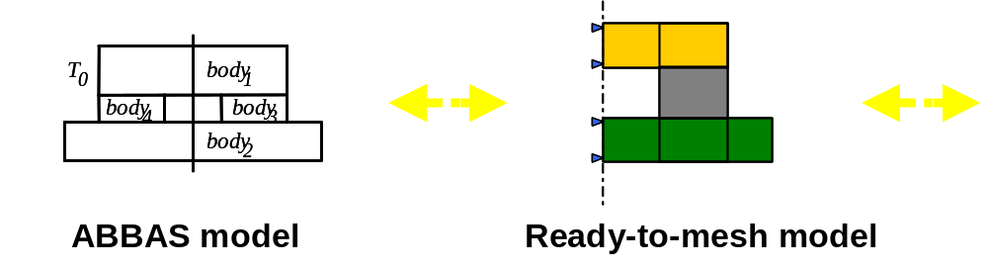
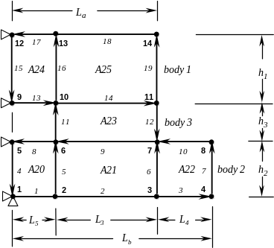
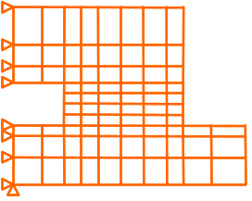
Main Stages at Level 3 for Generating Complex FEA Models
Analytical Model
(ABB Assembly)
Decomposed
Analytical Model
(decomposed ABB Assembly)
Solution Method Model
(SMM)
preprocessor model
Chopper
Binder
(RMM)
mesh model
Continuum Mechanics
View
Decomposed into easily
meshable regions
GIT Approach:
- ABB assembly = pre-pre & post-post processor model
- Richer semantics and context
- Chopper and vendor-neutral binder algorithms
Traditional FEA tool

Slide 48
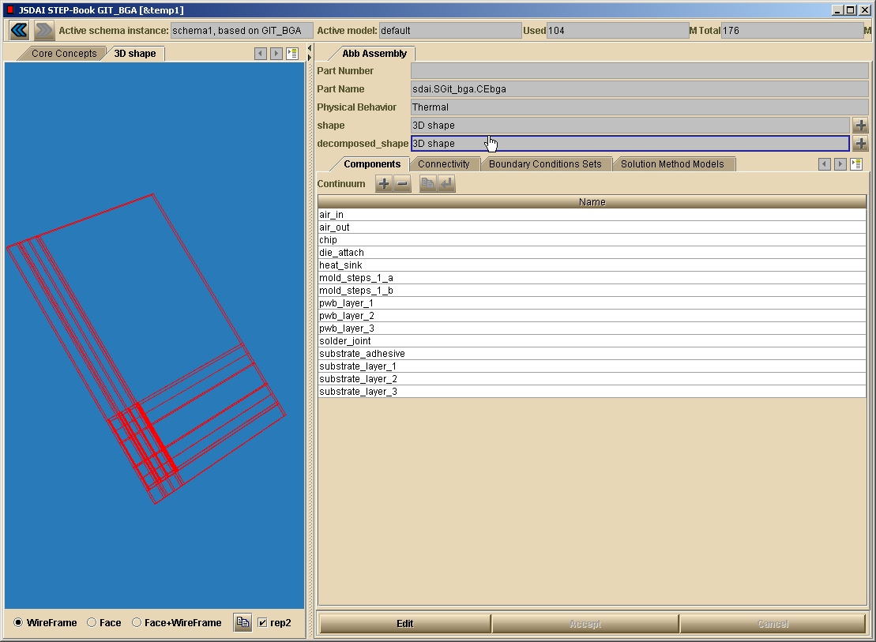
BGA Model ABB Assembly - Ready for FEA processing
Decomposed continuum bodies shape representation
18. Click here to view ABB assembly decomposed continuum bodies
~680 decomposed idealized bodies
(ready-to-mesh)

Slide 49
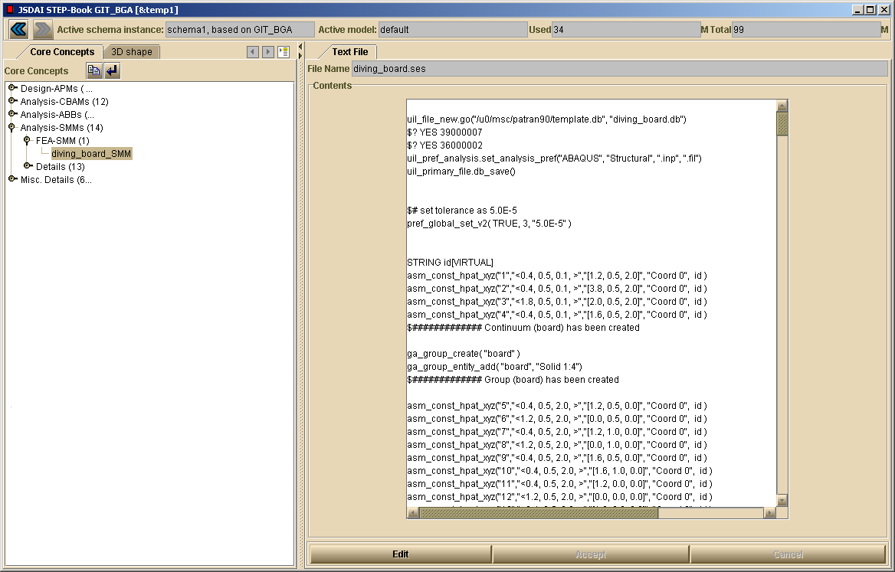
BGA Model SMM - Binding to FEA Model
FEA tool inputs: preprocessor model
21a. FEA tool inputs: preprocessor model (Patran/Abaqus session file)

Slide 50
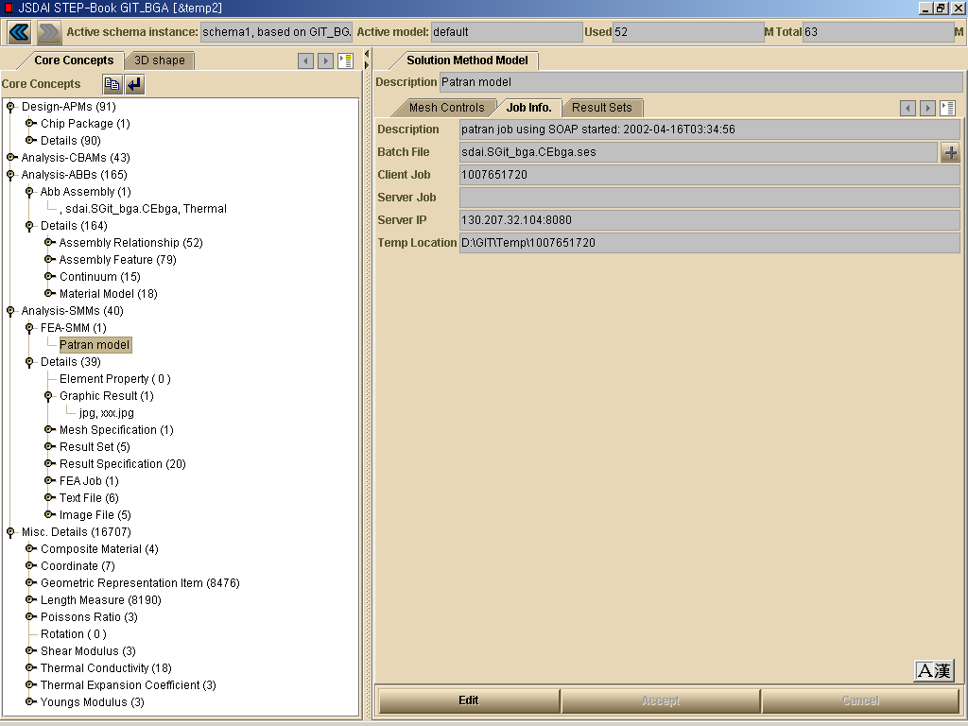
BGA Model SMM
Patran/Abaqus Model : Job Information Details
21a. Click here to see FEA preprocessor model (input file)
20. FEA job details

Slide 51
Using Internet/Intranet-based Analysis Solvers
Thick Client Architecture - Engineering-Oriented ASP
Users
Engineering Service Bureau
Client PCs
Host Machines
June’99-Present:
EIS Lab
- Regular internal use
U-Engineer.com
- Demo usage:
- US (SMEs, OEMs, Gov. labs)
- Japan
Nov.’00-Present:
Electronics Co.
- Began production usage
(dept. Intranet)
Future:
Other company Intranets
and/or
U-Engineer.com
(commercial)
- Other solvers
Thick Client
CORBA Daemon
XaiTools
Iona orbixdj
CORBA IIOP
CORBA Servers
Internet
XaiTools Ansys
Solver Server
XaiTools Ansys
Solver Server
XaiTools Math.
Solver Server
XaiTools Ansys
Solver Server
FEA Solvers
Ansys
Internet/Intranet
Math Solvers
...
Mathematica
2002-04 Updates: SOAP protocol; Patran/Abaqus wrappers
ASP= application service provider

Slide 52

BGA Analysis Template (CBAM) Results
Thermal resistance vs. air flow velocity summary table
24-a. Click the analysis template id to see the results summary (in terms of the product context)
23. Click here to update SMM and CBAM based on the Patran/Abaqus FEA output

Slide 53


BGA Analysis Template (CBAM) Results
Temperature Distribution Contour
24-b. Graphical results for one load case

Slide 54
Contents
Motivation
Scalable Vector Graphics (SVG) Overview
Application Development Toolkit
with STEP Express & XML-based widgets
Example Gap-Filling Applications
  Circuit board design
  Electronic package analysis
Summary

Slide 55
Summary
Other applications:
  Systems engineering standard development aid (AP233)
  Other analysis templates
Addressing fundamental gaps
  Coverage, semantics, fine-grained associativity
Promising capability to create gap-filling applications
STEP Express & XML-based widgets & infrastructure
Combines standard schemas with in-house knowledge in the form of custom schemas
Enhanced knowledge capture
  Modular & re-usable
  Richer & more complete
  Facilitates downstream usage (e.g., more automation)

