Slide 1

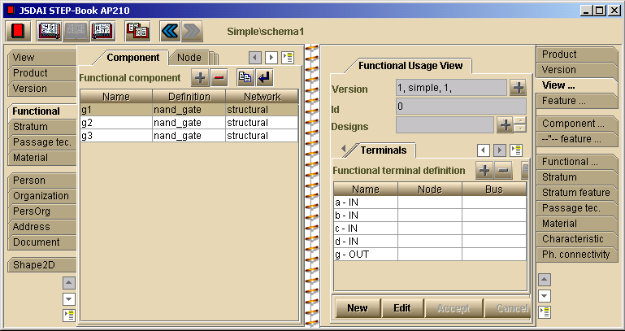
STEP-Book AP210 a viewer for:
PDM
PCB, PCA views (both Usage and Design view)
Functional views
Parts, Packages
Functional and physical networks, connectivity
Templates, components, features
Technologies (passage, stratum, manufacturing)
www.lksoft.com
a - With 2002-04 additions

Slide 2
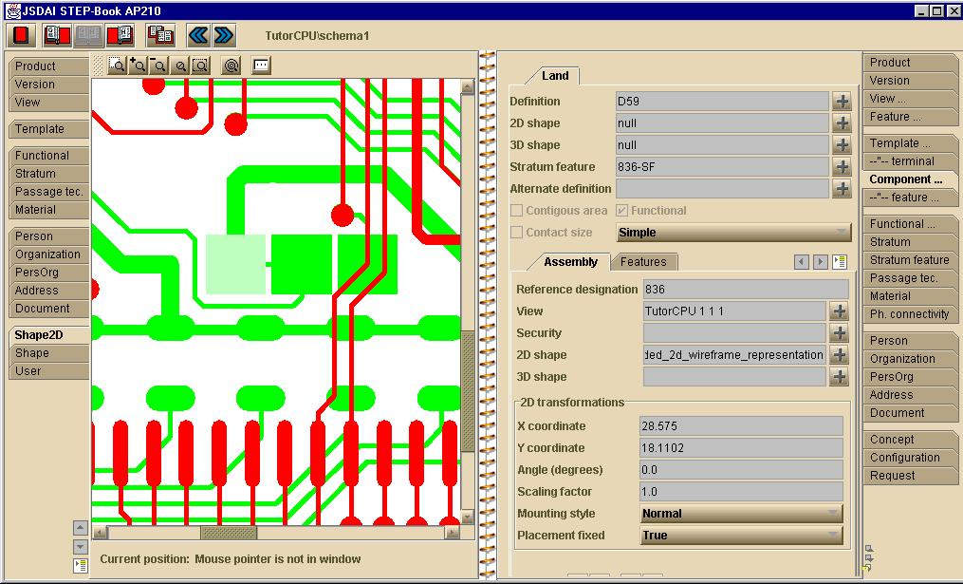
STEP-Book AP210
(continue)
Material characteristics
2D and 3D geometry (relationship between 2D and 3D designs)
Passages (plated, unplated, blind etc.)
Rules, requirements
Analytical models
Export PCB data to the GERBER format

Slide 3
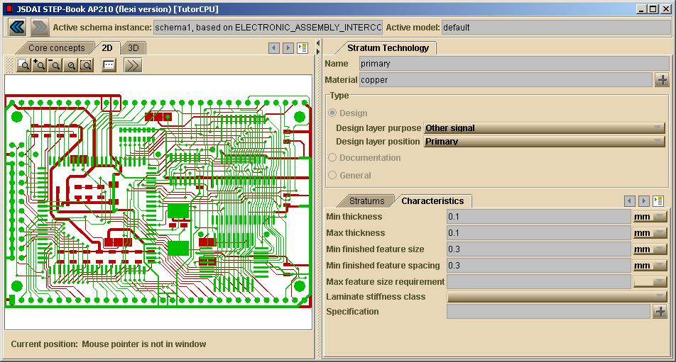
STEP-Book AP210 (continue)

Slide 4
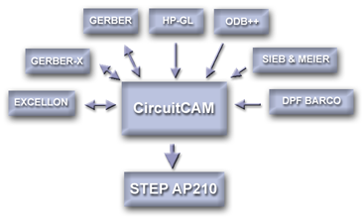
AP210 CircuitCAM Interface
www.LPKF.de

Slide 5
EAGLE <-> AP210 Interface
EAGLE is a PCB/PCA Cad System from CadSoft Computer GmbH.
Low cost, a share-ware version is available
More than 30,000 users
AP210 interface/converter is based on the JSDAI API.
Bi-directional + EAGLE libraries

Slide 6
EAGLE <-> AP210 (continue)
Combined PCB and PCA information.
Functional networks, thermal reliefs lands,
constraint areas.
Includes connectivity checker/converter, assuring the integrity of all the connectivity information.
Multi-layer stack-ups (stratums)
Free web service will be established for conversion.

Slide 7
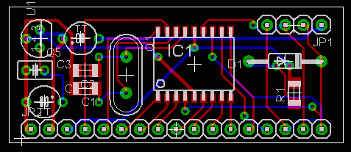
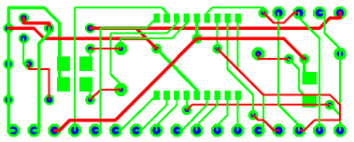
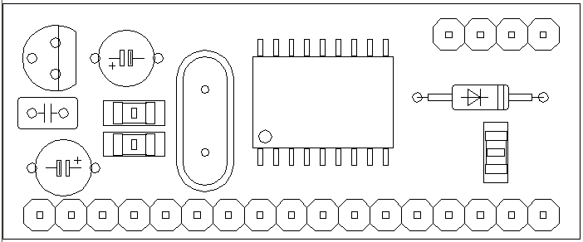
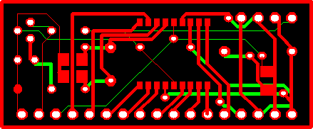
EAGLE <-> AP210 (continue)
EAGLE
AP210 (PCB)
AP210 (PCA)
Gerber

Slide 8
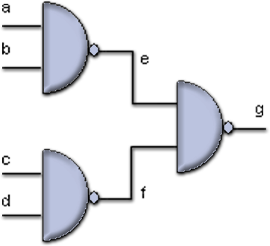
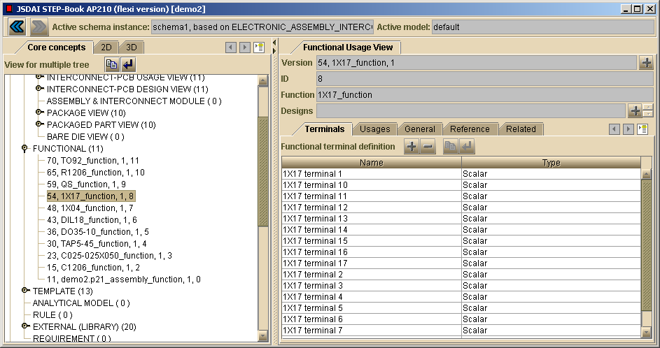
VHDL <-> AP210 Interface (prototype)
ENTITY simple IS
PORT (a,b,c,d:IN BIT; g: OUT BIT);
ENDsimple;
ARCHITECTURE structural OF simple IS
COMPONENT nand_gate
PORT (a,b : IN BIT; y : OUT BIT);
END COMPONENT;
SIGNAL e,f : BIT;
BEGIN
g1:nand_gate PORT MAP(a,b,e);
g2:nand_gate PORT MAP(c,d,f);
g3:nand_gate PORT MAP(e,f,g);
ENDstructural;

Slide 9
Future Interfaces
Zuken Visula <-> AP210
Mentor PCB <-> AP210
For more details, see presentation by Giedrius Liutkus at
http://www.estec.esa.int/conferences/aerospace-pde-2002

