Slide 1

LKSoft STEP-Book
Usage Examples & Exercises
With an Emphasis on AP210 Capabilities
2003-07-08
Contacts:
manas.bajaj@eislab.gatech.edu
russell.peak@marc.gatech.edu
Georgia Tech
eislab.gatech.edu
www.marc.gatech.edu

Slide 2
Contents Overview
Part 1: 2003-07-08 Additions
Based on STEP-Book AP210 v1.0.x (alpha version)
  Interim update for AP210 course in Cedar Rapids, IA
Part 2: 2002-04-22 Content
Based on STEP-Book AP210 v0.y (alpha versions)
  Original baseline

Slide 3
Part 1: 2003-07-08 Additions
Based on STEP-Book AP210 v1.0.x (alpha version)

Slide 4
Enhancing Design-for-Manufacturability
Using the ISO 10303 Standard for Electronics Design: AP210
Conference Series Archive: http://step.nasa.gov/
Georgia Tech (GIT): Russell Peak (presenter), Manas Bajaj, Miyako Wilson, Injoong Kim
Rockwell Collins (RCI): Tom Thurman, Mike Benda, M. C. Jothishankar
U. Illinois (UIUC): Placid Ferreira, Jami Stori, Deepkishore Mukhopadhyay, Dong Tang
LKSoft: Giedrius Liutkus, Lothar Klein
This presentation overviews recent work to deploy AP210 within Rockwell Collins to enhance the printed circuit assembly (PCA) design-for-manufacturability (DFM) process. PCA design models in the form of AP210 are created here by combining information from Zuken Visula electrical CAD models with other product model sources. The resulting AP210 models are then checked against corporate DFM guidelines implemented in a rule-based expert system.
This work illustrates the challenges and benefits of addressing common engineering framework gaps, including gathering information from various sources, managing different levels of abstraction, and addressing semantic mismatches.
X = design, mfg., sustainment, and other lifecycle phases.

Slide 5

STEP-Book AP210 Usage within a
Design-Analysis Process
DFX Example based on Rockwell Collins (RCI) SFM Project
Design
Evaluation
Intended
Design Changes
CAD/E/M/X Tools
Model
Information
Automated
DFX Checking
DFX
Analysis Results
LKSoft ECAD-AP210 Interfaces/Converters
Browser &
Gap-Filling Editor
STEP AP210
Other Design Verification
Analysis & Simulation
LKSoft
STEP-Book AP210
DFX Guidelines
SFM Project Focus:
High-value rules not supported
by typical CAD tools
DFX = Design-for-Manufacturability, -Reliability, -Test, -Maintenance, … SFM = Simulation for Flexible Mfg.

Slide 6
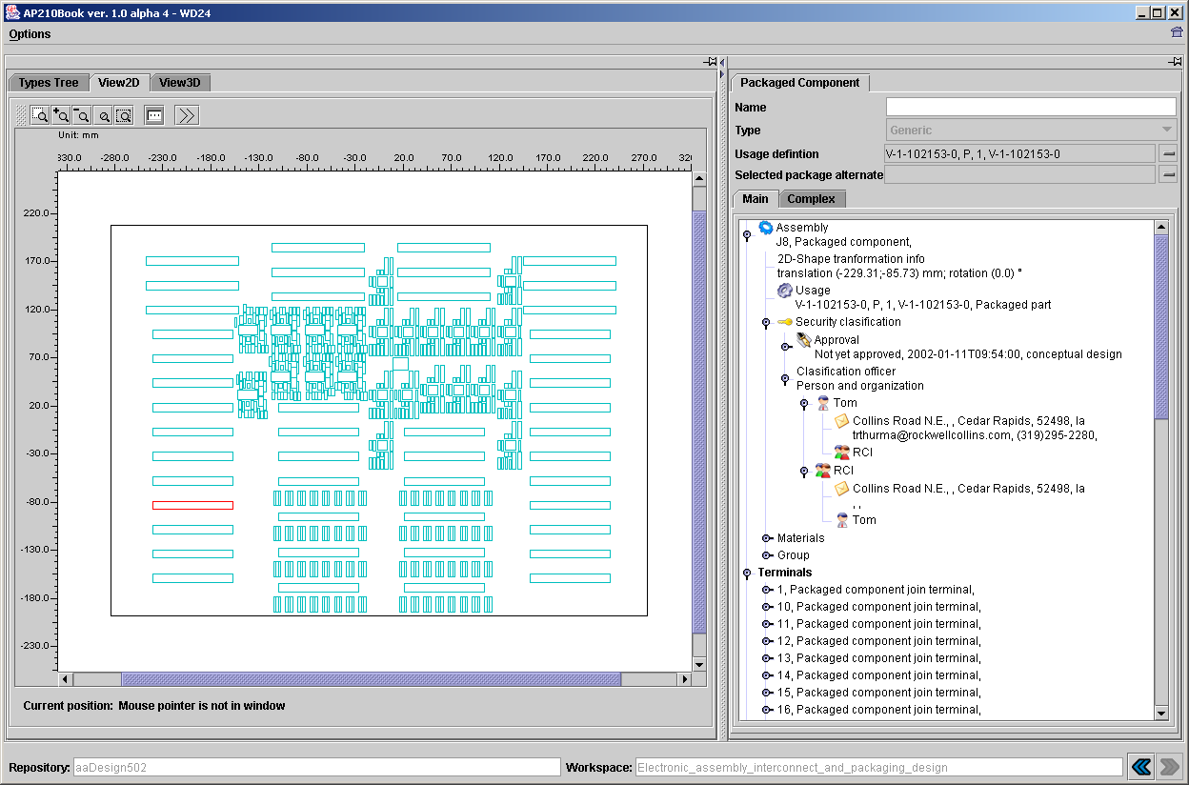
RCI Design -502 in STEP Book AP210
Production design: -502
728 components; 6 layer stackup
Notes:
Note: this is from the STEP-Book version included with the a6 release of the LKSoft CADIF-210 translator. The design model is from the translator plus manual edits by RCI to include additional information.

Slide 7
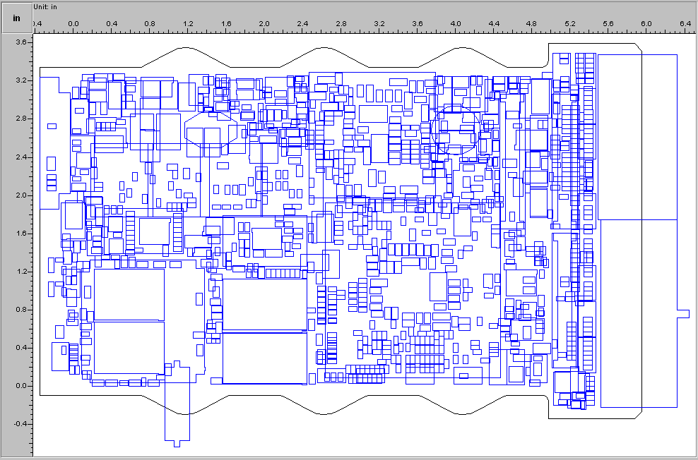
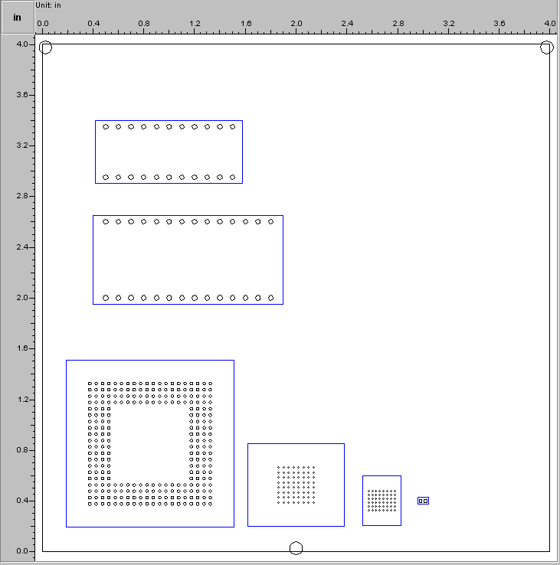
RCI Test Cases -053 and -503 in STEP Book AP210
Production design: -503
1043 components; 20 layer stackup
V&V design: -053
fiducials test;16 layer stackup

Slide 8
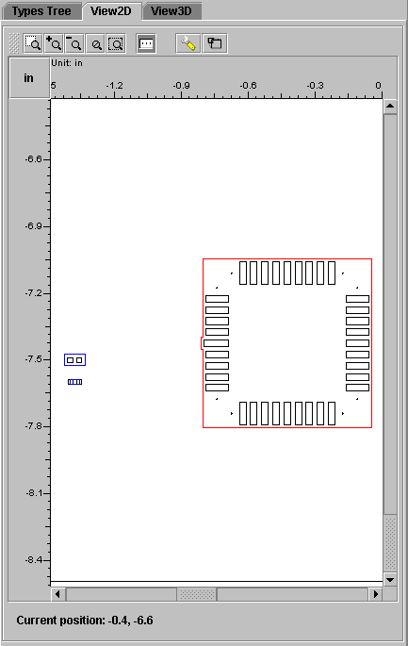
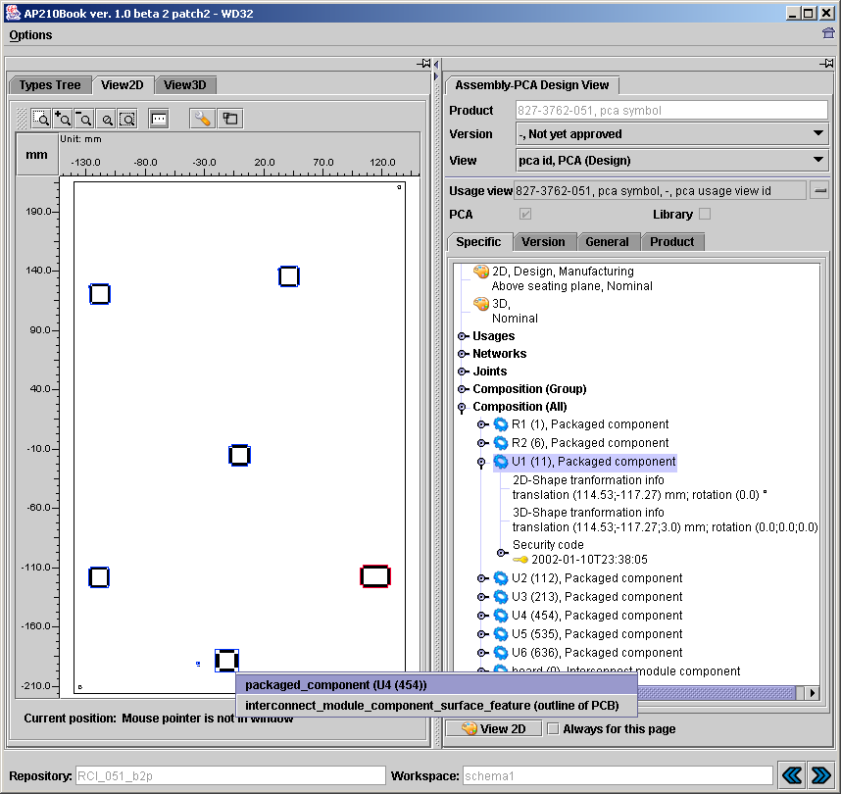
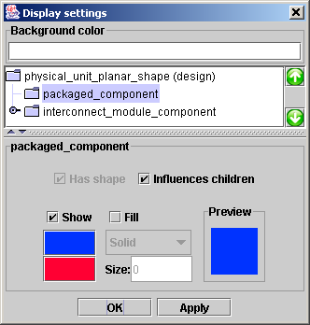
RCI V&V Case -051 in STEP Book AP210
Notes:
Note: this is from the STEP-Book version included with the a6 release of the LKSoft CADIF-210 translator. The design model is from the translator plus manual edits by RCI to include additional information.

Slide 9
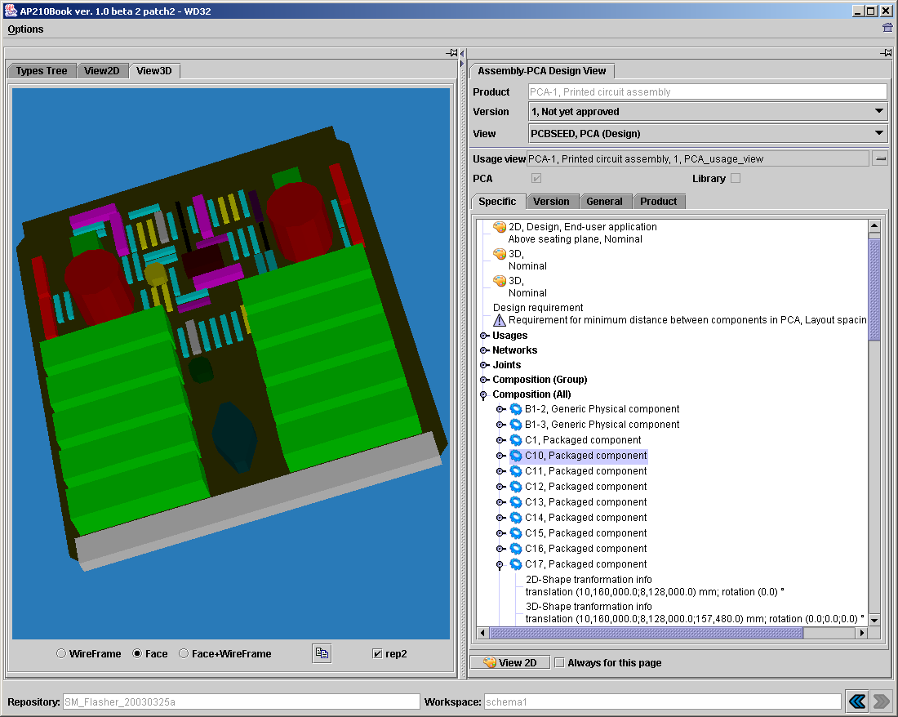
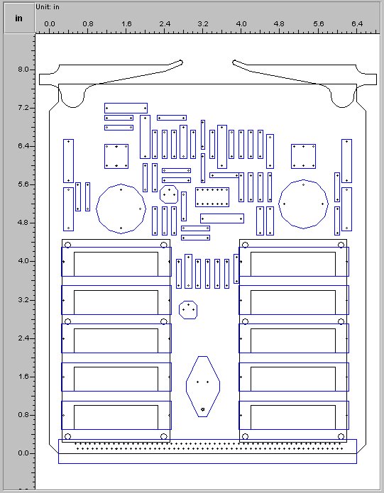
Rich Features in AP210: PCB Assembly: 3D & 2D
STEP-Book AP210 Browser - www.lksoft.com
PDES Inc. EM Pilot
Test Case:
Cable Order Wire
(COW) Board

Slide 10
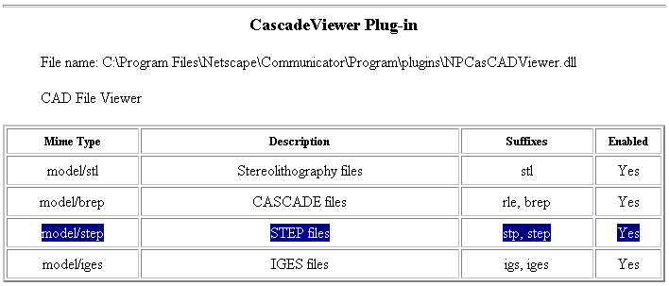
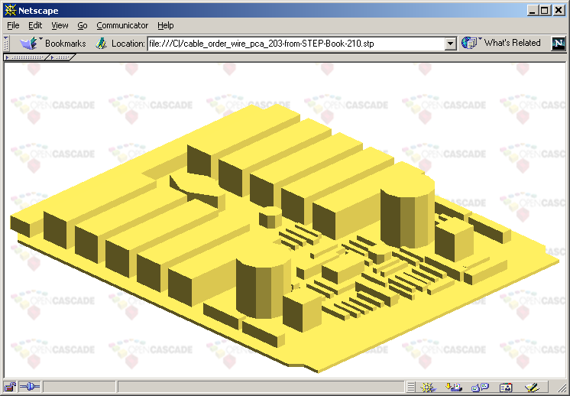
EM Pilot Test Case: COW Board
3D MCAD model (AP203) in OpenCASCADE Plugin as exported from STEP-Book AP210

Slide 11
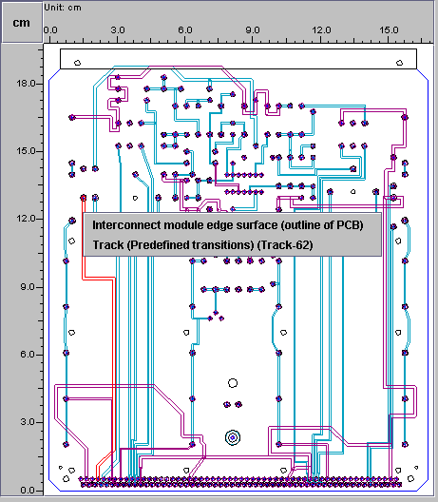
EM Pilot Test Case
Cable Order Wire (COW) Board in STEP-Book AP210

Slide 12
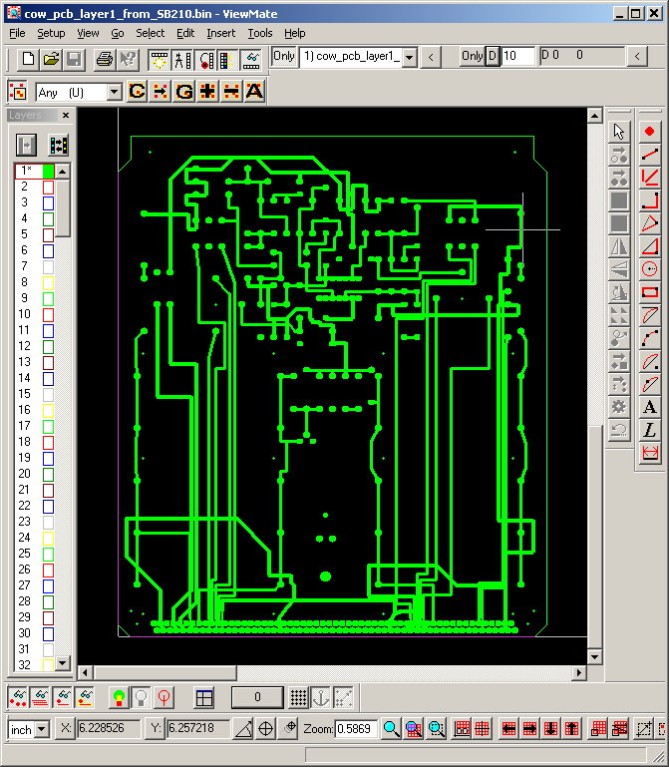
EM Pilot Test Case: COW Board
AP210 - Gerber Interoperability Scenario
AP210 Model (from LKSoft Converter)
In STEP-Book AP210
Gerber in
PentaLogix ViewMate v8.2
(for PCB fabrication)

Slide 13
Part 2: 2002-04-22 Content
Based on STEP-Book AP210 v0.x (alpha versions)

Slide 14

Context
This assumes you have obtained STEP-Book for AP210 from LKSoft (www.lksoft.com) and have installed it in the default location. It may include others, too, like STEP-Book AP203
This documentation was tested using this alpha version:
  JSDAI v3.0.1a2 (dated 2002-04-17)
  Note: screen shots may vary slightly (some are from early versions)
This documentation is a user-oriented supplement to their existing online documentation. It emphasizes illustration of AP210 capabilities
See first the following prerequisites:
  General STEP-Book Usage
    Start Menu, LKSoft-JSDAI, STEP-Book Documentation

Slide 15
STEP-Book Usage Hints
In 2D/3D geometry shape view windows:
  Zoom: Right-Button and move mouse
  Pan: Shift-Left-Button and move mouse
  Rotate (3D): Left-Button and move mouse
Sometimes after a mouse single-click or double-click, there may be a ~5-10 sec delay on some responses (an hour glass may not show - example during Import)
Sometimes the back button does not behave as expected (go back to the Core Concepts and select again if necessary - the 2D/3D shape you previously selected will still be there)
You cannot have more than one model loaded at a time
Sometimes you may have to exit and re-start to load in a new model
See other known caveats described in these Release Notes
  Start Menu, LKSoft-JSDAI, STEP-Book Known Problems

Slide 16
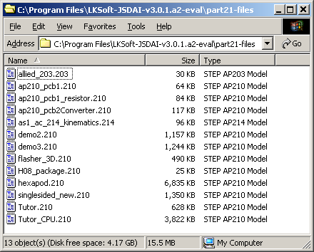
Examples included in STEP-Book
For other STEP model examples, see also:
www.cax-if.org (ap203)
www.ap210.com
  Includes examples showing same design in EAGLE ECAD tool and StepBook
pdm-if.org (pdm_schema)
etc.

Slide 17
Contents
AP210 Examples
  hexapod.210
    Translated from the common example in the EAGLE ECAD tool
    Interconnect-PCB Design View
      2D layout (bare board - including table of traces)
    Interconnect-PCA Design View
      2D layout (including table of components)
  H08-Package.210
    Package view
      3D, … feature table, seating plane, …
  flasher_3D.210
    Includes both 2D and 3D PCA shape views
  demo2.210
    Interconnect-PCB Design View
      physical network join relationships

Slide 18
Contents (continued)
AP210 Examples - continued
  Other electronic component examples
AP203 Examples
  Dual in Line Package
    3D Substrate and Socket View
  allied_203.203 - Mechanical Part
    3D View
Tool Usage Quiz - AP210 Exercises
  demo2.210
    Land patterns, physical networks, passage technologies, …
    Documents
  flasher_3D.210
    Example end user queries

Slide 19
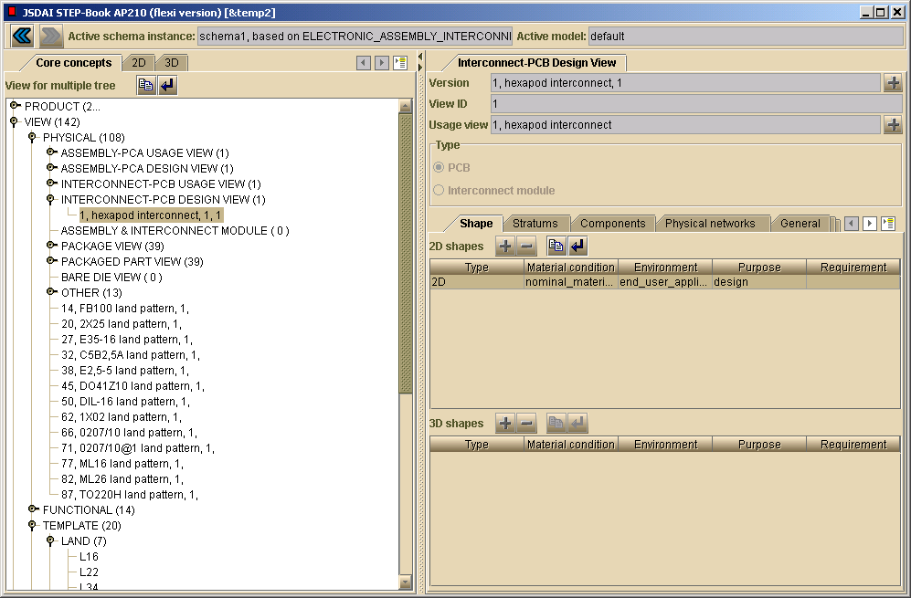
AP210 Interconnect-PCB Design View pca: hexapod.210 aspect: overview of features
3
1
2
(double-click here, then select 2D shape/geometry view)
Follow these steps to see the indicated aspects

Slide 20
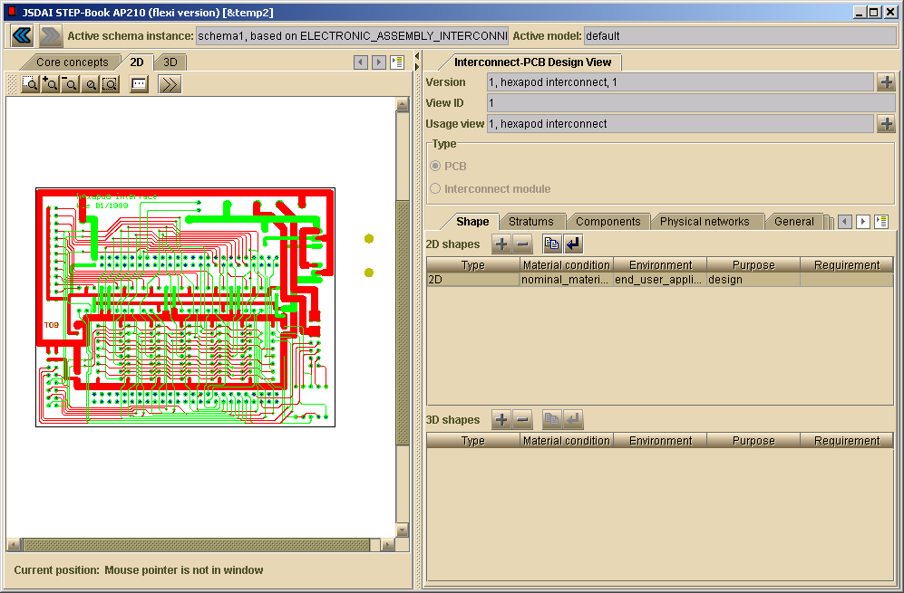
AP210 Interconnect-PCB Design View pca: hexapod.210 aspect: 2D view of traces/features
4 - View table of traces, etc.

Slide 21
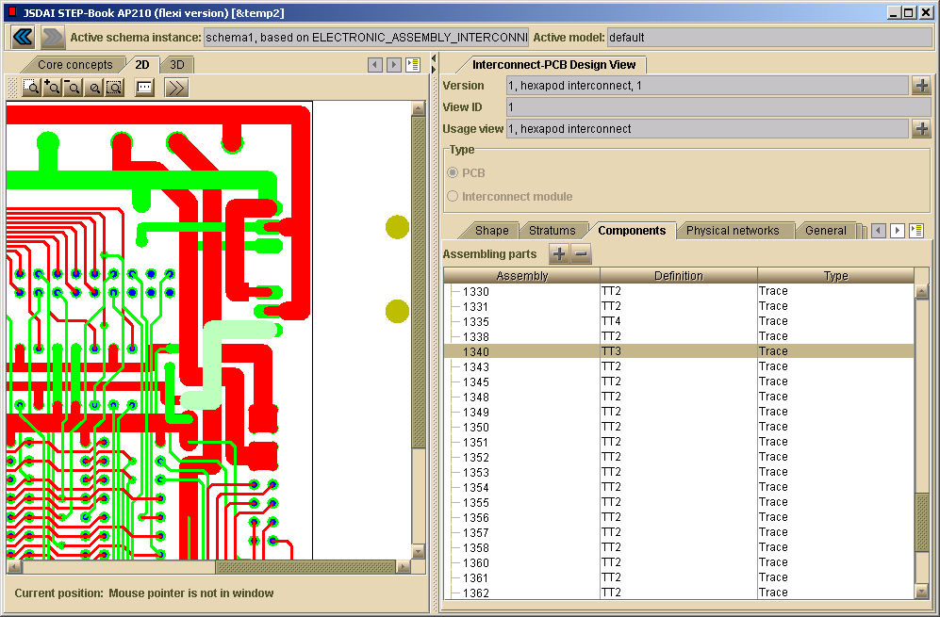
AP210 Interconnect-PCB Design View pca: hexapod.210 aspect: table of traces (“components”)
6 (zoom)
5a (select a row - can also add/remove/re-arrange table columns)
5b (selected trace is auto-highlighted)

Slide 22
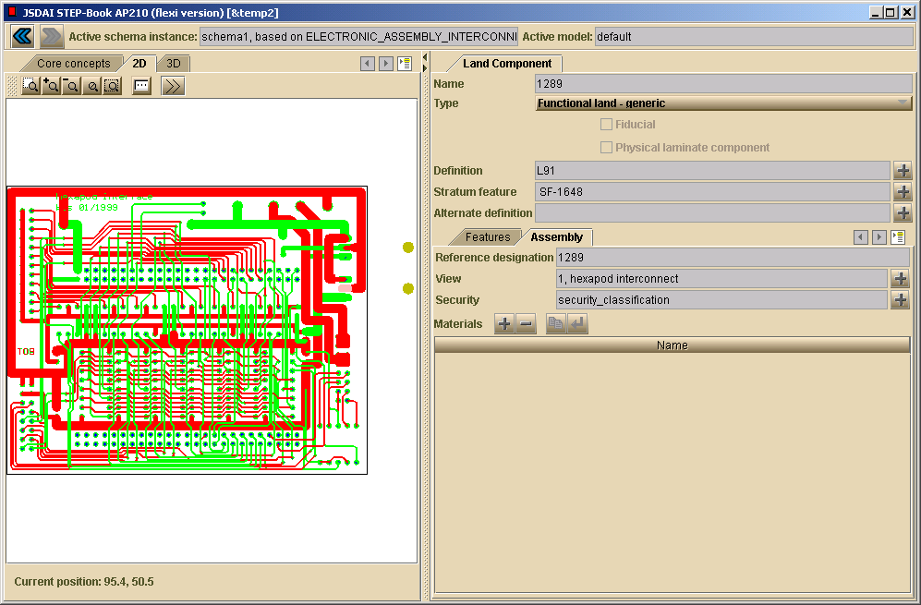
AP210 Interconnect-PCB Design View pca: hexapod.210 aspect: selected feature (land)
7 - Can also double-click features in left pane to see their details above

Slide 23
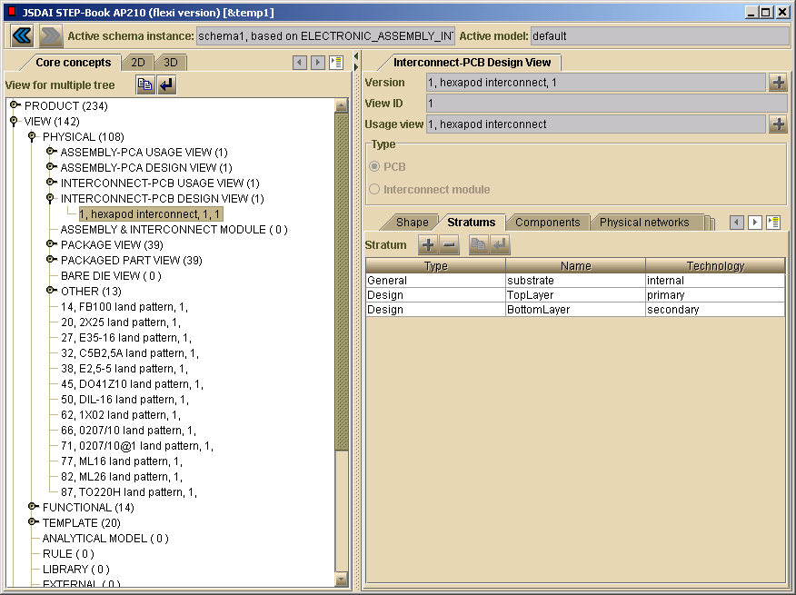
AP210 Interconnect-PCB Design View pca: hexapod.210 aspect: list of stratums (layer stackup)

Slide 24
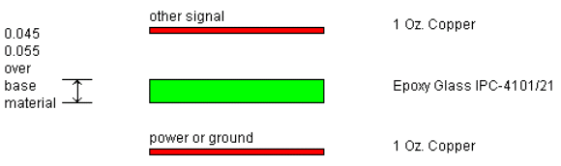
WIP Extension: Stackup OEM View Smart Figure
AP210 Interconnect-PCB Design View pca: hexapod.210 aspect: list of stratums (layer stackup)
Target smart figure illustrating idealized meaning of above attributes

Slide 25
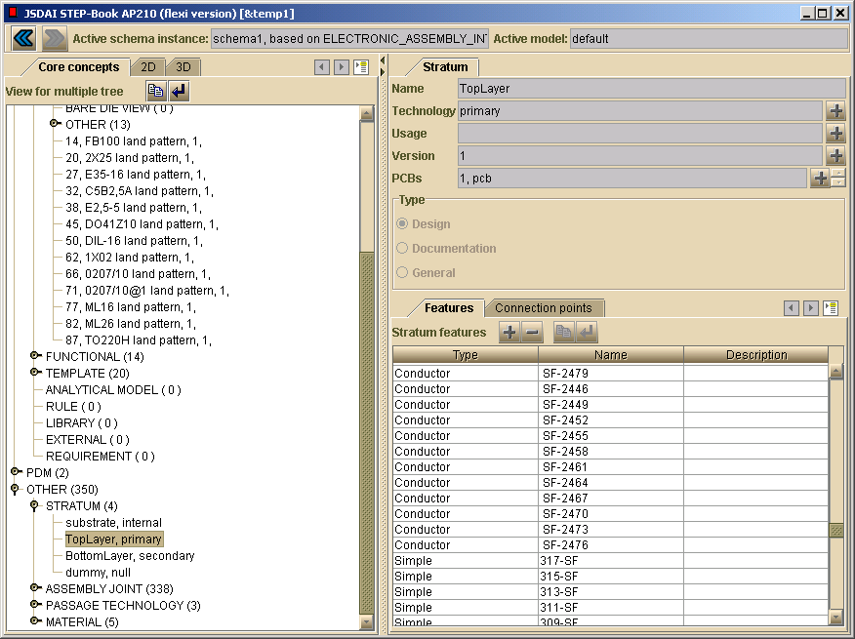
AP210 Interconnect-PCB Design View pca: hexapod.210 aspect: stratum feature details (in TopLayer)

Slide 26
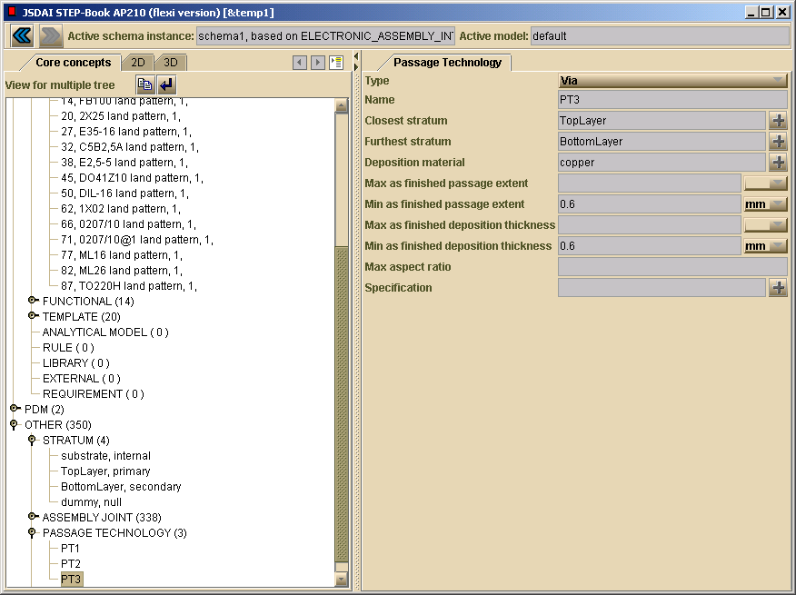
AP210 Interconnect-PCB Design View pca: hexapod.210 aspect: passage technology (via/pth template)
pth = plated-through hole

Slide 27
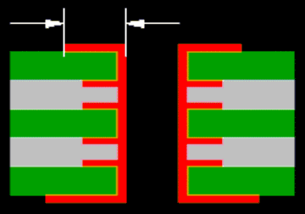
WIP Extension: Via/PTH Template Smart Figure
AP210 Interconnect-PCB Design View pca: hexapod.210 aspect: passage technology (via/pth template)
Target smart figure illustrating idealized meaning of above attributes
pth = plated-through hole

Slide 28
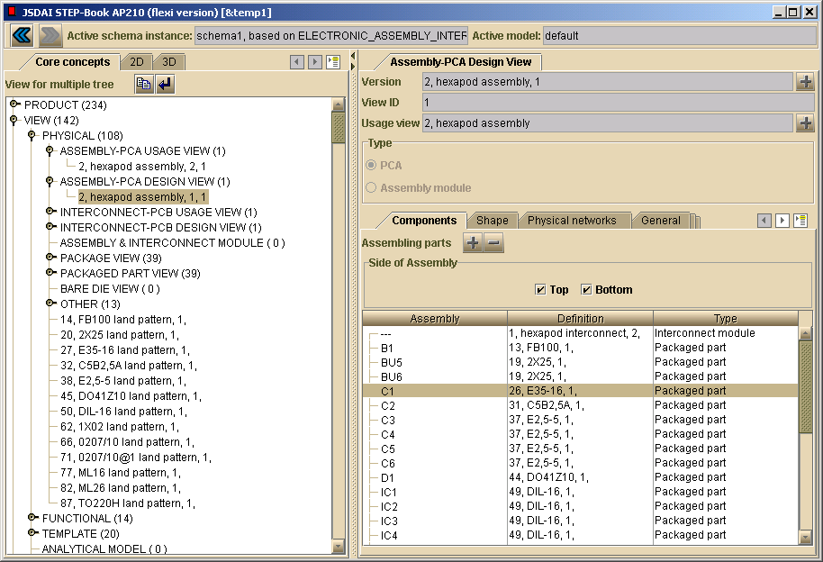
AP210 Assembly-PCA Design View pca: hexapod.210 aspect: overview of features
4
2
3
1

Slide 29
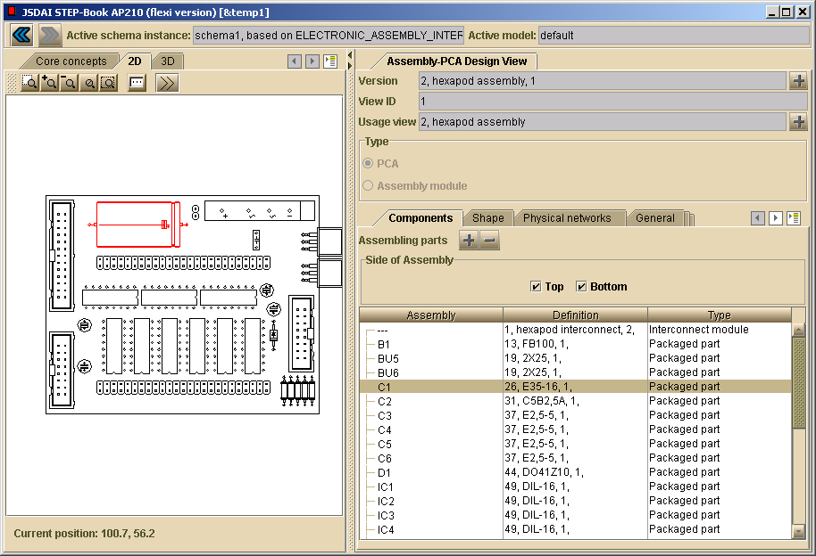
AP210 Assembly-PCA Design View pca: hexapod.210 aspect: view selected component - C1
5a (select a component)
5b (selected component is auto-highlighted)

Slide 30
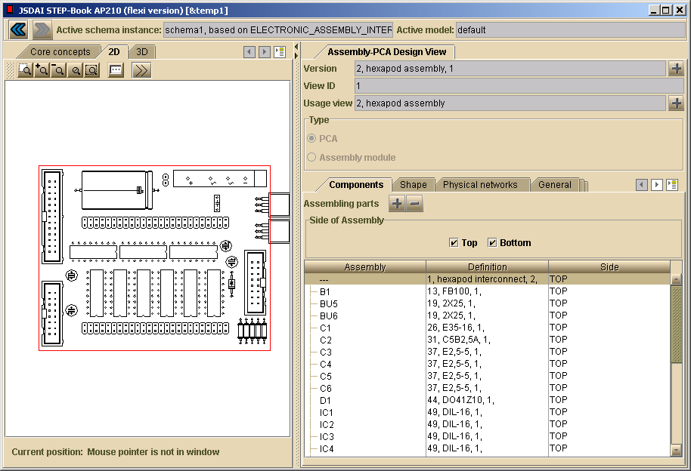
AP210 Assembly-PCA Design View pca: hexapod.210 aspect: view selected component - board
6 (board/PCB is also a selectable “component”)

Slide 31
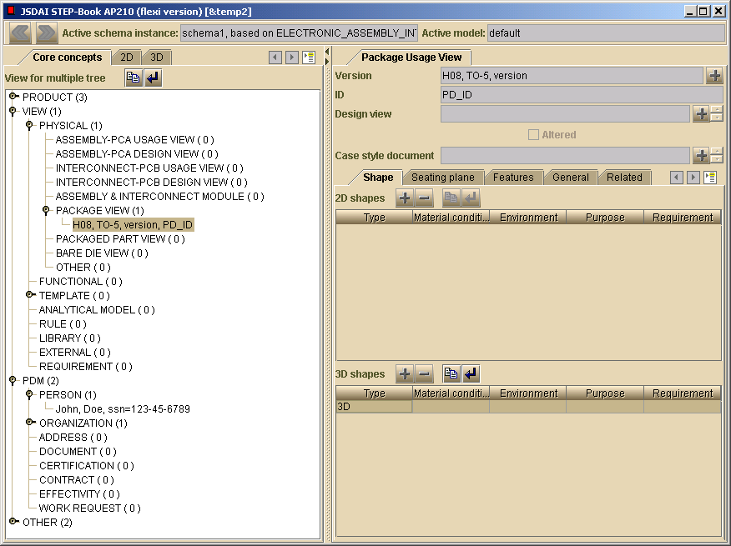
AP210 Package View (Component) component: H08-Package.210 aspect: overview of attributes
4
2
1
3

Slide 32
Contents
AP210 Examples
  hexapod.210
    Translated from the common example in the EAGLE ECAD tool
    Interconnect-PCB Design View
      2D layout (bare board - including table of traces)
    Interconnect-PCA Design View
      2D layout (including table of components)
  H08-Package.210
    Package view
      3D, … feature table, seating plane, …
  flasher_3D.210
    Includes both 2D and 3D PCA shape views
  demo2.210
    Interconnect-PCB Design View
      physical network join relationships

Slide 33
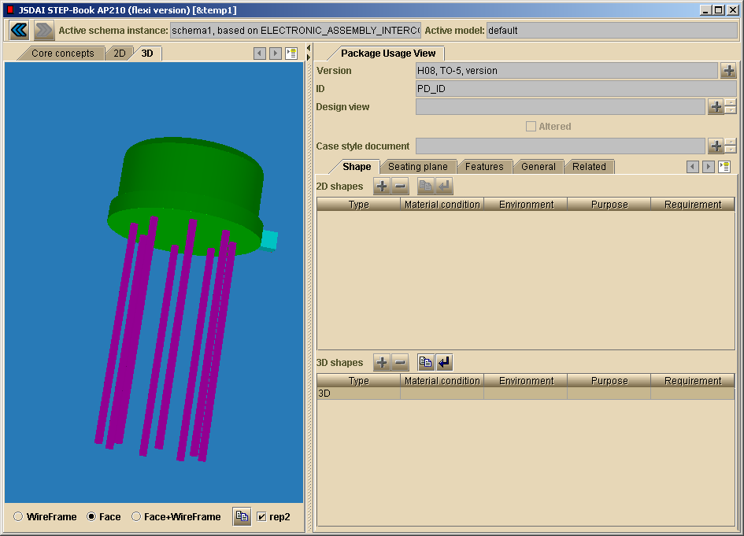
AP210 Package View (Component) component: H08-Package.210 aspect: 3D shape
5
See also: video clip
http://www.ap210.com/video/package.rm

Slide 34
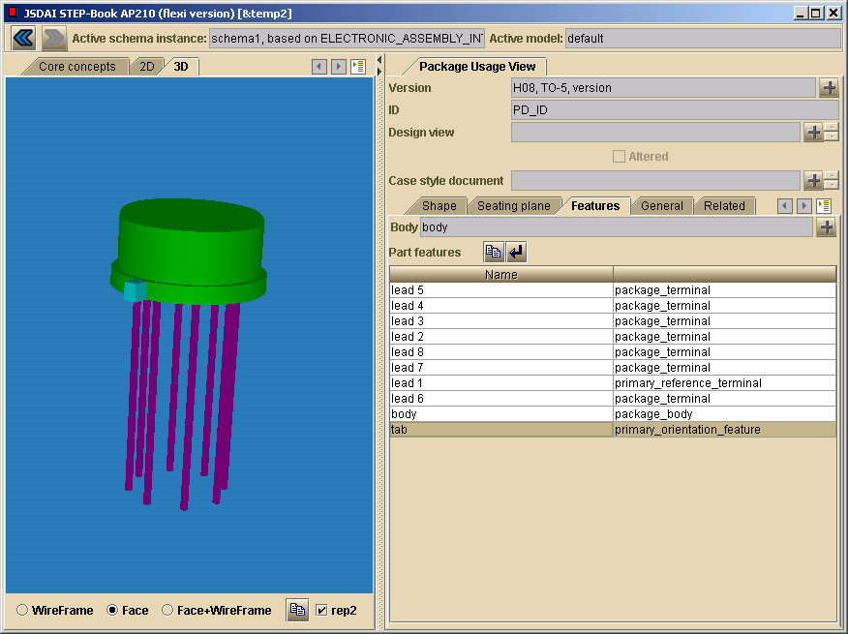
AP210 Package View (Component) component: H08-Package.210 aspect: list of features
5b (selected
smart feature = tab)
The 3D shape is generated from these “smart features”. Thus, the 210-based model is much richer than a typical 3D MCAD package model.
210 can also support the detailed design of a package itself (its insides, including electrical functions and physical behaviors).

Slide 35
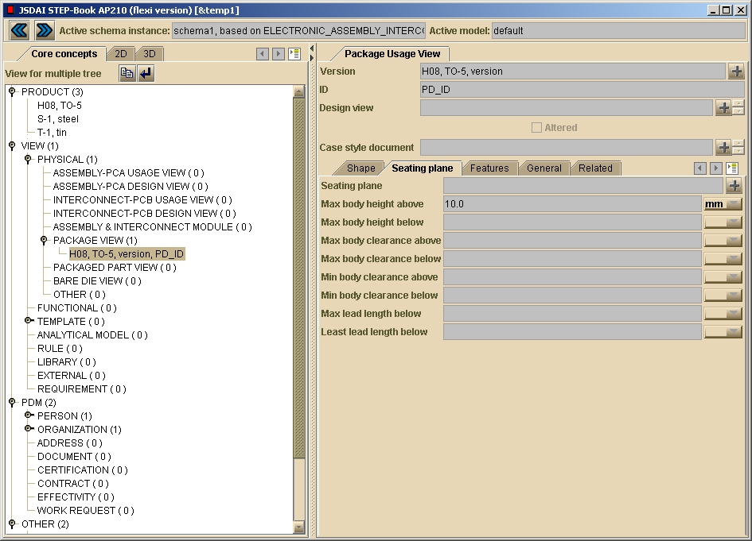
AP210 Package View (Component) component: H08-Package.210 aspect: seating plane
3
  See also video overview of
  AP210 support for electronic packages (using this example):
  http://www.ap210.com/video/package.rm (7Mb)

Slide 36
Contents
AP210 Examples
  hexapod.210
    Translated from the common example in the EAGLE ECAD tool
    Interconnect-PCB Design View
      2D layout (bare board - including table of traces)
    Interconnect-PCA Design View
      2D layout (including table of components)
  H08-Package.210
    Package view
      3D, … feature table, seating plane, …
  flasher_3D.210
    Includes both 2D and 3D PCA shape views
  demo2.210
    Interconnect-PCB Design View
      physical network join relationships

Slide 37
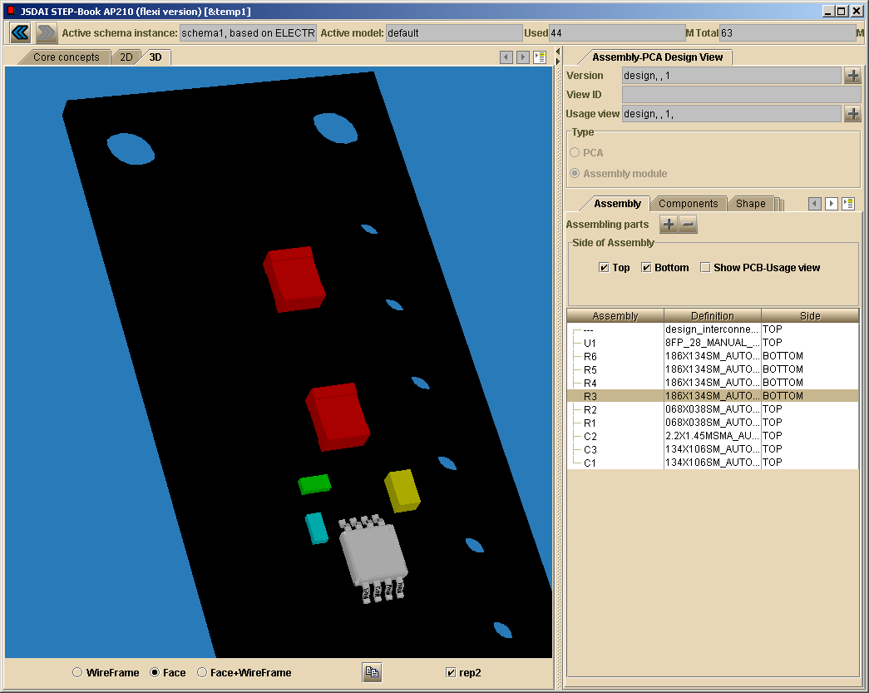
AP210 Assembly-PCA Design View pca: flasher_3D.210 aspect: 3D PCA Assembly

Slide 38
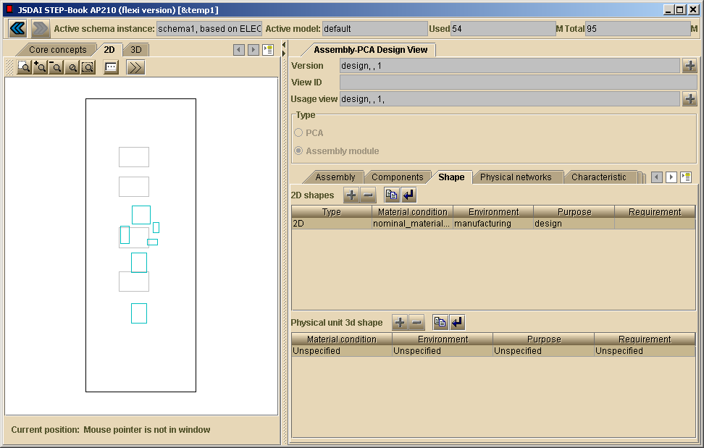
AP210 Assembly-PCA Design View pca: flasher_3D.210 aspect: 2D PCA Assembly
Note that both a 2D and a 3D shape are included in this design model (illustrating support for multiple fidelities of viewpoint).

Slide 39
Contents
AP210 Examples
  hexapod.210
    Translated from the common example in the EAGLE ECAD tool
    Interconnect-PCB Design View
      2D layout (bare board - including table of traces)
    Interconnect-PCA Design View
      2D layout (including table of components)
  H08-Package.210
    Package view
      3D, … feature table, seating plane, …
  flasher_3D.210
    Includes both 2D and 3D PCA shape views
  demo2.210
    Interconnect-PCB Design View
      physical network join relationships

Slide 40
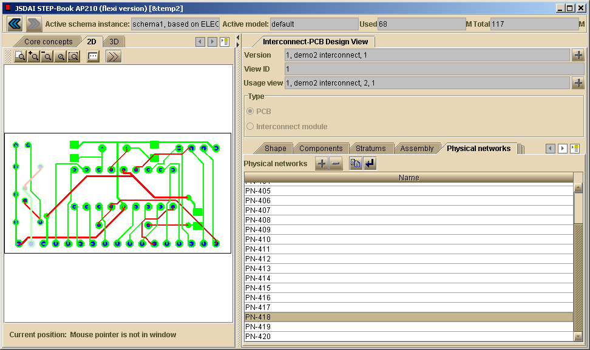
AP210 Interconnect-PCB Design View pca: demo2.210 aspect: physical network
Selected physical network (composed of multiple vias, pads, and traces) on right is highlighted here.

Slide 41
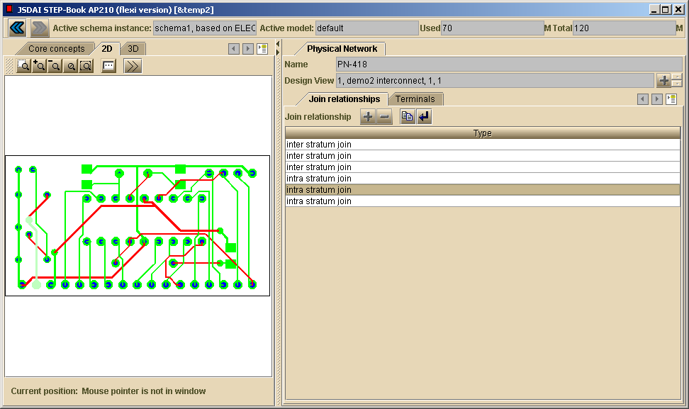
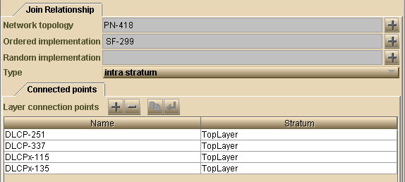
AP210 Interconnect-PCB Design View pca: demo2.210 aspect: physical network joins & terminals
a. Join relationship on right is highlighted here.
b. Double-click above row to see details as given here.

Slide 42
Contents (continued)
AP210 Examples - continued
  Other electronic component examples
AP203 Examples
  Dual in Line Package
    3D Substrate and Socket View
  allied_203.203 - Mechanical Part
    3D View
Tool Usage Quiz - AP210 Exercises
  demo2.210
    Land patterns, physical networks, passage technologies, …
    Documents
  flasher_3D.210
    Example end user queries

Slide 43
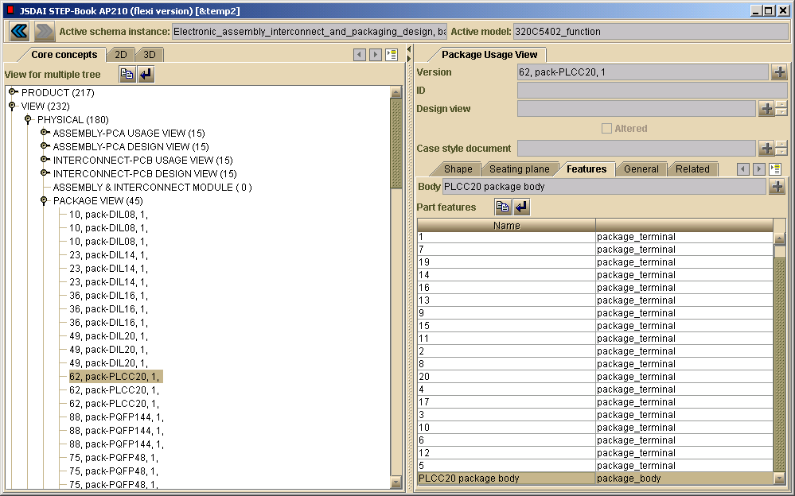
AP210 Package View (Component) component: PLCC20 in texas.p21 aspect: part features

Slide 44
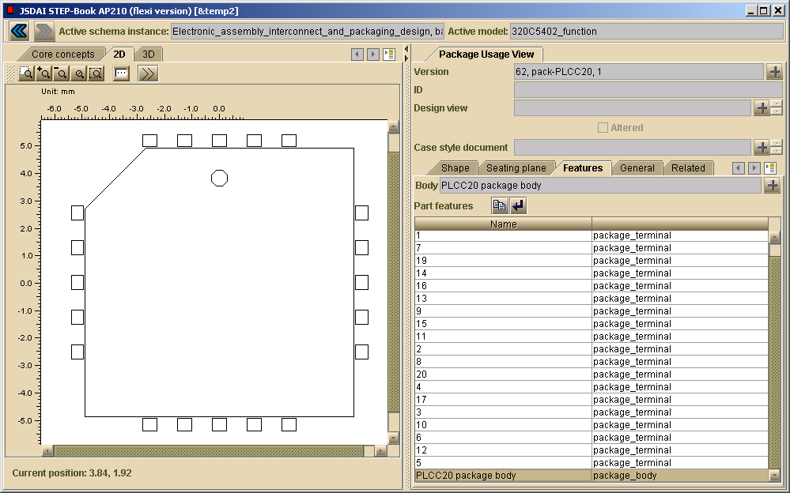
AP210 Package View (Component) component: PLCC20 in texas.p21 aspect: 2D shape

Slide 45
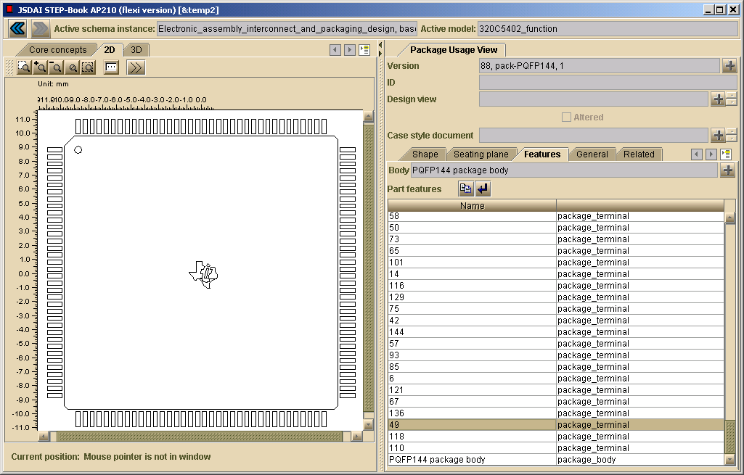
AP210 Package View (Component) component: PQFP144 in texas.p21 aspect: 2D shape

Slide 46
Contents (continued)
AP210 Examples - continued
  Other electronic component examples
AP203 Examples
  Dual in Line Package
    3D Substrate and Socket View
  allied_203.203 - Mechanical Part
    3D View
Tool Usage Quiz - AP210 Exercises
  demo2.210
    Land patterns, physical networks, passage technologies, …
    Documents
  flasher_3D.210
    Example end user queries

Slide 47
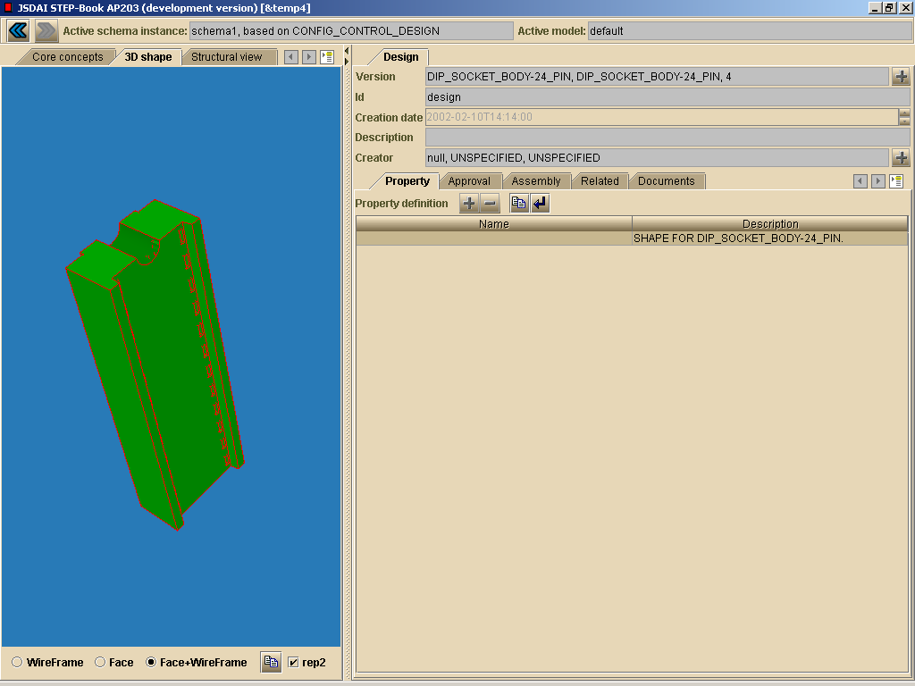
Dual-in-Line Package dip-14-socket.203 Substrate and Socket View

Slide 48
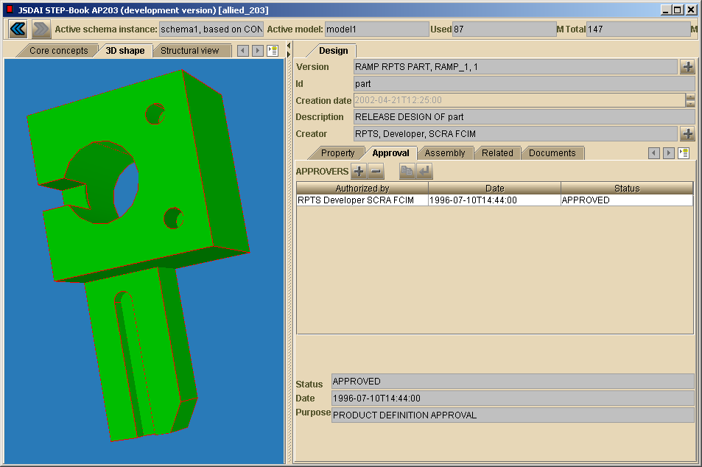
Mechanical Part allied_203.203 3D View

Slide 49
Contents (continued)
AP210 Examples - continued
  Other electronic component examples
AP203 Examples
  Dual in Line Package
    3D Substrate and Socket View
  allied_203.203 - Mechanical Part
    3D View
Tool Usage Quiz - AP210 Exercises
  demo2.210
    Land patterns, physical networks, passage technologies, …
    Documents
  flasher_3D.210
    Example end user queries

Slide 50
STEP-Book AP210 Tool Usage Quiz
(Optional Hands-on Exercises)
Contact russell.peak@marc.gatech.edu if you would like to check your answers.

Slide 51
demo2.210 - PCB aspects
Use STEP-Book to find these answers for the above model file. Indicate the user interface path you used to find the main source of information.
How many conductive layers are there in this PCB?
Find the TAP5-45 land pattern “product”
  What is its id value?
  Draw its design view shape
Find physical network PN-402 (a PCB Design View concept)
  Draw its shape and approximate position on the PCB
  Label your drawing to show the associated joins with their type and id
Find passage technology PT3 (a characteristic board aspect)
  What is its material?
  What is the minimum deposition thickness?

Slide 52
demo2.210 - PCA & misc. aspects continued
Find the component occurrence with reference designator C4
  Draw a picture to indicate its location on the board and its approximate 2D shape
What is the identifier and publisher for the single document represented in this model?

Slide 53
flasher_3D.210 - PCA aspects
Find the 3D usage view of the PCA
  How many components are on the top?
  How many are on the bottom?
  How many holes (passage components) are visible in this view?
    What type attribute value do these passage components have?
Explore other features on your own (e.g., follow connectivities)
Bonus credit:
  Obtain 210 Viewer (by Mike Keenan @ Boeing)
  View above and:
    Determine their position (x, y, side)
    Change values and see them move
  Other 210 models include “keep out / restricted” regions you can visualize and see

