Slide 1
Overview of Product Information Interoperability
Using STEP (ISO 10303)
The Structure and Usage of the STEP Family of Standards
Authors: Diego Tamburini and Russell Peak
eislab.gatech.edu
www.marc.gatech.edu
Based on Graduate Course Lectures
Georgia Tech
COA/CS/ME 6754
April 22, 2002

Slide 2
Version History and Known Caveats
Version History
~5/97 - Diego Tamburini: Initial version
10/30/00 - Russell Peak: Minor corrections
2/12/01 - Russell Peak: Updates
4/22/02 - Russell Peak: Updates
Known Caveats
Some items like STEP-on-a-Page need updating

Slide 3
Product Information Interoperability (PII) & Product Data Exchange (PDE)
“The ability to describe and exchange in a digital or computerized format all useful information about a given product.” (US Product Data Association).
Intent: Enable those involved in the development of a product (designers, analysts, manufacturers, support personnel) to define, access, and exchange all useful information in a computer-sensible (electronic) form.
PDE - tends to imply file exchange
PII - tends to imply more dynamic interaction in-memory or via databases
  See STEP implementation levels

Slide 4
PDE Scenarios
Internal communication (within the organization).
External communication (clients, contractors, suppliers, partners).
Make engineering data generated by one application program readable by other application programs.
Long-term archiving.

Slide 5
PDE Approaches: Direct Translation
Proprietary
Format
A
Proprietary
Format
B
CAE System
“A”
A to B
CAE System
“B”
B to A

Slide 6
PDE Approaches: Direct Translation
Proprietary
Format
A
Proprietary
Format
B
CAE System
“A”
A to B
CAE System
“B”
B to A
B to C
A to C
C to A
C to B
Number of translators: n(n-1)
Number of new translators for each new
system = 2n
CAE System
“C”

Slide 7
PDE Approaches: Neutral Format
Proprietary
Format
A
Neutral
Format
Proprietary
Format
B
CAE System
“A”
A to N
B to N
CAE System
“B”
N to A
N to B

Slide 8
PDE Approaches: Neutral Format
Proprietary
Format
A
Neutral
Format
Proprietary
Format
B
CAE System
“A”
A to N
B to N
CAE System
“B”
N to A
N to B
C to N
N to C
Number of translators: 2n
Number of new translators for each new
system = 2
CAE System
“C”

Slide 9
PDE Approaches: Typical Shortcomings
Direct translation:
  Two translators for each pair of applications exchanging data.
  Maintenance is a nightmare:
    Requires knowledge of both proprietary formats.
    Each new release requires changes in many translators.
De facto standards:
  Not well-supported by all vendors (e.g., DXF).
  Not controlled by a neutral authority
    Changes may not be consensus-oriented

Slide 10
PDE Approaches: Shortcomings
Early Standards:
  Too narrow in scope (e.g., EDIF for integrated circuit design data only).
  Ambiguity (e.g., IGES different interpretation of the same generic entities).
  Different vendors support different subsets (e.g., IGES).
  Lack of conformance methods.
  Data mixed with information (comments, scoping rules) intended for human interpretation.

Slide 11
PDE Approaches: Shortcomings
Proposed solution: a new generation neutral standard:
  Computer-interpretable.
  Unambiguous.
  Represents product data throughout its entire life cycle (design, analysis, manufacture, production, support and disposal).
  Specifies conformance testing.

Slide 12
STEP (ISO 10303)
Mid 1980s: IGES/PDES Organization (IPO) initiated the development of a second generation of PDE standard called Product Data Exchange Specification (PDES).
1988: IPO submitted this standard to the International Organization for Standardization (ISO), which adopted it as the basis for STEP (Standard for the Exchange of Product Model Data).
March 1994: Initial release of the International Standard with MCAD emphasis.
2001: Second major release with rich features
Today: Other advances in-process

Slide 13
STEP (ISO 10303)
STEP is not just a STANDARD it is a METHODOLOGY for the development of product data specification.
Requirements
  Long term archive: storage and retention of product information
  Reduction of ‘islands of automation’
  Independence of product models from software tools
  Communication of product information within and across enterprise

Slide 14
STEP (ISO 10303)
STEP Principles
  Define Architecture for product data
  Support standardization of industry application semantics
  Define requirements for implementation of product data exchange
  Define requirements for the assessment of PDE implementations

Slide 15
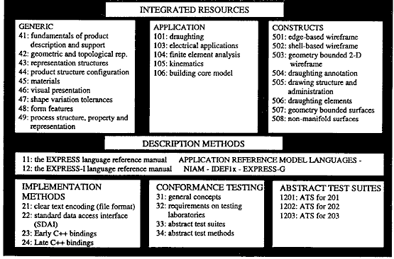
“STEP On A Page” (SOAP)
Integrated Resources, Etc. (page half: A)
~1996 - From Eastman Figure 5.3
See latest “STEP On A Page”
at NIST SC4 web site

Slide 16
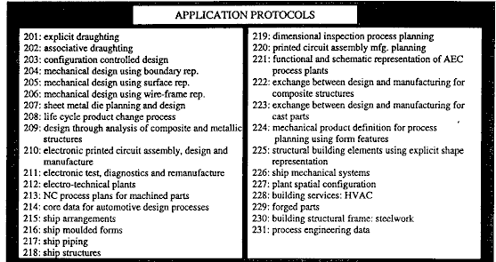
“STEP On A Page” (SOAP)
Integrated Resources, Etc. (page half: B)

Slide 17
Integrated Resource Models
Fundamental building blocks of product data
Created to service the needs of APs
A single large data model
Structurally and semantically integrated, not a simple pile of models
Example topics include geometry, product structure, configuration management, finite elements, drafting resources, etc.
From PDES Inc.

Slide 18
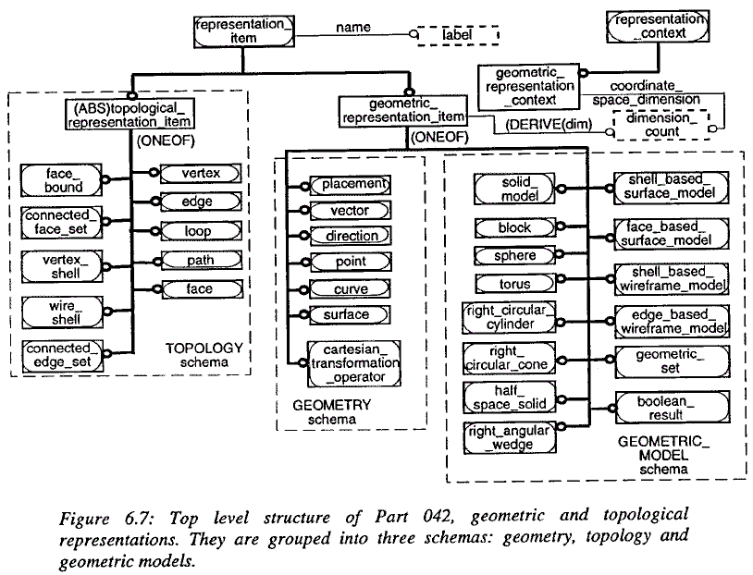
Integrated Resource Models
Part 42: Shape Representation
From
Eastman, 1999
Figure 6.7

Slide 19
Application Protocols (APs)
An Application Protocol (AP) defines the usage of STEP Product Data for a given application context
An Application Protocol represents a measurable and shareable subset of STEP capability that is expressed in an industry’s or discipline’s terminology
Application Protocols are the implementable parts of STEP and conformance testing is done for APs
From PDES Inc.

Slide 20
Components of an AP &
Abstract Test Suite
A
P
P
L
I
C
A
T
I
O
A
N
P
P
L
I
C
A
T
I
O
N
R
E
F
E
R
E
N
C
S
E
C
O
P
E
/
R
E
Q
U
I
R
E
M
E
N
T
S
I
N
T
E
R
P
R
E
T
E
D
M
O
D
E
L
(
A
I
M
M
)
O
D
E
L
(
A
R
M
&
)
C
O
M
M
O
N
A
L
I
T
I
E
S
H
o
w
d
o
I
r
e
p
r
e
s
e
n
W
t
h
a
t
I
n
f
o
r
m
a
t
i
o
n
O
v
e
r
l
a
p
s
?
t
h
i
s
i
n
f
o
r
m
a
t
i
o
W
n
h
a
t
i
n
f
o
r
m
a
t
i
o
W
n
h
a
t
F
u
n
c
t
i
o
n
s
?
w
i
t
h
S
T
E
P
d
?
o
I
n
e
e
d
t
o
d
W
o
h
a
t
P
r
o
d
u
c
t
L
i
n
e
s
?
S
c
h
e
m
m
a
y
j
o
b
?
E
n
t
i
t
y
P
r
o
d
u
c
W
t
h
a
t
K
i
n
d
o
f
S
o
f
t
w
a
r
e
S
y
s
t
e
m
?
P
i
d
:
S
t
r
i
n
E
g
n
t
i
t
y
C
o
m
p
o
s
i
t
i
o
A
n
s
s
e
m
b
l
y
:
P
i
C
d
o
m
p
o
n
e
n
t
:
S
e
t
o
f
P
i
d
A
S
S
E
M
B
L
Y
C
O
M
P
O
N
E
N
T
S
E
N
T
I
T
Y
C
U
R
V
E
.
;
.
.
E
N
D
_
E
N
T
I
T
Y
;
C
O
N
F
O
R
M
A
N
C
E
R
E
Q
U
I
R
E
M
E
N
T
S
A
B
S
T
R
A
C
T
T
E
S
T
S
U
I
T
&
E
T
E
S
T
P
U
R
P
O
S
E
S
W
h
a
t
w
i
l
l
I
t
e
s
t
f
o
r
?
S
T
A
T
E
S
T
C
A
S
E
S
F
i
n
d
C
e
n
t
e
r
P
o
i
n
t
s
o
f
H
u
b
a
n
d
W
h
e
e
F
l
i
n
d
t
h
e
S
i
z
e
o
f
t
h
e
W
h
e
e
l
T
h
e
C
o
m
p
l
e
t
e
S
e
t
o
f
A
b
s
t
r
a
c
t
T
e
s
t
C
a
s
e
F
s
i
n
d
t
h
e
C
i
r
c
u
l
a
r
T
o
l
e
r
a
n
c
e
N
e
c
e
s
s
a
r
y
t
o
P
e
r
f
o
r
m
C
o
n
f
o
r
m
a
n
c
e
T
e
s
t
i
n
F
g
i
n
d
A
l
l
C
o
m
p
o
n
e
n
t
P
a
r
t
s
i
n
t
h
e
A
s
s
e
m
b
l
y
From PDES Inc.

Slide 21


ISO 10303-214: Core Data for Automotive Mechanical Design Processes
http://public.prostep.de/spo/
Geometry
Solids Data
Surface Data
Wireframe
Measured Data
Presentation
Drawing
Visualization
Manufacturing
NC-Data
Process Plans
Analysis
Simulation
Technology Data
Material Data
Form Features
Tolerance Data
Surface Conditions
Specification/Configuration
Product Structure Data
Management Data

Slide 22
STEP (ISO 10303)
STEP Architecture
  Application Protocols - e.g AP214 excerpts
    Data specification that satisfy the product data needs of a given industrial application
specifies an application protocol (AP) for automotive mechanical design processes. This application protocol defines the context, scope, and information requirements for various development stages during the design of a vehicle and specifies the integrated resources necessary to satisfy these requirements. This application protocol addresses the requirements of the automotive industry covering cars, trucks, busses, and motorcycles.
  Integrated Resources - e.g Part 47 (IS): Shape variation tolerances
    Generic data specification that support the consistent development of AP across many application areas

Slide 23
STEP (ISO 10303)
STEP Architecture
  Application Protocols - e.g AP214
EXAMPLE 1 -- Typical constituents of the body are frame, doors, roof, engine hood, windshield, or bumpers. The power train includes the engine, transmission, and drive line.
EXAMPLE 2 -- Typical constituents of the power train are gear box, pistons, and exhaust pipe. The chassis includes all parts which are responsible for the vehicles handling.
EXAMPLE 3 -- Typical constituents of the chassis are the front axle, rear axle, steering, suspension, wheels, shock absorbers, and brakes. Interior parts include parts that are built into the interior of the vehicle and not related to the power train.
EXAMPLE 4 -- Typical interior parts are seats, instrument panel, door panels, the mechanism for power windows, air conditioning system, or stereo equipment. Only the mechanical aspects of a vehicle and its components are covered by this AP; the functional aspects, such as electronic, hydraulic, and pneumatic, are not covered.
EXAMPLE 5 -- For a battery or a switch, product characteristics such as shape, material, or mass are covered but the electrical functionality is not covered.
Finite element analysis (FEA) is not supported by this AP.

Slide 24
STEP (ISO 10303)
STEP Architecture
  Application Protocols - e.g. AP214
EXAMPLE 6 -- Typical technologies for primary shaping are molding or casting, for transforming are bending or stamping, for separating are milling or lathing, for coating are painting or surface coating, and for fitting are welding or riveting. b) process plan information to manage the relationships between parts and the tools used to manufacture them and to manage the relationships between intermediate stages of parts or tools, referred to as in-process parts;
c) product definition data and configuration control data pertaining to the design phase of a product's development;
d) changes of a design, including tracking of the versions of a product and data related to the documentation of the change process;
e) identification of alternate representations of parts and tools during the design phase;
f) identification of standard parts, based on international, national, or industrial standards, and of library parts, based on company or project conventions;
g) release and approval data for various kinds of product data;
h) data that identify the supplier of a product and any related contract information;

Slide 25
STEP (ISO 10303)
AP214 - Example 6 (continued )
i) any of eight types of representation of the shape of a part or tool:
  1) 2D--wireframe representation;
  2) 3D--wireframe representation;
  3) geometrically bounded surface representation;
  4) topologically bounded surface representation;
  5) faceted--boundary representation;
  6) boundary representation;
  7) compound shape representation;
  8) constructive solid geometry representation. j) shape representation of parts or tools that is a combination
  of any two or more of these eight types of shape representation;
k) data that pertains to the presentation of the shape of the product;
l) representation of portions of the shape of a part or a tool by form features;
m) product documentation represented by explicit and associative draughting;
n) references to product documentation represented in a form or format other than that specified by ISO 10303;
(SGML) [8].
o) simulation data for the description of kinematic structures and configurations of discrete tasks;
EXAMPLE 8 -- The simulation data for a windshield wiper includes the geometry of the windshield as
well as the kinematic structure of the wiper including all necessary links and joints.
p) properties of parts or tools;
q) surface conditions;
r) dimensional and geometrical tolerance data.
The following are outside the scope of this part of ISO 10303:
a) product definition data pertaining to any life cycle phase of a product not related to design;
b) business or financial data for the management of a design project;

Slide 26
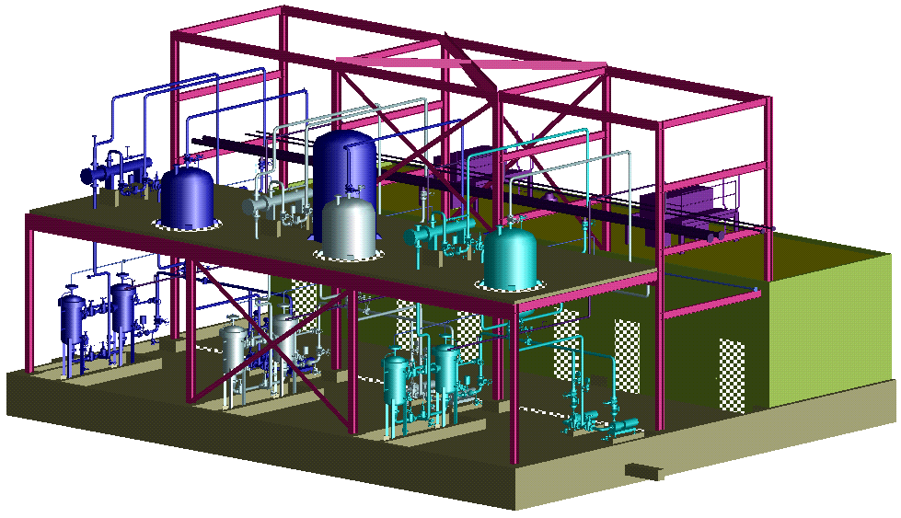
ISO 10303-227: Plant Spatial Configuration http://cic.nist.gov/plantstep/plantstp/ap227/ap227.htm
Plant Layout
Location of Plant-items
Site Description
Change Control
Plant Item
Type
Connections
Functional/Physical
Definition/Occurrence
Shape
Explicit Shape
Brep
CSG
Plant Systems
Line Definitions
Composition
Capabilities
Component Connectivity
Functional/Analysis
Interference
Performance Requirements
Requirement Satisfaction

Slide 27
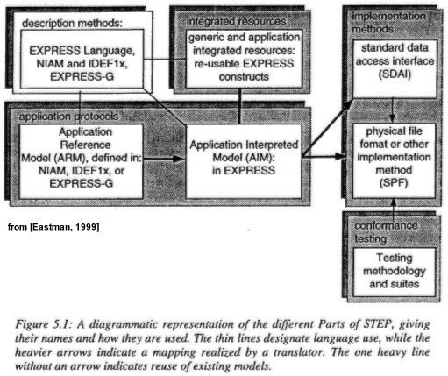
STEP (ISO 10303)-STEP Architecture
See also more recent work on modules

Slide 28
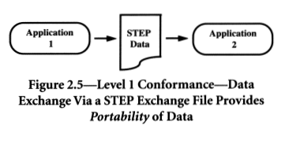
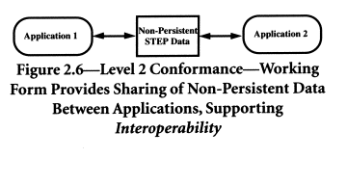
STEP Implementation Levels
Levels 1&2
Level 1:
File Exchange
Level 2:
Working Form
From Al-Timimi & MacKrell, 1996
Compare with “Integration Levels” in Chapter 1 of Kemper & Moerkotte, 1994

Slide 29
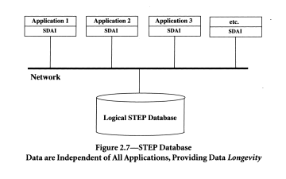
STEP Implementation Levels
Level 3 & 4
Level 3:
Shared Database
SDAI = STEP
Data Access Interface
Level 4:
Shared Knowledgebase
Replace “Database” above with “Knowledgebase” (KB)
KB = Database + Rules/Constraints/Extensibility

Slide 30
Vision
Collaborative Engineering Environment with Advanced Interoperability
Potential Standards-based Architecture (after G. Smith, Boeing)
PDM
Schema
System
Engineering
Schema
Mechanical
Schema
(AP203)
Electrical
Schema
(AP210)
Analysis
Schema
(AP209)
Catalog &
View
Schemas
Mfg.
Capabilities
(AP220)
(Express)
(UML)
Repository Schema Generator
Application Access/Translation Layer
Documentation Facility
(Text, XML,
SGML, etc.)
Data Views and PDM
Requirements Design & Analysis
(STEP)
Objects
Entities,
Relations &
Attributes
Request
Broker
Or
Remote
Access
Mech.
Data Viewer
(STEP, XML)
Object Oriented or
Object Relational
DBMS
Cross Domain Analysis
(STEP)
Domain Specific Analysis
(STEP)
Negotiation/
Communications
Agents
Analysis
Agents
CAx Applications and PDMs
(STEP)
Model Development and Interactive Environment
Data Dictionary Facility

Slide 31
Towards Model-Centric Interoperability
Existing Tools
Tool A₁
...
Tool A_{n}
Legend
“dumb” information capture
(only human-sensible,
I.e., not computer-sensible)
(2)
(1)
Typical end-user tools
(for novices ↔ experts)
Product Model
(e.g., AP210 + AP2xx + ...)
Instance population tools
(for experts)
Ancillary
Information
Tool B₁
...
Tool B_{n}
Tool C₁
Typical Situation Today:
(1) No logical product model*
(2) Insufficient information capture
(3) Lack of interactive tools for other information
(3)
Needed Tools

Slide 32
Video:
“STEP: A Global Standard for Global Industries”
Take note of:
Industry usage
  Variety of scenarios
  Variety of product domains
  How STEP structure supports this diversity
Needs being addressed

Slide 33
STEP Status (2001-02)
Industry usage to date:
  Primarily Level 1 Implementation (File Exchange)
  Primarily AP203 (MCAD - geometric modeling)
Growing surge in other implementation levels and domains
Current R&D topics for STEP technology:
  Leveraging XML and the Web
  Modularization and reusability
  Multi-schema interactive repositories
  More usage of rules, constraints, and parametrics

Slide 34
STEP Resources
Web:
  ISO work site: http://www.tc184-sc4.org/
  PDES Inc. (International consortium) http://pdesinc.aticorp.org/
    Industry usage examples
  NASA-ESA STEP Workshops http://step.nasa.gov/ (held annually)
    Especially Jan. 16, 2001: STEP Tutorial Sessions (archived online)
  Other links via EIS Lab http://eislab.gatech.edu/step/
Suggested Reading:
  STEP: Towards Open Standards - Al-Timimi & MacKrell, 1996
  STEP: The Grand Experience - Kemmerer ed. (NIST), 1999
  Information Modeling the EXPRESS Way - Schenk & Wilson, 1994
  Developing High Quality Data Models - West & Fowler, 1996
  http://www.stepcom.ncl.ac.uk/epistle/data/mdlgdocs.htm
  Building Product Models - Eastman, 1999 (architecture/engr./construction)
    Esp. Chapter 5 (Overview; Express); Chapter 6 (Integrated Resources)

