Slide 1
ISO 10303-210
Overview
July 8, 2003
Thomas R. Thurman
Rockwell Collins Inc.
Notes:
1

Slide 2
Contributors
The Following are Recognized for Their Direct and Indirect Contribution to this Material:
  Michael Keenan (Boeing)
  Greg Smith (Boeing)
  Craig Lanning (Northrup Grumman)
  Mike Benda (Rockwell Collins)
  Stephen Waterbury (NASA Goddard)
  Manas Bajaj (Rockwell Collins/GIT)
  Russell Peak (GIT)

Slide 3
Agenda
Domain, Scope, and Usage Requirements
Models
  Configuration and Design Management
  Requirements
  Functional Models & Port Mapping
  Part Models
  Assembly Concepts
  Interconnect Model
  Physical Design Control

Slide 4
Agenda
Models Continued
  Technology Capability
  Material
  Characteristics
  External Definition
  Geometry
  Rule Definition
  Document
Reference Web Sites

Slide 5
AP 210 Project Contributors
Army Tobyhanna Depot
Boeing Defense & Space Group
Delphi-Delco Electronics Systems
IBM
LKSoft GMBH
Naval Supply Systems Command RAMP Program Office
NASA Goddard Space Flight Center
NASA Jet Propulsion Labs
PDES, Inc.
Rockwell Collins Inc.
NIST
Georgia Institute of Technology
University of Illinois at Champaign-Urbana

Slide 6
AP210 Development Summary
ISO 10303-210: 2001 Available
ISO 10303-210 Rev 1 Preparation
Next Milestones
  Deliver Rev 1
  Continue Test Case Development
  Support Implementors
    Update Rules
    Update Recommended Practices & Con Ops
    SEDS

Slide 7
AP210 Terminology
Predefined: Data structures & Rules are defined in the Standard.
Externally defined: The semantics of the data are not defined in the Standard, but the Standard provides a means to represent the data in a standard way and provides some formal support (e.g., rise time is not predefined, but time, voltage, sequence, is supported)
Explicitly defined: Synonym for Predefined.

Slide 8
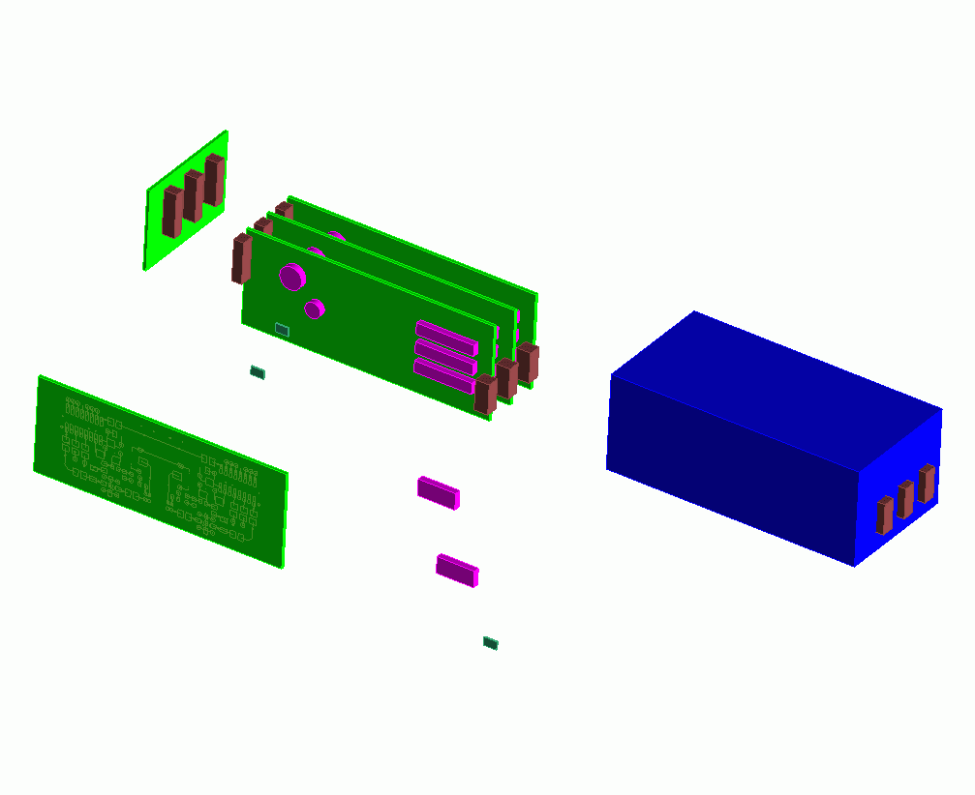

AP 210
Domain: Electronic Design
Configuration Controlled Design and Use of Electronic Assemblies,
their Interconnection and Packaging
Interconnect
Assembly
Printed Circuit Assemblies
(PCAs/PWAs/Modules)
Product Enclosure
Die/Chip
Packaged Part
Die/Chip
Package
Interconnect
Substrate (PCBs/PWBs/Cables)
External Interfaces

Slide 9
AP210 Scope
Scope is the “As-Required” & “As-Designed” Product Information
  Design “In Process” & “Release”
Sharing Partners:
  Engineering Domains
  Design / Analysis
  Manufacturing / Analysis
Sharing Across Several Levels of Supply Base
Notes:
3

Slide 10


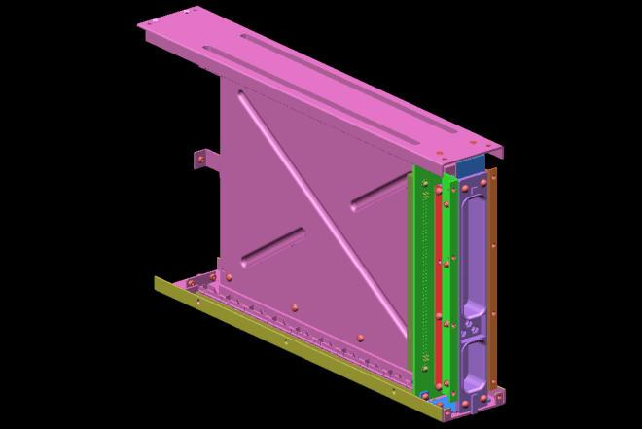



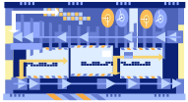

System Design Process
PWA – PWB Design Process
Enclosure Design Process

Slide 11



Enclosure Design Process
Guidelines
Create
Component
Models
Design
Enclosure
Communicate With
PWA Design
Validate
Corrections
Requirements
Definition
Release
Learn
Fabricate
Assemble
Test/Inspect
Copyright Rockwell Collins Inc., 2003

Slide 12
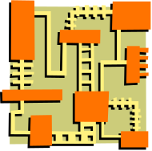



PWA - PWB Design Process
Guidelines
Enclosure
Footprint
Design
Place
Components
Route
Wiring
Validate
Corrections
Requirements
Definition
Release
Learn
Fabricate
Assemble
Test/Inspect
Copyright Rockwell Collins Inc., 2003

Slide 13
Industrial (User) Requirements
Replace legacy hybrid (drawing & computer based) systems & processes.
Integrate Design Engineering, Manufacturing Engineering, and Production Data.
Configuration Management Data for “Virtual Enterprise” between Part Vendors (Functional and Interconnect), Designer, Assembler, and Customer.
Support Intellectual Property Requirements

Slide 14
Industrial
Requirements (Cont’d)
Integrate Systems Engineering /EE / ME / Analysis
  Library and Product Data.
  Replace GIF pictures With Computer Sensible Data Sheets in Web Based Publishing
  Synchronized 3D and 2D Views of Parts, Interfaces.
  Individual Shape Representations tailored to Analysis Purposes .
  Functional Data
    Schematics & Schematic symbols
    Models

Slide 15
Industrial
Requirements (Cont’d)
Maintain Requirements as Design Progresses Instead of Replacing Requirements with Final Design, e.g., Keep a Copy of “As Required Board Outline”.
Be Technology Independent to Maximum Extent Possible
  Standard Should NOT be Obsolete when Implemented.
  Useful for Microwave / Photonic Designs

Slide 16
Industrial
Requirements (Cont’d)
Support hierarchical product design; enclosure, black box, module, pca, mcm, ball grid array, pcb, parts, cabling.
Compatible with EDIF (desired), VHDL, MHDL, etc.
Allow Users to Replace IGES, Gerber, IEC 1182-1 (IPC), GDS-II.

Slide 17




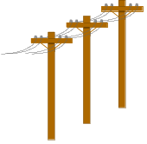

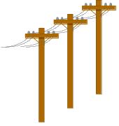
Data Flow in The Supply Chain
System Engineer
Package Data
Supplier
Simulation Model
Supplier
Requirements
Design Team
Configuration Managed
Corporate Data
Process (PDM/Library)
Customer
ECAD
MCAD
Device
Supplier
Analyst
Assembly & Fabrication
Suppliers
Notes:
6

Slide 18
AP210 Usage
Engineering Interaction
System Engineer
EE
Vendor Web Site
Final
Data Package
Stored in
Repository
Initial Task
Negotiation
and data dump
to EE
Sys Eng
Gets More
Data
Sys Eng
sends data
to EE
EE Performs
Task
EE
Transmits
Data to Sys
Eng

Slide 19

Protecting Intellectual Property
Customer
Accessible
Data
(Interfaces,
ICDs,
Pin Maps,
Computer
Behavioural
Models,
Organizational
Ownership
Declarations,
Parameters...)
Design
Archives
Published
Library
Data
Configuration
Managed
Relationships
High Accuracy Models,
Design Definitions
Relationships Between Design Definition and
“Published Library Data” May be Established
and Managed Under Configuration Control.
Details are Invisible to Customer.

Slide 20
Re-using Intellectual Property
Design
Library
Archives
Design
Instance
Configuration
Managed
Relationships
Qualified
Design Definitions
and Associated Engineering Data
Relationships Between Design Definition, Requirements and
Re-use of that Data in Other Designs Should be Established and Managed Under Configuration Control.
Relationships Should be Provided at a Detailed Level as Opposed to a Typical Library Which only Supports “Black Box Copy”.

Slide 21
Typical Data Architecture
Library &
Design
Archives
Data Supplier
Published
Library
Data
Configuration
Managed
Relationships
High Accuracy Models,
Design Definitions
Library
Manager
Data Transport Mechanism
OEM
Published
Library
Data
Library &
Design
Archives
Configuration
Managed
Relationships
Delivered
Library &
Design
Data
High Accuracy Models,
Design Definitions, physically separate

Slide 22
Interdisciplinary Design
Design Requires: system, s/w, electrical, mechanical, manufacturing, logistics, analysis
Synthesis Based Design
  Synthesis
    Relates a Construct Extracted from a Discipline Specific Library to a Design Structure and Establishes Intentional Connections and Parametric Relationships Between the Constructs in that Structure
  Analysis
    Evaluate (Discipline Specific) Design Structure for Compliance with Requirements

Slide 23
Interdisciplinary Design
Typical Optimization Loop:
  Setup
    Establish initial conditions of parametric relationship between some properties in the structure that are controllable by an execution engine e.g., part placement/thickness.
  Repeat Until Done:
    Evaluate (Discipline Specific) Design Structure for Compliance with Requirements; determine parametric change; pass to other discipline tool.

Slide 24
PCA System Design Process
(Goals and Sub-Goals)
Start Electronics Design
Partition the system into PWAs (PWB + Components)
How many of them
Single sided or double sided?
Decide PWB dimensions and Layer Stackup
Decide Length
Decide Width
Decide Thickness
Decide Layer Stackup
Create System Specifications
Functions
Conditions of operation
Standalone/Part of an assembly
Decide Panel Dimensions
Decide Length
Decide Width
Identify component usage
Components used?
Associated Package types?
Create System Schematics
How are PWA functions realized
How are these connected
Assemble PWB and Components (to realize PWA)
Check for global fiducials
Component placement
Sequential
Forward Chaining
End Electronic design

Slide 25
Interdisciplinary Design
Discipline Library
  Validated Only Within the Context of that Discipline
  May Include Multiple Product Definitions that are Related at Detailed Level
  May be Obtained From Another Organization
  May need Interpretation

Slide 26
Interdisciplinary Design
Discipline Product Definition
  The Synthesis Result
  Tied to a Product Version in PDM with one Relationship -- Discipline View

Slide 27
Interdisciplinary Design Issues
Engineering Properties Data Sources for Material Queries Exist
  Internet/Intranet Query/Response Capability
  May or May not be Accurate
  May need Interpretation
  Traceability/Persistence Issues

Slide 28
Interdisciplinary Design Issues
On-line Engineering ECAD/MCAD Models to Support Synthesis are Needed but on-line Detailed Packaging Definitions are images.
IEC geometry descriptions are images even though the dictionary is interpretable.

Slide 29
Interdisciplinary Design Issues
Examples
  Connector off by 2 mm
  Signal off by 1 pin
  Design Change Caused EMC Problem
  Manufacturing Change Caused Interference Problem
  Thermal Source Moved causing drift problem
  Physical Pin Name Doesn’t Match Simulation Model Port Name

Slide 30
Interdisciplinary Design Issues
results
MRP
Nodal Analysis
Text requirements
Sneak Circuit Analysis
Functional Analysis
PWB Fabrication
results
EDIF
Gerber
ODB++
GenCAM
PWB
PWA/PWB Design Tool
Gerber, ODB++
GenCAM, Vendor
Proprietary
Design Capture
PWA/PWB Design
Vendor
Proprietary
GDS II
Vendor
Proprietary
Mfg Analysis
IDF/DXF
PWB Warpage/Stackup
Assembly Simulation
Component Footprint
Artwork
CAM Tools
Mech Design Tool
PWA
results
Enclosure
Design
Vendor
Proprietary
FAB
In-Circuit Test
Flying Probe
Bed of Nails
Function Test
results
Analysis
Thermal EMC
Producibility Durability
results
results
Notes:
Each tool has own proprietary models of component
Process/Data Translation
Static transfers, no inherent traceability, too late!

Slide 31

Engineering Information Integration Using Enterprise Proprietary Formats
Enterprise System Integration Specifications
Enterprise
Proprietary PWA
Encoding s/w
Enterprise
Proprietary ME
Encoding s/w
PWA/PWB Design Tool
Mech Design Tool
Proprietary
Encoded
Data
Proprietary
Encoded
Data
PC
DESIGN
Database
ME
DESIGN
Database
Enterprise
Systems
Notes:
Each tool has own proprietary models of component
Process/Data Translation
Static transfers, no inherent traceability, too late!

Slide 32
Increasing Information Level Possibilities in Standards Based Engineering Design
Electrical
CAD Tools
Systems Engineering
Tools
Traditional
Tools
Eagle
Doors
- Eurostep AP233 Demonstrator
- XaiTools AP233
Zuken
Visula
Slate
AP210
interface
Product Model
Components
AP 210
AP 233
AP 239
PDM Schema
XaiTools
PWA-B
LKSoft, …
STEP-Book AP210,
SDAI-Edit,
STI AP210 Viewer, ...
Gap-Filling
Tools
XaiTools
PWA-B
PGEF
LKSoft, …
PWB Stackup Tool,
…
Core
PDM Tool
Instance Browser/Editor
Adopted from R. Peak 2003

Slide 33
Results
AP 210 Approach
AP 210 Overview
  Several Specific Product Models
  Specific Services to Support Those Product Models
  Ability to Integrate Externally Defined Models

Slide 34
AP 210 Approach
Focus on Interfaces!
  Provide a Standard Way to Describe Structural Relationships Connecting Discipline Views
  Formal Mapping Technology Based on Explicit Instance Relationships (I.e., not based on names)
  Relationships are Implemented in Library
  Relationships may be simple or based on algorithm
  Relationships allow Data Verification
  Use Generic External Mechanism for purely Behavioral Property Data (i.e., resistance, rise time)

Slide 35
AP 210 Approach
Relationship Categories (From 10,000 Ft)
  Between Different Design Definition Views
    Feature based relationships
  Between ‘Electrical’ and ‘Mechanical’ Geometry
  (2D <--> 3D)
    Transformation Controlled by reference frame relationship
  Between Features and Simulation Models
    Feature to Port Relationship
  Between Geometry and Simulation Models
    Reference frame to Port relationship

Slide 36
AP210-based Multidisciplinary Model Associativity
Ex. Application: Requirements & Functions Allocation Traceability
Generic Electrical/Mechanical Engineering
Layered Domain Model
Requirements
Functions (Abstract Design Intent)
Physical Netlists
Assemblies
Interconnect
Requirements
Decomposition
Functional
Decomposition
(Network)
Each column is a typical “stovepipe” (a CAx tool island of automation)
Physical
Unit
Network
Physical
Assembly
Decomposition
Physical
Interconnect
Decomposition
Requirement
To Function
Requirement
To Assembly
Requirement
occurrence
Requirement
To Interconnect
Function
Occurrence
Functional
Path Subset
To Assembly
Physical
Occurrence
Layout
Occurrence
Requirement
Verification
Model
Functional
Path
Subset
(Single
Node)
Function to
Physical
Map
Physical Unit
Network
Subset
(Single Node)
Assembly to
Interconnect
Layout
Network
Subset to
Implement
Node
Function to
Layout
“Design”
“Library”
Function
Definition
Each yellow bubble is a typical associativity gap (problem area)
Physical Macro &
Component
Definition
Layout
Macro &Template
Definition
Omitted for Clarity:
1. Recursive definition; test benches
2. “Pin Mapping” in library
3. Simulation model library and associativity aspects.
Simulation
Model
Definition
Notes:
Color Key:
Light Pink: Requirement decomposition
Violet: Product decompositions
Yellow: Requirement allocations
Green: Network subsets in the scope of the referenced decomposition
Dark Pink: Simulation model Library
References to Simulation models from Design/Decomposition levels and from components omitted for clarity.
Inclusion of decomposition relationships in library omitted for clarity.
Some details of relationships omitted for clarity.
Requirements may be allocated to a total design or to a component or between network subsets.
Functional Decomposition forms a requirement for Assembly.
Assembly forms a requirement for Interconnect. (these two are for the case where not all requirements are explicitly detailed using other mechanisms.
AP 210 for instance does not fully map all the assembly details into a separate requirements tree to avoid data explosion.
Physical Netlists are the physical interconnect requirements to be satisfied by the interconnect.

Slide 37

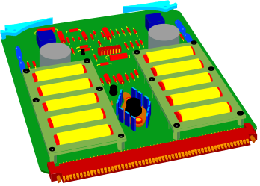
AP210: Overview
R
Requirements Models
Component / Part Models
Functional Models
Design
Constraints
Interface
Allocation
Analysis Support
Package
Material Product
Properties
“White Box”/ “Black Box”
Test Bench
Functional Unit
Interface Declaration
Network Listing
Simulation Models
Signals
Test Bench
Rules Models
Design
Manufacturing
…
Interconnect Models
Assembly Models
User View
Design View
Bare Board Design
Layout templates
Layers
User View
Design View
Component Placement
Material product
Complex Assemblies with Multiple Interconnect
Configuration Mgmt
Geometric Models
Identification
Authority
Effectivity
Control
Net Change
2D
3D
CSG, Brep…
EDIF, IPC, GDSII compatible “trace” model
Design Control
Geometric Dimensioning and Tolerancing
Notes:
5

Slide 38
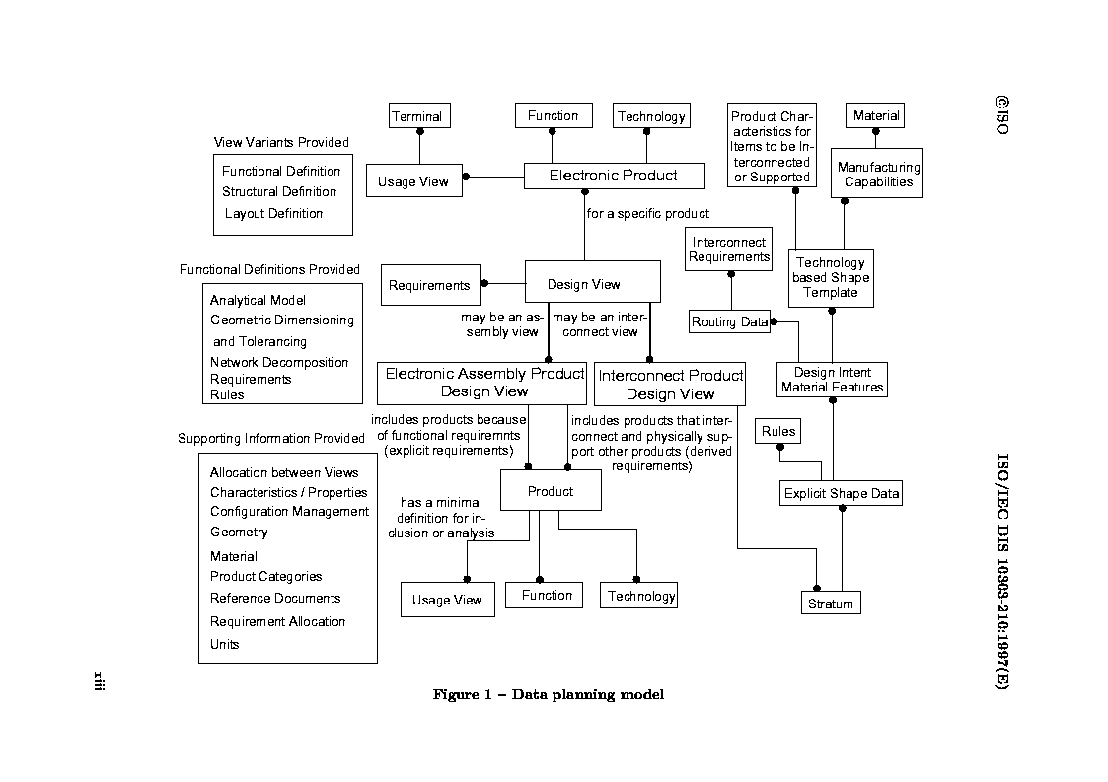

Slide 39
AP 210 Conformance Classes
A Predefined Subset of the Standard
  Corresponds to “Consensus” Exchange Clusters Among the Activities in the Product Design Life Cycle.
  Basis for Contract for Implementation
    “I only need a Functional Requirement Model”
    “I don’t need Fab Design”
  Basis for Test Case Development

Slide 40
AP210 Conformance Classes
Class 1 - Device Functional and Physical Characterization
Class 2 - Interconnect Technology Constraints
Class 3 - Assembly Technology Constraints
Class 4 - Assembly Functional Requirements
Class 5 - Assembly Physical Requirements
Class 6 - Interconnect Functional Requirements
Class 7 - Interconnect Physical Requirements
Class 8 - Assembly Physical Design
Class 9 - Interconnect Design
Class 10 - Interconnect Design (Microwave)

Slide 41
AP210 Conformance Classes
Class 11 - Geometric Dimensioning and Tolerancing
Class 12 - Product Rule
Class 13 - Functional Decomposition
Class 14 - Package Functional and Physical Characterization
Class 15 - Geometrically Bounded Surface Model
Class 16 - Wireframe Model with Topology
Class 17 - Advanced Boundary Representation
Class 18 - Constructive Solid Geometry
Class 19 - Extruded Solid
Class 20 - Geometrically Bounded 2d Wireframe Model

Slide 42
AP210 Conformance Classes
Class 21 - Wireframe 2d Model with Topology
Class 22 - Curve 2d
Class 23 - Basic Curve 2d
Class 24 - Laminate Assembly Design
Class 25 - Connection Zone Based Model Extraction
Class 26 - Functional Specification
Class 27 - Physical Unit Physical Characterization
Class 28 - Packaged Part White Box Model
Class 29 - Printed Part Functional and Physical Characterization
Class 30 - Open Shell Model

Slide 43
AP210 Conformance Classes
Class 31 - Assembly Functional Interface Requirements
Class 32 - Assembly Physical Interface Requirements
Class 33 - Assembly Requirement Allocation
Class 34 - Interconnect Requirement Allocation
Class 35 - Functional Requirement Allocation
Class 36 - Product Requirement Allocation
Class 37 - Datum Difference Based Model Definition
Class 38 - Datum Difference Based Characteristic
Class 39 - Design Management

Slide 44
AP 210 Models
High Value to Enterprise Drives Identification Which Results in a Product Model
Versioning
  Configuration Management Support
  Fine-grained Change Communication
    Direct Support for Multiple Discipline Iterative Design
May Include Dependencies on Other Product Models

Slide 45
AP210 Models
  Assembly
  Interconnect
  Piece Part
  Configuration Management
  Functional Interface
  Functional Network
  Functional Specification
  GD&T
  Mechanical Part
  Physical Network
  Requirements
  Footprint
  Padstack
  Boundary Element Based Trace Template
  Multi-purpose Part Shape Model
    Environment
    Design/Analysis Purpose
    Material Condition
  Simulation Model
  Rule Definition
  Physical Interface
  Package

Slide 46
AP 210 Model Application
Explicit Mapping is Provided Between the “Features” of Different Product Model Types to Support Validation Through the Process
Correlation Between 2D and 3D Models
Programmable “Make From” Parts
Shape Based Constraints
Requirements Traceability
Manufacturing Process Planning
Design Analysis

Slide 47
AP 210 Model Application
AP 210 predefines some commonly understood “Features” of Different Product Model Types:
  Functional to Physical “Pin Mapping”
  Simulation model Ports
  Datum
  Part feature
  Component feature

Slide 48
AP 210 Models
Requirements Traceability
Individual Model Descriptions

Slide 49
AP210-based Multidisciplinary Model Associativity
Ex. Application: Requirements & Functions Allocation Traceability
Generic Electrical/Mechanical Engineering
Layered Domain Model
Requirements
Functions (Abstract Design Intent)
Physical Netlists
Assemblies
Interconnect
Requirements
Decomposition
Functional
Decomposition
(Network)
Each column is a typical “stovepipe” (a CAx tool island of automation)
Physical
Unit
Network
Physical
Assembly
Decomposition
Physical
Interconnect
Decomposition
Requirement
To Function
Requirement
To Assembly
Requirement
occurrence
Requirement
To Interconnect
Function
Occurrence
Functional
Path Subset
To Assembly
Physical
Occurrence
Layout
Occurrence
Requirement
Verification
Model
Functional
Path
Subset
(Single
Node)
Function to
Physical
Map
Physical Unit
Network
Subset
(Single Node)
Assembly to
Interconnect
Layout
Network
Subset to
Implement
Node
Function to
Layout
“Design”
“Library”
Function
Definition
Each yellow bubble is a typical associativity gap (problem area)
Physical Macro &
Component
Definition
Layout
Macro &Template
Definition
Omitted for Clarity:
1. Recursive definition; test benches
2. “Pin Mapping” in library
3. Simulation model library and associativity aspects.
Simulation
Model
Definition
Notes:
Color Key:
Light Pink: Requirement decomposition
Violet: Product decompositions
Yellow: Requirement allocations
Green: Network subsets in the scope of the referenced decomposition
Dark Pink: Simulation model Library
References to Simulation models from Design/Decomposition levels and from components omitted for clarity.
Inclusion of decomposition relationships in library omitted for clarity.
Some details of relationships omitted for clarity.
Requirements may be allocated to a total design or to a component or between network subsets.
Functional Decomposition forms a requirement for Assembly.
Assembly forms a requirement for Interconnect. (these two are for the case where not all requirements are explicitly detailed using other mechanisms.
AP 210 for instance does not fully map all the assembly details into a separate requirements tree to avoid data explosion.
Physical Netlists are the physical interconnect requirements to be satisfied by the interconnect.

Slide 50
Individual Model Descriptions

Slide 51
Configuration and Design Management Capabilities
All Product Models are Managed
Configuration Mgmt
Identification
Authority
Effectivity
Control
Net Change
Net Change Capability:
  Add, Delete, Change Properties
  Applies to Any Sensible Object
Change Request / Change Order:
  Reference Net Change Capability to Identify Explicit Change Request or Change Applied
  Reference Text Description
Conventional Design Control
Notes:
17

Slide 52
Design Change Management
(ABS)
managed_design_object
1
1,3
1,2
4,2
1,1
analytical_model_port_assignment
analytical_model_port
work_request
analytical_model
4,1
2,3
work_order
(ABS)
analytical_model_vector_port_assignment
ee_product_definition
*previous_design
*current_design
(ABS)
design_object_management_relationship
*current_design_object
1
*previous_design_object
*previous_design_object
change_design_object_management_relationship
delete_design_object_management_relationship
*current_design_object
add_design_object_management_relationship

Slide 53
Design Change Management
STRING
status
evaluated_characteristic_or_description
4,2(3)
4,1(3)
reason
(ABS)
referenced_work_request S[1:?]
(ABS)
work_request
(INV) implementation_order S[0:1]
work_order
3,1
recommended_solution1 S[1:?]
design_object_management_relationship
1
1
change_order
change_request

Slide 54
Characteristics (Parametric Data)
Explicitly Defined Type System that Supports Non-Geometric Data
  Base Types: string, Boolean, logical, physical, externally defined.
  Physical: Names and Prefixes Predefined (Based on SI Units & Prefixes in ISO 30.)
Uncertainty Information (based on ISO guide to Uncertainty)
Explicit Models of Several forms of Tolerances for Variables (+/-, max/min..)
Simple and Complex Characteristics may be Exchanged
Tabular Data (e.g., Multi-variable Plots) are Supported
Extensible Model using “Externally Defined” Mechanism.

Slide 55
Requirements Model
Requirements Model is a Product Model.
Requirements Model has a Tree Structure.
Each Requirement may be for one of Several Purposes (e.g.,Design, Constraint, Test, Inspection, Interface..).
Each Requirement may be composed of other Requirements using AND, OR combinations.
Each Requirement may be DERIVED from other Requirements.
Source Specification is Identified
Requirements
Design
Constraints
Interface
Allocation
Notes:
10

Slide 56
Requirements Models
Requirements may be Allocated to Almost any Design Aspect.
Some Design aspects are Predefined as Explicit Requirements for Other Design Aspects
  - Connectivity for Layout
  - Assembly for Interconnect

Slide 57
Functional Models
Functional Models
Functional Unit
  Product Model
  EE Paradigm
  Includes Interface Declaration
  Includes Definition Declaration
    Behavioral Description
    Network Listing Description
Functional Unit
Interface Declaration
Network Listing
Simulation Models
Signals

Slide 58
Functional Models
Functional Models
Functional Unit
Interface Declaration
Network Listing
Simulation Models
Signals
Interface Declaration
  “Usage View”
  Contents
    Parameter Declaration
    Terminal Declaration
    Function Name Declaration

Slide 59
Functional Models
Network Listing Definition
  “Design View”
  Folded Hierarchical Network listing
  Flattened Network Listing
  Flattened Network Listing With Routing Constraints
  Nodal Representation
  Instantiation of Simulation Models
  Provide Mapping Between Folded and Flattened
Notes:
11

Slide 60
Functional Models
Simulation Model
Simulation Model is a Product Model
Simulation Model includes Interface Declaration
Simulation Model includes Source Code whose Syntax is Defined by External Simulation Language (I.e., VHDL, Spice, VHDL-AMS, Mast, Verilog, ...)

Slide 61
Functional Models
Simulation Model Port Type Classification defines the Engineering Domain that the Network Listing models Represent
  Assignment of a Port to a Functional or Physical Terminal asserts that the “Across” Property of that Port is the “Across” Property of the Terminal.
  Assignment of a Port to a Functional or Physical Terminal asserts that the “Through” Property of that Port is the “Through” Property of the Terminal.
  Ports can be Conservative or non-Conservative

Slide 62
Conservative Laws (Node Basis)
Functional Models
Σ current = 0 (Electrical)
Σ torque = 0 (Rotational Mechanics)
Σ force = 0 (Translational Mechanics)
Σ flux = 0 (Magnetic)
Σ flow rate = 0 (Hydraulic)
Σ power = 0 (Thermal)
Σ luminous flux = 0 (Light)

Slide 63
Functional Models
Multiple Simulation Models may be Referenced in a Network to represent different Aspects
  Thermal-Electrical-Mechanical
Explicit Assignment to Product Data is provided in order to map from Geometric model space into other model spaces.

Slide 64
Functional Specification
Behavioral Characterization:
  Model of Functional “Test Bench”
  Modeled from Data Sheet Functional Definition (Charts, Graphs, …)
  Signal Data Type Definition Uses External Definition Capability (e.g., ATLAS)
  Representation, not graphics (uses Characteristics model).

Slide 65
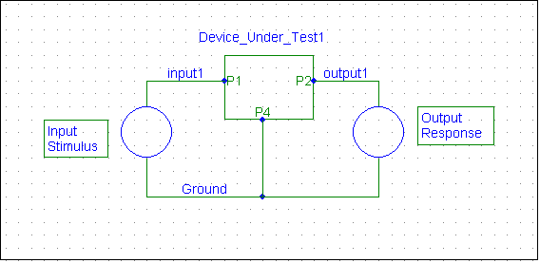
Functional Specification
  Functional Specification (cc26) Defines the Information needed to Characterize a Device Under Test via Measured Data.
  May be Many Inputs and Outputs
Vin
Vout
Application objects: Functional_specification, Signal_specification, Representation etc.

Slide 66
AP210: Part Concept
Package
Packaged
Part
Packaged
Part
Terminal
Package Body
Connection
Zone
Bare
Die

Slide 67
Component / Part Models
Component / Part Models
Information structures Usually found in “Library”
  Tightly Coupled Simulation Models and Product Definition Data
  Defined Parameter Types
  Defined Port Names and Types
  Models Instantiated by Explicit Assignment of Product Definition Data to Parameters and Ports
Functionality
Termination
Shape 2D, 3D
Material Product
Characteristics
Notes:
15

Slide 68
Component / Part Models
Electrical /Mechanical Components -- Product Model
Altered Parts
  Programmed; Geometry Mods
Functional and Physical Interface Description
Package (container) -- Product Model
Functional and Physical Characterization Including Dimensions and Tolerances
Provides verifiable correlation between the 2D and the 3D Product Definition of the Component
Provides Highly Explicit Model for Analysis Support
Component / Part Models
Analysis Support
Package
Material Product
Properties
“White Box”/ “Black Box”

Slide 69
Part Model Capability
(cont-d)
Migrate Package Definition from Drawings to Digital Data
Provides Capabilities for Complex Breakout Definitions for Advanced Packages
Pin Mapping is Explicit, Object Oriented, not name based.
Multi-level Multi-Discipline Part Shape Representation
  Environment
  Purpose
  Material Condition
Part
Functionality
Termination
Shape 2D, 3D
Material Product
Characteristics

Slide 70
Motivation - Package Orientation Issues
Basic Problem:
  2D Models may be Randomly Oriented in CAD Library A with respect to CAD Library B, and the 2D Environment does not capture enough information leading to Real “e-business” problems.
  3D Models may be Randomly Oriented.
Solution:
  Use AP 210 Orientation Features and GD&T Types to Capture A Geometric Context Invariant set of Relationships
  Define Geometric Representations (symbols) for the GD&T types used to Allow end-user Validation.
  Define Transformation Algorithms Between 2D and 3D based on Above.
  Build a “Reference Library” that contains the populated set of AP 210 data (2D, 3D, relationships, features)

Slide 71
3-D CAD Reference Assembly Layout Model
C
1
Y
Y
1
5
5
X
8
8
X
Y
X
B
Z
Z
T
Top
Surface
X
Y
X
Y
X
A
Z
B
Bottom
Surface
Bottom
Surface
Direction
Vector
D
1

Slide 72
2-D CAD Reference Assembly Layout Model
1
Y
Y
1
5
5
X
8
X
8
Y
X

Slide 73
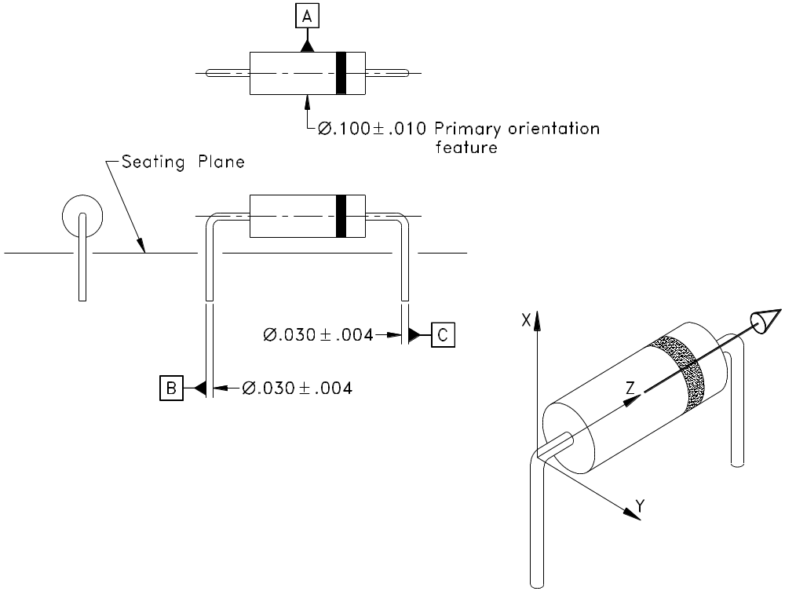
Part Library Definition Uses
Datum Reference Frame From GD&T

Slide 74
From “Building a Library Package Definition”
Tertiary orientation feature
Datum Plane in role of Seating Plane
Package
Geometric
Origin
Primary
Reference
Terminal
Note: IS version claimed the
Orientation mark was a Primary_orientation_feature!

Slide 75
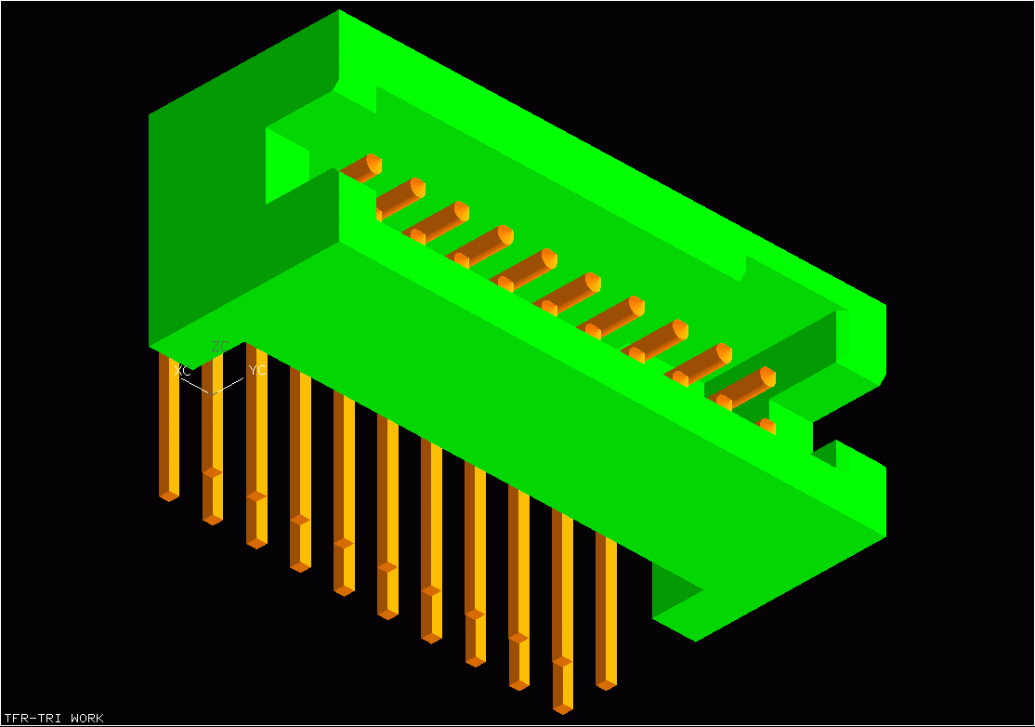
Packaged_connector in AP 210
Join Terminals
mate with some
interconnecting
material in a
Layout
Interface Terminals
Interface Terminals
Mate with Other
Interface Terminals
in an Assembly
Join Terminals
Orientation
Feature
Packaged_connector has additional functionality:
There is a short between an Interface Terminal
and a Join Terminal

Slide 76
Mapping between Structural and Simulation Models
Establishes Explicit Relationship between Functional or Physical Model and Simulation Models.

Slide 77
Example - Feature Mapping to Simulation Model Ports
Part_feature: Some aspect
of a Product that is identified
for the purpose of communicating
design intent.
Note:
Analytical_model is
Formal term in
AP 210 for
“Simulation Model”.
AIM elements shown in
parentheses
Analytical_model_port: An Access Point
for an Analytical_model
Analytical_model_port
This feature is also “Assigned” to this relationship
Part_feature
This feature is Assigned to this relationship
Part_feature_analytical_model_port_assignment
Establishing an Explicit Relationship Between Instances is an Approach that
Eliminates the Need to Synchronize Names (and alphabets!)

Slide 78
Connection_zone To Model port Assignment
analytical_model
connection_zone
Connection_zone:
An area on a feature suitable for
making a mechanical connection to the feature for electrical or mechanical purposes.
analytical_model_port
connection_zone_model_port_
assignment

Slide 79
Datum_difference to Model port Assignment
analytical_model
analytical_model_port
Datum_difference
Datum_difference:
a measure of the relative displacement
between two datum.
Datum_difference_analytical_
model_port_assignment

Slide 80
Assembly Models
Assembly Models
Assembly Model
  Product Model
  Includes Interface Declaration
    Physical & Functional
      Externally Visible Connector Partial Reference Designator for Traceability Purposes
  Includes Definition Declaration
    Physical & Functional
    Supports Multiple Interconnect
User View
Design View
Component Placement
Material product
Complex Assemblies with Multiple Interconnect

Slide 81
Assembly Models
Assembly Model
  Assembly Features
  Connectivity Implementation Assigned to Specific Interconnect
  Assembly Model Reflects Connectivity Requirements and Layout Requirements
  Assembly Model May be used in Process Planning (Assy. Panel)
Assembly Models
User View
Design View
Component Placement
Material product
Complex Assemblies with Multiple Interconnect

Slide 82
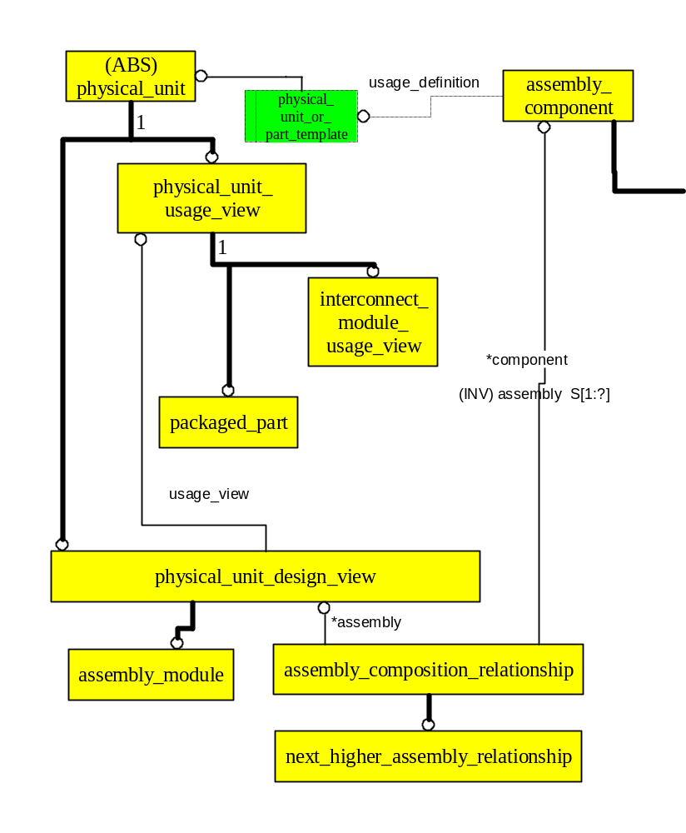
Assembly Relationship

Slide 83
Assembly Joint
Declares that two features in an assembly are joined.
  Supports Traceability for topology for Physical Network to Layout
  Supports Traceability between Functional and Physical domains
  Supports Assembly Mating Condition Evaluation
  Supports Detailed Physical Analysis

Slide 84
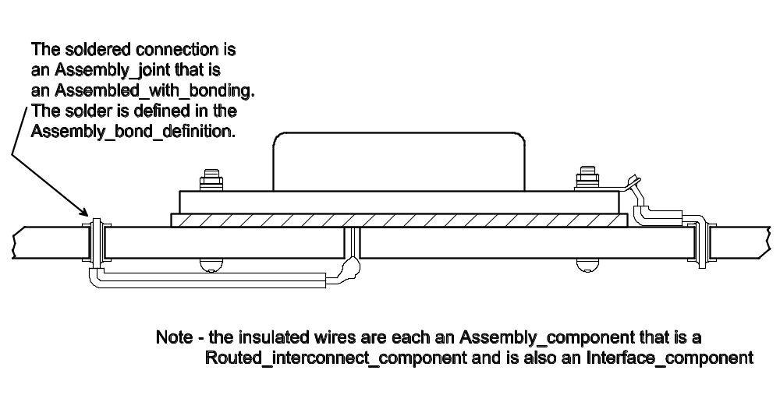
Assembly_joint

Slide 85
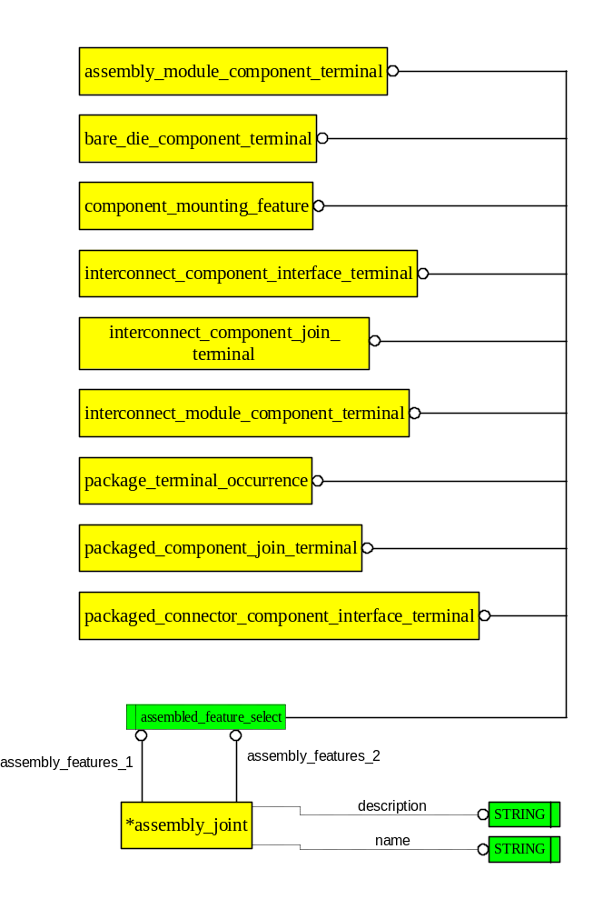
Assembly_joint

Slide 86
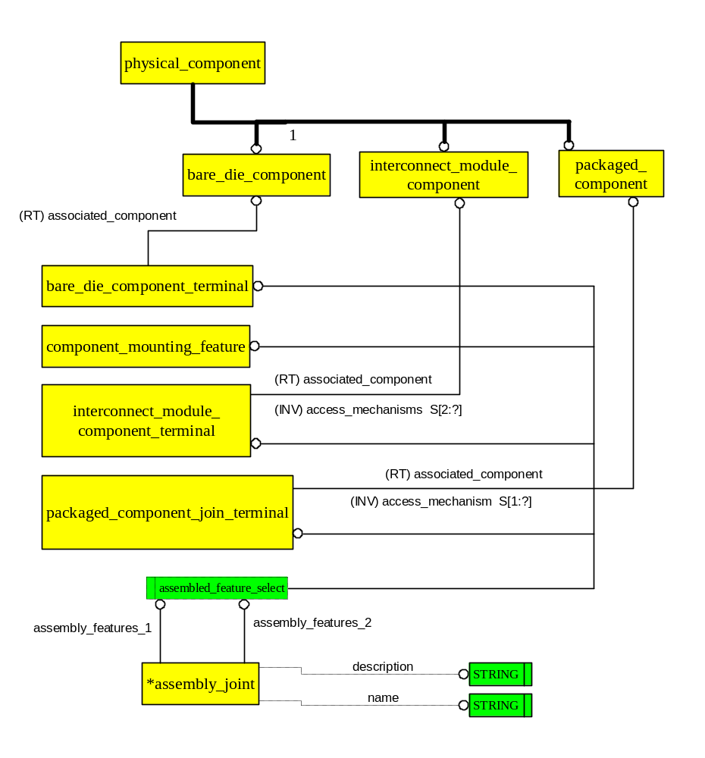
Assembly_joint

Slide 87
Mating Conditions
Based on Assembly_joint
  Identifies Constraining Joints and Degrees of Freedom Constrained.
  Does Not use a Link Model
  Assembly_joint May Be Populated Many More Times Than Needed For Physical Constraint.

Slide 88
Interconnect Models
Interconnect Models
Product Model
  Includes Interface Description
    Physical & Functional
  Includes Design Description
    Physical & Functional
    Layout “Metal” Description
    Material Stackup
    Complex Stackups
Interface Description
Design View
Bare Board Design
Layout templates
Layers
  planar
  non-planar
conductive
non-conductive

Slide 89
Interconnect Models
Interconnect Models
  Embedded Components
  Paste Components
  Footprint Definition
  Padstack Definition
  Arrayed Placement
  Does Not Directly Reference Package Model (except for Embedded component)
Interface Description
Design View
Bare Board Design
Layout templates
Layers
  planar
  non-planar
conductive
non-conductive

Slide 90
Interconnect Models
  Feature Based
  Connectivity Driven
  Topologically Explicit
  Supports Differing Fidelity Design and Analysis Tools
  Maintains Design Intent Knowledge for Downstream Applications / Trade Studies

Slide 91
Interconnect Models
  Some Explicit Layout Requirements Capture
  “Layout Metal” mapped back to Original Connectivity Requirements Explicitly Allowing Multi-Domain Network Listing to Drive One Layout (e.g., thermal and electrical nodes each drive to their own material implementation for connecting the “Terminals”.)

Slide 92
Interconnect Models
  Flexible “Physics Based” Model
  Knows that Physical Layers have two surfaces and an “Average Surface”
  Multiple Physical Layers May be based on Reference layer shape (complex metallization stackup (e.g., cu, ni, gold…))
  2d, 3d
    Supports routing over “corners”

Slide 93
Interconnect Models
  Robust Trace Model
  Separates Connectivity Requirements from the Implementation
    External
    Inter layer
    Intra layer
  Robust Plane Model, including partial planes, spacing,…

Slide 94
Interconnect Models
Interconnect Models
  Supports Bare Board Test
  Sequential Lamination
  Support Requirements from Multiple Assemblies
  Design Model also applies to Manufacturing Tooling Creation (Panelization)
Interface Description
Design View
Bare Board Design
Layout templates
Layers
  planar
  non-planar
conductive
non-conductive

Slide 95
Interconnect Models
Downstream Apps
  Direct Support for MID
  Easily Mapped to STL equipment
  Closed form curves direct drive to plotters
  Fiducial Support for Yield Enhancement
  GD&T model data
    Inspection Equipment
    STEP NC (map to)
  Explicitly models Hole, Line width tolerances

Slide 96
Physical Design Control
Design Control
Industrial Benefit
  Groundwork for Significantly Improving Cycle Time
  Basis for Rule-Based GD&T engines in CAD/CAM
Methodology
  Application-to-application exchange (e.g., between CAD/ CAM and Coordinate Measurement Machines.) Without Human Interpretation
  Explicitly Based on the ASME Y14.5M and ISO 1101 Standards for Drawing Based Exchange of GD&T Data.
  Highly Detailed Model
Geometric Dimensioning and Tolerancing

Slide 97
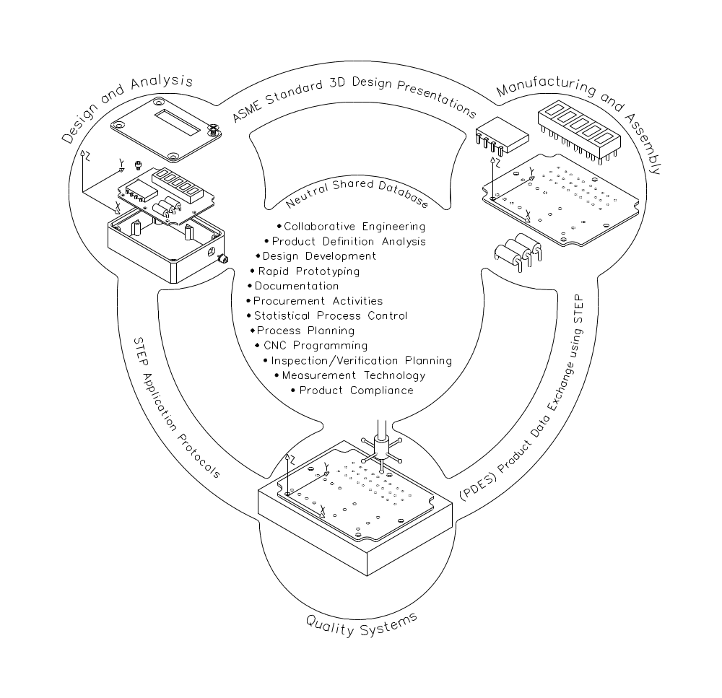
Physical Design Control

Slide 98
Technology Capability
Technology
Fabrication Design Rules
Product Design Rules
Generic Assembly and Interconnect Data Model
  Through hole, SMT, fine-line, MCM’s, molded parts, single chip package, etc.
Design for Manufacture: Technology Capability and Constraints
  Example: Explicitly State Relationship Between Land Shape Requirements and Interconnect Fabrication Technology Data.
    Material Identification & Composition (e.g., IPC -xxxx)
    Interconnect Fabricator Process Capability
    Package Terminal Characteristics
    Substrate to Terminal Joint Characterization (I.e., solder joint models)
Product Design Rule Constraints

Slide 99
Technology Capability
Technology
Fabrication Design Rules
Product Design Rules
Passage_technology: Processed hole properties
Stratum_technology: layered material properties
Toleranced Characteristics
Assembly constraints

Slide 100
Material Model
Material Description
Material Composition
Material Assembly
Material Identification via Standard Registration Document
Material Description can be as Simple or as Complex as Needed
Notes:
13

Slide 101
External Definition
Implementation Architecture for AP 210 is multi-layered:
  Base Characteristics (units from 10303-41)
  Explicit Data Structures defined in AP 210
  External References for Specific Constructs
  Well-defined Name Space {ref doc, name, value}
Result is that AP 210 provides a well founded Framework for Integration in a consistent Context
Externally Defined Data Types Support Technology Independence.

Slide 102
External Definition
Externally Defined Data types Reference Authoritative Documents, for example:
  Frequency Modulation ( Frequency, Deviation, Modulation Percent) defined in ARINC ATLAS …
  transition frequency (ft, MHz) defined in Spice Language Reference Manual v1.2
  Transition frequency (AAXYZABC-22311) defined in some data dictionary agreed to by participants whose ID is also passed in the exchange.

Slide 103
Geometry Capabilities
Explicit compatibility with IPC and EDIF and Gerber and GDSII
Geometry Models based on AP 203 and others (not all geometry from AP 203 used).
Moves electronic product representation into 3D technology
Geometry
Geometrically Bounded 2-D Wireframe with Topology
Surfaces
Advanced BREP Solids
Constructive Solid Geometry
Open Shell Model
Simple 2d Curve
Extrusion Solid
Open Shell Model Supports Molded Interconnect Technology.

Slide 104
Geometry Capabilities
CSG (2D & 3D)
Curve Swept Solid
  Supports Accurate 3D Flex Cable Layouts
Parametric Curves (tapers, etc.) to support microwave
  Stub ready for Part 50, 51 for Function Declaration
Migration Path Available to Follow AP 203 2nd ed
Geometry
Geometrically Bounded 2-D Wireframe with Topology
Surfaces
Advanced BREP Solids
Constructive Solid Geometry
Open Shell Model
Simple 2d Curve
Extrusion Solid

Slide 105
Rule Definition
Is a Product Model -
  Rev 1 Converted to Using Product Model Approach
Generic Rule Definition Facility
  Premise/Conclusion --Query on Product Data
  AND/OR
  Uses Algorithm Construct Similar to Simulation Model - Ready for MathML or 10303-50

Slide 106
Document
Similar to Product Model -
  This Edition Includes Document Specific CM Structure Instead of using Product Model Approach
  Document Identification
Structured Text
  Intended for: Notes, Extracts, Source Code...
May be Tagged Text
  SGML, XML...

Slide 107
Additional Information
AP 210 Central web site:
www.ap210.org
NASA STEP web site: http://www.step.nasa.gov
ISO TC 184/SC4 web site: http://www.tc184-sc4.org

