Slide 1
Functional Product Structure
July 8-10, 2003
Cedar Rapids, IA

Slide 2
Functional Product Structure
A Functional Product Definition is a view of a specific (Functional) Product Version.
A Functional Product Definition is NOT Necessarily a view of a Physical Product (but MAY be).
Application objects: Ee_product_definition, Functional_unit_definition, Ee_product_version, Ee_product, Functional_unit_usage_view

Slide 3
Functional Product Structure
A Functional Product Definition Consists of:
  Function Identification
  Interface Definition
  Optionally, A Functional Network Definition
  Optionally, A Simulation Model with Parameters

Slide 4
Functional Silo
Functions (Abstract Design Intent)
Functional
Decomposition
(Network)
Function
Occurrence
“Design”
“Library”
Function
Definition
Omitted for Clarity:
1. Recursive definition; test benches
2. “Pin Mapping” in library
3. Simulation model library and associativity aspects.
Simulation
Model
Definition
Notes:
Color Key:
Light Pink: Requirement decomposition
Violet: Product decompositions
Yellow: Requirement allocations
Green: Network subsets in the scope of the referenced decomposition
Dark Pink: Simulation model Library
References to Simulation models from Design/Decomposition levels and from components omitted for clarity.
Inclusion of decomposition relationships in library omitted for clarity.
Some details of relationships omitted for clarity.
Requirements may be allocated to a total design or to a component or between network subsets.
Functional Decomposition forms a requirement for Assembly.
Assembly forms a requirement for Interconnect. (these two are for the case where not all requirements are explicitly detailed using other mechanisms.
AP 210 for instance does not fully map all the assembly details into a separate requirements tree to avoid data explosion.
Physical Netlists are the physical interconnect requirements to be satisfied by the interconnect.

Slide 5
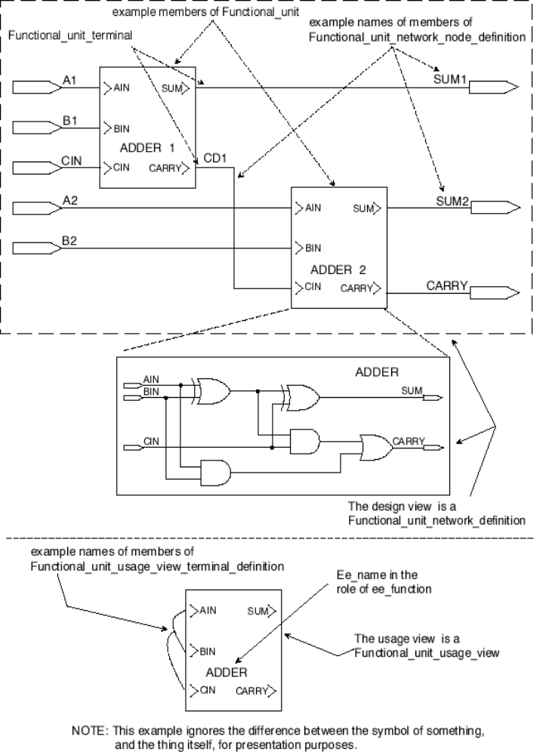
Figure 46, functional_unit
Notes:
1
1

Slide 6
ARM Diagram
ee_product
*versioned_item
(INV) product_version S[1:?]
ee_product_version
*version
analytical_representation
(INV) product_definition S[1:?]
(ABS)
ee_product_definition
1
analytical_functional_unit_representation S[1:?]
(ABS)
functional_unit_definition
1
functional_unit_network_definition
usage_view
functional_unit_usage_view

Slide 7
Functional Product Structure
A Functional Interface:
  Is A Version Controlled View of Functionality
  Inherits the Function Identifier from Functional_unit_definition
  Specifies the Function Terminals
  Optionally:
    Binds Parameter Values to Simulation Models
    Binds Function Terminals to Simulation Model Ports
Application Object: Functional_unit_usage_view

Slide 8
ARM Diagram
analytical_model
functional_unit_usage_view
*accessed_analytical_model
*associated_functional_unit_definition
(INV) access_mechanism S[1:?]
(INV) access_mechanism S[1:?]
analytical_model_port
functional_unit_usage_view_terminal_definition
model_representation
assigned_analytical_model_port
scalar_terminal_definition
assigned_functional_unit_terminal
analytical_model_port_assignment
Note: This is only one of the possibilities for the select type.
analytical_model_port_assignment_select
model_port_assignment S[1:?]
analytical_representation

Slide 9
Functional Product Structure
A Functional Network Definition:
  Is A Version Controlled View of Functionality
  References the Associated Functional Interface
  Contains Instantiation Relationships between Functional Products that “Creates” Hierarchy
  Contains Network of the Connected Functional Terminals
Application Objects: Functional_unit_network_definition, Functional_unit_network_node_definition, Functional_unit

Slide 10
ARM Diagram
definition
(ABS)
functional_unit_definition
1
usage_view
functional_unit_usage_view
functional_unit_network_definition
*associated_functional_unit_definition
*composed_network
(INV) access_mechanism S[1:?]
functional_unit
*associated_functional_unit_definition
functional_unit_usage_view_terminal_definition
accessed_functional_unit
functional_unit_network_node_definition
*connected_terminal
(INV) access_mechanisms S[1:?]
(INV) node_assignment S[0:1]
definition
functional_unit_terminal
*composed_node
*composed_node
*connected_terminal
(INV) external_node_access S[0:1]
(INV) node_assignment S[0:1]
functional_unit_terminal_node_assignment
functional_unit_network_terminal_definition_node_assignment

Slide 11
Functional Product Structure
Example Domains/Diagrams Represented by A Functional Network Definition:
    Function Flow Block Diagrams
    State Charts / State Transition Diagrams
    Control System Block Diagrams
    Circuit Diagrams (Analog/Digital/Mechanical)…
    Electro-mechanical Systems (non-linear ODE)
    S-Parameter Domain
Domain Abstractions
  Are Defined in the Simulation Models
  May Require external exchange agreements to Intepret Functional_unit_network_node_definition

Slide 12
ARM Diagram
STRING
STRING
model_parameter_type
unit_of_measure
parameter_type
type_name
parameter S[1:?]
model_parameter
analytical_model
*accessed_analytical_model
(INV) access_mechanism S[1:?]
port_type
distributed_properties
BOOLEAN
unit_of_measure
STRING
analytical_model_port

Slide 13
Functional Product Structure
A Functional Instantiation Relationship:
  References as definition either:
    Functional Product Interface for leaf node
    Functional Product Network Definition for further Decomposition
  Specifies the Network Being Composed
  Optionally Specifies Instance Bound Parameter Values
  Managed (add, delete, change)
Application Objects: Functional_unit, Managed_design_object

Slide 14
Functional Product Structure
Instance Bound Parameter Values
  Populate Critical Values (Gain, Speed, Bandwidth)
  Override Default Values (Settling Time)
  Populate Environmental Values (Operating Temp)
  User Declared, Persistent
  Used in Electro-technical Design to Select Specific Physical Components for Packaging
  managed (add, delete, change)
Application objects: Functional_unit, Functional_unit_definition, Analytical_representation, Model_parameter, Characteristic, External_definition

Slide 15
ARM Diagram
analytical_representation
analytical_functional_unit_representation S[1:?]
definition
(ABS)
functional_unit_definition
type_name
STRING
1
usage_view
functional_unit_usage_view
characteristic
functional_unit_network_definition
functional_property S[1:?]
*composed_network
functional_unit
Note: Managed_design_object not shown for clarity

Slide 16
Portion of ARM Diagram for Characteristic
ARM Diagram for External_definition
ee_document
data_element
measure_value
REAL
unit_of_measure
STRING
standard_or_reference_document
reference_document
code
STRING
external_definition
reference_document
code_value
STRING
STRING
type_name
numeric_or_non_numeric_select
property_value
characteristic

Slide 17
Functional Product Structure
Network of Instantiated Terminals:
  Nodal Formulation is used in AP 210.
  All Terminals connected to a Node are assigned the Nodal Property type and value.
  Nodes Connected Via Hierarchy shall have the same Property type and value.
    Conservative Laws not a requirement!
    Predefined subset for AP 210 -- units in part 41 etc.
  Managed (add, delete, change)
Application objects: Functional_unit_network_node_definition, Functional_unit_terminal_node_assignment, Functional_unit_network_terminal_definition_node_assignment.

Slide 18
ARM Diagram
definition
(ABS)
functional_unit_definition
1
usage_view
functional_unit_usage_view
functional_unit_network_definition
*associated_functional_unit_definition
*composed_network
(INV) access_mechanism S[1:?]
functional_unit
*associated_functional_unit_definition
functional_unit_usage_view_terminal_definition
accessed_functional_unit
functional_unit_network_node_definition
*connected_terminal
(INV) access_mechanisms S[1:?]
(INV) node_assignment S[0:1]
definition
functional_unit_terminal
*composed_node
*composed_node
*connected_terminal
(INV) external_node_access S[0:1]
(INV) node_assignment S[0:1]
functional_unit_terminal_node_assignment
functional_unit_network_terminal_definition_node_assignment

Slide 19
Functional Product Structure
Simulation Model
  A View of Functionality (May be Versioned)
  User Defined Algorithm
      Externally Defined Language
      Source or Executable Included
  Explicitly Defined Interface
    Model Parameters
    Model Port Type Data:
        string, logical, physical, boolean, units, lumped or distributed, direction
        May be bound to physical context
Application objects: Analytical_model, Analytical_model_port, Library_item, Ee_product_definition

Slide 20
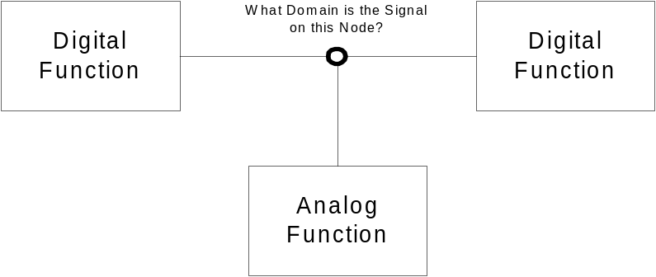
Functional Product Structure
Property Type Resolution Between Analytical_model_port types shall be Provided (if necessary) by Tools in Accordance with Documented Constraints. Usually handled by Simulator.
Example: Electrical System

Slide 21
NOTE:
Functional_unit_network_node_definition is not Explicitly Typed.
There is a Structure that Enforces a Single Property on All Terminals Assigned to the Node.
  E.g. Default is Nodal Representation with Voltage being the Property

