Slide 1
Product Classification
July 8-10, 2003
Cedar Rapids, IA

Slide 2
Product Classification
Products may be placed into categories that are sensible within the context of an Organization.
Organization Publishes Document Defining Classification Scheme.
Properties may be Assigned to a Category
Properties may be Assigned to a Specific Function

Slide 3
Application Objects
Ee_product
Ee_product_category
Ee_product_related_product_category
Ee_product_specific_parameter_value_assignment

Slide 4
ARM EXPRESS
ENTITY Ee_Product_Category
SUBTYPE OF (Managed_Design_Object);
category_parameter : SET [1:?] OF Model_Parameter;
category_specific_values : SET [1:?] OF Parameter_Assignment;
name : Ee_Name;
reference_document : OPTIONAL Ee_Document;
END_ENTITY;
ENTITY Ee_Product_Category_Relationship
SUBTYPE OF (Managed_Design_Object);
sub_category : Ee_Product_Category;
category : Ee_Product_Category;
END_ENTITY;

Slide 5
ARM EXPRESS
ENTITY Ee_Product_Related_Product_Category
SUBTYPE OF (Ee_Product_Category);
of_product : SET [1:?] OF Ee_Product;
END_ENTITY;
ENTITY Ee_Product_Specific_Parameter_Value_Assignment
SUBTYPE OF (Managed_Design_Object);
associated_product_category : Ee_Product_Related_Product_Category;
of_product : Ee_Product;
assigned_parameter : Parameter_Assignment;
END_ENTITY;

Slide 6
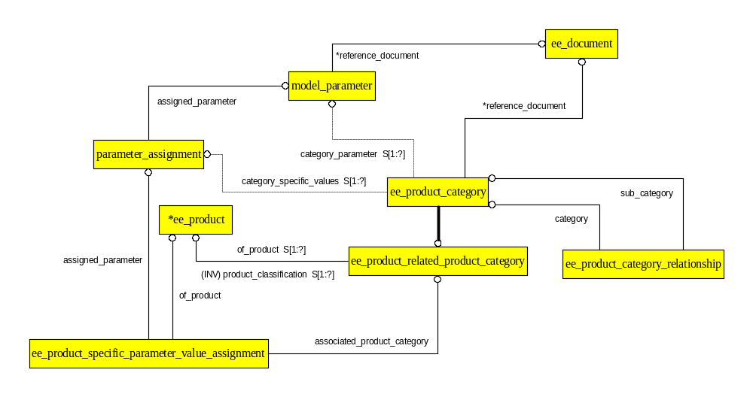
ARM EXPRESS-G

Slide 7
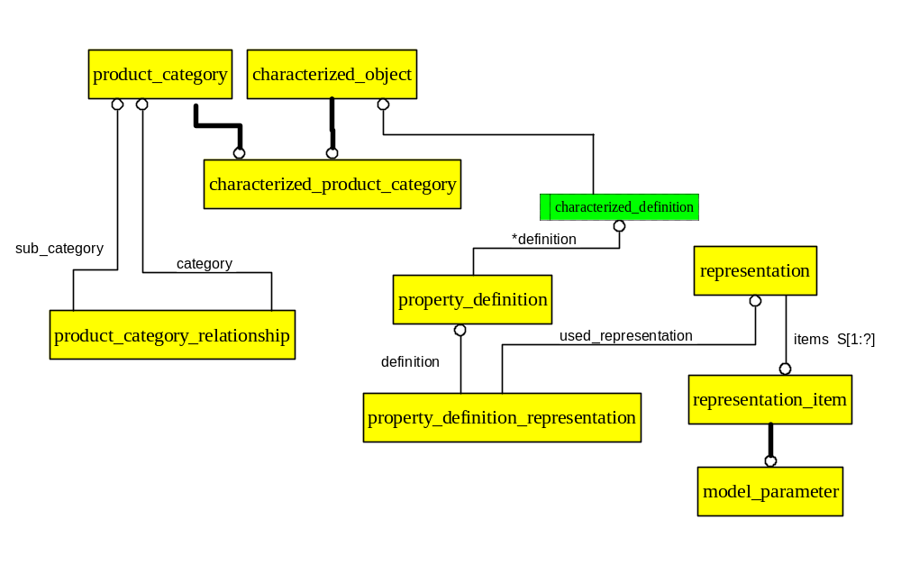
AIM EXPRESS-G

Slide 8
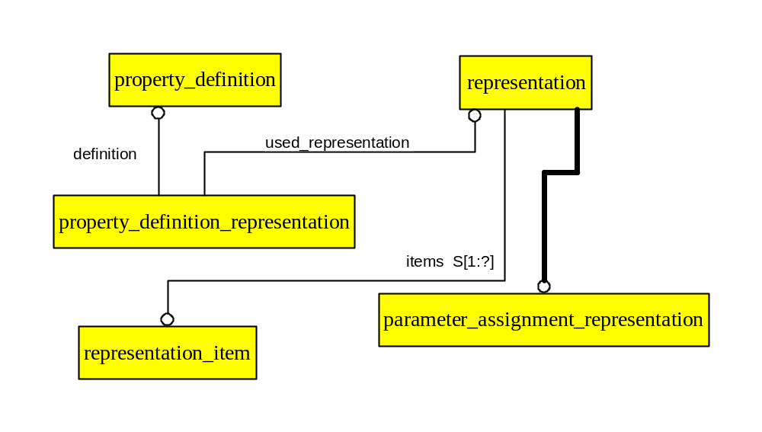
AIM EXPRESS-G

