Slide 1
Layout Physical Design
July 8-10, 2003
Cedar Rapids, IA
Rev 7/5/2003 tt

Slide 2
UoF: interconnect_module_design
The interconnect_module_design UoF defines the information needed to describe the required physical design data for an interconnect substrate.
The information includes stackup, conductive patterns, feature tolerances, design intent, interface feature design, plated and unplated passages, various forms of cutout and edge treatments, and traceability capability from design features back to design intent.
  Note: This presentation covers only selected concepts.

Slide 3
UoF: interconnect_module_design
Role of Layout Design is to Complete Elaboration of the Stratum_features and Inter_stratum_features that are Required to satisfy the Layout connectivity Requirement.
  Reference: Layout Connectivity Lecture for Connectivity Requirements

Slide 4
UoF: interconnect_module_design
Various design definitions may exist for the same interconnect module Product depending on the discipline and enterprise perspective.
Primary User:
  Fabrication
  Analysis
  Manufacturing

Slide 5
UoF: interconnect_module_design
Application Objects Discussed:
  Interconnect_module
  Interconnect_module_stratum_assembly_relationship
  Stratum
  Stratum_feature
  Next_higher_assembly_relationship
  Laminate_component

Slide 6
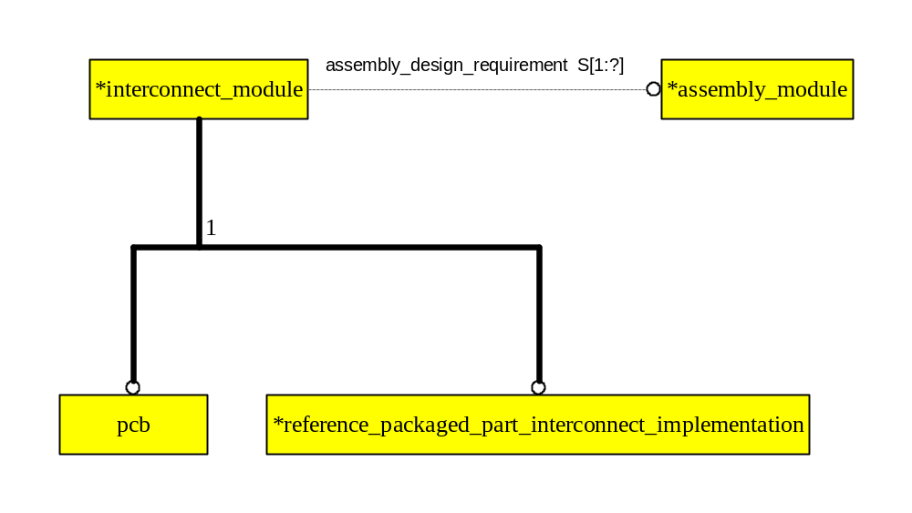
AO: Interconnect_module

Slide 7
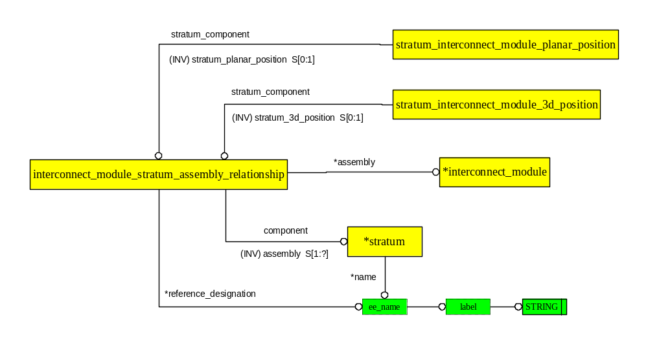
AO: Interconnect_module_stratum_ assembly_relationship

Slide 8
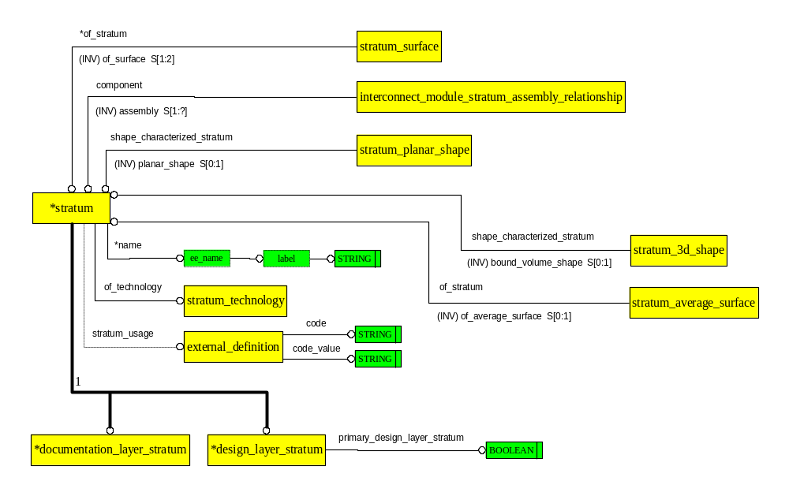
AO: Stratum

Slide 9
AO: Stratum_feature
laminate_component
1
stratum
stratum_feature_template_component
stratum_feature_implementation
stratum_feature
*resident_stratum
1
conductor
conductive_filled_area
fiducial_stratum_feature
multi_layer_stratum_feature
1
non_functional_land
land
*connected_area_component

Slide 10
AO: Next_higher_assembly_relationship
(ABS)
physical_unit
1
physical_unit_usage_view
usage_view
physical_unit_design_view
part_template
Interconnect_module
physical_unit_or_part_template
*assembly
usage_definition
assembly_component
*component
(INV) assembly S[1:?]
Laminate_component
assembly_composition_relationship
next_higher_assembly_relationship

Slide 11
AO: Laminate_component
code
STRING
cad_layer
external_definition
code_value
STRING
laminate_component
(RT) usage_definition
*part_template
1
*printed_component
(ABS)
stratum_feature_
routed_printed_
probe_access_area
(ABS)
special_symbol_
laminate_text_
laminate_text_
fiducial
physical_laminate_component
conductive_interconnect_element
template_component
component
inter_stratum_feature
laminate_component
component
string_component
feature_of_size
of_character
*STRING
BOOLEAN

Slide 12
AO: Laminate_component
Laminate_component is the attachment point for the Actual
Geometry in the Layout design.
Stratum and Stratum_feature do not normally have their own geometry.
Exception may be for molded or folded Stratum.

Slide 13
UoF: interconnect_module_usage_view
The interconnect_module_usage_view UoF defines the information needed to describe the interface definition of the interconnect substrate.
This view may be used for the purpose of simulation and verifying the mechanical fit of the interconnect substrate when installed in the next level of assembly.

Slide 14
UoF: interconnect_module_usage_view
Application Objects:
  Interconnect_module_interface_terminal
  Interconnect_module_join_terminal
  Interconnect_module_primary_surface
  Interconnect_module_secondary_surface
  Interconnect_module_surface_feature
  Interconnect_module_terminal
  Interconnect_module_usage_view
  Located_interconnect_module_thickness_requirement
Notes:
The EXPRESS-G for the Interconnect_module_interface_terminal Application Object and the Interconnect_module_join_terminal Application Object are part of the Application Object Interconnect_module_terminal.
The EXPRESS-G for the Interconnect_module_primary_surface Application Object and the Interconnect_module_secondary_surface Application Object are part of the Application Object Interconnect_module_surface_feature.

Slide 15
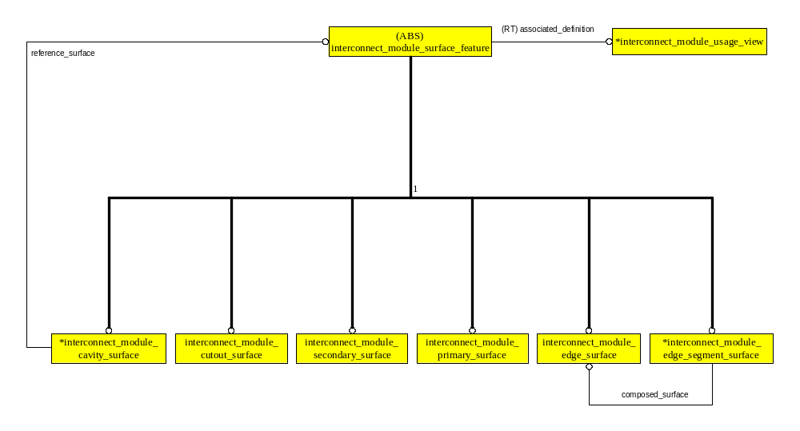
AO: Interconnect_module_surface_feature

Slide 16
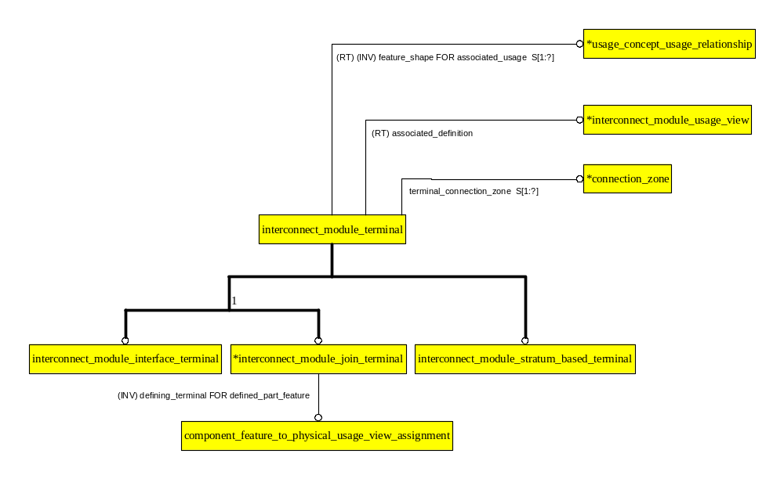
AO: Interconnect_module_terminal

Slide 17
AO: Interconnect_module_usage_view
physical_unit_usage_view
implemented_function
functional_unit_usage_view
measurement_condition
restraint_condition
maximum_thickness_over_dielectric_requirement
minimum_thickness_over_dielectric_requirement
1
maximum_thickness_over_metal_requirement
*length_data_element
minimum_thickness_over_metal_requirement
maximum_thickness_requirement
minimum_thickness_requirement
located_thickness_requirement S[1:?]
located_interconnect_
*interconnect_module_usage_view
module_thickness_
requirement

Slide 18
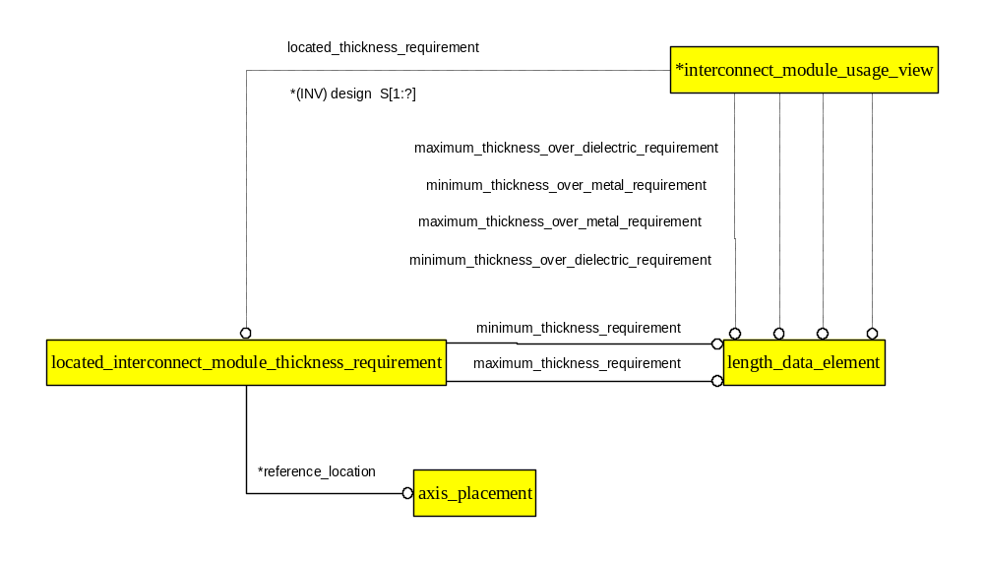
AO: Located_interconnect_module_thickness_requirement

