Slide 1
Requirements
July 8-10, 2003
Cedar Rapids, IA

Slide 2
Contents of a Requirements Definition
Requirements Structure
Functional Requirements
  Functionality Definition
  Functional Specification
  Interface Definition
  Schematic Symbol
  Simulation Models
Physical Requirements
  Shape Definition
  Interface Definition
  Simulation Models
Interface Requirements
  Functional
  Physical

Slide 3
Requirements Model
Requirements
Design
Constraints
Interface
Allocation
Requirements Model is a Version Controlled Product Model (i.e., Requirements Product).
Requirements Model has a Tree Structure.
Each Requirement may be for one of Several Purposes (e.g., Design, Constraint, Interface..).
Each Requirement may be composed of other Requirements using AND, OR combinations.
Each Requirement may be DERIVED from another Requirement.
Source Specification is Identified
Text from Source Specification may be included

Slide 4
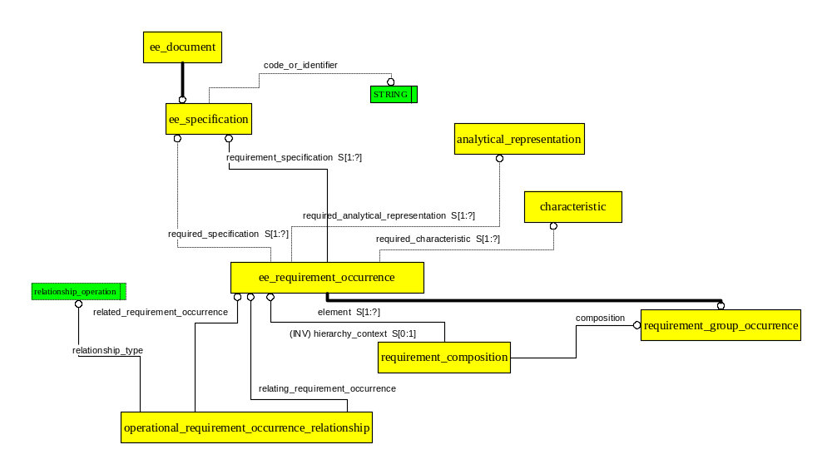

Slide 5
Requirement Allocation Model
Requirements may be Allocated to Almost any Design Aspect.
Some Design aspects Serve as Explicit Requirements for Other Design Aspects
  Connectivity for Layout
  Assembly for Interconnect
Planned Characteristics Reference Allocated Requirements
Evaluated Characteristics Reference Planned Characteristics

Slide 6
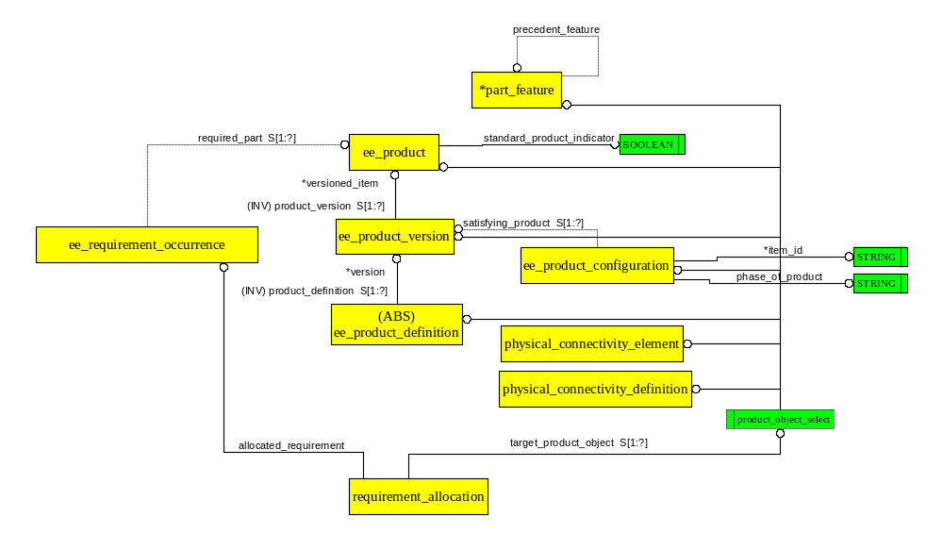
General Requirement Allocation Facility
Several product_object_select targets omitted for Clarity

Slide 7
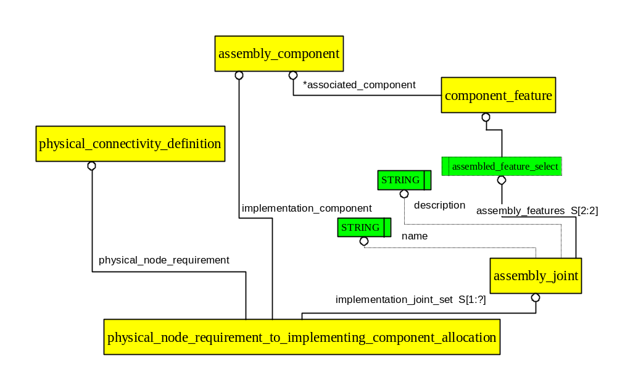
Allocating Physical Connectivity to Layout ARM Diagram

Slide 8
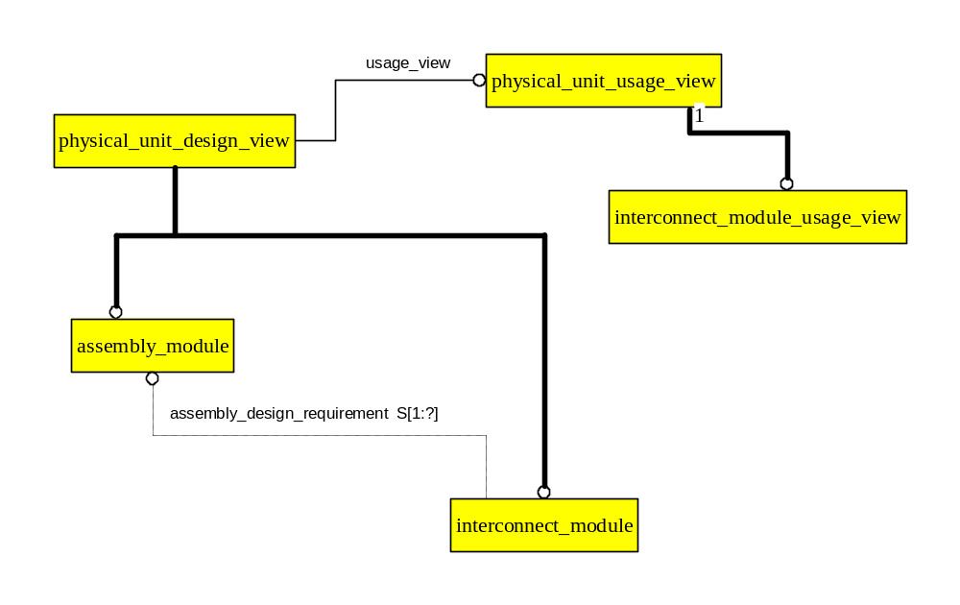
Reference Assembly Designs Provide Requirements for Interconnect Design

Slide 9
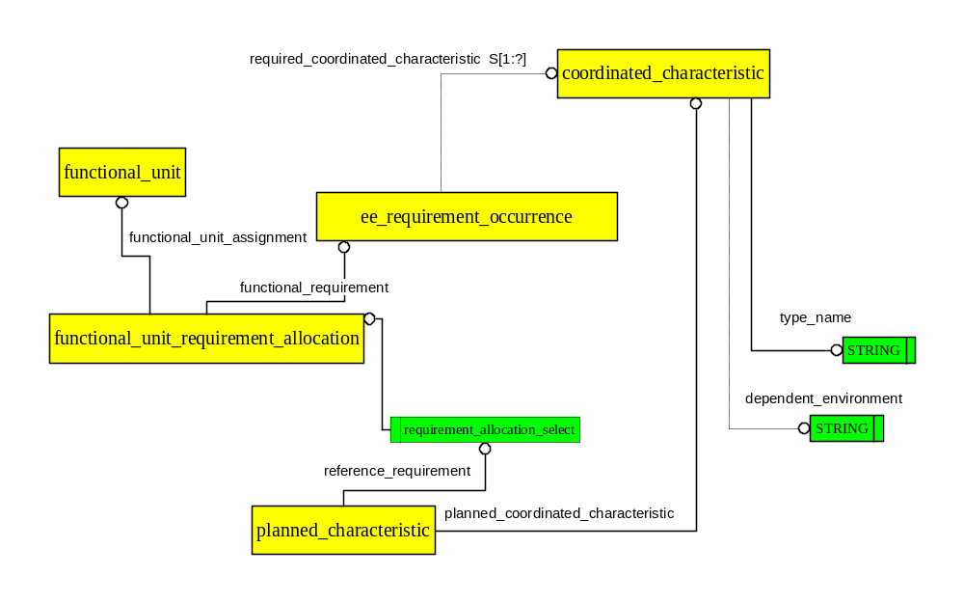
Planned Characteristics are Based on Allocated Requirement
(Typical requirement allocation)

Slide 10
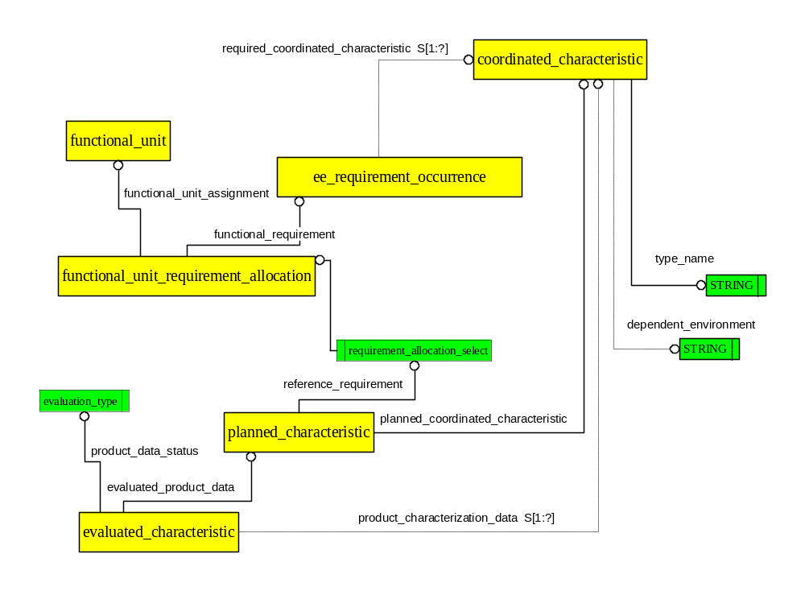
Evaluated Characteristic is the Result of an Experiment

Slide 11
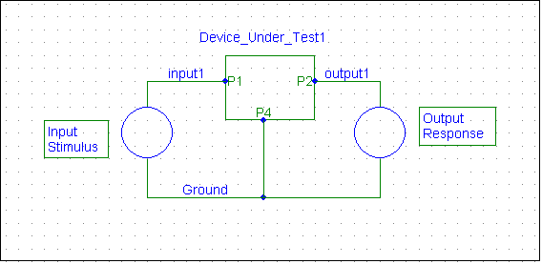
Contents of a Requirements Definition
Functional Specification (CC 26)
  Functional Specification defines the information needed to characterize a device under test via measured data
  May be many Inputs and Outputs
  Application Objects: Functional_specification, Signal_specification, Representation, etc.
Vin
Vout

Slide 12
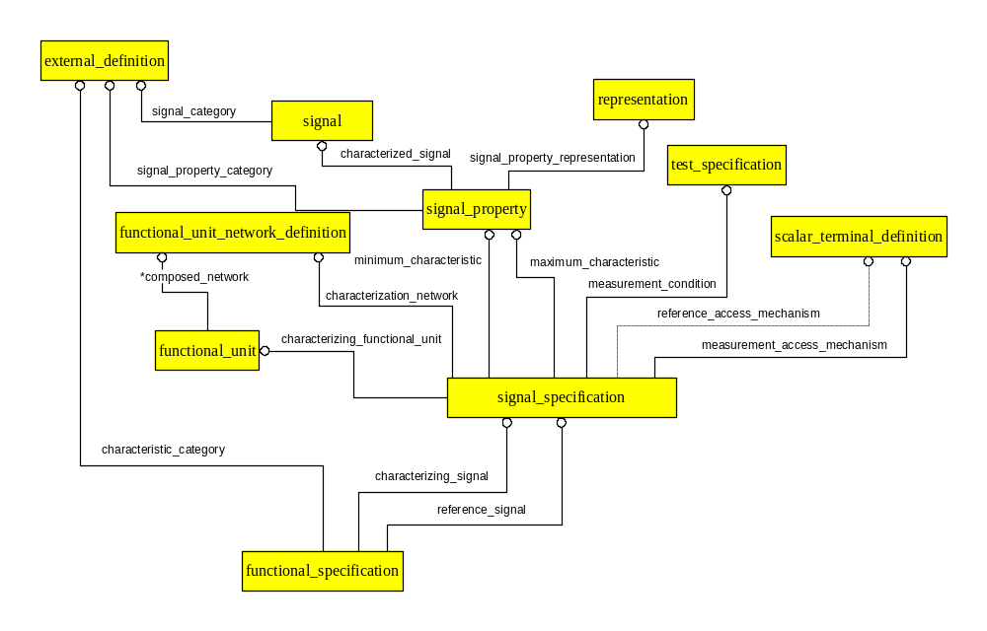
ARM Diagram

