Slide 1
Mapping Between Design and Usage Views

Slide 2
Note
The ARM Application Objects specified for each Unit of Functionality to be covered are not the complete listing, only the ones deemed a priority for this AP 210 Training Session.

Slide 3
UoF: assembly_design_information_ assignment_to_usage_view
The assembly_design_information_assignment_to_usage_view UoF defines the information that describes the association between product data necessary for a design view and product data necessary to define a usage view.
A product engineer may choose to only release usage view information in order to allow other designers to incorporate the product into a higher level assembly.

Slide 4
UoF: assembly_design_information_ assignment_to_usage_view
This information is developed and maintained by a design organization in order to control the accuracy and integrity of externally released data.

Slide 5
UoF: assembly_design_information_ assignment_to_usage_view
Application Objects:
  Component_feature_to_physical_usage_view_assignment
  Component_terminal_to_assembly_module_interface_terminal_assignment
  Component_terminal_to_assembly_module_join_terminal_assignment

Slide 6
AO: Component_feature_to_ physical_usage_view_assignment
precedent_feature
defined_part_feature
part_feature
(INV) design_view_definition_component_feature S[0:1]
component_feature_to_physical_usage_view_assignment
assigned_design_object
component_feature
(INV) defined_product_feature S[0:1]
1
component_terminal_to_assembly_
component_terminal_to_assembly_
component_terminal_to_interconnect_
component_terminal_to_interconnect_
component_terminal_to_pca_
module_join_terminal_assignment
module_interface_terminal_assignment
module_join_terminal_assignment
module_interface_terminal_assignment
terminal_assignment

Slide 7
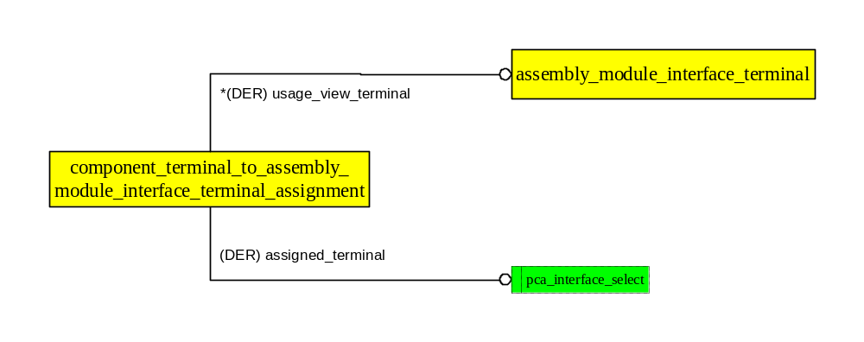
AO: Component_terminal_to_assembly_ module_interface_terminal_assignment

Slide 8
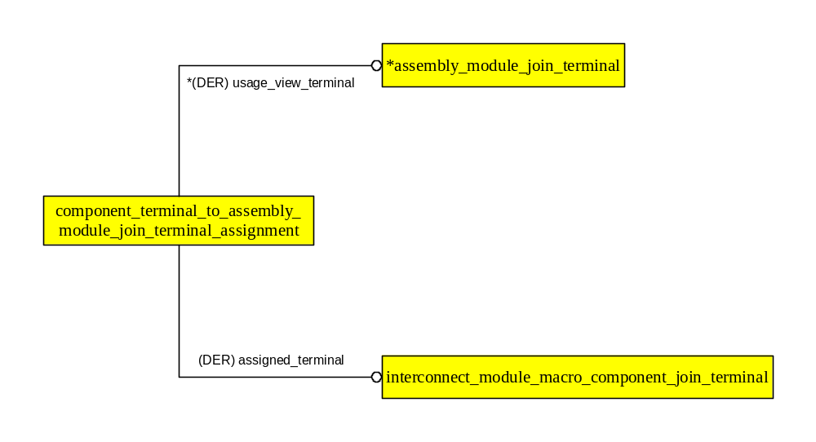
AO: Component_terminal_to_assembly_ module_join_terminal_assignment

