Slide 1
Building a Design Definition
July 8-10, 2003
Cedar Rapids, IA

Slide 2
Note
The ARM Application Objects specified for each Unit of Functionality to be covered are not the complete listing, only the ones deemed a priority for this AP 210 Training Session.

Slide 3
Packaging
Units of Functionality:
  functional_decomposition_to_assembly_design
  functional_decomposition_with_nodal_representation_to_assembly_mapping
  functional_definition_to_physical_unit_usage_view_mapping
  package
  packaged_part_black_box_model
  part_feature

Slide 4
UoF: functional_decomposition_ to_assembly_design
The functional_decomposition_to_assembly_design UoF defines the information needed to describe the assignment of a functional unit in a network definition to an element in the assembly.
Usually, this information is provided by a packaging application.

Slide 5
UoF: functional_decomposition_ to_assembly_design
This UoF defines the different means of describing swapping accomplished within a design.
The types of swapping covered are the ones between gates in a single package instance, between gates in different package instances, and between terminals in a gate.

Slide 6
UoF: functional_decomposition_ to_assembly_design
Note: Constraints on swapping are not included in this UoF. The terminals swapped with this UoF are on the functional elements in the hierarchical design network listing and not the flattened network listing. Applications that perform swapping on flattened representations will need to map to the hierarchical representation.

Slide 7
UoF: functional_decomposition_ to_assembly_design
Application Objects:
  Design_composition_path
  Design_functional_unit_allocation_to_assembly_component

Slide 8
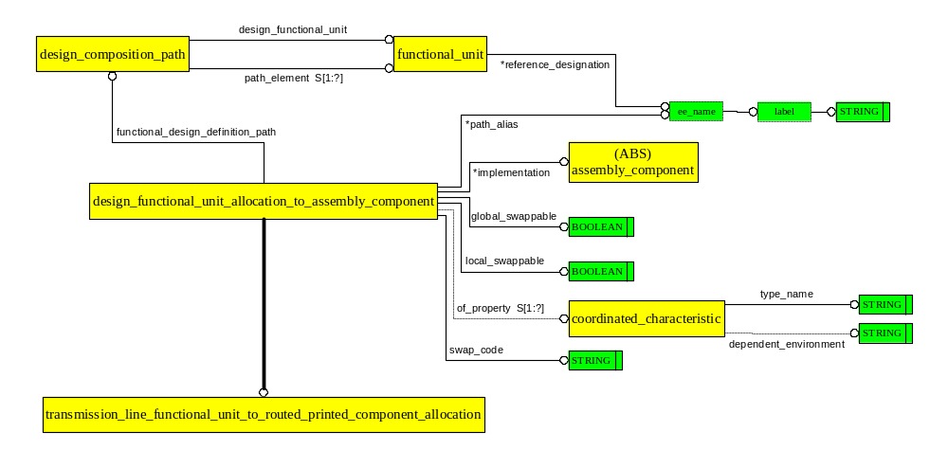
AO: Design_functional_unit_ allocation_to_assembly_component

Slide 9
UoF: functional_decomposition_with_ nodal_representation_to_assembly_mapping
The functional_decomposition_with_nodal_representation_to_assembly_mapping UoF defines the information necessary to describe the association between the multi-level hierarchical nodal representation and the single level nodal representation described by a physical_connectivity_definition.
Multi-level hierarchy is represented in this part of ISO 10303 by a graph, and there are several graph instances involved in this UoF.

Slide 10
UoF: functional_decomposition_with_ nodal_representation_to_assembly_mapping
The lowest level primitives in the design graph are also the lowest level primitives in the functional definition of a physical unit.
A mapping is defined between paths contained in two graph instances in order to define equivalent functionality for a design element and a library element that contributes to the functionality of a physical_unit or part_template whose definition is in a library.

Slide 11
UoF: functional_decomposition_with_ nodal_representation_to_assembly_mapping
Information is provided to exchange the constraints determined on the allowed alternatives that may be selected by a mapping activity.
The constraints may be applied to individual elements and also to individual terminals.

Slide 12
UoF: functional_decomposition_with_ nodal_representation_to_assembly_mapping
Example 1: A packaging application that used this mapping would assign element names "A,B,C" of a multi-element part to three path instances in the design. A second mapping is defined to allow the packaging application to associate the reference designator of the assembly_component to the three paths through the design graph that are implemented with that assembly_component. It may be determined by the design activity that element "A" is permitted to be exchanged with element "B" but not with element "C".

Slide 13
UoF: functional_decomposition_with_ nodal_representation_to_assembly_mapping
Application Objects:
  Aggregate_connectivity_requirement
  Connectivity_allocation
  Design_composition_path
  Design_functional_unit_allocation_to_assembly_component
  Design_functional_unit_allocation_to_reference_functional_unit
  Functional_usage_view_to_part_terminal_assignment
  Minimally_defined_component_terminal
  Package_external_reference

Slide 14
UoF: functional_decomposition_with_nodal_ representation_to_assembly_mapping
Application Objects:
  Package_terminal_external_reference
  Part_terminal_external_reference
  Physical_component_terminal
  Reference_composition_path
  Reference_functional_unit_assignment_to_part

Slide 15
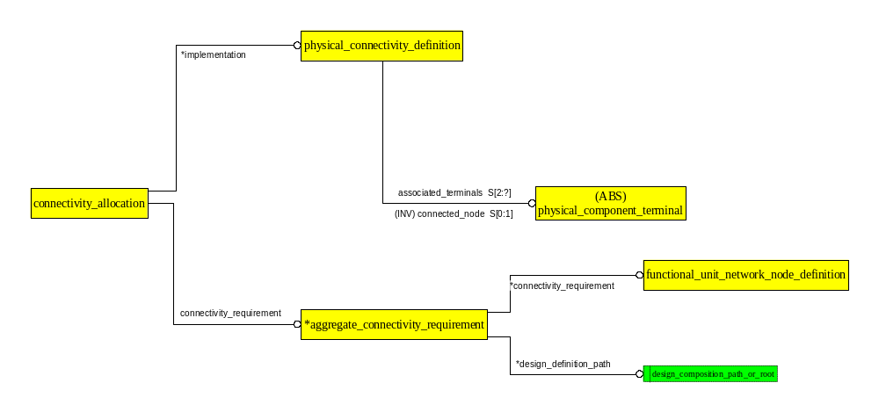
AO: Connectivity_allocation

Slide 16
AO: Design_functional_unit_ allocation_to_assembly_component
Notes:
This is the same EXPRESS-G diagram as found in slide #8.

Slide 17
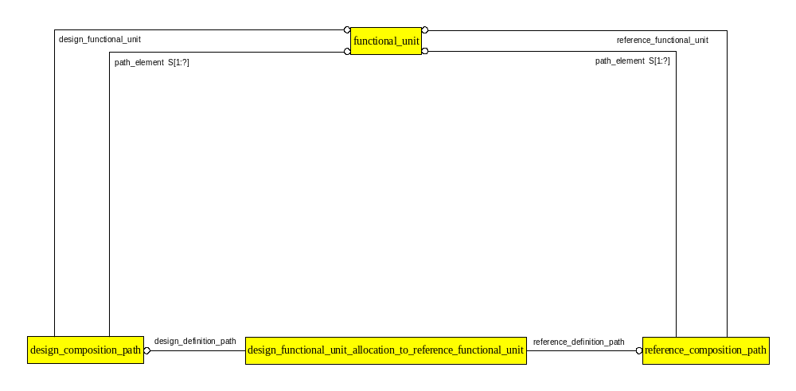
AO: Design_functional_unit_allocation_ to_reference_functional_unit

Slide 18
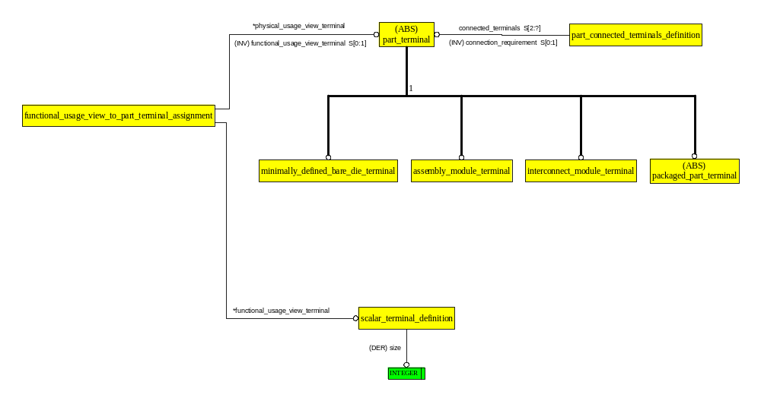
AO: Functional_usage_view_to_ part_terminal_assignment

Slide 19
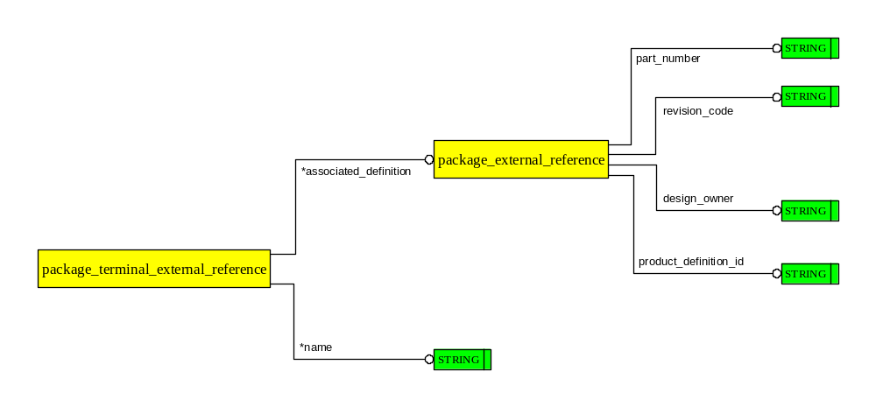
AO: Package_external_reference

Slide 20
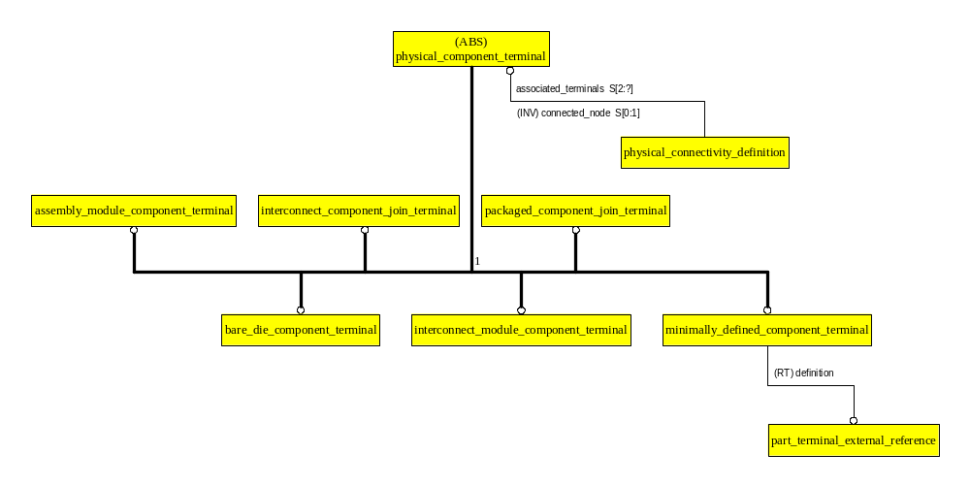
AO: Physical_component_terminal

Slide 21
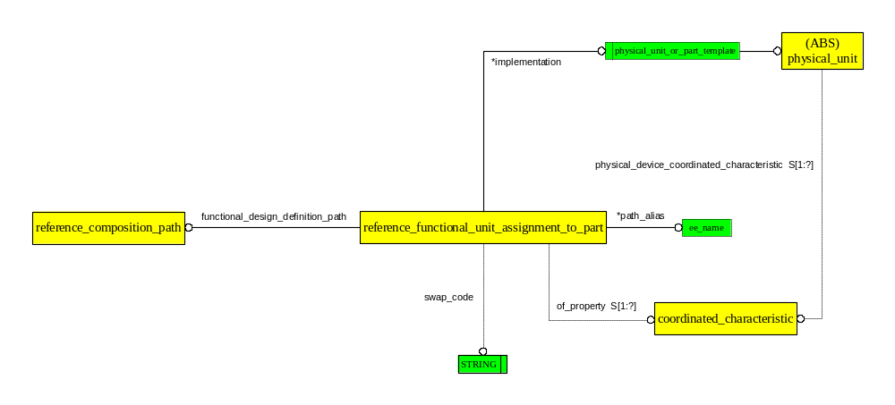
AO: Reference_functional_unit_ assignment_to_part

Slide 22
UoF: part_feature
The part_feature UoF defines the information needed to describe the distinctive aspects of separately manufactured products included in the design.
Explicit models of the aspects may be combined in the explicit model for the products.
Classification of feature functionality is supported, with several predefined functions provided.

Slide 23
UoF: part_feature
Application Objects:
  Part_feature
  Part_terminal
Notes:
The EXPRESS-G diagram for the Primary_reference_terminal Application Object can be found in slide # 30.

Slide 24
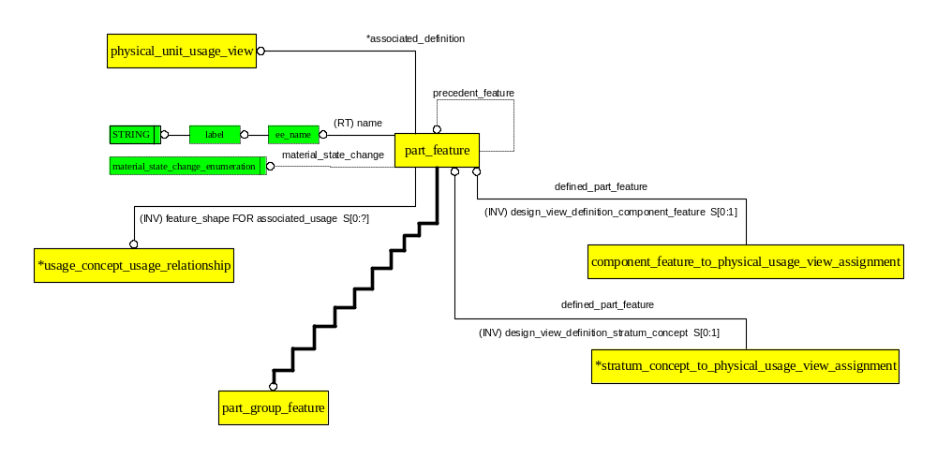
AO: Part_feature

Slide 25
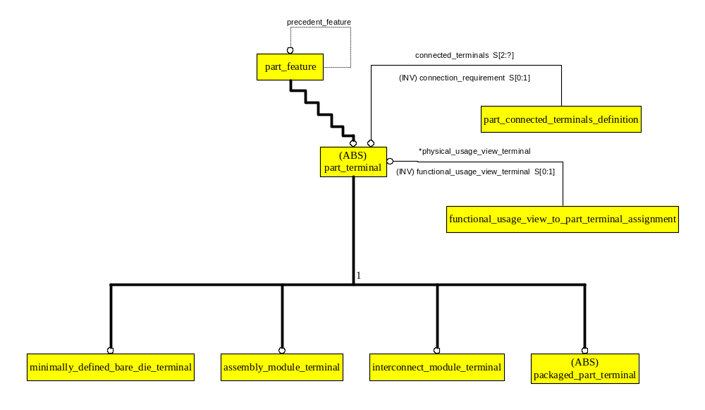
AO: Part_terminal

Slide 26
Contents of a Design Definition (CC 8)
Functional Definition
  Functionality Definitions in the Design are Network Definitions
  Interface Definition – previously discussed
Physical Definition
  Shape Definition in the Design is Assembly Shape
  Part instantiation
  Interface Definition – previously discussed

Slide 27
Contents of a Design Definition (CC 8)
Packaging Definition
  Establishing the Allocation of Function to Physical in the Design
Part level information
  Functionality Definition – previously discussed
  Shape Definition – not discussed herein
  Mapping Between Functional Interface and Physical Interface
  Version Management
    Design Definition includes a snapshot of the Library Subset Used in the Design

Slide 28
Building a Design Functional Definition
A nand gate definition (fuuv1) and a power block definition (fuuv2) are explicitly referenced.
The Packaged_part definition is explicitly referenced (not illustrated).
Design Network Definitions are: fund1 through fund4.
Design Functional_unit_usage_views are: fuuv11 through fuuv14.
Fund1 includes three functional units: two nand gate instances and one power block instance. Fund1 specifies fuuv11.

Slide 29
Building a Design Functional Definition
Fund2 includes only one functional unit: an instance of the network definition fund1. Fund2 specifies fuuv12.
Fund3 includes three functional units: an instance of the network definition fund1, an instance of the network definition fund2 and an instance of the nand gate. Fund3 specifies fuuv13.
Fund4 includes one functional unit: an instance of the network definition fund3. Fund4 specifies fuuv14.

Slide 30
Building a
Design Functional Definition
fund 4
fuuv14
fu5
Design items:
fund1, fund2, fund3, fund4,
fuuv11, fuuv12, fuuv13, fuuv14,
fu1,fu2,fu3,fu4,fu5,fu11,fu13, fu14.
Library items:
fuuv1,fuuv2
fund3
fuuv13
fu4
fund2
fuuv12
fu14
fu3
fu13
fund1
fuuv4
fu11
fuuv2
fu1
fu2
Legend:
fu: functional_unit
fuuv: functional_unit_usage_view
fund: functional_unit_network_definition
fuuv1

Slide 31
Building a Design Functional Definition
fund 4
fuuv14
fu5
Design items:
fund1, fund2, fund3, fund4,
fuuv11, fuuv12, fuuv13, fuuv14,
fu1,fu2,fu3,fu4,fu5,fu11,fu13, fu14.
Library items:
fuuv1,fuuv2
fund3
fuuv13
fu4
fund2
fuuv12
fu14
fu3
fu13
fund1
fuuv4
Legend:
fu: functional_unit
fuuv: functional_unit_usage_view
fund: functional_unit_network_definition
fu11
fuuv2
fu1
fu2
fuuv1

Slide 32
Building a
Design Physical Definition (CC8)
U3
U1
U4
U2
Four Packaged_components
reference a Packaged_part
as a definition.

Slide 33
Building a
Design Physical Definition (CC8)
Instance Data:
  Reference Designation, 2D & 3D Component Location, Orientation, Board Side, Network Listing of Components.

Slide 34
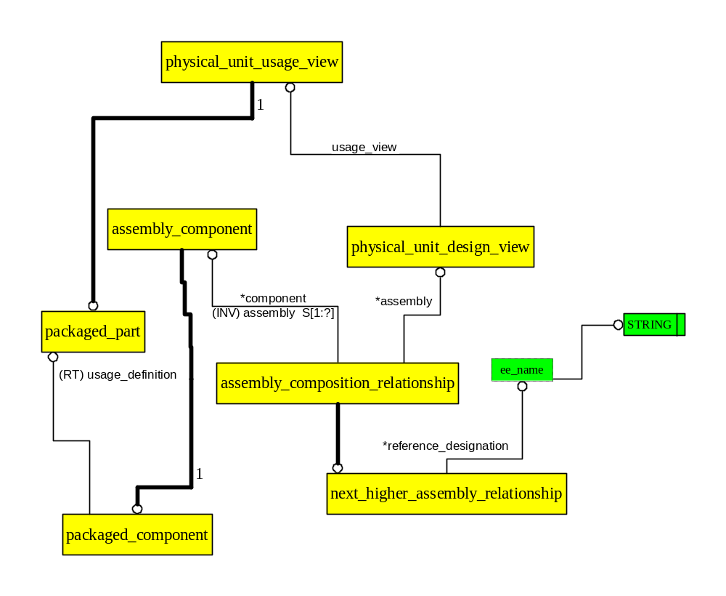
ARM Diagram for Reference Designation

Slide 35
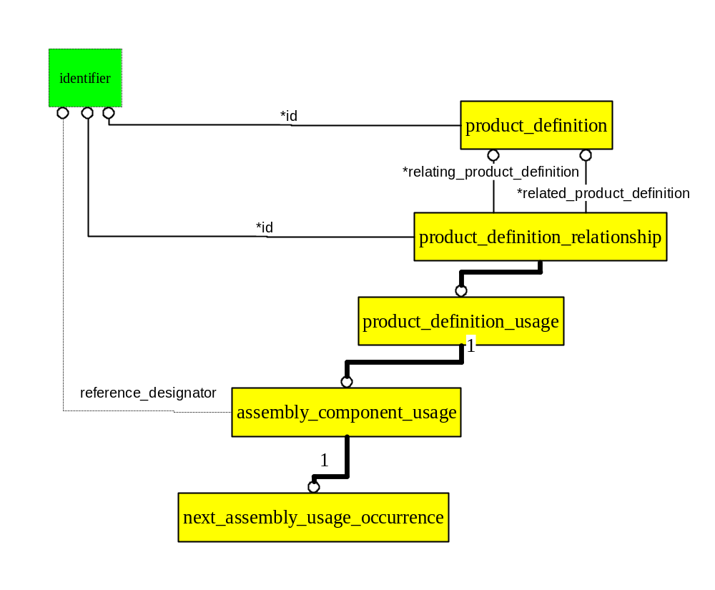
AIM Diagram for Reference Designation

Slide 36
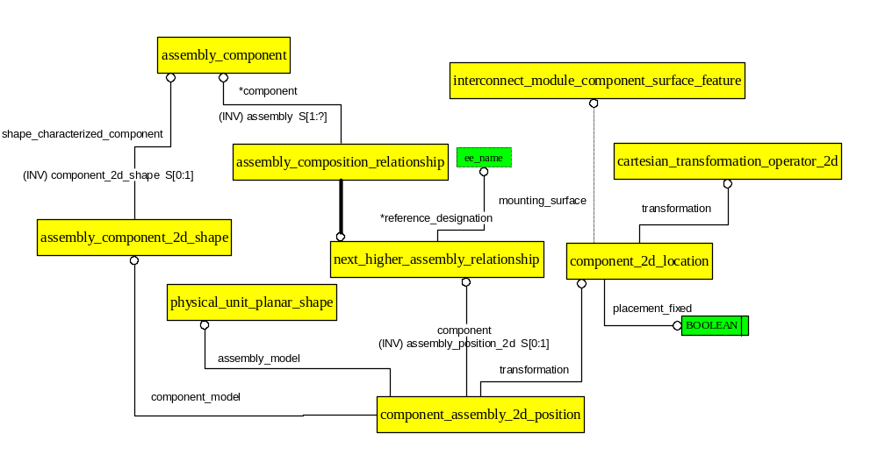
ARM Diagram for 2D Component Location, Orientation, & Side

Slide 37
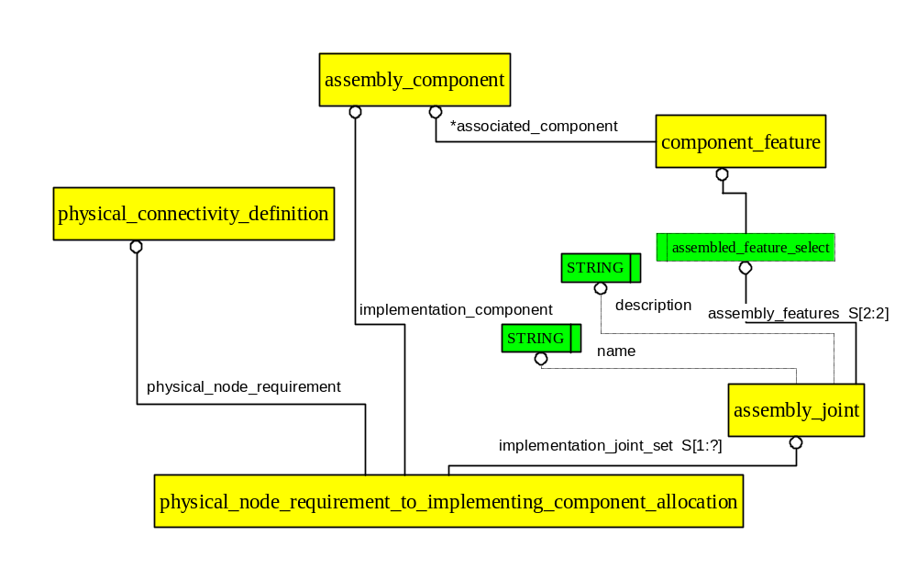
Physical_connectivity_definition Supports Component Network Definition

Slide 38
Packaging the Design Function in the Physical Definition
A Packaged_component is an instance of a Packaged_part in the context of a Design.
A Packaged_component Reference_Designation corresponds to a Distinct Location in the Design Physical Definition.
Each Path Through the Design Functional DAG Corresponds to a Distinct Location in a Packaged_component in the Design Physical Definition.

Slide 39
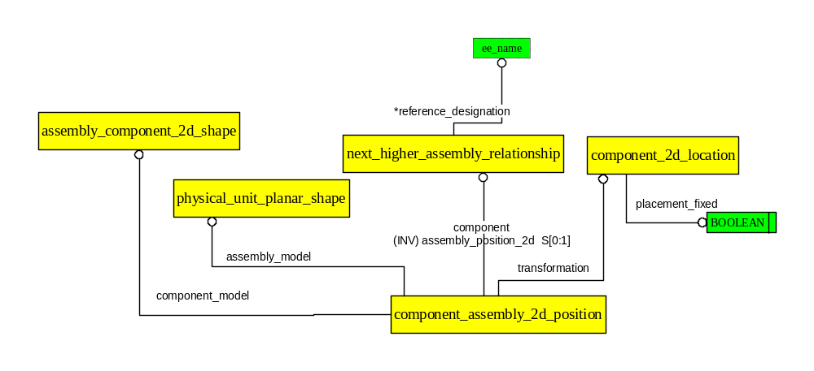
Reference Designation to Distinct Location
Reference Designation shall be Unique Within a Design View;
No More than one Location per Reference Designation.

Slide 40
Formal Definition of Library Path
fund6
A Reference_composition_path is
a set of functional_unit that are in
one path from a leaf node to the
root node in a library functional unit network definition.
fu10
fund5
fu8
fuuv1

Slide 41
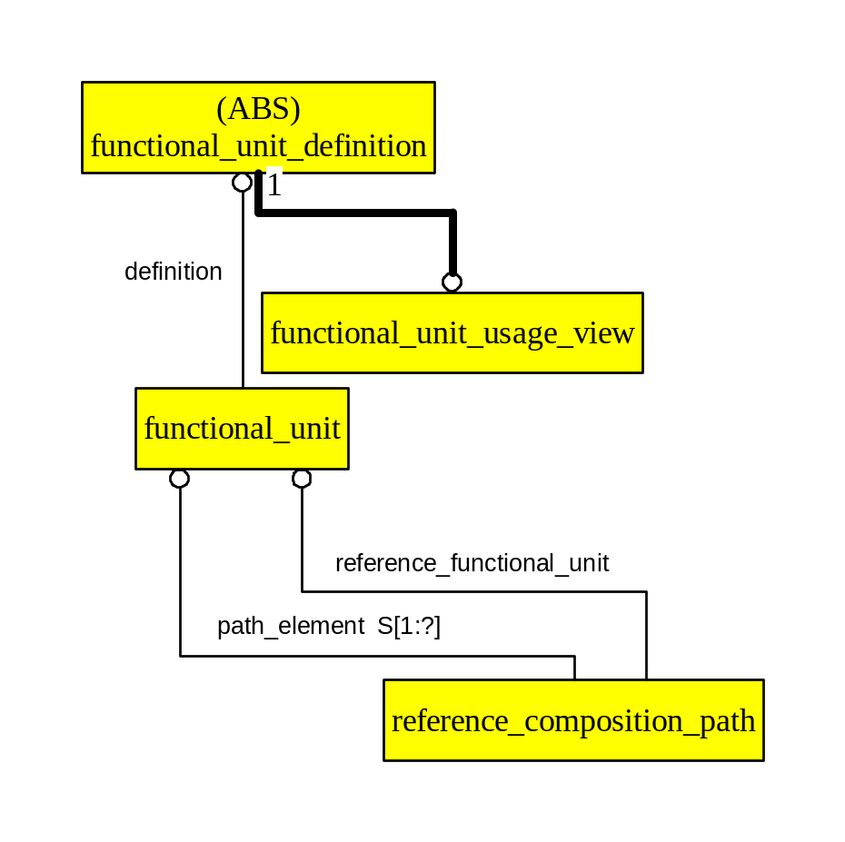
ARM Diagram: Leaf Node is the Definition of the Reference Functional Unit

Slide 42
Formal Definition of Design Path
fund 4
A Design_composition_path is the set of
functional_unit that are in one path from a leaf
node to the root node in a design.
“Root node” refers to end-user selected object,
used when the functional graph is partitioned
for packaging.
It is not necessarily the root of the
entire functional graph.
A set is used because the graph itself provides
Topographical structure
fu5
fund3
fu14
fund1
fu2
fuuv1

Slide 43
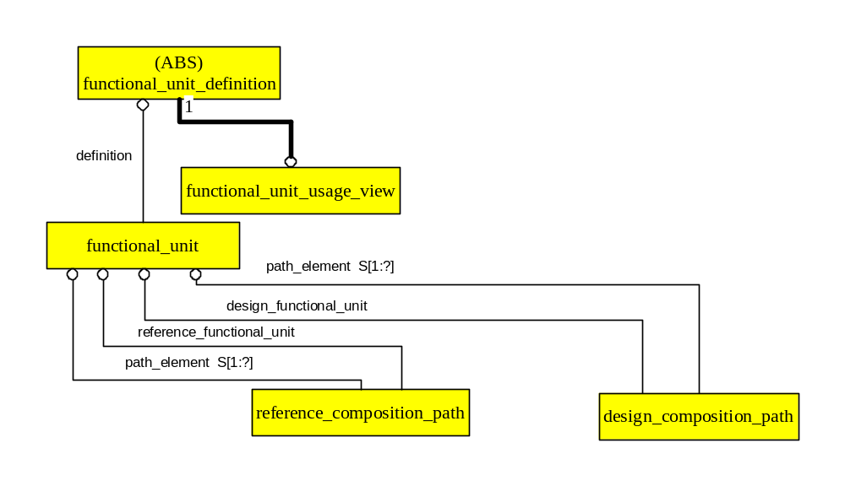
ARM Diagram: Leaf Node is the Definition of the Design Functional Unit

Slide 44
Packaging the Function in the Design
design_functional_unit_allocation
_to_assembly_component
fund 4
Packaging Result: Design Path Allocated to section “A” of U1
“U1” specified
in Design
fu5
Design Path
Allocated to Reference Path
by Packaging Application
fund3
U1 Defined
by Packaged_part
fund6
fu14
design_functional_unit_allocation
_to_reference_functional_unit
fu10
fund1
fund5
fu2
Reference Path
Assigned to
section “A”
OF Packaged_part
in Library by reference_functional_unit_assignment_to_part
fu8
fuuv1

Slide 45
ARM Diagram: The Same Leaf Node is the Definition of the Design Functional Unit and of the Reference Functional Unit

Slide 46
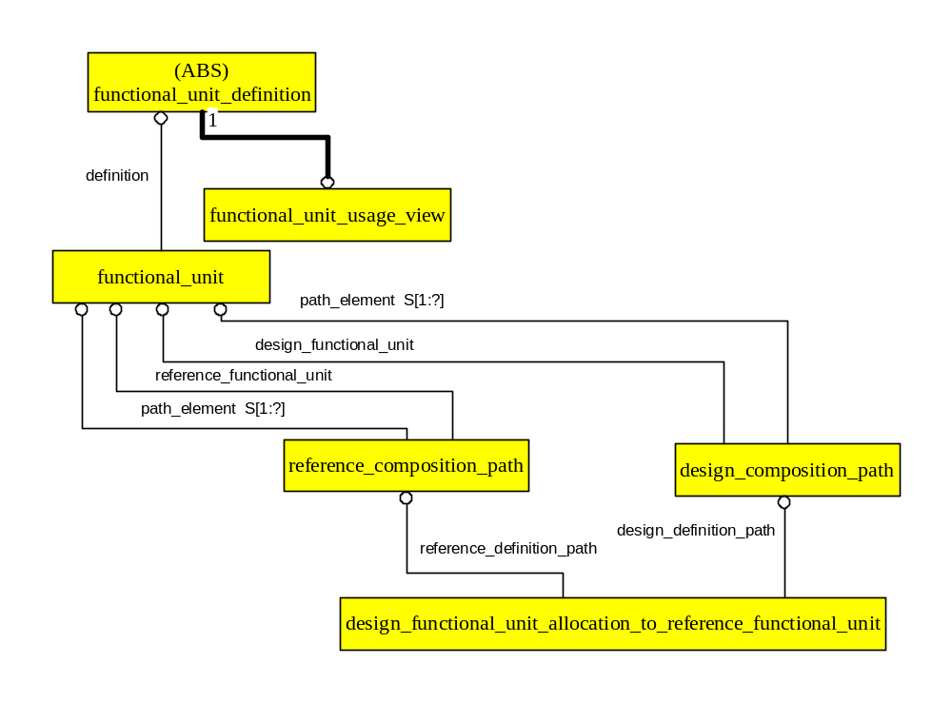
Design Path Allocated to Reference Path

Slide 47
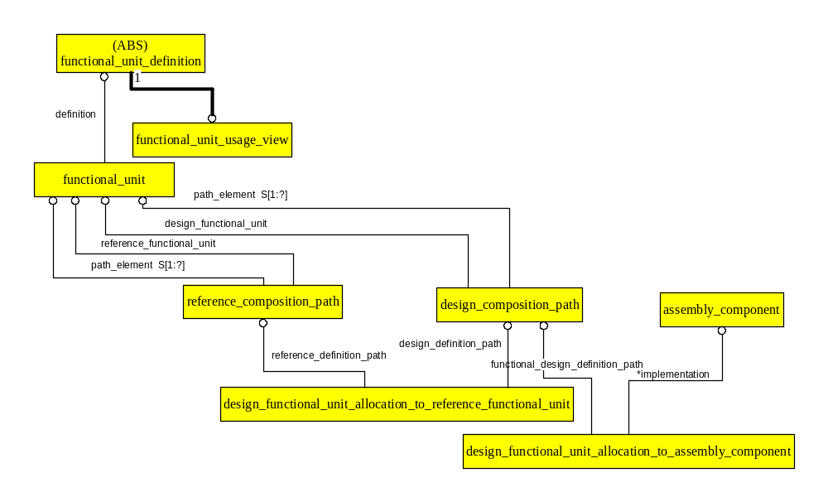
Design Path Allocated to U1

Slide 48
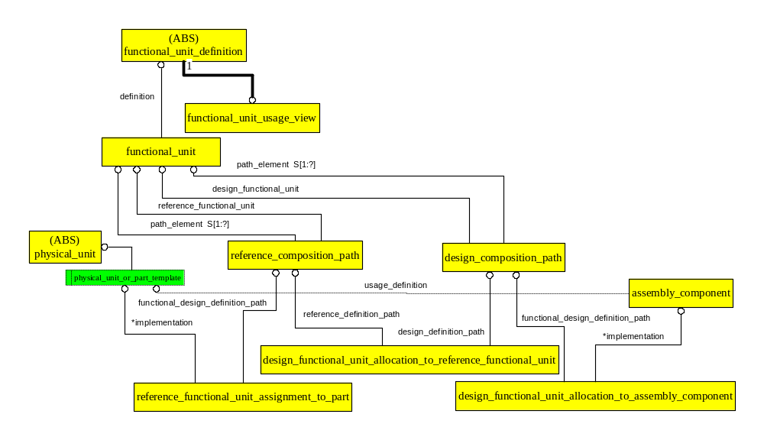
Completed Path From Library Through Design (Less Terminals)

Slide 49
AP210 AIM Implementation Glossary:
Pd: Product_definition (Part 41)
Pdr: Product_definition_relationship (Part 41)
Functional_unit: subtype of Product_definition that is the AP 210 AIM implementation of ARM Functional_unit_definition, Functional_unit_network_definition
Component_functional_unit: subtype of Product_definition that is the AP 210 AIM implementation of ARM functional_unit

Slide 50
AP210 AIM Implementation
DAG Nodes: functional_unit
DAG Links:
  Pdr-->Component_functional_unit<--Pdr
Tree Nodes: Product_definition
Path Definition: Product_definition
DAG Link to Path Definition: One Pdr to Pd in Each Link in the Path up the DAG
Relationship Between Path Definitions: Pdr

