Slide 1
Building a Library Definition
July 8-10, 2003
Cedar Rapids, IA

Slide 2
Note
The ARM Application Objects specified for each Unit of Functionality to be covered are not the complete listing, only the ones deemed a priority for this AP 210 Training Session.

Slide 3
Contents of a Library Definition
Added Data:
  Library Identification
Functional Definition
  Functionality Definition – previously discussed
  Interface Definition – previously discussed
  Schematic Symbol – see AP212
  Simulation Models – previously discussed

Slide 4
Contents of a Library Definition
Physical Definition
  Shape Definition – not discussed herein
  Interface Definition – Package definition
  Simulation Models – previously discussed
Part Definition
  Mapping between Functional Interface and Physical Interface
  Part Level Simulation Models

Slide 5
UoF: package
The package UoF defines the information needed to describe the package of a component that is part of the assembly.
The shape of the component both as purchased and as delivered to a customer are provided.
A common identifier for the shape of the package and placement orientation alignment information between 2 dimensional and 3 dimensional models are also provided.

Slide 6
UoF: package
The information needed to allow industry or enterprise groups to populate explicit models and define associated properties and associated categories for standard packages and their versions is provided.

Slide 7
UoF: package
Application Objects:
  Package
  Package_terminal
  Primary_reference_terminal
  Wire_terminal

Slide 8
Building a Library Package Definition (CC 14)
Note: This page is a presentation of a 3D representation
Datum Plane in role of Seating Plane
Package
Geometric
Origin
Primary
Reference
Terminal

Slide 9
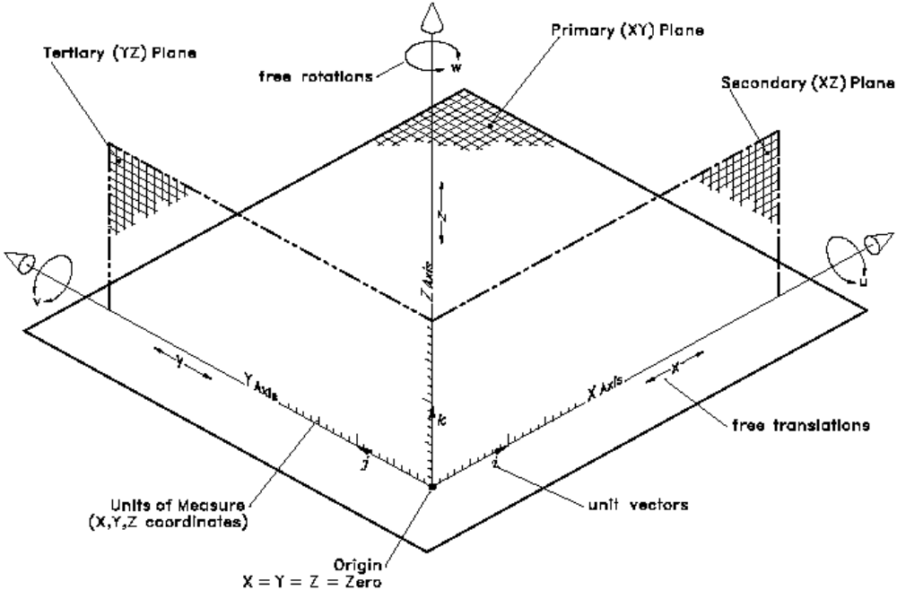
Building a Library Package Definition: Datum Reference Frame

Slide 10
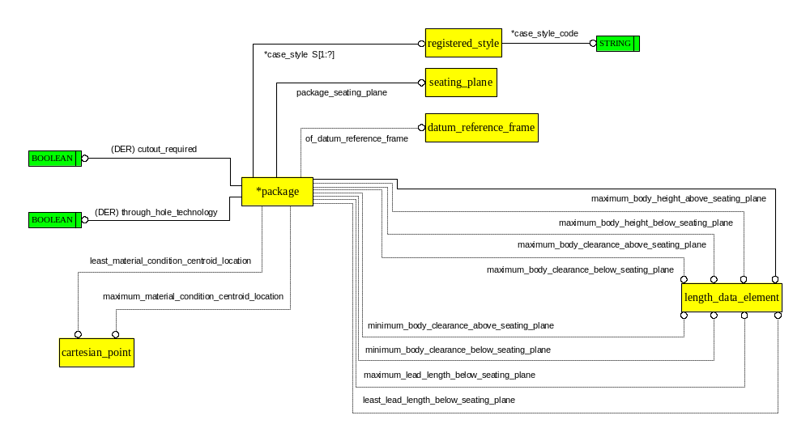
AO: Package

Slide 11
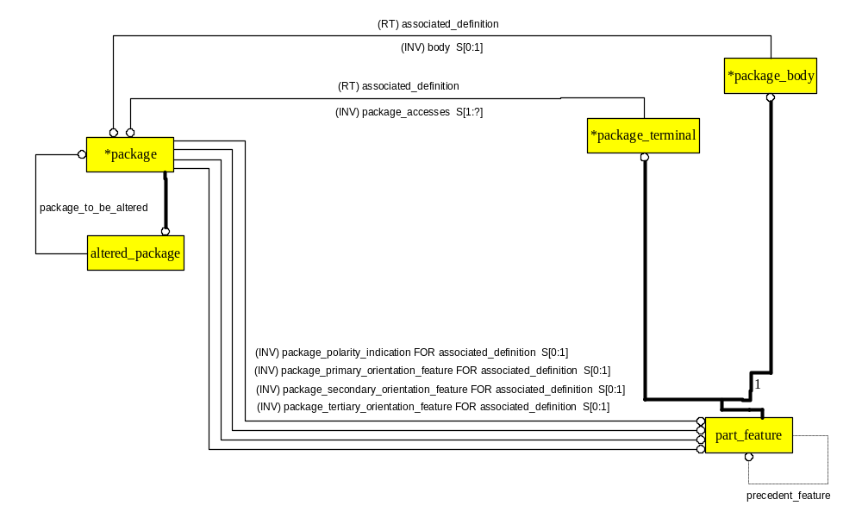
AO: Package

Slide 12
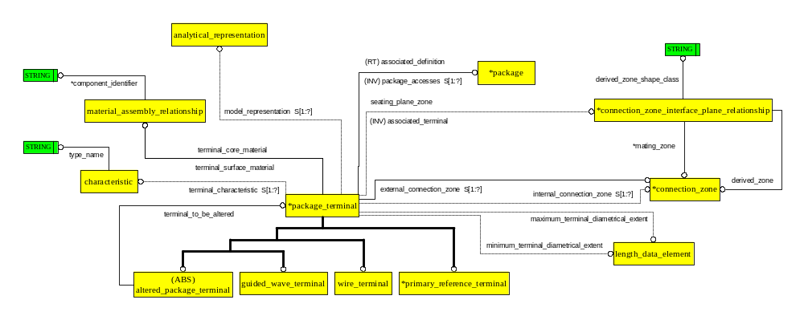
AO: Package_terminal

Slide 13
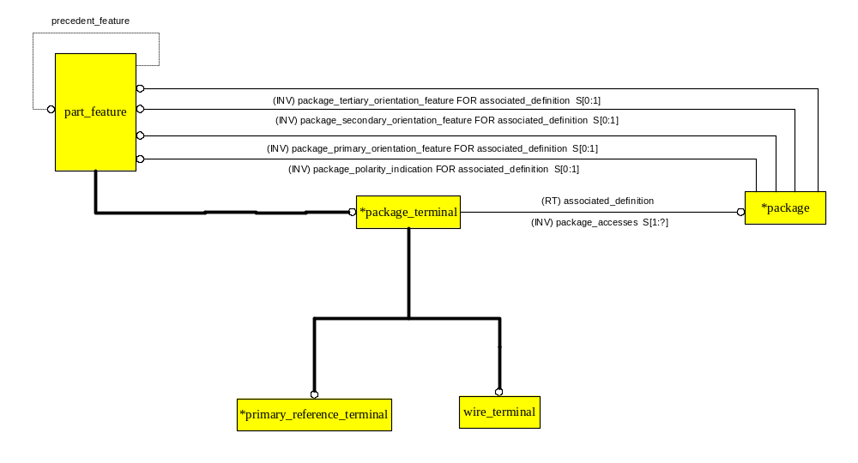
AO: Primary_reference_terminal

Slide 14
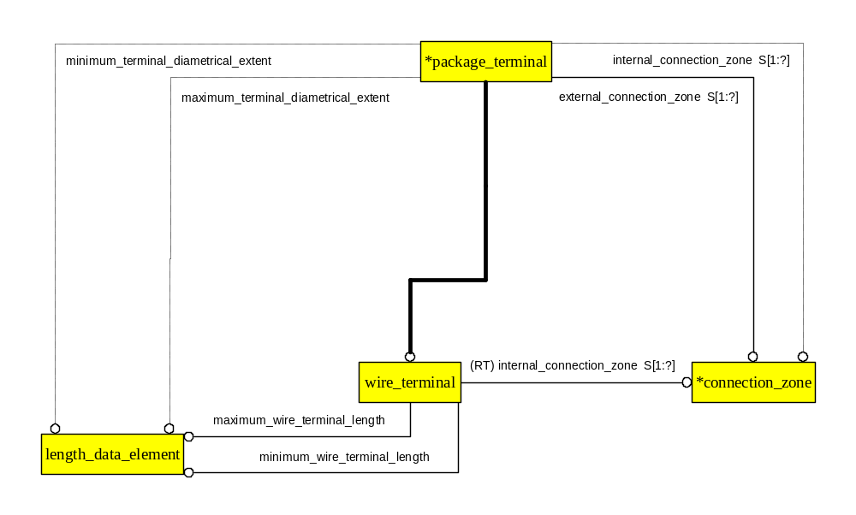
AO: Wire_terminal

Slide 15
Terminals
The fact that Terminals are in a sequence is specified explicitly
The sequence is an ordering on the Name attribute inherited from Shape_element

Slide 16
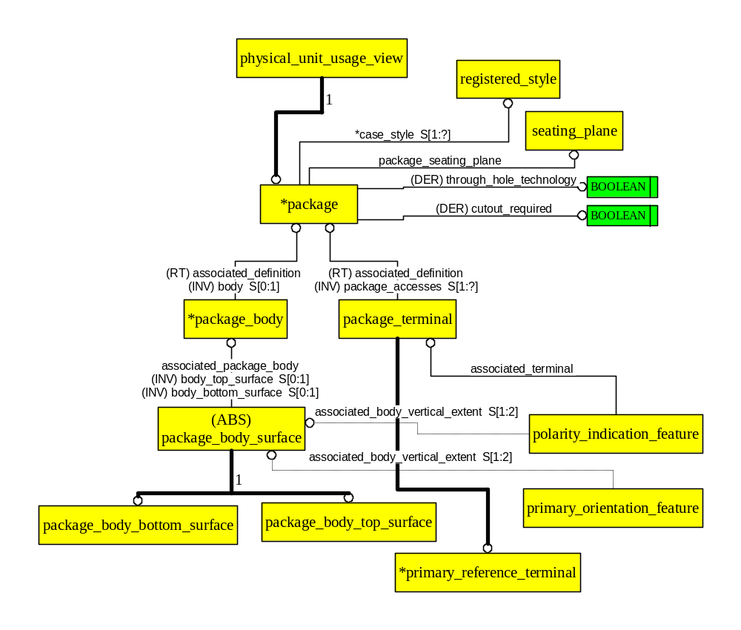
Terminals ARM Diagram

Slide 17
Flattened ARM EXPRESS of Package_terminal AO
ENTITY package_terminal;
ENTITY managed_design_object;
ENTITY shape_element;
name : LABEL;
description : OPTIONAL LABEL;
ENTITY physical_feature_or_part_template;
ENTITY part_feature;
[associated_definition : physical_unit_usage_view;]
[feature_shape : OPTIONAL SET [1:?] OF feature_shape_occurrence;]
precedent_feature : OPTIONAL part_feature;
ENTITY package_terminal;
part_feature.associated_definition : package;
external_connection_zone : SET [1:?] OF connection_zone;
internal_connection_zone : OPTIONAL SET [1:?] OF connection_zone;
terminal_surface_material : material_assembly_relationship;
part_feature.feature_shape : SET [1:?] OF feature_shape_occurrence;
model_representation : OPTIONAL SET [1:?] OF analytical_representation;
terminal_characteristic : OPTIONAL SET [1:?] OF characteristic;
terminal_core_material : material_assembly_relationship;
minimum_terminal_diametrical_extent : OPTIONAL length_data_element;
maximum_terminal_diametrical_extent : OPTIONAL length_data_element;
END_ENTITY;

Slide 18
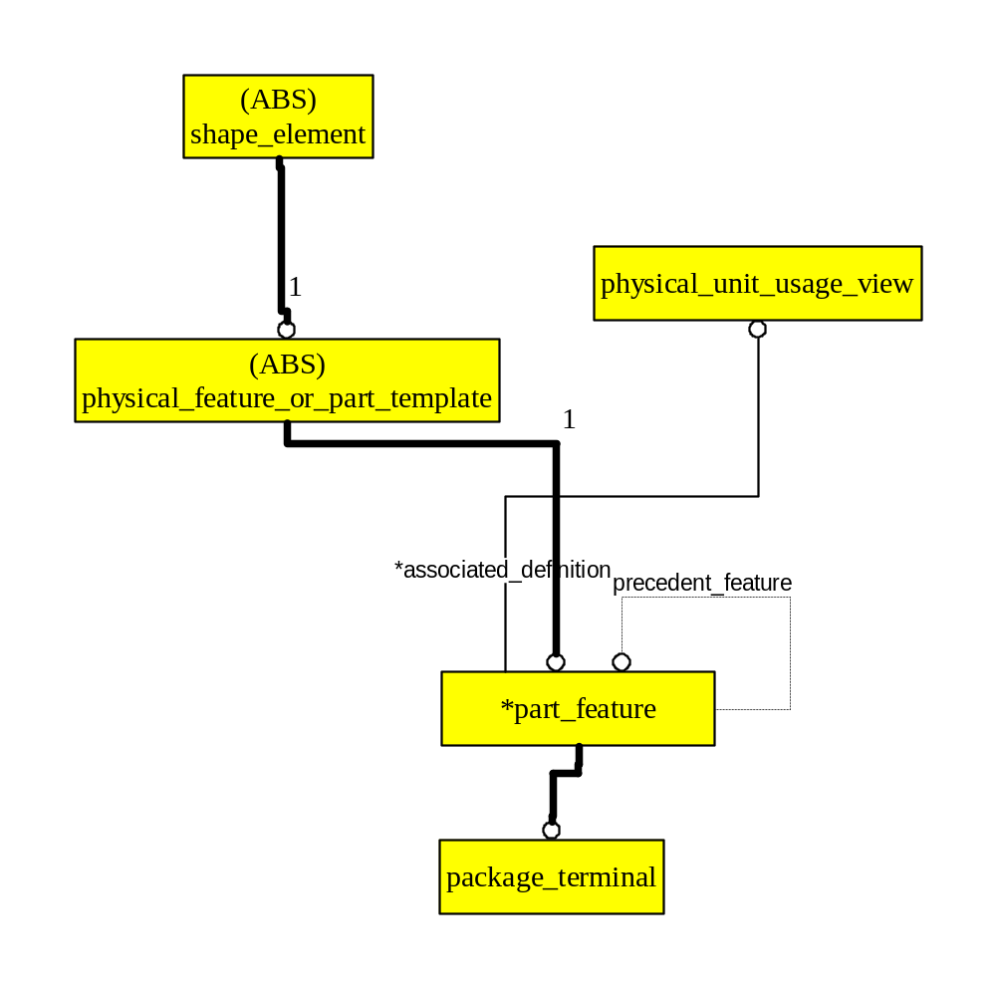
Package Terminal ARM Diagram

Slide 19
Building a Library Functional Definition (subset of CC 13)
Fuuv1 is for example, a nand gate in a library.
Fuuv2 is for example, a power block in a library.
In order to build a quad nand gate (e.g., for a library), you need one power block and 4 usages of the nand gate.
Fu6,7,8,9 are the four occurrences of the nand gate in the library for the network definition fund5, an intermediate definition (also in the library).

Slide 20
Building a Library Functional Definition (subset of CC 13)
Fund6 (also in the library) is the network definition that provides a complete (logical domain) functional definition for an electrical component commonly known as a “quad nand gate”.
Fund6 is the composition of the occurrence fu10 of the intermediate aggregation fund5 and the occurrence fu12 of the power block fuuv2.
Each functional unit network definition references the usage view where its terminals are found.

Slide 21
Single Nand Gate Functionality
Minimum AP210 data (shown below) is that provided by Functional_unit_usage_view_1.
Additional data provided by Functional_unit_network_definition is not available for this gate.
Note: This page is not a presentation of a geometric representation.
in1
in2
out

Slide 22
Single Power Block Functionality
Minimum AP210 data (shown below) is that provided by Functional_unit_usage_view_2.
Additional data provided by Functional_unit_network_definition is not available for this power block.
Note: This page is not a presentation of a geometric representation.
Vp
Vm

Slide 23
Quad Nand Gate Functional Interface
A Minimum example is illustrated.
Real cases may contain 1000 terminals.
AP 210 Requires that ALL Functional Pins that are to be mapped to a physical terminal shall be included at the TOP level usage view.
Terminal names must be UNIQUE within the scope of the Functional Definition.
(Example: “VSS” may appear only once, no matter how many Packaged_part_terminal’s will be assigned to it.)

Slide 24
Quad Nand Gate Functional Interface
Note: This page is a presentation of a Functional_unit_usage_view_3.
ina1
inc2
ina2
outc
outa
ind1
inb1
ind2
inb2
outd
outb
pwr1
inc1
pwr2

Slide 25
Building a Library Functional Definition
fuuv3
fund6
Legend:
fu: functional_unit
fuuv: functional_unit_usage_view
fund: functional_unit_network_definition
fu12
fu10
fuuv2
fund5
fuuv4
fu6
fu8
fu9
fu7
fuuv1

Slide 26
Building a Library Physical Definition
AP 210 Part Concept
Packaged Part
Package:
Physical Definition
  Shape Definition – Not Discussed Herein
  Package Definition
  Interface Definition
    Interface Features:
      Primary Orientation Feature
      Primary Reference Terminal
      Seating Plane
      Axis placement as Origin
  Simulation Models – Previously Discussed

Slide 27
UoF: packaged_part_black_box_model
The packaged_part_black_box_model UoF defines the information necessary to describe a product as a part for the next level of assembly.
The inner structure of this part isn't visible by the electronic assembly designer.
This UoF defines the information necessary to describe the product terminals that are directly connected for the purposes of normal usage.

Slide 28
UoF: packaged_part_black_box_model
Example 1: All terminals that are to be connected to a certain power supply voltage may be specified by use of the information defined in this UoF.
Note: When an enterprise designs a part specifically for use on an electronic assembly, this allows the designer of the electronic assembly to have just enough information to use that part, like any other part, in the design process of the electronic assembly.

Slide 29
UoF: packaged_part_black_box_model
Application Objects:
  Packaged_connector
  Packaged_connector_terminal_relationship
  Packaged_part
  Packaged_part_interface_terminal
  Packaged_part_join_terminal
  Packaged_part_terminal
  Part_connected_terminals_definition

Slide 30
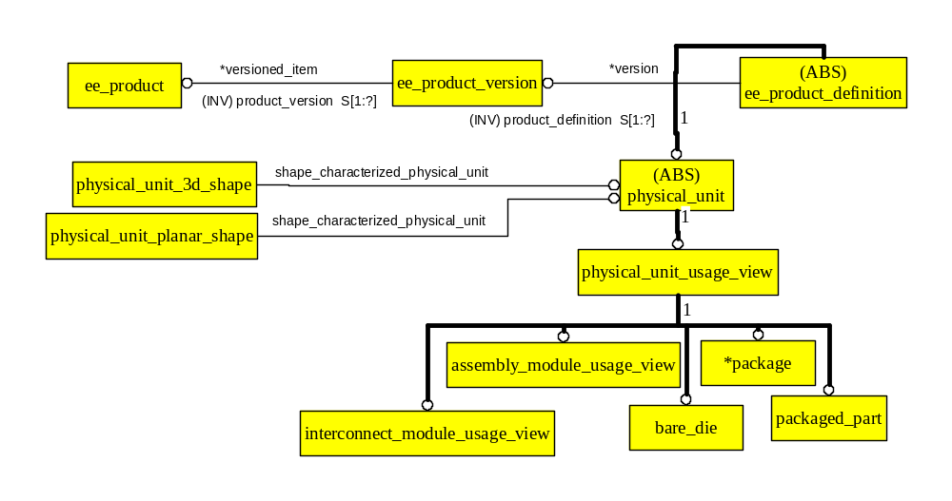
AP210 Part Concept

Slide 31
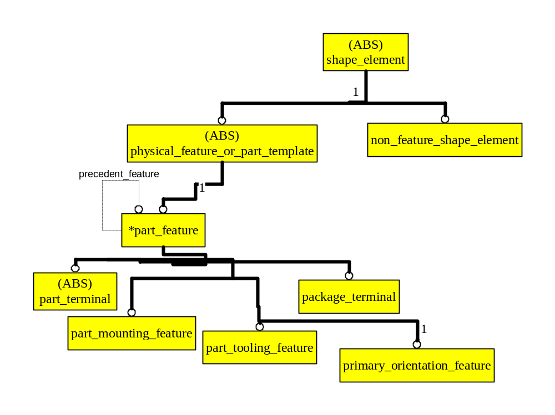
AP210 Part Feature Concept
Note: This is an incomplete picture! AP210 has a rich feature structure.

Slide 32
AP 210 Packaged Part Concept
Package
Packaged
Part
Packaged
Part
Terminal
Package Body
Connection
Zone
Bare
Die

Slide 33
Building a Library Packaged Part Definition
CC1 – Device Functional and Physical Characterization
Mapping Between Functional Interface and Physical Interface Accomplished at Top Level
Part Level Simulation Models
  Black Box Model – Packaged_part example follows
  White Box Model – not discussed herein
Analytical Model Associations:
  Part_feature_model_port_assignment – not discussed herein
  Connection_zone_model_port_assignment – not discussed herein

Slide 34
Building a Library Packaged Part Definition
(Note: This page is not a presentation of a geometric representation)
Functional_unit_usage_view 3
Package
ina1
inc2
ina2
outc
outa
ind1
inb1
ind2
inb2
outd
outb
pwr1
inc1
pwr2
Role is used_package
Role is implemented_function
Packaged_part
A Packaged_part is a Physical_unit that has functionality defined by a
Functional_unit_usage_view and the physical information defined by a Package.

Slide 35
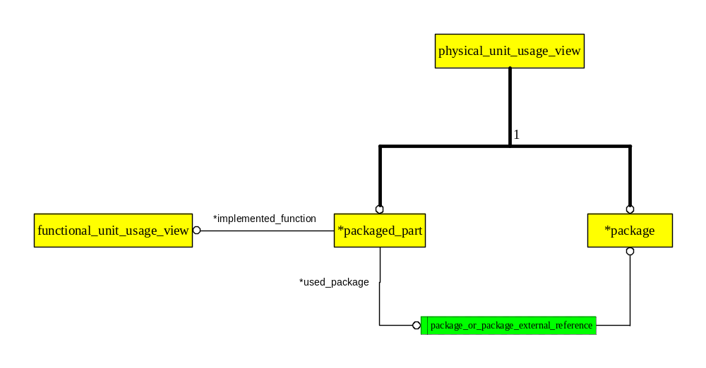
Packaged_part Concept

Slide 36
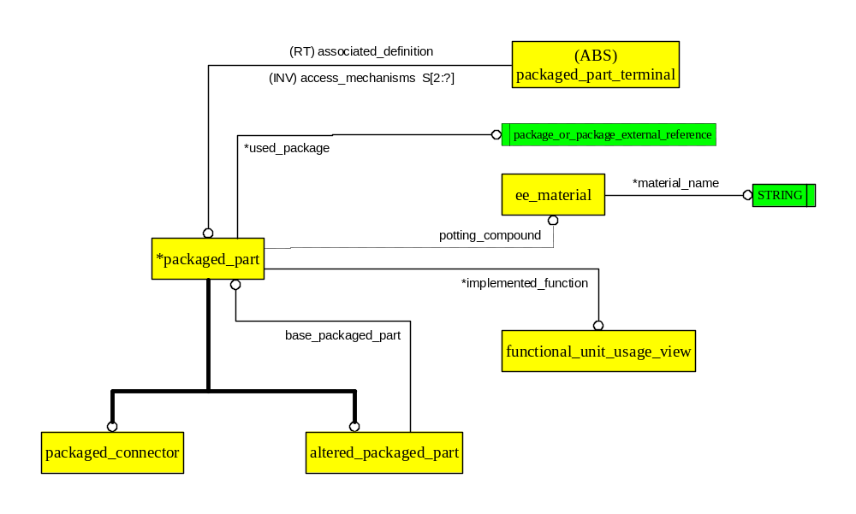
AO: Packaged_part

Slide 37
Building a Pin Map
ina1
inc2
ina2
outc
outa
ind1
inb1
ind2
inb2
outd
outb
pwr1
inc1
pwr2
Role is functional_usage_view_terminal
Role is physical_usage_view_terminal
Functional_usage_view_to_part_terminal_assignment
A Functional_usage_view_to_part_terminal_assignment ARM application object provides the pin map capability in AP 210.
Many physical terminals may be mapped to the same functional terminal using instances of this Application Object.

Slide 38
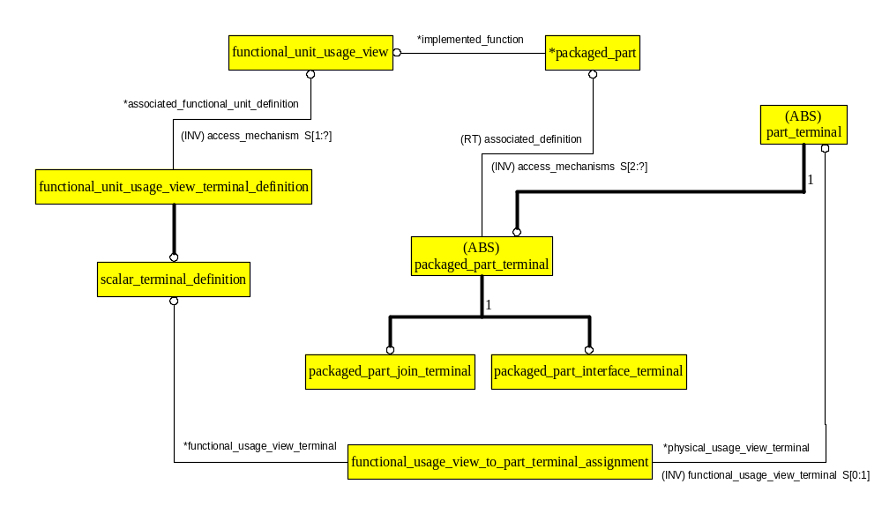
Building a Pin MAP

Slide 39
Defining the Shorted Terminals
ina1
inc2
ina2
outc
outa
ind1
inb1
ind2
inb2
outd
outb
pwr1
inc1
pwr2
Shorts can not be defined in the Functional Unit (rules)
Role is connected_terminals
Part_connected_terminals_definition
ARM application object provides the formal definition in AP 210.
This Data Must be Available for Interconnect for Example.

Slide 40
Defining the Shorted Terminals
Defining which of the Terminals on a Part are Connected
  This Specification is used as both a Design Constraint and as a Design Requirement Depending on User Role.
  This Application Object is Intended for Use in Capturing the Connectivity Requirement in One Place, and is NOT Intended to Replace Multiple uses of Functional_usage_view_to_part_terminal_assignment

Slide 41
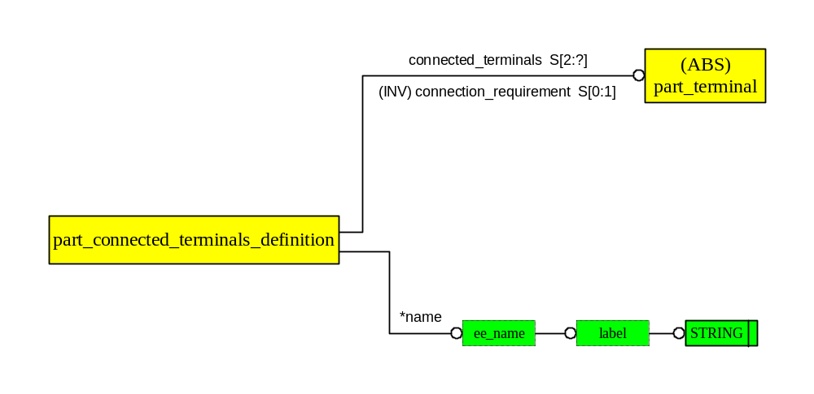
AO: Part_connected_ terminals_definition

Slide 42
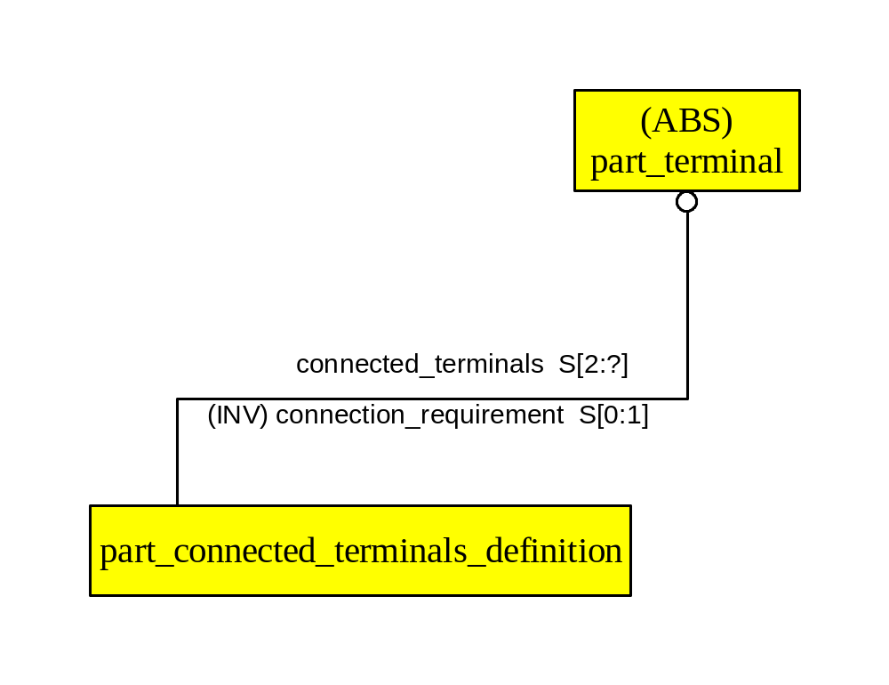
Defining which of the Terminals on a Part are Connected
This Specification is used as both a Design Constraint
and as a Design Requirement Depending on User Role.
This Application Object is Intended for Use in
Capturing the Connectivity Requirement in One Place,
and is NOT Intended to Replace Multiple uses of
Functional_usage_view_to_part_terminal_assignment.

Slide 43
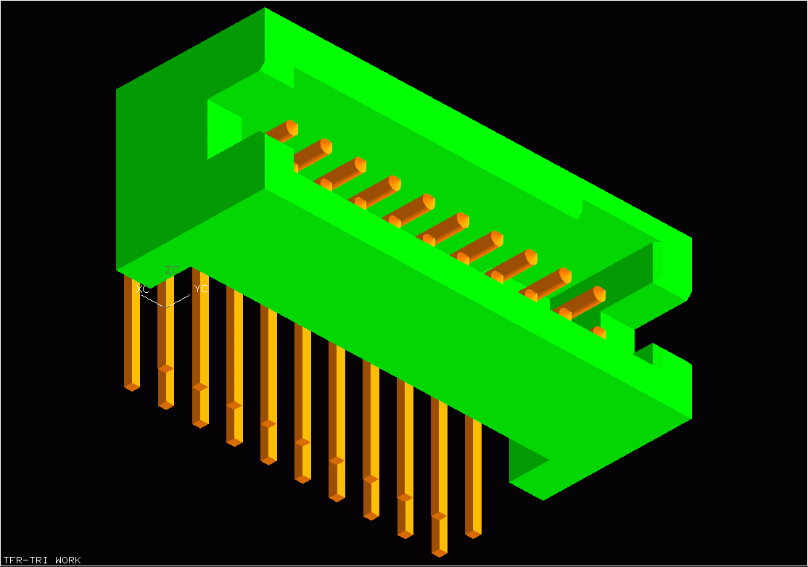
AP 210 Packaged Connector Concept
Join Terminals mate with some
interconnecting
material in a Layout
Interface Terminals
Interface Terminals
Mate with Other
Interface Terminals
in an Assembly
Join Terminals
Packaged_connector functionality is Explicitly Modeled in the Standard.
There is a defined short between an Interface Terminal and a Join Terminal.
Interface and Join Terminals Have Different Identifiers.

Slide 44
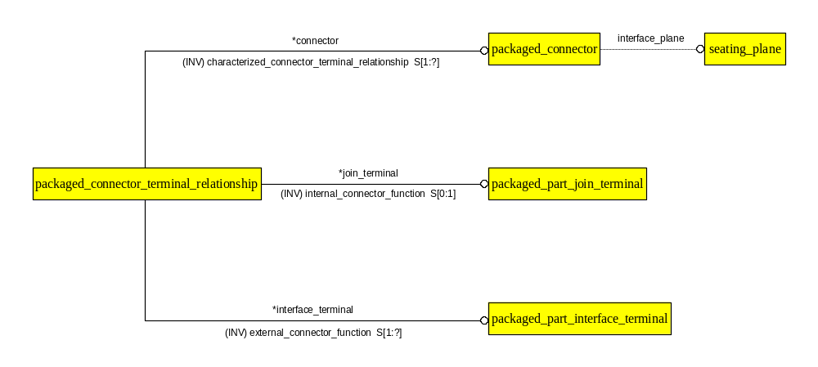
AO: Packaged_connector_ terminal_relationship

Slide 45
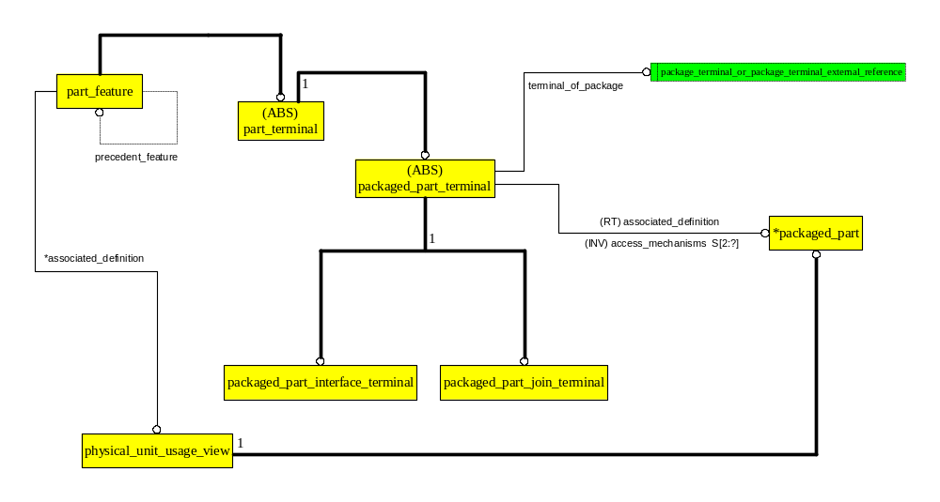
AO: Packaged_part_terminal

Slide 46
The Resulting Library Definition
The Functionality Definition
  A nand gate definition, fuuv1, and a power block definition, fuuv2.
  Network definitions fund5, fund6, along with their usage views: fuuv3, fuuv4.
  Instance definitions fu6, fu7, fu8, fu9, fu10, fu12 that help compose fund5 and fund6.
The Package definition.
The Packaged_part definition.
The pin mapping for the Packaged_part, functional_unit_usage_view_to_part_terminal_assignment (14 needed).

